Slide 1
Adolescence health
Fatima Alshammarni
Sarah Alshehri
Deema Alturki
Jawaher Alabdulkarem
Fay Alruwais
Najoud Alotaibi

Slide 2
Definition
WHO identifies adolescence as the period in human growth and development that occurs after childhood and before adulthood, from ages 10 to19.
Around 1 in 6 persons in the world is an adolescent: that is 1.2 billion people aged 10 to 19.
Globally, there are 49 births per 1000 girls aged 15 to 19 per year.

Slide 3
السكان حسب الجنس وفئات العمر والجنسية ( سعودي/ غير سعودي) *
Population by Single Age , Nationality (Saudi/Non-Saudi) and Gender
 |  |  |  | منتصف العام 2017 |  |  |  | اجمالي المملكة
فئات العمر | سعوديون Saudi |  |  | غير سعوديين Non-Saudi |  |  | الجملة Total
 | ذكور MALE | اناث FEMALE | جملة Total | ذكور MALE | اناث FEMALE | جملة Total | ذكور MALE | اناث FEMALE | جملة Total
4 - 0 | 1106701 | 1067283 | 2,173,984 | 287003 | 273329 | 560,332 | 1,393,704 | 1,340,612 | 2,734,316
9 - 5 | 1081142 | 1043747 | 2,124,889 | 363070 | 347698 | 710,768 | 1,444,212 | 1,391,445 | 2,835,657
14 - 10 | 964304 | 937211 | 1,901,515 | 298963 | 283506 | 582,469 | 1,263,267 | 1,220,717 | 2,483,984
19 - 15 | 911303 | 880048 | 1,791,351 | 245053 | 229068 | 474,121 | 1,156,356 | 1,109,116 | 2,265,472
24 - 20 | 1054864 | 965980 | 2,020,844 | 289368 | 215931 | 505,299 | 1,344,232 | 1,181,911 | 2,526,143
29 - 25 | 979569 | 958219 | 1,937,788 | 736427 | 437555 | 1,173,982 | 1,715,996 | 1,395,774 | 3,111,770
34 - 30 | 882178 | 866771 | 1,748,949 | 963851 | 435030 | 1,398,881 | 1,846,029 | 1,301,801 | 3,147,830
39 - 35 | 773509 | 754795 | 1,528,304 | 1415664 | 559211 | 1,974,875 | 2,189,173 | 1,314,006 | 3,503,179
44 - 40 | 654842 | 630501 | 1,285,343 | 1336843 | 509983 | 1,846,826 | 1,991,685 | 1,140,484 | 3,132,169
49 - 45 | 550260 | 520676 | 1,070,936 | 983252 | 273808 | 1,257,060 | 1,533,512 | 794,484 | 2,327,996
54 - 50 | 438873 | 414863 | 853,736 | 669537 | 102938 | 772,475 | 1,108,410 | 517,801 | 1,626,211
59 - 55 | 342010 | 314325 | 656,335 | 400875 | 67287 | 468,162 | 742,885 | 381,612 | 1,124,497
64 - 60 | 247814 | 231960 | 479,774 | 214599 | 48138 | 262,737 | 462,413 | 280,098 | 742,511
69 - 65 | 150818 | 159559 | 310,377 | 74465 | 29692 | 104,157 | 225,283 | 189,251 | 414,534
74 - 70 | 110039 | 112808 | 222,847 | 34081 | 19175 | 53,256 | 144,120 | 131,983 | 276,103
79 - 75 | 70770 | 72831 | 143,601 | 15918 | 4718 | 20,636 | 86,688 | 77,549 | 164,237
+ 80 | 85286 | 91498 | 176,784 | 12595 | 6653 | 19,248 | 97,881 | 98,151 | 196,032
* تقديرات أولية في منتصف العام مبنية من واقع نتائج المسح الديموغرافي2016م

Slide 4
السكان حسب الجنس وفئات العمر والجنسية ( سعودي/ غير سعودي) *
Population by Single Age , Nationality (Saudi/Non-Saudi) and Gender
 |  |  |  | منتصف العام 2017 |  |  |  | اجمالي المملكة
فئات العمر | سعوديون Saudi |  |  | غير سعوديين Non-Saudi |  |  | الجملة Total
 | ذكور MALE | اناث FEMALE | جملة Total | ذكور MALE | اناث FEMALE | جملة Total | ذكور MALE | اناث FEMALE | جملة Total
14 - 10 | 964304 | 937211 | 1,901,515 | 298963 | 283506 | 582,469 | 1,263,267 | 1,220,717 | 2,483,984
19 - 15 | 911303 | 880048 | 1,791,351 | 245053 | 229068 | 474,121 | 1,156,356 | 1,109,116 | 2,265,472
* تقديرات أولية في منتصف العام مبنية من واقع نتائج المسح الديموغرافي2016م

Slide 5
adolescents - people face a range of health and social challenges.
many serious diseases in adulthood have their roots in behaviors initiated during adolescence. So, adolescence health important :-
1. to address their specific health needs to ensure that they realize their fullest potential and are able to contribute to national development.
2.providing health services.
3.collecting and using the data needed to plan and monitor health sector interventions.
4.developing and implementing health-promoting and health-protecting policies and mobilizing and supporting other sectors.
5- because Adolescent Health and Development affect Economic Prosperity.
6-Investing in Youth Helps Break the Cycle of Poverty.
7-reversing the spread of HIV/AIDS; reducing maternal deaths; reducing infant and child deaths; developing and implementing strategies for decent and productive work for youth; and reducing poverty.

Slide 6
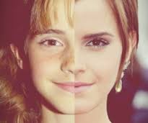
Adolescence: physical changes
For girls:-
early physical changes from about 10 or 11 years, but they might start as young as 8 years or as old as 13 years. Physical changes around puberty include:
breast development
changes in body shape and height
growth of pubic and body hair
the start of periods (menstruation).
For boys:-
physical changes usually start around 11 or 12 years, but they might start as young as 9 years or as old as 14 years. Physical changes include:
growth of the penis and testes (testicles)
changes in body shape and height
erections with ejaculation
growth of body and facial hair
changes to voice.
Notes:
http://raisingchildren.net.au/articles/physical_changes_teenagers.html

Slide 7
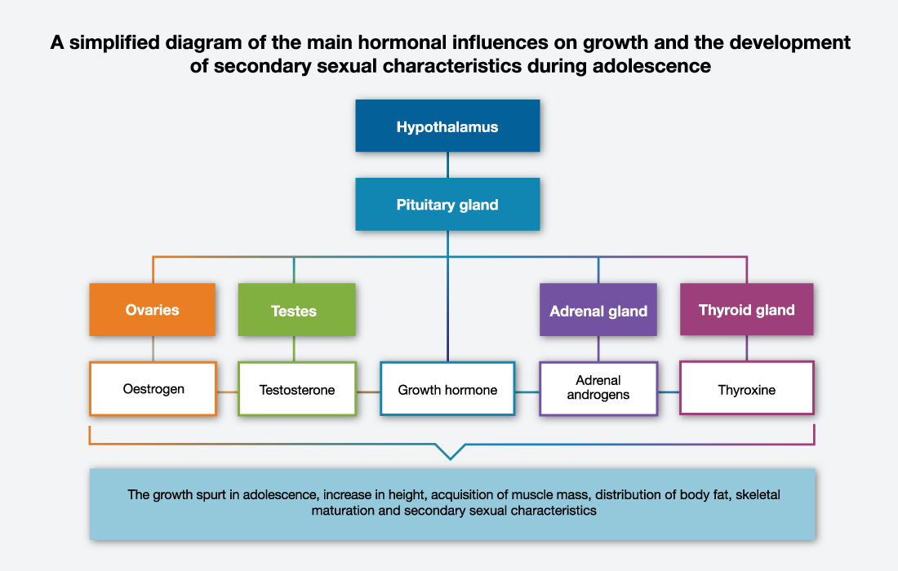

Slide 8
Adolescence: neurodevelopmental changes
These developments are linked to hormonal changes but are not always dependent on them. Developments are taking place in regions of the brain, such as :-
1-the limbic system, that are responsible for pleasure seeking and reward processing, emotional responses and sleep regulation.
2-changes in the pre-frontal cortex, the area responsible for what are called executive functions: decision-making, organization, impulse control and planning for the future. The changes in the pre-frontal cortex occur later in adolescence than the limbic system changes.

Slide 9
Adolescence: psychological and social changes
Linked to the hormonal and neurodevelopmental changes
1- increasing cognitive and intellectual capacities. Over the course of the second decade, adolescents develop stronger reasoning skills, logical and moral thinking, and become more capable of abstract thinking and making rational judgments.

Slide 10
Malnutrition and obesity
Adolescence health problems .
Physical
psychological
infectious
Early pregnancy and childbirth
Injuries
Alcohol and drugs
Violence
HIV
Depression
suicide

Slide 11
Main health issues include:
Early pregnancy and childbirth
Complications linked to pregnancy and childbirth are the second cause of death for 15-19-year-old girls globally.
HIV
More than 2 million adolescents are living with HIV
Mental health
Depression is the top cause of illness and disability among adolescents and suicide is the third cause of death
Malnutrition and obesity
Anemia resulting from a lack of iron affects girls and boys, and is the third cause of years lost to death and disability.
Violence
Alcohol and drugs
Injuries

Slide 12
Violence and bulling in adolescent
• An estimated 180 adolescents die every day as a result of interpersonal violence.
• Around 1 of every 3 deaths among adolescent males of the low- and middle-income countries in the WHO Americas Region is due to violence.
• Globally, some 30% of girls aged 15 to 19 experience violence by a partner.

Slide 13
Factors Which Increase Risk of Violent Behavior:
1- Being the victim of physical abuse and/or sexual abuse.
2- Exposure to violence in the home and/or community.
3- Genetic factors.
4- Exposure to violence in media (TV, movies, etc.).
5- Use of drugs or alcohol.
6- Presence of firearms in home.
7- Combination of stressful family socioeconomic factors

Slide 14
Prevention
individual Protective Factors
Intolerant attitude toward deviance
Family Protective Factors
Connectedness to family or adults outside the family
Social Protective Factors
school-based anti-bullying prevention programs.
High IQ
High grade point average (as an indicator of high academic achievement
Ability to discuss problems with parents
Perceived parental expectations about school performance are high
programs that support parents and teach positive parenting skills.
therapeutic approaches for youths at high risk of being involved in violence;
community and problem-oriented policing.
interventions to reduce the harmful use of drug , reducing access to alcohol.
Notes:
https://www.cdc.gov/violenceprevention/youthviolence/riskprotectivefactors.html

Slide 15
Notes:
http://www.who.int/violence_injury_prevention/violence/world_report/en/full_en.pdf

Slide 16
What can be done?
Whenever a parent or other adult is concerned, they should immediately arrange for a comprehensive evaluation by a qualified mental health professional
the goals of treatment typically focus on helping them to: learn how to control there anger; express anger and frustrations in appropriate ways; be responsible for there actions; and accept consequences. In addition, family conflicts, school problems, and community issues must be addressed.
Notes:
https://www.aacap.org/AACAP/Families_and_Youth/Facts_for_Families/FFF-Guide/Understanding-Violent-Behavior-In-Children-and-Adolescents-055.aspx

Slide 17
Bullying in Saudi Arabia
AlBuhairan et al. Jeeluna. 2014
Adolescent health survey ( 12,575 )
One out of every 4 adolescents were found to have been bullied at school during the 30 days preceding the study (AlBuhairan et al., 2014)
________________
Al Eissa et al., 2013) ICAST-CH survey
One out of every 2 adolescents (47%) of the students had been exposed to bullying during the year preceding the study, ICAST (Al Eissa et al., 2013)

Slide 18
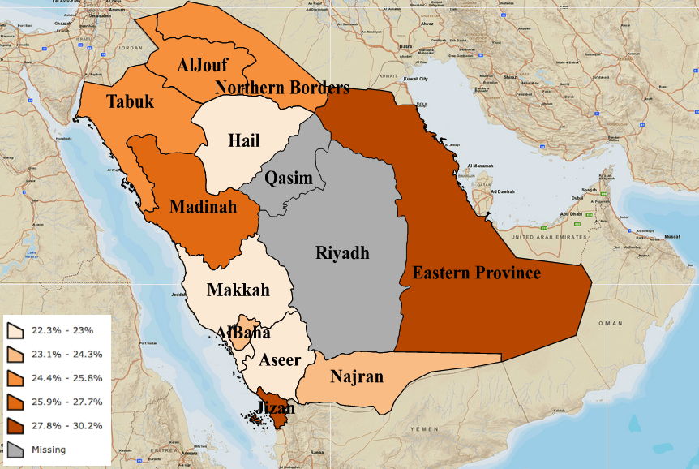
Regional prevalence of bullying among adolescents at schools in Saudi Arabia
AlBuhairan et al. Jeeluna. 2014
Notes:
Jizan and Eastern Regions having the highest rates, 30.2% and 29.4% respectively (AlBuhairan et al., 2014)
Jizan and Eastern Regions having the highest rates, 30.2% and 29.4% respectively (AlBuhairan et al., 2014)

Slide 19
Bullying in Saudi Arabia (cont.)
ICAST-CH
AlEissa, et al., Child Abuse and Neglect International Journal, 2016

Slide 20
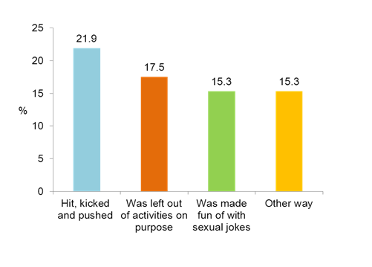
Bullying in Saudi Arabia (cont.)
Almuneef – Adverse Childhood Experience –International Questionnaire (ACE-IQ )
Figure : Prevalence of bullying during the first 18 years of life
Figure : Types of bullying
Almuneef et.al 2013 CAN Journal

Slide 21
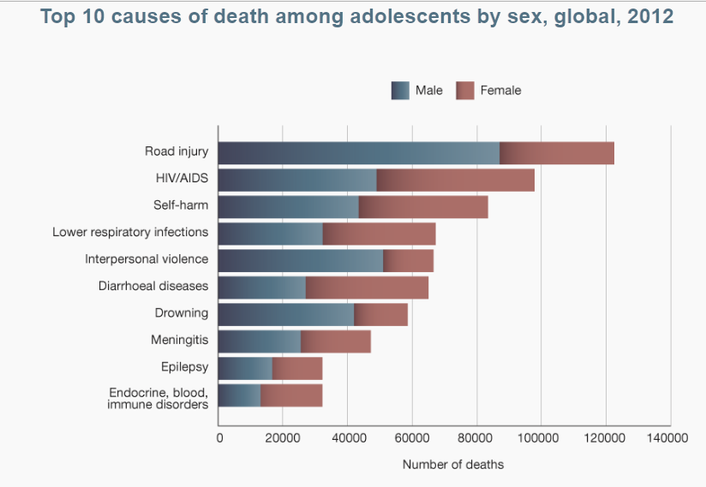
The leading causes of death globally among adolescents in 2012 :
Notes:
http://apps.who.int/adolescent/second-decade/section3/page2/mortality.html
This section describes the most recent (2012) estimates of the burden of disease during the second decade: the main causes of mortality, morbidity and disability-adjusted life years (DALYs), a measure that combines mortality and morbidity. It compares the 10–14 and 15–19 age groups, males and females, and different regions of the world

Slide 22
 Types of injury
Intentional
e.g. violence, suicide, homicide, intentional fire-arm injuries, etc
accidental
(Non-Intentional)
e.g. road-traffic injuries, fires, falls, poisoning, drowning asphyxia, burns, sports, accidental firearm injuries, electrical shock etc
Unintentional injuries are a leading cause of death and disability among adolescents.
In 2012, 120 000 adolescents died as a result of road traffic accidents.
Drowning is also a major cause of death among adolescents.
Notes:
http://www.who.int/mediacentre/factsheets/fs345/en/
https://www.cdc.gov/safechild/pdf/National_Action_Plan_for_Child_Injury_Prevention.pdf

Slide 23
 The leading causes of death and disability globally among adolescents in 2012 :
Top causes of deaths in adolescents
Road traffic injuries
Top causes of illness and disability
Depression
Road traffic injuries
Anaemia
HIV/AIDS
Self-harm
Back and neck pain
Diarrhoea
Anxiety disorders
Asthma
Lower respiratory infections
HIV/AIDS
Suicide
Lower respiratory infections
Violence
Diarrhoea
Drowning
Meningitis
Epilepsy
Endocrine, blood, immune disorders
Notes:
http://www.who.int/mediacentre/news/releases/2014/focus-adolescent-health/en/

Slide 24
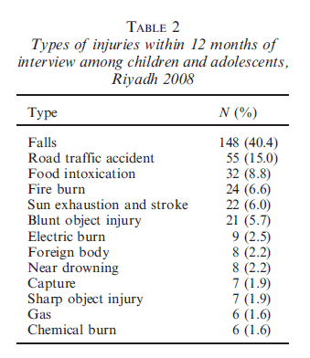

Slide 25
عدد الحوادث حسب المناطق الإدارية لعام 2015
Notes:
المصدر : الهيئة العامة للإحصاء الكتاب الإحصائي السنوي لعام 2015
https://www.stats.gov.sa/ar/3465

Slide 26
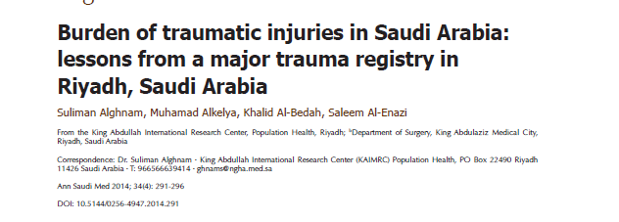
In Saudi Arabia
Saudi Arabia (SA) is among many developing countries that have suffered a major burden of morbidity and mortality due to injuries.
Preventable injuries are the second leading cause of death, accounting for about a fifth of all reported fatalities in the country.
Because SA is a relatively young country (40% of the population is 19 years old and younger), injuries can have significant implications on the country’s health and prosperity.
According to the Global Burden of Disease report, traumatic injuries represent 22.6% of years of potential life lost in SA.
Notes:
http://www.annsaudimed.net/index.php/vol34/vol34iss4/730.html
Years of potential life lost (YPLL) or potential years of life lost (PYLL), is an estimate of the average years a person would have lived if he or she had not died prematurely. It is, therefore, a measure of premature mortality.

Slide 27
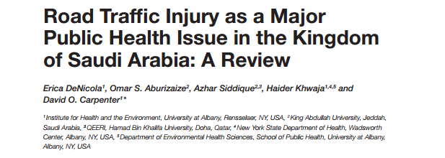
In Saudi Arabia
According to the Global Burden of Disease , injury is the leading cause of disability-adjusted life years (DALYs) lost in the Kingdom of Saudi Arabia.
In 2013, the most frequent cause of death in the Kingdom of Saudi Arabia was injury.
Saudi Arabia spends roughly SR 13 billion ($6.25 billion USD) annually to treat road traffic-related injuries and on other matters related to road traffic, which is roughly 4% of the national income. However, the true economic cost is difficult to estimate because it includes the cost of medical care and rehabilitation services and the loss of productivity due to disability or absenteeism
Notes:
https://www.ncbi.nlm.nih.gov/pmc/articles/PMC5044776/pdf/fpubh-04-00215.pdf
https://www.ncbi.nlm.nih.gov/pmc/articles/PMC4404474/pdf/SaudiMedJ-36-418.pdf
What are DALYs?
Disability-adjusted life years (DALYs) are a measure of the years of healthy life lost due to ill health, disability or premature death. They estimate the gap between current health status and an ideal health status, with the entire population living to an advanced age free of disease and disability.
For a specific health condition, DALYs are calculated as the sum of the years of life lost (YLL) due to premature death plus disability (YLD) for people living with the health condition.

Slide 28
Causes
Noncompliance with traffic laws,
Especially:
wearing of seat belts
Over speeding
Violation of signals
Driving without a license
Use of cellphones while driving
Poor education, young age, and aggressive personality traits.
Other factors related to people include: poor child restraint and unsupervised children playing in the streets, resulting in injuries as pedestrians.
Prolonged exposure to heat,
adverse weather conditions, such as precipitation, fog, and dust,
Notes:
https://www.ncbi.nlm.nih.gov/pmc/articles/PMC2850182/
https://www.ncbi.nlm.nih.gov/pmc/articles/PMC4404474/pdf/SaudiMedJ-36-418.pdf

Slide 29
 What to do ?
The action plans in KSA so far have mostly focused on seat belt laws, speed detection cameras (Saher system), emergency medical rescue services.
Primary prevention of the risks of RTAs should be initiated to modify the behavior of young drivers, particularly, through mass media campaigns. This can be achieved by distributing health messages at points of care, such as shopping malls, and schools.
Moreover, efforts can be strengthened by strict reinforcement of laws in residential areas, and also providing alternate options for entertainment by building health fitness, or sport facilities, or parks in the communities.
Notes:
https://www.ncbi.nlm.nih.gov/pmc/articles/PMC4404474/pdf/SaudiMedJ-36-418.pdf

Slide 30
Types of Tobacco Products
Shisha
cigar
Pipe tobacco
Cigarettes

Slide 31
Globally speaking
In 2015, over 1.1 billion people smoked tobacco. Far more males than females smoked tobacco.
WHO has estimated that tobacco use (smoking and smokeless) is currently responsible for the death of about six million people across the world each year with many of these deaths occurring prematurely. This total includes about 600,000 people are also estimated to die from the effects of second-hand smoke
Notes:
http://apps.who.int/iris/bitstream/10665/156262/1/9789241564922_eng.pdf
http://www.who.int/gho/tobacco/use/en/

Slide 32
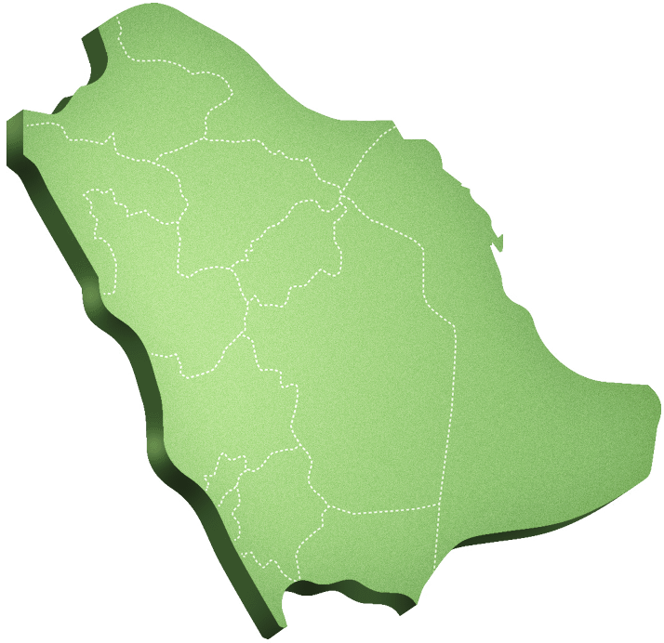
In Saudi Arabia
Saudi health information survey (SHIS)
Current smokers:
23,7%
1,5%
Notes:
http://www.tcpmoh.gov.sa/media/Docs/a28a5370-f43d-44b1-a2dc-d315ad3e78a7.pdf

Slide 33
In Saudi Arabia
Saudi health information survey (SHIS)
15-24 years :
16.1%
0.8%
Notes:
http://www.tcpmoh.gov.sa/media/Docs/a28a5370-f43d-44b1-a2dc-d315ad3e78a7.pdf

Slide 34
In Saudi Arabia
Saudi health information survey (SHIS)
Initiation of smoking during adolescence is closely associated with persistent smoking in adulthood and with the many adverse health effects associated with chronic smoking.
Mean age to start smoking
: 19 : 21
Notes:
http://www.uptodate.com/contents/prevention-of-smoking-initiation-in-children-and-adolescents

Slide 35
Prevalence of second hand smoking in KSA
Saudi health information survey (SHIS)
AVERAGE EXPOSURE TO
SECOND HAND SMOKING
D/WK
2.9%
4.8
13%
5.5
Notes:
http://www.tcpmoh.gov.sa/media/Docs/a28a5370-f43d-44b1-a2dc-d315ad3e78a7.pdf

Slide 36
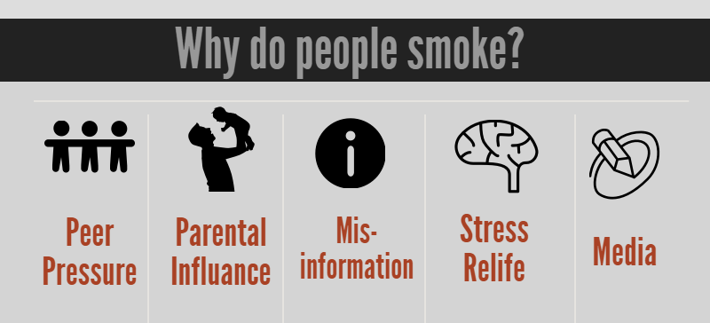
Notes:
http://www.uptodate.com/contents/prevention-of-smoking-initiation-in-children-and-adolescents
FACTORS CONTRIBUTING TO SMOKING INITIATION
Attitudes and beliefs — Attitudes toward smoking are an important predictor of smoking initiation. As an example, in a longitudinal study of adolescents who had never smoked at baseline, 40 percent became experimenters and 8 percent had an established smoking habit during four years of follow-up [25]. The absence of a firm decision not to smoke was the strongest predictor of experimentation.
Attitudes toward smoking are influenced by several factors:
●Peer and family influence – The presence of smokers in the network of family or friends is associated with less negative attitudes towards smoking and is an important predictor of initiating smoking during adolescence [7,8,26-30]. Refusing a cigarette in the face of social pressure is challenging for many adolescents; among adolescents who were occasional or daily smokers, only 44 percent felt confident that they could refuse a cigarette at a party [30].
●Age – Either positive or negative attitudes toward smoking often become more pronounced during adolescence [28]. As an example, in a study of Swiss children 11 to 14 years of age, parental approval significantly influenced children's intention to smoke, but this effect decreased for older adolescents [31].
●Misperceptions – Adolescents tend to overestimate the frequency of smoking among their peers and among adults [32]. Conversely, adolescents tend to underestimate their own smoking habits [33].
●Marketing – Although the direct advertising of tobacco to youth is banned in the United States, indirect marketing efforts and positive images of cigarette use in the media have important effects on teenage smoking behavior [8,26,27]. Many advertisements use images or other techniques to suggest that smoking is associated with good health, thinness, and social acceptance. (See 'Advertising and media influence' below.)
Nicotine dependence — Nicotine is a strongly addictive substance, and many individuals develop nicotine dependence after days to weeks of exposure [34]. Youth are particularly vulnerable to becoming dependent on nicotine, as compared with adults [8]. As a result, experimentation or a light smoking habit can rapidly escalate into daily or heavy smoking, and many adolescent smokers have difficulty quitting although they are often motivated to do so. Teens using tobacco three to five times in the preceding month were two to four times more likely to have symptoms of tobacco dependence, compared with teens using tobacco one to two times in the preceding month [35]. Nicotine dependence is an important factor in determining which individuals become regular smokers after smoking experimentation [7,36-38].
The first symptoms of nicotine dependence can appear within days to weeks of the onset of occasional cigarette use, and often appear before the onset of daily smoking [7,37]. As an example, among sixth grade students (median age 12 years) who smoked at least once per month at baseline, 53 percent experienced symptoms of nicotine dependence, and 40 percent escalated to daily smoking during the next four years [36]. Early emergence of dependence symptoms predicted escalation in smoking frequency, and smoking frequency accelerated the appearance of dependence symptoms [38].
The specific symptoms of nicotine dependence are discussed separately. (See"Management of smoking cessation in adolescents", section on 'Nicotine dependence'.)
Availability of flavored tobacco products

Slide 37
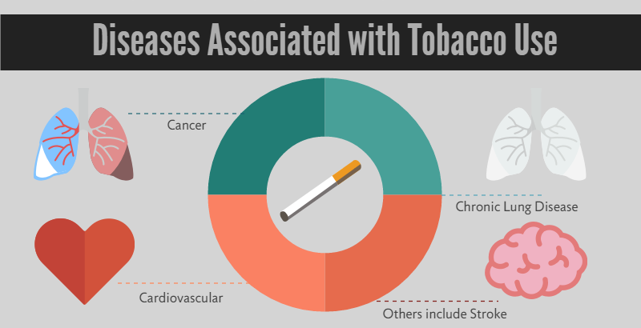
Notes:
Cardiovascular Disease:
stroke
coronary heart disease
Respiratory diseases:
COPD, which includes emphysema and chronic bronchitis.
lung cancer
Triggers asthma attack
Smoking can cause cancer almost anywhere in your body

Slide 38
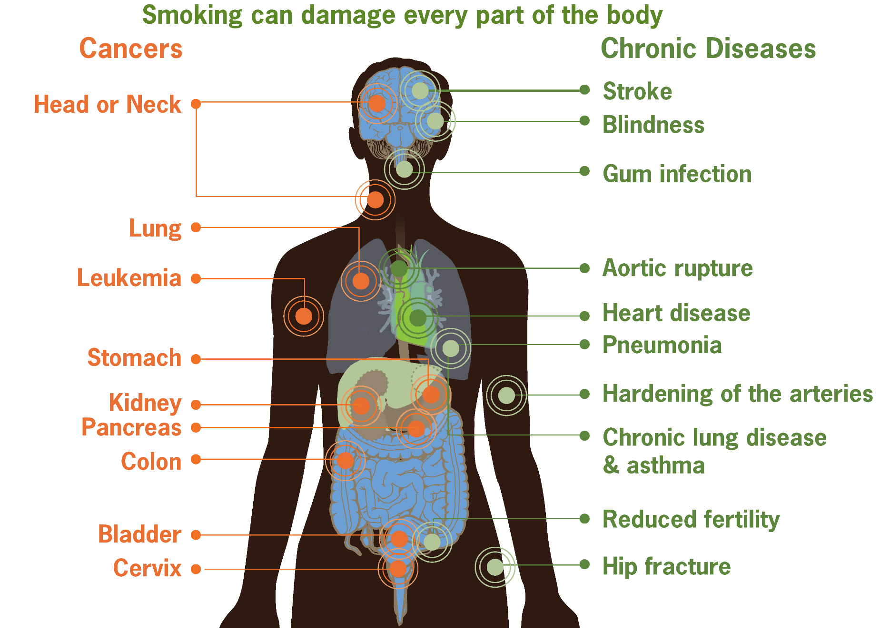
Smoking risks
Notes:
https://www.cdc.gov/tobacco/infographics/health-effects/index.htm#smoking-risks

Slide 39
Role of PHC and smoking cessation clinics
“Approaching smokers to quit”
It deals with smokers who are not thinking of quitting yet, and others thinking of quitting, and some ready to quit and already quitters.
It includes also pharmacological preparations and long–short term follow-ups.

Slide 40
 The 5 As approach:
1.Ask : about tobacco USE
2.Advise : tobacco users to QUIT
3.Assess : Readiness to make a quit attempt
4.Assist : In Quit Attempt
5.Arrange: Follow-up care
Smoker / recent quitters?
Type and amount of tobacco used, level of nicotine dependence, and willingness to quit?

Slide 41
 The 5 As approach:
1.Ask : about tobacco USE
2.Advise : tobacco users to QUIT
3.Assess : Readiness to make a quit attempt
4.Assist : In Quit Attempt
5.Arrange: Follow-up care
Advice should be:
Clear
Strong
Personalized

Slide 42
 The 5 As approach:
1.Ask : about tobacco USE
2.Advise : tobacco users to QUIT
3.Assess : Readiness to make a quit attempt
4.Assist : In Quit Attempt
5.Arrange: Follow-up care
determine if the patient is willing to quit at this time.

Slide 43
Not Thinking About Quitting
3.Assess
1
Ask about and discuss the impact of smoking on the patient’s life.
Link every smoking-related illness in the patient to his/her smoking.
Encourage patient to make his/her house and car smoke free.
Provide relevant educational materials.
Focus on short term benefits

Slide 44
3.Assess
2
Thinking About Quitting
increase patient’s motivation to quit.
Offer to help your patient.
Ask about your patient’s concerns about quitting and discuss ways of dealing with them
Provide patient materials
Suggest a follow-up visit.

Slide 45
3.Assess
Getting ready to quit
Start your smoking cessation plan with "START "
S = Set a quit date.
T = Tell family, friends, and co-workers that you plan to quit.
A = Anticipate and plan for the challenges you'll face while quitting.
R = Remove cigarettes and other tobacco products from your home, car, and work.
T = Talk to your doctor about getting help to quit.

Slide 47
3.Assess
Ready to Quit
3
To help the patient find the right treatment.
Assess past quitting history and comorbidity.
Ask about other smokers in the patient’s home and workplace.

Slide 48
3.Assess
Dealing with already quitted smokers:
3
Support Strategies
Congratulate the patient on his/her efforts.
Encourage the patient to establish a self reward system and use positive self-talk.
Behavioral Strategies
Discuss coping strategies for withdrawal symptoms, urges and triggers.
Discuss strategies for dealing with slips and relapses
Tools
Review use of stop-smoking medications, if relevant.
Follow-up
Develop a specific follow-up plan that includes several visits or numerous phone contacts.

Slide 49
 The 5 As approach:
1.Ask : about tobacco USE
2.Advise : tobacco users to QUIT
3.Assess : Readiness to make a quit attempt
4.Assist : In Quit Attempt
5.Arrange: Follow-up care

Slide 50
Role of PHC and smoking cessation clinics
“Approaching smokers to quit”
Some advices that could help in quitting:
spend as much free time as you can in public places where smoking is not allowed.
If you miss the feeling of having a cigarette in your hand, hold something else ( a pencil, a coin ) .
If you miss the feeling of having something in your mouth, try (toothpicks, cinnamon sticks, السواك)

Slide 51
Role of PHC and smoking cessation clinics
“Approaching smokers to quit”
Some advices that could help in quitting:
Call a friend, family member when you need extra help or support.
Work out to relieve stress
Attend group behavior therapy involves scheduled meetings where people who smoke receive information, advice and encouragement and some form of behavioral intervention

Slide 52
 Case based discussion
27 year-old male visits the PHC clinic. He is willing and ready to quit from smoking.
How to approach this patient?
1- Taking history of smoking (type, numbers per day, comorbidities, for how long, If tried to quit before?, other smokers at home/work place?)
2- Assess the patient willing (START?)
3- other options ?

Slide 53
 Substance Abuse
●Risky use/abuse
characterized by consumption amounts that increase the likelihood of health consequences.
●Physical dependence
A state of adaptation that is manifested by a withdrawal syndrome that can be produced by abrupt cessation of a substance or by tolerance to the substance.
●Addiction
A primary, chronic, neurobiologic disease, with psychosocial, and environmental factors influencing its development and manifestations. Addiction is characterized by behaviors that include impaired control over substance use, compulsive use, continued use despite harm, and craving.

Slide 54
Substance use disorders in Saudi Arabia: review article
Medhat Bassiony Published online: 19 Feb 2013
Adolescents initiated the use of illicit drugs before or roughly simultaneously with tobacco smoking in the vicinity of 15 years of age, with amphetamine usually being the first drug to be used after tobacco smoking.
According to the published studies, the most commonly abused substances over the last two decades were amphetamine, heroin, alcohol and cannabis, respectively.
Notes:
http://www.tandfonline.com/doi/abs/10.3109/14659891.2011.606349

Slide 55
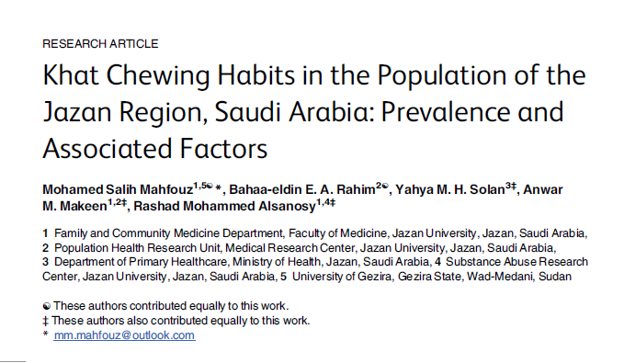
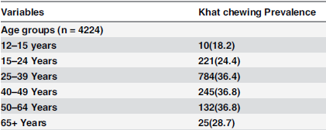
Although khat cultivation and trade is officially prohibited in the Kingdom of Saudi Arabia,
the majority of the participants, almost 68.7%, stated that it is very easy or easy to obtain khat.

Slide 56
Substance Abuse
It has a negative academic and social effect.
It reduces self-control and increases risky behaviors, such as unsafe sex or risky driving.
It is a primary cause of injuries (including those due to road traffic accidents), violence, and premature deaths.
It also can lead to health problems in later life and affect life expectancy.
Notes:
http://www.who.int/mediacentre/factsheets/fs345/en/
Understanding the early risk factors and processes that make these youths vulnerable to substance abuse disorders is crucial to the development of effective strategies for prevention
School-based prevention programs should be the first step in the global prevention programs in Saudi Arabia.
There are three specialized hospitals for treatment of substance abuse in the Eastern, Western and Central regions of Saudi Arabia. These hospitals use the residential model where the patients admitted pass through
detoxification phase, behavior modification phase and finally relapse prevention phase.

Slide 57
Obesity In Adolescents
https://www.youtube.com/watch?v=82kYQ7j7X2s
https://www.youtube.com/watch?v=6A2pnWyz7h0

Slide 58
Epidemiology
Overweight and obesity are now a global epidemic, with more than
one out of five people qualifying as obese worldwide.
Saudi Arabia, which has become increasingly westernized over the past few decades now has one of the highest prevalence rates of overweight and obesity.
https://www.ncbi.nlm.nih.gov/pubmed/26351801

Slide 59
Epidemiology
A study was carried out with the aim of identifying the health risk
behaviours and health status of adolescents in Saudi Arabia, in 2015.
It was a cross-sectional, school-based study was in all 13 regions of
Saudi Arabia with a total of 12,575 adolescents participated.
28% of adolescents reported having a chronic health condition
30.0% were overweight/obese
Almost half of all adolescents did not engage in any physical
exercise. Females reported complete absence of exercise much
more than males
42% spent at least 2 hours/day watching television.
https://www.ncbi.nlm.nih.gov/pmc/articles/PMC3883599/

Slide 60
Epidemiology
The prevalence of obesity among adults in Saudi Arabia increased from 22% in 1990-1993 to 36% in 2005, and future projections of the prevalence of adult obesity are needed by health policy-makers. The overall prevalence of obesity was projected to increase from around 12% in 1992 to 41% by 2022 in men, and from 21% to 78% in women. Women had much higher projected prevalence than men, particularly in 35-44 years group.
https://www.ncbi.nlm.nih.gov/pubmed/25356689

Slide 61
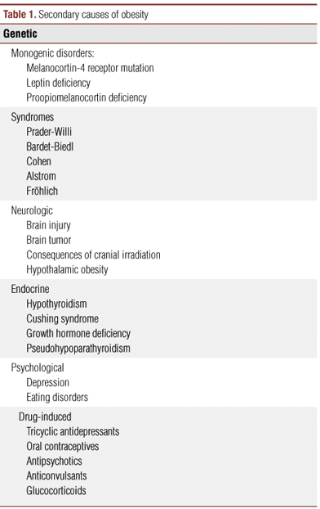
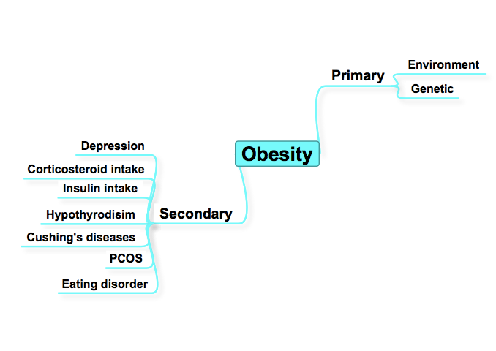
Aetiology

Slide 62
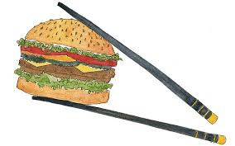
Aetiology: Environment
# Competing cultures is partly to blame, as the combination of
persisting traditional Saudi cultural practices, modern cultural
changes, and economic prosperity has created an obesogenic
environment that promotes unhealthy eating, sedentary lifestyles, and weight gain.
Interventions targeting the environment are needed in order to promote greater health through healthy eating decisions and increased physical activity or exercise.
A study conducted among 1,335 Saudi males students aged from 13-19 years old found that :
64% had low physical activity
51% had been involved in physical fighting at least once or more in the last 12 months.
43% ate sweets once or more daily .
https://bmcpublichealth.biomedcentral.com/articles/10.1186/1471-2458-14-1215
https://www.ncbi.nlm.nih.gov/pubmed/26351801

Slide 63
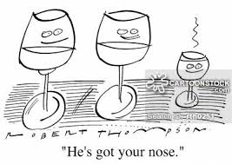
Aetiology: Genetics
A study found that having an overweight or obese father and healthy-weight mother significantly increased the odds of childhood and adulthood obesity; however, having an obese mother and a healthy-weight father was not associated with an increased risk of obesity in childhood.
This discrepancy suggests a role for epigenetic factors in hereditary risk.

Slide 64
Co-morbidities

Slide 65
A study investigating the effect of obesity and underweight on the early vocal maturation in adolescent boys. The results revealed significant main effect of the group
http://www.saudijobesity.com/article.asp?issn=2347-2618;year=2014;volume=2;issue=1;spage=29;epage=32;aulast=Balasubramanium;type=0

Slide 66
Children, particularly adolescents, who are
obese have a high probability of becoming
adults who are obese; hence, the bimodal
distribution of obesity portends a large-scale
obesity epidemic in the next few decades. Taller children generally tend to be more obese than shorter peers, are more insulin-resistant, and have increased leptin levels.
Adolescent obesity poses a serious risk for severe obesity for the rest of life.
This calls for a stronger emphasis on
weight reduction during early
adolescence, specifically targeting
groups at greater risk.

Slide 67
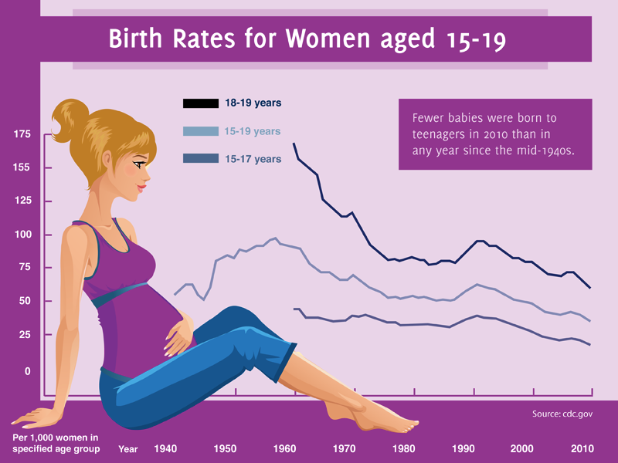
Adolescent pregnancy
Epidemiology
About 16 million girls aged 15 to 19 and some 1 million girls under 15 give birth every year—most in low- and middle-income countries.
There has been a marked, although uneven, decrease in the birth rates among adolescent girls since 1990, but some 11% of all births worldwide are still to girls aged 15 to 19 years old. The vast majority of these births (95%) occur in low and middle-income countries.
Adolescent pregnancy remains a
major contributor to maternal and
child mortality, and to the cycle of
ill-health and poverty.

Slide 68
Health effects
Pregnancy and childbirth complications are the second cause of death amon 15 to 19 year olds globally.
Some 3 million unsafe abortions among girls aged 15 to 19 take place each year, contributing to maternal deaths and to lasting health problems.
Early childbearing increases the risks for both mothers and their newborns. Babies born to adolescent mothers face a substantially higher risk of dying than those born to women aged 20 to 24.
The younger the mother, the greater the risk to the baby. Newborns born to adolescent mothers are also more likely to have low birth weight, with the risk of long term effects.

Slide 69
Economic and social consequences
Adolescent pregnancy can also have negative social and economic effects on girls, their families and communities. Many girls who become pregnant have to drop out of school. A girl with little or no education has fewer skills and opportunities to find a job. This can also have an economic cost with a country losing out on the annual income a young woman would have earned over her lifetime, if she had not had an early pregnancy.

Slide 70
Case #1
A mother came to your clinic with her 15 years old boy, complaining about her sun losing weight and being less energetic than he used to be before they moved to Riyadh. The mother said “I think because my sun doesn't’t eat much he cant concentrate in school and this is why his grades are low lately. I noticed this when we moved here form Dammam after his father and I got divorced. He always feels sleepy and tired during the day but he can’t sleep at night, I think he just misses his father”.
Notes:
Hx
Ask & look for potentially co-existing psychiatric disorders.

Slide 71
Case #2
A mother with her teenage daughter came to your clinic. The mother is complaining of her daughter isolating herself from family gatherings. And when the daughter does go, she doesn't interact with people and usually sit alone in the corner and when someone tries to talk to her she gets nervous and her face blushes. Also, she’s inactive in classes.

Slide 72
Physical Examination.
Vital signs. (if PR/BP are high>he might have anxiety), look for signs of anemia, hypothyroidism.
Depression/Anxiety screening tests
Investigations.
Hgb level
Thyroid hormone level.
Vit.D level
Vit. B-12 level
Electrolytes level
Treatment.
Anti-depressents medications
Psychotherapy

Slide 73
Columbia University/New York State Psychiatric Institute

Slide 74
British Columbia

Slide 75
Adolescents mental health
Depression (major depressive disorder) is a common and serious medical illness that negatively affects how you feel, the way you think and how you act. It causes feelings of sadness and/or a loss of interest in activities once enjoyed. It can lead to a variety of emotional and physical problems and can decrease a person’s ability to function at work and at home. ]American Psychiatric Association[
Anxiety is an emotion characterized by feelings of tension, worried thoughts and physical changes like increased blood pressure. People with anxiety disorders usually have recurring intrusive thoughts or concerns. They may avoid certain situations out of worry. They may also have physical symptoms such as sweating, trembling, dizziness or a rapid heartbeat. ]American Psychological Association[

Slide 76
Adolescents mental health Globally
According to WHO:
The World Mental Health Survey found that many mental disorders usually start during childhood or adolescence, although diagnosis and treatment may be delayed for years. Half of all lifetime mental disorders appear to start by age 14.
Many high income countries report rates of 5–10% suicide attempts. Rates are slightly higher—around 15%—in several low and middle income countries.
Depression is the top cause of illness and disability among adolescents and suicide is the third cause of death. Violence, poverty, humiliation and feeling devalued can increase the risk of developing mental health problems.

Slide 77
Adolescents mental health in Saudi Arabia
In a study conducted in Abha city, 15.5% of 1552 adolescent school age boys and girls had mental disorders. The most frequent mental symptoms were phobic anxiety (17.3%), interpersonal sensitivity (14.7%), and obsessive compulsive (14.5%). ^{Source}
Another study was carried out on 1024 secondary school female students with an age ranging 15-17 years in Taif Area showed that, 54.9%, 42.9%and 23.1% of participants have significant anxiety, depression and obsessive compulsive symptoms, respectively. ^{Source}

Slide 78
Adolescents mental health in Saudi Arabia
A study carried out on 785 students of 4 schools in National Guard Housing, Riyadh. The overall prevalence of mental disorders was found to be 48% (41% in males and 51% in females); more than 80% of these cases were mild to moderate.
Females showed significantly more severe disorders than males (P= 0.017) and students with excellent performance degrees showed a significantly lower rate of mental disorders than others. ^{Source}

Slide 79
Promote good mental health among adolescents
Building life skills in children and adolescents and providing them with psychosocial support in schools and other community settings.
Programs to help strengthen ties between adolescents and their families are also important. If problems arise, they should be detected and managed by competent and caring health workers.

Slide 80
PHC role in Adolescence
Screen adolescents for hypertension, eating disorders, sexual activity, abuse, and school performance at each health visit.
Gain adolescents’ trust
Adolescent health education and counseling.

Slide 81
ADOLESCENT CARE TIMELINE

Slide 82
How family physician approach adolescents
Some may prefer same gender physician
Begin with the teen and parents discussing the teen's past medical history and parents' concerns
Take parents’ consent of to talk with the a adolescents in private.
Establish ground rules for confidentiality
Obtain information
Maintain an open door policy and encourage adolescents and caregivers to seek help for problems early.

Slide 83
5 Fs to approach adolescents:
Explain Facts
Explore Fears
Address any Fables
Explore the adolescent's relationship with their Family.
Ask how the adolescent views the Future.
Notes:
:adolescents should have a clear understanding of their illness. adolescents may have concerning their illness or its effects on their life. They may also be worried about their body image, their identity, their peers, or other interpersonal relationships.
: adolescents may be misinformed about their illness or about adolescence; eg, the effects of masturbation.
What are communication and trust like within the family unit? How does the teen settle conflicts that arise at home?
:We make it clear that we are accessible, and the teen is given a contact phone number.

Slide 84
Family role in Adolescence
Providing a secure-base
Guidance and boundaries
Role modelling

Slide 85
School role in Adolescence
Making rules and protocols
Awareness
Non curriculum activities ( sports, clubs, …)
Special prevention programs (bullying, pregnancy, …)
Providing consolers (university, problems, …)

Slide 86
Community role in Adolescence
Awareness
local community activities or volunteering
Support organizations (bullying,
pregnancy, …)

Slide 87
Benefits adolescents take from activities:
Identity and connection
Skills
independence
Self-confidence, mental health and wellbeing

Slide 88
PHC barriers in Adolescence
1- Lack of knowledge and awareness
2- Inability to access Health care
Insurance / unaffordable costs / shortage of health faculties
3- Poor communication

Slide 89
References
https://www.cdc.gov/violenceprevention/youthviolence/riskprotectivefactors.html
WHO/http://www.who.int/mediacentre/factsheets/fs345/en/
Al Eissa, M., Almadani, S., AlAnazi, S., Qayad, M., AlBuhairan, F., Almuneef, M. (2013) ICAST-CH Survey Report.
Al Buhairan, F., Al Dubayee, M., Tamim, H., Al Shehri, S., Tamimi, W., Ahmed, N., Magzoub, M., Al Alwan, I. (2014)
National Assessment of the Health Needs of Adolescents in Saudi Arabia: Screening for health risk behaviors and chronic illness- Jeeluna Study Report.
http://www.who.int/violence_injury_prevention/violence/world_report/en/full_en.pdf
https://www.ncbi.nlm.nih.gov/pubmed/26351801
https://www.ncbi.nlm.nih.gov/pubmed/25356689
World health organization (WHO)
Medescape
https://www.ncbi.nlm.nih.gov/pubmed/26351801
http://www.saudijobesity.com/article.asp?issn=2347-2618;year=2014;volume=2;issue=1;spage=29;epage=32;aulast=Balasubramanium;type=0
Saudi journals of obesity
“Patterns Of Clustering Of Six Health-Compromisin Behaviours In Saudi Adolescents” by Alzahrani, Saeed G et al.
https://www.ncbi.nlm.nih.gov/pmc/articles/PMC3883599/
An approach to interviewing adolescents, Diane Sacks, MD FRCPC¹ and Michael Westwood, MB ChB FRCPC²
Sense of community in adolescence, Elvira Cicognani, Bruna Zani, Cinzia Albanesi Department of Sciences of Education “G.M.Bertin”
Barriers to providing Healthcare for All!, May 10, 2013, By Shireen Soofi of Solidarity Across Borders

