Slide 1
APPROACH TO OBESE PATIENT
RAWAN ALYAHY, GHADAH ABDULAZIZ, SARAH ALANGARI, NOURAH ALRAYES, GHADEER ALZAHRANI, REEMA ALAJAJI

Slide 2
MCQ
1) Which of the following is not a secondary cause of obesity?
CUSHING SYNDROME
INSULINOMA
HYPOTHYROIDISM
DM

Slide 3
MCQ
2) What causes obesity?
A. Heredity
B. Poor eating habits
C. Lack of physical activity
D. All of the above

Slide 4
MCQ
3) Which one of the following BMIs is considered to be obese?
A. ≥ 25
B. ≥ 30
C. ≥ 18
D. ≥ 29

Slide 5
MCQ
4) You are caring for an obese 30-year-old woman who would like to consider pharmacotherapy for the treatment of her obesity. Which of the following medications, if any, demonstrates maintenance of weight loss once off the medication?
A. ORLISTAT
B. PHENTERMINE
C. SEBUTRAMINE
D. NONE OF ABOVE

Slide 6
MCQ
5) What obesity measurement is best in its predictive value of CVD?
BMI
B. Hip circumference
C. Waist to hip ratio
D. Chest to waist ratio

Slide 7
Role play

Slide 8
DEFINITION AND PREVALENCE

Slide 9
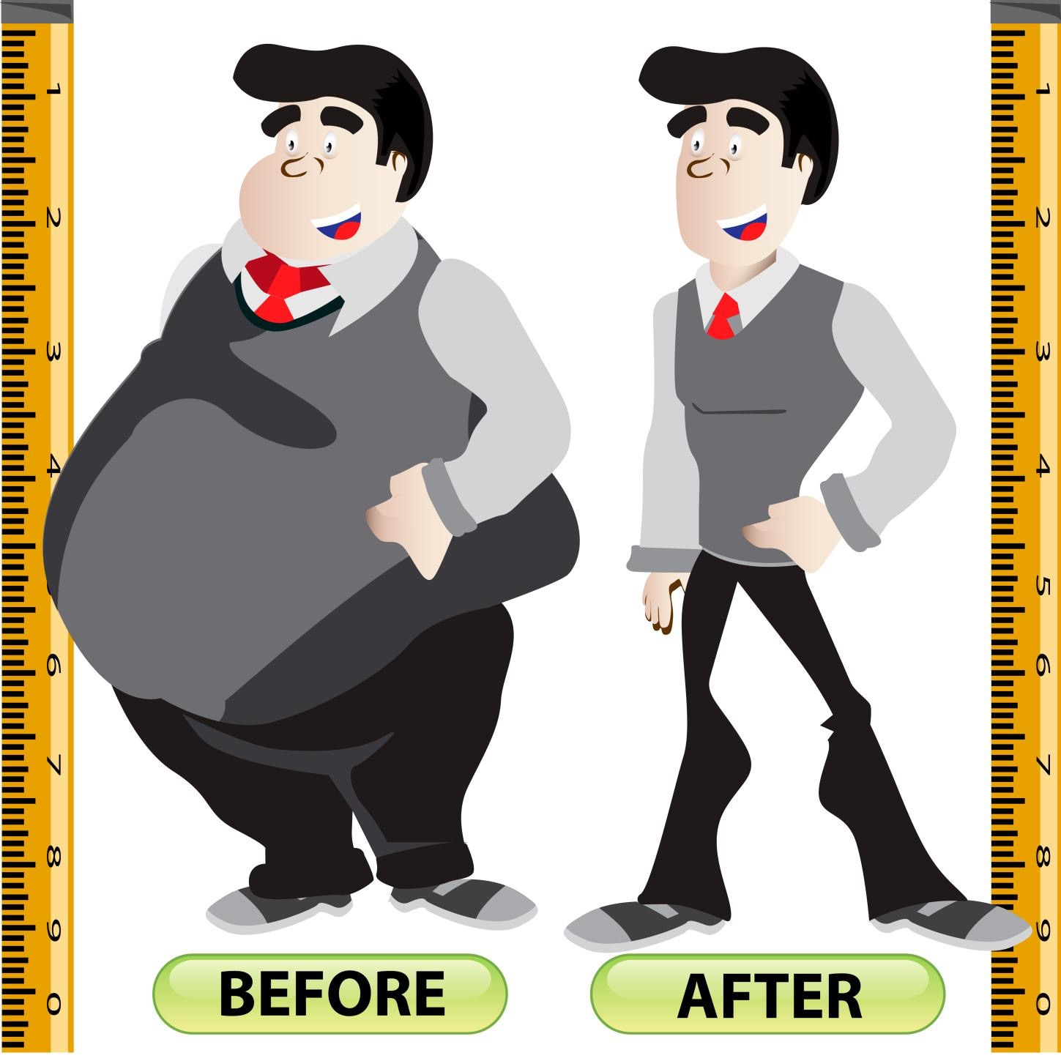
Definition of obesity:
Weight that is higher than what is considered as a healthy weight for a given height is described as overweight or obese.
Overweight and obesity are defined as abnormal or excessive fat accumulation that may impair health.

Slide 10
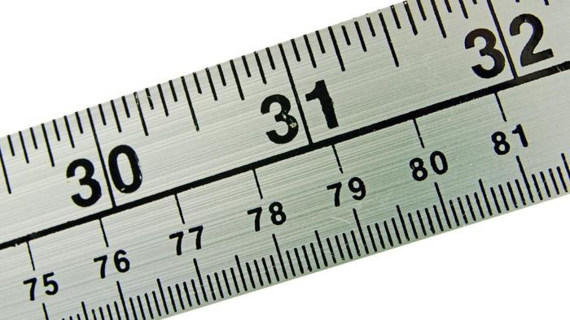
obesity can be measured by:
Body mass
index(BMI)
Waist circumference
Waist to hip ratio

Slide 11
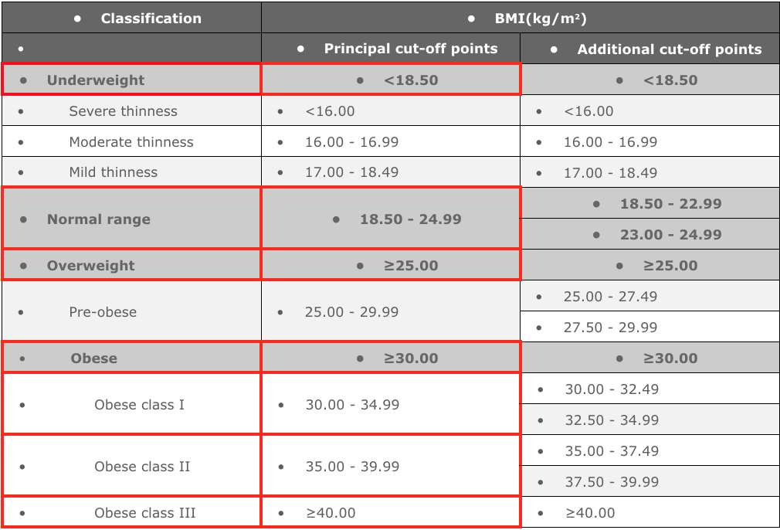
Classification according to the BMI
The International Classification of adult underweight, overweight and obesity according to BMI
• Source: Adapted from WHO, 1995, WHO, 2000 and WHO 2004.

Slide 12
obesity according to waist circumference
waist circumference is done to till if you're carrying excess body fat around your middle area.
Waist circumference should be measured at the midpoint between the lower margin of the least palpable rib and the top of the iliac crest. (WHO, 2008b)
Your health is at risk if your waist size is
Men | Over 94 cm (about 37 inches)
Women | Over 80 cm (about 31.5 inches)
These guidelines are based on World Health Organization and National Health and Medical Research Council recommendations.

Slide 13
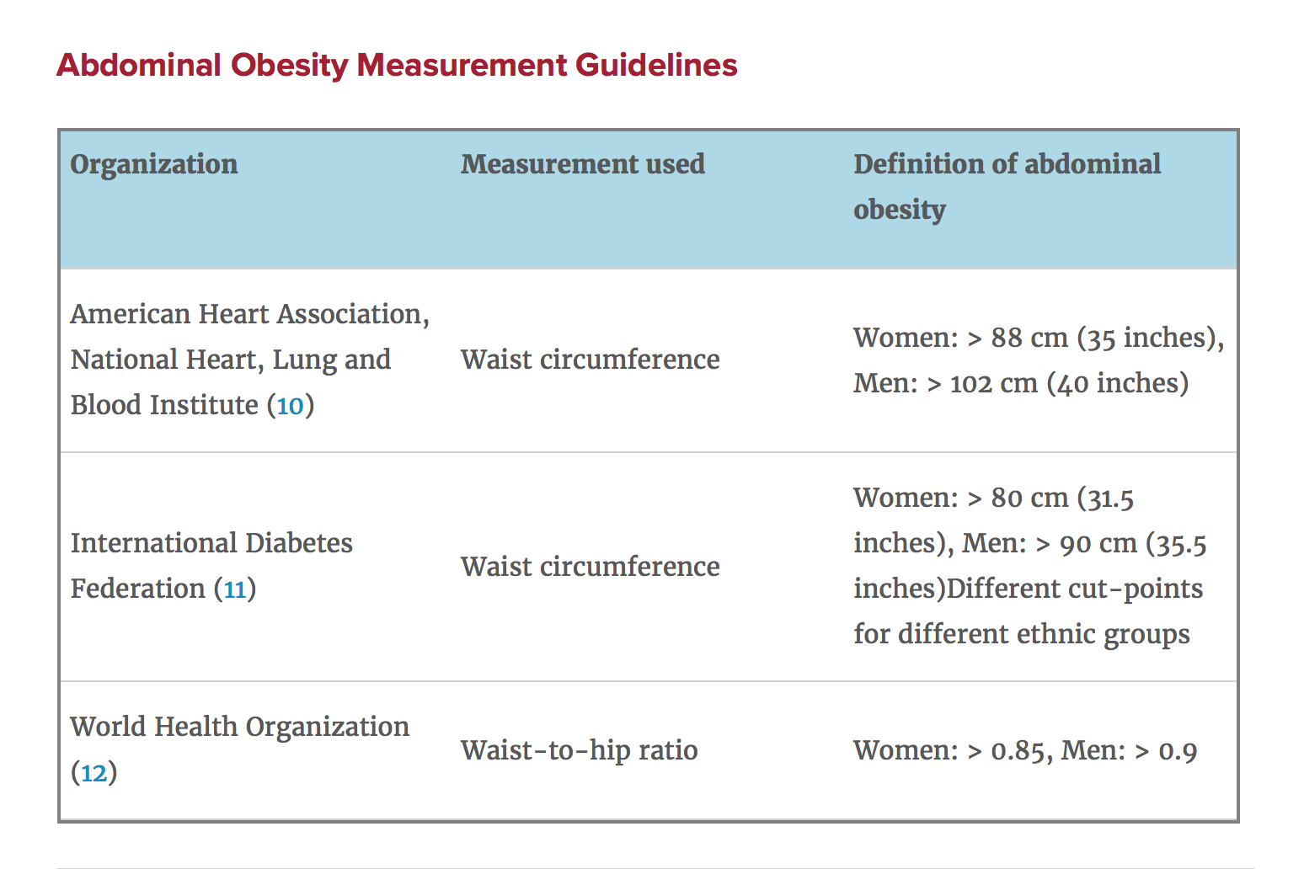
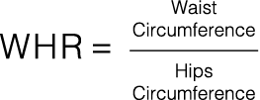
obesity according to waist-hip ratio
hip circumference measured from the widest portion of the buttocks.
the most predictive value for CVD

Slide 14
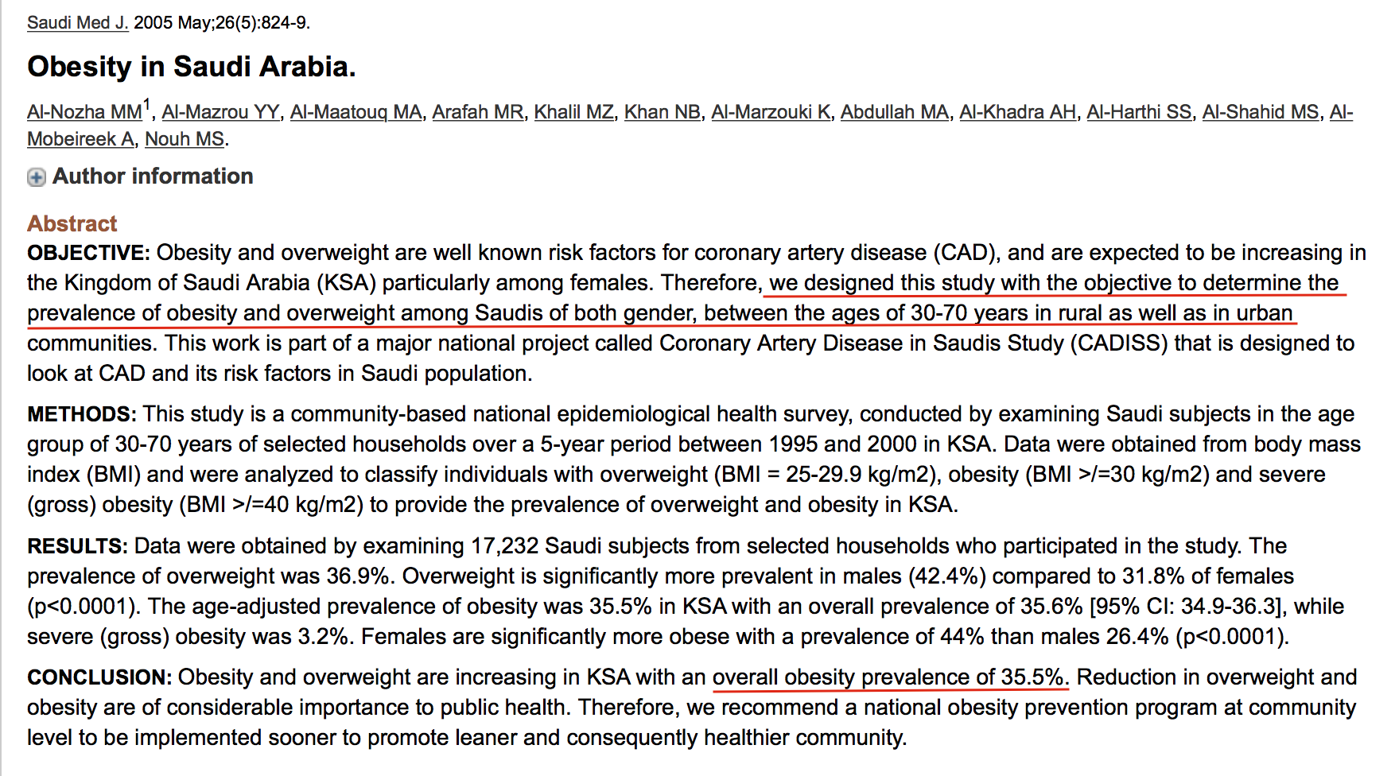
prevalence of obesity in Saudi Arabia

Slide 15
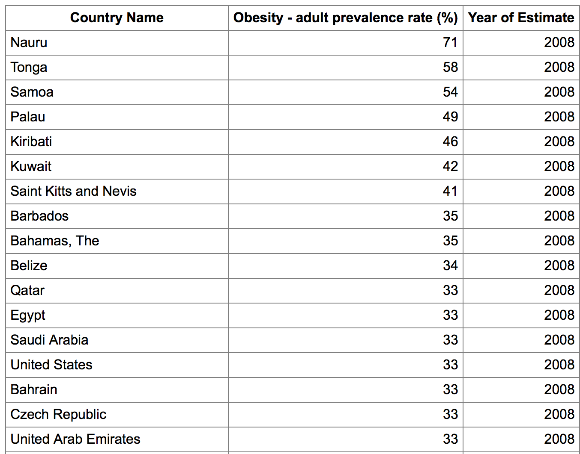
Ranking of countries with high prevalence of obesity
13

Slide 16
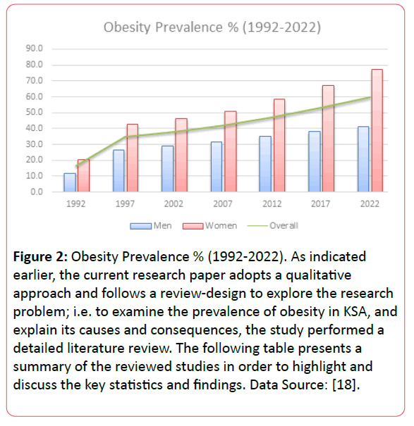

Slide 18
REFERENCES
1http://apps.who.int/iris/bitstream/10665/44583/1/9789241501491_eng.pdf
2-https://www.hsph.harvard.edu/obesity-prevention-source/obesity-definition/abdominal-obesity/
3- https://www.cdc.gov/obesity/adult/defining.html
4-https://www.heartfoundation.org.au/your-heart/know-your-risks/healthy-weight/waist-measurement
5-https://www.indexmundi.com/map/?v=2228
6- http://obesity.imedpub.com/a-review-of-prevalence-of-obesity-in-saudi-arabia.php?aid=17699

Slide 19
PREVENTION
Sarah Saad Alangari

Slide 21
Obesity Happen on Pound at Time. So Does Prevention.

Slide 22
How Can We Prevent Obesity?

Slide 23
Individual level
1- Follow a Healthy Diet.
2- Eat Small Portions of Food.
3- Exercise at Least 30 Minutes Daily.
4- Reduce Screen Time.

Slide 24
Individual level
5- Be Active.
6- Keep Track of your Weight, Body Mass Index, and Waist Circumference.
7-Avoid Using Food as a Reward or Withholding Food as a Punishment.

Slide 25
Community Level
1- Encourage Discussion of the Prevention of Childhood Obesity with Pregnant Mothers.
2-Increase Support for Breastfeeding.
3- Screening for Obesity (Using BMI and Waist Circumference).

Slide 26
Community Level
4-Increase Availability of Healthier Food and Beverage Choices in Public Facilities.
5-Improve Availability of Affordable Healthier Food and Beverage Choices in Public Facilities.
6-Restrict Availability of Less Healthy Foods and Beverages in Public Facilities.

Slide 27
Community Level
7-Institute Smaller Portion Size Options in Public Facilities.
8-Limit Advertisements of Less Healthy Foods and Beverages.
9-Discourage Consumption of Sugar-Sweetened Beverages.

Slide 28
Community Level
10-Require Physical Education in Schools.
11-Increase the Amount of Physical Activity in PE Programs in Schools.
12-Improve Access to Outdoor Recreational Facilities.
13-Enhance Infrastructure Supporting Bicycling.
14-Enhance Infrastructure Supporting Walking.

Slide 29
Community Level
15-Support Locating Schools within Easy Walking Distance.
16-Improve Access to Public Transportation.
17-Enhance Personal Safety in Areas Where Persons Are or Could Be Physically Active.
18- Promote Awareness-Raising Campaigns.

Slide 30
REFERENCES
https://www.cdc.gov/mmwr/pdf/rr/rr5807.pdf
https://www.nhlbi.nih.gov/health/health-topics/topics/obe/prevention

Slide 31
CAUSES OF OBESITY
Ghadeer Alzahrani

Slide 32
What are the most common causes of obesity in the community?

Slide 33
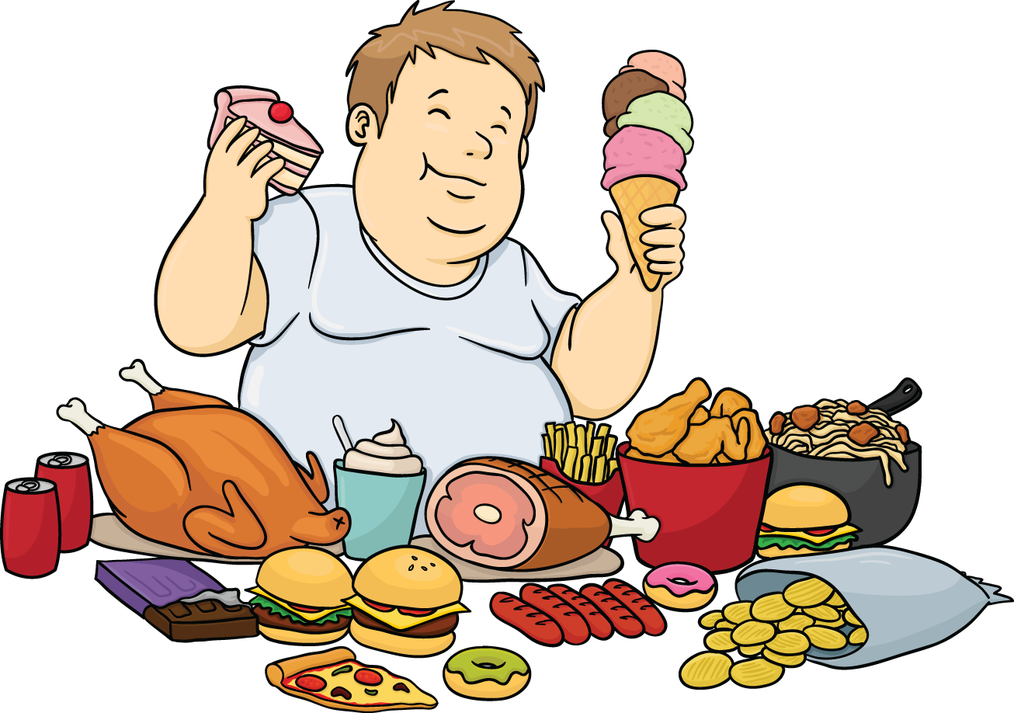

Slide 34
Unhealthy diet
Fast food & fizzy drinks
Wide variety of sweats
Saudi traditional food contains high fat
Diet high in simple carbohydrates
High consumption of red meat
No portion size control
Overeating
Frequency of eating (controversial)

Slide 35
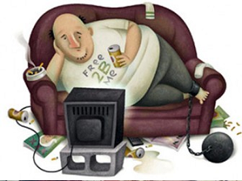

Slide 36
Physical inactivity
Sedentary lifestyle
Lack of exercise
Transportation mode (mostly cars)
Use of electronic devices for a long time in children

Slide 37
Diseases
Hypothyroidism
Polycystic ovary syndrome
Cushing's syndrome

Slide 38
Other causes:
Genetics
Psychological factors: such as boredom, sadness, stress, anger
Medications: certain antidepressants, anticonvulsants

Slide 39
Risk factors of obesity
Genetics
Family lifestyle.
Inactivity.
Unhealthy diet.
Medical problems.
Certain medications.
Social and economic issues.
Age.
Pregnancy.
Quitting smoking.
Lack of sleep.

Slide 40
REFERENCES
http://www.medicinenet.com/obesity_weight_loss/page3.htm
http://www.mayoclinic.org/diseases-conditions/obesity/basics/risk-factors/con-20014834

Slide 41
The HEALTH RISKS OF OVERWEIGHT AND OBESITY
RAWAN AL-YAHYA

Slide 42
People who are obese, compared to those with a normal or healthy weight, are at increased risk for many serious diseases and health conditions, including the following;

Slide 43
Obesity and Mortality:
Several epidemiologic studies found that mortality begins to increase with BMIs above 25 kg/m².
Persons with a BMI of 30 kg/m² or above have an increased mortality rate by 50 to 100 percent above that of persons with BMIs in the range of 20 to 25 kg/m². usually due to cardiovascular disease.
BMI of >40 carries a threefold increase in mortality.
Global status report on non-communicable diseases 2010 published by WHO estimated that 2.8 million people die each year as a result of being overweight.

Slide 44
Metabolic Syndrome:
A large waistline (abdominal obesity) is a greater risk factor for heart disease than excess fat in other parts of the body, such as on the hips.
The risk of having metabolic syndrome is closely linked to overweight and obesity and a lack of physical activity.
Those individuals have Insulin resistance and elevated blood glucose levels and may develop type 2 diabetes. Both cross-sectional and longitudinal studies show that abdominal obesity is a major risk factor for type 2 diabetes.

Slide 45
Metabolic Syndrome:
However, even those individuals who do not develop type 2 diabetes are at increased risk for coronary heart disease.
Hyperinsulinemia is associated with hypertension, increased total cholesterol levels with low HDL and high LDL, and increased triglyceride levels, all cardiovascular disease risk factors.
Genetics (ethnicity and family history) and older age are other factors that may play a role in causing metabolic syndrome.

Slide 46
Dyslipidemia:
Obesity result in an elevation in total cholesterol and triglycerides and a reduction HDL. Abdominal obesity can cause an increased production of LDL, putting an individual at greater risk of atherosclerosis. It has been estimated that, on average, each 10 pounds of excess fat produces an additional 10 mg of cholesterol daily.
A cross sectional study conducted on 1956 subjects aged (25 – 65) by Veghar et al in 2015, Hypercholesterolemia was associated with abdominal obesity.

Slide 47
Cardiovascular Disease:
Obesity leads to an increase in both heart attacks and strokes, independent of the effects associated with diabetes, hypertension, and elevated cholesterol.
As with diabetes and hypertension, abdominal fat appears to be of special concern in the development of cardiovascular disease.
The recent meta-analysis of Coutinho et al 2011. illustrates that central obesity is directly associated with cardiovascular mortality.
In addition to an increased risk of CHD, obesity has been associated with myocardial hypertrophy, cardiomyopathy, and congestive heart failure.
Excess adipose tissue requires an increase in blood flow, the supply of which requires greater cardiac output and increased cardiac work load

Slide 48
Hypertension:
High blood pressure is one of the most common complications of obesity, especially abdominal adiposity.
Obesity-related hypertension appears to be associated with the cytokines produced by adipose tissue
Data from the cohort study indicate that for every 10-pound weight gain, systolic blood pressure rose by an average of 4.5 mm Hg.
Conversely, a decrease of 1 kg. (2.2 pounds) in body weight results in a decrease of 0.3 to 1 mm Hg.
A study conducted by the Canadian Agency for Drugs and Technologies in Health in 2014 reveled that Greater weight loss correlated positively with greater reductions in blood pressure and cardiovascular risk.

Slide 49
Obstructive Sleep Apnea:
Obesity, particularly upper body obesity, is a risk factor for sleep apnea and has been shown to be related to its severity.
It has been estimated that as many as 60% to 70% of persons suffering from OSA are obese.

Slide 50
Cancer:
The World Health Organization estimates that between one-fourth and one-third of cancer cases in the world are attributable to excess weight and physical inactivity.
The American Cancer Society has published data showing increased mortality for colorectal and prostate cancer among obese men and for postmenopausal breast, endometrial, cervical, ovarian, and gallbladder cancer among obese women.

Slide 51
Colon Cancer:
Many studies have found a positive relation between obesity and colon cancer in men but a weaker association in women.
Breast Cancer:
Obesity is directly related to mortality from breast cancer, predominantly in postmenopausal women. As adipose tissue is the main source of estrogen for postmenopausal women.
Endometrial Cancer:
Obesity increases the risk of endometrial cancer. The risk is three times higher among obese women (BMI ≥ 30 kg/m2) compared to normal- weight women.

Slide 52
Women’s Reproductive Health:
Many Study suggested that the greater the BMI at age 18 years, the greater the risk of subsequent ovulatory infertility.
The most prominent condition associated with abdominal obesity is polycystic ovarian syndrome.
Obesity is associated with increased obstetric morbidity, including difficult labour and potential anaesthetic risks.

Slide 53
Osteoarthritis:
Overweight or obese individuals have an increased risk for the development of osteoarthritis.
It can cause mild or severe pain and usually affects weight-bearing joints in people who are obese.
It is a major cause of knee replacement surgery in patients who are obese for a long time.
It has been reported by a study done by CADTH in 2014 that participants who lost 10% or more of baseline body weight had greater reductions in knee pain, as well as gained greater improvement in function than those who didn’t .

Slide 54
Rheumatoid arthritis:
Obesity has been shown to increase the risk of rheumatoid arthritis (RA).
A meta-analysis of 13 studies, involving 400,609 participants, found that the relative risk RA was 1.21 for patients who were obese and 1.05 for patients who were overweight.
A 13% increase in the risk of RA was seen for every 5 kg/m2 increase in BMI

Slide 55
Gallbladder disease
Being overweight or obese may increase your chances of having gallstones.
Researchers have found that people who are obese may produce high levels of cholesterol. This may produce bile having more cholesterol than it can dissolve. When this happens, gallstones can form.
Nonalcoholic Fatty Liver Disease
NAFLD is more common in people who have central obesity (excessive abdominal fat), insulin resistance or type 2 diabetes, hypertension and dyslipidaemia.

Slide 56
Psychological Disorders:
There are numerous theories concerning the link between obesity and depression. Many causes have been proposed, including social stigma, negative self-image, dieting issues, the poor health that often accompanies obesity, and a neurochemical connection between the two conditions. k
cross-sectional study by Rene L et al in 2015 stated that an increased waist circumference were associated with depression. Female gender. Furthermore, low education and morbid obesity were risk factors for severe depression.

Slide 57
Psychological Disorders:
It has been estimated that over 30% of persons seeking medical treatment for obesity are binge eaters.
A meta-analysis showed that baseline excess weight was associated with depression in people 20 years or older, but not younger.⁶²
People who were obese had a 55% increased risk of depression, and people who were depressed had a 58% increased risk of becoming obese.

Slide 58
Children:
Overweight children are 2.4 times more likely to have total cholesterol levels of greater than 200 mg/dl than normal-weight children and adolescents.v
In a study conducted by Pires,Martins et al in 2015. 38.1% of obese children had insulin resistance and 12.5% had a combined dyslipidemic pattern.
Overweight children were 2.4 times as likely to have elevated diastolic blood pressures and 4.5 times as likely to have elevated systolic blood pressures as were their normal-weight counterparts.

Slide 59
Children:
In a study by Martín-espinosa et al in 2017, high levels of adiposity are associated with high blood pressure in early childhood in Spanish children.
Obese children were 77% more likely to have asthma symptoms. Researchers have suggested that the increased weight on the lungs compromises the airways, causing asthma symptoms; in addition, excess weight could lead to inflammation in the respiratory tract.

Slide 60
References
Overweight and Obesity. LAST UPDATED: February 23, 2017 - National Heart, Lung, and Blood Institute, National Institute of Health
Obesity: Definition, Comorbidities, Causes, and Burden. June, 2016 - American Journal of Managed Care
Dieting and Gallstones. LAST UPDATED: March 2013 - National Heart, Lung, and Blood Institute, National Institute of Health
Obesity and Obesity-Related Comorbidities in a Canadian First Nation Population, January 2011 - CDC
Non-alcoholic fatty liver disease: assessment and management, NICE guideline. July 2016 - National Institute of Health.
Obesity: Facts, Figures, Guidelines. December 2002 - West Virginia Department of Health and Human Resources.
Childhood Obesity: A Review of Increased Risk for Physical and Psychological Co-morbidities. jan 2013 - Clinical Therapeutics.
Global status report on noncommunicable diseases 2010 - WHO
Central obesity and survival in subjects with coronary artery disease: a systematic review of the literature and collaborative analysis with individual subject data. Coutinho et al, 2011
Depression, Obesity, and Metabolic Syndrome: Prevalence and Risks of Comorbidity in a Population-Based Representative Sample of Mexican Americans. Rene L et al, 2015.
Prevalence of high blood pressure and association with obesity in Spanish schoolchildren aged 4-6 years old. Martín-espinosa et al, 2017
Insulin resistance, dyslipidemia and cardiovascular changes in a group of obese children. Pires,Martins et al, 2015
The association between abdominal obesity and serum cholesterol level. by Veghar et al – 2015
Obesity management interventions delivered in primary care for patients with hypertension or cardiovascular disease: a review of clinical effectiveness. Ottawa: Canadian Agency for Drugs and Technologies in Health (CADTH). Rapid Response. 2014

Slide 61
EVIDENCE BASED APPROACH TO DECREASE WEIGHT
Reema Al-Ajaji

Slide 62
Diet and exercise

Slide 63
Clinical Scenario
A 52-year-old overweight man with hypertension and diabetes has made some dietary changes, but he has not initiated an exercise program for weight loss. He wonders if exercise will really make a difference?!

Slide 64
Clinical Question
How effective is exercise in reducing body weight and improving cardiac risk factors in overweight or obese patients?

Slide 65
Evidence-Based Answer
Exercise leads to a weight loss of (0.5 to 7.6 kg), compared with (0.1-kg) weight loss to a weight gain of (0.7 kg) with no treatment. Patients participating in higher-intensity exercise lose (1.5 kg) more than those participating in low-intensity exercise.
Regardless of whether the patient loses weight, exercise improves diastolic blood pressure and triglyceride, high-density lipoprotein, and glucose levels.
When a low-calorie diet is compared with exercise alone, a low-calorie diet leads to more weight loss [2.8 to 13.6 kg] versus (0.5 to 7.6 kg) .
However, trials with three to 12 months of follow-up show that participants who combine a low-calorie diet with exercise lose (1.1 kg) more than those who only diet.¹
^{(Cochrane Database Syst Rev.)}

Slide 66
Drug treatments

Slide 67
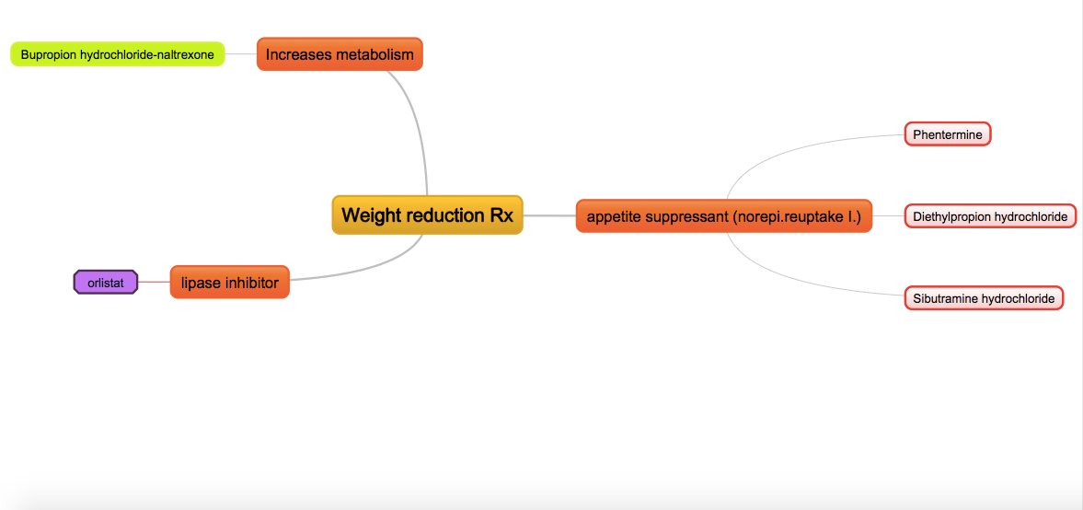
Types of drugs

Slide 68
Evidence Based Review of Weight Loss Medicines:
A report commissioned by the New Zealand Accident Compensation Corporation (ACC) NZHTA REPORT
August 2004
A systematic review

Slide 70
Bariatric surgery

Slide 71
When To refer Pt. to a bariatric surgeon?
Obesity: identification, assessment and management
Clinical guideline
Bariatric surgery is a treatment option for people with obesity if all of the following criteria are fulfilled:
• They have a BMI of 40 kg/m2 or more, or 35 kg/m2 and other significant disease (for example, type 2 diabetes or high blood pressure) that could be improved if they lost weight.
• All appropriate non-surgical measures have been tried but the person has not achieved or maintained adequate, clinically beneficial weight loss.
• The person is generally fit for anaesthesia and surgery.
• The person commits to the need for long-term follow-up.

Slide 72
Bariatric Surgical procedures:
Gastric banding.
Sleeve gastrectomy.
Gastric bypass.

Slide 73
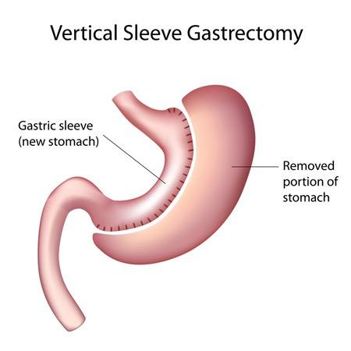

Slide 74
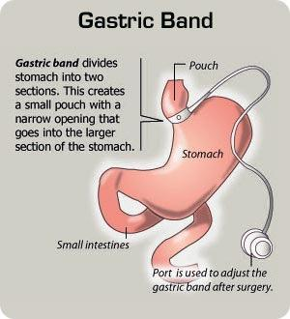

Slide 75
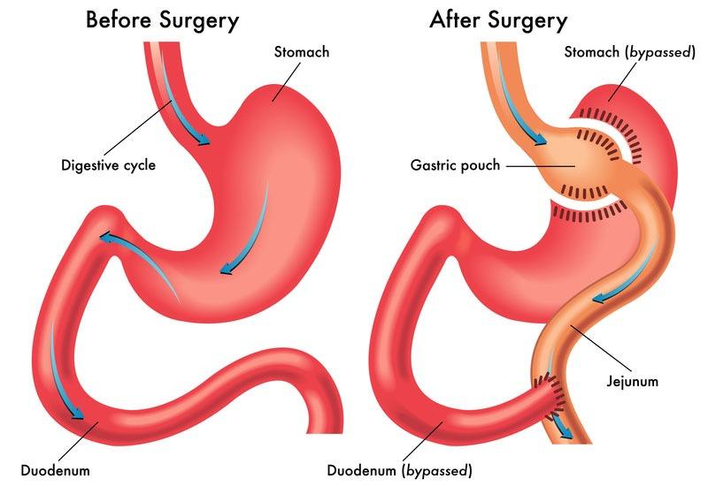

Slide 76
Bariatric surgery: an evidence-based analysis.
Health Quality Ontario.
Bariatric surgery generally is effective for sustained weight loss of about 16% for people with BMIs of at least 40 kg/m(2) or at least 35 kg/m(2) with comorbid conditions (including diabetes, high lipid levels, and hypertension)
Regarding specific procedures, there is evidence that malabsorptive techniques are better than other banding techniques for weight loss and resolution of comorbid illnesses. However, there are no published prospective, long-term, direct comparisons of these techniques available.
A decision-analysis model showed bariatric surgery results in increased life expectancy in morbidly obese patients when compared to diet and exercise.
A cost-effectiveness model showed bariatric surgery is cost-effective relative to nonsurgical management.

Slide 77
REFERENCES
American family physician organisation
Shaw K, Gennat H, O'Rourke P, Del Mar C. Exercise for overweight or obesity. Cochrane Database Syst Rev. 2006;(4):CD003817....
NZHTA REPORT August 2004 Volume 7 Number 6
https://www.nice.org.uk/guidance/cg189/chapter/1-recommendations
PUBMED

Slide 78
Role of Schools, Medical Students and Health Professionals in the Community

Slide 79
Role of School in Preventing Childhood and Adolescent Obesity
Obese adolescent females demonstrated significantly lower levels of self-esteem, which led to sadness, loneliness, and high-risk behaviors, such as smoking or alcohol consumption (Strauss, 2000).
The effects of childhood obesity do not stop at physical and psychological outcomes: Recent research indicates that childhood obesity may also affect cognition and therefore academic achievement (Yau et al., 2012).

Slide 80
Role of School in Preventing Childhood and Adolescent Obesity
1- Serving healthy choices in the lunchroom with adequate calories and nutrients.
2- Healthy meal should have increased vegetables, fruit, and whole grains; and curbed sodium, saturated fat, and trans fat.
3- Limiting availability and marketing of unhealthful foods and sugary drinks.

Slide 81
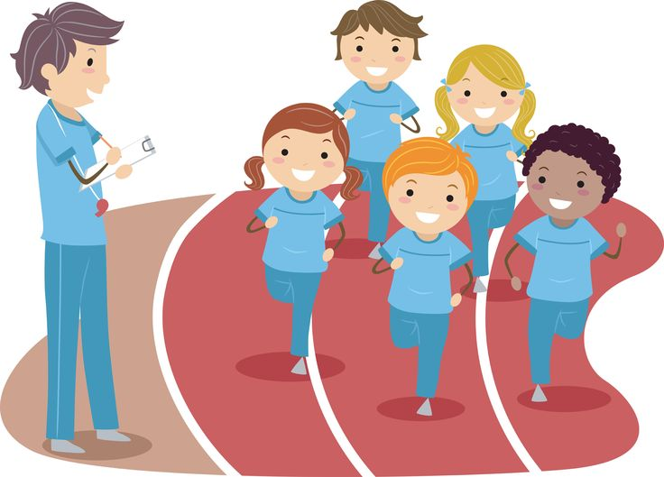
Role of School in Preventing Childhood and Adolescent Obesity
4-Provide nutritional education to the students through developmentally appropriate, culturally relevant, fun, participatory activities that involve social learning strategies.
5- Offering opportunities for physical activity. Schools should ensure that all children and youth participate in a minimum of 30 minutes of moderate to vigorous physical activity during the school day in a regular fashion.

Slide 82
Role of Medical Students and Health Professionals in the Community
Healthcare Professionals as Advocates
Serve as leaders and role models, within one’s practice and community, to encourage healthy changes in physical activity, nutrition, and the built environment.

Slide 83
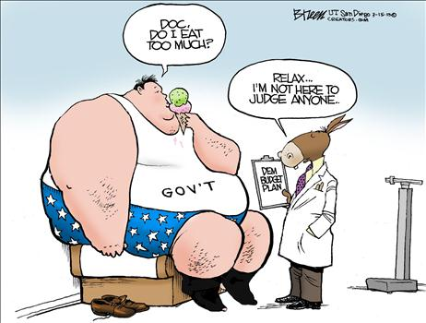
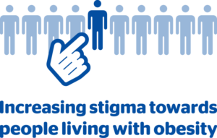
Role of Medical Students and Health Professionals in the Community
A recent study in the Lancet, showed that :
1- Most doctors are more reluctant to do some screening tests in patients with obesity than providing them education about health.
2-Obese patients receive lower quality of health care due to weight bias by their healthcare providers.

Slide 84
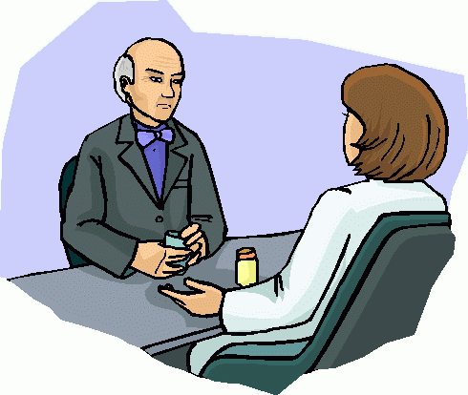
Role of Medical Students and Health Professionals in the Community
Require training in obesity prevention and lifestyle counseling, such as :
•Interpreting BMI percentile for age
•Counseling on nutrition and physical activity
•Motivational interviewing skills

Slide 85
Role of Medical Students and Health Professionals in the Community
Talking to Patients about Obesity
A recent study found that overweight and obese adults who report that their doctors have told them they are overweight are more likely to have accurate perceptions of their own weight and are also more likely to be interested in losing weight, and to have tried losing weight.

Slide 86
Role of Primary Care Physicians and Obstetricians in Preventing Obesity
1- Routinely measuring body mass index (BMI)
2- Counseling patients on healthy eating and activity
3-Prenatal providers can promote breastfeeding
4-They should also stress the importance of staying at a healthy weight before and during pregnancy.
5-Encourage pregnant women to quit smoking.

Slide 87
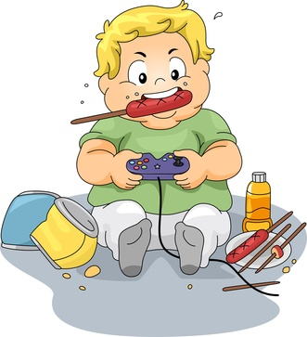
Role of Primary Care Physicians and Pediatricians in the Community
•Measure patients’ BMI percentile for age for children ages 2 and older; for younger children, measure weight-for-length percentile
•Counsel all patients and their families on healthy eating, physical activity, and healthy growth, regardless of current weight status
•Counsel all patients and their families to limit television time to no more than two hours per day and to remove televisions from children’s bedroom
•Establish procedures for follow-up assessment (including laboratory tests), counseling, and treatment plans for children who are overweight or obese

Slide 88
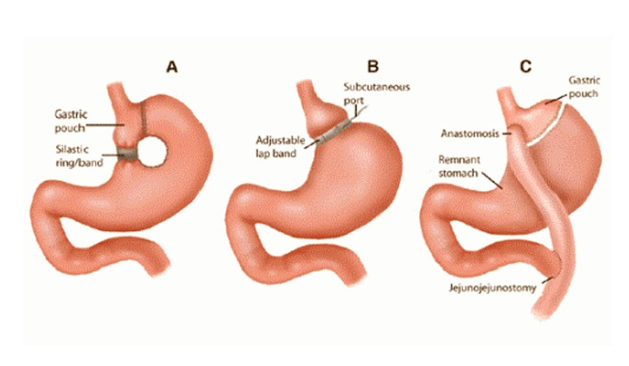
Role of Adult Physicians in Preventing Obesity
1- Routinely measure BMI in all adult patients
2- Order appropriate follow-up laboratory tests for patients who are overweight and obese and prescribe a long-term treatment strategy, which may include:
Counseling the behavioral interventions on diet/lifestyle change
Weight loss medication
Bariatric surgery

Slide 89
REFERENCES
•https://www.hsph.harvard.edu/obesity-prevention-source/obesity-prevention/healthcare/healthcare-professional-obesity-prevention/
•https://www.cdc.gov/mmwr/preview/mmwrhtml/00042446.htm
•Management of obesity: improvement of health-care training and systems for prevention and care, Lancet.
Medsacpe

Slide 90
MCQ
1) Which of the following is not a secondary cause of obesity?
CUSHING SYNDROME
INSULINOMA
HYPOTHYROIDISM
DM

Slide 91
MCQ
1) Which of the following is not a secondary cause of obesity?
CUSHING SYNDROME
INSULINOMA
HYPOTHYROIDISM
DM

Slide 92
2) What causes obesity?
A. Heredity
B. Poor eating habits
C. Lack of physical activity
D. All of the above

Slide 93
2) What causes obesity?
A. Heredity
B. Poor eating habits
C. Lack of physical activity
D. All of the above

Slide 94
3) Which one of the following BMIs is considered to be obese?
A. ≥ 25
B. ≥ 30
C. ≥ 18
D. ≥ 29

Slide 95
3) Which one of the following BMIs is considered to be obese?
A. ≥ 25
B. ≥ 30
C. ≥ 18
D. ≥ 29

Slide 96
4) You are caring for an obese 30-year-old woman who would like to consider pharmacotherapy for the treatment of her obesity. Which of the following medications, if any, demonstrates maintenance of weight loss once off the medication?
A. ORLISTAT
B. PHENTERMINE
C. SEBUTRAMINE
D. NONE OF ABOVE

Slide 97
4) You are caring for an obese 30-year-old woman who would like to consider pharmacotherapy for the treatment of her obesity. Which of the following medications, if any, demonstrates maintenance of weight loss once off the medication?
A. ORLISTAT
B. PHENTERMINE
C. SEBUTRAMINE
D. NONE OF ABOVE

Slide 98
5)What obesity measurement is best in its predictive value of CVD?
BMI
B. Hip circumference
C.Waist to hip ratio
D.Chest to waist ratio

Slide 99
5)What obesity measurement is best in its predictive value of CVD?
a. BMI B. Hip circumference C.Waist to hip ratio
D.Chest to waist ratio

