Slide 1
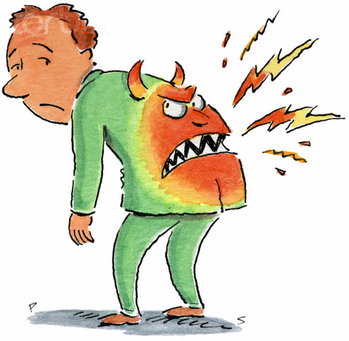
BACK PAIN
Done by :
Areej Alwehaib
Nuha Alhomyed
Amjad Abalkhail
Anjod Almuhareb

Slide 2
Objectives
Common causes Diagnosis including history, Red Flags, Examination
Brief comment on Mechanical, Inflammatory, Root nerve compression, Malignanc
Role of primary health care in management
When to refer to specialist Prevention and Education

Slide 3
back pain
(Introduction)

Slide 4
Back pain—in particular, low back pain—is a cause of many visits to the emergency department (ED).
In general practitioner between 70% and 85% of the population will suffer from back pain at some point in their lives.
low back pain is the primary cause of disability in individuals younger than 50 years.[1]
What poses an interesting challenge to physicians is determining the cause of this back pain.
The sources can include intervertebral disks, facet joints, vertebrae, neural structures, muscles, ligaments, and fascia.

Slide 5
Causes of the back pain
"non-specific" back pain
(there's no obvious cause)
Mechanical: the pain originates from the joints, bones or soft tissues in and around the spine).
Inflammatory back pain
Nerve root compression
malignancy

Slide 6
Mechanical pain :1-lumbr strain or sprain
2-degeneretaive processes of disc and facet joint
3-hernated disc and spinal stenosis
4- spondylolisthesis
5- spondylolysis
Malignancy :
1-multiple myeloma
2- metastatic carcinoma
infections:
1- osteomyelitis
2- TB
3- brucellosis
inflammation
1- Ankylosing spondylitis (AS)
2- psoriatic spondylitis
Differential diagnosis
Notes:
http://annals.org/aim/article/715687/diagnostic-evaluation-low-back-pain-emphasis-imaging

Slide 7
Mechanical pain:
1- tends to get better or worse depending on your position – for example, it may feel better when sitting or lying down
typically feels worse when moving
2- can develop suddenly or gradually
3- might sometimes be the result of poor posture or lifting something awkwardly, but often occurs for no apparent reason
may be due to a minor injury such as sprain (pulled ligament) or strain (pulled muscle)
Inflammatory back pain:
Age at onset of back pain <45 years
Back pain lasting > 3 months
Night pain
Early morning pain and stiffness lasting more than one hour
Insidious onset
Tenderness/inflammation over the joint
Increased by Rest and Relived by activity

Slide 8
Nerve Root Compression :
is characterized by radicular pain arising from nerve root impingement due to herniated discs.
Malignancy :
1- Metastatic tumors are found mostly in patients older than 50 years .
2-Metastatic disease is more common than primary tumors of the spine, and thoracic spine metastatic lesions are more common than lumbar
3- Patient usually has constitutional symptoms such as 9 fever ,Wight loss, loss of appetite and N\V

Slide 9
Classification
Acute
Last less than 3 months
Chronic
lasts longer than 3 months

Slide 10
Risk factors
smoking
obesity
age
female gender
physically strenuous work
psychologic factors
trauma
deformity
Notes:
http://www.uptodate.com/contents/evaluation-of-low-back-pain-in-adults

Slide 11
History
Personal data
Pain hx
Any neurological deficit
PMH
past surgical hx
medication hx
family hx
red flags

Slide 12
Physical Examination
back examination

Slide 13
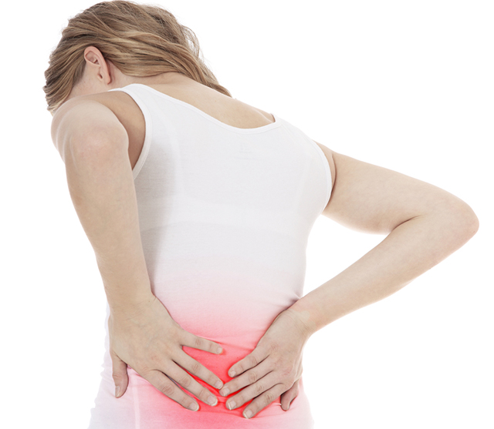
Case 1
Monirah is a 49 year old lady, presented to the clinic complaining of Lower back pain and leg pain for the last 2 Months

Slide 14
What do you want to ask Monirah ?

Slide 15
History:
1st : General Information:
Age, Gender, Occupation
2nd : Chief Complaint:
What brought you here today?
Since When? For how long?
3rd : History of Presenting Illness:
Site: where exactly ?
Onset: Rapid or insidious?
Character: Is the pain electrical or shock-like?
Radiation: to the thigh? to the knee ?
Alleviating factors? Sitting? Bending forward ? Exercise?
Time: Moring? Night?
Exacerbating factors?
Severity: Did it affect her daily activity? Analgesic requirements? Walking aids?
Previous Similar Episodes: When? How did it revile? Did you go to the doctor? Diagnosis? Medication?

Slide 16
Hx of Trauma?
Hx of Fractures?
Physiotherapy ?Any relief ?
Associated Symptoms:
Any pain in other joints?
Any joints swelling? Is it activity induced?
Morning stiffness?
Numbness? Paresthesia ?
Systemic manifestations ?
Constitutional Symptoms:
Nausea? Vomiting?
Night swats?
Fever?
Fatigue?
Loss of weight? Loss of appetite

Slide 17
4th: Past Medical & Surgical History
- Medical: Chronic, Past, Childhood diseases or problems?
- Previous Surgery: What? When? Why? Complications?
- Previous hospital admission?
- Physiotherapy or Rehabilitation?
- Medication History
- Blood Transfusion: When? Why? units? Complications?
- Allergies: What? Reaction? Relief?
5th: Social History
Marital status? Social support? Living conditions? Diet? Exercise? Traveling?
Smoking
Alcohol
6th:Systemic Review

Slide 18
History:
Lower back pain
Shooting Pain in the buttock and thigh that is worse when sitting
Hip pain
Burning or tingling down the leg
Weakness, numbness, or difficulty moving the leg or foot
A constant pain on one side of the rear
A shooting pain that makes it difficult to stand up

Slide 19
Physical Examination
General :
Permission
Explain
Privacy
Vital signs
Patient should be standing with the whole trunk exposed.
look
feel
movement
Neurological test
Special test
Motor
Sensory
Reflex
Straight leg raising
look for deformity
Side:
Normal kyphosis and lordosis > Ankylosing spondylitis
Back:
Scoliosis ( lateral curvature)
Feel each vertebral body for tenderness and palpate for muscle spasm .
Palpate over the SI joint.

Slide 20
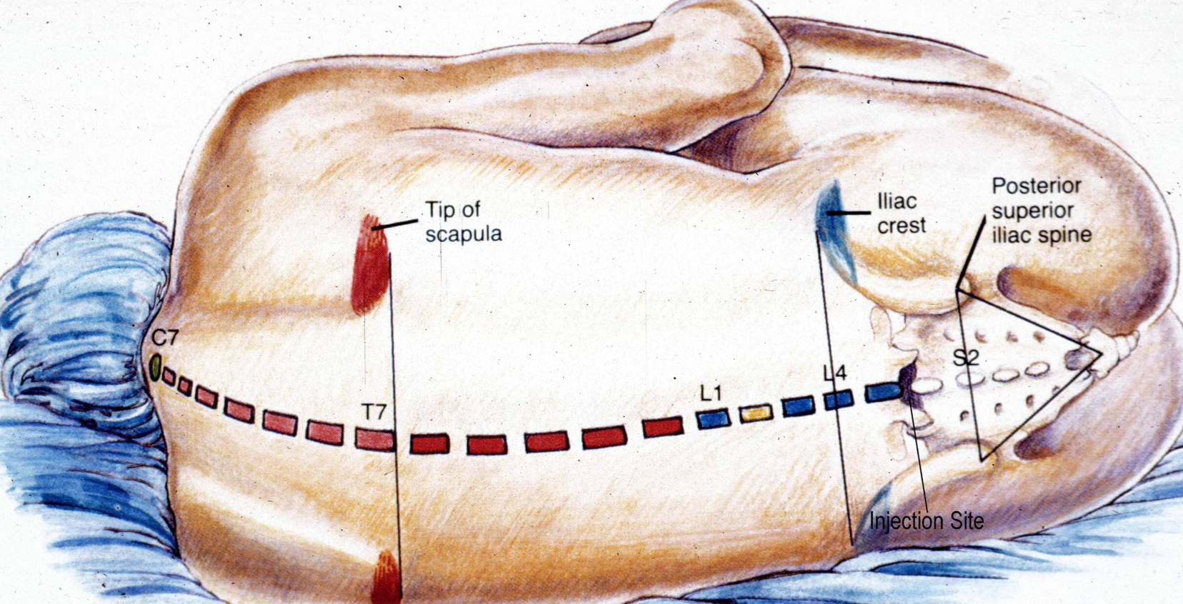
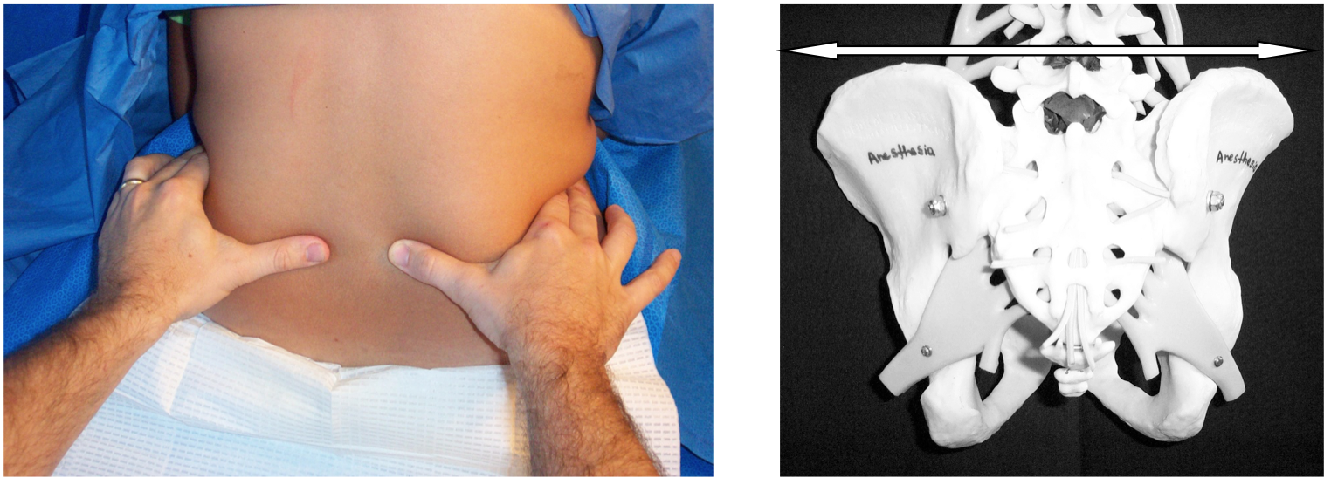

Slide 21
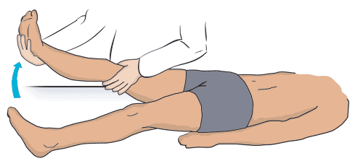
Straight leg raising (SLR)
raises the patient's extended leg with the ankle dorsiflexed.
Normally 80 – 90 degrees no pain
It will be limited by sciatica pain in lumbar disc prolapse. ( <60 ) → ( exactly from 30 to 60 )

Slide 22
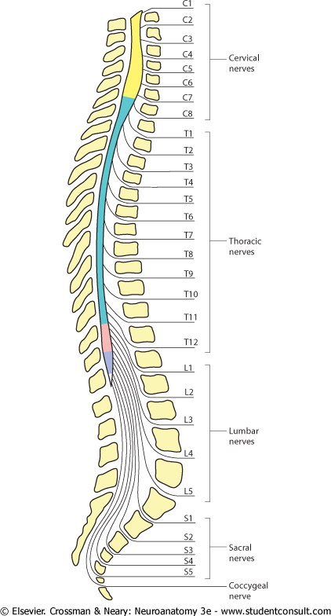
Neurologic testing
We should focus on the L5 and S1 nerve roots
98% of disc herniations occur at L4-5 and L5-S1
Reflexes
Motor
sensory

Slide 23
1- Reflexes
Knee (L3-4)
Ankle (S1-2)
Babinisky reflex

Slide 24
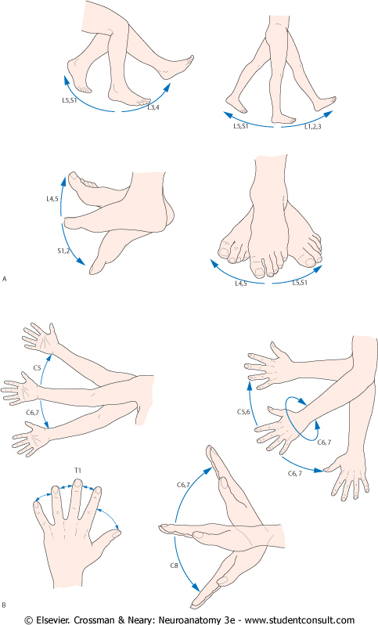
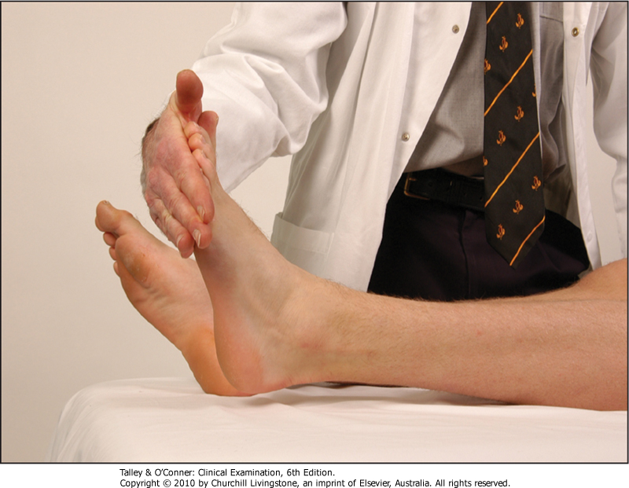
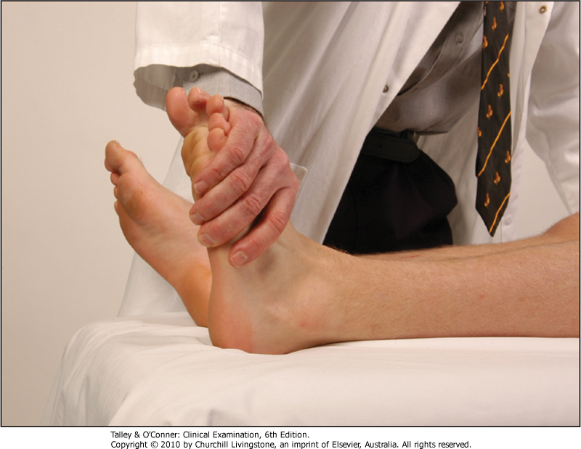
2- Motor
Ankle plantar flexion
Ankle dorsiflexion

Slide 25
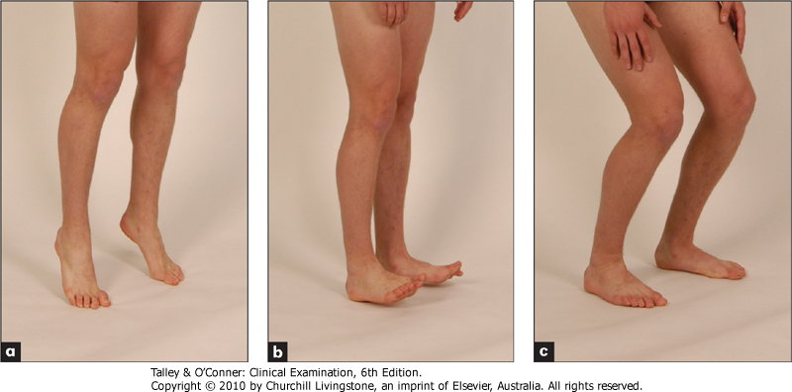
Motor
Walking on toes
Walking on heels
S1
L5

Slide 26
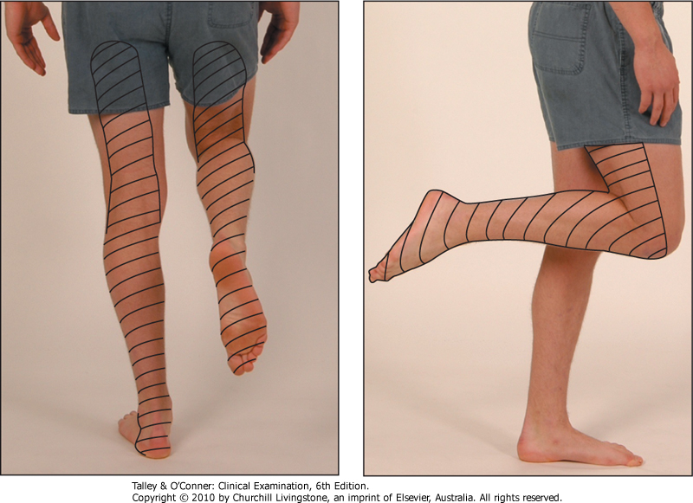
3- Sensory
Sciatic nerve (L4,5,S1,2)
Sensory distribution of the sciatic nerve

Slide 27
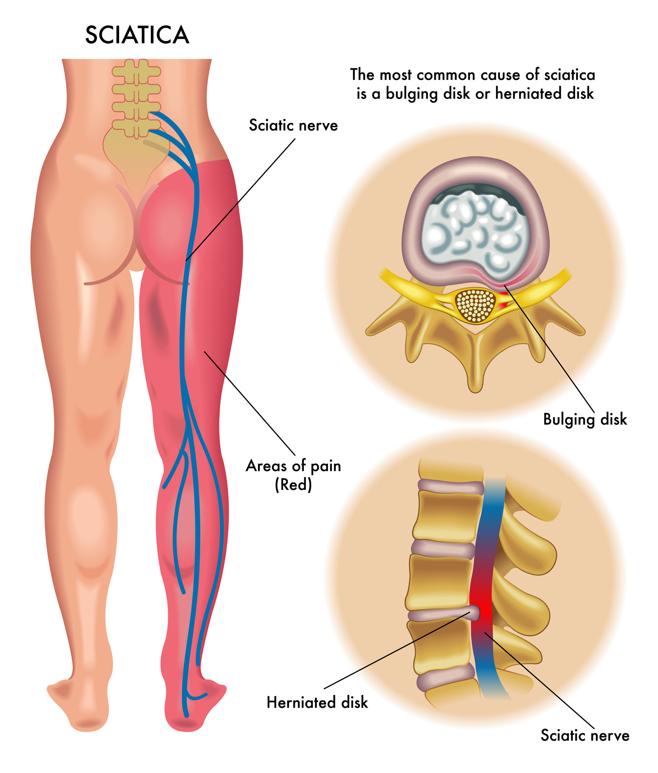
What is Sciatica ?
most commonly due to a prolapsed intervertebral disc pressing on a nerve root (L4–S1 nerve roots)
is characteristically more intense than referred low back pain
is aggravated by coughing and straining and
is often accompanied by symptoms of root pressure such as numbness and paraesthesiae, especially in the foot.

Slide 28
Diagnosis
In most cases medical imaging is not needed.
Exceptions to this are when :
bowel or bladder function is affected.
there is significant loss of feeling or weakness.
symptoms are long standing.
there is a concern of a tumor or infection.
Imaging
Do not routinely offer imaging in a non-specialist setting
Explain to the patient that if she/he is being referred for specialist opinion, she/he may not need imaging.
Consider imaging for people with low back pain with or without sciatica only if the result is likely to change management.

Slide 29
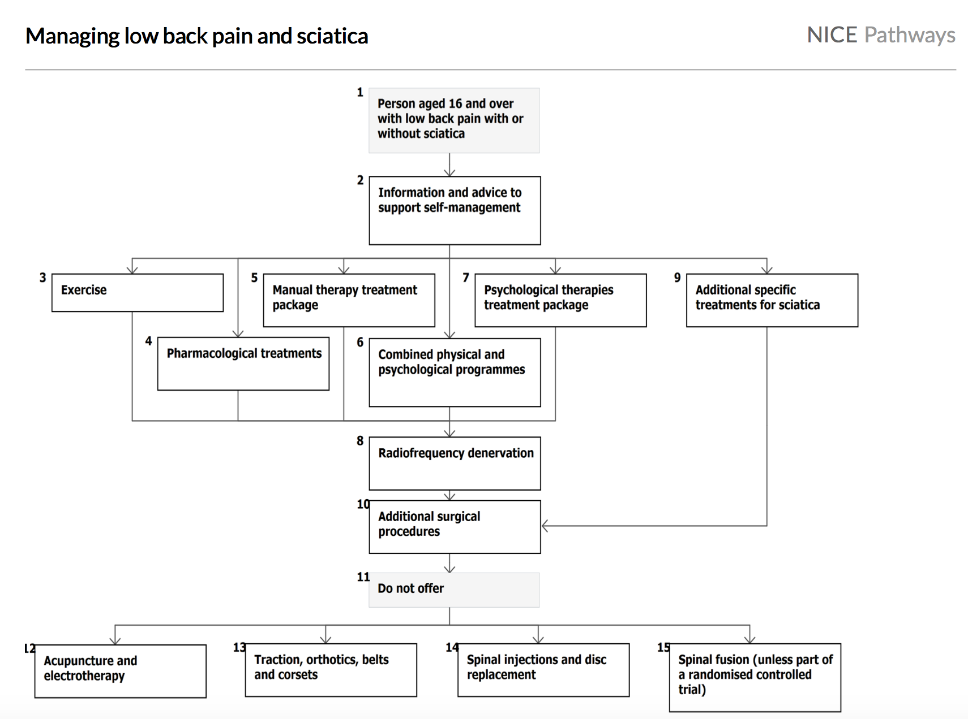
Management

Slide 30
Evidence-Based Medicine: http://www.aafp.org/afp/2002/0301/p925.html
Oral drugs
Analgesics
Antidepresant
Muscle relaxant
NSAIDS
Local injection
EPIDURAL STEROID
FACET JOINT
TRIGGER POINT AND LIGAMENTOUS
Nondrug
Heat therapy
physiotherapy
Acupuncture

Slide 31
Physiotherapy for sciatica

Slide 32
Prevention and education
1- Lose weight
2- Wear flat shoes
3- Avoid sudden movements which can cause muscle strain
4- Try to reduce any stress, anxiety and tension
5- Read more about recognizing and managing stress
Notes:
Keeping your back strong and supple is the best way to avoid getting back pain. Regular exercise, maintaining good posture and lifting correctly will all help.
1- Lose weight – too much upper body weight can strain the lower back; you can use the healthy weight calculator to find out whether you need to lose weight or not.
2- Wear flat shoes with cushioned soles as they can help reduce the pressure on your back
3- Avoid sudden movements which can cause muscle strain.
4- Try to reduce any stress, anxiety and tension, which can all cause or worsen back pain.
5- Read more about recognizing and managing stress,
stay active with regular exercise, such as walking and swimming, is an excellent way of preventing back pain.

Slide 33
Prevention and Education
Posture and Standing:
Sleeping:
Sitting
Lifting and carrying
Carrying backpack
Exercise
Notes:
1- Posture:
How you sit, stand and lie down can have an important effect on your back.
2- Standing:
Stand upright, with your head facing forward and your back straight. Balance your weight evenly on both feet and keep your legs straight.
3- Sitting
Make sure you sit upright with support in the small of your back. Your knees and hips should be level and your feet should be flat on the floor
4- Sleeping:
Your mattress should be firm enough to support your body while supporting the weight of your shoulders and buttocks, keeping your spine straight.
5- Lifting and carrying:
One of the biggest causes of back injury, particularly at work, is lifting or handling objects incorrectly.
Think before you lift:
can you manage the lift?
Push rather than pull – if you
have to move a heavy object across
the floor, it is better to push it
rather than pull it.
Distribute the weight evenly – if you are carrying shopping bags or luggage, try to distribute the weight evenly on both sides of your body
7- Exercise:
Exercise is both an excellent way of preventing back pain and of reducing it, but should seek medical advice before starting an exercise programs if you've had back pain for six weeks or more.
Exercises such as walking or swimming strengthen the muscles that support your back without putting any strain on it or subjecting it to a sudden jolt.

Slide 34
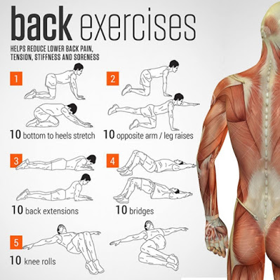

Slide 35
Red Flags of Back pain
Age of onset <20 yrs or >55yrs
Fever
Unexplained weight loss
Night sweats
History of violent trauma
Constant progressive, non mechanical pain (no relief with bed rest)
Past medical history of malignant tumors
Prolonged use of corticosteroids
Drug abuse, immunosuppression, HIV
Systematically unwell
Neurological symptoms (including cauda equine syndrome)

Slide 36
Case Scenario
A 30-year-old male presents to his family doctor with a six-month history of back pain. Currently, the pain is in the midline lower back and radiates into the buttock region bilaterally. He reports it is aggravated by his daily activities and also awakens him frequently at night. On direct questioning, he admits to being very stiff in the morning and somewhat less after doing his exercises.
He recalls stopping some of his sports activities in high school due to persistent hip pain that subsequently resolved.

Slide 37
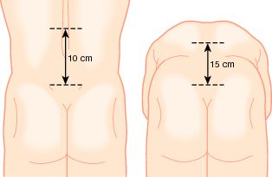
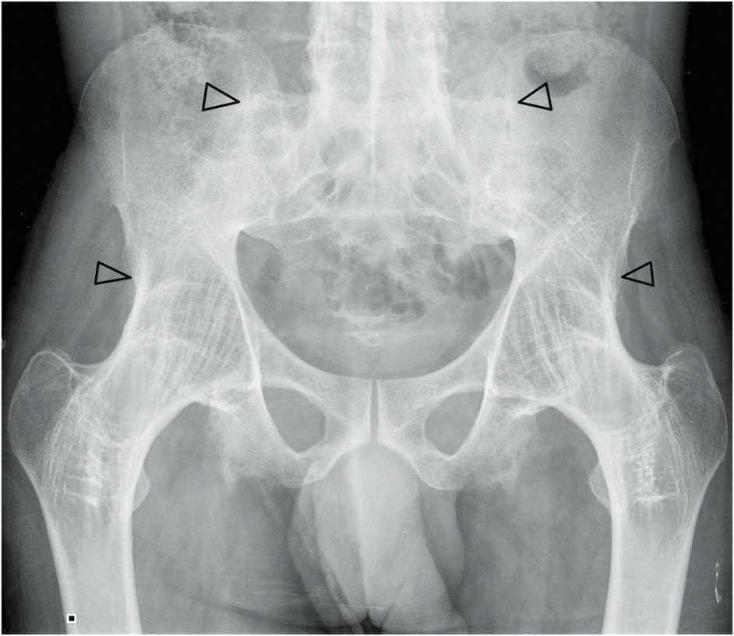
Examination
Investigation
X-ray ( loss of joint space and sclerosis at sacroiliac joint)
ESR elevation.
HLA B27 antigen +ve
Sacroiliac joint tenderness.
Schober’s test reveals limited lumbar flexion

Slide 38
Ankylosing spondylitis
DDX
It is a chronic inflammatory disorder of the axial skeleton, most often affect young adult males.
Sacroiliitis is the hallmark of the disorder. Ankylosing spondylitis can be associated with inflammatory bowel disease (Crohn’s and colitis) and anterior uveitis
Ankylosing spondylitis (AS)
Septic sacroiliitis.
Osteoid osteoma.
Spondylolisthesis.

Slide 39
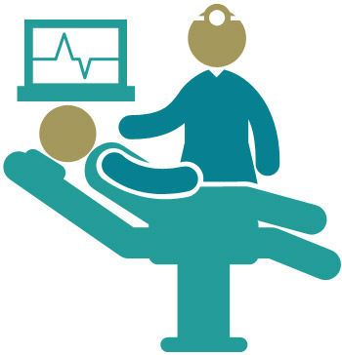
Treatment
Educational program on maintenance exercises with regular reinforcement
NSAIDs
Steroid

Slide 40
Case Scenario
A 66-year-old man presented with sharp, constant, low back pain, dating from a fall from a ladder 6 weeks earlier. On direct questioning, he did admit to vague malaise for over 6 months

Slide 41
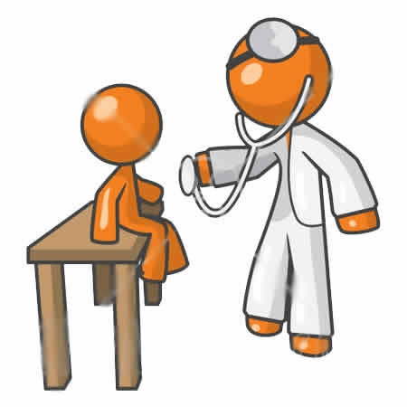
Examination
Our patient he was in considerable pain but otherwise seemed fairly fit.
He was mildly Anaemic but had no lymphadenopathy and no fever.
There were no signs of bruising, no finger clubbing, no hepatosplenomegaly and no abdominal masses

Slide 42
Investigation
His Hemoglobin was low (102g/l)
He had a normal differential white-cell count and a normal platelet count but his ESR was 98mm/h.
Raised Total serum proteins.
His serum albumin, creatinine and urea were normal.
He had a raised serum calcium level (3.2mmol/l)
Bone marrow examination showed an increased number of atypica plasma cells.

Slide 43
Diagnosis
DDX
Multiple myeloma is a malignancy of plasma cells.
It mainly affects patient over-60s age group. It may present with fatigue or bone pathology, such as bone pain, or even pathological fractures.
Increased osteoclast activity can result in hypercalcaemia, which can lead to, among other symptoms, weakness, polyuria, constipation and confusion. Marrow involvement can result in anaemia and infections.
Multiple Myeloma
Chronic lymphocytic leukemia
Metastatic cancer
Non-Hodgkin's lymphoma

Slide 44
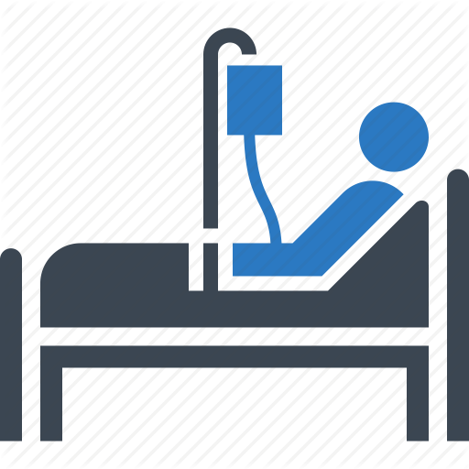
Treatment
Treatment can include therapy for anaemia, infection and hypercalcaemia.
Pathological fractures may require orthopaedic input and radiotherapy may have a role in the management of bone pain.

Slide 45
Case Scenario
A 40 years old lady, complaining of on/off low back pain for 6 months, she feels the pain during sleep and increased in intensity by movement.
No Hx of trauma, No fever or night sweat.
she lost 3 Kg over the past 6 months.
PMH, PSH: unremarkable
medication: Nil
Social Hx:
She is a teacher, her husband passed away last year. She is 'not satisfied of her job and thinking of quitting. She has 5 healthy children.

Slide 46
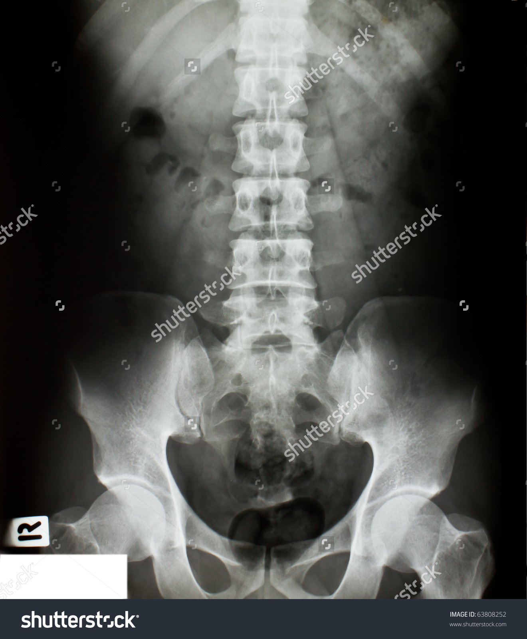
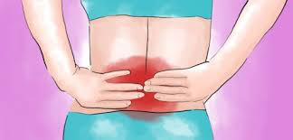
Examination
Investigation
There is a tenderness over the lumbar area but when the patient is distracted there is no pain.
other tests are unremarkable.
x-ray shows mild osteoarthritis.

Slide 47
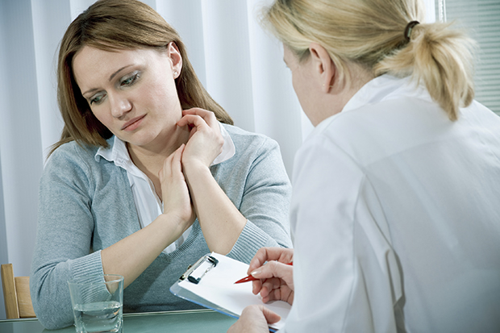
Treatment
counseling/ support.
antidepressant medication.
Psychotherapy
On follow up:
she is getting better with the antidepressant medication.
which suggest a psychological back pain
Notes:
Atkinson, Slater, Patterson, Grant, and Garfin (1991), in a systematic study of depressed male Veterans Administration chronic pain patients, found that 42% of patients experienced the onset of depression prior to the onset of pain, whereas 58% experienced depression after the pain began.
Polatin et al. (1993) reported that 39% of the chronic low back pain patients they evaluated displayed symptoms of pre-existing depression.
More recently, in a review of research studies in this area, Linton (2000) found that in 14 of the 16 reviewed studies, depression was found to have increased the risk for developing back pain problems.

Slide 48
Role of PHC in back pain management.

Slide 49
PHC provides non invasive treatment.
initial evaluation (Hx and PEx).
initial management of simple cases.
referral of complicated cases.
prevention and education

Slide 50
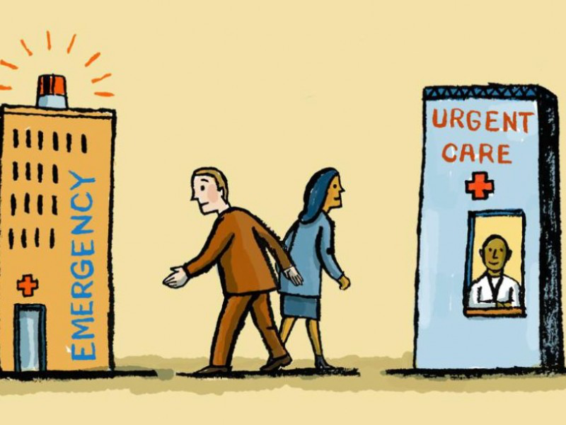
When to refer patients with back pain to specialist!!
Notes:
IN GENERAL, PRESENCE OF RED FALGS IS INDICATION FOR REFFERAL .
Specialty referral should be considered for potential surgical candidates, those for whom the diagnosis is uncertain, or those unresponsive to therapy. Referral may be appropriate for certain patients simply to provide reassurance.
Consider referral if the pain does not respond to 4-6 weeks of conservative management.

Slide 51
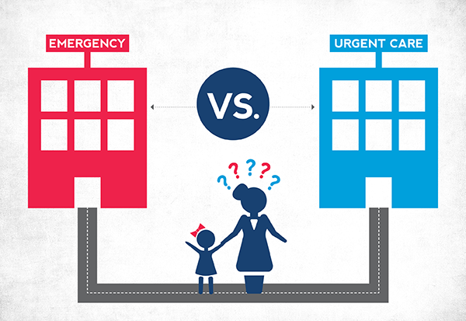
Cauda Equina Syndrome - EMERGENCY referral to ER.
Significant trauma – consider fractures – check for instability and refer URGENTLY to spinal surgery.
Weight loss, fever, history of cancer/HIV, Use of IV drugs or steroids – consider infection/tumor – refer URGENTLY for MRI Scan and to spinal surgery.
Widespread neurological signs – consider infection/tumor/neurological disease – refer SOON to neurology/spinal surgery/investigate further.

Slide 52
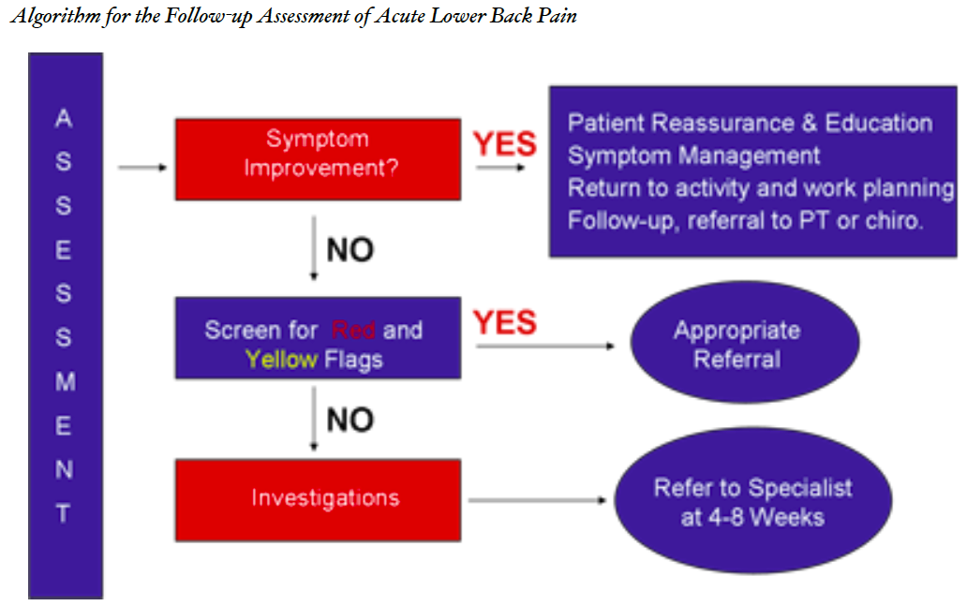

Slide 53
Mcq’s
Q1:Which one of these presentations considered to be mechanical back pain?
Get worse or better depending on patient positon
Relived by activity.
Associated with night pain
Notes:
Get worse or better depending on patient positon

Slide 54
Mcq’s
Q2:Which one of these presentations considered to be inflammatory back pain?
Get worse or better depending on patient positon
Relived by activity.
Associated with night pain
Notes:
Relived by activity.

Slide 55
Mcq’s
Q3:Which of the following is considered a Red flag in case of back pain?
Gender
Being underweight
History of malignancy
History of DM
Notes:
History of malignancy

Slide 56
Mcq’s
Q4:Psycho-social factors such as stress, depression, cognitive functioning, and job dissatisfaction can trigger back pain. This statement is ?
True
False
Notes:
(true) Back pain is directly associated with psychological and emotional distress. Even work dissatisfaction has been linked to persistent back pain. According to a press release from the University of Western Australia, 'workers who resign themselves to work in unsatisfactory jobs are more likely to suffer from serious, persistent lower back pain than others with a positive attitude'.

Slide 57
References
http://www.immunologyclinic.com/case.asp?chap=06&case=7
http://bestpractice.bmj.com/best-practice/monograph/179/diagnosis/differential.html
Steven J Atlas, Richard A Deyo, Evaluating and Managing Acute Low Back Pain in the Primary Care Setting.
Approach to Back Pain. Year 3 Clerkship Guide, Family Medicine Department, Schulich School of Medicine and Dentistry.
https://www.nice.org.uk/guidance/cg88/chapter/1-Guidance#referral-for-surgery
the Patient History: An Evidence-Based Approach to Differential Diagnosis, Edited By Mark c. HenderSon, Md, FacP
NICE guideline [NG59]: Low back pain and sciatica in over 16s: assessment and management.
American Academy of Family Physicians, Treatments for Sciatica.
Apley’s System of Orthopaedics and Fractures, Ninth Edition
Clinical Examination, 7th Edition “Talley and O’Connor
Institute for Quality and Efficiency in Health Care (October 9, 2014). "Slipped disk: Overview". Retrieved 2 July 2015.

