Slide 1
Breaking Bad News

Slide 3
Objectives :
Definition & importance of bad news.
Barriers to effectively braking bad news.
Role of primary care physicians.
Approaches to break bad news:
SPIKES technique
ABCDE technique
Examples.

Slide 4
What can be considered as a bad news ?
any information that adversely and negatively alters the patient’s view of her or his future.
* Buckman R. Breaking bad news: why is it so difficult? BMJ 1984;288:1597-9.
Notes:
N.B: Bad news doesn't always have to be fatal. Like telling a patient that he/she requires a knee surgery, this could be a bad news for them. It is subjective.

Slide 5
Importance of Breaking Bad News Skills
It changes how the news will affect the patient.
More satisfying for patients and their families.
Has positive therapeutic outcome.

Slide 6
“The life of a sick person can be shortened not only by the acts, but also by the words or the manner of a physician.”
American Medical Association’s first code of medical ethics 1847

Slide 7
Barriers to Effectively Braking Bad News
Differences in cultural beliefs and values.
Language barriers.
The level of involvement of the family in discussions and decisions.
Fear of causing pain, or being blamed for therapeutic failure.
Lack of training in breaking bad news.
* Breaking bad news: Evidence from the literature and recommended steps.
Notes:
**Breaking bad news: Evidence from the literature and recommended steps**

Slide 8
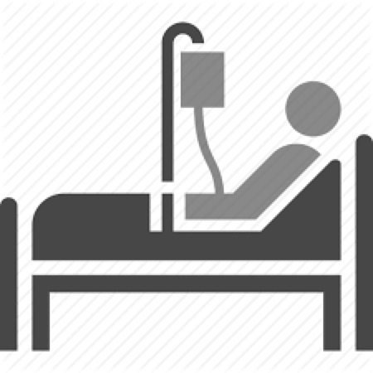
How to break bad news?
SPIKES
Baile and Buckman
ABCDE
Rabow and Mc phee’s

Slide 9
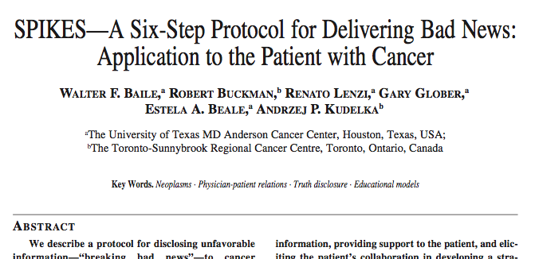

Slide 10
Step 1: Setting Up the Interview
Arrange for some privacy.
Involve significant others.
Sit down
Make connection with the patient.
Manage time constraints and interruptions
Notes:
Arrange for some privacy. An interview room is ideal, but, if one is not available, draw the curtains around the patient’s bed. Have tissues ready in case the patient becomes upset.
• Involve significant others. Most patients want to have someone else with them but this should be the patient’s choice. When there are many family members, ask the patient to choose one or two family representatives.
• Sit down. Sitting down relaxes the patient and is also a sign that you will not rush. When you sit, try not to have barriers between you and the patient. If you have recently examined the patient, allow them to dress before the discussion.
• Make connection with the patient. Maintaining eye con- tact may be uncomfortable but it is an important way of establishing rapport. Touching the patient on the arm or holding a hand (if the patient is comfortable with this) is another way to accomplish this.
• Manage time constraints and interruptions. Inform the patient of any time constraints you may have or inter- ruptions you expect. Set your pager on silent or ask a colleague to respond to your pages.

Slide 11
Step 2: Assessing the patient Perception
Using open-ended questions to create a reasonably accurate picture of how the patient perceives the medical situation. ex“What have you been told about your medical situation so far?” or “What is your understanding of the reasons we did the MRI?”. Based on this information you can correct misinformation and tailor the bad news to what the patient understands.
Notes:
For example, “What have you been told about your medical situation so far?” or “What is your understanding of the reasons we did the MRI?”.

Slide 12
Step 3: Obtaining The Patient’s Invitation
Ask the patient: “do you want to hear the test results?” If patients do not want to know details, offer to answer any questions they may have in the future or to talk to a relative or friend.
Notes:
For example, “What have you been told about your medical situation so far?” or “What is your understanding of the reasons we did the MRI?”.

Slide 13
Step 4: Giving Knowledge And Information To The Patient
Warning the patient that bad news is coming may lessen the shock that can follow the disclosure of bad news. Ex “I'm sorry to tell you that…”.
Try to use nonmedical words “spread” instead of “metastasized” and “sample of tissue” instead of “biopsy.”
Avoid excessive bluntness.
Give information in small chunks and check periodically as to the patient’s understanding
When the prognosis is poor, avoid using phrases such as “There is nothing more we can do for you.”
Notes:
Bluntness example: (“You have very bad cancer and unless you get treatment immediately you are going to die.”)

Slide 14
Step 5: Addressing The Patient’s Emotions With Empathic Responses
Patients’ emotional reactions may vary from silence to disbelief, crying, denial, or anger.
Observe for any emotion on the part of the patient.
After you have given the patient a brief period of time to express his or her feelings,
Let the patient know that you have connected the emotion with the reason for the emotion by making a connecting statement.

Slide 15
Step 6: Strategy and Summary
Before discussing a treatment plan, it is important to ask patients if they are ready at that time for such a discussion.
Exploring the patient's knowledge, expectations, and hopes (step 2 of SPIKES) will allow the physician to understand where the patient is and to start the discussion from that point.
Presenting treatment options to patients when they are available is not only a legal mandate in some cases, but it will establish the perception that the physician regards their wishes as important.
Notes:
Bluntness example: (“You have very bad cancer and unless you get treatment immediately you are going to die.”)

Slide 16
ADVANCE PREPARATION
BUILD A THERAPEUTIC RELATIONSHIP
COMMUNICATE WELL
DEAL WITH PATIENT AND FAMILY REACTIONS
ENCOURAGE AND VALIDATE EMOTIONS

Slide 17
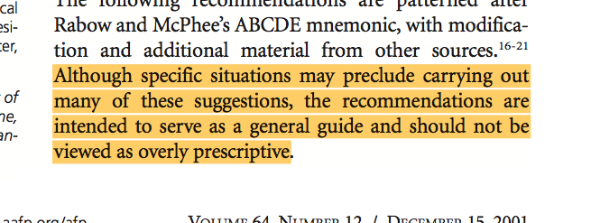
Notes:
Bluntness example: (“You have very bad cancer and unless you get treatment immediately you are going to die.”)

Slide 18
ADVANCE PREPARATION
Arrange for adequate time, privacy and no interruptions (turn pager off or to silent mode).
Review relevant clinical information.
Mentally rehearse, identify words or phrases to use and avoid.
Prepare yourself emotionally.
Notes:
Bluntness example: (“You have very bad cancer and unless you get treatment immediately you are going to die.”)

Slide 19
BUILD A THERAPEUTIC RELATIONSHIP
Determine what and how much the patient wants to know.
Have family or support persons present.
Introduce yourself to everyone.
Warn the patient that bad news is coming.
Use touch when appropriate.
Schedule follow-up appointments.
Notes:
Bluntness example: (“You have very bad cancer and unless you get treatment immediately you are going to die.”)

Slide 20
COMMUNICATE WELL
Ask what the patient or family already knows.
Be frank but compassionate; avoid euphemisms and medical jargon.
Allow for silence and tears; proceed at the patient's pace.
Have the patient describe his or her understanding of the news; repeat this information at subsequent visits.
Allow time to answer questions; write things down and provide written information.
Conclude each visit with a summary and follow-up plan.
Notes:
Bluntness example: (“You have very bad cancer and unless you get treatment immediately you are going to die.”)

Slide 21
DEAL WITH PATIENT AND FAMILY REACTIONS
Assess and respond to the patient and the family's emotional reaction; repeat at each visit.
Be empathetic.
Do not argue with or criticize colleagues.
Notes:
Bluntness example: (“You have very bad cancer and unless you get treatment immediately you are going to die.”)

Slide 22
ENCOURAGE AND VALIDATE EMOTIONS
Explore what the news means to the patient.
Offer realistic hope according to the patient's goals.
Use interdisciplinary resources.
Take care of your own needs; be attuned to the needs of involved house staff and office or hospital personnel.
Notes:
Bluntness example: (“You have very bad cancer and unless you get treatment immediately you are going to die.”)

Slide 23
Role of Primary Care Physicians
Notes:
The family physician has a legal obligation to obtain informed consent from the patient and a duty to inform the patient of the news, unless the patient refuses. Ideally, the physician can take advantage of the knowledge of the family to promote a congenial family alliance. Asking the family why they don't want to tell the patient can uncover relational issues and dysfunctional family dynamics.4 The family physician must be prepared for the wide range of emotions available for the patient and the family. These may vary from loving acceptance to anger and rage.
Finally, the physician must be able to assess personal emotional reactions to the conversation.

Slide 24
Communicating bad news is an essential skill for primary care physicians.
When patients are diagnosed with cancer, primary care physicians often must deliver the bad news, discuss the prognosis, and make appropriate referrals.
Must be prepared for the wide range of emotions
Must be able to assess personal emotional reactions to the conversation.
Notes:
Bluntness example: (“You have very bad cancer and unless you get treatment immediately you are going to die.”)

Slide 25
Examples

Slide 26
A 57-year-old male school teacher recently received a screening colonoscopy. During the procedure, a mass was biopsied. The mass was diagnosed as a poorly differentiated adenocarcinoma. The patient is waiting at the clinic to see you ( a primary care physician) to discuss the results.
How would you tell this patient the news?
Notes:
Bluntness example: (“You have very bad cancer and unless you get treatment immediately you are going to die.”)

Slide 27
A 27-year old male came to your primary care clinic for pre-mariatal medical assessments. His results showed him to be positive for HIV.
How would you approach this patient?
Notes:
Bluntness example: (“You have very bad cancer and unless you get treatment immediately you are going to die.”)

Slide 28
Quiz

Slide 29
Which of the following is a correct statement regarding the family of the patient in breaking bad news?
Do not allow them to join the conversation.
Invite them but only after delivering the bad news
It is recommended to involve them in the meeting of breaking bad news.
All above is correct

Slide 30
Which of the following habits is good for preparation prior to delivering the bad news?
Warn the patient that a bad news are coming
Set a public place to tell the patient the bad news. So, they can’t cry.
Do not make anyone of the patient’s family to set with you during telling the news.
Let the nurse set with you. So, she/he can witness any harmful thing can caused by the angry patient

Slide 31
When you were telling a mother that her daughter has a fetal congenital heart disease, she started crying. What is the appropriate thing to do?
Tell her that her daughter will be okay to give her a hope.
Stay in silence and give the mother time.
Be empathetic
Say to the mother: “you are adult. You have to stop crying”

Slide 32
Which of the following consequences is expected to happen when the physician delivers the bad news in inappropriate way?
Patients may harsh treatments beyond the point where treatment may be expected to be helpful
Can cause psychological harm to the patient
Considered as ethical issue.
All above

Slide 33
Thank You

Slide 34
References
Pfeifer, Mark P., et al. "The discussion of end-of-life medical care by primary care patients and physicians." Journal of General Internal Medicine 9.2 (1994): 82-88.
Baile, Walter F., et al. "SPIKES—a six-step protocol for delivering bad news: application to the patient with cancer." The oncologist 5.4 (2000): 302-311.
Vandekieft, Gregg K. "Breaking bad news." American family physician 64.12 (2001).
Special thanks to group A1 - 433.

