Slide 1
Common Psychiatric Problems in Primary Care
Arwa Al-Naseeb
Nada Dawood
Hajar Al-Otaibi
Mariam Bawazir
Afnan Al-Shenaifi

Slide 2
Objectives
Highlight the prevalence of anxiety, depression , and somatization in Saudi Arabia.
Highlight the aetiology of anxiety, depression and somatization.
Highlight on use of Tricyclic antidepressants and Selective Serotonin Reuptake Inhibitors “SSRI”.
Discuss the clinical features and management of anxiety in family medicine setting.
Discuss the clinical features and management of depression in family medicine setting.
Discuss the clinical features and management of psycho-somatic illness in family medicine setting.
Brief discussion about the role of counseling and psychotherapy in the management of common psychiatric problems in family medicine.
When to refer to Psychiatrist.

Slide 3
Q1
Generalised Anxiety Disorder (GAD) is a pervasive condition in which the sufferer experiences:
Fear of fear.
Continual apprehension and anxiety about future events.
Continual flashbacks to past events.
A desire to check that the environment is safe.

Slide 4
Q2
If a person is diagnosed with specific phobia that interferes with his life, what is the best way of management:
SSRI.
Exposure therapy.
Avoidance of feared object.
All above.

Slide 5
Q3
In Obsessive Compulsive Disorder (OCD) compulsions are generally thought to be which of the following:
Repetitive or ritualized behaviour patterns that the individual feels driven to perform in order to prevent some negative outcome happening.
Repetitive thoughts about harming or distressing others.
Overwhelming desires to behave in an inappropriate fashion.
Ritualised worrying about negative outcome of events.
Notes:
Correct!
Compulsions : Repetitive or ritualized behaviour patterns that an individual feels driven to perform in order to prevent some negative outcome happening.

Slide 6
Q4
What is the most common psychatric disorder?
Phobia
Obsession
Anxiety
Depression

Slide 7
Q5
Somatizing patients may present with:
Back pain.
Depression.
Headache.
All of the above.

Slide 8
1 in 4 people in the world will be affected by mental or neurologic disorders at some point in their lives
World Health Organization

Slide 9
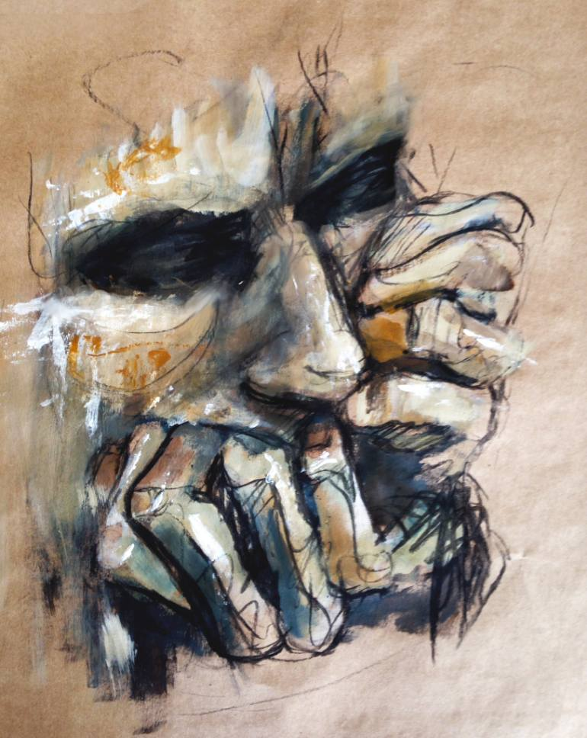
Anxiety
Arwa Al-Naseeb

Slide 10
Anxiety disorders
Anxiety is a normal human physiological response that helps us respond to potential threats or dangers. We cannot get by without it.
With an increase in anxiety, our performance should increase accordingly (e.g. preparing for exams).
Anxiety becomes a problem when the stressor overwhelms us, resulting in poor performance, or if the unwanted consequences of the anxiety response give us undesirable physiological consequences
The stressor causes limbic activation, which in turn leads to autonomic and neuro-endocrine activity (down-regulation) that causes various physiological responses.

Slide 11
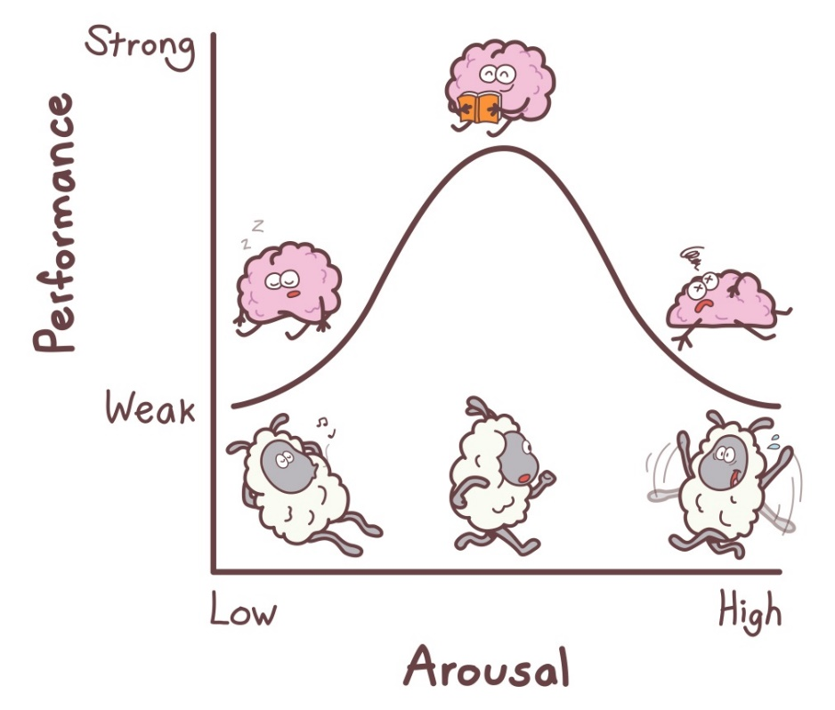
Prevalence and classification of anxiety
Anxiety disorders affect 14% of the population, with many people fulfilling the criteria for multiple anxiety disorders.
also a common co-diagnosis of depression. Specific phobias are the most common anxiety-related diagnosis (1 in 5 women and 1 in 10 men), and PTSD is the most common disorder (over 6%).

Slide 12
Etiology
The first consideration is the possibility that anxiety is due to a known or unrecognized medical condition.
Substance-induced anxiety disorder (over-the-counter medications, herbal medications, substances of abuse) is a diagnosis that often is missed.
Genetic factors significantly influence risk for many anxiety disorders.
Environmental factors such as early childhood trauma can also contribute to risk for later anxiety disorders.
Some individuals appear resilient to stress, while others are vulnerable to stress, which precipitates an anxiety disorder.

Slide 13
Generalized Anxiety Disorder
Comprises excessive anxiety and worry about various life circumstances and is not related to a specific activity, time or event such as trauma, obsessions or phobias.

Slide 14
Clinical Features
General features:
• persistent unrealistic and excessive anxiety
• worry about a number of life circumstances for 6 months or longer
Physical
Psychological
Autonomic overactivity:
dry mouth
palpitations/tachycardia sweating/cold, clammy hands flushes/chills
difficulty swallowing or ‘lump in throat’
diarrhoea/abdominal distress
frequency of micturition
difficulty breathing/smothering feeling
dizziness or lightheadedness
Apprehension/fearful anticipation
Irritability
Exaggerated startle response
Sleep disturbance and nightmares
Impatience
Panic
Sensitivity to noise
Difficulty concentrating or ‘mind going blank’
Motor tension:
muscle tension/aching
tension headache
trembling/shaky/twitching
restlessness
tiredness/fatigue

Slide 15
Diagnosis of Generalized Anxiety Disorder DSM-5 criteria
The presence of excessive anxiety and worry occurs more often than not for at least 6 months and is clearly excessive.
The worry is experienced as very challenging to control.
The anxiety and worry is associated with at least 3 of the following physical or cognitive symptoms (In children, only 1 symptom is necessary for a diagnosis of GAD.):
Edginess or restlessness.
Tiring easily; more fatigued than usual.
Impaired concentration or feeling as though the mind goes blank.
Irritability (which may or may not be observable to others).
Increased muscle aches or soreness.
Difficulty sleeping (due to trouble falling asleep or staying asleep, restlessness at night, or unsatisfying sleep).
Hard to carry out day-to-day activities and responsibilities. They may cause problems in relationships, at work, or in other important areas.
These symptoms are unrelated to any other medical conditions and cannot be explained by the effect of substances including a prescription medication, alcohol or recreational drugs.
These symptoms are not better explained by a different mental disorder.

Slide 16
Management
psychotherapy
Pharmacologic
The key principles of using medication for anxiety disorders are:
• SSRIs and other antidepressants have shown to benefit some anxiety disorders but their benefits are not as long lasting as psychological and behavioural approaches.
• assess efficacy after at least 12 weeks and treat for at least 6 months
• benzodiazepines have a limited role in anxiety disorders. If used, they should be reserved for people who have not responded to at least 2 therapies (e.g. psychological therapy and antidepressant) and used only in the short term (stop within 6 weeks).
Mainly
Cognitive behaviour therapy (CBT), in which maladaptive thinking, feelings, perceptions and related behaviours are identified, assessed, challenged and modified, of considerable benefit.
Hence psychological therapy and non-drug strategies are first-line therapy for most anxiety disorders.
Life coaching.

Slide 17
Panic Attack
A panic attack is defined as a discrete period of intense fear or discomfort in which four (or more) of the following symptoms develop abruptly and reach a peak within 10 minutes:
• shortness of breath or smothering sensations
• dizziness, unsteady feelings, lightheadedness or
faintness
• palpitations or accelerated heart rate
• trembling or shaking
• sweating
• feeling of choking
• nausea or abdominal distress
• depersonalisation or derealisation
• numbness or tingling sensations (paraesthesia)
• flushes (hot flashes) or chills
• chest pain or discomfort
• fear of dying
• fear of going crazy or of doing something uncontrolled.
*Organic disorders that simulate a panic attack are hyperthyroidism, phaeochromocytoma and hypoglycaemia..
Note:
A single panic attack is not synonymous with panic disorder. Some 40% of young people have had at least one spontaneous panic attack. Panic disorder is when there are recurrent attacks that are followed by at least a month of worrying about future attacks and/or the consequences of them. Panic disorder can occur with or without associated agoraphobia, though >90% of people with agoraphobia develop it as a result of recurrent panic attacks.

Slide 18
Management
Reassurance, explanation and support (as for generalised anxiety). This is the mainstay of treatment.
breathing techniques to help control hyperventilation (e.g. timing breaths, breathing through nose, slow inspiration, measured medium-sized breaths).
Relaxation techniques.
Cognitive behaviour therapy (CBT)
Pharmacological treatment:
Antidepressants can be useful in reducing panic attacks but, not in the acute attacks.
Benzodiazepine is now no longer recommended for anxiety.

Slide 19
Case Study
Kristen is a 38 year-old divorced mother of two teenagers. She has had a successful, well-paying career for the past several years in upper-level management. Even though she has worked for the same, thriving company for over 6 years, she’s found herself worrying constantly about losing her job and being unable to provide for her children. This worry has been troubling her for the past 8 months. Despite her best efforts, she hasn’t been able to shake the negative thoughts. Ever since the worry started, Kristen has found herself feeling restless, tired, and tense. She often paces in her office when she’s there alone. She’s had several embarrassing moments in meetings where she has lost track of what she was trying to say. When she goes to bed at night, it’s as if her brain won’t shut off. She finds herself mentally rehearsing all the worse-case scenarios regarding losing her job, including ending up homeless.
Notes:
generalized anxiety disorder

Slide 20
Phobic Disorders
Nada Dawood

Slide 21
What is phobia?
It is anxiety related to specific situations or objects.
Patients avoid these objects or situations, become anxious when they anticipate having to meet them and/or endure them with intense distress.
Common phobias are spiders, people and social situations, flying, open spaces, confined spaces, heights, cancer, thunderstorms, death and heart disease.
Notes:
Difference between phobia and fear

Slide 22
Signs & Symptoms
Anxiety is the most common feature in phobic disorders
Manifestations include the following:
Elevated heart rate
Elevated blood pressure
Tremor
Palpitations
Diarrhea
Sweating
Dyspnea
Paresthesias
Dizziness

Slide 23
Notes:
social anxiety disorder known as social phobias
In Saudi Arabia no statistics

Slide 24
Agoraphobia
Avoidance includes staying away from many situations where there are issues of distance from home, crowding or confinement.
Typical examples are travel on public transport, crowded shops and confined places.

Slide 25
Treatment
If associated with panic SSNRI, venlafaxine controlled release (75–225 mg)
Agoraphobia without panic, no medication required Cognitive behavioural therapy (CBT)

Slide 26
Social anxiety disorder
Is experienced in anxiety provoking social situations in which the person feels subject to critical public scrutiny (e.g. canteens, restaurants, staff meetings, speaking engagements).
The sufferer may be a shy and self-conscious.
Often related to sympathetic overactivity.
Notes:
The treatments for the two subtypes are quite different

Slide 27
Types & management

Slide 28
Specific phobias
It is anxiety caused by the presence or thought of a specific object or situation that usually poses little or no actual danger.
Specific phobias are the most common anxiety-related diagnosis (1 in 5 women and 1 in 10 men)

Slide 29
There are more than 500 specific phobias !!

Slide 30
Treatment
Cognitive behavioural therapy (CBT)
Exposure therapy is a particularly effective form of CBT for specific phobias.
No medication required.
Notes:
It involves the exposure of the patient to the feared object or context without any danger, in order to overcome their anxiety and/or distress

Slide 31
DSM-5 criteria
Agoraphobia | Social anxiety disorder | Specific phobia
Marked fear or anxiety about at least 2 of the following 5 situations: (1) Using public transportation. (2) being in open spaces. (3) being in enclosed places. (4) standing in line or being in a crowd. (5) being outside the home alone. | Marked fear or anxiety about 1 or more social situations in which the individual might be scrutinized by others, such as social interactions, being observed, and performing in front of others. | Marked fear or anxiety about a specific object or situation.
The situations/ objects (in specific phobia) almost always provokes immediate fear or anxiety.
The situations/ objects (in specific phobia) actively avoided or endured with intense fear or anxiety.
The individual avoids these situations because of thoughts that escape might be difficult. | The individual fears acting in a way or showing anxiety symptoms that will be negatively evaluated .
 | The fear, anxiety or avoidance cannot be attributed to the physiologic effects of a substance or another medical condition.
If another medical condition (eg, Parkinson disease, obesity, or disfigurement caused by a burn or injury) is present, the fear, anxiety, or avoidance is clearly unrelated or is excessive.
The fear, anxiety, or avoidance persists, typically for 6 months or longer.
The fear or anxiety is out of proportion to situation and to the sociocultural context.
The fear, anxiety or avoidance causes clinically significant distress or impairment in social, occupational, or other important areas of functioning.
The fear, anxiety or avoidance cannot be better explained by the symptoms of another mental disorder .
Notes:
Open spaces like in parking
Closed spaces like shops
Mental disorders like OCD or specific phobia

Slide 32
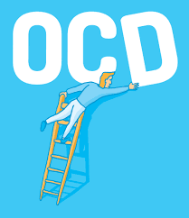
Obsessive Compulsive Disorder
Hajar Al-Otaibi

Slide 33
What is obsessive compulsive disorder?

Slide 34
Obsessive - Compulsive disorder
recurrent and persistent intrusive ideas, thoughts, impulses or images that are usually resisted by the patient.
It will cause Anxiety.
repetitive, purposeful and intentional behaviors conducted in response to an obsession to prevent a bad outcome for the patient.
It impact daily life.

Slide 35
OCD cycle
obsession
Relief
Anxiety
Compulsion

Slide 36
Prevalance
3% of the population
men= women
start: childhood/teens

Slide 37
Examples of obsessions and compulsions
obsessions
compulsions
Germ
Unsafe
Disorder causes anxiety
Mental rituals
Cleaning
Checking
Arranging
Call good thoughts

Slide 38
https://www.youtube.com/watch?v=pKq4zzpya7k

Slide 39
Diagnosis
Diagnostic and Statistical Manual of Mental Disorders-5(DSM-5) criteria:
1- presence of obsessions, compulsions or both.
2- time consuming(distress to daily life).
3-not physiological effects of substance or medical conditions.
4- not better explained by another
mental disorder.

Slide 40
Causes
UNKNOWN
- Genetics + environment
( identical twins more often than non- identical)
- Serotonin neurotransmission

Slide 41
Treatment
1- psychotherapy:
cognitive behavior therapy
* Exposure & Response
lower the anxiety without compulsions
2- medications:
SSRI

Slide 42
When to Refer
If the diagnosis is doubtful.
• If drug and alcohol dependence or withdrawal
complicate the management.
• If depression or a psychosis appears to be
Involved.
• Failure of response to basic treatment.

Slide 43
Depression
Mariam Bawazir

Slide 44
The most common psychiatric illness.
Lifetime prevalence of nearly 17% for major depression and about 2% for bipolar I and II disorders
More common in women than in men
Mean age is around 27 yrs ?

Slide 45
Prevalence in Saudi Arabia
Adult depression screening in Saudi primary care: prevalence, instrument and cost (2012)
Its prevalence in primary care varies between 15.3-22%, with global prevalence up to 13% and between 17-46% in Saudi Arabia
significantly associated with female gender (p-value 0.049), married , and higher educational level (p-value 0.002)

Slide 46
Depressive Disorders ( DSM-V) :
Major Depressive Disorder, Single and Recurrent Episodes
2. Persistent Depressive Disorder (dysthymic Disorder & chronic major depressive disorder)
3. Disruptive Mood Dysregulation Disorder (in children).
4. Premenstrual Dysphoric Disorder
5. Substance/Medication-Induced Depressive Disorder
6. Depressive Disorder Due to another Medical Condition

Slide 47
Etiology and Pathophysiology of Mood Disorder
Genetics
Social and Environmental Factors
Neurobiology (catecholamine hypothesis, decrease of norepinephrine) \ serotonin ?
Neuroimaging Studies (subgenual prefrontal cortex (SGPFC) ↓ blood flow
Abnormalities in Neuroendocrine Function (abnormal diurnal variation in cortisol production , hypothalamic-pituitary-adrenal axis , GH ?

Slide 48
glucocorticoid
Activity
neuronal mitochondrial
activity
(BDNF) Serotonin, noradrenalin
dopamine
neuronal death

Slide 49
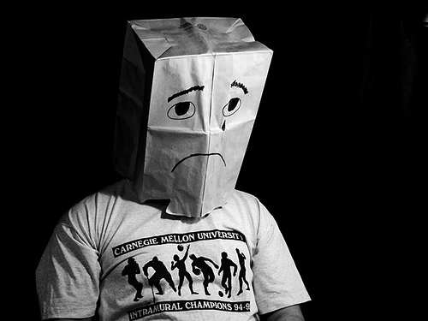
Clinical Findings
Alteration of mood
lack of energy
think a about death or suicide
Decreased or increase appetite
Insomnia or sleep most of the day
Psychomotor retardation\ agitation
Feelings of worthlessness and guilt \ hopeless
weight loss
difficulty in concentrating or thinking clearly
Diurnal variation
Decrease sex drive

Slide 51
Management

Slide 52
Suicide Assessment
Low risk
support and treatment options.
Medium risk
Organise reassessment within 1 week
High risk
Ensure that the person is safe
reassessment within 24 hours and monitor
Develop a safety plan
follow-up consultation

Slide 53
Useful Management Guidelines
Mild depression:
psychological therapy
Moderate depression:
psychological therapy and/or antidepressants
Severe depression:
antidepressants, and consider addition of psychological therapy to maintain remission. Consider psychiatric review, Electroconvulsive therapy (ECT).

Slide 54
Notes:
Selective serotonin reuptake inhibitors (SSRI).  Selective serotonin – Norepinephrine Reuptake Inhibitors(SNRIs) e.g. venlafaxine,duloxetine.  Or Monoamine oxidase inhibitors (MAOI). Avoid combining with SSRI or tricyclic antidepressants.

Slide 55
Therapeutic Uses of (SSRIs) and (TCAs)
Depression.
Anxiety Disorder.
Eating disorders- bulimia nervosa (fluoxetine), Anorexia nervosa .
Post traumatic stress disorder.
Attention Deficit Hyperkinetic Disorder (ADHD).

Slide 56
Role of primary care
Perinatal depression
children and adolescents
Nearly half of the patients visiting primary care have some depressive symptoms, which require further exploration into their psychiatric history.
Postnatal
depression
secondary to substance abuse
Depression secondary to medical diseases
secondary to medications
Depression in the elderly

Slide 57
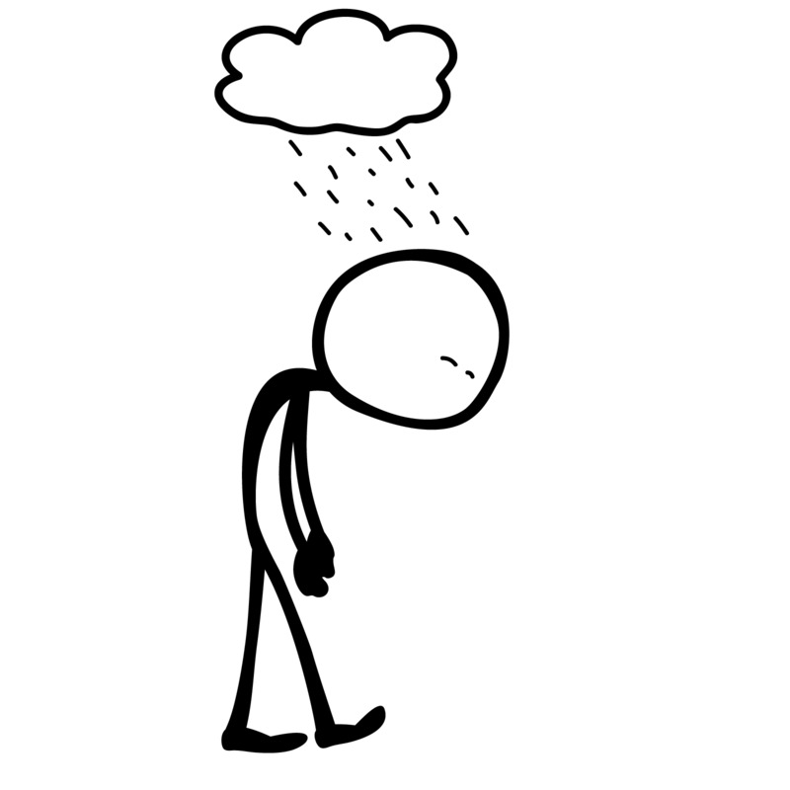
When to Refer
Uncertainty about diagnosis
Inpatient care obviously necessary
Severe depression
Inability to cope at home
Psychotically depressed (with delusions or
hallucinations)
Substantial suicide risk
Failure of response to routine antidepressant
therapy
Associated psychiatric or physical disorders
Depression in the elderly can be a difficult
problem—where diagnosis including dementia is doubtful
Children with apparent major depression

Slide 59
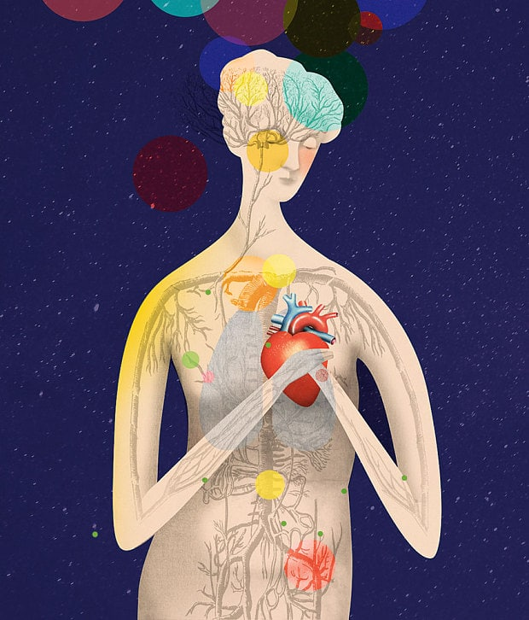
Somatization
Afnan Al-Shenaifi

Slide 60
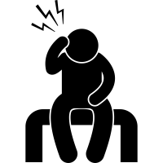
Somatization
A nonspecific physical symptoms that cannot be fully explained by a known medical condition after appropriate investigation.
In addition, the symptoms may be caused or exacerbated by anxiety, depression.
It is common for somatization, depression, and anxiety to all occur together.

Slide 61
Prevalence in Saudi Arabia
Saudi Arabia 2002
Abha
2014
431
400
19.3 %
60.8 %
Asir
2008
227
16 %
Notes:
In Saudi Arabia
A study was performed in Saudi Arabia 2002, out of 431 primary care patients shows clinically significant prevalence rates of somatization (19.3 %) .
A study was performed in Asir region 2008, of the 227 patients who were approached, (N=37, 16%) shows Somatic Symptoms.
High prevalence rates reported (60.8%) among 400 adults attending the primary health care centers in Abha City 2014. High prevalence of somatization was reported among patients in the age group 51-60 years. This finding is higher than what have been reported in a very large international study conducted by the WHO that found somatization in 20% of primary care attenders.

Slide 62
Aetiology
The etiology of somatic symptom disorder is not well understood.
However, studies have determined that risk factors for chronic and severe somatic symptoms include childhood neglect, sexual abuse, and a history of alcohol and substance abuse.
Recent stressful life events.
Patients may also present with physical symptoms when psychiatric symptoms are stigmatized.
A genetic data indicate that, in at least some families, the transmission of somatization disorder has genetic components.

Slide 63
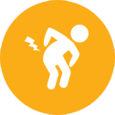
Clinical Features
The essential feature of somatization is a chronic history of unexplained physical symptoms, which the patient attributes to a nonpsychiatric disease.
Somatizing patients present with a wide array of symptoms:
Pain symptoms, including headache, back pain, dysuria, joint pain, diffuse pain, and extremity pain.
Gastrointestinal symptoms, including nausea, vomiting, abdominal pain, bloating, gas, and diarrhea.
Cardiopulmonary symptoms, including chest pain, dizziness, shortness of breath, and palpitations.
Pseudoneurologic symptoms, including fainting, pseudoseizures, amnesia, muscle weakness, dysphagia, double or blurred vision, difficulty walking, difficulty urinating, deafness, and hoarseness or aphonia

Slide 64
Diagnosis
Somatic Symptom Disorder
According to Diagnostic and Statistical Manual of Mental Disorders, Fifth Edition (DSM-5):
Diagnostic criteria:
One or more somatic symptoms that are distressing or result in significant disruption of daily life.
Excessive thoughts, feelings, or behaviors related to the somatic symptoms or associated health concerns as manifested by at least one of the following:
Disproportionate and persistent thoughts about the seriousness of one’s symptoms.
Persistently high level of anxiety about health or symptoms.
Excessive time and energy devoted to these symptoms or health concerns.
C. Although any one somatic symptom may not be continuously present, the state of being symptomatic is persistent (typically more than 6 months).

Slide 65
Diagnosis
Specify if:
With predominant pain (previously pain disorder): This specifier is for individuals whose somatic symptoms predominantly involve pain.
Specify if:
Persistent: A persistent course is characterized by severe symptoms, marked impairment, and long duration (more than 6 months).
Specify current severity:
Mild: Only one of the symptoms specified in Criterion B is fulfilled.
Moderate: Two or more of the symptoms specified in Criterion B are fulfilled.
Severe: Two or more of the symptoms specified in Criterion B are fulfilled, plus there are multiple somatic complaints (or one very severe somatic symptom).

Slide 66
Diagnosis

Slide 67
Management
The CARE MD treatment approach was developed to help primary care clinicians work more effectively with patients who have somatic symptom disorder
Consultation (psychiatry or cognitive behavior therapy)
Consult and collaborate with mental health professionals.
Assessment
Evaluate for other medical and psychiatric diseases.
Regular visits
Schedule short-interval follow-up to stop overuse of medical care (e.g., inappropriate emergency department visits, excessive calls) and avoid the need for symptoms to get an appointment.
Empathy
Spend most of the time listening to the patient and acknowledge that what he or she is feeling is real.
Medical-psychiatric interface
Emphasize the mind-body connection; avoid comments such as “there is nothing medically wrong with you”.
Do no harm
Limit diagnostic testing and referrals to subspecialists; reassure the patient that serious medical diseases have been ruled out.
Notes:
It is important to remember that the patient with somatization, as with all patients, remains at risk for developing new and potentially serious medical conditions.
Cognitive behavioral therapy
Cognitive and behavioral therapies can be used individually or in combination as a program of interventions known as cognitive behavioral therapy or CBT. CBT often includes education, relaxation exercises, coping skills training, stress management, or assertiveness training.

Slide 68
Management
Psychotropic Medication
Use of antidepressant medication.
They may play a useful role even if the patient is not depressed.

Slide 69
Referral
The patient has a psychiatric disorder, on psychotropic medications, or has a past history of such.
The patient with disturbing, demanding behavior.
Risk of suicide.
Diagnostic uncertainty with suspicion of a psychiatric problem behind the physical symptoms.
The patient has asked to see a psychiatrist. However, patients are usually reluctant to see psychiatrist.

Slide 70
References
Murtagh’s General Practice 6th Edition
http://emedicine.medscape.com/article/288016-overview#a1
http://bmcpsychiatry.biomedcentral.com/articles/10.1186/1471-244X-14-190
http://ksumsc.com/download_center/2nd/1-%20CNS%20block/Female/Psychiatry/1-%20DEPRESSIVE%20DISORDERS.pdf
INTRODUCTORY TEXTBOOK OF Psychiatry
S I X T H E D I T I O N by : Donald W. Black, M.D. Nancy C. Andreasen, M.D., Ph.D. Washington, DC.
http://ksumsc.com/download_center/2nd/1-%20CNS%20block/Female/Pharmacology/10-%20Drugs%20used%20in%20Depression-new%20groups.pdf
https://youtu.be/I8Jofzx_8p4
Alqahtani MM, Salmon P. PREVALENSCREENING CE OF SOMATIZATION AND MINOR PSYCHIATRIC MORBIDITY IN PRIMARY HEALTHCARE IN SAUDI ARABIA: A PRELIMINARY STUDY IN ASIR REGION. Journal of Family & Community Medicine. 2008;15(1):27-33.
FOR SOMATOFORM DISORDERS AMONG ADULT PATIENTS ATTENDING PRIMARY HEALTH CARE CENTERS]. Aamj.eg.net.
Becker S, Al Zaid K, Al Faris E. Screening for Somatization and Depression in Saudi Arabia: A Validation Study of the Phq in Primary Care. The International Journal of Psychiatry in Medicine. 2002;32(3):271-283.
The American Psychiatric Publishing Textbook of Psychiatry, 6th Edition.
Synopsis of Psychiatry byKaplan & Sadock, 10th Edition.
STUART L. KURLANSIK, PhD, and MARIO S. MAFFEI, MD, Somatic Symptom Disorder. American Academy of Family Physicians 2016.
UpToDate, Somatization: Epidemiology, pathogenesis, clinical features, medical evaluation, and diagnosis
THE EVIDENCE FOR TREATMENTS FOR SOMATOFORM DISORDERS A View From the Trenches Susan Levenstein, M.D
UpToDate, Overview of psychotherapy
M. A. Al-Sughayir - Manual of Basic Psychiatry
Primary Care: A Collaborative Practice by Terry Mahan Buttaro‏،JoAnn Trybulski‏،Patricia Polgar Bailey‏،Joanne Sandberg-Cook
Hani Raoul Khouzam, Susan Field, Somatization Disorder: Clinical Presentation and Treatment in Primary Care‏

Slide 71
Thank You

