Slide 1
HYPERTENSION

Slide 2
Shaikhaa

Slide 3
WHAT IS HYPERTENSION?

Slide 4
Blood Pressure Category | Systolic mm Hg (upper #) |  | Diastolic mm Hg (lower #)
Normal | less than 120 | and | less than 80
Prehypertension | 120 - 139 | or | 80 - 89
High Blood Pressure (Hypertension) Stage 1 | 140 - 159 | or | 90 - 99
High Blood Pressure (Hypertension) Stage 2 | 160 or higher | or | 100 or higher
Hypertensive Crisis (Emergency care needed) | Higher than 180 | or | Higher than 110

Slide 5
Epidemiology of Hypertension in KSA
The prevalence of hypertension was 26.1% in crude terms.
For males, the prevalence of hypertension was 28.6%, while for females; the prevalence was significantly lower at 23.9% (p<0.001).
Hypertension in Saudi Arabia. Saudi Med J. 2007 Jan;28(1):77-84.

Slide 6
Non-modifiable Risk Factors
Family history
Age
Gender
Race

Slide 7
Modifiable Risk Factors
Lack of physical activity
An unhealthy diet, especially one high in sodium
Notes:
Too much salt (sodium) in your diet
Too much sodium in your diet can cause your body to retain fluid, and also causes the arteries in your body to constrict. Both factors increase blood pressure.
Too little potassium in your diet
Potassium helps balance the amount of sodium in your cells. Potassium causes the smooth muscle cells in your arteries to relax, which lowers blood pressure.
Not being physically active
Exercise increases blood flow through all arteries of the body, which leads to release of natural hormones and cytokines that relax blood vessels, which in turn lowers blood pressure. Lack of physical activity also increases the risk of being overweight.
The more you weigh the more blood flow you need to supply oxygen and nutrients to your tissues. As the volume of blood circulated through your blood vessels increases, so does the pressure inside your arteries.
Having more than two drinks per day can cause hypertension, probably by activating your adrenergic nervous system, causing constriction of blood vessels and simultaneous increase in blood flow and heart rate.
Using tobacco can cause your blood pressure to temporarily increase and can contribute to damaged arteries. Secondhand smoke, exposure to other people’s smoke, also increases the risk of heart disease for nonsmokers.
Cough and cold medicines frequently contain decongestants such as pseudoephedrine and phenylephrine. These medications cause your blood pressure and heart rate to rise, by constricting all your arteries, not just those in you nose.

Slide 8
Waad

Slide 10
Video describing the mechanism and systemic effect of hypertension

Slide 11
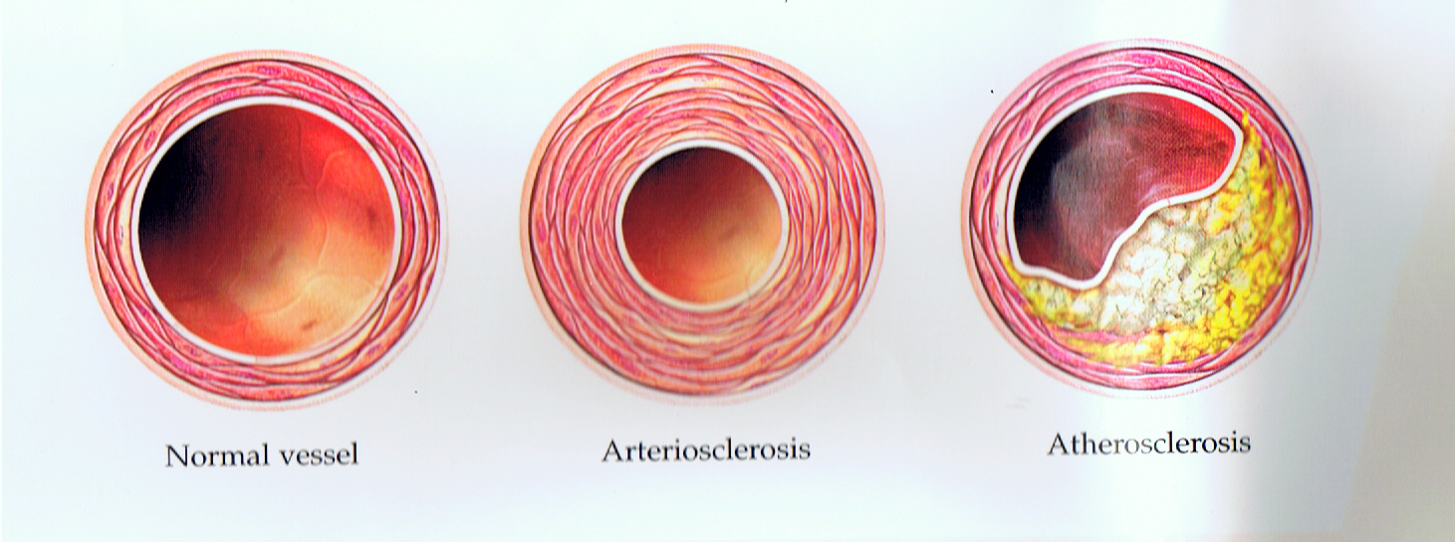
HTN ORGAN SPECIFIC COMPLICATIONS

Slide 12
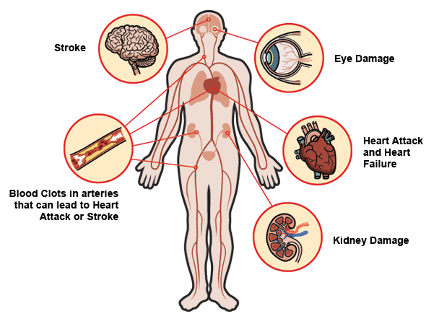

Slide 13
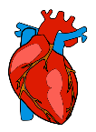
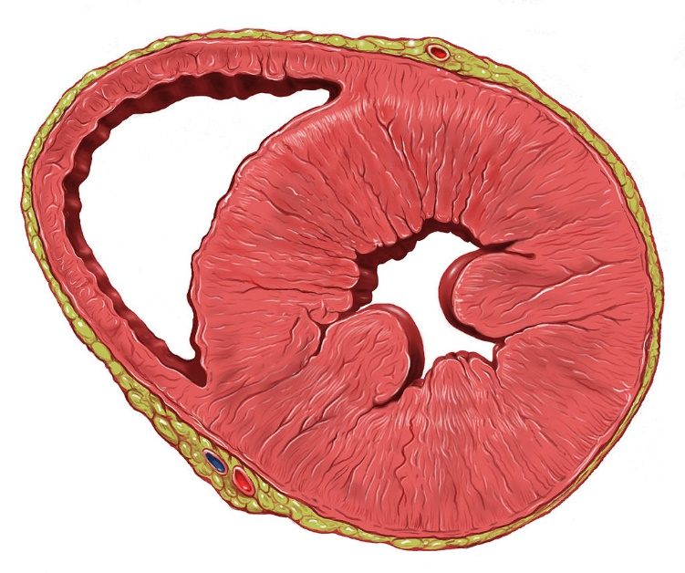
HTN organ specific complications
Heart :
Left ventricular hypertrophy (25%)
Systolic defect
Congestive heart failure
Notes:
individuals with left ventricular hypertrophy are at increased risk for, stroke,^{[21]} CHF,^{[21]} and sudden death.

Slide 14
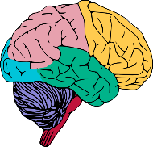
HTN organ specific complications
Brain
Brain infarction and hemorrhage
Stroke
Hypertensive encephalopathy
Notes:
Hypertensive encephalopathy occurs in eclampsia, acute nephritis and crises in essential hypertension. Symptoms of hypertensive encephalopathy include headache, restlessness, nausea, disturbances of consciousness, seizures, bleeding in the retina, and papilledema.
either intracerebral hemorrhage or subarachnoid hemorrhage.
hypertension is an important risk factor for brain infarction (85%) and hemorrhage (15%)
The incidence of stroke rises progressively with increasing blood pressure levels, particularly systolic blood pressure in individuals >65 years.

Slide 15
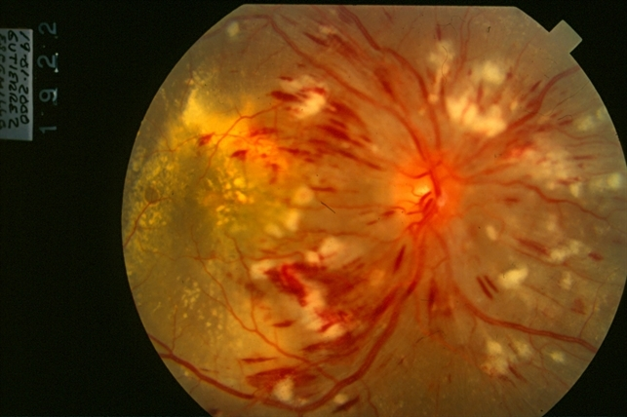
HTN organ specific complications
Eye :
Hypertensive retinopathy

Slide 16
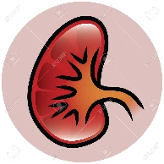
HTN organ specific complications
Kidney :
Renal injury (related to SBP)
Glomerulosclerosis
End stage renal disease

Slide 17
Zhour

Slide 19
How to measure BP correctly and make a diagnosis of Hypertension:
https://www.youtube.com/watch?v=f6HtqolhKqo

Slide 20
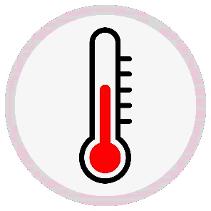
Factors that affect readings of BP at clinical setting
Caffeine. Smoking. Posture. Emotions. Exercise. | Drugs. fullness of bladder. Pain, shock, dehydration. acute changes in temperature.
Notes:
age
heart condition
Emotions
Activity
and the medications you take

Slide 22
Notes:
1- NICE guidelines for HTN
https://www.ncbi.nlm.nih.gov/books/NBK83269/?report=classic

Slide 23
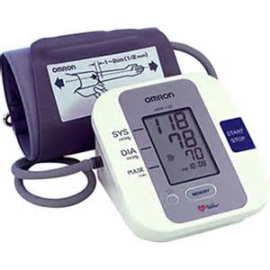
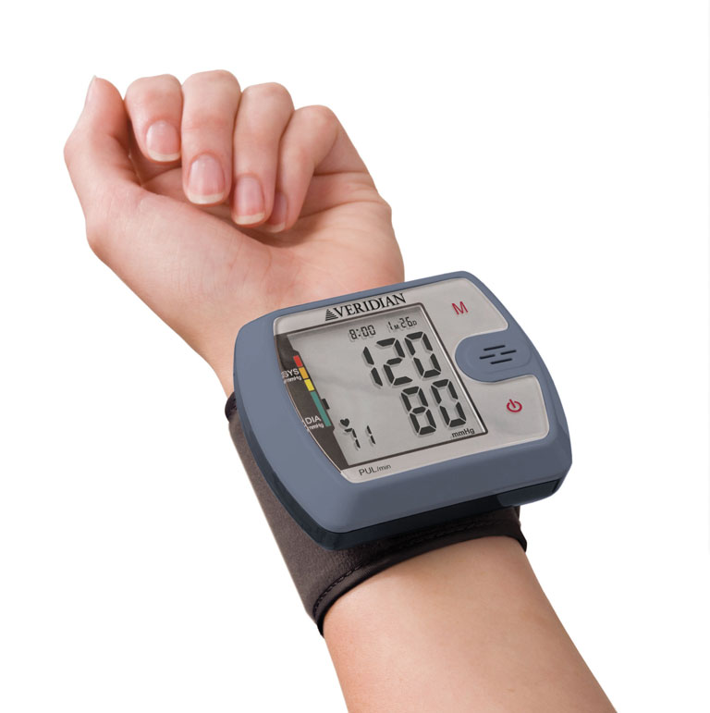
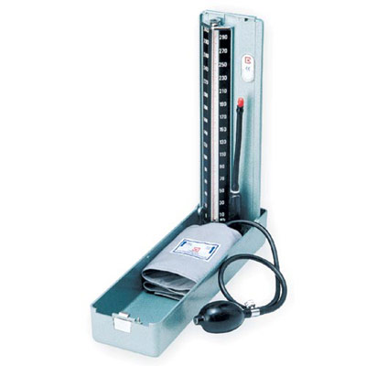
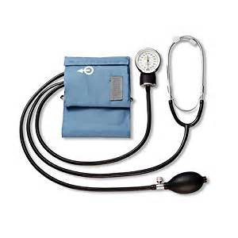
Types of Blood Pressure monitors
Mercury sphygmomanometer
Aneroid monitors
Digital monitors
Notes:
6.5.1. Mercury sphygmomanometer
The mercury sphygmomanometer has been used for the traditional measurement of blood pressure. It is reliable and provides the reference standard for indirect measurement. However it is bulky, fragile and there are particular safety and economic concerns about the toxic effects of mercury. Mercury is being phased out of clinical use and mercury sphygmomanometers have already been removed from clinical areas in hospitals and primary care. Thus, alternatives to mercury sphygmomanometer are now required for routine clinical use.
Non-mercury devices that operate in a similar way to the traditional mercury column devices are available and provide a suitable alternative to mercury devices when manual auscultation is required to measure blood pressure.
6.5.2. Aneroid sphygmomanometers
Aneroid sphygmomanometers measure pressure using a lever and bellows system. They may be less accurate than mercury sphygmomanometers and their alternatives (see above), especially over time. Using the manual auscultation technique they are subject to the same sources of observer error.
6.5.3. Automated devices
Automated devices are increasingly being used in hospitals and primary care. All sphygmomanometers need regular maintenance. Rubber tubing can crack and leak making cuff deflation hard to control, underestimating systolic and overestimating diastolic readings. Faulty valves can cause similar problems.
6.6. Ambulatory blood pressure monitors
Ambulatory Blood Pressure monitoring (ABPM) involves a cuff and bladder connected to electronic sensors which detect changes in cuff pressure and allow blood pressure to be measured oscillometrically. The cuff is inflated by a battery powered compressor and sensors within the cuff detect changes in pressure oscillations during cuff deflation. Systolic and diastolic pressure readings are deduced from the shape of these oscillometric pressure changes using an algorithm built into the measuring device. Developed as a research tool in the 1960s, these devices have considerably reduced in size and now can be described properly as ambulatory. Thus a patient's blood pressure can be automatically measured at repeated intervals (commonly every 30 minutes) throughout the day and night, while they continue routine activities. Systolic and diastolic pressure can be plotted over time, with most devices providing average day, night and 24 hour pressures. An advantage of ABPM is the removal of observer error with automated reading. However, oscillometric measurement may be difficult in the presence of arrhythmias, particularly rapid atrial fibrillation, and in a subgroup of the general population in whom oscillometric readings are inaccurate for unknown reasons.
A number of ABPM devices are available varying in size, weight, noise level, data manipulation and cost. Devices should be independently validated to one or both of two internationally accepted standards from the British Hypertension Society and the Association for the Advancement of Medical Instrumentation.
When using ABPM, patients need some understanding of how the device works and instruction about manual deflation, missed readings, arm position, and machine location: fitting takes 15–30 minutes. An appropriately sized cuff is necessary as with non-ambulatory monitoring and if one arm gives a higher reading at baseline then this should be used subsequently. Patients may be asked to make diary records of events that are known to affect blood pressure so that readings can be related to them, for example, periods of sleep. Sleeping times can be recorded or fixed times may be predefined, including preparing for sleep (e.g. 9pm – midnight) and waking up (e.g. 6am – 9 am).

Slide 24
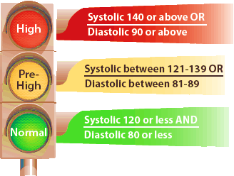
Blood pressure reading

Slide 25
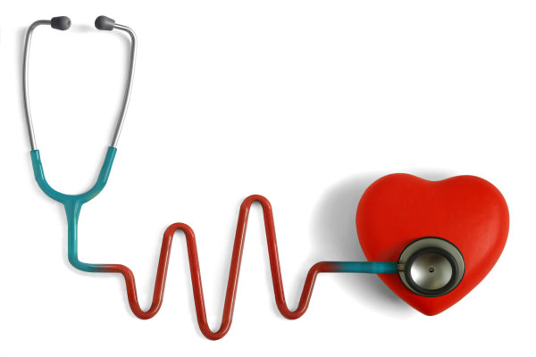
Key points to look for in hypertension:
Smoker
Family history of HTN
at least two or>2 measurement of blood pressure high.
Being overweight
Stress & lack of exercise
High cholesterol
few people may have: (usually don't occur until high BP
has reached a severe or life-threatening stage)
1-headaches
2-shortness of breath
3-nosebleeds

Slide 26
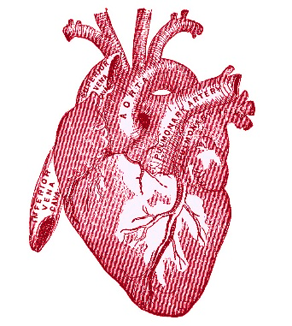
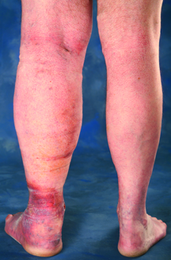
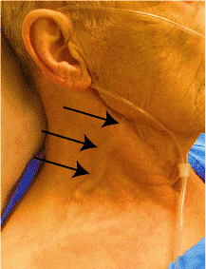
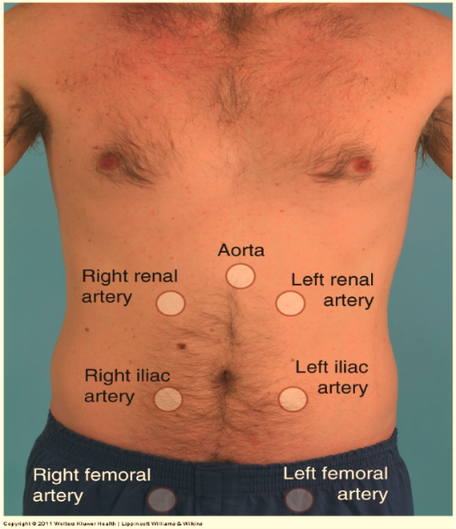
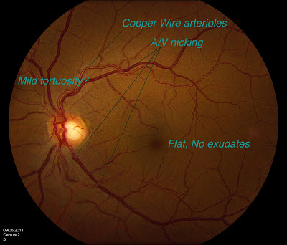
In examination:
Physical Exam
Notes:
Check for Extra heart sounds
Cardiovascular exam
Swollen (distended) neck veins.
Abnormal sounds when the doctor listens to the blood vessels in the abdomen (abdominal bruits) or (renal artery stenosis).
Abnormal sound of blood flow (bruit) or diminished or absent blood flow (pulses) in the blood vessels of the arms and legs.
Abnormal buildup of fluid in the abdomen or legs (edema).
Abnormalities of the blood vessels in the back of the eye.

Slide 27
Diagnosing Hypertension
NORAH ALNAEIM

Slide 28
Guidelines to Diagnose Hypertension
http://shms.wildapricot.org/

Slide 29
Guidelines to Diagnose Hypertension
https://www.nice.org.uk/guidance/cg127

Slide 30
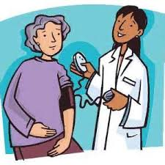
Diagnosing Hypertension
Measure blood pressure in both arms.
If the difference in readings between arms is more than 20 mmHg, then what should we do?
Repeat the measurement
If the difference in readings between arms remains more than 20 mmHg on the second measurement, measure subsequent blood pressures in the arm with the higher reading.

Slide 31
Diagnosing Hypertension
If blood pressure measured in the clinic is 140/90 mmHg or higher
What’s the next step?
Take a second measurement during the consultation.
If the second measurement is substantially different from the first, take a third measurement.
Record the lower of the last two measurements as the clinic blood pressure.

Slide 32
Courtesy of: The Canadian journal of cardiology
Notes:
https://www.researchgate.net/figure/273509700_fig1_Diagnostic-algorithm-for-hypertension-BP-blood-pressure-DBP-diastolic-blood-pressure

Slide 33
Ambulatory Blood Pressure Monitoring
If the office blood pressure is 140/90 mmHg or higher, offer ABPM
What is ABPM?
Notes:
Ambulatory blood pressure monitoring (ABPM) involves a cuff and bladder connected to electronic sensors which detect changes in cuff pressure and allow blood pressure to be measured oscillometrically.
A patient's blood pressure can be automatically measured at repeated intervals throughout the day and night, while they continue routine activities. Systolic and diastolic pressure can be plotted over time, with most devices providing average day, night and 24-hour pressures. NICE recommends recording a daytime average to confirm diagnosis.

Slide 34
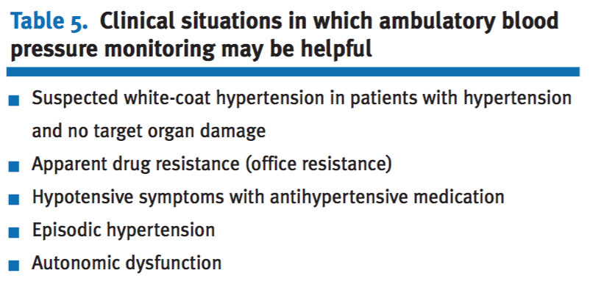
Notes:
White coat hypertension is defined when a patient has a persistently elevated clinic BP
≥ 140/90 and a normal HBPM or ABPM day
time average, i.e. <135/85
White coat hypertension is present in as many as 25% of patients, possibly leading to:
Incorrect diagnosis of hypertension.
Diagnosis of uncontrolled hypertension (receive inappropriate dose titrations or additional antihypertensive agents)
Resistant hypertension, with a reported prevalence of 37 to 44 % in some studies.

Slide 35
Ambulatory Blood Pressure Monitoring
When using ABPM to confirm a diagnosis of hypertension:
At least two measurements per hour are taken during the person's usual waking hours.
Use the average value of at least 14 measurements.

Slide 36
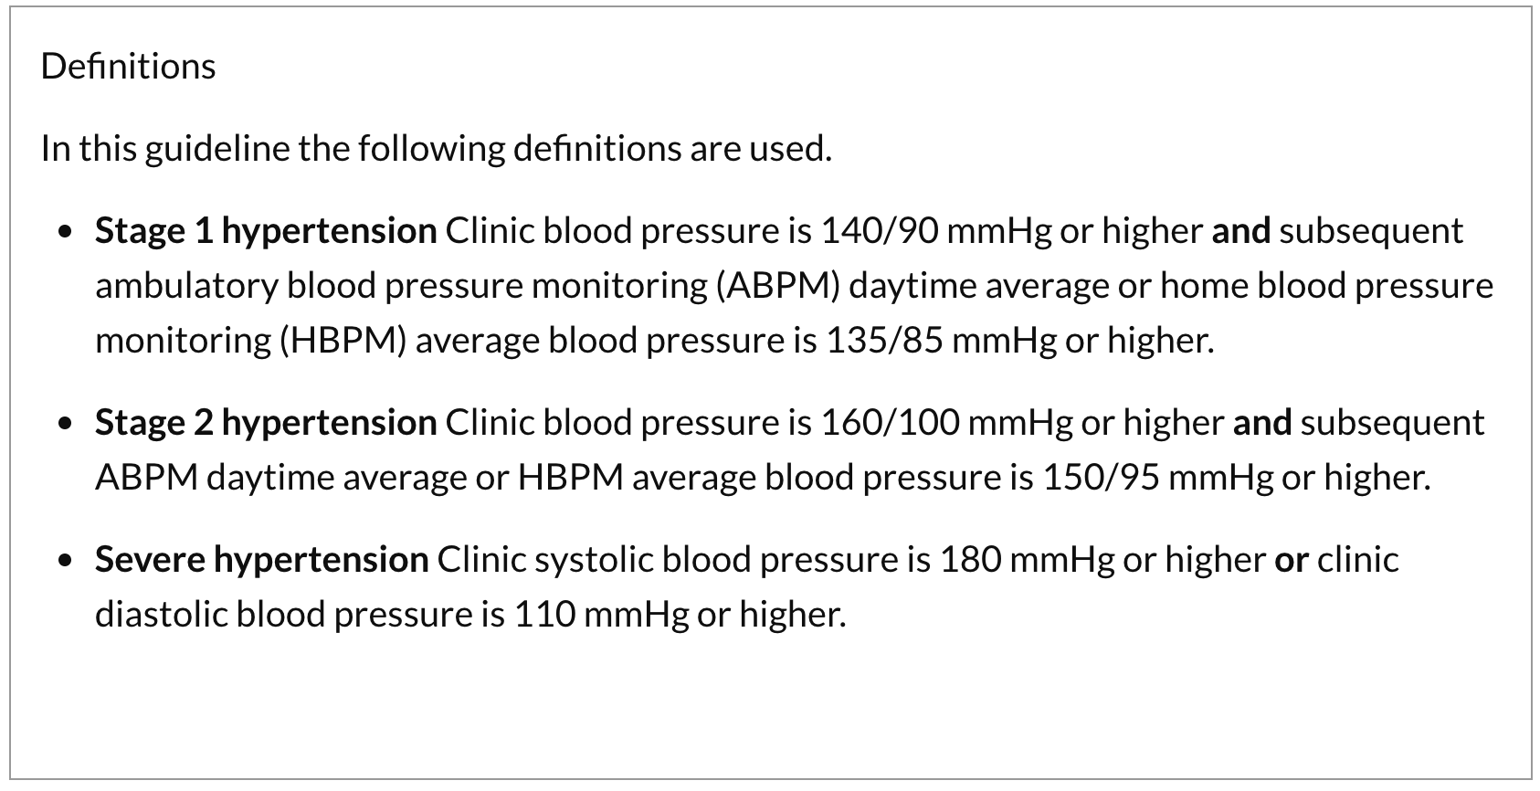
Definition of hypertension in ABPM (NICE):

Slide 37
ABPM Report

Slide 38
Home Blood Pressure Monitoring
If a person is unable to tolerate ABPM, home blood pressure monitoring (HBPM) is a suitable alternative to confirm the diagnosis of hypertension.
https://www.youtube.com/watch?v=GqorFdyF038
Notes:
When using HBPM to confirm a diagnosis of hypertension, ensure that:
For each blood pressure recording, two consecutive measurements are taken, at least 1 minute apart and with the person seated.
Blood pressure is recorded twice daily, ideally in the morning and evening.
Blood pressure recording continues for at least 4 days, ideally for 7 days.
Discard the measurements taken on the first day and use the average value of all the remaining measurements to confirm a diagnosis of hypertension

Slide 39
Home Blood Pressure Monitoring
When using HBPM to confirm a diagnosis of hypertension, ensure that:
For each blood pressure recording, two consecutive measurements are taken, at least 1 minute apart and with the person seated.
Blood pressure is recorded twice daily, ideally in the morning and evening.
Blood pressure recording continues for at least 4 days, ideally for 7 days.
Notes:
When using HBPM to confirm a diagnosis of hypertension, ensure that:
For each blood pressure recording, two consecutive measurements are taken, at least 1 minute apart and with the person seated.
Blood pressure is recorded twice daily, ideally in the morning and evening.
Blood pressure recording continues for at least 4 days, ideally for 7 days.
Discard the measurements taken on the first day and use the average value of all the remaining measurements to confirm a diagnosis of hypertension

Slide 40
HBPM cuffs and devices (BHS guidelines)
Devices used for HBPM should be clinically validated for home use.
Check patients’ monitors against other validated devices.
An appropriately sized cuff, containing the correct sized inflatable bladder, must be used.
Upper arm monitors are preferred to wrist or watch devices.

Slide 41
INVESTIGATIONS
SHAHAD ALMUHAIDEB
Davidsons Principles and practice of medicine_22Ed - Page 610

Slide 42
Urinalysis ( blood, protein , glucose, Uric Acid and Calcium )
Blood urea, electrolytes and creatinine
Hematocrit

Slide 43
Blood glucose
Lipid Profile

Slide 44
ECG
Chest X-ray

Slide 45
Waad

Slide 46
Case: 46 years old male came in the primary clinic to do regular check ups. While taking history you found out that he’s an accountant, smokes 1 pack a day for the past 20 years. When asked about his diet he says that he lives on his own, and orders lots of junk food. He doesn’t do any type of exercise. His father died from stroke at the age of 54. His mother is alive and has hypertension.
His vitals were:
Temp: 37.2 RR:18/min
HR:120 bpm BP: 148/92 mmHg
Height: 176cm BMI: 33.9
Weight : 105KG

Slide 47
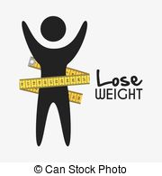
Measures of prevention
Weight loss
Losing just 10 pounds (4.5 kilograms) can help reduce your blood pressure.
The systolic value fell by 4.5 mmHg, the diastolic by 3 mmHg.
Notes:
Blood pressure often increases as weight increases. Being overweight also can cause disrupted breathing while you sleep (sleep apnea), which further raises your blood pressure.
Weight loss is one of the most effective lifestyle changes for controlling blood pressure.

Slide 48
Measures of prevention
2. Exercise regularly
Regular physical activity — at least 30 minutes most days of the week — can lower your blood pressure by 4 to 9 millimeters of mercury (mm Hg).
Notes:
If you have slightly high blood pressure (prehypertension), exercise can help you avoid developing full-blown hypertension.

Slide 49
Measures of prevention
3. Eat a healthy diet
Eating a diet that is rich in whole grains, fruits, vegetables and low-fat dairy products and skimps on saturated fat and cholesterol can lower your blood pressure by up to 14 mm Hg.
Notes:
This eating plan is known as the Dietary Approaches to Stop Hypertension (DASH) diet.

Slide 50
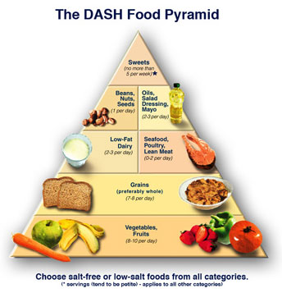
Notes:
The first DASH diet research showed that it could lower blood pressure as well as the first line blood pressure medications, even with a sodium intake of 3300 mg/day.
It has been proven to be an effective way to lose weight and become healthier at the same time.
It is a plan that follows US guidelines for sodium content, along with vitamins and minerals
The DASH diet eating plan is a diet rich in fruits, vegetables, low fat or nonfat dairy.
It also includes mostly whole grains; lean meats, fish and poultry; nuts and beans.
It is high fiber and low to moderate in fat.

Slide 51
Measures of prevention
4. Reduce sodium in your diet
Even a small reduction in the sodium in your diet can reduce blood pressure by 2 to 8 mm Hg.

Slide 52
Measures of prevention
lower sodium intake — 1,500 mg a day or less — is recommended for :
Anyone age 51 or older
Anyone diagnosed with hypertension, diabetes or chronic kidney disease

Slide 53
Measures of prevention
5. Quit smoking
Each cigarette you smoke increases your blood pressure for many minutes after you finish.

Slide 54
Kholoud

Slide 55
Antihypertensive medications
1st line
2nd line
1)ACE Inhibitors
Captopril
Lisinopril
Enalapril
2)Angiotensin II Receptor Blockers
Losartan
Valsartan
Candesartan
Irbesartan
3)Diuretics
Thiazides
4)Calcium Channel Blockers
Nifedipine
Amlodipine
Felodipine
Beta blockers
Atenolol
Bisoprolol
Carvedilol
Notes:
Why beta blocker consider as 2nd line of treatment ? It used to be 1st line

Slide 56
When to decide the start of medication?
Blood pressure is >= 150/90 mmHg in adult 60 years and older.
Blood pressure is >= 140/90 mmHg in adult younger than 60 years.
In patient with hypertension and diabetes when blood pressure >= 140/90 mmHg regardless of age
Notes:
Before it was patient with Blood pressure >= 140/90 mmHg in adult 60 years and older.
Reference :
http://www.aafp.org/afp/2014/1001/p503.html

Slide 57
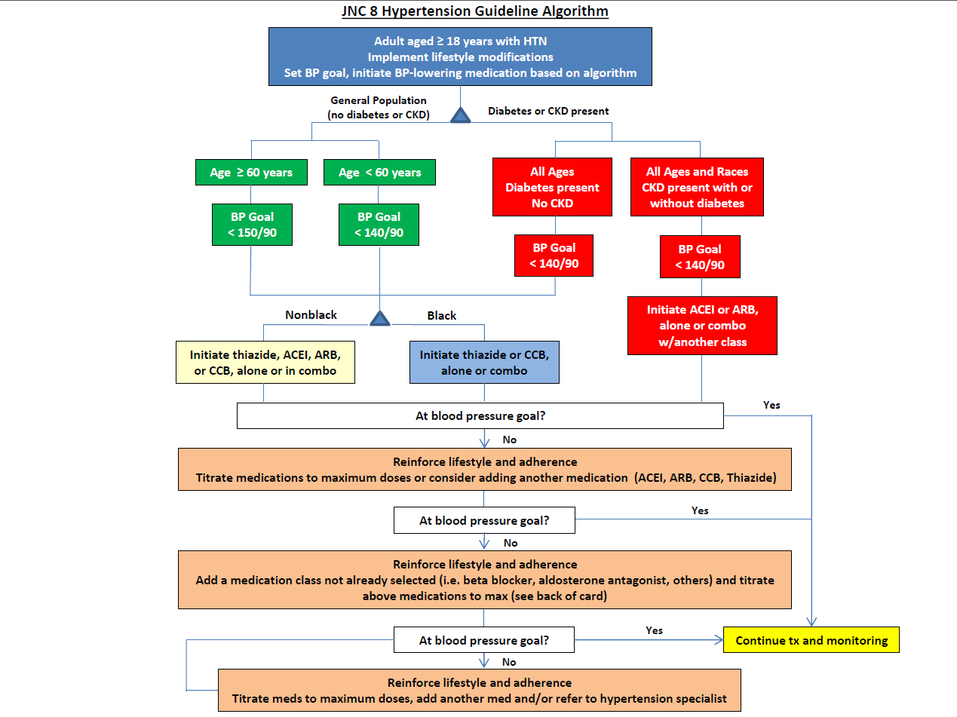
Notes:
Initial antihypertensive treatment should include:
General nonblack population (Thiazide diuretic,calcium channel blocker, ACE inhibitor, or ARB)
General black population (Thiazide diuretic or calcium channel blocker)
Angiotensin receptor blockers should be reserved for patients who cannot tolerate angiotensin-converting enzyme inhibitors.
Reference:
http://www.aafp.org/afp/2014/1001/p503.html

Slide 58
Combination therapy
Combination therapy is treatment with two or more agents administered
separately or in a fixed-dose combination pill and is required by most
patients with hypertension to reach target blood pressure.
In many cases, combination therapy improves rates of blood
pressure control and requires less time to achieve target blood pressure.
Potential disadvantages include:
Increased cost for some combinations .
Increased risk of adverse events and drug-drug interactions.
Patients’ perception that taking more medications is equated with
being sicker.
Notes:
Most patients with hypertension require more than a single antihypertensive agent, particularly if they have comorbid conditions.
References
http://www.aafp.org/afp/2008/0501/p1279.pdf

Slide 59
Indications for combination therapy
Blood pressure is not at goal level on a single agent.
Patient experiences adverse effects of single agent that may be improved by the addition of a second agent.
(e.g., adding an angiotensin-converting enzyme inhibitor to a calcium channel blocker to reduce peripheral edema)
Systolic blood pressure ≥ 20 mm Hg or diastolic blood pressure ≥ 10 mm Hg above goal.
Notes:
References
http://www.aafp.org/afp/2008/0501/p1279.pdf

Slide 60
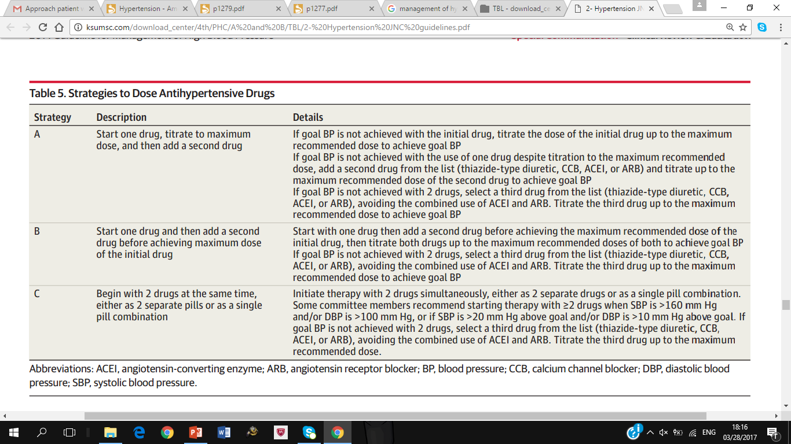
Notes:
Reference:
https://www.michigan.gov/documents/mdch/2014_Evidenced-Based_Guidelines_for_Management_of_HBP_in_Adults_444163_7.pdf

Slide 62
Treatment choice | Indication
ACEI, ARBs, diuretics, BB, or aldosterone antagonists | Heart failure
Diuretics, BB, ACEI, ARBs, and/or CCB | Diabetes
Diuretic, BB, ACE, and/or CCB | Coronary artery disease
BB, ACEI, and aldosterone antagonists | Post-MI
ACEI and ARBs. | Chronic kidney disease
Diuretic and ACEI | Stroke
Notes:
Certain chronic illnesses like Diabetes, IHD, Stroke, heart failure)
Hypertensive patients with heart failure : angiotensin-converting enzyme inhibitors, angiotensin receptor blockers, diuretics, beta blockers, or aldosterone antagonists .
Hypertensive patients with diabetes: diuretics, beta blockers, angiotensin-converting enzyme inhibitors, angiotensin receptor blockers, and/or calcium channel blockers.
Hypertensive patients with increased risk of coronary disease: diuretic, beta blockers, angiotensin-converting enzyme inhibitors, and/or calcium channel blocker.
Hypertensive patients who are postmyocardial infarction: beta blockers, angiotensin-converting enzyme inhibitors, and aldosterone antagonists.
Hypertensive patients with chronic kidney disease: angiotensin-converting enzyme inhibitors and angiotensin receptor blockers.
Recurrent stroke prevention in patients with hypertension: diuretic and angiotensin-converting enzyme inhibitors.
Reference :
http://www.aafp.org/afp/2008/0501/p1279.pdf

Slide 63
Notes:
Tight control of blood pressure is associated with significant reductions in the risk of stroke, macrovascular complications, and diabetes-related mortality.
Patients with diabetes whose diastolic blood pressure (DBP) was less than 80 mm Hg had a 50 percent reduction in major cardiovascular events compared with those whose DBP was less than 90 mm Hg.
Recommend a blood pressure goal of less than 130/80 mm Hg in patients with diabetes.
Patients with diabetes whose systolic blood pressure is between 130 and 139 mm Hg or whose DBP is between 80 and 89 mm Hg are candidates for
a three-month trial of lifestyle modifications.
Patients who do not achieve a blood pressure of less than 130/80 mm Hg with lifestyle modifications, and those whose blood pressure is greater than 140/90 mm Hg, should be treated with pharmacologic therapy.
Angiotensin-converting enzyme (ACE) inhibitors prevent or delay microvascular and macrovascular complications of diabetes and are recommended as first-line antihypertensive agents in patients with diabetes.
Reference :
http://www.aafp.org/afp/2008/1201/p1277.pdf

Slide 64
Notes:
Reference :
http://www.aafp.org/afp/2008/1201/p1277.pdf

Slide 65
Case
46 years old male obese known case of hypertension came to the primary clinic to do regular check ups.
His lab results showed:
FPG ≥126 mg/dL
2-h plasma glucose ≥200 mg/dL
Hb A1C ≥6.5%
How to approach this patient?

Slide 66
Shahad

Slide 67
Hypertension in pregnancy
May or may not have protein in the urine | Before pregnancy or before 20 weeks | Chronic hypertension
No protein in the urine | After 20 weeks of pregnancy | Gestational hypertension
Protein in the urine | After 20 weeks of pregnancy | Preeclampsia/eclampsia
Notes:
Reference:
http://www.aafp.org/afp/2016/0115/p121.pdf

Slide 68
Antihypertensive meds in pregnancy
Methyldopa, labetalol, and nifedipine are the most commonly used oral agents to treat severe chronic hypertension in pregnancy.
Beta blocker atenolol also may cause intrauterine growth restriction.
Thiazide diuretics that were used before pregnancy may be continued, but should be stopped if preeclampsia develops to avoid worsening intravascular volume depletion.
Angiotensin-converting enzyme inhibitors and angiotensin II receptor blockers are contraindicated because of their association with intrauterine growth restriction, neonatal renal failure, oligohydramnios, and death.
Notes:
Reference:
http://www.aafp.org/afp/2016/0115/p121.pdf

Slide 69
Follow up

Slide 70
If you have diabetes or have had a prior heart attack or stroke, your blood pressure control will need to be more stringent to prevent recurrent events
Notes:
. Check with your doctor as to what blood pressure readings you should be aiming for on a consistent basis.

Slide 71
With aging and progression of the process of hardening of the arteries, your systolic blood pressure may creep up with time. A treatment that once worked well may no longer work.
Notes:
Your drug dosage may need to be changed or you may be prescribed a new medication.

Slide 72
Quiz

Slide 73
Which of the following is correct?
Hypertension is an important risk factor for brain infarction.
Lifestyle modifications are not essential for the prevention of high BP.
A nutritionist and exercise specialist are often not helpful in changing lifestyle and initiating weight loss.

Slide 74
What are the routine investigations in hypertension?
Urinalysis and electrolytes.
ECG and ultrasound.
Renal angiography and ECG.

Slide 75
What is the Ideal blood pressure ?
90-119 /60-79
120-139 /80-89
140-159 /90-99

Slide 76
REFRENCES
https://www.ncbi.nlm.nih.gov/pubmedhealth/PMH0072415/
http://dashdiet.org/what_is_the_dash_diet.asp
http://emedicine.medscape.com/article/2172178-overview?pa=3xbTjm7d3Td5EFg6MypbuE%2FDcwgukYInbWdLcqklPcze6qwIzXzkN2MkAUkJyYO0xFp%2FkFoXpbCnBehgP1kDsXf7Bj2Gvk6BKC47oRZ1BB8%3D
https://www.nhlbi.nih.gov/files/docs/guidelines/phycard.pdf
http://www.webmd.com/hypertension-high-blood-pressure/guide/high-blood-pressure-follow-up-care
http://www.aafp.org/afp/2016/0115/p121.pdf
http://www.aafp.org/afp/2008/1201/p1277.pdf

Slide 77
REFRENCES
NICE guidelines (November 2016): https://www.nice.org.uk/guidance/CG127/chapter/1-Guidance#diagnosing-hypertension-2
Research gate/The Canadian journal of cardiology https://www.researchgate.net/figure/273509700_fig1_Diagnostic-algorithm-for-hypertension-BP-blood-pressure-DBP-diastolic-blood-pressure
Home Blood Pressure Monitoring Protocol (British Hypertension Society)
http://www.bhsoc.org/files/4414/1088/8031/Protocol.pdf
Dr. Batais Hypertension Lecture notes.

Slide 78
THANK YOU FOR LISTENING!
Any questions?

