Slide 1
Osteoporosis and Vitamin D Deficiency

Slide 2
Objectives :
Definition of Osteoporosis and Osteomalacia / Rickets.
Highlight on Vitamin D deficiency.
Prevalence in world / Saudi Arabia
Factors lead to Osteoporosis and Vitamin D deficiency
How patients could be presented
Common fractures with osteoporosis
Vitamin D and Comorbidities

Slide 3
Objectives :
Diagnosis, through
X- Ray
Role of DXA and how interpret (Normal, Osteopenia [Grades] and Osteoporosis)
Biochemistry
Management: (Osteopenia and Osteoporosis)
Prevention and advice
Role of Vitamin D and Calcium
Vitamin deficiency in pregnancy
Role of medications for osteoporosis

Slide 4
Definitions :
Osteoporosis :
Characterized by low bone mass(osteopenia), micro.architectural disruption, and increased skeletal fragility resulting in an increased risk of fracture mostly due to hormonal or calcium or vitamin D deficiency despite the normal mineralization.
Osteomalacia :
Deficient mineralization of bone and occurs after the closure of the growth plates (in adulthood).
Rickets :
Deficient mineralization of bone and cartilage and occurs before the closure of the growth plates (in childhood) resulting in bow legs.

Slide 6
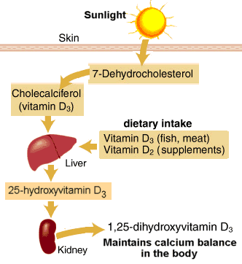
Vitamin D: From where do we get vitamin D ?

Slide 7
Vitamin D: Role of vitamin D :

Slide 8
Prevalence of vitamin d deficiency :
- The prevalence of vitamin D deficiency depends upon the definition used (<20 or <30 ng/mL [50 or 75 nmol/L]).
- The prevalence of low vitamin D levels may be increasing globally In a review of vitamin D levels in different regions of the world, vitamin D levels below 30ng/mL (75 nmol/L) were prevalent in every region studied, and low vitamin D levels (<10 ng/mL [25 nmol/L]) were more common in South Asia and the Middle East than in other regions .
- In Saudi Arabia, osteoporosis is already a serious issue a report in the eastern region of Saudi Arabia indicates an incidence of postmenopausal osteoporosis (PMO) of 30 percent to 40 percent, with over 60 percent of postmenopausal women already having some degree of osteopenia.
Saudi Med J. 2004 Oct;25(10):1423-7.

Slide 9
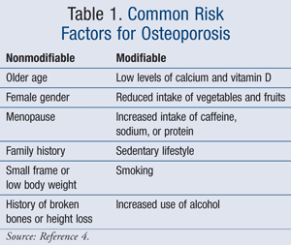
Factors lead to Osteoporosis and Vitamin D deficiency:

Slide 10
RISK Factors : Smoking
- Cigarette smoking was first identified as a risk factor for osteoporosis more than 20 years ago.
- Recent studies have shown a direct relationship between tobacco use and decreased bone density.
How does smoking affect bone health?
Cigarette smoke generates huge amounts of free radical and disturb balance of hormones (like estrogen) that bones need to stay strong.
Increased levels of the hormone cortisol, which leads to bone breakdown.
Smoking also damages blood vessels, so there is poor blood supply.

Slide 11
RISK Factors : Physical inactivity
- People who spend a lot of time sitting have a higher risk of osteoporosis than do those who are more active.
- Physical activity prevent osteoporosis is based on evidence that it can regulate bone maintenance and stimulate bone formation and this reducing the overall risk of falls and fractures.
- Most experts recommend exercising for at least 30 minutes three times per week.

Slide 12
RISK Factors : Medical diseases
Premature menopause
Malabsorption
Chronic liver disease
IBD

Slide 13
RISK Factors : Medication
Steroids
Thyroxine(hight ammount)
Phenytoin and Barbiturates
Aromatase Inhibitors and methotrexate
Thiazolidinediones
Chronic Lithium use

Slide 14
How patients could be presented ?
There are no symptoms in the early stages of bone loss. But once bones have been weakened by osteoporosis, you may have signs and symptoms that include:
Back pain, caused by a fractured or collapsed vertebra
Loss of height over time
A stooped posture
A bone fracture that occurs much more easily than expected

Slide 15
Common fracture with osteoporosis :

Slide 16
Spine :
The most common type of spinal fracture (also known as a vertebral fracture) in people with osteoporosis is called a wedge or compression fracture.
Severe osteoporosis : a spinal fracture may be caused by simple movements such as lifting a light object, sneezing, or even just bending forward.
Moderate osteoporosis : more force may be required, for example, a fall or lifting a heavy object.

Slide 17
Hip and pelvis :
The most mobile type of joint in the body.
The two most common types of hip fractures:
Femoral neck fractures : occurring in the narrow section of bone between the main shaft of the femur and the ball
Intertrochanteric hip fractures : where the shaft of the femur breaks just below the femoral neck.

Slide 18
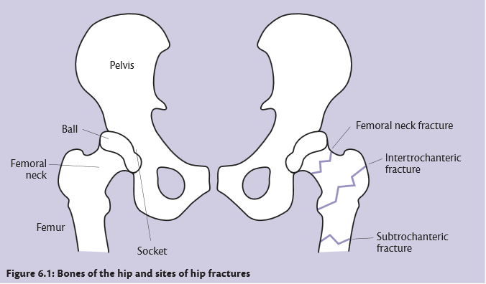

Slide 19
Wrist and forearm :
Falls are the most common cause of fractures of the wrist and forearm.
The two most common types of wrist fracture are:
Colles’ fracture : this is a fracture to the lower end of the radius, and very common in people with osteoporosis.
Scaphoid fracture : the scaphoid is a wedge-shaped bone located on the thumb side of the wrist, just where it meets the radius. These fractures are less commonly related to osteoporosis.

Slide 20
Comorbidities and Vitamin D :
CVS
Hypertension
Obesity
Diabetes

Slide 21
CVS :
- In the National Health and Nutrition Examination Study (NHANES) 2001 to 2004, the prevalence of coronary heart disease (angina, myocardial infarction) ,heart failure and peripheral arterial diseases was more common in adults with 25-hydroxyvitamin D levels <20 ng/mL compared with ≥30 ng/mL.
- Observational studies show an association between low vitamin D status and risk of hypertension and cardiovascular events. But, most randomized trials have not shown a cardiovascular benefit of vitamin D supplementation.
- In one of the larger trials included in the meta-analyses, there was no beneficial effect on cardiovascular or metabolic risks after increasing baseline 25-hydroxyvitamin D levels from 23 to well above 40 ng/mL (58 to 100 nmol/L).

Slide 22
Hypertension :
- Observational studies are consistent with these preclinical data. In normotensive and hypertensive individuals, there is an association between 25-hydroxyvitamin D concentration and blood pressure .
- A 2015 meta-analyses of 46 intervention trials did not show a benefit of vitamin D supplementation on systolic or diastolic blood pressure .

Slide 23
Obesity :
- The prevalence of VDD was considered high in obese adolescents and their relationship with the obesity and related diseases was found in adolescents.

Slide 24
diabetes mellitus type 2 :
- In several cross-sectional and prospective cohort studies, type 2 diabetes and conditions known to be part of the metabolic syndrome were associated with a poor vitamin D status . As an example, a meta-analysis of 21 prospective studies showed a relationship between circulating 25-hydroxyvitamin D levels and the risk of type 2 diabetes
- In a meta-analysis of eight trials evaluating the effect of vitamin D supplementation on glycemia, there was no effect of supplementation on glycemia or incident diabetes.

Slide 25
diabetes mellitus type 1 :
- Observational studies in humans suggest an association between vitamin D deficiency and type 1 diabetes.
- Several observational studies, mainly case-control studies, showed that vitamin D supplementation in early infancy reduced the subsequent risk of type 1 diabetes by about 30 percent .However, there are no randomized trials evaluating the effect of vitamin D supplementation on the incidence of type 1 diabetes in childhood.

Slide 26
Diagnosis :
X-ray
DEXA
Labs

Slide 27
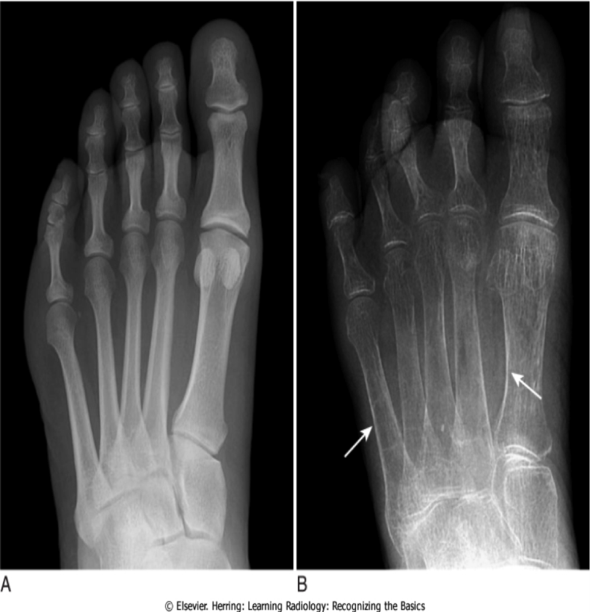
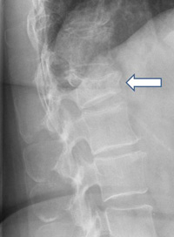
X-ray :
Signs of Osteoporosis in an X-ray:
- Cortical thinning
- Increased radiolucency

Slide 28
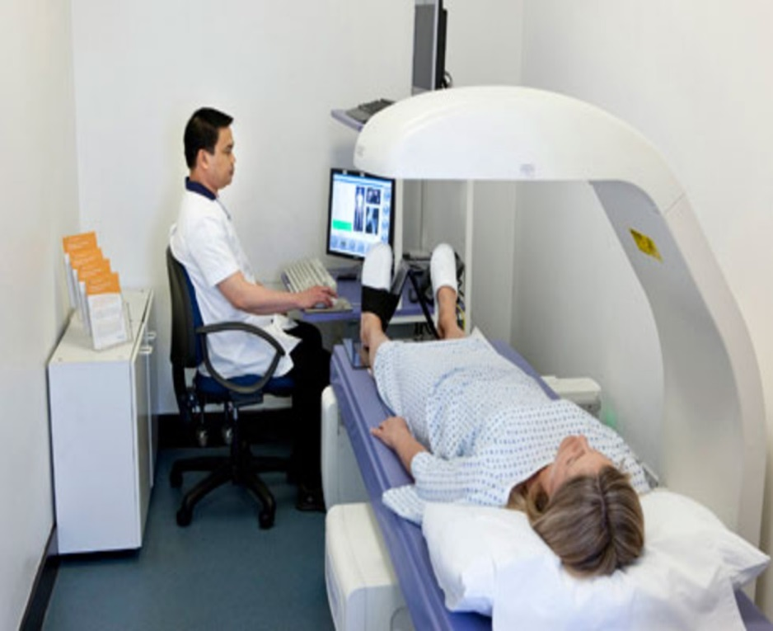
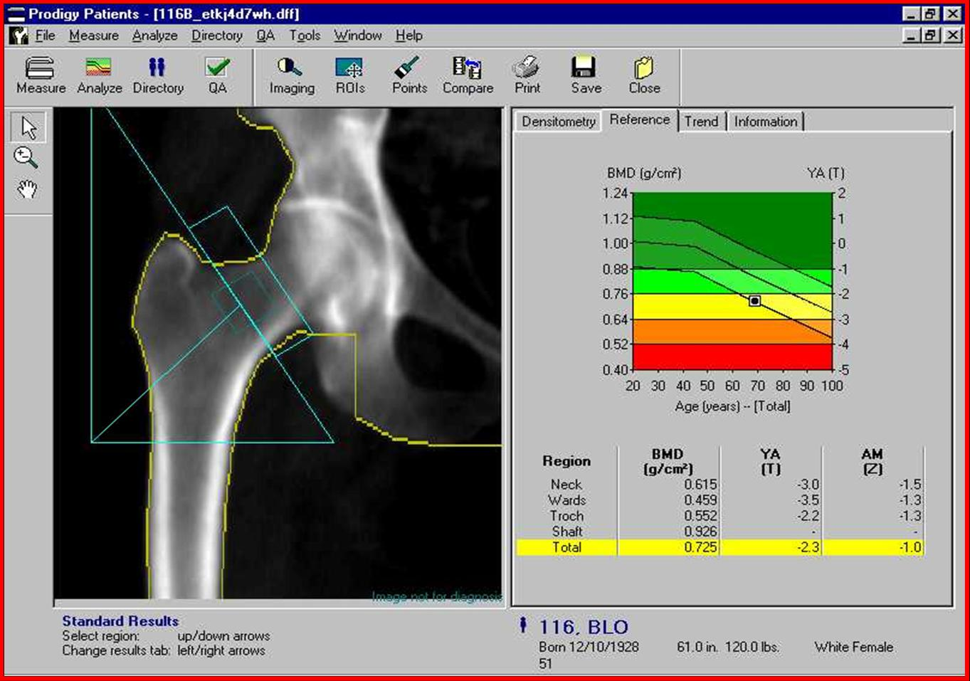
Dual-energy x-ray absorptiometry (DEXA) :
DXA is the most widely used method for measuring BMD because it gives very precise measurements at clinically relevant skeletal sites. The major disadvantages of DXA are that the machine is large (not portable) and expensive, and that it uses ionizing radiation.

Slide 29
DEXA :
- Bone mineral density
- T-score : according the SD difference between a patient's BMD and that of a young-adult reference population

Slide 30
DEXA :
- Z-score : is a comparison of the patient's BMD to an age-matched population.
- A Z-score of -2.0 or lower is considered below the expected range for age. Thus, the presence of Z-score values more than 2 SD below the mean should clarify the presence of coexisting problems (eg, glucocorticoid therapy or alcoholism) that can contribute to osteoporosis.

Slide 31
Labs :
- Laboratory evaluation – postmenopausal women with low BMD (T-score below -2.5) and/or fragility fracture have the following basic tests
•Biochemistry profile (especially calcium, phosphorous, albumin, total protein, creatinine, liver enzymes including alkaline phosphatase, electrolytes).
•25-hydroxyvitamin D (25[OH]D).
•Complete blood count (CBC).
Vitamin D deficiency, characterized by hypocalcemia and/or hypophosphatemia

Slide 32
Osteoporosis Management :
Management Goals:
Prevent fractures.
Improve Quality of Life.
Increase Bone Density and Mineralization.
Prevent Further Falls.

Slide 33
Prevention :
Patients identified as at risk for osteoporosis (including children and adolescents) should undergo preventive measures, including adequate calcium intake, vitamin D intake, and exercise. It is recommended to counsel patients to avoid tobacco and excessive alcohol use.
Role of vitamin D and calcium:
Calcium and vitamin D work together to protect your bones, calcium helps build and maintain bones, while vitamin D helps your body effectively absorb calcium.
If you take adequate amount calcium but you are Vit D deficit it won't benefit you

Slide 34
Pharmacological therapy :
- There is no role for pharmacological therapy as a means to maximize peak bone mass, except in very special circumstances. As an example, pharmacological doses of vitamin D for some children on anticonvulsant therapy or with celiac disease may be necessary to optimize skeletal health.
- In addition to lifestyle measures, patients at high risk for fracture should receive pharmacologic therapy. Our recommendations for initiation of therapy are largely in agreement with the National Osteoporosis Foundation (NOF) recommendations.
We recommend pharmacologic therapy for postmenopausal women with a history of fragility fracture or with osteoporosis based upon bone mineral density (BMD) measurement (T-score ≤-2.5).
We also suggest pharmacologic therapy for the treatment of high-risk postmenopausal women with T-scores between -1.0 and -2.5

Slide 35
Pharmacological therapy :
- Choice of drug : In the absence of high quality head-to-head drug comparison trials to determine the relative efficacy of the individual drugs, choice of therapy should be based upon efficacy, safety, cost, convenience, and other patient-related factors.
- Oral bisphosphonates are the first-line therapy. Oral bisphosphonates is preferred as initial therapy because of their efficacy, favorable cost, and the availability of long-term safety data.
- We favor alendronate or risedronate over other available bisphosphonates because of clinical trial data .

Slide 36
Pharmacological therapy :
Calcitonin
Parathyroid hormone
Denosumab
Estrogen Agonists/Antagonists (Raloxifene)
Hormone Replacement (Estrogen) Therapy
Teriparatide (PTH Analogue)

Slide 37
Vitamin deficiency in pregnancy :
- Low calcium and vitamin D levels have been associated with adverse health outcomes in mother and child, but it is unclear whether low levels are the causal factor or a marker of poor health.
- The value of routine vitamin D supplementation in pregnancy is an active and controversial area of investigation, but there is no clear evidence of a reduction in adverse pregnancy outcomes.
- In a 2016 Cochrane review including data from seven small trials, pregnant women who received daily vitamin D supplementation had higher 25-hydroxyvitamin D levels than those receiving placebo, but the response was heterogeneous .

Slide 38
References:
Uptodate
Harold N Rosen, MD. (May 27, 2016). Clinical manifestations, diagnosis, and evaluation of osteoporosis in postmenopausal women
Harold N Rosen, MD. (Feb 02, 2016). Calcium and vitamin D supplementation in osteoporosis
Michael Kleerekoper, MD. (Sep 22, 2015). Screening for osteoporosis .
Roger Bouillon, MD, PhD, FRCP. (Mar 09, 2016). Vitamin D and extraskeletal health
Nutr Hosp 2016 Jul 19;33(4):381. doi: 10.20960/nh.381 Obesity, related diseases and their relationship with vitamin D deﬁciency in adolescents

Slide 40
Osteoporosis is :
A- A disease of children caused by vitamin D deficiency.
B- A condition in which the bones become brittle and fragile from loss of tissue.
C-A condition in which the bones become soft due to decreased in mineralization.
D-All of the above.

Slide 41
Which of the following are considered signs of Osteoporosis in X- ray:
A- Increased Radiolucency.
B- Cortical Thinning.
C- Cortical thickening.
D- A and B.

Slide 42
Which one of the following isn't a risk factor for osteoporosis?
smoking
post-menopause
history of fragility fracture
D.M

Slide 43
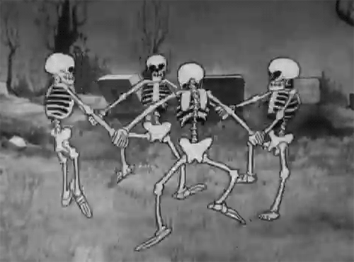
Thank You

