Slide 1
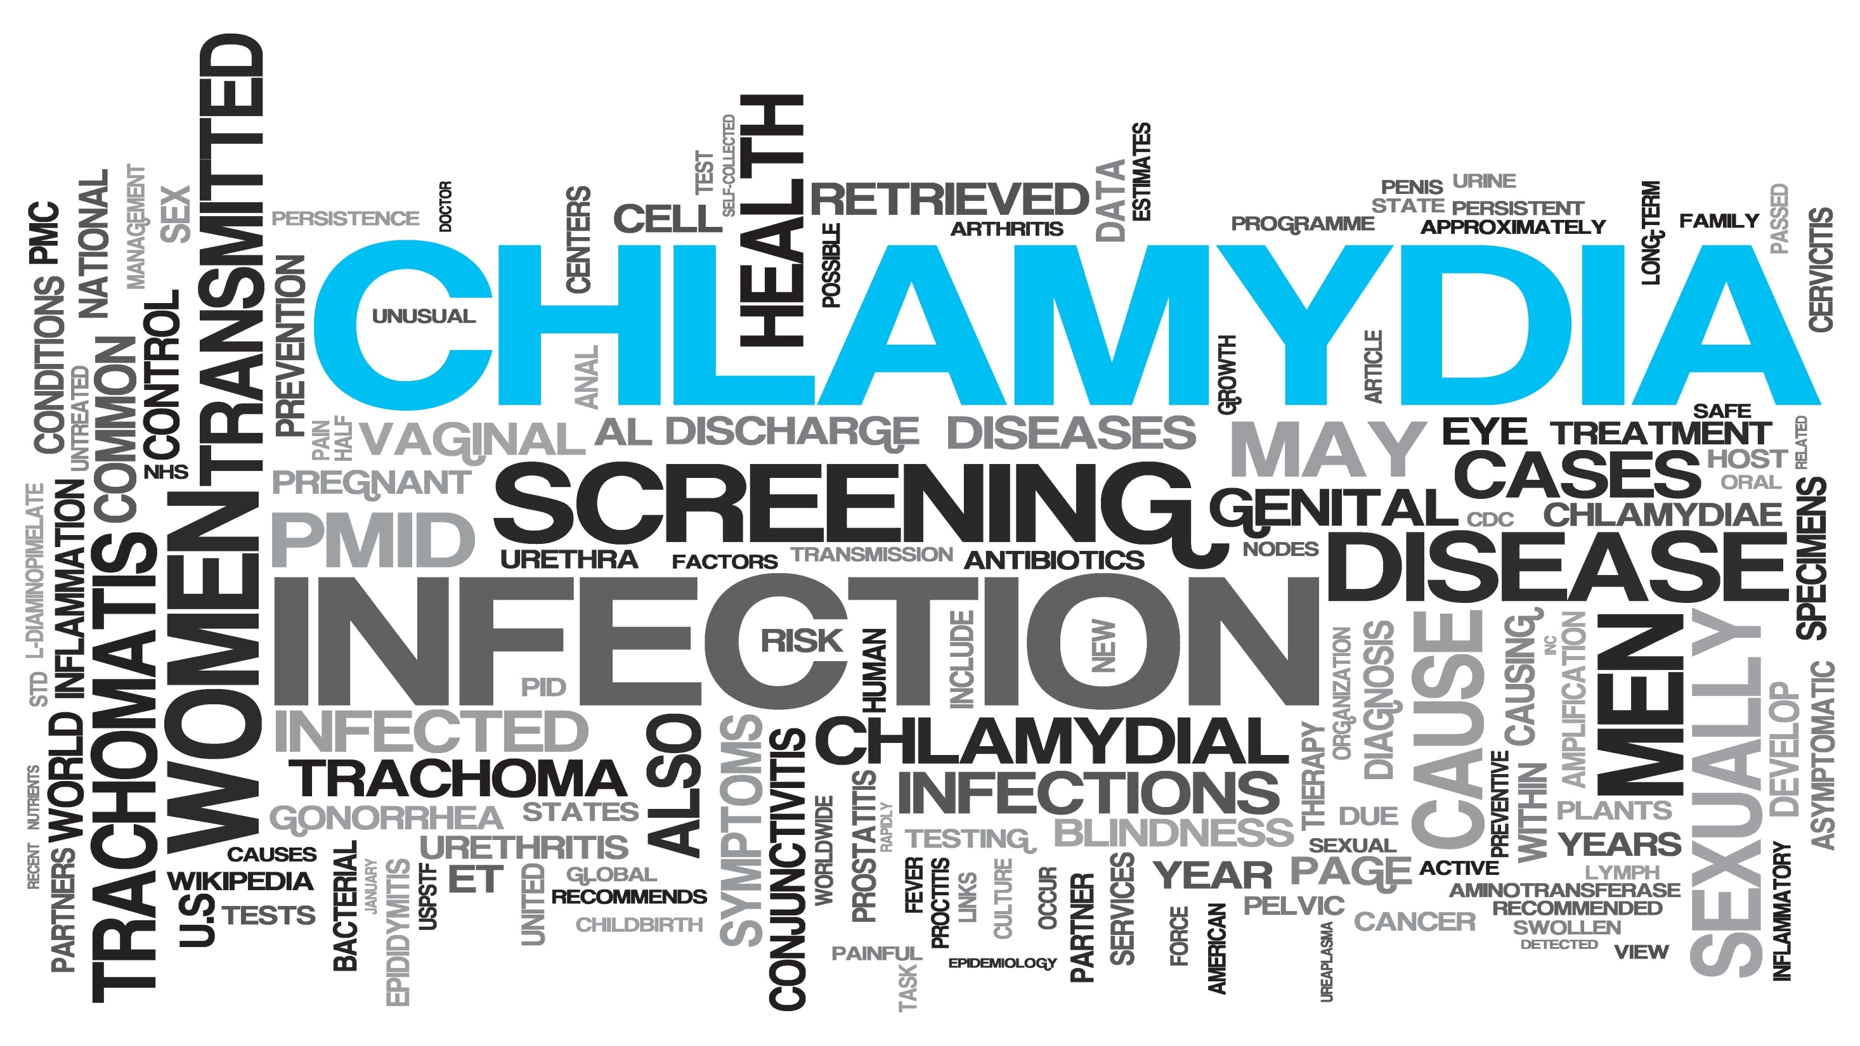

Slide 2
Sexual transmitted diseases
Group 7

Slide 3
Question 1
Common sites of perinatal gonorrheal infection include all of the following except
  Genitals
  Conjunctiva
  Pharynx
  Respiratory system

Slide 4
Question 2
  Which of the following best describes the clinical signs/symptoms of chlamydial urethral infection in men?
  Yellow discharge from penis
  Dysuria
  Scrotal pain
  Most men are asymptomatic.

Slide 5
Question 3
Patient comes to you complaining of urinary frequency. When you examined her you found Frothy yellowish vaginal discharge and strawberry cervix:
What is the most likely diagnosis?
  HIV
  Trichomoniasis
  Gonorrhea
  Syphilis

Slide 6
Question 4
Which of the following is required to diagnose a patient with AIDS?
  A CD4 count of less than 200 cells/mm3
  A CD4 count of less than 1000 cells/mm3
  A CD4 count of less than 2000 cells/mm3
  A CD4 count of less than 100 cells/mm3

Slide 7
Question 5
Which of the following is the drug of choice in the treatment of Trichomoniasis :
  Azithromycin
  Doxycycline
  Ceftriaxone
  Metronidazole

Slide 8
All of the following statements about Gram stain in gonorrhea diagnosis are true except
  A Gram stain is reliable to diagnose gonorrhea in males.
  A Gram stain is reliable to diagnose gonorrhea in females.
  A Gram stain does not have a high sensitivity in asymptomatic males.
  A Gram stain is not recommended to diagnose pharyngeal gonorrhea.
Which of the following is not one of the characteristic symptoms of reactive arthritis?
  Prostatitis
  Urethritis
  Conjunctivitis
  Oligoarthritis
Which of the following best describes the clinical signs/symptoms of chlamydial infection in women?
  Most women complain of a discharge.
  Most women complain of urinary symptoms.
  Clinical signs/symptoms depend on the duration of infection.
  Most women are asymptomatic.
Which of the following statements is true about C. trachomatis in women?
  The majority of women are symptomatic.
  The majority of women with infection can be identified by clinical examination.
  The most frequent sequelae of untreated disease is having a life-threatening ectopic pregnancy.
  Chlamydia-associated PID is sometimes sub-acute or silent.

Slide 9
The majority of cases of PID are:
  Symptomatic with moderate symptomatology
  Symptomatic with severe symptomatology
  Caused by a single organism
  Subclinical or asymptomatic
After completion of parenteral therapy for PID, one should continue oral therapy to complete a total of _____days of therapy?
  7
  14
  21
  28

Slide 10
What is Sexually Transmitted Disease (STDs)?!
Areej Al-Alwan

Slide 11
“Sexually transmitted infections (STIs) are infections that are spread primarily through person-to-person sexual contact. There are more than 30 different sexually transmissible bacteria, viruses and parasites.” World Health Organization.
According to the American Social Health Organization, one out of four teens in the United States becomes infected with an STD each year. By the age of 25, half of all sexually active young adults will get an STD.

Slide 12
COMMON SEXUAL TRANSMITED
DISEASEs
HIV
SYPHILIS
Chlamydia
Gonorrhea
Trichomoniasis

Slide 13
Why it’s important ?
Each year, there are an estimated 357 million new infections with 1 of 4 STIs: chlamydia, gonorrhoea, syphilis and trichomoniasis.
More than 500 million people are estimated to have genital infection with herpes simplex virus (HSV).
The majority of STIs have no symptoms or only mild symptoms that may not be recognized as an STI.
In some cases, STIs can have serious reproductive health consequences beyond the immediate impact of the infection itself (e.g., infertility or mother-to-child transmission)
Drug resistance, especially for gonorrhoea, is a major threat to reducing the impact of STIs worldwide.

Slide 14
Bacterial
Syphilis
viral
Herpes
Parasitic
Trichomonas vaginalis
Chlamydia
Gonorrhea
chancroid
Human Papilloma Virus
HIV
Hepatitis B Virus

Slide 15
Differential diagnosis:
Vaginal discharge
Urethral discharge
Genital ulcers
Candida
Bacterial vaginosis
Chlamydia trachomatis
Herpes simplex virus
Neisseria gonorrhea
Chlamydia trachomatis
Syphilis
Herpes
chancroid
Also may associated fever, pain, itch, malodour, genital swelling, skin rash, joint pains and eye symptoms.
Notes:
once we think of a possible STDS, think of the cause of(symptoms) :

Slide 16
How to approach a patient with STI:
history
Some patients may not be comfortable talking about their sexual history, sex partners, or sexual practices. Try to put patients at ease and let them know that taking a sexual history is an important part of a regular medical exam or physical history.

Slide 17
Taking a sexual history:
Introduce yourself and establish your role as clinician.
Interview patient alone or with an unrelated translator.
Be non-judgmental and objective to enhance patient behavioral outcomes
Use active listening, open-ended questions, and clarify/verify your own and patient understanding.
Actively listen for informational content, emotional content, comprehension, omitted information, etc.
Begin with least sensitive questions (e.g.; general health history), then progress to sexual behaviors
; do not use labels ("straight," "bisexual," "gay," "queer," “shooter,” etc.)

Slide 18
History must cover the 5Ps:
The five “P”s stand for:
Partners
Practices
Protection from STDs
Past history of STDs
Prevention of pregnancy
Notes:
These are the areas that you should openly discuss with your patients. You probably will need to ask additional questions that are appropriate to each patient’s special situation or circumstances

Slide 19
Ways of Transmission
STDs can be transmitted many different ways, but most can be passed by:
Vaginal sex
Anal sex
Oral sex
Skin-to-skin contact
Infected Mother to child

Slide 20
STD behavioral and partner risk indicators
Adolescence
Residence in high prevalence of STDs
Residence in poor access to health care
A history of prior STD diagnosis and treatment (past 1-2 years)
New partner in the last two or three months
More than one sex partner (past 1-4 months, past year)
Current use or a history of injection drug use or substance abuse by patient or sex partners
HIV-infected patients with high risk behaviors

Slide 21
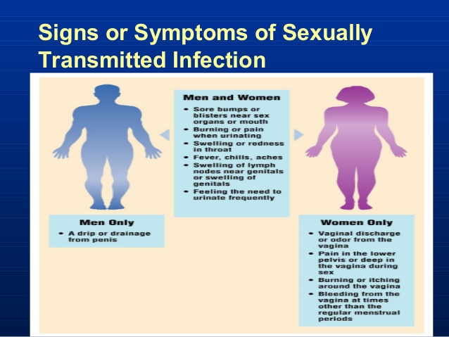

Slide 22
Examination:
A. General examination must include the mouth, throat, skin and lymph nodes in all patients.
B. The inguinal, genital and perianal areas should be examined with a good light source.
C. The groins should be palpated for lymphadenopathy and hernias.
D. The pubic hair must be examined for nits and lice.
E. The external genitalia must be examined for signs of erythema, fissures, ulcers, chancres, pigmented or hypopigmented areas and warts.
F. The urethral meatus is located and the presence of discharge noted
G. The cervix should be inspected for ulceration, discharge, bleeding and ectopy and the walls of the vagina for warts.

Slide 23
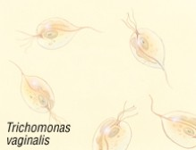
Ethar Alqarni

Slide 24
Trichomoniasis
A sexually transmitted disease (STD) caused by a microscopic parasite, usually found in the vagina and urethral tissues.

Slide 25
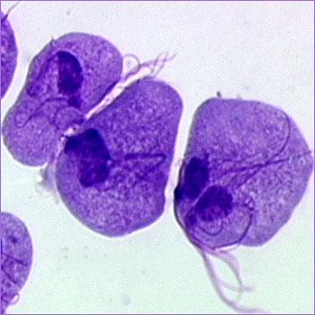
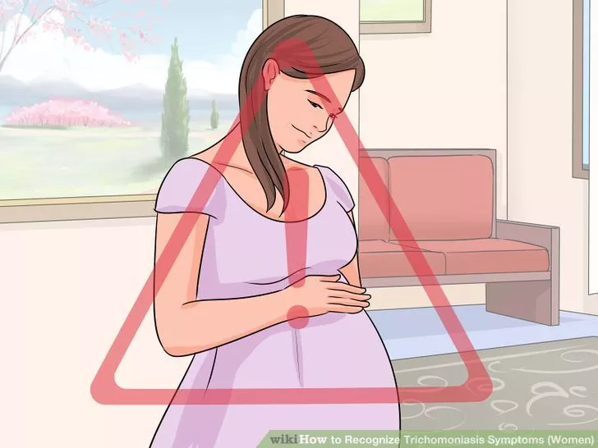
Etiology:
Trichomonas Vaginalis
Mode of transmission:
  Sexual contact.
  perinatal, from mother to child.
Complication During pregnancy:
  Preterm delivery
  Low birth weight

Slide 26
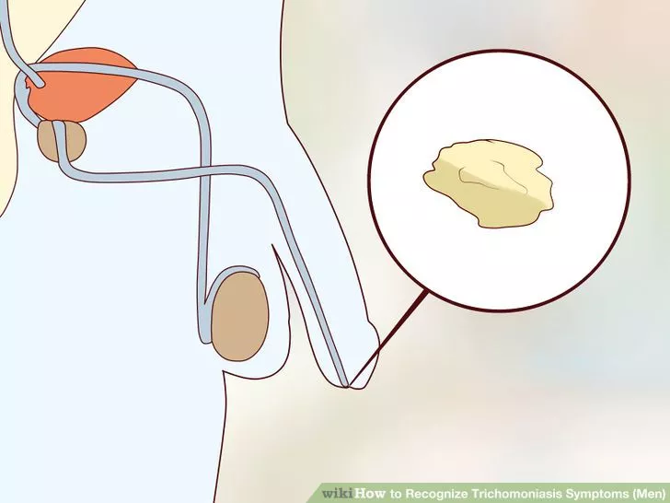
Men
Usually asymptomatic in beginning . Irritation inside the penis. Slight burning after urination or ejaculation. urethral discharge.

Slide 27
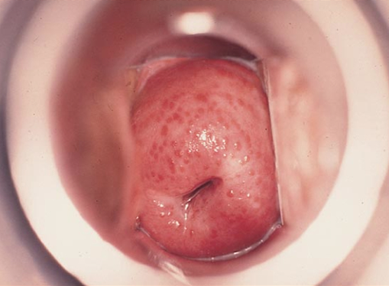
Women
Greenish-yellow, frothy vaginal discharge with a strong odor. Painful urination. Vaginal itching and irritation. Discomfort during intercourse. The cervix may have multiple small hemorrhagic areas which lead to the description strawberry cervix.
Strawberry cervix

Slide 28

Diagnosis:
History
Examination
Laboratory :
  sample of vaginal or urethral fluid
  to look for the disease causing parasite.

Slide 29
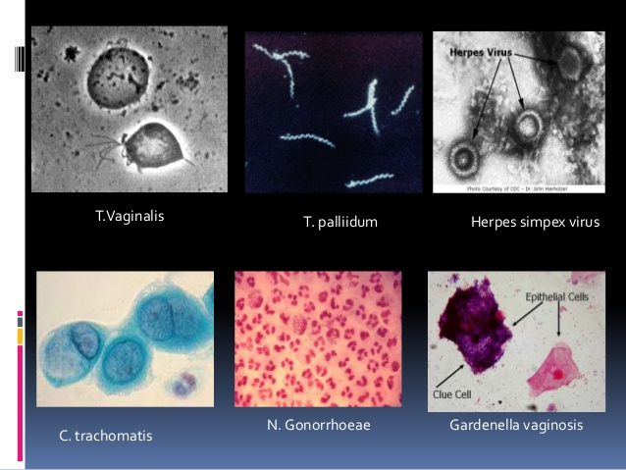
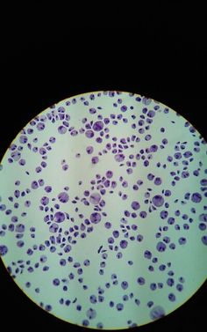
  Dark field microscopy:
  Positive in 40-80% of women
  and 30% of men.
  Culture techniques :
  confirm the diagnosis.

Slide 30
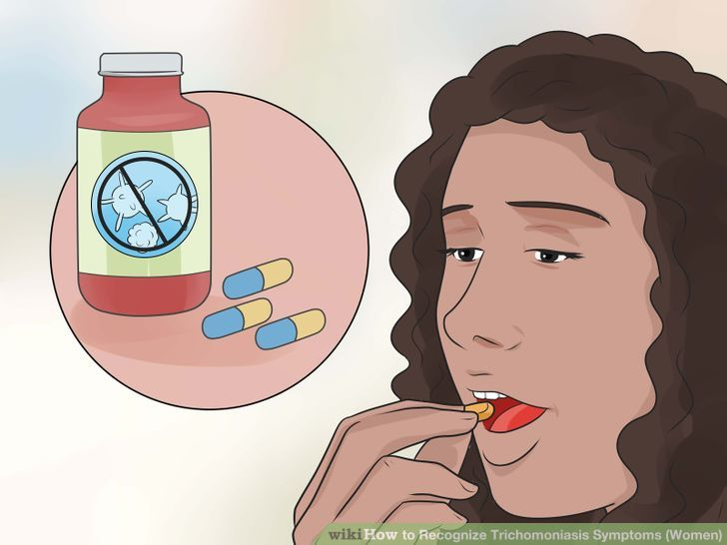
  Treatment:
  Metronidazole or Tinidazole.
  For
  symptomatic
  asymptomatic
  partner.

Slide 31
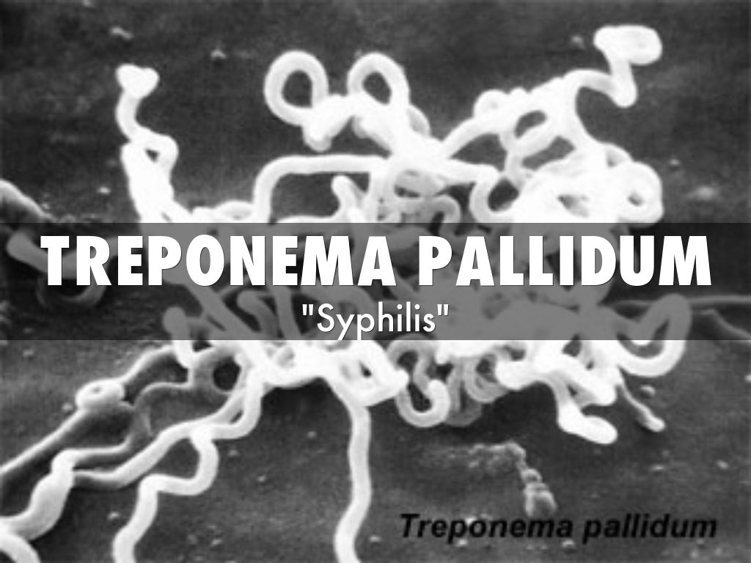

Slide 32
Syphilis
Sexual transmitted with the bacterial infection which spread through broken skin or mucous membranes.

Slide 33
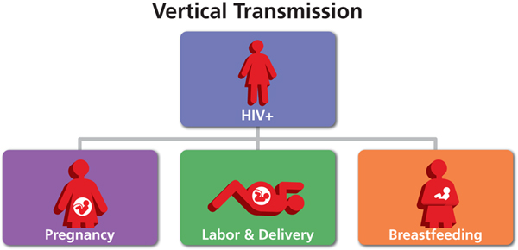
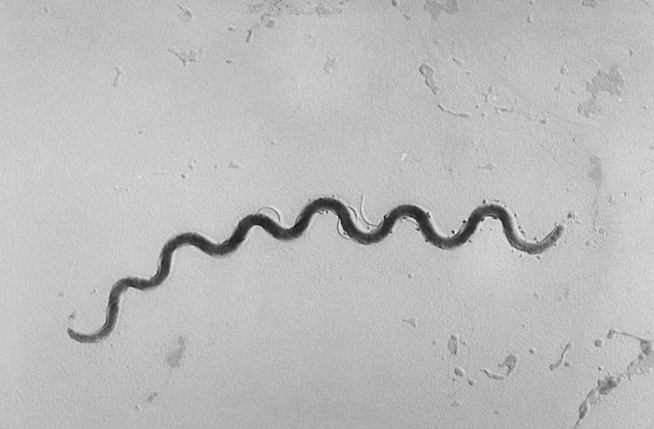
Etiology:
Treponema pallidum.
Mode of transmission:
Sexual and vertical

Slide 34
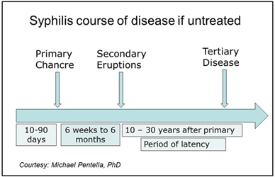

Slide 35
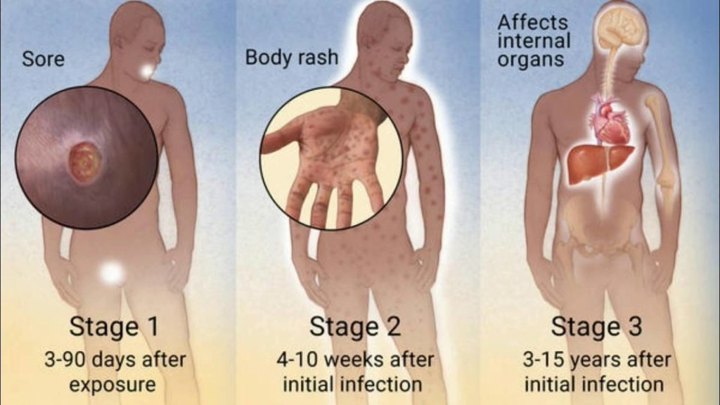
Chancre
Erythema Multiforms

Slide 36
Chancre of tongue
Penile Chancre
Labial Chancre
Nickel/Dime Lesions
Erythema Multiforms
Condylomata lata

Slide 37
Diagnosis:
Laboratory | Examination | History
detect T. pallidum from lesion exudate or tissue by dark field microscopy. Serologic tests Nontreponemal tests. Treponemal tests. | Oral cavity . Lymph nodes . Skin upper body. Palms and soles . Genitalia and perianal area. Neurologic examination . Abdomen . | History of syphilis. Known contact to an early case of syphilis. Typical signs or symptoms of syphilis in the past 12 months. Most recent serologic test for syphilis.

Slide 38
Dark field microscopy of smear:
primary or secondary stage.

Slide 39
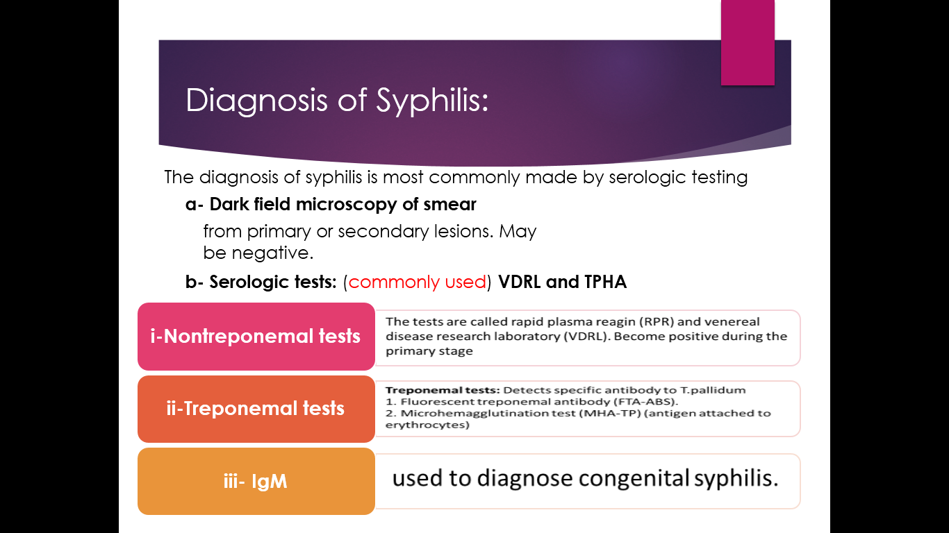
Serologic tests:

Slide 40
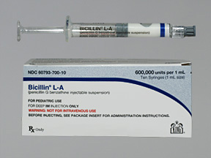
Treatment:
Benzathine penicillin
G 2.4 million units
intramuscularly in a single dose
(Bicillin L-A®)
If penicillin allergic
Doxycycline 100 mg orally twice daily for 14 days,
or Tetracycline 500 mg orally 4 times daily for 14 days .

Slide 41
Shuaa AlSayyari

Slide 42
Gonorrhoea
Gram-negative diplococcus Neisseria gonorrhoeae.
Transmission :
Direct inoculation of infected secretions from one mucous membrane to another.
Primary sites of infection :
Mucous membranes of the urethra, endocervix, rectum, pharynx and conjunctiva.

Slide 43
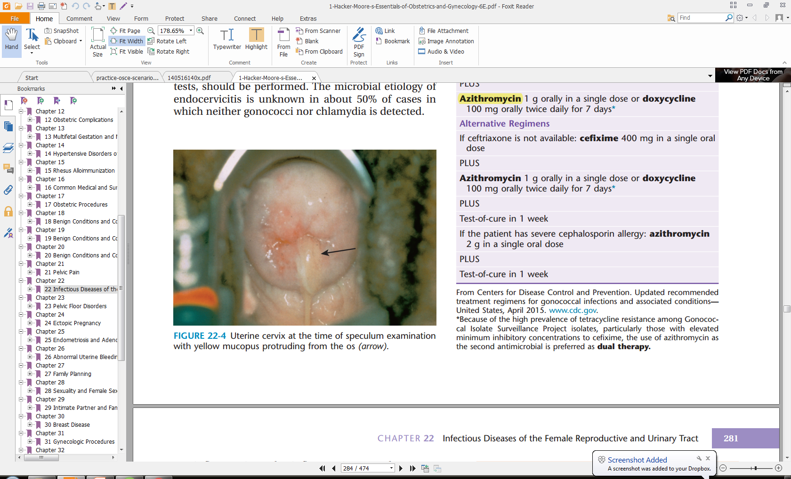
Clinical features
Men
Urethritis
Symptoms:
Urethral discharge (80%) and/or dysuria (50%) within 2-5 days
Urethral infection can be asymptomatic (10%)
Signs:
Mucopurulent or purulent urethral discharge
Rarely, epididymal tenderness/swelling or balanitis may be present
Women
Urogenital infection
Symptoms:
Increased or altered vaginal discharge is the most common symptom (up to 50%)
Lower abdominal pain may be present (up to 25%)
Urethral infection may cause dysuria (12%) but not frequency
Gonorrhoea is a rare cause of intermenstrual bleeding or menorrhagia
Signs:
Mucopurulent endocervical discharge and easily induced endocervical bleeding (50%)
Pelvic/lower abdominal tenderness (5%)
Commonly, no abnormal findings are present on examination
Notes:
Incubation: 1-14 d (usually 2-5 d)
Balanitis is inflammation of the glans penis
urethritis is the major manifestation of gonococcal infection
Initial characteristics include burning upon urination and a serous discharge. A few days later, the discharge usually becomes more profuse, purulent, and, at times, blood-tinged.
Endocervix infection is frequently asymptomatic (up to 50%)
Acute epididymitis: Usually unilateral and often occurs in conjunction with a urethral exudate
The most common site of gonococcal infection in women is the endocervix (80%-90%), followed by the urethra (80%), rectum (40%), and pharynx (10%-20%).

Slide 44
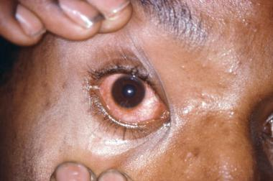
Extra-genital infections:
Rectal infection is usually asymptomatic but may cause anal discharge (12%) or perianal/anal pain or discomfort (7%)
Pharyngeal infection is usually asymptomatic (90%)
Eye involvement in adults : purulent conjunctivitis, may rapidly progress to panophthalmitis
Notes:
Eye involvement in adults occurs by autoinoculation of gonococci into the conjunctival sac from a primary site of infection usually unilateral
Pharyngitis is often asymptomatic; however, it may present as exudative pharyngitis with cervical lymphadenopathy.
Rectal infection is often asymptomatic, but rectal pain, pruritus, tenesmus, and rectal discharge may be present if the rectal mucosa is infected. Bloody diarrhea may also occur. Rectal infection may occur from anal intercourse or, in women, by local spread of the organism.

Slide 45
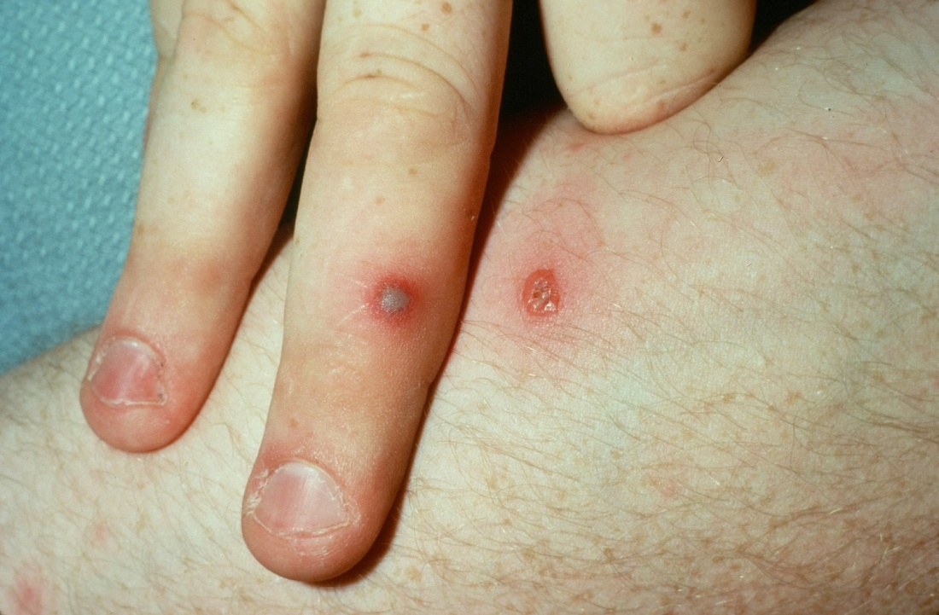
Complications
Men: Transluminal spread my result in epididymo-orchitis or prostatitis
Women: pelvic inflammatory disease (PID).
Disseminated gonoccoccal infection: may occur following haematogenous dissemination causing skin lesions, arthralgia, arthritis and tenosynovitis.
Notes:
the classic presentation of disseminated gonococcal infection (DGI) is an arthritis-dermatitis syndrome. Joint or tendon pain is the most common presenting complaint in the early stage of infection. The second stage of DGI is characterized by septic arthritis. The knee is the most common site of purulent gonococcal arthritis
When gonococcal cervicitis is either asymptomatic or unrecognized, the patient may progress to PID

Slide 46
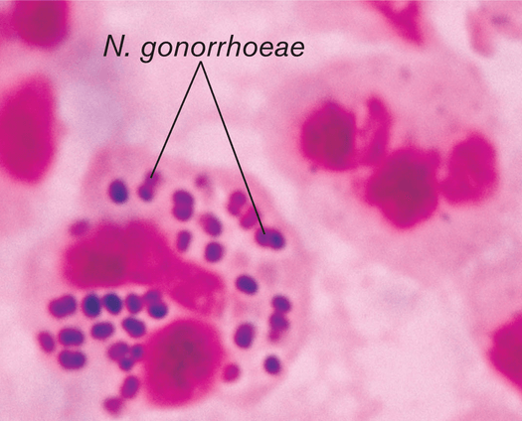
Diagnosis
Microscopy
N. gonorrhoeae as monomorphic Gram-negative diplococci within polymorphonuclear leukocytes.
Sensitivity is 90 – 95% in men with urethral discharge
Nucleic Acid Amplification Tests (NAATs)
High sensitivity (96%) in both asymptomatic and symptomatic infection.
Equivalent sensitivity in urine and urethral swab specimens from men and in vaginal and endocervical swabs from women.
Culture
Culture continues to offer a specific, sensitive and cheap diagnostic test at genital sites.
It allows confirmatory identification and antimicrobial susceptibility testing.

Slide 47
Management
A culture should be taken in all cases of gonorrhoea diagnosed by NAATs
Screening for coincident STIs
Indications for therapy
Identification of intracellular Gram-negative diplococci on microscopy of a smear from the genital tract
Positive culture or NAAT for N. gonorrhoeae from any site
Recent sexual partner(s) of confirmed cases of gonococcal infection
Consider offering on epidemiological grounds following sexual assault
Notes:
A culture should be taken in all cases of gonorrhoea diagnosed by NAATs prior to antibiotics being given, if possible, for susceptibility testing
Screening for coincident STIs should routinely be performed in patients with or at risk of gonorrhoea

Slide 48
Treatment for uncomplicated anogenital infection:
Ceftriaxone 500 mg i.m. as a single dose with azithromycin 1 g oral as a single dose
Treatment of Gonococcal PID
Ceftriaxone 500mg i.m. immediately followed by oral doxycycline 100mg twice daily plus metronidazole 400mg twice daily for 14 days
Treatment of Gonococcal epididymo-orchitis
Ceftriaxone 500 mg i.m. plus doxycycline 100 mg twice daily for 10–14 days
Notes:
Azithromycin is recommended as co-treatment irrespective of the results of chlamydia testing (IV, C), to delay the onset of cephalosporin resistance.

Slide 49
Chlamydia
Genital chlamydial infection is caused by the obligate intracellular bacterium C. trachomatis.
Chlamydia is the most commonly reported curable bacterial STI in the UK.
The highest prevalence rates are in 15–24-year olds.
Chlamydia infection has a high frequency of transmission.
Notes:
The incubation period is 1-3 weeks.
Approximately 50% of infected males and 80% of infected females are asymptomatic

Slide 50
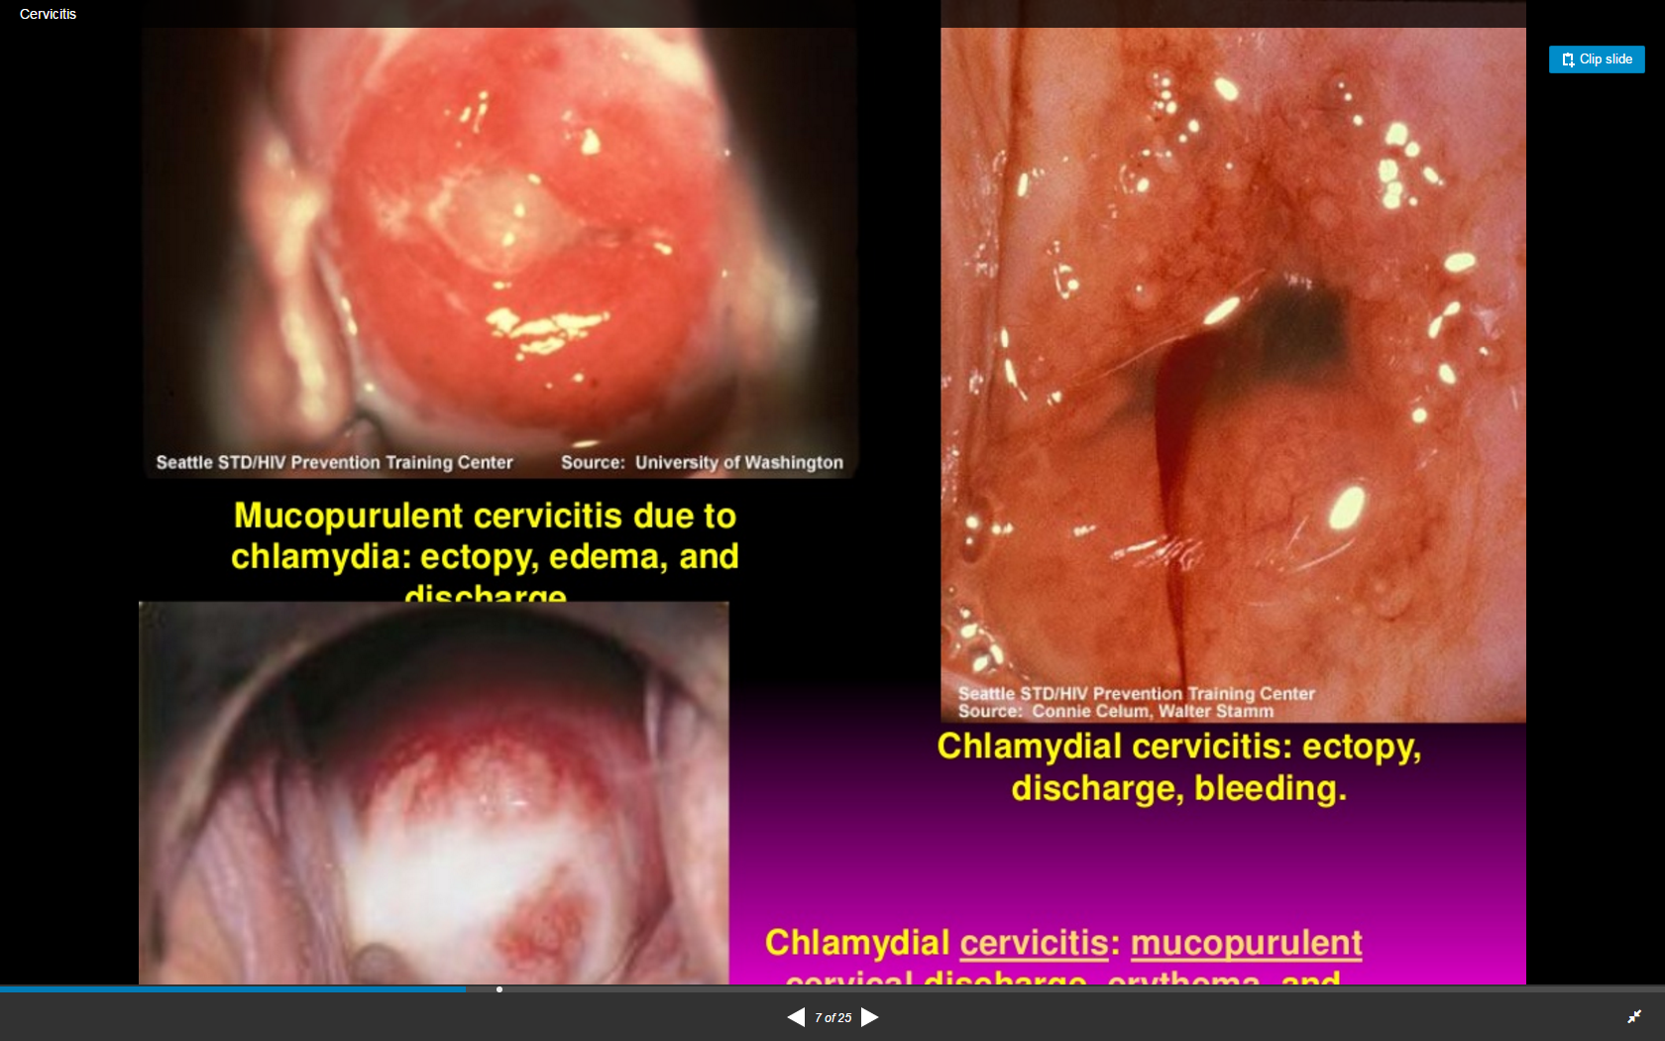
Clinical features
Men
Symptoms (may be so mild as to be unnoticed):
Urethral discharge
Dysuria
Signs:
Urethral discharge
Women
Symptoms:
In the majority, infection is asymptomatic
Increased vaginal discharge
Post-coital and intermenstrual bleeding
Dysuria
Lower abdominal pain
Deep dyspareunia
Signs:
Mucopurulent cervicitis with or without contact bleeding
Pelvic tenderness
Cervical motion tenderness

Slide 51
Extra-genital infections:
Rectal infection Rectal infection is usually asymptomatic, but anal discharge and anorectal discomfort may occur
Pharyngeal infection: is usually asymptomatic
Conjunctival infections: Usually sexually acquired - the usual presentation is of unilateral low-grade irritation; however, the condition may be bilateral
Complications: Potential to transmit to newborn during delivery – Conjunctivitis, pneumonia

Slide 52
Complications
Men
Sexually aquired reactive arthritis
Epididymo-orchitis.
Women
PID, endometritis, salpingitis
Tubal infertility
Ectopic pregnancy
Sexually acquired reactive arthritis (SARA) (<1%)
Perihepatitis
Lymphogranuloma venereum (LGV)
Asymptomatic infection may occur
Tenesmus
Anorectal discharge (often bloody) and discomfort
Diarrhoea or altered bowel habit
Notes:
-Reiter syndrome, a reactive arthritis secondary to an immune-mediated response, has been associated with a primary chlamydial infection.
-Fitz-Hugh-Curtis syndrome (perihepatitis) is a rare complication of PID that is 5 times more likely to be caused by Chlamydia than by N gonorrhoeae. It frequently presents without the typical examination findings associated with PID (ie, the pelvic examination is normal).
Women with a chlamydial infection (especially one caused by serotype G) are at increased risk for the development of cervical cancer; the risk is as much as 6.5 times greater than it is in women without infection. Chlamydial infections also increase the risk of acquiring HIV infection by increasing genital mucosal inflammation.
- Lymphogranuloma venereum (LGV) is an uncommon sexually transmitted disease (STD) caused by Chlamydia trachomatis. LGV is a subtype of genital ulcer diseases

Slide 53
Diagnosis
Nucleic Acid Amplification Tests (NAATs)
Vulvo-vaginal swabs (VVS):
A vulvo-vaginal sample is the specimen of choice in women.
First-catch urine:
In men is reported to be as sensitive or more sensitive than urethral sampling .
Extra-genital sampling:
Rectal swabs and pharyngeal swabs: NAATs

Slide 54
Management
Uncomplicated urogenital infection and pharyngeal infection:
Doxycycline 100mg bd for seven days (contraindicated in pregnancy)
or
Azithromycin 1g orally in a single dose
Alternative regimens:
if either of the above treatment is contraindicated:
Erythromycin 500mg bd for 10–14 days
or
Ofloxacin 200mg bd or 400mg od for seven days

Slide 55
Pelvic Inflammatory Disease
Infectious and inflammatory disorder of the upper female genital tract, including the uterus, fallopian tubes, and adjacent pelvic structures.
The organisms most commonly isolated in cases of acute PID are
N gonorrhoeae and C trachomatis.
Notes:
: Symptoms of PID include the following:
Lower abdominal pain (most consistent symptom of PID)
Increased vaginal discharge or mucopurulent urethral discharge
Dysuria (usually without urgency or frequency)
Cervical motion tenderness
Adnexal tenderness (usually bilateral) or adnexal mass
Intermenstrual bleeding
Fever, chills, nausea, and vomiting (less common)
is an infectious and inflammatory disorder of the upper female genital tract, including the uterus, fallopian tubes, and adjacent pelvic structures. Infection and inflammation may spread to the abdomen, including perihepatic structures (Fitz-Hugh−Curtis syndrome).
linically, gonorrheal infection may be asymptomatic or may manifest similarly to chlamydial infection; however, it more often produces more acute symptomatic disease. An estimated 10-20% of untreated chlamydial or gonorrheal infections progress to PID

Slide 56
Diagnostic Considerations
Empiric treatment of PID is indicated when a patient who is at risk for sexually transmitted disease (STD) has pelvic or lower abdominal pain, no identifiable cause for her illness other than PID, and, on pelvic examination, 1 or more of the following minimal criteria{Re36}:
Cervical motion tenderness
Uterine tenderness
Adnexal tenderness
Notes:
Because of the relatively poor specificity and sensitivity of clinical findings, the Centers for Disease Control and Prevention (CDC) has established minimal criteria for the diagnosis of PID. According to these criteria, empiric treatment of PID is indicated when a patient who is at risk for sexually transmitted disease (STD) has pelvic or lower abdominal pain, no identifiable cause for her illness other than PID, and, on pelvic examination, 1 or more of the following minimal criteria{Re36}:
Cervical motion tenderness
Uterine tenderness
Adnexal tenderness
A delay in diagnosis or treatment can result in long-term sequelae, such as chronic pelvic pain and tubal infertility
Differential Diagnoses
Adnexal Tumors
Appendicitis
Ectopic Pregnancy
Endometriosis
Interstitial Cystitis
Ovarian Cysts
Ovarian Torsion

Slide 57
Case
Suzy Jones is a 17 year old college student who presents to the Student Health Center seeking advice about contraception.
White female
College student
Seeking advice about contraception
Shy talking about her sexual practices
Has never had a pelvic exam
Has had 2sex partners in past 6months
Does not use condoms or any other contraceptives
Her periods have been regular, but she has recently noted some spotting between periods. Last menstrual period was 4 weeks ago.
Denies vaginal discharge, dyspareunia, genital lesions, or sores

Slide 58
Physical Exam:
Vital signs: blood pressure 118/68, pulse 74, respiration 18, temperature 37.1° C
Breast, thyroid,and abdominal exam within normal limits
The genital exam reveals normal vulva, and vagina.
The cervix appears inflamed, bleeds easily, with a purulent discharge coming from the cervical os.
The bimanual exam is normal without cervical motion pain, uterine or adnexal tenderness.
Which laboratory tests should be ordered or performed?
What is the most likely microbiologic diagnosis?
Based on Suzy’s history and physical exam, what is the initial clinical diagnosis?
Notes:
1- Cervicitis:
The clinical diagnosis of cervicitis is made when a purulent or mucopurulent exudate is seen coming from the endocervical canal, or on a swab placed in the endocervix (swab test). Some experts also make the diagnosis of cervicitis based on cervical friability, or easily induced bleeding.
2- Chlamydia and/or gonorrhea:
Based on the patient’s age and the overall epidemiology of STDs, chlamydia and/or gonorrhea are the most likely diagnoses.
HSV and Trichomonas vaginalis tend to cause an ectocervicitis instead of a purulent endocervical exudate. Also, trichomoniasis is usually accompanied by a copious vaginal discharge and vaginal irritation. Herpetic cervicitis is often accompanied by ulcerations on other parts of the genital tract. In many cases of cervicitis, no etiologic agent is found.
3- Appropriate laboratory tests include the following:
A pregnancy test – Irregular bleeding can also be caused by pregnancy.
Chlamydia trachomatis – NAAT is the most sensitive test for detection.
Neisseria gonorrhoeae – NAAT is the most sensitive test for detection. Saline wet mount, pH, and KOH preparation of vaginal secretions – A microscopic examination of vaginal secretions can help identify other etiologies of cervicitis, such as trichomoniasis, candidiasis or bacterial vaginosis.
Counseling and testing for HIV – Age and history of sexual activity are an indication for offering HIV testing.
Depending upon local epidemiology, additional testing for syphilis (RPR or VDRL) or trichomoniasis might be indicated.

Slide 59
Herpes zoster virus

Slide 60

Herpes zoster virus
Herpes simplex virus type 2
At least 50 million people in the United States—about one in six adults—are infected with HSV. Genital herpes is more common in women than in men.
HSV is spread through direct contact with herpes sores, HSV also can be present on the skin even if there are no sores. If a person comes into contact with the virus on an infected person’s skin, he or she can become infected.
First Infection > nerve ganglia > trigger > reactivate > sores and bluster
From mother to the neonate

Slide 61
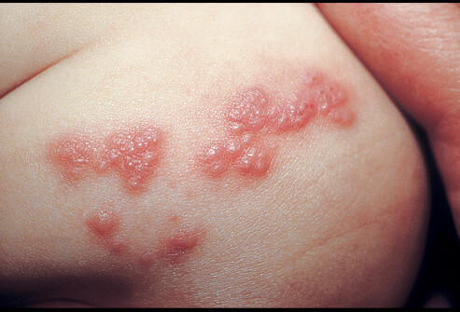
Diagnosis
presentation
Multiple, bilateral, and painful genital vesicles or ulcer.
Fever, headache, malaise, and lymphadenopathy.
Investigation
PCR accurate
Serology tests and antibodies.
complications
Rectal inflammation Proctitis
Meningitis
Involvement of sacral plexus urine retention
Management
Antiviral medications: acyclovir, famciclovir and Valacyclovir.
Partner must be tested and treated.
C.S in infected mother.

Slide 62



Slide 63
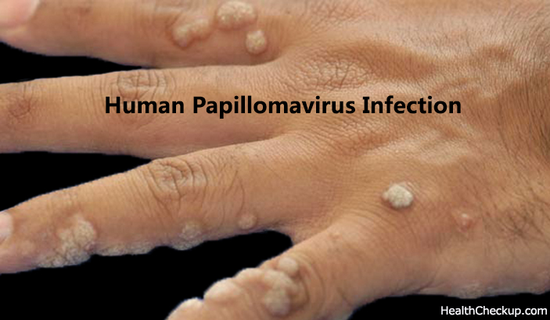
Human papilloma virus…
Human papillomaviruses (HPV) are common viruses that can cause warts in the skin. There are more than 100 types of HPV.
They can be low risk or high risk.
The center of disease control estimates that 14 million people get a new HPV infection every year in U.S.
Risk factors
Multiple partners
Immunocmpromised
Contact with infected person
Mother to newborn rare

Slide 64
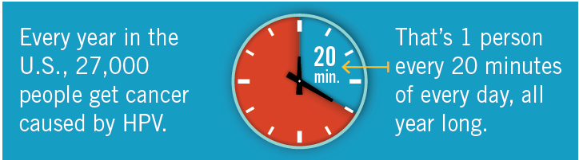
Diagnosis
Presentation Asymptomatic
Genital warts usually appear as a small bump or groups of bumps in the genital area. They can be small or large, raised or flat.
In women may cause vaginal discharge and bleeding.
Recurrence is common.
HPV cancers include cancer of the cervix, vulva, vagina, penis, or anus. HPV infection can also cause cancer in the back of the throat, including the base of the tongue and tonsils.
Biopsy

Slide 65

Investigation
HPV test Check for the virus.
Pap test check for any cell changes.
Under age 30: Pap test every 3 year
From 30 to 65: HPV test and Pap test (co-testing) every 5 years

Slide 66
Management
Medical therapy
Cryotherapy
Surgical excision
Electro cautery
complications
Most serious is cancer.
Prevention
HPV vaccine Gardasil and Cervarix. 3 doses

Slide 67

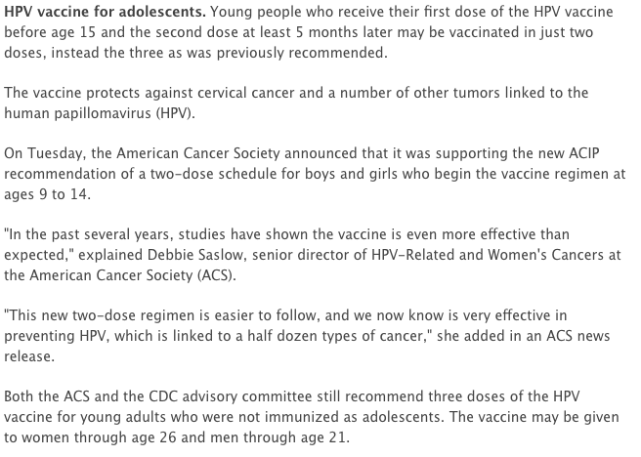

Slide 68
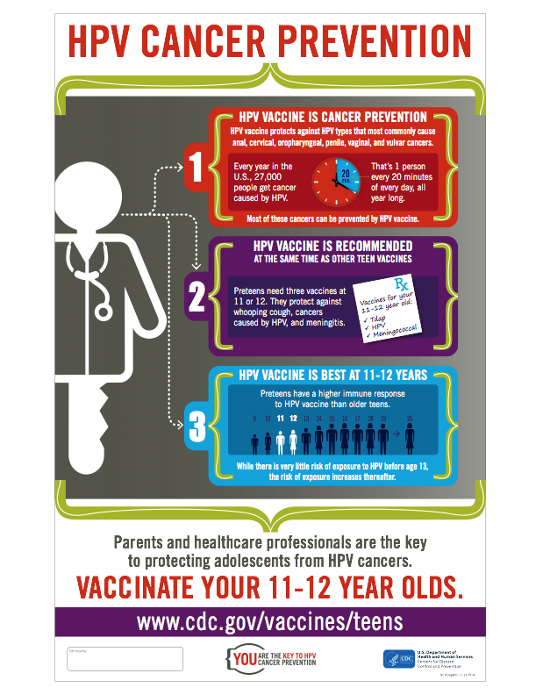

Slide 69
Case …
Anne Drew is a 34-year-old woman who comes in stating that she wants to get "checked out" because her partner, has small solid "bumps" on the skin at the base of his penis. He told her that he was diagnosed and treated for genital warts about a year ago, and his health care provider told him they could recur.
History
No history of abnormal Pap tests and no history of STDs.
Last Pap test was performed 4 months ago.
Sexually active since age 16 with multiple partner.
Currently sexually active with one partner for the last eight months.
Uses oral contraceptives for birth control.
No vaginal discharge
Physical Examination
Vital signs: blood pressure 96/74, pulse 78, respiration 13, temperature 37.1° C
Chest, heart, musculoskeletal, and abdominal exams within normal limits
Pelvic exam is normal
Visual inspection of the genitalia reveals multiple small (<0.5 cm), flesh-colored, papular painless lesions in the perineal area

Slide 70

Hepatitis
Alanood Almehaidib

Slide 71
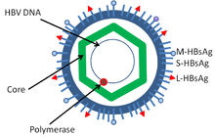
Hepatitis B
Hepatitis B is an infection of the liver caused by the hepatitis B virus.
It can be:
  Acute(<6 months of liver inflammation )
  Chronic(>6 months of persistent liver inflammation)

Slide 72
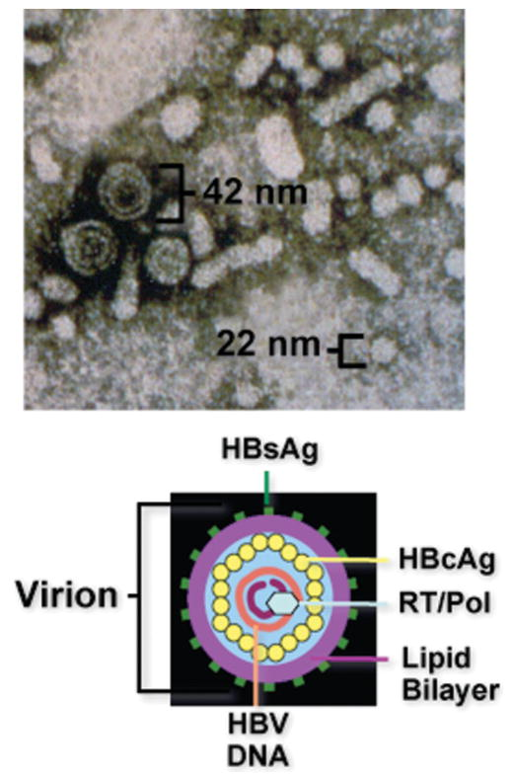
Hepatitis B virus
Notes:
HBsAg: indicate current hepatitis b infection
HBcAg: core particle enclosing viral genome
HBeAg: a marker of high levels of replication of the virus

Slide 73
Modes of Transmission
The incubation period is 75 days on average, but can vary from 30 to 180 days.
Parenteral
  Blood transfusion
  Sharing needles
  Needles stick
  Tattooing
Sexual
Perinatal

Slide 74
Signs and Symptoms
Anorexia
Nausea & Vomiting
Low-grade fever
Myalgia
Fatigability
Right upper quadrant pain
Jaundice
Dark Urine
Notes:
Acute and Chronic infection

Slide 75
Investigation
Lab:
  Serology:
    HBsAg
    HBeAg
    HBcAg
    HBV-DNA
    Anti-HBc (IgM,IgG)
  Liver Function test
  PCR: to detect viral DNA
Notes:
**the presence of serum antigens and immunoglobulins is the most important factor for diagnosing viral hepatitis. These are helpful for deter- mining the acuity or chronicity of illness as well as adequate immunity
Acute HBV infection is characterized by the presence of HBsAg and immunoglobulin M (IgM) antibody to the core antigen, HBcAg
HBeAg is usually a marker of high levels of replication of the virus, The presence of HBeAg indicates that the blood and body fluids of the infected individual are highly contagious.
Chronic infection is characterized by the persistence of HBsAg for at least 6 months (with or without concurrent HBeAg)

Slide 76
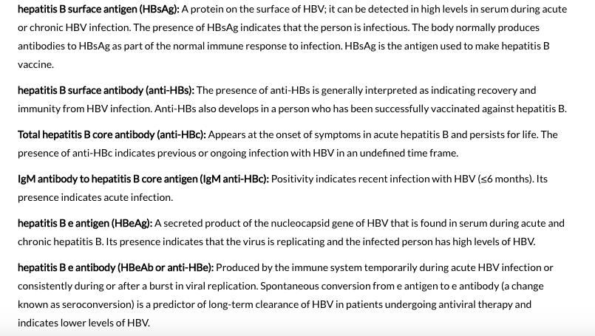

Slide 77
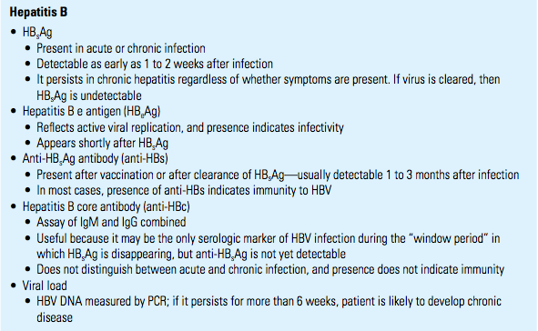

Slide 78
Management
Acute Infection:
  No medication, supportive treatment.
Chronic Infection:
  Antiviral agents such as lamivudine
  “slow the progression of cirrhosis, reduce incidence of liver cancer and improve long term survival”
  Interferon

Slide 79
Prevention
Hepatitis B Vaccine:
  Subunit vaccine composed of HBsAg.
  3 doses “0,1,6 months “

Slide 80
Complications
Cirrhosis
Liver failure
Hepatocellular carcinoma (HCC)
Glomerulonephritis
Polyarteritis nodosa

Slide 81
Case
A 35 year old man came to the clinic for screening, as one member in his family is HBV positive. The following HB markers are shown below:
  Hepatitis B S antigen …………….. Negative
  Anti-Hepa B Core IgG …………..… Positive
  Hep-B e Antigen ………………..…… Negative
  Anti- Hepa B e Antigen …………… Negative
  Anti- Hepa B Surface ……………… Positive
What is your diagnosis?
  Immune post exposure to HB virus
How are you going to deal with patient?
  Reassurance, No further actions could be taken

Slide 82
Case
A 23 years old medical student came to the clinic for screening. The following HB markers are shown below:
  Hepatitis B S antigen: Negative
  Anti-Hepa B Core IgG: Negative
  Hep-B e Antigen: Negative
  Anti- Hepa B e Antigen: Negative
  Anti- Hepa B Surface: Positive
What is your diagnosis?
  Immune post Vaccination

Slide 83
Hepatitis C
The hepatitis C virus is a bloodborne virus
The incubation period is 2 weeks to 6 months.
Modes of Transmission:
  Mainly Blood Transfusion + IV Drug Abuse
  Less common Sexual Transmission and prinatal
Symptoms and signs:
  Fever, fatigue, decreased appetite, nausea, vomiting, abdominal pain, dark urine, joint pain and jaundice.
Notes:
Acute or Chronic

Slide 84
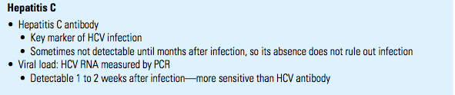
Diagnosis:
  Anti-HCV Antibodies
  If the test is positive for anti-HCV antibodies, a nucleic acid test for HCV-RNA is needed to confirm chronic infection

Slide 85
Treatment:
  Interferon (IFN)
  Liver transplantation in advanced disease
No Vaccine
Complications:
  Cirrhosis
  Liver Failure
  Liver Cancer

Slide 86
Human immunodeficiency virus (HIV)
Viral Infection
Eman alenezi

Slide 87

Etiology:
  Retrovirus, either HIV-1 or HIV-2.
Modes of Transmission:
  Sexual intercourse (Vaginal or Anal)
  Mother-to-child (transplacental, perinatal, breastfeeding).
  Contaminated blood, blood products and organ transplantation.
  Contaminated needles.
Notes:
Worldwide, the predominant virus is HIV-1, So when we generally say HIV, we are referring to HIV-1. The relatively uncommon HIV-2 type is concentrated in West Africa and is rarely found elsewhere.
HIV-1 and HIV-2 have many similarities including their intracellular replication pathways, transmission modes and clinical effects leading to acquired immune deficiency syndrome (AIDS). However, HIV-2 is less likely to progress into AIDS because of its lower transmissibility. Thus, individuals infected by HIV-2 mostly remain non-progressors for a long period of time, while patients infected by HIV-1 progress faster and contract AIDS.

Slide 88
Risk factors and stages of HIV infection
  STIs (due to open sores).
  Unprotected sexual intercourse.
  Multiple sexual partners.
  Uncircumcised males.

Slide 89
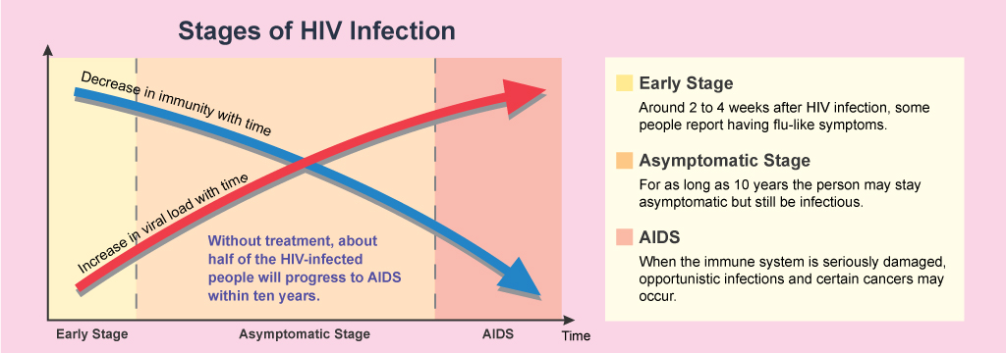

Slide 90
Diagnosis of HIV
ELISA
Screening
PCR
Measure the viral load
Western Blot
Confirmatory test

Slide 91
ELISA
initial test to detect infection with HIV (Antibodies).
  If antibodies to HIV are present (positive), if not (negative) the test is usually repeated to confirm the diagnosis.

Slide 92
When to use Western blot
It is done to confirm the results of two positive ELISA tests.

Slide 93
When to use PCR
This test may be done in the days or weeks after exposure to the virus, before development of the antibodies.
This test is done to confirm the presence of virus RNA and viral Load.

Slide 94
Treatment of HIV
Antiviral Therapy
Triple therapy HAART:
  Nucleoside reverse transcriptase inhibitors
    Zidovudine, Nevirapine.
  Protease inhibitor
    Saquinavir, Indiniavir.

Slide 95
prevention
Use a new condom every time you have sex.
Tell your sexual partners if you have HIV.
if you're pregnant, get medical care right away.
Consider male circumcision.

Slide 96
prevent mother-to-baby transmission :
We recommend that women start HIV medications as soon as possible during pregnancy if they are not already taking them.
You will also need to give an intravenous injection of AZT (zidovudine) during delivery.
Delivery method:
depends upon her HIV viral load during pregnancy. In general, a vaginal delivery is preferred (when the HIV viral load is low). For women with high levels of virus in their blood, a cesarean section is recommended.

Slide 97
Complications
Tuberculosis (TB).
Cytomegalovirus.
Candidiasis.
Toxoplasmosis.
Kaposi's sarcoma.
Lymphomas.

Slide 98
Common sites of perinatal gonorrheal infection include all of the following except
  Genitals
  Conjunctiva
  Pharynx
  Respiratory system
All of the following statements about Gram stain in gonorrhea diagnosis are true except
  A Gram stain is reliable to diagnose gonorrhea in males.
  A Gram stain is reliable to diagnose gonorrhea in females.
  A Gram stain does not have a high sensitivity in asymptomatic males.
  A Gram stain is not recommended to diagnose pharyngeal gonorrhea.
Which of the following best describes the clinical signs/symptoms of chlamydial urethral infection in men?
  Yellow discharge from penis
  Dysuria
  Scrotal pain
  Most men are asymptomatic.
Which of the following is not one of the characteristic symptoms of reactive arthritis?
  Prostatitis
  Urethritis
  Conjunctivitis
  Oligoarthritis
Which of the following best describes the clinical signs/symptoms of chlamydial infection in women?
  Most women complain of a discharge.
  Most women complain of urinary symptoms.
  Clinical signs/symptoms depend on the duration of infection.
  Most women are asymptomatic.
Which of the following statements is true about C. trachomatis in women?
  The majority of women are symptomatic.
  The majority of women with infection can be identified by clinical examination.
  The most frequent sequelae of untreated disease is having a life-threatening ectopic pregnancy.
  Chlamydia-associated PID is sometimes sub-acute or silent.

Slide 99
References
World Health Organization
American Academy of Family Physicians
Kumar and Clark's Clinical Medicine (9th Ed)
US National Library of Medicine, National Institutes of Health :
https://www.ncbi.nlm.nih.gov/pmc/articles/PMC3312652/
CDC website
AVERT.org
JR II in MD Microbiology at SRTR Govt Medical College & Hospital:
https://www.slideshare.net/vishalvlk/sexually-transmitted-infections-54632665
Definition of vertical transmission :
https://aidsinfo.nih.gov/education-materials/glossary/738/vertical-transmission
Pictures :
http://healthlifemedia.com/healthy/understanding-stds-syphilis/
http://www.wikihow.com/Recognize-Trichomoniasis-Symptoms-(Men)
http://www.wikihow.com/Recognize-Trichomoniasis-Symptoms-(Women)
http://www.webmd.com/hiv-aids/human-immunodeficiency-virus-hiv-test
http://www.aidsmap.com/Mother-to-baby-transmission/page/1044918/
http://www.microbeworld.org/component/jlibrary/?view=article&id=9229
https://www.haikudeck.com/treponema-pallidum-uncategorized-presentation-mNTZBPTAfJ
https://www.cdc.gov/hepatitis/hbv/hbvfaq.htm
http://www.who.int/mediacentre/factsheets/fs204/en/
http://emedicine.medscape.com/article/177632-overview
https://www.cdc.gov/hiv/basics/transmission.html
http://www.mayoclinic.org/diseases-conditions/hiv-aids/basics/risk-factors/con-20013732
https://www.uptodate.com/contents/hiv-and-pregnancy-beyond-the-basics#H3
http://emedicine.medscape.com/article/256448-differential
https://www.slideshare.net/elnashar/cervicitis-37322962
http://emedicine.medscape.com/article/218059-overview
http://emedicine.medscape.com/article/214823-overview
https://www2a.cdc.gov/stdtraining/ready-to-use/default.htm
http://www.webmd.com/sexual-conditions/guide/sexual-health-stds#1
https://www.cdc.gov/std/treatment/sexualhistory.pdf
https://www.slideshare.net/drmcbansal/stds-40446788
http://nnptc.org/wp-content/uploads/Clinical-Approach-Curriculum-Module-2011.pdf

