Slide 1
UPPER RESPIRATORY TRACT INFECTIONS
Aisha Alsafi
Hissah Alshalawi
Fadah Alanazi
Rawan Alghmlas
Ebtesam Alateeg

Slide 2
objectives
Sore Throat (clinical features, differential diagnosis, complications, management).
Sinusitis including Allergic Rhinitis (Clinical features and management).
Otitis Media in children (AOM and Secretory OM, Features, management).
How can we differentiate between Viral and Bacterial Infections?
Update in management and role of Antibiotics.
How can we modify help seeking behavior of patients with flu illness?

Slide 3
Sore throat
By: Aisha Alsafi

Slide 4
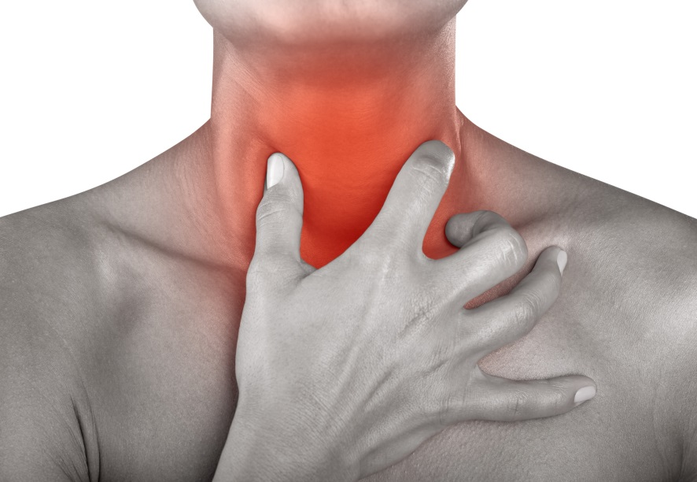
definition
sore throat is pain, scratchiness or irritation of the throat that often worsens with swallowing .

Slide 5
Clinical presentation
Coughing.
Rhinorrhea.
Fever.
Hoarseness.
Headache.
Pain or a scratchy sensation in the throat.
Pain that worsens with swallowing or talking.
Difficulty swallowing.
Sore, swollen glands in neck or Jaw.
Swollen, red tonsils.
White patches or pus on tonsils.

Slide 6
differential diagnosis
Infectious:
Pharyngitis.
Tonsillitis.
Noninfectious:
GERD.
Allergy.
Trauma.
Toxins.
Neoplasia.

Slide 7
Infectious causes
Bacterial causes:
Viral causes:
Most of Infectious sore throat is caused by viruses.
Rhinovirus.
Coronavirus.
Parainfluenza virus.
Influenza virus.
Adenovirus.
Herpes simplex virus type 1.
EBV (causes infectious mononucleosis).
Group A streptococcus (Streptococcus pyogenes) The most important cause.
Streptococcus pneumoniae.
Haemophilus influenza.
Corynebacterium diphtheriae.

Slide 8
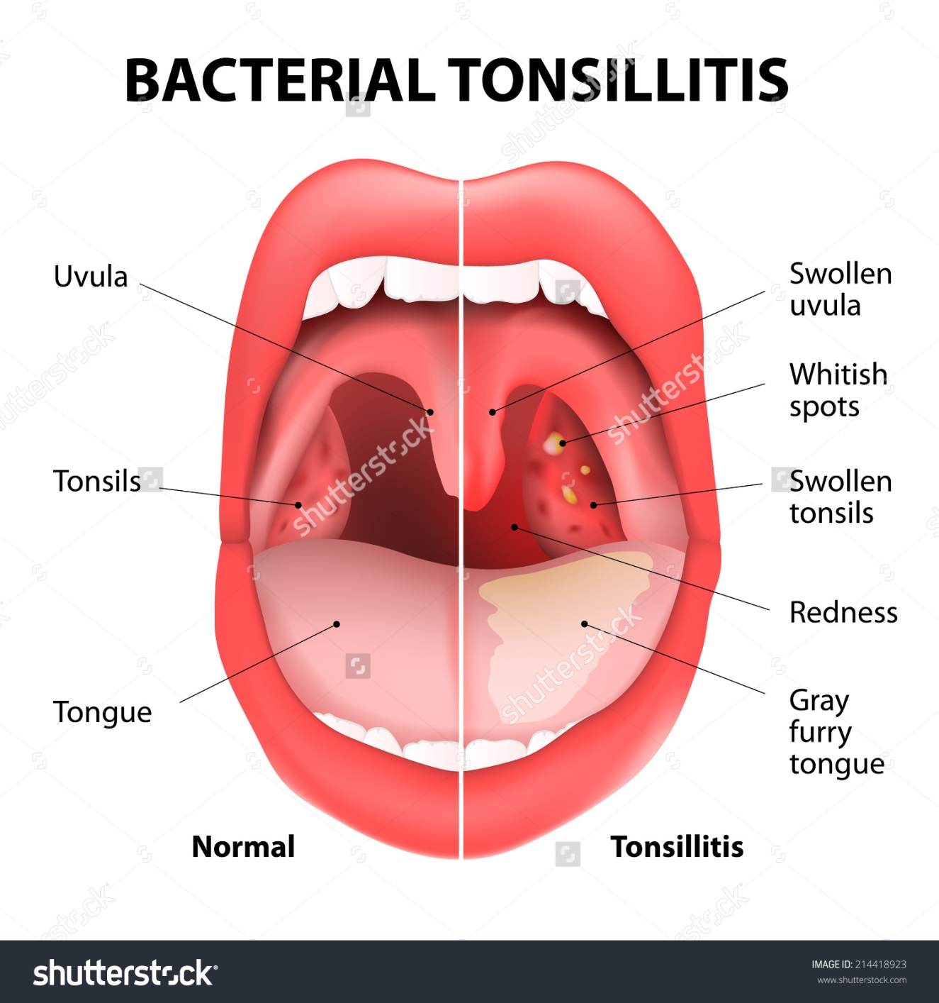
Tonsillitis
Inflammation of tonsils.
Commonly caused by: Streptococcus Infection.
Could be caused by viral infections, such as: influenza virus, EBV .
The main symptom is Throat Pain.

Slide 9
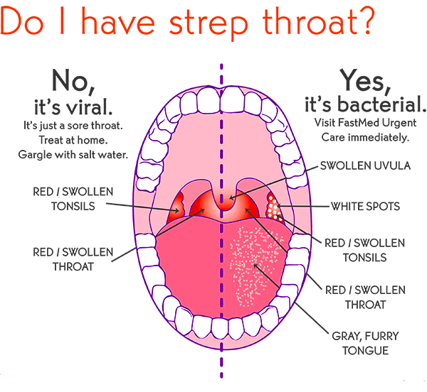
Pharyngitis
Pharyngitis is inflammation of the pharynx.
Sudden and usually self limiting.
Commonly caused by viral infections such as: common cold, influenza virus and mononucleosis.
Less commonly caused by bacterial infection, such as: Group A streptococcus.

Slide 10
video
Tonsillitis:
https://www.youtube.com/watch?v=X6f47kUG-Xo
Pharyngitis:
https://www.youtube.com/watch?v=J_aOlhtdkss

Slide 11
Group A streptococcus(GAS)
GAS infection is most common in children aged 4-7 years.
Sudden onset is consistent with GAS pharyngitis; pharyngitis after several days of coughing or rhinorrhea is more consistent with a viral etiology.
Contact with others who have GAS or rheumatic fever with symptoms consistent with GAS raises the likelihood of GAS pharyngitis.
Headache is consistent with GAS infection
Cough is not usually associated with GAS infection.
Vomiting is associated with GAS infection.

Slide 12
Diagnosis of Gas Infection

Slide 14
Management
Most cases, whether viral or bacterial, are relatively benign and self-limited. Treated by rest and antipyretic and analgesics.
The main aim of treating GAS infection is to prevent complications .
Drink plenty of cool or warm fluids, and avoid very hot drinks.
Eat cool, soft foods.
Avoid smoking and smoky place.
These are general roles that can be applied for viral or bacterial (pharyngitis or tonsillitis) .

Slide 15
Management of pharyngitis
All patients : supportive care, Analgesics and Salt water gargling or anesthetic sprays may provide temporary relief from the pain of pharyngitis.
without confirmed group A Streptococcus (GAS) or history of rheumatic fever:
Delayed or no antibiotic therapy.
with confirmed group A Streptococcus (GAS) or history of rheumatic fever:
First line treatment is:
Amoxicillin: children: 50 mg/kg/day orally given in 2 divided doses for 10 days, maximum 1000 mg/day; adults: 875 mg orally twice daily for 10 days or
Phenoxymethylpenicillin potassium: children ≤27 kg: 250 mg orally two to three times daily for 10 days; children >27 kg and adults: 500 mg orally two to three times daily for 10 days or
Benzathine benzylpenicillin: children ≤27 kg: 600,000 units intramuscularly as a single dose; children >27 kg and adults: 1.2 million units intramuscularly as a single dose

Slide 16
Management of tonsillitis
Acute tonsillitis not due to group A beta-hemolytic streptococcal infection:
The treatment mainly symptomatic (analgesics).
Acute tonsillitis due to group A beta-haemolytic streptococcal infection:
Analgesics + antibiotic therapy.
First line treatment is :
Amoxicillin: children: 50 mg/kg/day orally given in 2 divided doses for 10 days, maximum 1000 mg/day; adults: 875 mg orally twice daily for 10 days or
Phenoxymethylpenicillin potassium: children ≤27 kg: 250 mg orally two to three times daily for 10 days; children >27 kg and adults: 500 mg orally two to three times daily for 10 days or
Benzathine benzylpenicillin: children ≤27 kg: 600,000 units intramuscularly as a single dose; children >27 kg and adults: 1.2 million units intramuscularly as a single dose
Recurrent episodes of tonsillitis : Tonsillectomy.
Generally, patients with severe episodes occurring at a frequency of more than 7 per year for one year, 5 per year for 2 years, or 3 per year for 3 years, and for whom there is no other explanation for the recurrent symptoms, benefit from tonsillectomy. Tonsillectomy is also indicated in children with additional exacerbating factors such as obstructive sleep apnoea; peri-tonsillar abscess; and PFAPA syndrome (periodic fever, aphthous stomatitis, pharyngitis, cervical adenitis).

Slide 17
Approach
History: Ask question to differentiate between various causes and do systemic review.
Examination: Assessment of airway patency, Temperature, Hydration status.
Head, ears, eyes, nose, and throat – Conjunctivitis, scleral icterus, rhinorrhea, tonsillopharyngeal/palatal petechiae, tonsillopharyngeal exudate, oropharyngeal vesicular lesions.
Lymphadenopathy (cervical or generalized).
Cardiovascular evaluation.
Pulmonary assessment.
Abdominal examination.
Skin examination.
Investigation.
Treatment and follow up.

Slide 18
Complications
Middle ear infection (Otitis Media).
Sinusitis.
Related to strep infection:
Rheumatic fever and rheumatic heart disease.
Cardiac death.
Glomerulonephritis.
Peri tonsillar abscess.
Toxic shock syndrome.
Mortality from pharyngitis is rare but may result from one of its complications, most notably airway obstruction.

Slide 19
Effect of treatment of gas infection on complications

Slide 21
sinusitis
By: Hissah Alshalawi

Slide 22
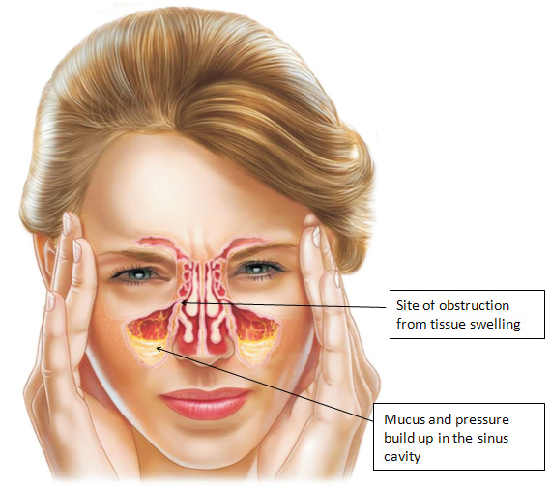
Definition
Inflammation of the nasal and sinus mucosa that is caused by obstruction, which leads to retention of secretions creating environment that is suitable for growth of pathogenic organisms.

Slide 23
Pathophysiology
Obstruction of sinus drainage pathways (sinus ostia).
Ciliary impairment.
Altered mucus quantity and quality.

Slide 24
Etiology
Viral (Rhinovirus, influenza, and parainfluenza viruses).
Bacterial (Streptococcus pneumonia, H.Influenza, Moraxella cattharalis).
Fungal.

Slide 25
CLASSIFICATION OF SINUSITIS
Acute Sinusitis:
Less than 4 Weeks.
Subacute Sinusitis:
Between 4 weeks and 12 weeks.
Chronic sinusitis:
More than 12 weeks.
Recurrent acute sinusitis:
Diagnosed when infection occurs 2-4 times per year.

Slide 26
CLINICAL FEATURES
Pain over cheek and radiating to frontal region or teeth, increasing with straining or bending down.
Redness of nose, cheeks, or eyelids.
Tenderness to pressure over the floor of the frontal sinus immediately above the inner canthus.
Referred pain to the vertex, temple, or occiput.
Postnasal discharge.
A blocked nose.
Persistent coughing or pharyngeal irritation.
Facial pain.
Hyposmia.
Fever.
Fatigue.

Slide 27
DIAGNOSIS: Physical examination
Anterior rhinoscopic examination.
Endoscopic examination.
Brief dental exam.
A basic evaluation of ocular and neurological function.
Purulent nasal secretions.
Purulent posterior pharyngeal secretions.
Mucosal erythema.
Periorbital edema.
Tenderness overlying sinuses.
Air-fluid levels on transillumination of the sinuses (60% reproducibility rate for assessing maxillary sinus disease).
Facial erythema.

Slide 28
Investigations
CBC, ESR: Non specific.
Culture: Life-threatening illness or an immunocompromised status or those who have disease that is unresponsive to therapy.
CT scan: Only in cases of treatment failure, chronic rhinosinusitis, when complications are suspected, or in the preoperative evaluation of surgical candidates.
Fiber optic sinus endoscopy: To exclude structural lesions, fungal disease, and granulomatous diseases.

Slide 29
Indications for urgent referral
Urgent early referral is essential for patients with symptoms that are concerning for complicated ABRS or have evidence of complications on imaging. These include patients with:
High, persistent fevers >102°F
Periorbital edema, inflammation, or erythema
Cranial nerve palsies; abnormal extraocular movements; proptosis; vision changes (double vision or impaired vision)
Severe headache
Altered mental status
Meningeal signs

Slide 30
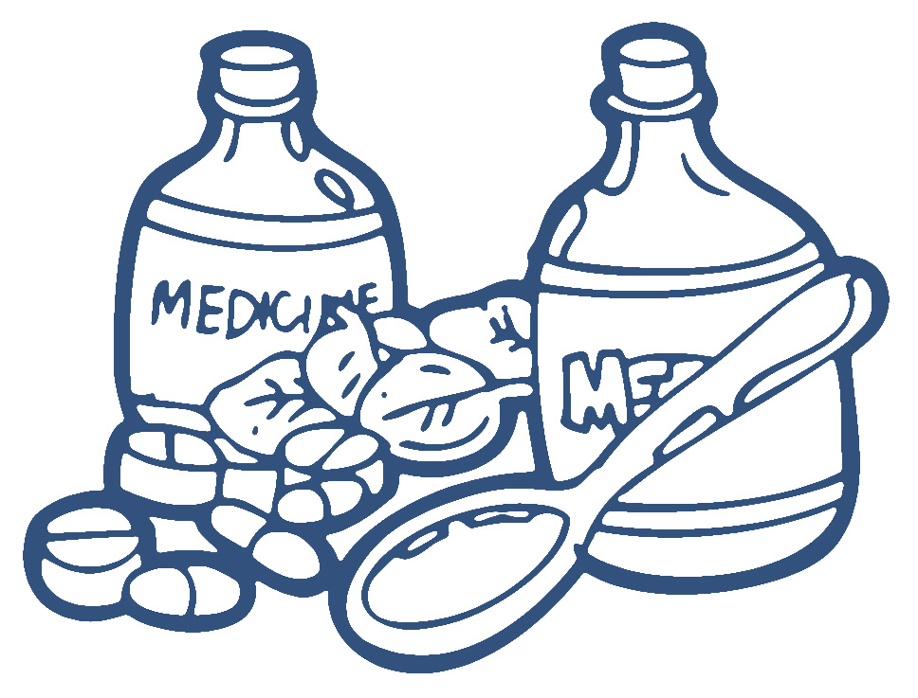
ACUTE VIRAL RHINOSINUSITIS TREATMENT
Patients with acute viral rhinosinusitis (AVRS) should be managed with supportive care.
AVRS may not completely resolve within 10 days but is expected to improve.

Slide 31
SYMPTOMATIC MANAGEMENT
Analgesics and antipyretics: such as NSAID and acetaminophen can be used for pain and fever relief as needed.
Saline irrigation: For symptoms relief
Intranasal glucocorticoids: Are likely to be most beneficial for patients with underlying allergic rhinitis. It decreases the mucosal inflammation which improves sinus drainage.
Oral decongestants: It may be useful when eustachian tube dysfunction is a factor for patients with AVRS. These patients may benefit from a short course (three to five days).
Intranasal decongestants: If used, topical decongestants should be used sparingly for no more than three consecutive days to avoid rebound congestion, addiction, and mucosal damage associated with long-term use.
Antihistamines: Used for symptom relief due to their drying effects, and are often associated with adverse effects (drowsiness, xerostomia)

Slide 32
ACUTE BACTERIAL RHINOSINUSITIS TREATMENT
Options for the outpatient management of uncomplicated acute bacterial rhinosinusitis (ABRS) are:
Observation.
Antibiotics depending on patient follow-up.

Slide 33
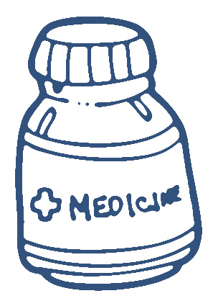
ACUTE BACTERIAL RHINOSINUSITIS TREATMENT
Immunocompetent patients with ABRS who have good follow-up:
Observation with symptomatic management.
Patients with stable symptoms (no worsening or improvement) after 7 days:
May be managed either with an additional 10 days of observation and symptomatic management or antibiotic therapy, depending on patient presentation, comorbidities, and social factors.
Patients with worsening symptoms or who fail to improve with an additional 10 days of watchful waiting:
should be started on antibiotics.

Slide 34
Allergic rhinitis
By: Fadah Alanazi

Slide 35
Definition
Allergic rhinitis (AR) is a common, yet under-appreciated inflammatory condition of the nasal mucosa.
Allergic rhinitis is commonly known as “hay fever”.
Allergic rhinitis takes two different forms:
Seasonal.
Perennial.
Notes:
Seasonal: Symptoms of seasonal allergic rhinitis can occur in spring, summer and early fall. They are usually caused by allergic sensitivity to airborne mold spores or to pollens from grass, trees and weeds.
Perennial: People with perennial allergic rhinitis experience symptoms year-round. It is generally caused by dust mites, pet hair or dander, cockroaches or mold. Underlying or hidden food allergies rarely cause perennial nasal symptoms.
some people may experience both types of rhinitis, with perennial symptoms getting worse during specific pollen seasons.

Slide 36
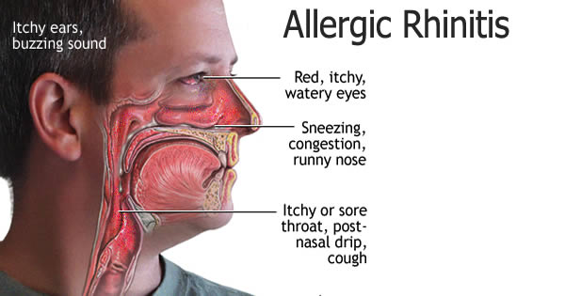
Approach: History
Nasal symptoms:
Pruritus.
Sneezing.
Rhinorrhea.
Nasal congestion, often the most bothersome.
Associated symptoms:
Associated palate, throat, ear, and eye itching.
Eye redness, puffiness, and watery discharge.
Constitutional symptoms:
Fatigue.
Irritability.
Notes:
Fatigue (often reported due to poor quality sleep as a result of nasal obstruction)

Slide 37
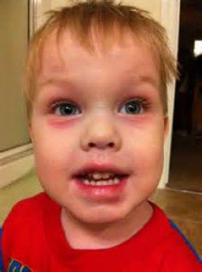
Approach: Physical examination
Anterior Rhinoscopic examination: Findings may include swelling of the turbinate's and nasal mucosa, as well as the presence of clear nasal mucus and/or a pale mucosa.
Allergic Shiners Allergic Salute Nasal crease
Notes:
Allergic Shiners: dark circles around the eyes and are related to vasodilation or nasal congestion.
Allergic Salute: a gesture characterized by rubbing the nose with the palm of the hand upwards to decrease itching and temporarily open the nasal passage.
Nasal crease: A transverse crease across the lower half of the bridge of the nose; caused by repeated rubbing and pushing the tip of the nose up with the hand.
The presence of nasal polyps in children warrants a sweat test to rule out cystic fibrosis.

Slide 38
Approach: Trial of therapy
Therapeutic trial of antihistamine or intranasal corticosteroid:
Oral or intranasal antihistamine can be used. In moderate or severe AR, a trial of an intranasal corticosteroid should be considered a preferred first choice, especially if nasal obstruction is an issue.
Re-assessed after a 4-week trial.

Slide 39
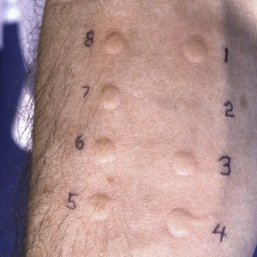
Approach: Allergy testing
Determination of specific IgE reactivity using:
Skin-prick testing.
In vitro specific IgE determination.
Sweat test:
Positive (sweat chloride ≥60 mEq/L).
Notes:
Determination of specific IgE reactivity using skin-prick testing or in vitro specific IgE determination is advisable if there is incomplete response to trial of therapy.
Either IgE in vitro determination or skin testing usually suffices, although on some occasions both modalities are used for optimal management.
The choice of which diagnostic study to select often depends on availability. In vitro IgE determination tends to be more readily available but is more expensive, and has traditionally been felt to provide less sensitivity and specificity than skin testing. However, it may be preferable in patients with severe eczema affecting the testing area, in patients with significant dermatographism, or for those unwilling or unable to stop their antihistamines or medications with antihistaminic properties (e.g., tricyclic antidepressants).
sweat test:The presence of nasal polyps in children warrants a sweat test to rule out cystic fibrosis.
may be positive (sweat chloride ≥60 mEq/L) in cystic fibrosis

Slide 40
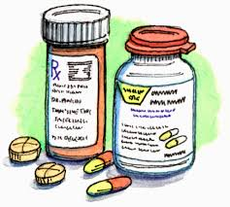
management
Allergen avoidance and environmental control measures:
Allergen avoidance is a major principle and first-line therapy for all patients with AR.
Pharmacotherapy:
Antihistamines.
Leukotriene receptor antagonists.
Decongestants.
Corticosteroid.
Immunotherapy.
Notes:
The goal of symptom amelioration or cessation may require institution of allergy avoidance measures, pharmacotherapy, immunotherapy, or a combination.
Allergen avoidance is one of the guiding principles of treatment. While environmental control measures can sometimes lead to complete symptom control (e.g., by removing a pet), they can at other times prove impractical, ineffective, or difficult to implement.
Intranasal corticosteroids remain the single most effective class of medications for treating AR. However, for most patients it is recommended that other therapies be attempted prior to starting intranasal corticosteroids.
Immunotherapy:
The clinician is able to elicit significant impact on quality of life (interference with hobbies, family life, activities of daily living, sleep, emotional well-being) along with patient's subjective impression that symptoms are severe
There is an incomplete response to trial of therapy of environmental and pharmacological interventions
There is an inability to adequately control associated conditions such as asthma or sinus disease.
http://secure.medicalletter.org/DOC_allergies

Slide 41
Otitis media
By: Rawan Alghmlas

Slide 42
definition
Is any inflammation of the middle ear, It is mainly a disease of childhood.
Types:
Otitis Media
Chronic >3mo
Tubotympanic
COME
Acute <3mo
Supparative
Non-Supparative
Atticoantral
Adhesive

Slide 43
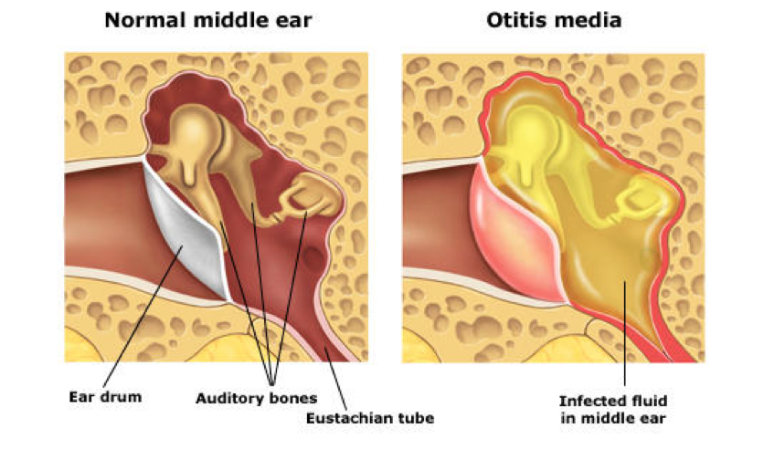
Acute Otitis Media
AOM implies rapid onset of disease associated with one or more of the following symptoms:
Otalgia.
Otorrhea.
Deafness.
Fever.
Headache.
Irritability.
Loss of appetite.
Vomiting.
Diarrhea.

Slide 44
Pathophysiology
Congestion of nasopharynx mucosa ( URTI or allergy)
Obstruction of Eustachian tube " isthmus" (dysfunction)
Negative pressure in middle ear cavity
Suction of mucosal secretion; a good environment of microorganisms
Infection starts and fluid is accumulated in middle ear cavity

Slide 45
Predisposing Factors
Age (More common in children).
Males.
Crowded living conditions.
Bottle feeding.
Associated conditions:
cleft palate.
Immunodeficiency.
ciliary dyskinesia.
cystic fibrosis.
craniofacial abnormalities (e.g. Down syndrome).
URTI and adenoid hypertrophy.

Slide 46
Etiology
Streptococcus Pneumoniae
Haemophilus Influenzae
Moraxella Catarrhalis
Route of infection:
• Eustachian tube( most common) • External auditory canal(rare)
• Blood born

Slide 47
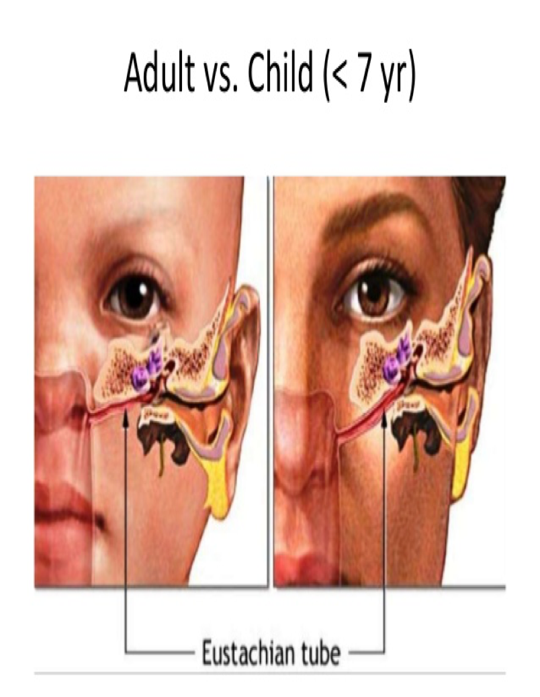

Slide 48
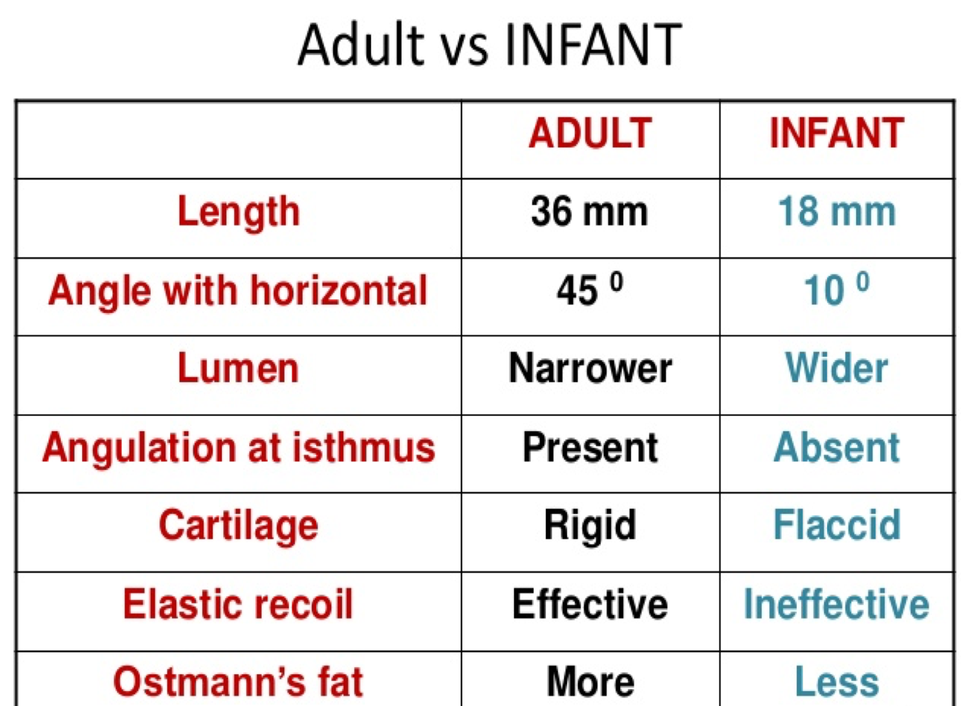

Slide 49
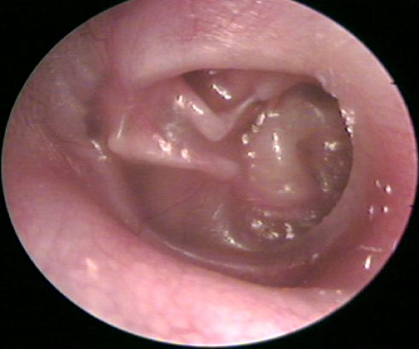
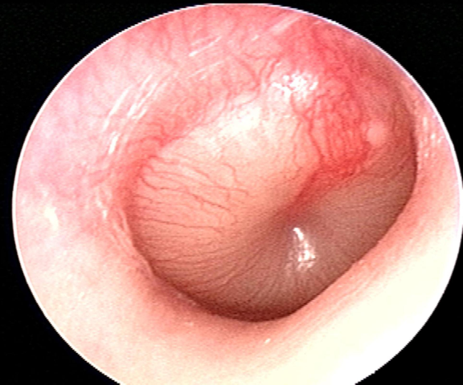
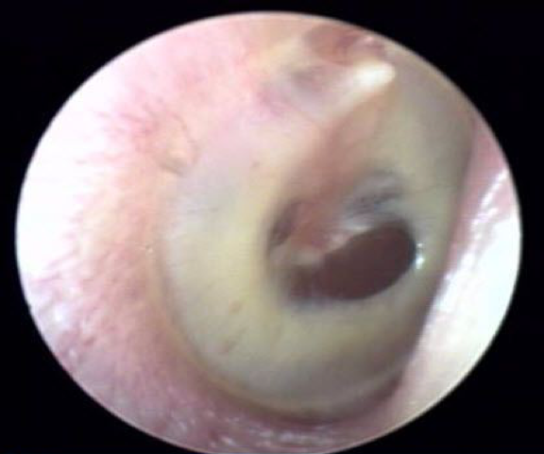
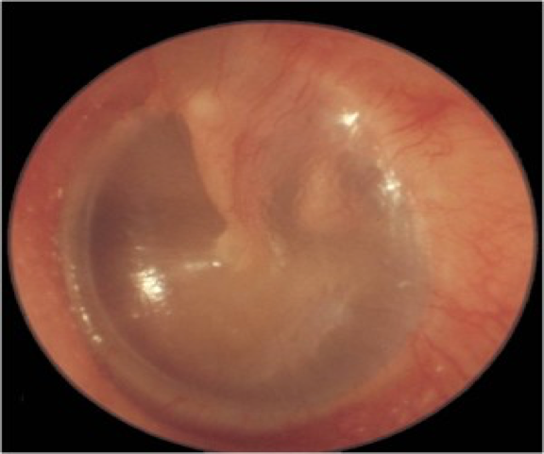
Notes:
Acute Otitis Media

Slide 50
Acute Otitis Media: Stages
Pathophysiology | Stage
ET dysfunction Retracted Tympanic membrane ± Loss of light reflex Discomfort / Earache | Tubal occlusion
Presence of pus in middle ear Bulging of tympanic membrane Fever | Suppuration
Resolve of pain and fever Otorrhea Deafness | Rupture
Either self heal or persist (COME) | Resolution

Slide 51
Diagnosis
Otoscopy is the standard diagnosis of acute and chronic otitis media.
The following findings may be found on examination in patients with AOM:
Signs of inflammation in the tympanic membrane.
Bulging of the tympanic membrane.
Perforation.
Presence of an opaque serum like exudate.
Pain with/without pulsation of the otorrhea.
Fever.

Slide 52
Management
Systemic and topical analgesics.
Antibiotics:
Amoxicillin is the first drug of choice.
For patients who report penicillin allergy :
Cephalosporin/Macrolides.
Pneumococcal resistant : TMP-SMX.
Who are normal with mild symptoms and signs and no otorrhea, initial observation may be appropriate.

Slide 53
Management
children
≥2 years
<2years
Immediate antibiotic (10 days)
Severe otalgia & fever
mild symptoms and signs
Immediate Abx (5 days)
Observation
Systemic and topical analgesics.
Antibiotics:
Amoxicillin is the first drug of choice
75 to 90 mg/kg/day (twice)

Slide 54
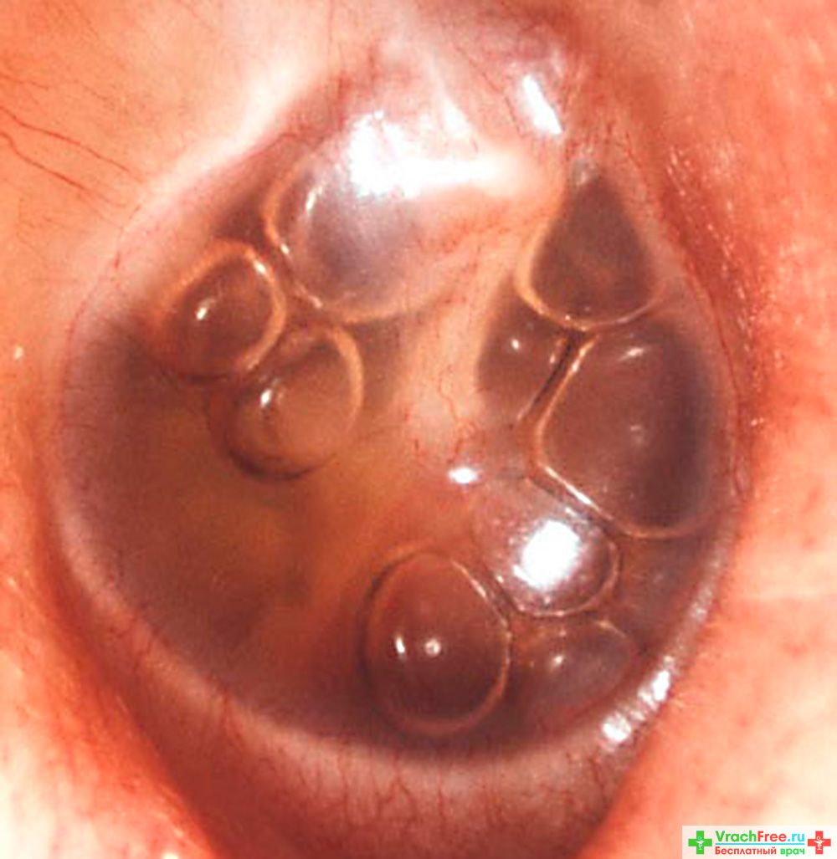
Otitis Media With Effusion (OME)
Is collection of serous and mucoid fluid in the middle-ear.
OME is the most common cause of hearing impairment.
Usually a result of improperly treated AOM.
Usually self-limiting (within 3 months).

Slide 55
causes
Inflammation of the adenoid
Immature eustachian tube
History of ear infections
Craniofacial abnormalities
Symptoms that may be indicative of OME include the following:
Hearing loss.
Tinnitus (buzzing in the ears).
Vertigo.
Otalgia.
Otorrhea (ear discharge).

Slide 56
Management:
It is a self-limiting illness and 90% of children will have complete resolution within 1 year, so reassure the parents.
If it symptomatic OME or persistent OME>3 months refer the child for a hearing test and to ENT specialist to do insertion of tympanostomy tubes.
There is no proven benefit from treatment with any medications or any complementary or alternative therapies.
Diagnosis:
• History • Clinical Examination : Tuning fork tests
• Audiological assessment:
Tympanometry - Pure tone audiogram (PTA)

Slide 57
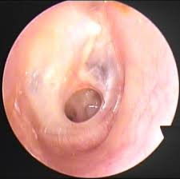
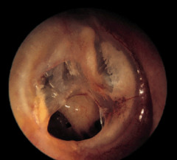
Chronic Supportive Otitis Media
Atticoantral (Unsafe) | Tubotympanic (Safe)
Large perforation and offensive discharge | Simple perforation and Discharge
Marginal perforation | Central perforation
Persistent | Intermittent
High risk of complications (Cholesteatoma) | Low risk of complications
Requires Mastoidectomy | Doesn’t require Mastoidectomy

Slide 58
Update in antibiotics management
By: Ebtesam Alateeg

Slide 59
Viral vs bacterial
Bacterial infections | viral infections
High grade Fever | Low grade fever or no fever
Infection spreads to nearby organs | Mostly contained and self limiting
Pus, purulent discharge | No pus, clear discharge
Acute deterioration after mild symptoms | Mild symptoms
Persist longer | Short course

Slide 60
update in managing and role of antibiotics
Antibiotic prescribing:
Do not start antibiotics without clinical evidence of bacterial infection.
To help prevent the development of resistance it is important to only prescribe antibiotics when they are necessary, and not for self-limiting mild infections.
Obtain cultures to narrow the use of broad spectrum therapy.
Consider a no or delayed antibiotic strategy for acute self limiting URTIs.
Patients should be given advice about the usual natural history of the illness, including the average total length of the illness.

Slide 61
Nice Guidance to antibiotics prescribing in URTI
A no antibiotic prescribing strategy or a delayed antibiotic prescribing strategy should be agreed for patients with the following conditions:
Acute otitis media.
Acute sore throat/acute pharyngitis/acute tonsillitis.
Common cold.
Acute rhinosinusitis.
Acute cough/acute bronchitis.

Slide 62
Nice Guidance to antibiotics prescribing in URTI
Depending on clinical assessment of severity, patients in the following subgroups can also be considered for an immediate antibiotic prescribing strategy:
Bilateral acute otitis media in children younger than 2 years.
Acute otitis media in children with otorrhoea.
Acute sore throat/acute pharyngitis/acute tonsillitis when three or more centor criteria are present.

Slide 63
Nice Guidance to antibiotics prescribing in URTI
An immediate antibiotic prescription should only be offered to patients in the following situations:
If the patient is systemically very unwell.
If the patient has symptoms and signs suggestive of serious illness and/or complications.
If the patient is at high risk of serious complications because of pre-existing comorbidity.
If the patient is older than 65 years with acute cough and two or more of the following criteria, or older than 80 years with acute cough and one or more of the following criteria:
Hospitalization in previous year.
Type 1 or type 2 diabetes.
History of congestive heart failure.
Current use of oral glucocorticoids.

Slide 64
Nice Guidance to antibiotics prescribing in URTI
When the no antibiotic prescribing strategy is adopted, patients should be offered:
Reassurance that antibiotics are not needed immediately because they are likely to make little difference to symptoms and may have side effects, for example, diarrhoea, vomiting and rash.
A clinical review if the condition worsens or becomes prolonged.

Slide 65
Nice Guidance to antibiotics prescribing in URTI
When the delayed antibiotic prescribing strategy is adopted, patients should be offered:
Reassurance that antibiotics are not needed immediately because they are likely to make little difference to symptoms and may have side effects, for example, diarrhoea, vomiting and rash.
Advice about using the delayed prescription if symptoms are not starting to settle in accordance with the expected course of the illness or if a significant worsening of symptoms occurs.
Advice about re-consulting if there is a significant worsening of symptoms despite using the delayed prescription.

Slide 66
How to modify patient help seeking behavior?

Slide 67
How to modify patient help seeking behavior?
Raise
Raise awareness of the seriousness of seasonal flu in high risk patients.
Increase
Increase the will to seek help in affected patients.
Increase
Increase awareness of the ways to protect infection within the household and work environment.
Increase
Increase the public attitude toward vaccination and encourage high risk people to get vaccinated early.
Raise
Raise awareness on personal hygiene and ways to avoid infecting other people or avoiding getting sick from contact with other people.
Advise
Advise flu patients to stay away from work and public for a day after their symptoms are alleviated.

Slide 68
Quiz
One of the differences between bacterial and viral pharyngitis is that in Bacterial pharyngitis there is usually:
A. No fever
B. Coughing and Wheezing
C. Conjunctivitis
D. Whitish spots on the tonsils.

Slide 69
Quiz
The duration of symptoms in subacute sinusitis is ?
A. Less than 4 weeks.
B. Between 3 and 4 weeks.
C. Between 4 weeks and 2 months.
D. More than 4 months.

Slide 70
Quiz
ALL of the below are considered to be good management choices to treat allergic rhinitis except :
A. Oral antihistamines.
B. Decongestants.
C. Avoiding exposure to allergic substances.
D. Antibiotics.

Slide 71
Quiz
An irritable 3 year old patient came with ear pain, difficulty in hearing , and fever. What is the diagnosis?
A. Pharyngitis.
B. Otitis Media.
C. Mastoiditis.
D. Sinusitis.

Slide 72
Quiz
A 3-year-old child diagnosed with acute otitis media, what is the drug of choice to treat him: A. Amoxicillin. B. Cephalosporin. C. Macrolides. D. Doxycycline.

Slide 73
THANK YOU …

Slide 74
references
http://onlinelibrary.wiley.com/doi/10.1002/14651858.CD000023.pub4/abstract?systemMessage=Wiley+Online+Library+will+be+unavailable+on+Saturday+25th+March+from+07%3A00+GMT+%2F+03%3A00+EDT+%2F+15%3A00+SGT+for+4+hours+for+essential+maintenance.++Apologies+for+the+inconvenience.
http://blogs.nejm.org/now/index.php/streptococcal-pharyngitis/2011/02/18/.
http://bestpractice.bmj.com/best-practice/monograph/5/highlights/overview.html.
http://emedicine.medscape.com/article/764304-overview#a8.
http://emedicine.medscape.com/article/232670-overview.
http://bestpractice.bmj.com/best-practice/monograph/232.html.
http://www.uptodate.com/contentLeukotriene receptor antagonists.

Slide 75
references
http://www.uptodate.com/contents/uncomplicated-acute-sinusitis-and-rhinosinusitis-in-adults-treatment?source=search_result&search=sinusitis+treatment&selectedTitle=1~150#H547040790
http://acaai.org/allergies/types/hay-fever-rhinitis.
http://emedicine.medscape.com/article/994656-overview.
http://www.nhs.uk/conditions/Otitis-media/Pages/Introduction.aspx.
http://patient.info/doctor/otitis-media-with-effusion.
https://www.nice.org.uk/guidance/cg69/chapter/1-Guidance.
http://emedicine.medscape.com/article/859316-overview.
http://emedicine.medscape.com/article/858990-overview.
http://www.chop.edu/conditions-diseases/otitis-media-effusion-ome.
http://www.cps.ca/en/documents/position/acute-otitis-media.
https://www.nice.org.uk/guidance.

