Slide 1
Smoking and Substance Abuse
By Group 6

Slide 3
Q1
The addictive ingredient in tobacco is :
A- Nicotin
B- Tar
C- Smoke
D- unknown

Slide 4
Q2
Sarah smokes a pack of cigarettes a day and has just given birth. Which of the following is FALSE regarding the health of her newborn, Her baby will:
A- Generally have normal birth weight
B- have an increased risk of sudden infant death syndrome
C- more likely develop chronic respiratory problems
D- be hospitalized more often and have poorer overall health

Slide 5
Q3
Which of the following is associated with smoking?
A-Chronic bronchitis
B-Tongue cancer
C-Lung cancer
D-All of the above

Slide 6
Q4
When a pregnant woman smokes, the greatest threat to the health of the developing fetus comes from which of the following:
A- Tar
B- Carbon monoxide
C- Non-tar partials
D- The increased cancer risk

Slide 7
Q5
What are the Factors that can lead to substance abuse?
A- Old age
B- Dark Hair color
C- Being male
D- English language

Slide 8
Epidemiology of smoking in Saudi Arabia
Risks of smoking (Morbidity and Mortality)
Effect of passive smoking on pregnancy, children, ….
How are you going to help the smoker to quit and how to overcome withdrawal symptoms
Role of PHC physician “smoking cessation clinic’
Update in pharmacological management, smoking cessation medication
Nicotine preparations, Varniciline, Bupropion, …….
Factors lead to substance abuse
Highlight on types of substance abuse
How to approach subjects with substance abuse

Slide 9
Epidemiology of smoking in Saudi Arabia
By Malak Almutairi.

Slide 10
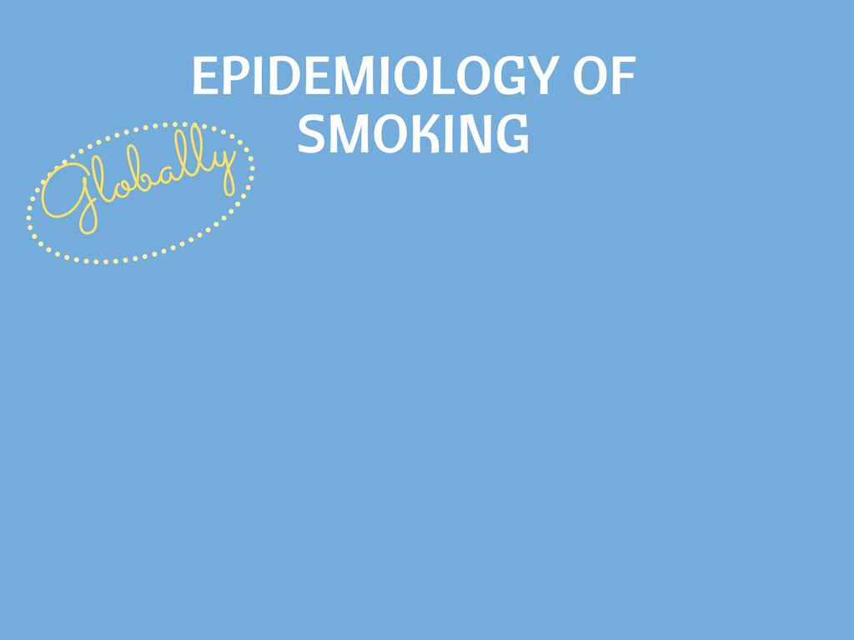
In 2015, over 1.1 billion people smoked tobacco. Far more males than females smoked tobacco.
WHO has estimated that tobacco use (smoking and smokeless) is currently responsible for the death of about six million people across the world each year with many of these deaths occurring prematurely. This total includes about 600,000 people are also estimated to die from the effects of second-hand smoke

Slide 11
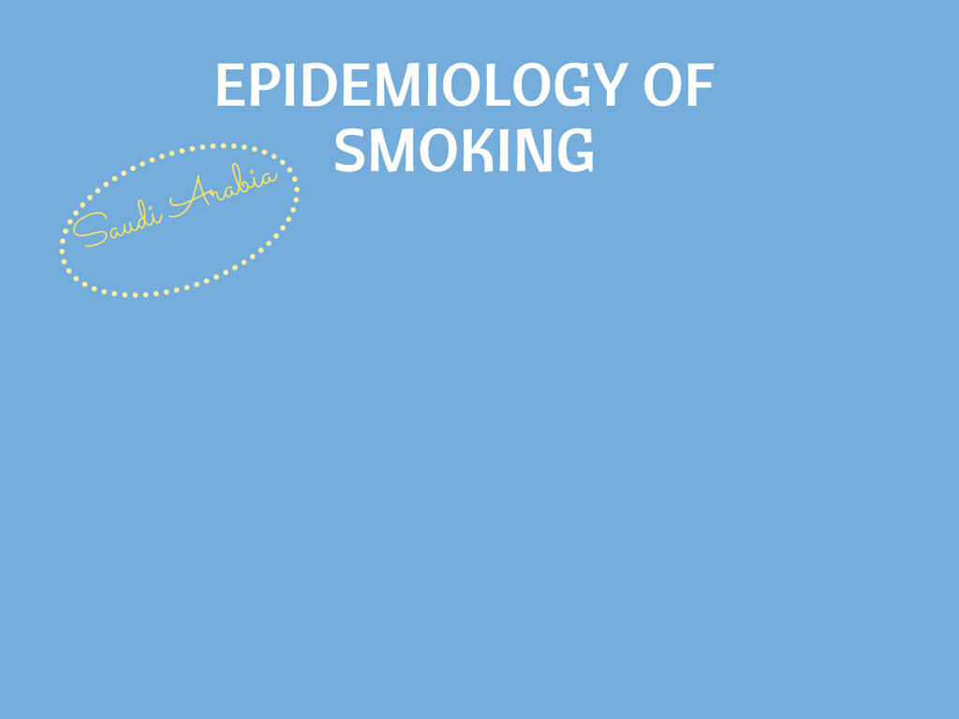
Saudi health information survey (SHIS)
Current tobacco smoker
1,5%
23,7%
Mean age to start smoking
21
19
Current smokers of hookah (shisha) daily
1,4%
20.9%

Slide 12
Gender differences in smoking behavior among adolescents
Out of 1,505 students
Current Cigarette smoker
11,1%
34%
Daily smoker
0.7 %
11.1%

Slide 13
A study was conducted in September 2005 to asses the prevalence of smoking habits among male medical students at the College of Medicine, King Saud University and it shows that

Slide 14
13% of male medical students were currently active smokers.
5.3% were ex-smokers, and 38.2% were passive smokers.
The common reason given for the smoking behavior was the influence of friends (35.6%). The study shows that 57.1% of current smokers were motivated to stop smoking.

Slide 15
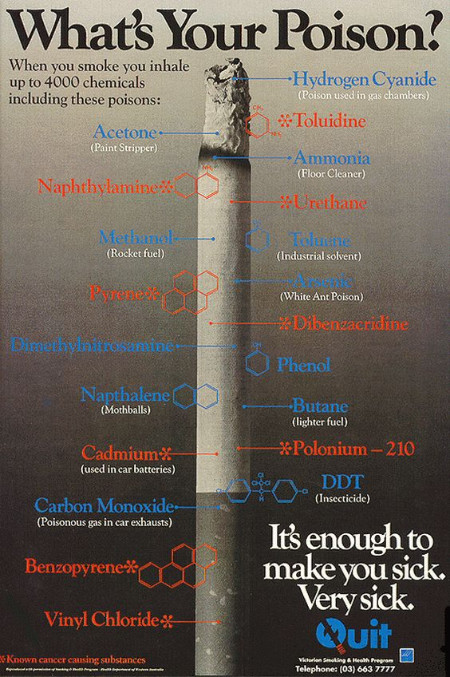

Slide 16
Epidemiology of smoking in Saudi Arabia
Risks of smoking (Morbidity and Mortality)
Effect of passive smoking on pregnancy, children, ….
How are you going to help the smoker to quit and how to overcome withdrawal symptoms
Role of PHC physician “smoking cessation clinic’
Update in pharmacological management, smoking cessation medication
Nicotine preparations, Varniciline, Bupropion, …….
Factors lead to substance abuse
Highlight on types of substance abuse
How to approach subjects with substance abuse

Slide 17
Risks of smoking (Morbidity and Mortality)
By Malak Almutairi.

Slide 18
Smoking and Death
Cigarette smoking causes more than 480,000 deaths each year in the United States. This is nearly one in five deaths.
Smoking causes more deaths each year than the following causes combined:
HIV
Illegal drug use
Alcohol use
Motor vehicle injuries
Firearm-related incidents
Smoking causes about 90% (or 9 out of 10) of all lung cancer deaths in men and women.1,2 More women die from lung cancer each year than from breast cancer.

Slide 19
Smoking and Cardiovascular System
Smoking causes stroke and coronary heart disease—the leading causes of death in the United States.
Smoking damages blood vessels and can make them thicken and grow narrower. This makes your heart beat faster and your blood pressure go up. Clots can also form.
Even people who smoke fewer than five cigarettes
a day can have early signs of cardiovascular disease.

Slide 20
Smoking and Respiratory System
Lung diseases caused by smoking include COPD, which includes emphysema and chronic bronchitis.
Smoking can cause lung disease by damaging the airways and the alveoli.
Cigarette smoking causes most cases of lung cancer.
In presence of asthma, tobacco smoke can trigger
an attack or make an attack worse.
Smokers are 12 to 13 times more likely
to die from COPD than nonsmokers

Slide 21
Smoking and Cancer
Smoking can cause cancer almost anywhere in your body:
Trachea, bronchus, and lung
Bladder
Esophagus
Larynx
Oropharynx (includes parts of the throat, tongue, soft palate, and the tonsils)
If nobody smoked, one of every three cancer deaths
in the United States would not happen.

Slide 22
Smoking and Other Health Risks
Smoking harms nearly every organ of the body and affects a person’s overall health :
Smoking can make it harder for a woman to become pregnant and can affect her baby's health before and after birth.
Smoking can reduce fertility and also increase risks for birth defects and miscarriage.
Smoking affects the health of your teeth and gums and can cause tooth loss.
Smoking is a cause of type 2 diabetes mellitus and
can make it harder to control.
The risk of developing diabetes is 30–40% higher for
active smokers than nonsmokers.
Other ??

Slide 23
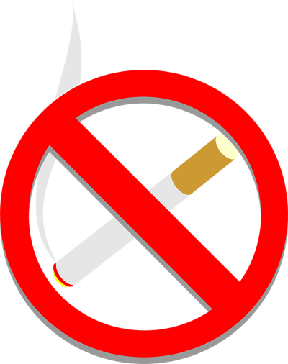
Quitting and Reduced Risks
Quitting smoking cuts cardiovascular risks. Just 1 year after quitting smoking, your risk for a heart attack drops sharply.
Within 2 to 5 years after quitting smoking, your risk for stroke could fall to about the same as a nonsmoker’s.
If you quit smoking, your risks for cancers of the mouth, throat, esophagus, and bladder drop by half within 5 years.
Ten years after you quit smoking,
your risk for lung cancer drops by half.

Slide 24
Epidemiology of smoking in Saudi Arabia
Risks of smoking (Morbidity and Mortality)
Effect of passive smoking on pregnancy, children, ….
How are you going to help the smoker to quit and how to overcome withdrawal symptoms
Role of PHC physician “smoking cessation clinic’
Update in pharmacological management, smoking cessation medication
Nicotine preparations, Varniciline, Bupropion, …….
Factors lead to substance abuse
Highlight on types of substance abuse
How to approach subjects with substance abuse

Slide 25
Effect of passive smoking on pregnancy, children
By Malak Alotaibi.

Slide 26
smoking effect on pregnancy
When we talk about smoking effect on pregnancy we don’t only mean pregnant women, but also women planning a pregnancy or who have a child aged up to 12 months

Slide 27
ACTIVE AND PASSIVE SMOKING EFFECT ON PREGNANCY
Miscarriage
Low birth weight
Preterm labor
Learning and behavioral defieciencies
Sudden infant death syndrome

Slide 28
Secondhand smoking effect on children
Studies show that older children whose parents smoke get sick more often. Their lungs grow than children who do not breathe secondhand smoke, and they get more bronchitis and pneumonia.
Wheezing and coughing are more common in children who breathe secondhand smoke.
Secondhand smoke can trigger an asthma attack in a child.
Children whose parents smoke around them get more ear infections.

Slide 29
Sudden Infant Death Syndrome (SIDS) is the sudden, unexplained, unexpected death of an infant in the first year of life. SIDS is the leading cause of death in otherwise healthy infants. Secondhand smoke increases the risk for SIDS.
Infants who are exposed to secondhand smoke after birth are also at greater risk for SIDS.
Chemicals in secondhand smoke appear to affect the brain in ways that interfere with its regulation of infants' breathing.
Infants who die from SIDS have higher concentrations of nicotine in their lungs and higher levels of cotinine (a biological marker for secondhand smoke exposure) than infants who die from other causes.

Slide 30
Secondhand Smoke Causes Cardiovascular Disease
Exposure to secondhand smoke has immediate adverse effects on the cardiovascular system and can cause coronary heart disease and stroke.
Secondhand smoke causes nearly 34,000 premature deaths from heart disease each year in the United States among nonsmokers.
Nonsmokers who are exposed to secondhand smoke at home or at work increase their risk of developing heart disease by 25–30%.
Secondhand smoke increases the risk for stroke by 20−30%.
Secondhand smoke exposure causes more than 8,000 deaths from stroke annually.⁴
Breathing secondhand smoke can have immediate adverse effects on your blood and blood vessels, increasing the risk of having a heart attack.
Breathing secondhand smoke interferes with the normal functioning of the heart, blood, and vascular systems in ways that increase the risk of having a heart attack.
Even brief exposure to secondhand smoke can damage the lining of blood vessels and cause your blood platelets to become stickier. These changes can cause a deadly heart attack.
People who already have heart disease are at especially high risk of suffering adverse effects from breathing secondhand smoke and should take special precautions to avoid even brief exposures

Slide 31
Secondhand Smoke Causes Lung Cancer
Secondhand smoke causes lung cancer in adults who have never smoked.
Nonsmokers who are exposed to secondhand smoke at home or at work increase their risk of developing lung cancer by 20–30%.
Secondhand smoke causes more than 7,300 lung cancer deaths among U.S. nonsmokers each year.
Nonsmokers who are exposed to secondhand smoke are inhaling many of the same cancer-causing substances and poisons as smokers.
Even brief secondhand smoke exposure can damage cells in ways that set the cancer process in motion.
As with active smoking, the longer the duration and the higher the level of exposure to secondhand smoke, the greater the risk of developing lung cancer.

Slide 35
Epidemiology of smoking in Saudi Arabia
Risks of smoking (Morbidity and Mortality)
Effect of passive smoking on pregnancy, children, ….
How are you going to help the smoker to quit and how to overcome withdrawal symptoms
Role of PHC physician “smoking cessation clinic’
Update in pharmacological management, smoking cessation medication
Nicotine preparations, Varniciline, Bupropion, …….
Factors lead to substance abuse
Highlight on types of substance abuse
How to approach subjects with substance abuse

Slide 36
Role of PHC physician “smoking cessation clinic
By Hanin Aljafri.

Slide 37
Case scenario:
A 29 year old pregnant lady in her 1st trimester, came to primary care clinic for check up?

Slide 38
A. Five A’s Counseling Strategy
Has been developed to allow physicians to incorporate smoking cessation counseling into busy clinical practices.
Consist of:
Ask
Advise
Assess
Assist
Arrange

Slide 39
Notes:
I am going to change the display method of some slides

Slide 41
B. 5 R’s approach

Slide 43
Epidemiology of smoking in Saudi Arabia
Risks of smoking (Morbidity and Mortality)
Effect of passive smoking on pregnancy, children, ….
How are you going to help the smoker to quit and how to overcome withdrawal symptoms
Role of PHC physician “smoking cessation clinic’
Update in pharmacological management, smoking cessation medication
Nicotine preparations, Varniciline, Bupropion, …….
Factors lead to substance abuse
Highlight on types of substance abuse
How to approach subjects with substance abuse

Slide 44
Update in pharmacological management, smoking cessation medication
By Hadeel Alsaif

Slide 45
Smoking cassation management
Behavioral management
Non-Pharmacological management
Pharmacological management

Slide 46
Behavioral:
No optimal behavioral approach exists; the therapy selected should depend on patient preference and your clinical judgment.
5A’s
5R’s
Self-management.
Stimulus control.
Behavioral

Slide 47
Non-Pharmacological :
Acupuncture
Exercise
Hypnotherapy
Telephone quitlines
Notes:
1-Acupressure, laser acupuncture, and electro acupuncture all have been proposed as cures for nicotine addiction or as a means to reduce withdrawal symptoms
2-Exercise: Small, heterogeneous studies provide little evidence that exercise improves quit rates34; however, it may be useful to promote weight control after smoking cessation
3-Hypnotherapy:A Cochrane review found a lack of evidence that hypnotherapy is beneficial compared with other therapies or no treatment

Slide 48
Pharmacological :
A pharmacological treatment for smoking cessation should both block the positive reinforcing effect of nicotine and prevent or reduce the development of withdrawal symptoms

Slide 49
Nicotine preparations, Varniciline, Bupropion
By Yasmine Alshehri.

Slide 50
Epidemiology of smoking in Saudi Arabia
Risks of smoking (Morbidity and Mortality)
Effect of passive smoking on pregnancy, children, ….
How are you going to help the smoker to quit and how to overcome withdrawal symptoms
Role of PHC physician “smoking cessation clinic’
Update in pharmacological management, smoking cessation medication
Nicotine preparations, Varniciline, Bupropion, …….
Factors lead to substance abuse
Highlight on types of substance abuse
How to approach subjects with substance abuse

Slide 51
First line Medications:
Nicotine Replacement Therapy (NRT):
Nicotine Patches:
The patch is worn on the skin and your body absorbs nicotine from it continuously.
The nicotine patch comes in three sizes and you can usually start with the strongest patch – either a 15 or 25mg, 16 hour patch (for use during the day only); or a 21mg, 24 hour patch (for use during the day and overnight).
Side effect: Skin reactions (up to 50 percent), headaches, insomnia (decreased if patient removes patch at night)
Gum :
Eating or drinking acidic foods or beverages within 30 minutes of use decreases effectiveness; Side effects: Gastrointestinal distress; mouth or throat irritation
Lozenges :
Eating or drinking acidic foods or beverages within 30 minutes of use decreases effectiveness; Side effects: Nausea, heartburn, headache
Notes:
NRT: The goal of nicotine replacement therapies (NRTs) is to relieve cravings for nicotine and reduce nicotine withdrawal symptoms

Slide 52
First line Medications:
Nicotine Replacement Therapy (NRT):
Inhaler:
Eating or drinking acidic foods or beverages within 30 minutes of use decreases effectiveness.
Side effect: Mouth or throat irritation (40 percent), coughing (32 percent), rhinitis (23 percent)
Nasal Spray:
Side effect: Moderate to severe nasal irritation within the first two days (94 percent) that often continues throughout use
Notes:
NRT: The goal of nicotine replacement therapies (NRTs) is to relieve cravings for nicotine and reduce nicotine withdrawal symptoms

Slide 53
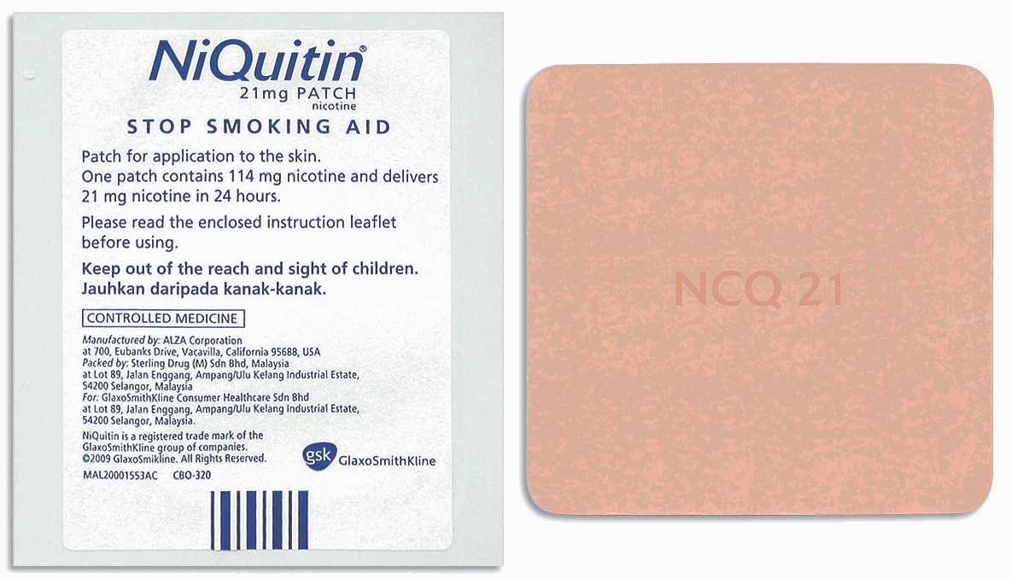
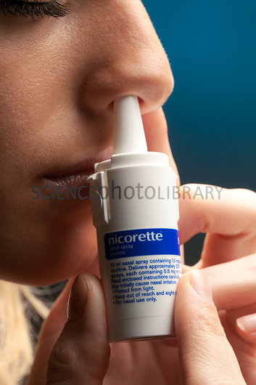
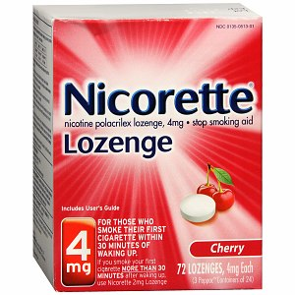
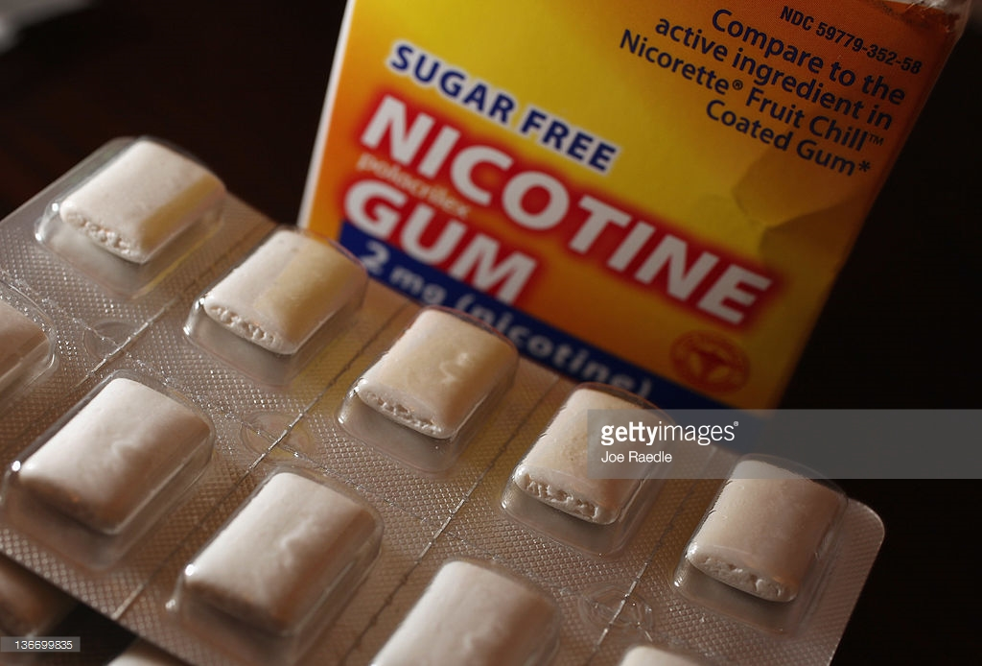
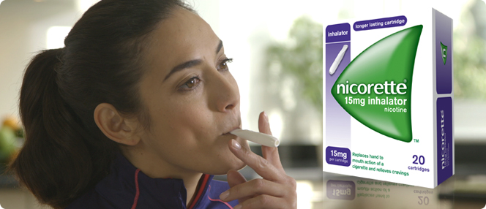

Slide 54
First-Line Medications: Other Begin therapy one to two weeks before the quit date, continue until 12 weeks (insufficient evidence to be a first-line therapy for adolescents)
Bupropion(Zyban):
MOA: Increase norepinephrine and dopamine via unknown mechanism
Can be combined with a nicotine replacement therapy for increased effectiveness.
Side effect: Insomnia and dry mouth, mood or behavior changes, unusual thoughts or feelings .
Contraindicated in persons with a history of seizure disorder or an eating disorder
Varenicline: (nicotine receptor agonist )
Mechanism of action : is a nicotinic ACh receptor partial agonist
Used for smoking cessation
-Should not be combined with a nicotine replacement therapy
Side effect: Headache, nausea (dose related), insomnia, abnormal dreams, flatulence
New studies showed increased risk of coronary events with vareniciline.
Notes:
Vareniclne: reduces cravings and withdrawal symptoms while blocking the binding of smoked nicotine.28 Varenicline increases the chances of a successful quit attempt two- to threefold

Slide 55
Second-Line Medications
Nortriptyline
Clonidine
Have demonstrated effectiveness in clinical trials for smoking cessation and they may be used if first-line medications are contraindicated or ineffective.

Slide 56
Epidemiology of smoking in Saudi Arabia
Risks of smoking (Morbidity and Mortality)
Effect of passive smoking on pregnancy, children, ….
How are you going to help the smoker to quit and how to overcome withdrawal symptoms
Role of PHC physician “smoking cessation clinic’
Update in pharmacological management, smoking cessation medication
Nicotine preparations, Varniciline, Bupropion, …….
Factors lead to substance abuse
Highlight on types of substance abuse
How to approach subjects with substance abuse

Slide 57
Factors lead to substance abuse
By Yasmine Alshehri.

Slide 58
Factors lead to substance abuse
People of any age, sex or economic status can become addicted to a drug. However, certain factors can affect the likelihood and speed of developing an addiction:
Family history of addiction. Drug addiction is more common in some families and likely involves genetic predisposition. If you have a blood relative, such as a parent or sibling, with alcohol or drug problems, you're at greater risk of developing a drug addiction.
Being male. Men are more likely to have problems with drugs than women are. However, progression of addictive disorders is known to be faster in females.
Having another mental health disorder. If you have a mental health disorder such as depression, attention-deficit/hyperactivity disorder (ADHD) or post-traumatic stress disorder, you're more likely to become dependent on drugs.

Slide 59
Factors lead to substance abuse
Peer pressure. Peer pressure is a strong factor in starting to use and abuse drugs, particularly for young people.
Lack of family involvement. Difficult family situations or lack of a bond with your parents or siblings may increase the risk of addiction, as can a lack of parental supervision.
Anxiety, depression and loneliness. Using drugs can become a way of coping with these painful psychological feelings and can make these problems even worse.
Taking a highly addictive drug. Some drugs, such as stimulants, cocaine or painkillers, may result in faster development of addiction than other drugs. However, taking drugs considered less addicting — so-called "light drugs" — can start you on a pathway of drug use and addiction.

Slide 60
Epidemiology of smoking in Saudi Arabia
Risks of smoking (Morbidity and Mortality)
Effect of passive smoking on pregnancy, children, ….
How are you going to help the smoker to quit and how to overcome withdrawal symptoms
Role of PHC physician “smoking cessation clinic’
Update in pharmacological management, smoking cessation medication
Nicotine preparations, Varniciline, Bupropion, …….
Factors lead to substance abuse
Highlight on types of substance abuse
How to approach subjects with substance abuse

Slide 61
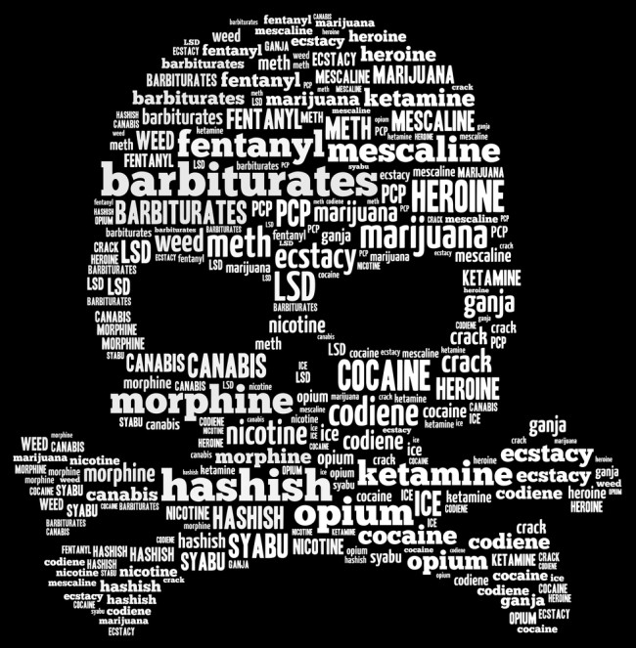
Types of substance abuse
By Fatima Alqarni.

Slide 62
Alcohol
Alcohol use is the fourth leading cause of preventable death in the United States.
Alcohol is responsible for of conditions such as :
- Cirrhosis
- Motor vehicle accidents
- Cancers
- Homicide
- Suicide
- Hemorrhagic stroke

Slide 63
Alcohol

Slide 64
Opioids
Opioids are powerful pain killers that are highly addictive such as morphine, heroin, …
According to the CDC, rates of opioid overdose deaths jumped significantly, from 7.9 per 100,000 in 2013 to 9.0 per 100,000 in 2014, a 14% increase.

Slide 65
Opioids
Symptoms of opioid abuse can be categorized by:
Intoxication state | Withdrawal state
Mild to moderate | CNS: sleeplessness, restlessness, tremors.
drowsiness, pupillary constriction, and slurred speech | Autonomic symptoms: diarrhea, rhinorrhea, diaphoresis, lacrimation, shivering, nausea, emesis
Severe | Craving for the medication
respiratory depression, stupor, and coma | Pain: abdominal cramping, bone pains, and diffuse muscle aching

Slide 66
Benzodiazeoines
According to the Drug Abuse Warning Network (DAWN) of the US Department of Health and Human Services, total emergency department (ED) visits for nonmedical use of benzodiazepines (BZDs) rose 149% from 2004 to 2011.
In 2014, a total of 27,060 (BZD) single-substance exposures were reported to US poison control centers. Of these, 370 (1.4%) resulted in major toxicity and 18 (0.07%) resulted in death.

Slide 67
Benzodiazeoines
The combination of BZDs and opioid analgesics can produce significant respiratory depression.
Symptoms of BZD overdose
Dizziness
Confusion
Drowsiness
Blurred vision
Unresponsiveness
Anxiety
Agitation

Slide 68
Cocaine
National Survey on Drug Use and Health: Trends in Prevalence of cocaine for Ages 12 or Older, Ages 12 to 17, Ages 18 to 25, and Ages 26 or Older; 2015 (in percent)*
 | Age 12 or older | Age 12 to 17 | Ages 18 to 28 | Ages 26 or older
Cocaine | 14.5 | 0.8 | 11.7 | 16.6
There are 3 reported phases of acute cocaine toxicity:
1- Phase I (early stimulation)
2- Phase II (advanced stimulation)
3- Phase III (depression and premorbid state)

Slide 69
Amphetamine
Estimated worldwide prevalence of illicit use of amphetamine type stimulants in 2013 was 0.3-1.1%
According to the United Nation's World Drug Report, amphetamine use worldwide declined overall from 2009 to 2013.

Slide 70
Amphetamine
Acute overdose | Chronic use
Seizures, Hypertension, Tachycardia, Myocardial infarction, Hyperthermia, Psychosis, Stroke, Death. | Severe psychological depression.

Slide 71
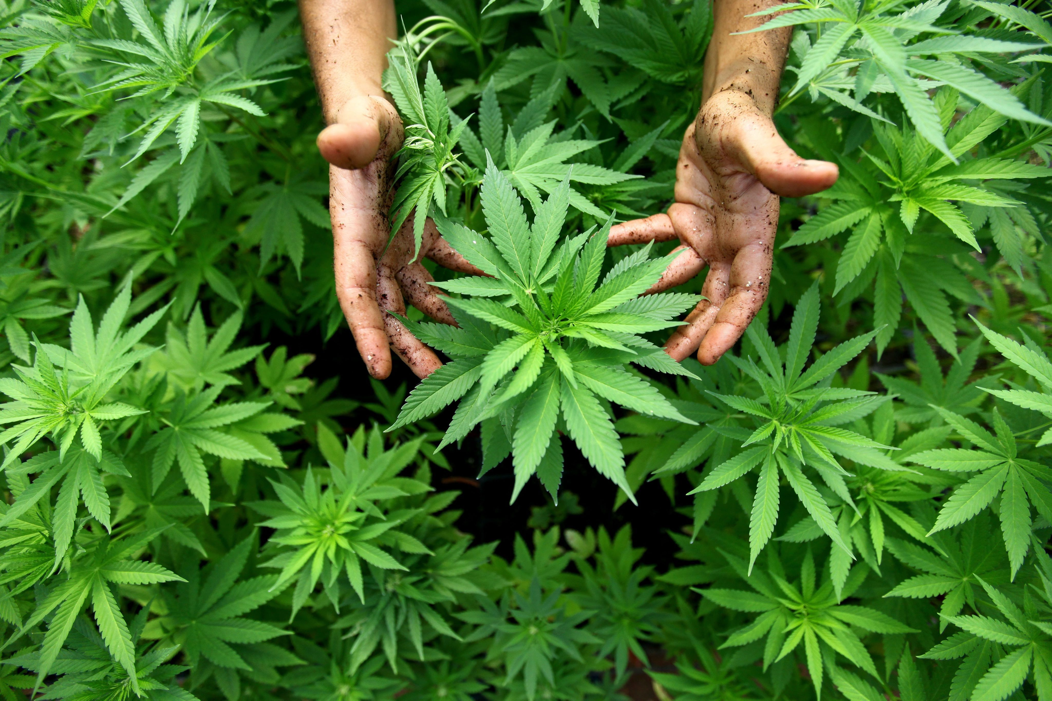
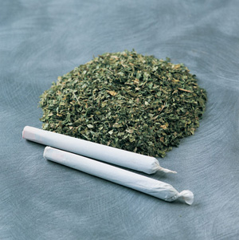
Cannabis
An estimated 22.2 million Americans aged 12 or older in 2014 were current users of marijuana.
An estimated 80.5 million European adults have used marijuana at least once and it is widely accepted that it is the most frequently used illicit substance in Western countries.

Slide 72
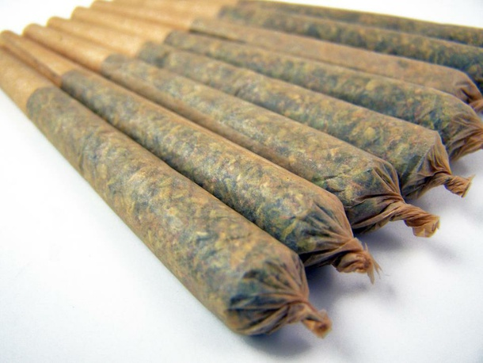
Cannabis
Cannabis consumption has been associated with multifactorial deaths, including marijuana-related accidents and deaths attributed to abuse of alcohol and other illicit substances
Clinicians are advised to identify at least 2 or more of the following physical symptoms, occurring within 2 hours of cannabis use, as defined by DSM-5 criteria:
- Conjunctival injection - Increased appetite
- Dry mouth - Tachycardia

Slide 73
Most commonly abused substance in Saudi Arabia
Amphetamine (4–70.7%,).
Heroin (6.6–83.6%).
Alcohol (9–70.3%).
Cannabis (1–60%).
There was an increase in the use of cannabis
and amphetamine and decrease in the use
of heroin and volatile substances.

Slide 74
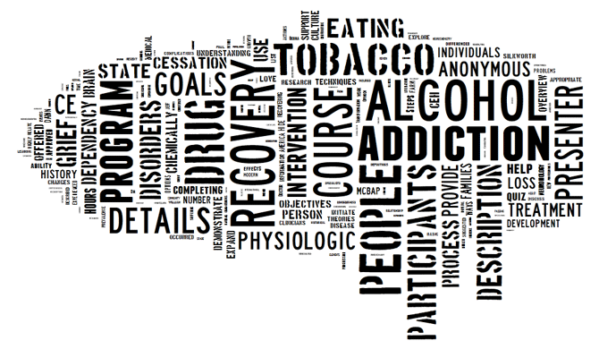
Approach patient with

Slide 75
Identification
Assessment
Brief intervention
Counseling
Approach patient with substance abuse

Slide 76
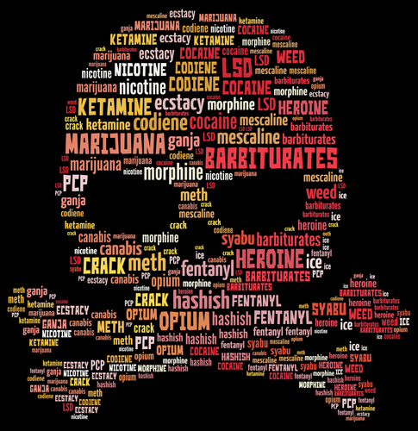
Approach patient with substance misuse
1- Identification of substance misuse
Clinician should ask patients routinely about recent legal and illicit drug use, questions should include :
Whether they have used drugs and, if so:
Of what type and method of administration
In what quantity
How frequently.
When last used

Slide 77
Approach patient with substance misuse
1- Identification of substance misuse
Clinician should consider asking patients about recent drug use if they present with symptoms that suggest the possibility of drug misuse, for example:
Acute chest pain in a young person.
Acute psychosis (EMERGENCY !).
Mood and sleep disorders.

Slide 78
Approach patient with substance misuse
2- Assessment of substance misuse.
- Clinician should consider the patient's:
Medical, psychological, social and occupational needs
History of drug use
Experience of previous treatment, if any
Goals in relation to his or her drug use
Treatment preferences.

Slide 79
Approach patient with substance misuse
2- Assessment of substance misuse.
Clinician should establish and sustain a respectful and supportive relationship with the patients and help them identify situations when he/she is vulnerable to drug misuse and to explore alternative coping strategies.
Clinician should maintain effective collaboration with other care providers such as psychiatrists, dietitians, …
Healthcare professionals should use biological testing (for example, of urine or oral fluid samples) as part of a comprehensive assessment of drug use.

Slide 80
Approach patient with substance misuse
3- Brief intervention.
Component of brief intervention :
Introducing the issue in the context of the patient's health
Screening, evaluating, and assessing
Providing feedback
Talking about change and setting goals
Summarizing and reaching closure
The stages-of-change model.

Slide 81
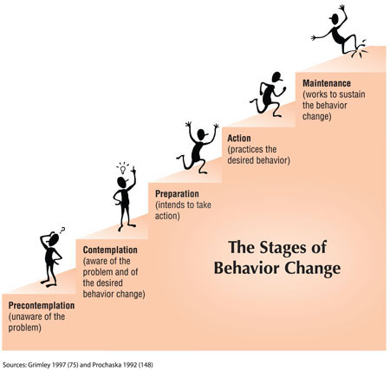
Stage-of-change model
appropriate motivational support

Slide 82
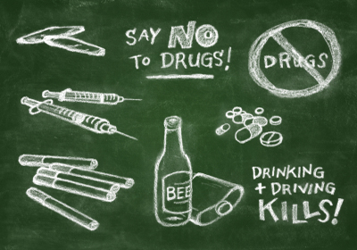
Approach patient with substance misuse
4- Counseling
Psychosocial interventions:
Contingency management
A set of techniques that focus on changing specified behaviors.
Behavioral couples therapy : interventions to service users in close contact with a non-drug-misusing family member
A range of evidence-based psychological interventions,
such as cognitive behavioral therapy.

Slide 83
Approach patient with substance misuse
4- Counseling
Medical intervention.
Collaboration with other health care provider to help managing and maintain the change.

Slide 85
Q1
The addictive ingredient in tobacco is :
A- Nicotin
B- Tar
C- Smoke
D- unknown

Slide 86
Q2
Sarah smokes a pack of cigarettes a day and has just given birth. Which of the following is FALSE regarding the health of her newborn, Her baby will:
A- Generally have normal birth weight
B- have an increased risk of sudden infant death syndrome
C- more likely develop chronic respiratory problems
D- be hospitalized more often and have poorer overall health

Slide 87
Q3
Which of the following is associated with smoking?
A-Chronic bronchitis
B-Tongue cancer
C-Lung cancer
D-All of the above

Slide 88
Q4
When a pregnant woman smokes, the greatest threat to the health of the developing fetus comes from which of the following:
A- Tar
B- Carbon monoxide
C- Non-tar partials
D- The increased cancer risk

Slide 89
Q5
What are the Factors that can lead to substance abuse?
A- Old age
B- Dark Hair color
C- Being male
D- English language

Slide 90
References:
https://www.ncbi.nlm.nih.gov/pmc/articles/PMC3927255/
http://www.aafp.org/afp/2012/0315/p591.html
http://search.proquest.com/docview/206257677?pq-origsite=summon
https://www.nice.org.uk/guidance/ph10/chapter/4-recommendations
http://www.quit.org.au/preparing-to-quit/choosing-best-way-to-quit/nicotine-replacement-products
http://www.mayoclinic.org/diseases-conditions/drug-addiction/basics/risk-factors/con-20020970
https://www.nice.org.uk/guidance/ph26
http://www.uptodate.com/contents/secondhand-smoke-exposure-effects-in-adults/abstract/7,8?utdPopup=true
https://www.cdc.gov/tobacco/data_statistics/fact_sheets/secondhand_smoke/health_effects/

Slide 91
References:
http://reference.medscape.com/medline/abstract/24967831
http://www.cdc.gov/mmwr/preview/mmwrhtml/mm64e1218a1.htm
http://www.samhsa.gov/data/2k13/DAWN2k11ED/DAWN2k11ED.htm
http://reference.medscape.com/medline/abstract/26624241
https://www.drugabuse.gov/drugs-abuse/cocaine
http://www.unodc.org/wdr2015/
https://www.researchgate.net/publication/262799110_Substance_use_disorders_in_Saudi_Arabia_Review_article
https://www.ncbi.nlm.nih.gov/books/NBK64942/

Slide 92
Thank you
By Group 6

