Slide 1
Maternal and Child health
Rawan AlOtaibi Sarah AlSeneidi
Malak AlAlwan Fatimah AlAli
Yara AlAnazi Munira AlGhufaily

Slide 2
Objectives
1-Health behaviors and health systems indicators that affect the health, wellness, and quality of life of women, children, and families. 2-Factors can affect pregnancy and childbirth, including: Preconception health status, Age, Access to appropriate preconception and interconception health care, Poverty
3-Health risks may include: Hypertension and heart disease, Diabetes, Depression, Genetic conditions, Sexually transmitted diseases (STDs), Tobacco use and alcohol Abuse, Inadequate nutrition, Unhealthy weight 4-Social and Physical Determinants of Maternal Health
5-Social and Physical Determinants of Infant and Child Health 6-How to improve the health and well-being of women, infants, children, and families.

Slide 3
Maternal and child health indicators :

Slide 4
Maternal and child health indicators :
Before going through health indicators you should know about its definition :
Definition: Health indicators are variables that reflect the state of health of persons in a community. (Oxford Dictionary of Epidemiology)
They inform about the quality of health care, and access of health care, and they are considered as quantitative measures.

Slide 5
Health indicators could be used to:
Assess the health care needs.
Compare health status of different areas or groups of people over
time, one country with other countries or worldwide.
Monitoring and evaluation of health services, activities and
programs-access, quality, effectiveness and equality.

Slide 6
The 11 indicators of maternal, newborn and child health
Children under five who are stunted
Under-five child mortality, with the proportion of newborn deaths
Maternal mortality ratio
Proportion of demand for family planning satisfied (met need for contraception)
Antenatal care coverage (at least four times during pregnancy)
Antiretroviral (ARV) prophylaxis among HIVpositive pregnant women
Skilled attendant at birth
Postnatal care for mothers and babies within two days of birth
Exclusive breastfeeding for six months (0–5 months)
Three doses of combined diphtheria-tetanuspertussis (DTP3) immunization coverage (12–23 months)
Antibiotic treatment for suspected pneumonia

Slide 7
Definitions
Under-five child mortality
It is the probability of a child born in a specific year or period dying before
reaching the age of five.
Maternal mortality ratio
It is the number of maternal deaths per 100,000 live births during a specified time period usually 1 year.
Children under five who are stunted
It is defined as the percentage of children, aged 0 to 59 months, whose height for age is below -2 SD (moderate and severe stunting) and -3 SD (severe stunting) from the median of the WHO Child Growth Standards.
Exclusive breastfeeding for six months (0–5 months)
Percentage of infants 0–5 months of age (<6 months) who are fed exclusively with breast milk.
Antenatal care coverage
The percent of women ages 15 to 49 with a live birth within a given time period who attended antenatal care (ANC) four or more times during their most recent pregnancy.

Slide 8
Factors and behaviors affecting maternal health and fetal development
Maternal nutrition
Smoking
Drinking
Diseases ( GDM, thyroid diseases , infections …etc.)
Drugs
Maternal age
Prenatal care

Slide 9
Factors can affect pregnancy and childbirth

Slide 10
Factors can affect pregnancy and childbirth
Preconception
health status
Age
Access to appropriate preconception
interconception health care
Poverty

Slide 11
1-Preconception health status
A)Maternal behaviors like : Tobacco use , alcohol use , failure to consume adequate folic acid.
B)Other conditions like : unintended pregnancy , experiencing physical abuse , experiencing high levels of stress.
C)Certain maternal health conditions like: Diabetes , hypertension , obesity.

Slide 12
2-Age
The chances of surviving the first year of life were better for infants born to mothers aged 20-34 years than for those born to mothers of other ages.
The most favorable survival rates were among first births to mothers aged 20-24 and among first and second births to mothers aged 25-29.
Your risk of pregnancy complications, such as high blood pressure and gestational diabetes, increases after 35 and continues to rise in your 40s. The odds of genetic problems also jump as you get older: At 40, your chance of conceiving a child with Down syndrome is one in 100; at 45 it's one in 30.

Slide 13
3-preconception and interconception health care
Preconception health care :
Inter-conceptional health care:
interconception health involves helping a woman understand the importance of being healthy between pregnancies and the need to wait at least 18 months before becoming pregnant again to help optimize birth outcome.
s the medical care a woman or man receives from the doctor or other health professionals that aimed to increase the chance of having a healthy baby.

Slide 15
4- antenatal care
Antenatal care is the care you receive from healthcare professionals during your pregnancy.
1- folic acid and vitamin D supplements
2- nutrition, diet and food hygiene
3- lifestyle factors : smoking, recreational drug use and drinking alcohol
4- antenatal screening tests
5-if you've had any complications or infections in a previous pregnancy
6- if you're being treated for a chronic disease.
Notes:
screening tests, including screening for sickle cell disease and thalassaemia, infectious diseases and screening for Down's syndrome. You should be offered screening for sickle cell disease and thalassaemia before 10 weeks.

Slide 17
5-Poverty
1- increased total fertility rates, unintended or teenage pregnancy and being a single mother
2-hose living in poverty were more likely to smoke, to have poorer dietary habits, lower levels of education, and engage in higher risk and health-demoting practices
3- overall excess mortality risk was approximately 60% compared with infants born to women living above the poverty level.
Notes:
https://www.ncbi.nlm.nih.gov/pmc/articles/PMC2528810/

Slide 18
6- Access to appropriate preconception and interconception health care
1- Talking to a health-care provider before becoming pregnant at least 6 months.
Why?
Because a woman might have a subsequent pregnancy, services in the postpartum period
2- ccessing services such as the Special Supplemental Nutrition Program for Women, Infants, and Children

Slide 19
High risk Factor in maternal and child health

Slide 20
HTN
Heart Disease
Tobacco & alcohol use
STDs
GDM
Nutrition
Unhealthy weight
Genetic factor
Post partum depression

Slide 21
Hypertension
most common medical problem encountered during pregnancy, complicating 2-3% of pregnancies.
complication:
preeclampsia : high BP and signs of damage to another organ system (proteinuria) , usually after 20 weeks of pregnancy
Why is high blood pressure a problem during pregnancy?
Decreased blood flow to the placenta
Placental abruption
Premature delivery
Future cardiovascular disease
Failure to thrive, seizures, , lack of energy, and difficulty in breathing can be associated with hypertension in neonates

Slide 22
Heart disease
Leading Cause of death of maternal death worldwide.
-Myocardial infarction
-Cardiomyopathy
-Rheumatic heart disease
-Congenital heart diseases.

Slide 23
Gestational Diabetes mellitus
is when a woman without diabetes, develops high blood sugar levels during pregnancy
Approximately 7% of all pregnancies are complicated by GDM more than 200,000 annually.
in gestational diabetes, blood sugar usually returns to normal soon after delivery. But you're at risk for type 2 diabetes.

Slide 24
Gestational Diabetes mellitus
Risk factors?
1-Age greater than 25
2-Excess weight (30 or higher BMI)
3-Family or personal health history.
Complication
Mother: Future DM - preeclampsia
Baby: high birth weight - Preterm birth with respiratory distress syndrome – low Blood sugars

Slide 25
Alcohol use
Can pregnant women drink small amount of alcohol or beer? Why?
There is No known safe amount of alcohol use during pregnancy. All types are equally harmful, including all wines and beer. When pregnant women drinks alcohol so does her baby.
Alcohol in the mother's blood passes to the baby through the umbilical cord
Complication of drinking alcohol during:
miscarriage, stillbirth
abnormal facial features
Growth and central nervous system problems

Slide 26
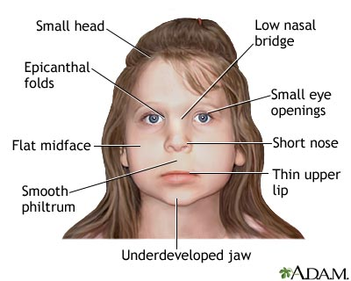
Fetal alcohol spectrum disorders
FASD is a group of disorders caused by prenatal exposure to alcohol.

Slide 27
Smoking
Why is it so dangerous to smoke during pregnancy?
Cigarette smoke contains more than 4,000 chemicals, including truly nasty things like cyanide, lead, and at least 60 cancer-causing compounds. When mom smokes during pregnancy, that toxic brew gets into her bloodstream, her baby's only source of oxygen and nutrients.

Slide 28
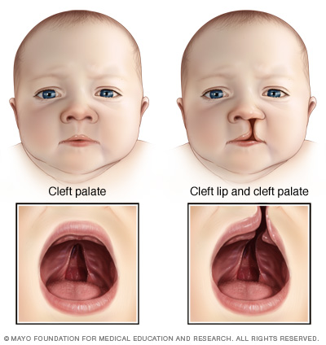
Smoking
Smoking effect:
harder for a woman to get pregnant.
placenta can separate
Sudden Infant Death Syndrome
Cleft lip or cleft palate
Second smoke effect:
- baby who weighs less.
- Ear infections AND asthma attacks

Slide 29
STD’s
1-Perinatal HIV/AIDS
It recommends that all women who are pregnant or planning to get pregnant should get tested for HIV as early as possible.
If a woman is treated for HIV early in her pregnancy, the risk of transmitting HIV to her baby can be 1% or less.
How to lower the risk of transmitting HIV from the mother to their babies?
HIV medicines
Cesarean delivery
No pre-chewing her baby’s food.

Slide 30
STD’s
2- Chlamydia :
Most women have NO symptoms and it is Easy to cure
Chlamydia lesions on genitals are highly contagious and infect the baby during labor
The risk in pregnancy : early delivery, eye infection or ectopic pregnancy.
3-Gonorrhea
The risk in pregnancy :miscarriage, preterm birth
The risk before and after pregnancy if untreated : cause pelvic inflammatory disease
Gonorrhea in newborns most commonly affects the eyes
4-Syphilis:
Typically occurs during second half of pregnancy
May be transmitted to baby by infected mother.
It be linked to premature birth, stillbirth.
death in some cases
5-Herpes simplex virus:
Herpes is safe in pregnant women until she get ready to deliver.
Herpes lesions on genitals are highly contagious and infect the baby during labor

Slide 31
Poor nutrition
malnutrition: fail to gain weight in pregnancy Mother die while pregnant
Baby : low-birth weight - restricted fetal growth
-Micro nutrition: Iron : Preterm birth
and anemia (risk of death from bleeding during childbirth)
Calcium: prevent baby from draw calcium from his mother bone.
Baby :
Folate : neural tube defect
Calcium: poor skeletal developmen
Iron: low birth weight

Slide 32
Unhealthy weight
A women weight before and during pregnancy are important indicators of health for both mother and child.
Recent studies showed overweight or obese before pregnancy associated with a higher pregnancy complication.

Slide 33
Genetic conditions
more than 50 per cent of miscarriages in the early stages of pregnancy are due to abnormalities of the chromosomes.

Slide 34
Social and Physical Determinants of Maternal Health

Slide 35
Social and Physical Determinants of Maternal Health
range of biological, social, environmental, and physical factors have been linked to maternal, infant, and child health outcomes.
Race , Ethnicity, Age , socioeconomic factors, such as income level, educational attainment, medical insurance coverage, access to medical care, pre-pregnancy health, and general health status.

Slide 36
Why it is important?
1-To know these factors help in Improving the well-being of mothers, infants, and children .
2- educating patients in a culturally sensitive manner about steps they can take to prevent diseases.

Slide 37
1-Social Determinants of Maternal Health
Race and ethnicity
-Physical Determinants of Maternal Health
Common barriers to a healthy pregnancy and birth include lack of access to appropriate health care before and during pregnancy.
Age
socioeconomic factors
access to medical care
pre-pregnancy health
general health status.
Affecting her health directly.
Affecting her ability to engage in healthy behaviors

Slide 38
Social and Physical Determinants of Child Health

Slide 39
Social and Physical Determinants of Child Health
Biological
Birth Weight: low birth weight (< 2.5 kg) & high birth weight (> 4 kg)
Socio-economic Factors
Low income countries Rural areas Low education Nutrition
Age of The Mother : <19 years) or >over 30 years
Repeated pregnancies : risk of miscarriage
Birth Spacing: < 1 year = 2-4 times risk of mortality
Multiple Births: more risk due to low birth weight
Family Size: 3 or more children, more frequent/prolonged illness
Breast & formula milk use
Health care quality
Violence (wife beating, infanticide, child abuse)
Environmental conditions
Cultural Factors
Religion Customs Early marriages Sex of child Quality of mothering Traditions affecting
cleanliness, •eating, clothing, •child care

Slide 40
How to improve the health and well-being of women, infants, children, and families.
First 24 hours : assessment of vaginal bleeding, uterine contraction, temperature and heart rate should be done routinely during the first 24 hours
Breastfeeding should be assessed
women should be asked about their emotional wellbeing, what family and social support they have
Iron and folic acid supplementation should be provided for at least 3 months after delivery.

Slide 41
Post partum depression
After 10–14 days, all women should be asked about postpartum depression
approximately 10 to 15% of women suffer from postpartum mood disorders (PPMDs), including postpartum depression (PPD), postpartum anxiety/OCD and postpartum psychosis

Slide 42
Post partum depression
What are the symptoms of PPD?
loss of pleasure or interest in things you used to enjoy
eating much more, or much less,
Sadness, crying
Feeling guilty or worthless—blaming yourself

Slide 43
Post partum depression
the risk factors for PPD?
Previous experience of depression or anxiety
premature birth
Isolation and lack of social support
Stress

Slide 44
Post partum depression
Causes
Physical changes.
Emotional issues.

Slide 45
the major reasons of maternal mortality? Women die from a wide range of complications in pregnancy, childbirth or the postpartum period. The four major killers are: severe bleeding (mostly bleeding postpartum), infections (also mostly soon after delivery), hypertensive disorders in pregnancy (eclampsia) and obstructed labor

Slide 46
How can maternal deaths be prevented?
We should ensure that women have access to family planning and safe abortion. This will reduce unwanted pregnancies and unsafe abortions

Slide 47
How to improve infancy health
infant Mortality
for every 1,000 babies that are born, almost 6 die during their first year, 45% of child deaths under the age of 5 years take place during the neonatal period.
. Most of these babies die as a result of
Birth defects
Preterm birth (birth before 37 weeks gestation) and low birth weight
Maternal complications of pregnancy
Sudden Infant Death Syndrome (SIDS)
Injuries (e.g., suffocation).

Slide 48
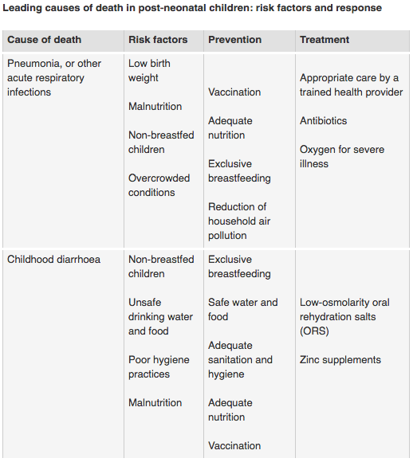

Slide 49
Improving infants health after delivery
Promote early and exclusive breastfeeding.
A full clinical examination should be done 1 hour after birth. This includes giving vitamin K prophylaxis and hepatitis B vaccination (within 24 hours).

Slide 52
References
http://www.apa.org/pi/women/resources/reports/postpartum-depression.aspx
http://www.postpartumprogress.com/how-many-women-get-postpartum-depression-the-statistics-on-ppd
http://www.knowabouthealth.com/who-worldwide-decline-in-maternal-deaths-by-34/6420/
https://www.cdc.gov/reproductivehealth/maternalinfanthealth/infantmortality.htm
http://www.bupa.com.sa/arabic/healthandwellness/healthinformation/articles/pages/vaccination-in-children.aspx
http://www.kidfb.com/vaccine-safety-before-during-and-after-pregnancy-t5.html
https://www.healthypeople.gov/2020/topics-objectives/topic/maternal-infant-and-child-health
http://www.acog.org/Patients/FAQs/Preeclampsia-and-High-Blood-Pressure-During-Pregnancy
http://emedicine.medscape.com/article/261435-overview
https://www.ncbi.nlm.nih.gov/pubmed/23411474
https://en.wikipedia.org/wiki/Gestational_diabetes
https://www.cdc.gov/ncbddd/fasd/alcohol-use.html
https://www.babycenter.com/0_how-smoking-during-pregnancy-affects-you-and-your-baby_1405720.bc
http://www.netdoctor.co.uk/conditions/pregnancy-and-family/a9096/chromosome-abnormalities-in-pregnancy/

Slide 53
Thank you
Any Questions ?

