Slide 1
Smoking And Substance Abuse
Student Lead Seminar
Group 5

Slide 2
DR. Haya Said its important to know there are resources to help people to quit smoking in Saudi Arabia, including:
جمعية نقاء

Slide 3
Competition and a Prize !

Slide 4
Q1
What is the main cause of death due to smoking?
A- CVD
B- COPD
C- Lung Cancer
D- Bladder cancer

Slide 5
Q2
Smoking can increase risk of having coronary heart disease (CHD) than non-smoking by?
A- 0 times
B- 0-1 times
C-1-2 times
D- 2-4 times

Slide 6
Q3
Intentional inhalation of smoke using the methods of smoking such as: cigarettes and cigars is :
A- Active smoking
B- Passive smoking
C- environmental tobacco smoke
D- Secondhand smoke

Slide 7
Q4
Which one of the following kills more people every year :
A- smoking
B- alcoholism
C- Cannabis
D – stamiulant

Slide 8
Q5
Which of the following antismoking drugs are the most effictive one:
A- Nicotine gum
B- Bupropion SR
C- Varenicline
D- Nicotine skin patch

Slide 9
Case scenario
29 years old female , pregnant in her 1st trimester, presented for her antenatal visit
Notes:
Take History!

Slide 10
Najla Alotaibi
Epidemiology of smoking In Saudi Arabia

Slide 11
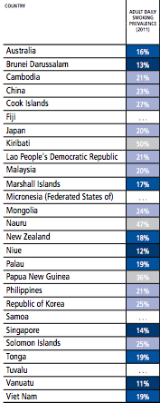
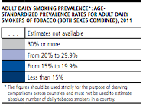
Epidemiology of smoking World Wide
Eastern Mediterranean
Western Pacific
The Americas
WHO REPORT ON THE GLOBAL TOBACCO EPIDEMIC (2011)

Slide 12
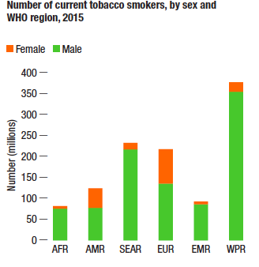
Epidemiology of smoking World Wide
In 2015, over 1.1 billion people smoked tobacco.1 Far more males than females currently smoke tobacco. Even though the prevalence of tobacco smoking is declining worldwide and in many countries, it appears to be increasing in the WHO Eastern Mediterranean Region and WHO African Region. In other regions, such as the WHO European Region and WHO Western Pacific Region, tobacco smoking is still prevalent and efforts must be intensified to reduce it.

Slide 13
Epidemiology of smoking in Saudi Arabia

Slide 14
Epidemiology of smoking in Saudi Arabia
Socio-demographic characteristics of the Saudi Health Interview Survey participants, Kingdom of Saudi Arabia, 2013

Slide 15
Najla Alotaibi
Risks of Smoking (Morbidity and Mortality)

Slide 16
Risks of smoking
Morbidity:
Smoking leads to disease and disability and harms nearly every organ of the body.
More than 16 million Americans are living with a disease caused by smoking.
For every person who dies because of smoking, at least 30 people live with a serious smoking-related illness.
Smoking causes cancer, heart disease, stroke, lung diseases, diabetes, and chronic obstructive pulmonary disease (COPD), which includes emphysema and chronic bronchitis.
Smoking also increases risk for tuberculosis, certain eye diseases, and problems of the immune system, including rheumatoid arthritis.

Slide 17
Risks of smoking
Smoking is estimated to increase the risk of:
Coronary heart disease by 2 to 4 times
Stroke by 2 to 4 times
Lung cancer by 25 times

Slide 18
Smoking and lung cancer
Lung cancer is the most commonly diagnosed cancer.
The leading cause of cancer death in the United States.
Most deaths from lung cancer are caused by cigarette smoking and exposure to secondhand smoke.

Slide 19
Risks of smoking
For current smokers, chronic bronchitis was the most prevalent (49%) condition, followed by emphysema (24%). For former smokers, the three most prevalent conditions were chronic bronchitis (26%), emphysema (24%), and previous heart attack (24%). Lung cancer accounted for 1% of all cigarette smoking-attributable illnesses.
Notes:
Current smoker: includes daily smokers and non-daily smokers (also known as occasional smokers).
Determined from the response to the question "At the present time do you smoke cigarettes every day, occasionally, or not at all?”
Former smoker: was not smoking at the time of the interview, however, answered "YES" to the question "Have you smoked at least 100 cigarettes in your life?"

Slide 20
Risks of smoking
Mortality:
Smoking is the leading cause of preventable death.
Worldwide, tobacco use causes nearly 6 million deaths per year, and current trends show that tobacco use will cause more than 8 million deaths annually by 2030.
On average, smokers die 10 years earlier than nonsmokers.

Slide 22
Dalal Ahmed
Effect of Passive Smoking on Pregnancy and Children

Slide 23
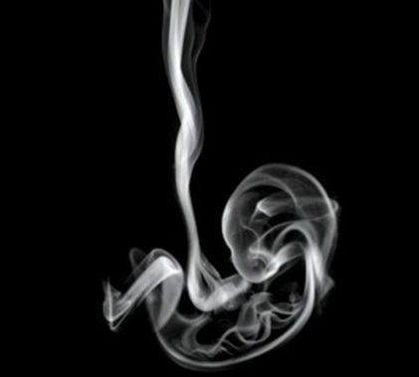
smoking effect on pregnancy:
Smoking effect on pregnancy doesn’t mean only during pregnancy but also women who are planning to get pregnant or having a child aged up to 12 months.

Slide 24
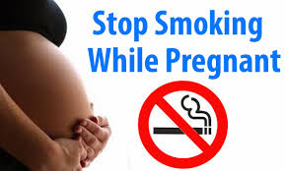
ACTIVE AND PASSIVE SMOKING EFFECT ON PREGNANCY:
Miscarriage.
Low birth weight.
Preterm labor.
Learning and behavioral deficiencies.
Sudden infant death syndrome.

Slide 25
Management before, during , after pregnancy:
assessment of the woman's exposure to tobacco smoke through discussion
Provide information (for example, a lea et) about the risks to the unborn child and the hazards of exposure to secondhand smoke for both mother and baby.
Explain about the health benefits of stopping for the woman and her baby.
Refer all women who smoke, or have stopped smoking within the last 2 weeks, to NHS Stop Smoking Services.
Use local arrangements to make the appointment and through the phone by giving the NHS Pregnancy Smoking Helpline number.
If her partner or others in the household smoke, suggest they contact NHS Stop Smoking Services. If no one smokes, give positive feedback.
check on the next appointment, if the woman took up her referral. If not, ask if she is interested in stopping smoking and offer another referral to the service.
Address any factors which prevent the women from using smoking cessation services.

Slide 26
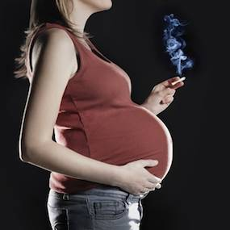
Interventions that are effective in helping women who are pregnant to quit smoking:
cognitive behavior therapy
motivational interviewing
Discuss the risks and benefits of NRT with pregnant women who smoke only used if smoking cessation without NRT fails. If they express a clear wish to receive NRT, use professional judgement when deciding whether to offer a prescription.
Advise pregnant women who are using nicotine patches to remove them before going to bed.

Slide 27
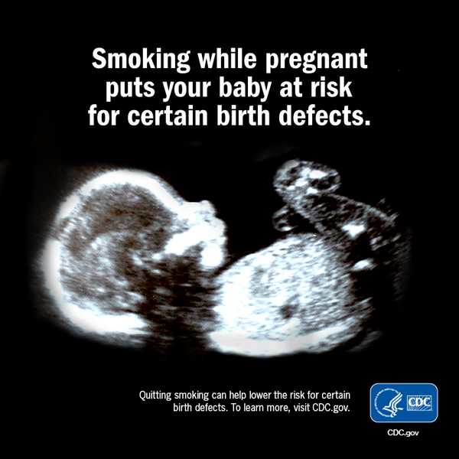
Secondhand smoking effect on children:
Studies show that older children whose parents smoke get sick more often.
Their lungs grow than children who do not breathe secondhand smoke, and they get more bronchitis and pneumonia.
Wheezing and coughing are more common in children who breathe secondhand smoke.
Secondhand smoke can trigger an asthma attack in a child.
Children whose parents smoke around them get more ear Infections.
psychological problems in childhood such as attention and hyperactivity problems (Button et al. 2007). In addition, it may have an effect on the child's educational performance (Batstra et al. 2003).

Slide 28
the management and counselling for the partner and and others in the household who smoke:
Provide clear advice about the danger that other people's tobacco smoke poses to the pregnant woman and to the baby – before and after birth.
Recommend not smoking around the pregnant woman, mother or baby.
Offer partners who smoke help to stop using a multi-component intervention. Discuss with them which options to use taking into account:
their preferences
contra-indications and the potential for adverse effects from pharmacotherapies such as NRT
the likelihood that they will follow the course of treatment
their previous experience of smoking cessation aids.
Do not favor one medication over another. Together, choose the one that seems most likely to succeed.

Slide 29
Amani Alsulami
Role of Physician in Smoking Cessation and withdrawal Symptoms

Slide 30
Role of PHC physician “smoking cessation clinic’
They should take the opportunity to advise all patients who smoke to quit when they attend a consultation. Those who want to stop should be offered a referral to an intensive support service.
If they are unwilling or unable to accept this referral they should be offered pharmacotherapy and additional support.
The smoking status of those who are not ready to stop should be recorded and reviewed with the individual once a year, where possible.

Slide 31
How are you going to help the smoker to quit and how to overcome withdrawal symptoms

Slide 32
A. Five A’s Counseling Strategy
Ask “Have you ever been a smoker or used other tobacco products? Do you use tobacco now? How much?”
Advise I think quitting smoking is very important for you because of your asthma. I want you to come back to the office next week so we can talk about this more.”
Assess “Have you ever tried to cut back on or quit smoking? Are you willing to quit smoking now? What keeps you from quitting? How soon after getting up in the morning do you smoke?”
Assist I would like to help you quit. Can I tell you about some of the things we know can increase your odds of success?”
Arrange “I would like to see you in the office (or talk to you by phone) on your quit date.”
Notes:
Ask "What made you want to start smoking?"
"What things make you crave a cigarette?"
"What made you decide to quit smoking?"
"What things have been stressing you out lately?"
"What could I do to help make quitting easier for you?"

Slide 35
The Stages of Change
1. Pre-contemplation (not thinking about quitting) People who are at this stage are not really thinking about quitting,.
These smokers are not likely to be receptive to messages about the health benefits of quitting.

Slide 36
2. Contemplation (thinking about quitting but not ready to quit) During this stage, smokers are considering quitting sometime in the near future (probably six months or less).
They are more aware of the personal consequences and consider smoking a problem that needs resolution.
they're more open to receiving information about smoking.

Slide 37
3. Preparation (getting ready to quit) In the preparation stage, smokers have made the decision to quit and are getting ready to stop smoking.
For example, they may be smoking fewer cigarettes. They make statements such as "This is serious... something has to change" and may actually set a date to quit smoking.

Slide 38
4. Action (quitting) In this stage, people are actively trying to stop smoking, perhaps using short-term rewards to keep themselves motivated and often turning to family, friends and others for support.
This stage, generally lasting up to six months, is the period during which smokers need the most help and support

Slide 39
5. Maintenance (remaining a non-smoker) Former smokers in the maintenance stage have learned to anticipate and handle temptations to smoke and are able to use new ways of coping with stress, boredom and social pressures that had been part of their "smoker's identity."
Although they may slip and have a cigarette, they try to learn from the slip so it doesn't happen again. This helps to give them a stronger sense of control and the ability to stay smokefree.

Slide 40
B. 5 R’s approach

Slide 41
Common nicotine withdrawal symptoms
Common nicotine withdrawal symptoms (e.g., irritability, anxiety, restlessness) peak within the first week of abstinence and last two to four weeks.

Slide 42
Depression
Smokers are more likely than nonsmokers to have a depressive episode, and smokers with depression are less likely to successfully quit.
physicians should consider monitoring the mood of smokers during quit attempts and screen for depression in those who have repeatedly been unable to quit.

Slide 43
Weight gain
Most smokers gain fewer than 10 lb (4.5 kg) after quitting, weight gain can vary (10 percent will gain 30 lb [13.5 kg])15; although this weight gain poses less health risk than smoking, concern about weight gain may interfere with the quit attempt.

Slide 44
Mechanism of coping and withdrawal symptoms

Slide 45
Story of a quitter
https://www.youtube.com/watch?v=UL7zLuMwhi8

Slide 46
Latifa Alanazi
Pharmacological Management For Smoking Cessation

Slide 47
Pharmacological Management
Some medications are designed to help smokers quite smoking, their actions include decreasing cravings and reduce withdrawal symptoms.
Before choosing a pharmacologic tool physician should consider “Advantages of each, Disadvantages, Contraindications”.
Smoker patients should be offered pharmacological help in their battle with addiction.

Slide 48
Pharmacological management
Nicotine replacement therapy
Bupropion
Varenicline.

Slide 49
Pharmacological tools:
There are different medications which helps quit smoking.
Nicotine replacement therapy:
The goal of nicotine replacement therapies (NRTs) is to relieve cravings for nicotine and reduce nicotine withdrawal symptoms
Quit rate range from 19% to 26%. NRT includes:
nicotine patch
nicotine gum
nicotine nasal spray
nicotine inhaler
Bupropion “Range of quitting about 24%”
Varenicline “Range of quitting about 33%”
Notes:
NRT: The goal of nicotine replacement therapies (NRTs) is to relieve cravings for nicotine and reduce nicotine withdrawal symptoms
Vareniclne: nicotinic receptor partial agonist, As a partial agonist it both reduces cravings for and decreases the pleasurable effects of cigarettes and other tobacco products. Varenicline increases the chances of a successful quit attempt two- to threefold
Varenicline is considered a class C pregnancy drug, as animal studies have shown no increased risk of congenital anomalies, however, no data from human studies is available
Bupropion acts as an norepinephrine-dopamine reuptake inhibitor (NDRI), and is also a nicotinic antagonist, The drug label advises that bupropion should not be prescribed to individuals with epilepsy or other conditions that lower the seizure threshold, such as anorexia nervosa, bulimia nervosa, active brain tumors, or concurrent alcohol and/or benzodiazepine use and/or withdrawal.

Slide 50
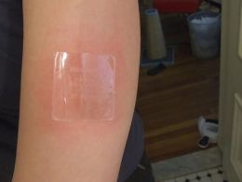
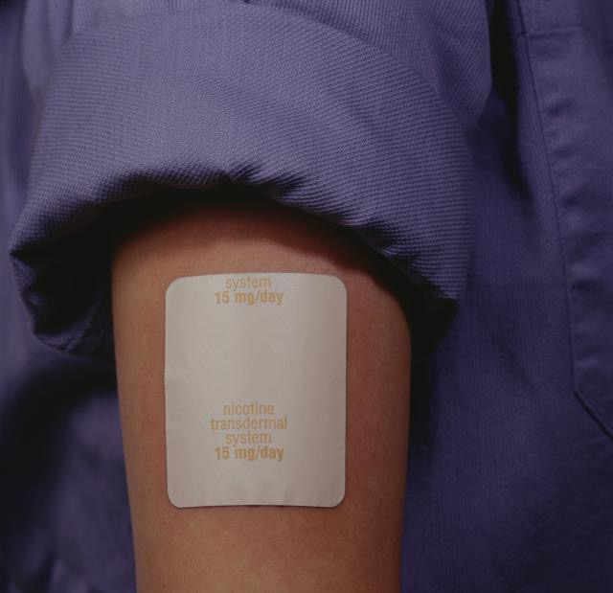
Nicotine replacement therapy
Nicotine skin patch: “Habitrol, Nicoderm, Nicotrol”
How to use?
For a light smoker (≤ 20 cigarettes per day), start 14 or 7 mg.
For a heavy smoker (> 20 cigarettes per day) start 21 mg
For how long?
8-12 weeks or longer if necessary.
Possible side effects?
local skin reaction, disturbed sleep, nightmares.
Contraindications?
pregnant and breastfeeding, have had unstable heart condition in the past 2 weeks
Advantages:
needs only to be applied once a day, can control craving for 24 hours, delays weight gain while using it.

Slide 51
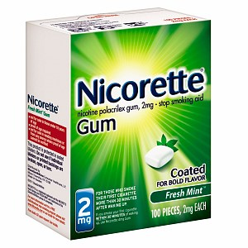
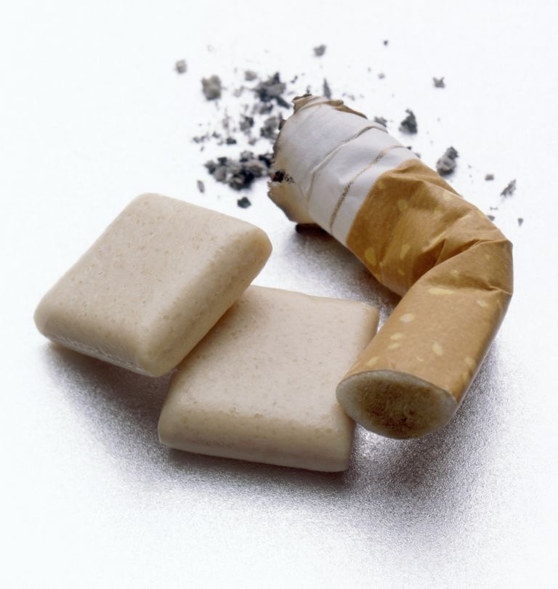
Nicotine replacement therapy
Nicotine gum (Nicorette)
How to use?
piece of gum every 1-2 hours. 2 mg for a light smoker (≤ 20 cigarettes per day).
4 mg for a heavy smoker (> 20 cigarettes per day). stop smoking before starting.
For how long?
several weeks to several months or longer if necessary.
Possible side effects?
burning in throat, hiccups if chewed too quickly, dental problems.
Contraindications?
pregnant and breast feeding. have had unstable heart condition in the past 2 weeks.
Advantages?
you can control when to take nicotine and how much. Satisfies oral cravings. Delays weight gain while using it.

Slide 52
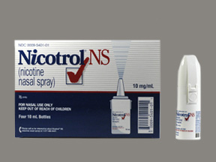
Nicotine Replacement Therapy
Nicotine nasal spray:
Nicotine is absorbed faster, and it’s available for for prescription use only.
Side Effects :
- Nasal/airway reactions.
- Dependency.
- Rhinitis and tearing.

Slide 53
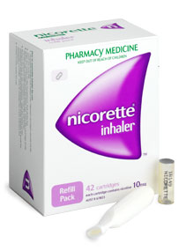
Nicotine replacement therapy
Nicotine inhalator :
It’s available for prescription use only, Despite its name, the nicotine does not reach the lungs but stops in the mouth and throat then absorbed through the lining of your mouth and enters the bloodstream.
Possible side effects:
Local irritation reactions, Coughing and rhinitis.
It is contraindicated in case of bronchospastic disease.
Notes:
The inhalator releases nicotine into your mouth when you inhale.
The nicotine is then absorbed through the lining of your mouth and enters the bloodstream. The nicotine is sufficient to relieve unpleasant withdrawal symptoms and to decrease the cravings for smoking.

Slide 54
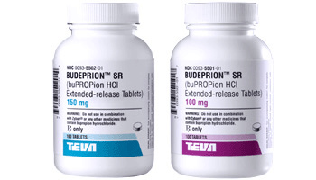
Bupropion
How to use it?
150 mg once a day (in the morning) for 3 days.
Then twice a day.
Start 7-14 days before quit date.
For how long?
7-12 weeks or longer if necessary.
Possible side effects:
Dry mouth & insomnia. Minimal weight gain while you use it.
Contraindications:
pregnant or breastfeeding. History of seizures. Eating disorders. Taking monoamine oxidase inhibitors.
Advantages:
Inexpensive. improves depression.
Notes:
About 24% of smokers who use Bupropion successfully quit.

Slide 55
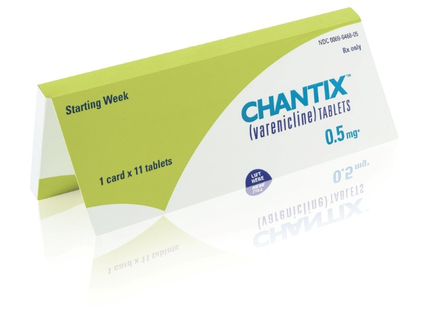
Varenicline
Possible side effects?
Neuropsychiatric effects including depression and suicidal thoughts
Abnormal dreams and Nightmares
Cardiovascular effects
Headache
Nausea
Insomnia
Visual disturbances
Notes:
https://www.nice.org.uk/guidance/ph10/chapter/4-Recommendations#pharmocotherapies-and-other-treatments
About 33% of smokers who use Varenicline successfully quit.

Slide 56
Alternative therapies
Hypnosis: A popular option that has produced good results. Hypnosis works by getting you into a deeply relaxed state where you are open to suggestions that strengthen your resolve to quit smoking and increase your negative feelings toward cigarettes.
Acupuncture: acupuncture is believed to work by triggering the release of endorphins (natural pain relievers) that allow the body to relax. As a smoking cessation aid, acupuncture can be helpful in managing smoking withdrawal symptoms.
Behavioral Therapy: Nicotine addiction is related to the habitual behaviors involved in smoking. Behavior therapy focuses on learning new coping skills and breaking those habits.
Motivational Therapies: One well known example is calculating the monetary savings. Some people have been able to find the motivation to quit just by calculating how much money they will save. It may be enough to pay for a summer vacation.
Notes:
There are several things you can do to stop smoking that don’t involve nicotine replacement therapy or prescription medications: Ask your doctor for a referral or see Resources and References below for help finding qualified professionals in each area.

Slide 57
Ghaida Hussain Alawaji
Factors leading to Substance Abuse

Slide 58
What are risk factors and protective factors?

Slide 59
Risk Factors and Protective Factors
Factors associated with greater potential for drug abuse are called “risk” factors, while those associated with reduced potential for abuse are called “protective” factors.
An important goal of prevention, then, is to change the balance between risk and protective factors so that protective factors outweigh risk factors.

Slide 60
Risk Factors and Protective Factors
These domains can then serve as a focus for prevention.
As the first two examples suggest, some risk and protective factors are mutually exclusive—the presence of one means the absence of the other.
For example, in the Individual domain, early aggressive behavior, a risk factor, indicates the absence of impulse control, a key protective factor.
Helping a young child learn to control impulsive behavior is a focus of some prevention programs.

Slide 61
What are the early signs of risk that may predict later drug abuse?

Slide 62
In the Family
Risk factors
Protection factors
Children’s earliest interactions occur within the family and can be positive or negative. For this reason, factors that affect early development in the family are probably the most crucial. Children are more likely to experience risk when there is:
lack of mutual attachment and nurturing by parents or caregivers;
ineffective parenting;
a chaotic home environment;
lack of a significant relationship with a caring adult;
a caregiver who abuses substances, suffers from mental illness, or engages in criminal behavior.
On the other hand, families can serve a protective function when there is:
a strong bond between children and their families;
parental involvement in a child’s life;
supportive parenting that meets financial, emotional, cognitive, and social needs;
clear limits and consistent enforcement of discipline.

Slide 63
Outside the Family
Risk factors
Protective Factors
Such as in their schools, with their peers, teachers, and in the community. Difficulties in these settings can be crucial to a child’s emotional, cognitive, and social development. Some of these risk factors are:
inappropriate classroom behavior, such as aggression and impulsivity;
academic failure;
poor social coping skills;
association with peers with problem behaviors, including drug abuse; and
misperceptions of the extent and acceptability of drug-abusing behaviors in school, peer, and community environments.
When children are outside the family setting, the most salient protective factors are:
age-appropriate parental monitoring of social behavior, including establishing curfews, ensuring adult supervision of activities outside the home, knowing the child’s friends, and enforcing household rules;
success in academics and involvement in extracurricular activities;
strong bonds with prosocial institutions, such as school and religious institutions; and
acceptance of conventional norms against drug abuse.

Slide 64
What are the highest risk periods for drug abuse among youth?

Slide 65
Highest Risk Periods for Drug Abuse Among Youth
Research has shown that the key risk periods for drug abuse occur during major transitions in children’s lives. These transitions include significant changes in physical development (for example, puberty) or social situations (such as moving or parents divorcing) when children experience heightened vulnerability for problem behaviors.
Further, when they enter high school, young people face additional social, psychological, and educational challenges. At the same time, they may be exposed to greater availability of drugs, drug abusers, and social engagements involving drugs. These challenges can increase the risk that they will abuse alcohol, tobacco, and other drugs.
Risks appear at every transition from early childhood through young adulthood; therefore, prevention planners need to consider their target audiences and implement programs that provide support appropriate for each developmental stage.

Slide 66
Raneem Alotaibi
Types of Substance abuse and How to Approach patients with substance abuse

Slide 67
Substance abuse
alcohol
cocaine
amphetamine
heroin
inhalants
Marijuana
Opioids

Slide 68
Types of substance abuse
 | Signs & symptoms |  | Signs & symptoms
alcohol | The person can’t control how much or when he or she drinks. He needs to take in more alcohol to get the same buzz as before. Withdrawal symptoms set in when alcohol consumption is stopped, and the person may feel sick, sweaty, shaky and anxious. Depression. Restlessness. | cocaine | Dilated pupils Runny nose Euphoria Depression Cardiac arrest
amphetamine | Increased body temperature Euphoria Increased blood pressure Dry mouth Faster breathing Dilated pupils Increased energy and alertness Decreased fatigue Decreased appetite | heroin | Shortness of breath Dry mouth Constricted (small) pupils Sudden changes in behavior or actions Disorientation

Slide 69
Types of substance abuse
 | Signs & symptoms |  | Signs & symptoms
inhalants | slurred speech lack of coordination euphoria dizziness lightheadedness hallucinations delusions | Opioids | vomiting and diarrhea, sedation and delayed reactions Weakened immune system functioning. bowel perforation Significant respiratory depression
Marijuana | Euphoria. Relaxation. Drowsiness. Altered sense of time. Impaired memory. Slowed reflexes and impaired motor skills. Increased appetite. Dry mouth. Increased heart rate.

Slide 70
Common substance abuse in KSA
60%
83.6%
70.3%
70.7%
risk factors for initiation as well as relapse of substance abuse.
Anxiety,
depression
hepatitis were the most common co-morbid disorders among the Saudi patients.

Slide 71
Approach patient with substance abuse
detoxification (the process by which the body rids itself of a drug)
behavioral counseling
medication
evaluation and treatment for co-occurring mental health issues such as depression and anxiety
long-term follow-up to prevent relapse

Slide 72
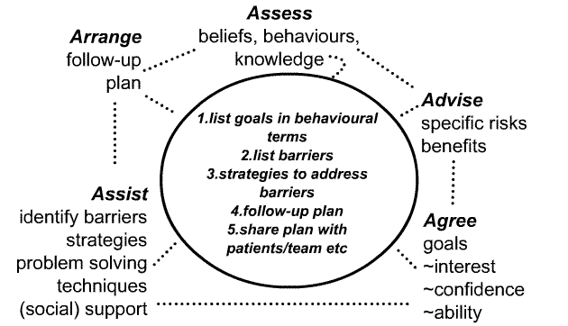
Approach patient with substance abuse

Slide 73
MCQ’s

Slide 74
Q1
What is the main cause of death due to smoking?
A- CVD
B- COPD
C- Lung Cancer
D- Bladder cancer

Slide 75
Q2
Smoking can increase risk of having coronary heart disease (CHD) than non-smoking by?
A- 0 times
B- 0-1 times
C-1-2 times
D- 2-4 times

Slide 76
Q3
Intentional inhalation of smoke using the methods of smoking such as: cigarettes and cigars is :
A- Active smoking
B- Passive smoking
C- environmental tobacco smoke
D- Secondhand smoke

Slide 77
Q4
Which one of the following kills more people every
:year
A- Smoking
B- Alcoholism
C- Cannabis
D – Stamiulant

Slide 78
Q5
Which of the following antismoking drugs are the most effictive one:
A- Nicotine gum
B- Bupropion SR
C- Varenicline
D- Nicotine skin patch

Slide 79
References
http://who.int/tobacco/surveillance/policy/country_profile/sau.pdf?ua=1
https://www.ncbi.nlm.nih.gov/pmc/articles/PMC4491232/
http://www.cdc.gov/tobacco/data_statistics/fact_sheets/health_effects/effects_cig_smoking
US National Institute on Drug Abuse – Guideline:
https://d14rmgtrwzf5a.cloudfront.net/sites/default/files/preventingdruguse_2_1.pdf
https://www.nice.org.uk/guidance/ph10/chapter/4-Recommendations#pharmocotherapies-and-other-treatments
https://www.nice.org.uk/guidance/PH26/chapter/1-Recommendations#recommendation-5-use-of-nrt-and-other-pharmacological-support
https://www.helpguide.org/articles/addiction/how-to-quit-smoking.htm
http://www.quit.org.au/preparing-to-quit/choosing-best-way-to-quit/quitting-medication
http://www.acog.org/Resources-And-Publications/Committee-Opinions/Committee-on-Health-Care-for-Underserved-Women/Smoking-Cessation-During-Pregnancy

Slide 80
Thank you for your time and attendance!

