Slide 1
IHD, Dyslipidemia, and CVD risk assessment
Dr Mohammed Batais
Assistant Professor & Consultant , Family Medicine, Diabetes and Chronic Disease Management
King Saud University

Slide 2
Objectives
Cardiovascular disease
Dyslipidemia and Introduction to new guidelines on lipid management
Comparison with ATP III guidelines
Current statin treatment recommendations
Criticism to AHA/ACC
Treat to target vs fire and forget

Slide 3
CAD
Pathogenesis:
CAD is the narrowing of the coronary artery, decreasing the blood supply to the heart, leading to ischemia of the heart muscle cells
Etiology:
CAD is mostly due to Atherosclerosis
Atherosclerosis and thrombosis are the most important pathogenic mechanisms

Slide 4
Primary prevention of CVD
The achievement and maintenance of good health is being emphasized in programs from The American Heart Association that promote seven ideal cardiovascular health metrics, including :
Not smoking
Being physically active
Having a normal blood pressure
Having a normal blood glucose level
Having a normal total cholesterol level
Being normal weight
Eating a healthy diet
-
Lloyd-Jones DM, Hong Y, Labarthe D, et al. Defining and setting national goals for cardiovascular health promotion and disease reduction: the American Heart Association's strategic Impact Goal through 2020 and beyond. Circulation 2010; 121:586.

Slide 5
CVD risk factors & FRS

Slide 6
CAD risk factors
Modifiable
Non-Modifiable
Cigarette and tobacco smoke
High blood cholesterol
High blood pressure
Physical inactivity
Obesity
Diabetes
Age
Gender
Family history of CVD

Slide 7
Emerging risk factors for CAD
Table 2. Emerging Risk Factors According to ATP III Final Report Update 2004
1. Elevated high-sensitivity C-reactive protein
2. Coronary artery calcification
3. Elevated lipoprotein (a)
4. Homocysteine
5. Fibrinogin

Slide 8
C-reactive protein
A person's baseline level of inflammation, as assessed by the plasma concentration of CRP, predicts the long-term risk of a first myocardial infarction.
In pt with chest pain and C reactive protein level is
Between 3 to 10 : → that indicate the pt is at high risk of develop an attack
If higher than 10 → that indicate that the pt is having an acute attack
Figure 4. clinical interpretation of hs-CRP for cardiovascular risk prediction.
Ridker P M Circulation 2003;108:e81-e85
Copyright © American Heart Association

Slide 9
The Framingham risk score
Scoring system used to calculate a pt’s risk of coronary events
The Framingham Heart Study first introduced the term risk factor to medical literature
The following risk factors are used to assess cumulative risk:
Age
Smoking Status
Systolic BP
HTN treatment
Total cholesterol levels
HDL-C levels

Slide 11
Calculating 10-Year Risk in Women
Age (years) 20-34 35-39 40-44 45-49 50-54 55-59 60-64 65-69 70-74 75-79
Points -7 -3 0 3 6 8 10 12 14 16
Points
Points
Total Age Age Age Age Age
Cholesterol 20-39 40-49 50-59 60-69 70-79
HDL
CHOLESTEROL Points
<160 (mg/dL) 0 0 0 0 0 ≥ 60 (mg/dL) -1
160-199 4 3 2 1 1 50-59 0
200-239 8 6 4 2 1 40-49 1
240-279 11 8 5 3 2 < 40 2
≥ 280 13 10 7 4 2
Systolic BP Untx”ed Tx”ed
Age Age Age Age Age
20-39 40-49 50-59 60-69 70-79
<120 0 0
120-129 3 1
130-139 4 4
140-149 5 3
≥ 160 6 4
Nonsmoker 0 0 0 0 0
Smoker 9 7 4 2 1
Points total: <9 9 10 11 12 13 14 15 16 17 18 19 20 21 22 23 24 ≥25
10 year Risk (%) <1 1 1 1 1 2 2 3 4 5 6 8 11 14 17 22 27 ≥30
Untx”ed = Untreated Tx”ed =Treated

Slide 12
Cases in which you don’t need FRS ? Patients who already have a high risk due to other diseases:
We don’t need FRS if:
Stroke or TIA
Bypass surgery or balloon angioplasty
Type 2 diabetes
Kidney disease
Abdominal aortic aneurysm
Familial hypercholesterolemia
Peripheral artery disease
Carotid artery disease
They already have HIGH RISK to develop CHD

Slide 13
FRS
Table 3. Classification of Patients based on The Framingham Risk Score
Low risk | <10% coronary heart disease risk at 10 years
Intermediate risk | 10-20% risk of coronary event at 10 years
High risk | >20% risk of coronary event at 10 years

Slide 14
Major CAD types
Stable Angina; due to atheroma
Acute Coronary Syndrome:
Unstable Angina
Myocardial Infarction (STEMI OR NSTEMI)
 | STEMI | NSTEMI | Unstable angina
ST | ↑ | N-↓ | N-↓
Troponin I,T | ↑ 2 weeks | ↑ | Normal
CK-MB | ↑ 3days | ↑ | Normal

Slide 15
Myocardial infarction
Signs & findings:
Table 4. Findings Indicating Myocardial Infarction According to JAMA 1998; 280: 1256-63 (N=200)
Positive Signs | Negative Signs
ST-segment elevation | Normal ECG
New Q-wave | Pleuritic, sharp or stabbing chest pain
Chest pain radiating to both the right and left arm simultaneously | Pain reproduced on palpation
Added heart sound “S3” | Positional chest pain
Hypotension

Slide 16
Treatment of Acute Coronary Syndrome
Aspirin (proven to prevent recurrent infarction and decreases mortality)
Clopidogrel
β- blockers
ACE inhibitors & ARBs (should be used if there is intolerance of ACE inhibitors)
Nitroglycerin
Heparin
Statins

Slide 17
Care following MI
Risk factor modification
Cessation of smoking.
Control blood sugar and blood pressure.
Physical Rehabilitation and exercise
Long-term medications:
Aspirin
Clopidogrel
β- blockers
ACE inhibitors
Aldosterone blockers
Statins

Slide 18
Dyslipidemia
A disorder of lipoprotein metabolism, including lipoprotein overproduction or deficiency.
May be manifested by elevation of the total cholesterol , (LDL) and the triglyceride concentrations, and a decrease in the (HDL) concentration in the blood

Slide 19
Types | Chylomicron | VLDL | LDL | HDL
Made by: | small intestines in the fed stat | the liver from excess dietary carbohydrate and protein along with the Chylomicron remnant | The Liver “VLDL once it has lost a lot of its TG’s” | the Liver and Small Intestine
Absorbed into | the lymph vessels, then into the blood
Rich in | TGs | TGs | Cholesterol
Function | transport fats from the intestinal mucosa to the liver | Deliver TGs to body cells | Deliver cholesterol to all body cells | Pick up cholesterol from body cells and take it back to the liver

Slide 22
Changes in Lipid Guidelines and Cholesterol Targets
2001
2002
2003
2004
2005
2006
2007
2008
2009
2010
2011
2012
2013
KEY TRIALS
HPS
ASCOT
PROVE-­‐IT TIMI 22
TNT CTTC
CTTC
(14 trials)
CTTC
(27 trials)
JUPITER
CANADIAN GUIDELINES
CCS
< 2.5 mmol/L
and TC:HDL-­‐C <4.0
CCS
< 2 mmol/L
or 50% Reduction
CCS
< 2 mmol/L
or 50% Reduction
CCS
< 2 mmol/L
or 50% Reduction
US GUIDELINES
NCEP ATP III, AHA/ACC
2.6 mmol/L
NCEP ATP III Revised 2.6mmol/L 1.8mmol/L Optional
AHA/ACC
2.6mmol/L 1.8mmol/L Optional
AHA/ACC
EU GUIDELINES
ESC
2nd Task Force
2.6 mmol/L
ESC
3rd Task Force
2.6mmol/L
(2.1 mmol/L if feasible)
ESC
4th Task Force
1.8mmol/L
or 50% Reduction

Slide 23
AHA/ACC vs IAS
International Atherosclerosis Society (IAS)
Apo B-containing lipoproteins is causally associated with ASCVD risk and that lowering “atherogenic cholesterol” (LDL-C and non-HDL-C) will reduce risk
ACC/AHA 2013
ACC/AHA (evolved from ATP IV/NHLBI efforts)
Many areas left to clinical judgment where RCT data were not available or limited
Recommendations based on what has been shown to reduce risk in RCTs
Treat to target
Fire and forget

Slide 24
ACC/ AHA
Use Critical Questions (CQs) to create the evidence search from which the guideline is developed
Cholesterol Panel: 3 CQs
Risk Assessment Work Group: 2 CQs
Lifestyle Management Work Group: 3 CQs

Slide 25
What has changed compared to ATP3 guideline?
No specific LDL cholesterol target
Initiate either moderate-intensity or high-intensity statin therapy for patients who fall into the four categories
Measure lipids during follow-ups to assess adherence to treatment, not to achieve a specific LDL target

Slide 26
 | ATP-III | AHA/ACC
Basis for recommendations | Expert opinion based on pathophysiology, observational, & RCT data | Evidence-based recommendations based on RCTs and systematic reviews
Risk stratification | CHD equivalents, risk factors, 10-year risk of MI | 4 specific risk groups based on benefits in clinical trials
Risk calculation | Framingham risk score | Pooled cohort equation
Goals of therapy | LDL & non-HDL levels (stratified by risk) | Statin intensity (% LDL reduction)
Role for monitoring | Fasting lipid panel to assess achievement of goal | Fasting lipid panel to assess adherence/therapeutic response
Role of non-statin agents | Encouraged use if needed to achieve LDL or non-HDL goal | Discourages use in most patients because of lack of evidence on improving outcomes

Slide 29
The scope of new the guidelines
Focus on treatment of blood cholesterol to reduce ASCVD risk in adults
Emphasize adherence to a heart healthy lifestyle as foundation of ASCVD risk reduction
Identify individuals most likely to benefit from cholesterol-lowering therapy “4 statin benefit groups “
Identify safety issues

Slide 30
ACC/AHA - Why Not Continue to Treat to Target?
Major difficulties:
Current RCT data do not indicate what the target should be
Unknown magnitude of additional ASCVD risk reduction with one target compared to another
Unknown rate of additional adverse effects from multidrug therapy used to achieve a specific goal
Therefore, unknown net benefit from treat-to-target

Slide 31
4 Major Statin Benefit Groups
Individuals with clinical ASCVD
Individuals with LDL >190
Individuals with DM, 40-75 yo with LDL 70-189 and without clinical ASCVD
Individuals without clinical ASCVD or DM with LDL 70-189 and estimated 10-year ASCVD risk >7.5%

Slide 32
Notes:
This algorithim summarizes the major guidelines in one page
You see the 4 statin benefit groups in the middle: on top, you see the patient’s group with clinical ASCVD, below that you see the group with LDL >190, below that you see the patient’s with history of DM 40-75 years old, and in the bottom, you see patients who don’t have the characteristics of the first 3 groups but their 10 year ASCD risk is greater than 7.5%
For the first group: based on the guidline, if you have clinical ASCD, are younger than 75 and don’t have any history of intolerance to statin, you should be started on high intensity statin. On the other hand, if you are older than 75, or not a candidate for high intensity statin due to lets say intolerance to statins, you are a candidate for moderate-intensity statin
For the second group, if your LDL is greater than 190, you need to be started on high-intensity statin, unless you have contra-indication to high dose →start on moderate dose
For the third group, individuals with diabetes with above mentioned group age, you need to calculate the 10 year ASCVD risk using a new equation/calculater called “pooled Cohort Equations” →if the 10 year risk is greater than 7.5%, start them on high-intensity, otherwise, you can start them on moderate-intensity statin
For the last group, you need to calculate patient’s risk factor and start them on moderate-to-high intensity statin if their estimated 10-y ASCVD risk is greater than 7.5%
Keep that in mind that what we mean by “high intensity” statin, is the daily dose of statin that lowers the LDL by appox greater than 50%, and what we mean by moderate intensity statin, is the daily dose of statin that lowers the LDL by appox 30-50%.

Slide 33
Don’t Forget Healthy Lifestyle
Healthy diet
Regular exercise
No Smoking
Maintain healthy weight

Slide 34
2013 ACC/AHA/NHLBI Guideline on Lifestyle for CVD Prevention
Mediterranean or DASH-type diet
Restrict consumption of saturated fats, trans fats, sweets, sugar-sweetened beverages, and sodium.
Physical activity of moderate to vigorous intensity lasting 40 minutes per session 3-4 times per week
Notes:
Eat a dietary pattern that is rich in fruit, vegetables, whole grains, fish, low-fat dairy, lean poultry, nuts, legumes, and nontropical vegetable oils consistent with a Mediterranean or DASH-type diet.

Slide 35
1. Patients with clinical ASCVD

Slide 36
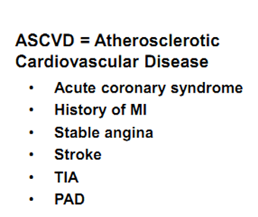

Slide 37
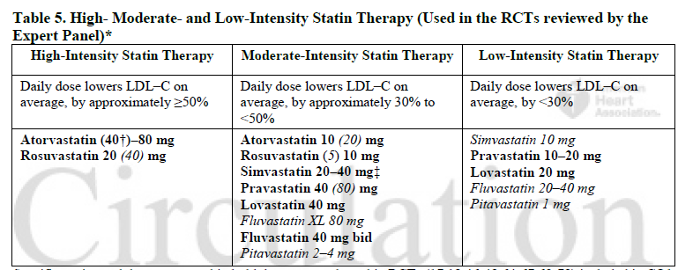
Dosing Statins

Slide 38
2. LDL greater than 190 mg/dl
These are patients with familial hyperlipidemia
They deserve special consideration
Often start with untreated LDL of 325-400 mg/dl

Slide 40
3. Patients with DM, age 40-75 years
All have indication for statin
Diabetics with > 7.5% 10 year risk get high intensity statin therapy
Diabetics with < 7.5% 10 year risk of CAD get moderate intensity statin therapy

Slide 42
4. Age 40-75 years that do not meet above criteria, but have a 10 year risk of >7.5 %
10 year and lifetime risk as determined by CV Risk Calculator.
Specifically designed for this trial
Downloadable on AHA or ACC site

Slide 43
Notes:
This algorithim summarizes the major guidelines in one page
You see the 4 statin benefit groups in the middle: on top, you see the patient’s group with clinical ASCVD, below that you see the group with LDL >190, below that you see the patient’s with history of DM 40-75 years old, and in the bottom, you see patients who don’t have the characteristics of the first 3 groups but their 10 year ASCD risk is greater than 7.5%
For the first group: based on the guidline, if you have clinical ASCD, are younger than 75 and don’t have any history of intolerance to statin, you should be started on high intensity statin. On the other hand, if you are older than 75, or not a candidate for high intensity statin due to lets say intolerance to statins, you are a candidate for moderate-intensity statin
For the second group, if your LDL is greater than 190, you need to be started on high-intensity statin, unless you have contra-indication to high dose →start on moderate dose
For the third group, individuals with diabetes with above mentioned group age, you need to calculate the 10 year ASCVD risk using a new equation/calculater called “pooled Cohort Equations” →if the 10 year risk is greater than 7.5%, start them on high-intensity, otherwise, you can start them on moderate-intensity statin
For the last group, you need to calculate patient’s risk factor and start them on moderate-to-high intensity statin if their estimated 10-y ASCVD risk is greater than 7.5%
Keep that in mind that what we mean by “high intensity” statin, is the daily dose of statin that lowers the LDL by appox greater than 50%, and what we mean by moderate intensity statin, is the daily dose of statin that lowers the LDL by appox 30-50%.

Slide 44
http://clincalc.com/Cardiology/ASCVD/PooledCohort.aspx
Notes:
This is the new equation, the pooled cohort risk assessment equation
As you can see, there are different parameters that you need to plug in to the equation to calculate the risk: gender, age, race, total cholesterol, HDL, systolic BP, whether or not you are on any anti-HTN meds, any history of DM or being a smoker

Slide 45
Clinical controversies
Management of other patient groups
Age <40 or >75 years without clinical ASCVD?
10-year risk of 5%-7.5%?
LDL >160mg/dl or other primary hyperlipidemias?
Additional risk assessment may be necessary
High sensitivity C-reactive protein
Ankle-brachial index
Coronary artery scores
Family history of premature CHD
Elevated lifetime risk of ASCVD

Slide 46
No recommendations on statin therapy for patients with
NYHA class II-IV
ESRD on dialysis

Slide 48
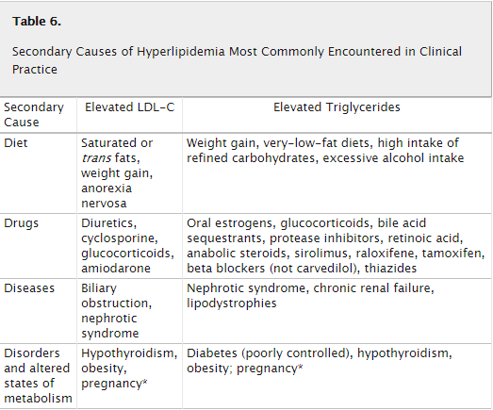

Slide 49
2013 AHA/ACC Cholesterol Guidelines
Monitoring of statins
Baseline ALT prior to initiation
Consider baseline CK in patients at risk for muscle disorders
Routine ALT or CK levels not recommended unless symptomatic
Baseline fasting lipid panel
4-12 weeks to assess therapeutic response and every 3-12 months if clinically warranted
Reinforce adherence if response is less than expected
Dose may be decreased if 2 consecutive LDL <40

Slide 50
STATIN Safety recommendations
Conditions that could predispose pts to statin side effect:
Impaired renal or hepatic function
History of previous statin intolerance or muscle disorder
Age >75
History of hemorrhagic stroke
Consider use of lower-intensity statin if any of these characteristics are present

Slide 51
STATIN Safety recommendations
Select the appropriate dose
Keep potential Side effects and drug-drug interaction In mind (grade A)
If high or moderate intensity statin not tolerated, use the maximum tolerated dose instead
It may be harmful to initiate simvastatin 80mg, or increase the dose of simvastatin to 80mg (Grade B)
Notes:
The next few slides tells you the new guidelines on the safety recommendations for statins

Slide 52
Management of adverse effects
Mild to moderate muscle symptoms
D/C statin until muscle symptoms resolve
Re-challenge with a lower dose
If symptoms resume, D/C statin and re-challenge with lower dose of different statin
Gradually titrate to target dose
If symptoms don’t resolve after 2 months, assume it is not statin-related and resume original statin
New onset diabetes
Reinforce lifestyle modifications
Memory impairment
Consider other potential causes before stopping statin

Slide 53
Non-statin therapies
Non statin therapies, alone or in combination with statins, do not provide acceptable risk reduction benefits compared to adverse effects.
These include:
Zetia
Fibrates
Fish oil
Niacin
For the most part, these should be avoided with few exceptions

Slide 54
The role of non-statin agents
Limited evidence to support use of non-statin agents
Consider use of non-statin agents in the following situations:
In addition to statins in high-risk patients with less than anticipated response:
Clinical ASCVD and age<75
Baseline LDL>190
Age 40-75 years with diabetes
Completely statin-intolerant
TG (>500)

Slide 55
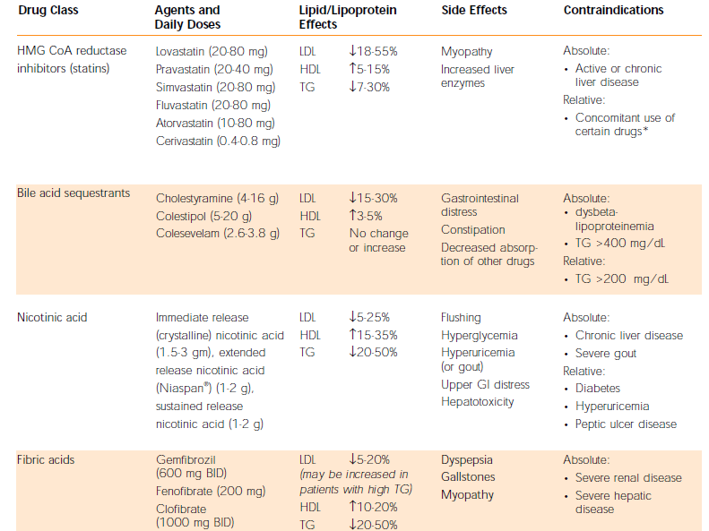

Slide 56
Summary
Fire and forget approach
Know the 4 high risk groups
Use medications proven to reduce risk, ie statins
Encourage healthy lifestyle
Don’t forget patient preference

Slide 57
Pooled Cohort Equations: Criticism
Estimates of 12 million to 45 million additional candidates for statin therapy based on CV risk estimates
Pencina* et al. estimated 87.4% of men and 53.6% of women ages 60-75 would now be eligible for statins
Validation attempts have yielded conflicting results:
75%-150% when applied to data from the Women’s Health Study and the Physician’s Health Study
Muntner‡ et al. reported good results in actual vs. predicted 5-year risks in a contemporary cohort of the REGARDS study

Slide 58
Observed and expected events for different scores were compared in MESA after a 10.2- year follow-up

Slide 59
Treat to target vs Fire and forget

Slide 60
Is There a Need for a Dramatic Change in Approach to ASCVD Prevention?
ACC/AHA
CCS
IAS
EAS/ESC
NLA

Slide 61
IMProved Reduction of Outcomes: Vytorin Efficacy International Trial
A Multicenter, Double-Blind, Randomized Study to Establish the Clinical Benefit and Safety of Vytorin (Ezetimibe/Simvastatin Tablet) vs Simvastatin Monotherapy in High-Risk Subjects Presenting With Acute Coronary Syndrome

Slide 62
Study Design
Patients stabilized post ACS ≤ 10 days:
LDL-C 50–125*mg/dL (or 50–100**mg/dL if prior lipid-lowering Rx)
*3.2mM
**2.6mM
N=18,144
Standard Medical & Interventional Therapy
Simvastatin 40 mg
Uptitrated to Simva 80 mg if LDL-C > 79
(adapted per FDA label 2011)
Ezetimibe / Simvastatin 10 / 40 mg
Follow-up Visit Day 30, every 4 months
90% power to detect
~9% difference
Duration: Minimum 2 ½-year follow-up (at least 5250 events)
Primary Endpoint: CV death, MI, hospital admission for UA,
coronary revascularization (≥ 30 days after randomization), or stroke
Cannon CP AHJ 2008;156:826-32; Califf RM NEJM 2009;361:712-7; Blazing MA AHJ 2014;168:205-12

Slide 63
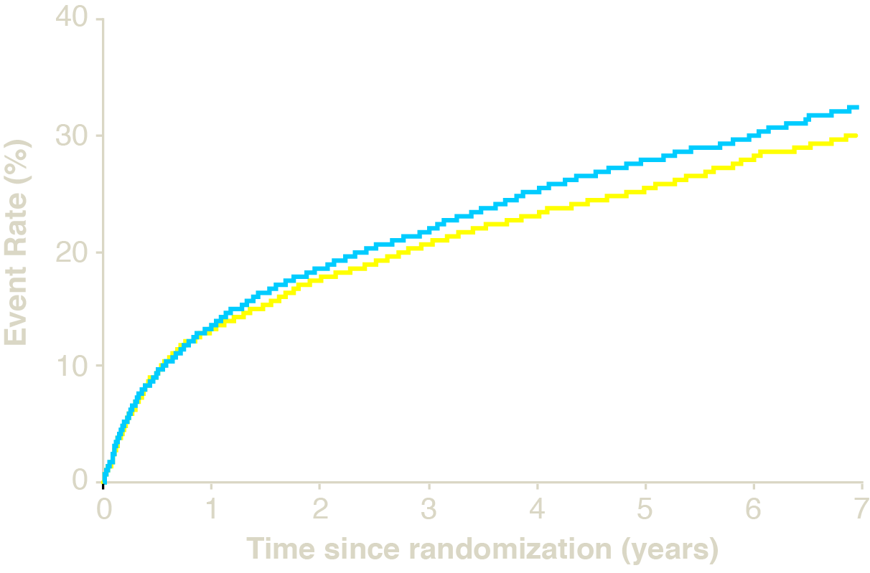
Primary Endpoint — ITT
Cardiovascular death, MI, documented unstable angina requiring rehospitalization, coronary revascularization (≥30 days), or stroke
HR 0.936 CI (0.887, 0.988)
p=0.016
Simva — 34.7%
2742 events
Mean LDL 69.5 mg/dl
NNT= 50
EZ/Simva — 32.7%
2572 events
Mean LDL 53.7 mg/dl
7-year event rates

Slide 64
Conclusions
IMPROVE-IT: First trial demonstrating incremental clinical benefit when adding a non-statin agent (ezetimibe) to statin therapy:
YES: Non-statin lowering LDL-C with ezetimibe reduces cardiovascular events
YES: Even Lower is Even Better (achieved mean LDL-C 53 vs. 70 mg/dL at 1 year)
YES: Confirms ezetimibe safety profile
Reaffirms the LDL hypothesis, that reducing LDL-C prevents cardiovascular events
Results could be considered for future guidelines

Slide 65
The Future of Guidelines
LDL-C reduction
Incorporate IMPROVE-IT data
Incorporate early PCSK9 trials
The data continues to support LDL-C targets and “lower is better”.

Slide 66
Thank you

