Slide 1

DM TBL
Lemmese AlWatban
MBBS, CCFP,
AS Women’s Health, AS Academic Family Medicine
Sexual Health Specialist
MCISc (Family Medicine Education)

Slide 2


Readiness Assessment TEST

Slide 3

1. A 48-year-old man, professor, with type 2 diabetes talks to you at a routine appointment about a drug he heard a discussion about it on the news. This patient currently takes gliclazide and metformin. He wants to know more about Incretins.
Which of the following best explains its mechanism of action?
a. Increases the sensitivity of the body to insulin
b. Increases the gastric emptying
c. Inhibits the hepatic gluconeogenesis
d. Stimulates the secretion of insulin

Slide 4
6. A 48-year-old man with type 2 diabetes talks to you at a routine visit about a drug he heard discussed on the news. This patient currently takes gliclazide and metformin and HbA1C 8.4%. he wants to know more about Sitagliptin (Januvia).
Which of the following best explains the mechanism of action?
Increase the sensitivity of the body to insulin
Increase gastric emptying
Inhibit hepatic gluconeogenesis
Suppress glucagon secretion

Slide 5
DM Mechanism
http://mediacenter.novomedlink.com/v/diabetes-pathophysiology

Slide 6
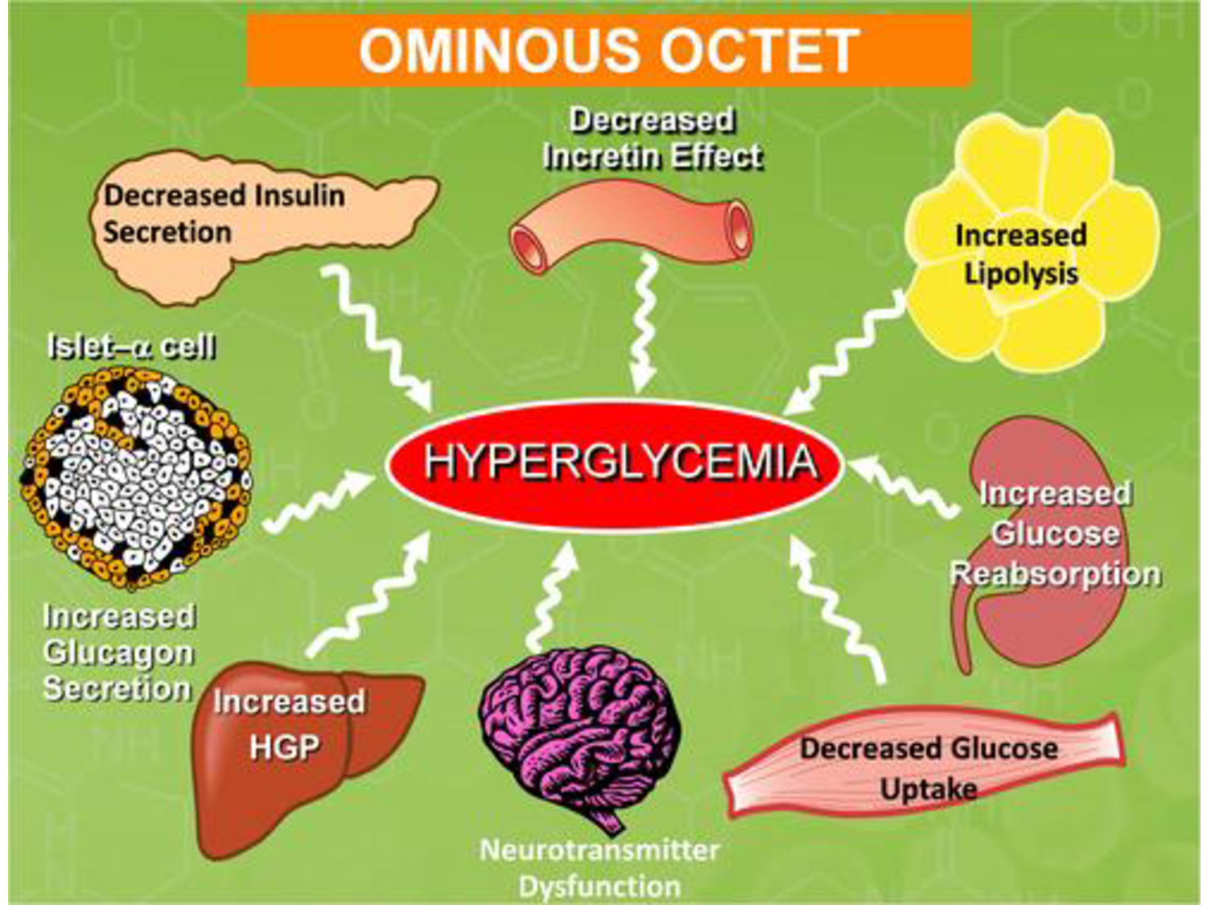

Slide 7

Oral Medication in Type 2 DM

Slide 8
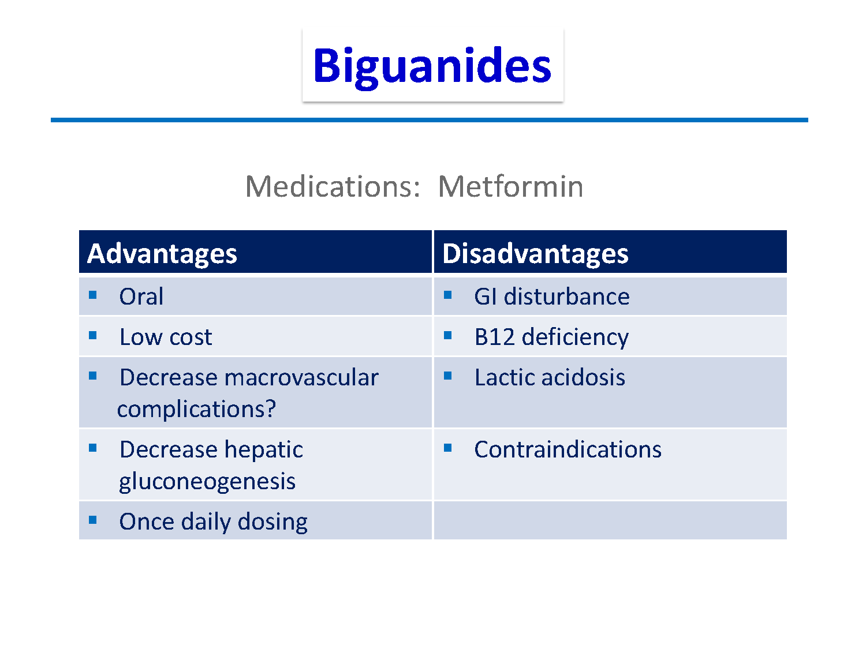

Slide 9
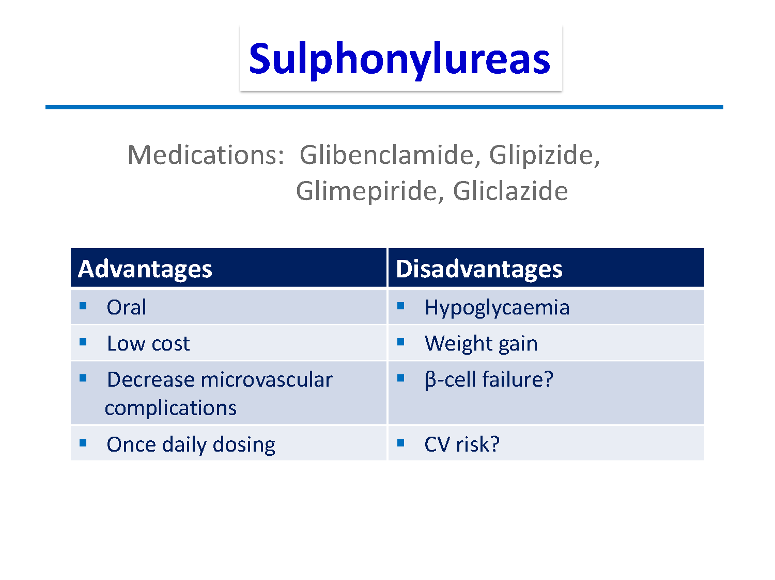

Slide 10
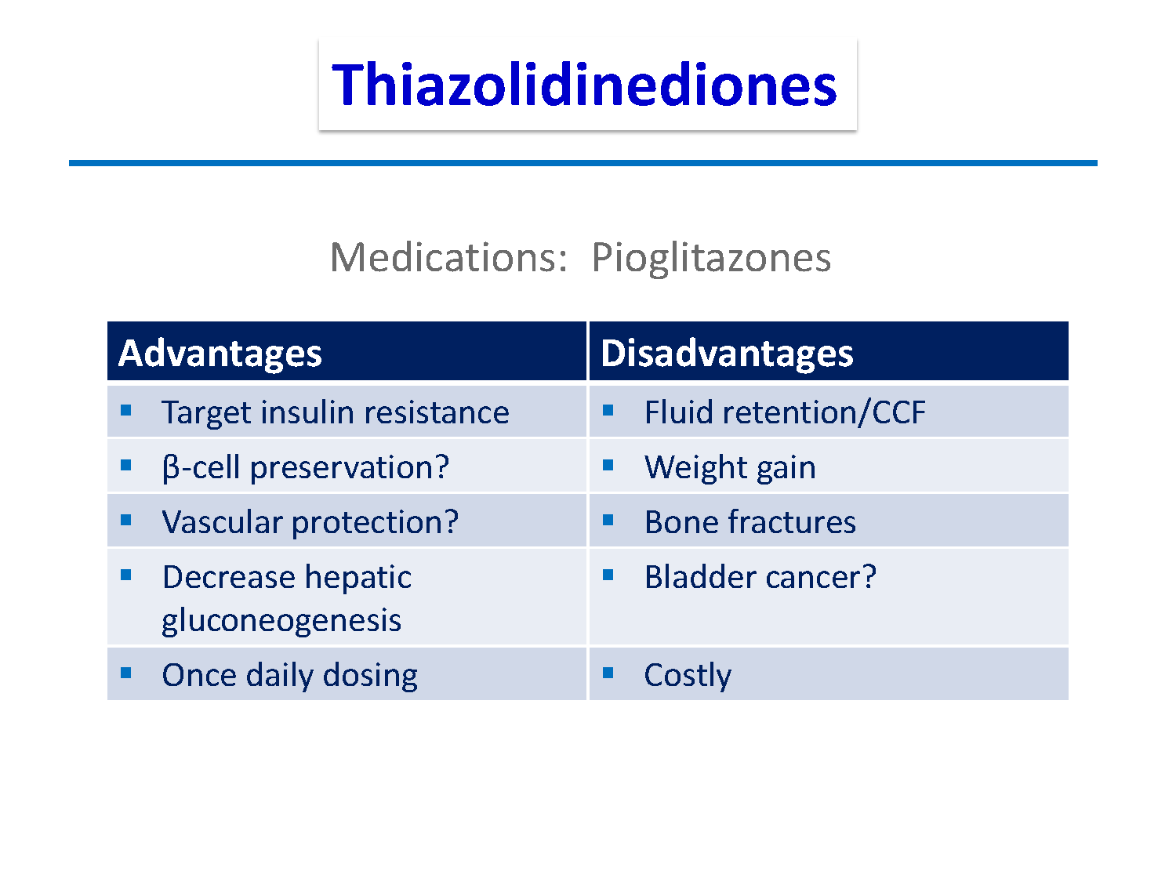

Slide 11

INCRETINS

Slide 12
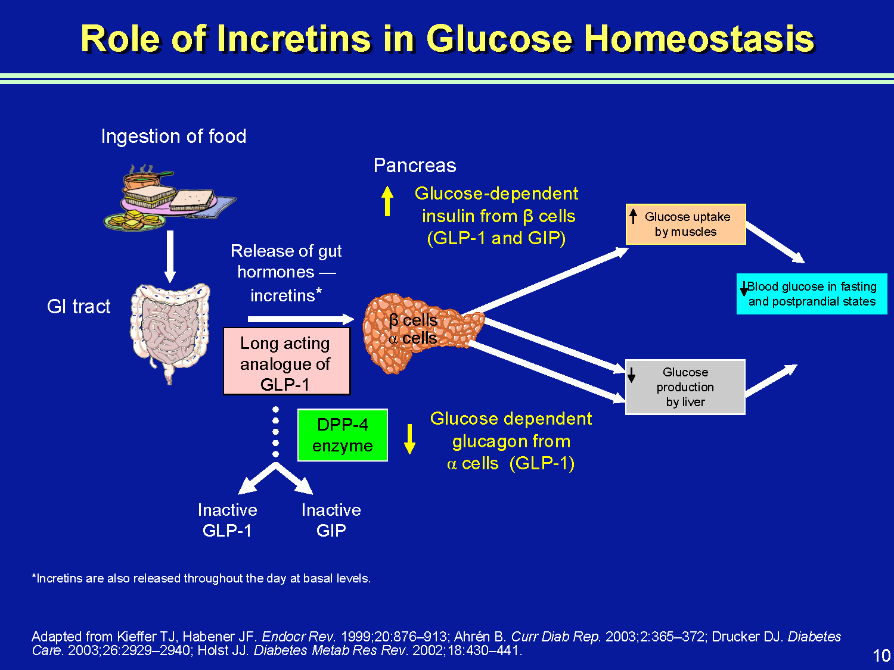

Slide 13
INCRETINS
The incretin system is impaired in patients with T2DM, which, as a consequence of its insulinotropic actions, contributes to fasting and postprandial hyperglycemia.
The impairment of GLP-1 secretion varies directly with the degree of insulin resistance; those who are more insulin resistant have a lower rise in GLP-1 in response to a meal.

Slide 14
Glucagon-like Peptide-1 (GLP-1)
secreted throughout the day by intestinal mucosa in response to oral glucose in the gut
stimulates all steps of insulin biosynthesis
provides continued and augmented release of insulin without overproduction
acts on islet alpha cells, causing strong inhibition of postprandial glucagon secretion
slows gastric emptying and acts on brain to promote early satiety

Slide 15
Dipeptidyl Peptidase-4 (DPP-4)
Within minutes of secretion or exogenous administration, GLP-1 is rapidly degraded by dipeptidyl peptidase-4 (DPP-4).
DPP-4 is found in many body tissues, including liver, renal, and intestinal brush- border membranes; lymphocytes; and endothelial cells.

Slide 16
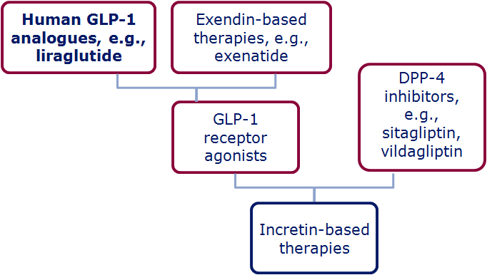
The Family of Incretin Based Therapies
Wick & Newlin. J Am Acad Nurse Pract 2009;21:623–30; White. J Am Pharm Assoc 2009;49(Suppl. 1):S30–40
Notes:
The family of incretin-based therapies
Incretin-based therapies can be broadly divided into:
DPP-4 inhibitors (i.e. sitagliptin, vildagliptin)
GLP-1 receptor agonists (Exenatide, lirgalutide)
Within this second category however, the GLP-1R agonists can be classed as either:
Exendin-based therapies (exenatide, exenatide LAR) which have ~50% sequence identity to human GLP-1
Human GLP-1 analogues (liraglutide) which have share a much higher percentage of amino acids with human GLP-1 (97%)

Slide 17
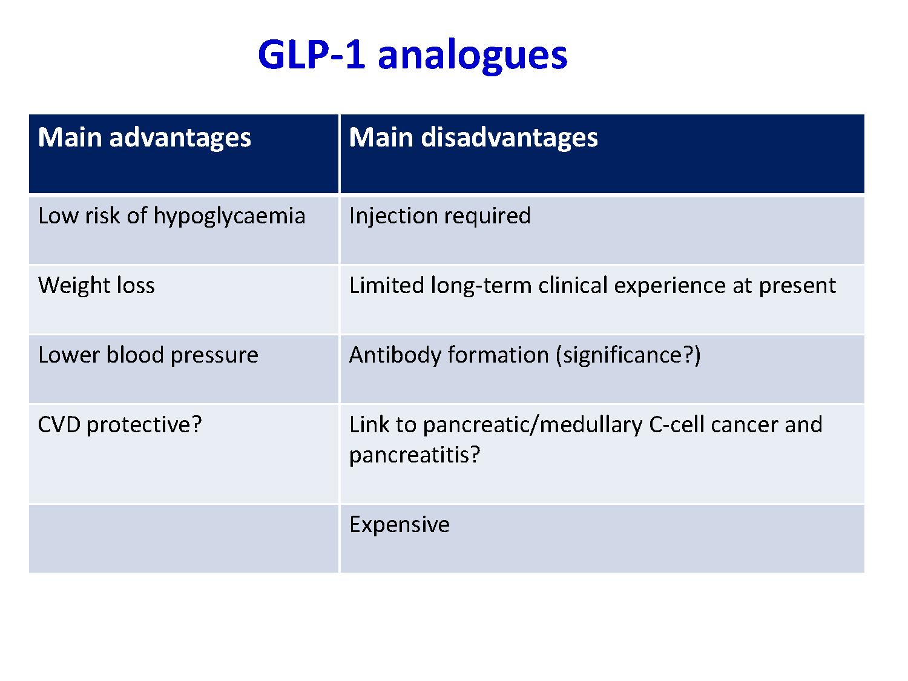

Slide 18
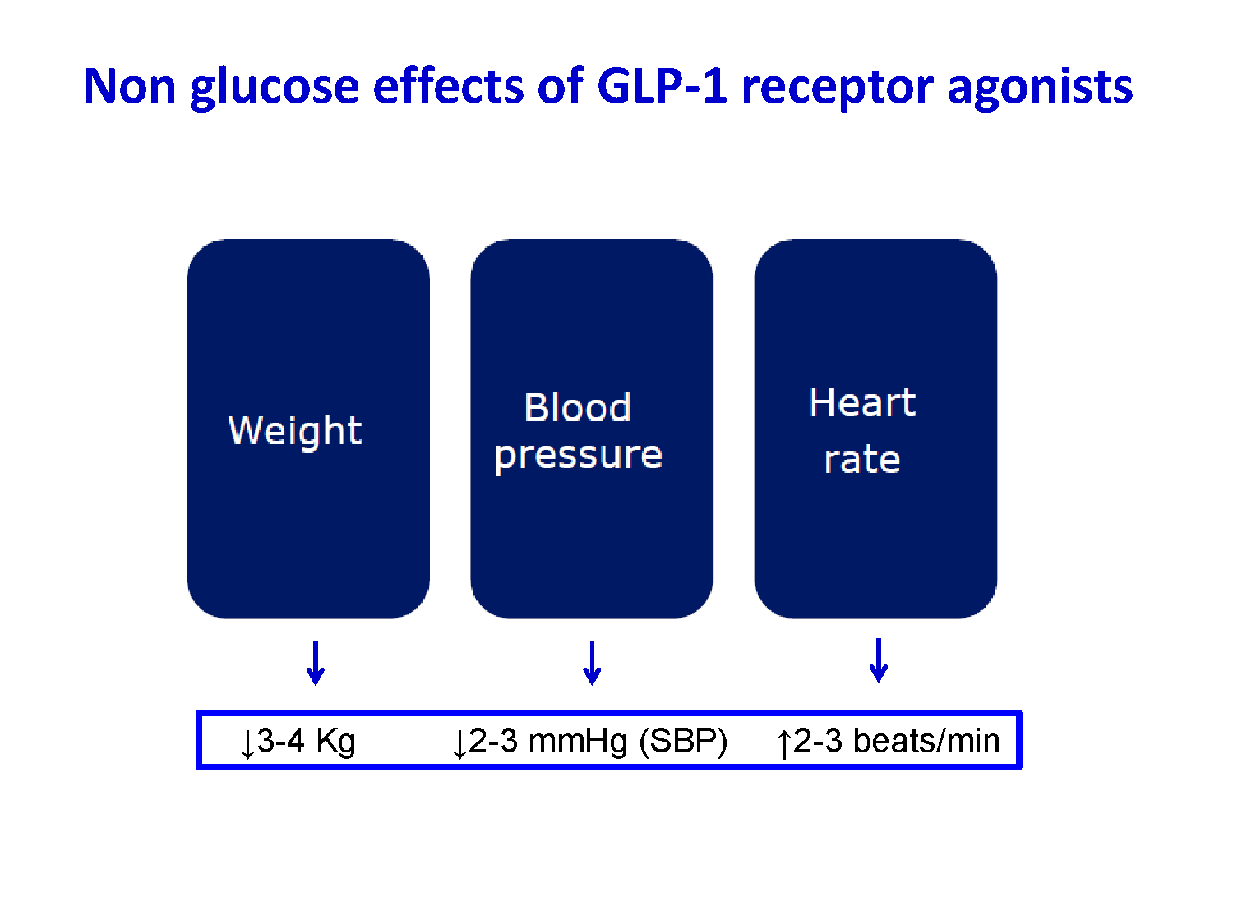

Slide 19
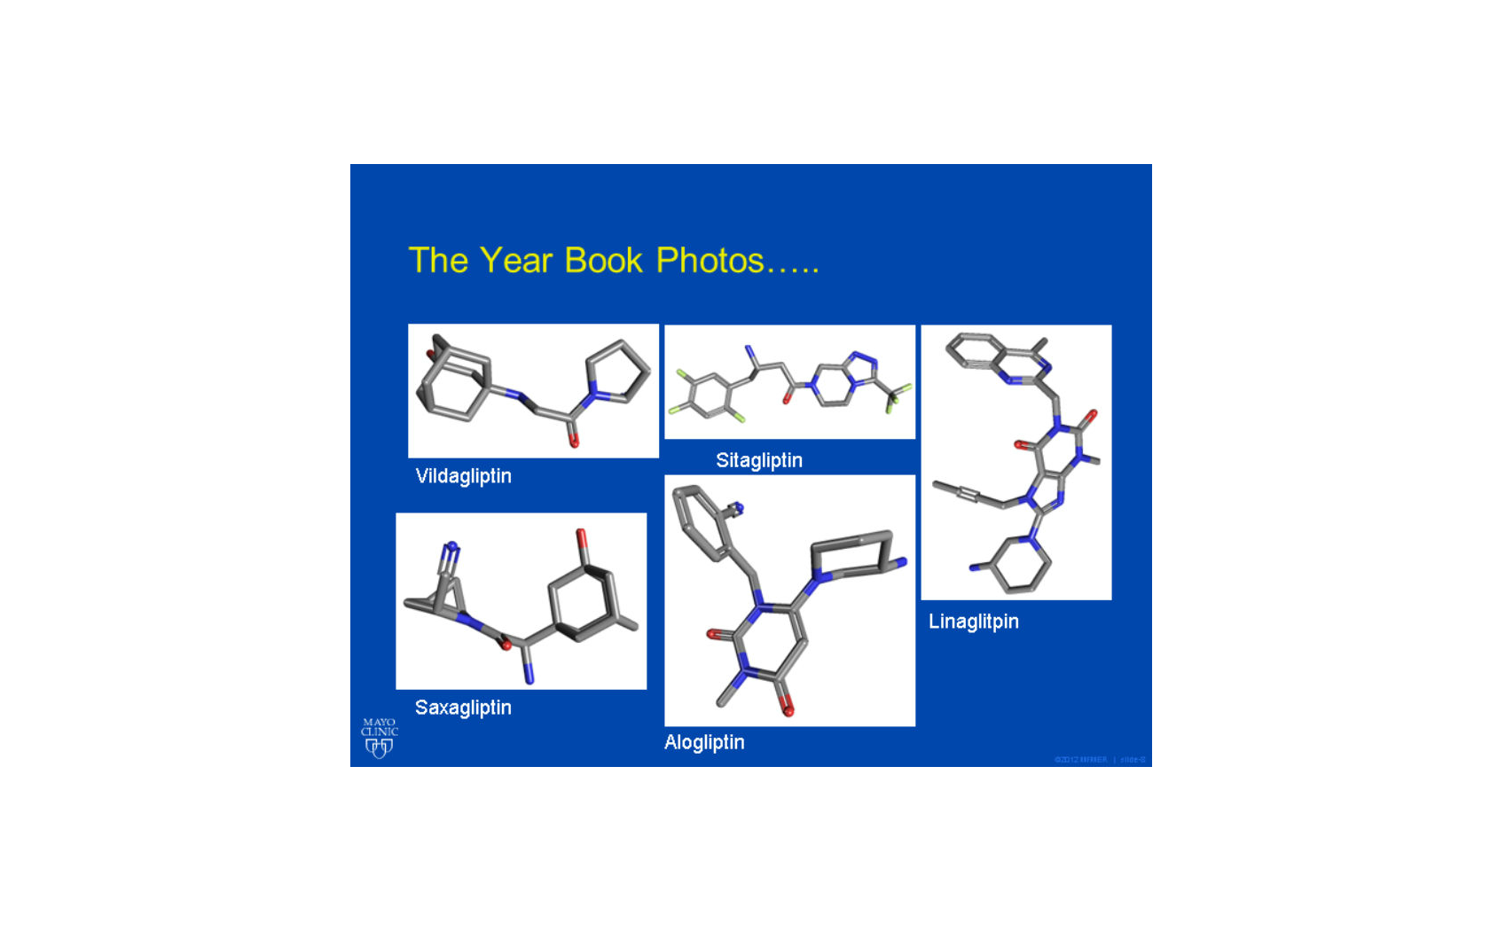
DPP 4 inhibitors

Slide 20
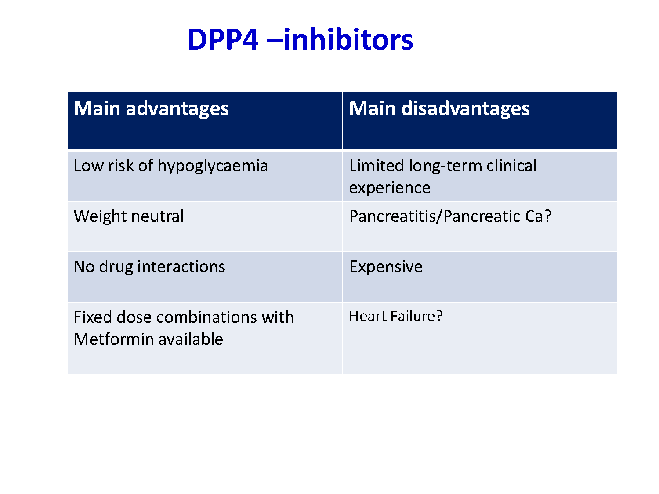

Slide 21
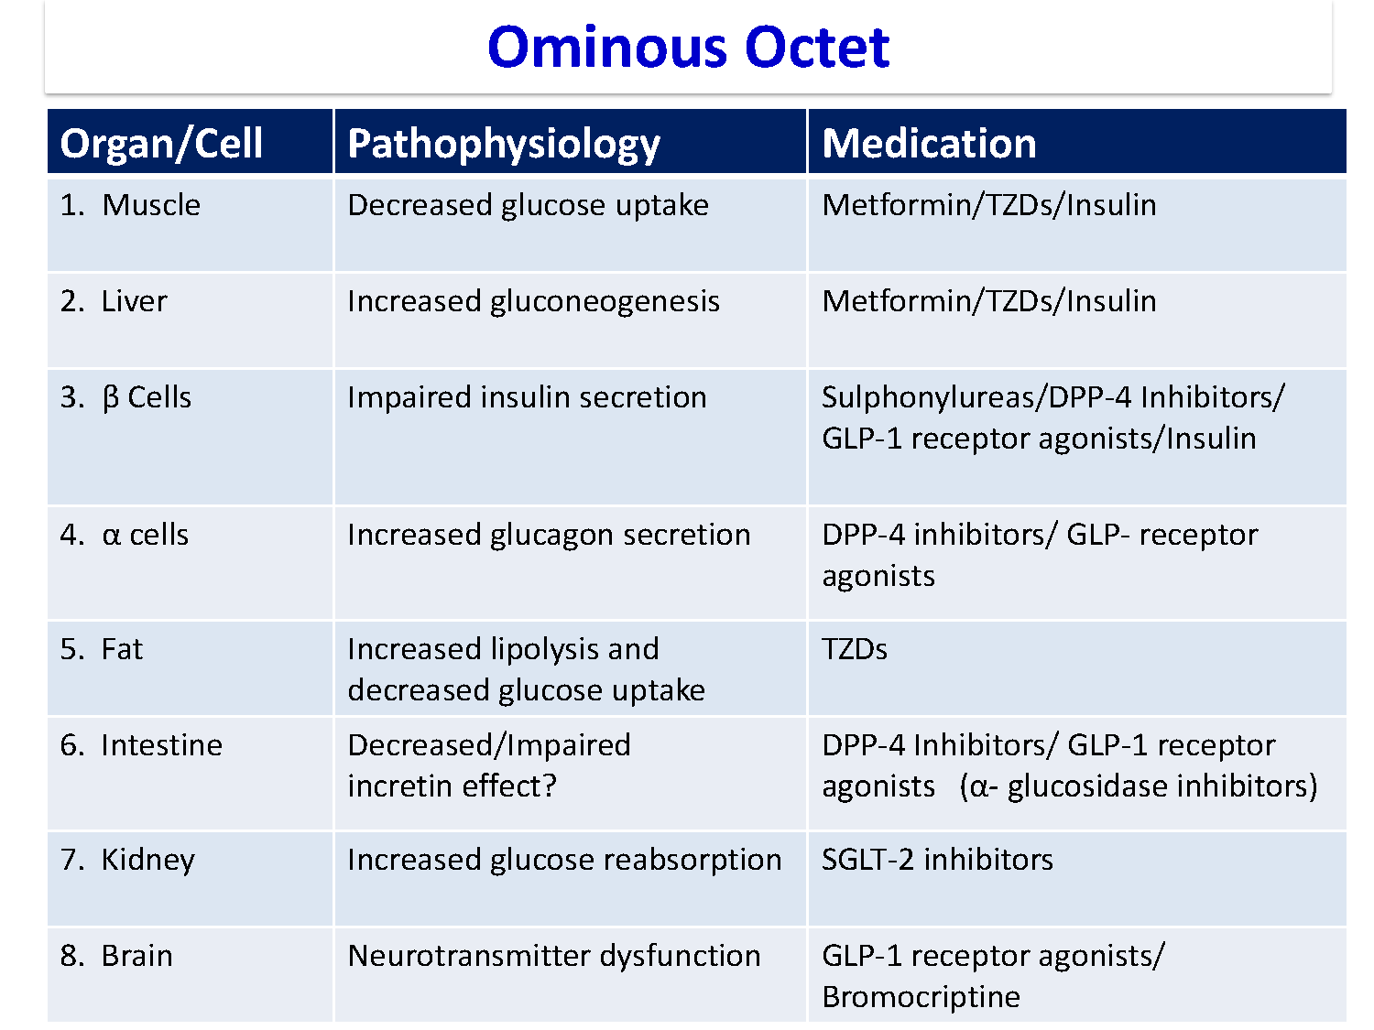

Slide 22
2. A 25-year-old female presents for annual checkup. She developed diabetes mellitus at the age of 15. Currently, she is treated with human mixed insulin twice daily. Over the last one year, she has suffered from episodes of dysuria and has received treatment with trimethoprim on four separate occasions for cystitis. Her blood pressure is 145/76 mmHg.
Investigations show:
HbA1C: …………. 7.1%
Urea: …………… 4.5mmol/L (2.5 – 7.5)
Creatinine: …….. 90 mmol/L (60 – 110)
Urinalysis: ……… Glucose 1+ WBC: nil RBC: nil
24 hr urine protein: …… 260 mg/ 24 hrs (≤ 150)
What would be the best therapeutic option to deal with her results?
Improve glycaemic control
Prescribe a low protein diet
Treat with ACE inhibitor
Use prophylactic antibiotics

Slide 24
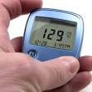
DM visits
Diabetes care is a team work
Individualize management
Set Target goals
  Glycaemic Targets
  BP goals
  Lipid goals
Education
Is associated with increased use of primary and preventive services and lower use of acute, inpatient hospital services.

Slide 25

PHYSICAL EXAMINATION
Height and Weight (BMI)
Blood Pressure (2 readings)
Fundus Examination ( Hard and soft exudates, new vessel formation, macular oedema….)
Cardiac examination
Lower Limbs:
  Skin Examination
  Evaluation of pulses
  Foot Examination
  Neurologic Examination

Slide 26


Investigation
FPG and 2 hr PP
Midstream Urine (for Ketones, protein, pus cells,…)
Urea and Creatinine
Lipid Profile (total cholesterol, LDLc, HDLc and triglycerides)
HbA1C (every 3 m for insulin / every 6 m for controlled)
Test for Microalbuminuria or Albumin to creatinine ratio / 24 hr urine collection for protein / Creatinine Clearance
ECG
Chest X-Ray

Slide 27
Yearly Check Up
Investigations
HbA1C
Urea and Creatinine
Lipid Profile (Cholesterol, Triglyceride, LDL-C and HDL-C)
Albumin to creatinine ratio / 24 hour urine collection for protein (Microalbuminuria 30 -<300 mg while Macroalbuminyria ≥ 300 mg).
Check :
Eye: Fundus Examination / eye referral
Feet : Visual inspection and Neurovascular status

Slide 28
3. A 63-year-old female with a 12-year history of hypertension and diabetes, has been treated with metformin 2g, gliclazide 90 mg, atorvastatin 20mg, lisinopril 10 mg, aspirin 81 mg and amlodipine 10 mg daily for the last two years.
At annual review her blood pressure is 138/87 mmHg, fundi reveal background diabetic retinopathy. Her results show:
HbA1c 7.2% (3.8-6.4)
Urea 12.5 mmol/L (2.5-7.5)
Creatinine 176 µmol/L (60-110)
Cholesterol 4.8 mmol/L
You decided to discontinue one of her medications.
Which of the following drugs should be withdrawn?
a) Atorvastatin
b) Gliclazide
c) Llisinopril
d) Metformin

Slide 29

Caution and Contraindications
Chronic Kidney Failure: Metformin, Acarbose,Sitagliptin, Insulin
& SUs (reduced dosage)
Heart Failure: TZDs
Osteoporosis: TZDs
Myocardial Infarction: Hypoglycemias should be avoided
when Insulin or SUs are taken.
Elderly people (>70 years): Hypoglycemias should be avoided
when Insulin or SUs are taken.

Slide 30
4. A 60-year old woman with a BMI of 33 attends your clinic. Her FBS is 8 mmols /L (144 mg). She has already tried to practice life style modification for four months without much success.
Which is the most likely drug as a first choice for this patient?
Acarbose
Glibenclamide
Metformin
Pioglitazone

Slide 32


Individualized Therapy

Slide 33
Antihyperglycemic Therapy in T2DM
Notes:
[note to speaker – use either this slide or the next slide depending on the audience and format of your talk]
Here is an overview of the ADA’s treatment algorithm for type 2 diabetes, moving from monotherapy, to duel therapy, to triple therapy, and then to combination injectable therapy. Lifestyle management is emphasized throughout the progression of care, and individualization based on efficacy, hypoglycemia risk, weight, side effects, and costs is recommended.
It is important to note that the ADA’s full Standards of Care provides tables on the properties of these agents, as well as the costs associated with them. Please visit professional-dot-diabetes-org-slash-S-O-C for more information.
The order in the chart was determined by historical availability and the route of administration, with injectables to the right; it is not meant to denote any specific preference. Potential sequences of antihyperglycemic therapy for patients with type 2 diabetes are displayed, with the usual transition moving vertically from top to bottom (although horizontal movement within therapy stages is also possible, depending on the circumstances). DPP-4-i, DPP-4 inhibitor; fxs, fractures; GI, gastrointestinal; GLP-1 RA, GLP-1 receptor agonist; GU, genitourinary; HF, heart failure; Hypo, hypoglycemia; SGLT2-i, SGLT2 inhibitor; SU, sulfonylurea; TZD, thiazolidinedione.
[SLIDE]
33

Slide 34
Notes:
[note to speaker – use either this slide or the previous slide depending on the audience and format of your talk]
Here is an overview of the ADA’s treatment algorithm for type 2 diabetes, moving from monotherapy, to duel therapy, to triple therapy, and then to combination injectable therapy. Lifestyle management is emphasized throughout the progression of care, and individualization based on efficacy, hypoglycemia risk, weight, side effects, and costs is recommended.
It is important to note that the ADA’s full Standards of Care provides tables on the properties of these agents, as well as the costs associated with them. Please visit professional-dot-diabetes-org-slash-S-O-C for more information.
The order in the chart was determined by historical availability and the route of administration, with injectables to the right; it is not meant to denote any specific preference. Potential sequences of antihyperglycemic therapy for patients with type 2 diabetes are displayed, with the usual transition moving vertically from top to bottom (although horizontal movement within therapy stages is also possible, depending on the circumstances). DPP-4-i, DPP-4 inhibitor; fxs, fractures; GI, gastrointestinal; GLP-1 RA, GLP-1 receptor agonist; GU, genitourinary; HF, heart failure; Hypo, hypoglycemia; SGLT2-i, SGLT2 inhibitor; SU, sulfonylurea; TZD, thiazolidinedione.
[SLIDE]
34

Slide 35
Glycemic Targets
Blood Glucose Targets for Non-Pregnant Adults With Diabetes
A1C <7.0% (53 mmol/L)
Fasting 4.4-7.2 mmol/L (80-130 mg/Dl )
Postprandial <10.0 mmol/L (<180 mg/dL )

Slide 36
Life Style Modification
For all patients, advise for
Weight Management (in overweight/obese
patients can improve insulin sensitivity targeting a loss of 7% of body weight )
Exercise (walking 150 mins / week)
Diet (Provided by a Dietitian)
Can reduce HbA1C by 1-2%
Problems
  Poor adherence over time

Slide 37
5. Which one of the following is true concerning the use of hemoglobin A1c levels to diagnose diabetes mellitus?
A) A level >6.0% is diagnostic of diabetes mellitus
B) Results can be misleading in patients with sickle cell disease
C) The test is equally sensitive in African-Americans and whites
D) The test is useful to diagnose diabetes during pregnancy

Slide 38

Diagnostic Criteria and limitations

Slide 39
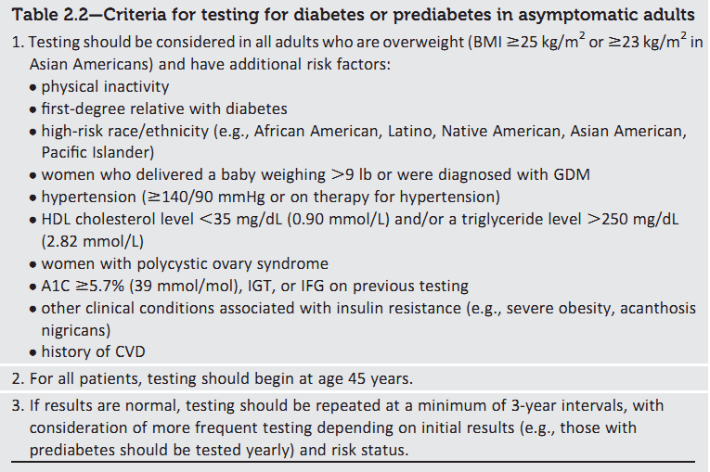
Screening for diabetes

Slide 40
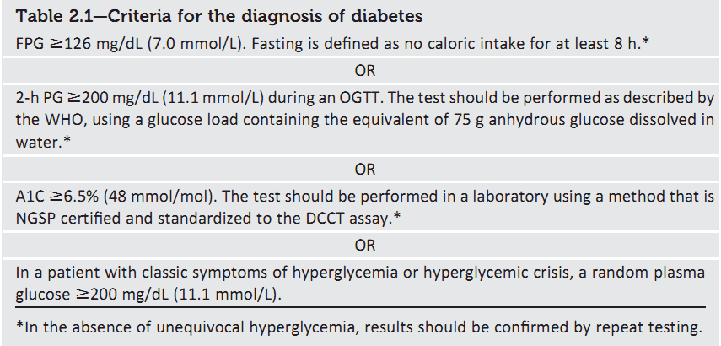
Diagnosis

Slide 41
HbA1C values are influenced by red cell survival
Falsely high values in patients with iron, vitamin B12, or folate deficiency anemia.
Falsely low values in patients with hemolysis or anemia and those treated for iron, vitamin B12, or folate deficiency, and patients treated with erythropoietin.

Slide 42
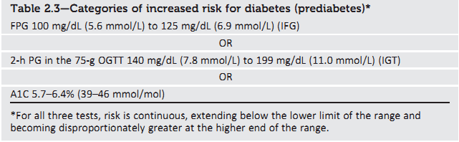
Prediabetes
To test for prediabetes, all these tests are equally appropriate.

Slide 43
Prediabetes
Should be counseled on lifestyle changes.
Three large studies of lifestyle intervention has shown sustained reduction in the rate of conversion to type 2 diabetes,
  43% reduction at 20 years in the Da Qing study.
  43% reduction at 7 years in the Finnish Diabetes Prevention Study (FDPS).
  34% reduction at 10 years in the U.S. Diabetes Prevention Program Study (DPPS)

Slide 44
When to add Metformin in pre-diabetes?
In addition to lifestyle counseling, Metformin is considered in IFG plus:
Hypertension
Low HDL cholesterol
Elevated triglycerides
Family history of diabetes (first-degree relative)
Obese
HX of GDM
Under 60 years of age

Slide 45
7. You are thinking about starting a type 2 diabetic on insulin to improve his blood glucose. His post prandial readings are always high ranging between 248 – 312 mg/dl. (13.7-17.3mmol/L)
Which of the following insulin types is appropriate to control such levels?
Insulin Glargine
Insulin NPH
Insulin Aspart
Insulin Detemir

Slide 46
9. A 42-year-old man presents to clinic for routine follow up of diabetes.He is taking:
  Metformin 500 mg three times daily
  Gliclazide 120 mg once daily
  Ramipril 10 mg once daily.
His lifestyle is still sensible. Investigations show:
  Fasting plasma glucose is 18.7 mmol/l
  HbA_{1c} 12.4%
  Urinalysis shows 4+ glucose (negative for ketones).
What is the most appropriate regimen of treatment you recommend to him?
Start glitazones like pioglitazone
Increase the dose of metformin and gliclazide
Start insulin therapy
Start DPP 4 inhibitor like sitagliptin

Slide 47
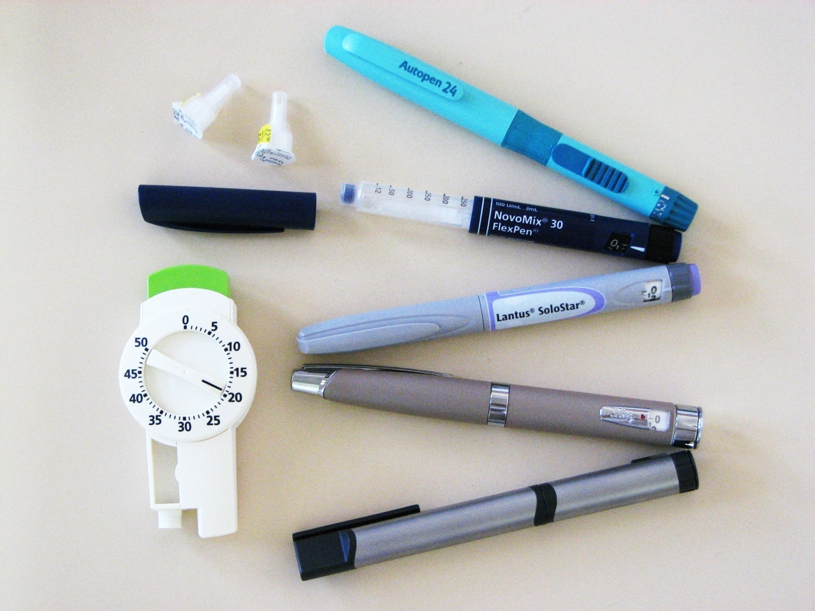
Insulin therapy

Slide 48
INSULIN AS INITIAL THERAPY
Glycated hemoglobin (A1C) >9.5 percent (80.3 mmol/mol),
Fasting plasma glucose >13.9 mmol/L (>250 mg/dL )
Random glucose consistently >16.7 mmol/L (>300 mg/dL )
Ketonuria, or Unplanned weight loss with hyperglycemia

Slide 49
Indication of Insulin in Type 2 DM
If HbA1c is ≥ 9 %
After maximum metformin and suphonylurea
You should consider adding Insulin and taper the Sulphonylurea.

Slide 50
TREATMENT REGIMENS
Conventional Insulin Therapy
Two injections of NPH and Regular Insulin
Mixed Insulin
Two injections of 70/30 or 60/40 or 50/50
Multiple Insulin Injections
1 or 2 injections of NPH plus 3 injections of Regular or Rapid Insulin
One injection of Glargine or Detemir plus 3 injections of rapid insulin(Lispro /Aspart)

Slide 51
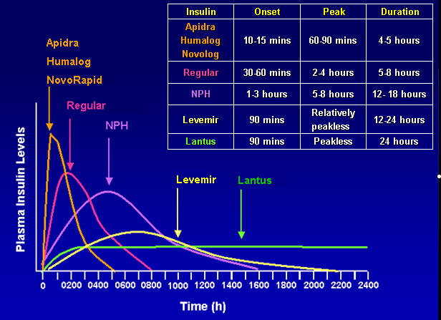

Slide 52
Initiation and adjustment of insulin regimens (Multiple injections)
Long acting insulin (Glargine) at bedtime 10 U or 0.2 U/Kg
Check FG, increase by 2 U every 3-4 days until FG 80 – 130 mg/dl
If hypoglycaemia occurs, or FG < 70 mg/dl reduce bedtime by 4 units or 10 % which is greater.
If FG in range, check 2 hrs after breakfast, lunch and dinner and add rapid (Aspart) insulin. Begin with 4 U before each. Adjust by 2 U every 3-4 days Untill 2hpp < 180 mg/dl .
Usually the dose of rapid insulin is near equal or higher than dose of Long acting insulin

Slide 53


