Slide 1
Child Psychiatry for Medical Students
Psychiatry Course 462 – Part (1)
Turki ALBatti, MD
Assistant Professor
Child & Adolescent Psychiatrist
Department of Psychiatry
College of Medicine
King Saud University
1434H/2013G
Notes:
JES-2003
1

Slide 2
Outlines
Introduction to Child & Adolescent psychiatry
Review disorders first usually diagnosed in Infancy, Childhood and Adolescence
  MR; PDD
  LD; Motor Skills; S/L; TS
  ADHD; Disruptive Disorders
Review childhood presentation of general psychiatric disorders
  Elimination disorders
  Mood
  Anxiety
  Psychosis
Notes:
JES-2003
2

Slide 3
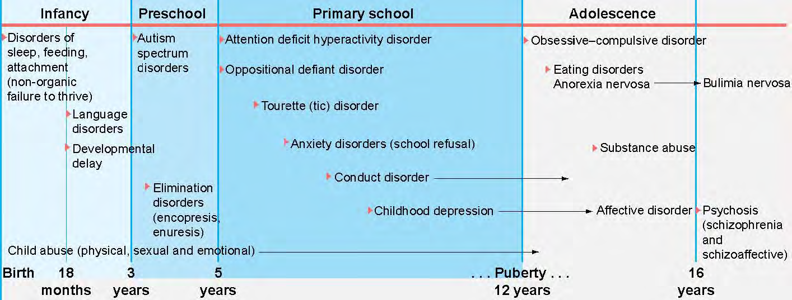

Slide 4
DSM‑IV‑TR | ICD‑10
Axis I Clinical syndrome Axis 2 Mental retardation Pervasive developmental disorders Specific developmental disorders Axis3 Physical disorders/illness Axis 4 Severity of current Psychosocial stressors Axis 5 Highest level of adaptive functioning in past year | Axis I Clinical syndrome Axis 2 Disorders of psychological development Axis3 Mental retardation Axis 4 Medical illness Axis 5 Abnormal psychosocial conditions Axis 6 Psychosocial disability

Slide 5
Introduction
Worldwide prevalence of clinically significant psychiatric disorder in children is at least 7%.
This rate rises in socially disadvantaged and densely populated urban areas. It also increases by 3%–4% after puberty.
Giving to roughly percentage of Childhood psychiatric problems that require treatment is about 7% to 10% of young people at some time.
Cited on:
Common child and adolescent psychiatric problems and their management in the community. By © 2007 Bruce Tonge

Slide 6
Comparisons of Chronic Medical Disorders
 | Desiase | Core Symptpms/Signs | Impairments | Desired Functional Outcome
 | Asthma | Wheezing and dyspnea | School attendance Social interaction Results of parental over protection | Normal physical activities Social activities Qol
 | ADHD | Hyperactivity, impulsivity, inattention | Accidents, impaired academic performance | Improved self-esteem, improved relationships Qol
Symptoms
Notes:
JES-2003
6

Slide 7
Introduction
According to the developmental principles, a mental disorder results from the interaction of a child and his or her environment.
These relationships are reciprocal. The brain shapes behavior, and learning shapes the brain.
Mental disorders must be considered within the context of the family and peers, school, home, and community.
Taking the social-cultural environment into consideration is essential to understanding mental disorders in children and adolescents, as it is in adults.

Slide 8

Remember: Children are NOT miniature adults
Notes:
8
Remember: Children are not miniature adults…..even though they act sometimes like adults

Slide 9
Evaluation Strategies
Patient Interview
Collateral Information
(Parents, School)
Testing :
(IQ, Education, Projective,
Personality, Neuropsychiatry,
labs, EEG, MRI)
Observation

Slide 10
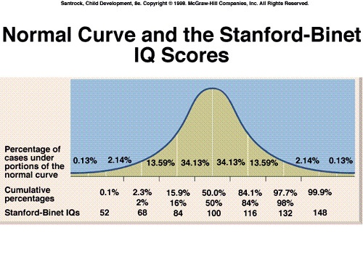
Mental Retardation
Epidemiology: 1-3% in US
IQ 70 or less on an individually administered IQ test
Onset before age 18
Delays in two or more adaptive areas, e.g., self care; communication; work; leisure; health; or safety
Testing:
  Intelligence testing - compares individual test performance to normative of age group
    E.g., WISC-IV (6 to17y) or Stanford-Binet V5 (2 to 85+y)
  Vineland Adaptive Behavior Scales -measure of personal and social skills

Slide 11
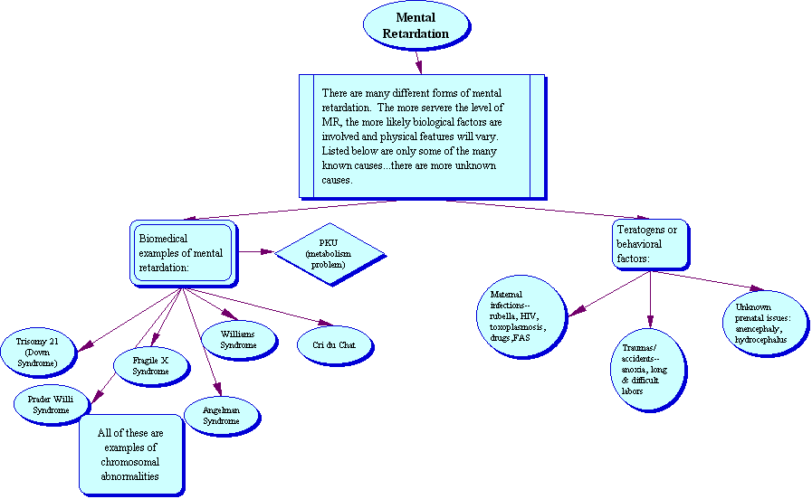

Slide 12
Mild MR: IQ 50/55 to 70 (~ 85%)
School: may acquire skills up to 6th grade level.
Social and Communication Skills: develop spontaneously.
May first be detected in school.
May acquire vocational skills and be self-supportive.
Moderate MR:
IQ 35/40 to 50/55 (~ 10%)
Social and Communication Skills: develop, but impaired.
Early detection (i.e., before entering school).
School: unlikely to progress past 2nd grade level.
May work under close supervision (sheltered workshop).

Slide 13
Servere MR:
IQ20/25 to 35/40 (~ 3%)
School: May learn to sight-read (survival words)
Social/Communication Skills: little or no communicative speech. Often display poor motor development.
May acquire elementary hygiene skills and perform simple tasks; unable to benefit from vocational training
Profound MR:
IQ Below 20/25 (~ 1-2%)
Social and Communication Skills: rarely have communicative speech efforts; minimal sensorimotor abilities.
Require constant aid and supervision; nursing care.

Slide 14
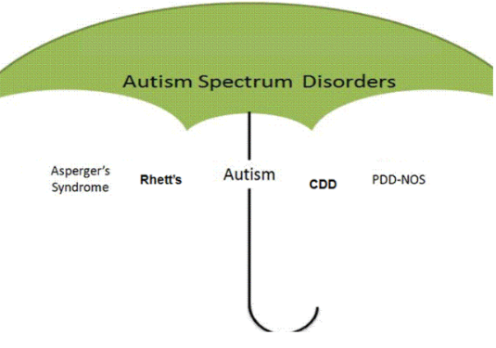
Pervasive Developmental Disorders
Disorders with severe and pervasive impairment in essential developmental areas:
Reciprocal social skills
Language development
Range of behavioral repertoire
DSM-IV includes the following under PDD:
  Autism
  Rett’s Disorder
  Childhood Disintegrative Disorder
  Asperger’s Disorder
  PDD, not otherwise specified
Language Disorders: Autism and Other Pervasive Developmental Disorders, Pediatr Clin N Am 54 (2007) 469–481
Notes:
Language Disorders: Autism and Other Pervasive Developmental Disorders
Helen Tager-Flusberg, PhD,*
Department of Anatomy and Neurobiology, Boston University School of Medicine,
715 Albany Street, L-814, Boston, MA 02118, USA
D Elizabeth Caronna, MD, Division of Developmental and Behavioral Pediatrics, Boston Medical Center,
91 East Concord St., Maternity 5, Boston, MA 02118, USA
Autism spectrum disorders (ASD) are increasingly common neurodevelopmental disorders that encompass a range of clinical presentations characterized by functional impairments in a triad of symptoms: (1) limited reciprocal social interactions, (2) disordered verbal and nonverbal communication, and (3) restricted, repetitive behaviors or circumscribed interests [1]. Included under the umbrella of the autism spectrum are the disorders defined in the Diagnostic and Statistical Manual of Mental Disorders, fourth edition, text revised (DSM-IV TR) as pervasive developmental disorders (PDD): autistic disorder, Asperger’s disorder, and pervasive developmental disorder, not otherwise specified (PDD-NOS). Rett’s disorder and childhood disintegrative disorder also appear in the DSM classification under the rubric of PDD, but they usually are considered to be distinct from the autism spectrum. The terminology used for ASD can be confusing, because clinicians and families may use different terms to describe the same clinical entities, often using the terms ‘‘autism,’’ ‘‘autism spectrum disorder,’’ and ‘‘PDD’’ interchangeably. In this article, the term ‘‘ASD’’ is used to include autistic disorder, Asperger’s disorder, and PDD-NOS. Young children who have autistic disorder generally exhibit marked impairments in all three domains of the triad before the age of 3 years. Often these children are referred for evaluation around the age of 2 years because of language delay, lack of interest in social contact with children or adults, and atypical, perseverative play (e.g., focusing on spinning wheels, flashing lights, or non-toy objects such as pieces of thread), although there is
Corresponding author-mail address: htagerf@bu.edu (H. Tager-Flusberg).
0031-3955/07/$ - see front matter 2007 Elsevier Inc. All rights reserved.
doi:10.1016/j.pcl.2007.02.011 pediatric.theclinics.com
Pediatr Clin N Am 54 (2007) 469–481

Slide 15
Autism Spectrum Disorders (ASD)
ASD are increasingly common neurodevelopment disorder
Characterized by functional impairments in a triad of symptoms:
(1) limited reciprocal social interactions
(2) disordered verbal and nonverbal communication
(3) restricted, repetitive behaviors or circumscribed interests
These behaviors can vary in severity from mild to disabling
IQ: At least half of all children who have autism have mental
retardation
Autism appears in early childhood, often as young as age 2 or 3
Prevalence rate for all ASD 0.6% (Am J Psychiatry 2005; 162(6): 1133-41)
Up to 25% have grand-mal seizures and about 50% non-specific EEG abnormalities
boys to girls 4:1
Asperger’s disorder 10:1 as many boys to girls
Genetic / environment
Notes:
15
Autism is an enigmatic, disabling neurodevelopmental disorder (J. Aust. Coll. Nutr. & Env. Med. Vol. 26 No.2 (August 2007) pages 3-7)
At least half of all children who have autism have mental retardation; those who do not have nonverbal cognitive delays are considered to be high functioning even though they may have significant impairments in adaptive functioning and language or communication (Pediatr Clin N Am 54 (2007) 469–481)
The epidemiology of autistic spectrum disorders: is the prevalence rising?
Lorna Wing 1 *, email: Lorna Wing (elliot.house@nas.org.uk)
Keywords: autism • autistic spectrum disorder • Asperger's syndrome • prevalence • diagnostic criteria • MMR vaccination
Abstract:
For decades after Konner's original paper on the subject was published in 1943, autism was generally considered to be a rare condition with a prevalence of around 2-4 per 10,000 children. Then, studies carried out in the late 1990s and the present century reported annual rises in incidence of autism in pre-school children, based on age of diagnosis, and increases in the age-specific prevalence rates in children. Prevalence rates of up to 60 per 10,000 for autism and even more for the whole autistic spectrum were reported. Reasons for these increases are discussed. They include changes in diagnostic criteria, development of the concept of the wide autistic spectrum, different methods used in studies, growing awareness and knowledge among parents and professional workers and the development of specialist services, as well as the possibility of a true increase in numbers. Various environmental causes for a genuine rise in incidence have been suggested, including the triple vaccine for measles, mumps and rubella (MMR]. Not one of the possible environmental causes, including MMR, has been confirmed by independent scientific investigation, whereas there is strong evidence that complex genetic factors play a major role in etiology. The evidence suggests that the majority, if not all, of the reported rise in incidence and prevalence is due to changes in diagnostic criteria and increasing awareness and recognition of autistic spectrum disorders. Whether there is also a genuine rise in incidence remains an open question.
MRDD Research Reviews 2002;8:151-161. © 2002 Wiley-Liss, Inc.Received: 21 May 2002; Accepted: 23 May 2002
DSM criteria of ASD:
A. Qualitative Impairment in Reciprocal Social Interaction
Marked lack of awareness of others’ feelings
No or abnormal comfort-seeking
No or impaired imitation
No or abnormal social play
Gross deficits in making friendships
Impaired non-verbal behavior (e.g. eye contact, body postures)
B. Impaired Verbal and Nonverbal Communication
Delay or lack of spoken language
Impaired ability to initiate or maintain conversation
Stereotypic, repetitive or idiosyncratic use of language
Impaired ability to converse with others
C. Restricted Repertoire of Activities
Stereotyped or repetitive body movements (e.g. hand flapping)
Inability to tolerate change, with insistence on routines
Narrow interests
Unusual attachments to objects
Preoccupation with object parts

Slide 16
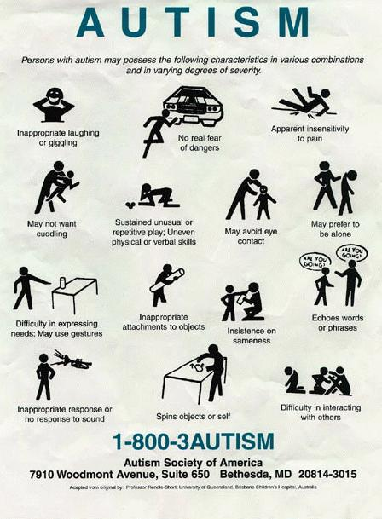

AUTISM
Autism is a developmental disorder that appears in the first 3 years of life, and affects the brain's normal development of social and communication skills.
Causes, incidence, and risk factors:
  Autism is a physical condition linked to abnormal biology and chemistry in the brain. The exact causes of these abnormalities remain unknown, but this is a very active area of research. There are probably a combination of factors that lead to autism.

Slide 17

Epidemiology of Autism
Prevalence rate of Autism Spectrum Disorders is about 1%
Up to 25% have grand-mal seizures and about 50% non-specific EEG abnormalities
50 to 70% have some degree of MR
Boys are effected 3 to 5 times more often than girls

Slide 18

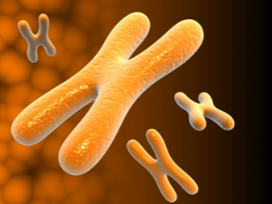
Etiology of Autism
Psychological theories have not been confirmed:
  Not caused by “refrigerator mother” or bad parenting
Heritability over 90%
Association with a variety of disorders:
  Congenital rubella & Postnatal infection
  Genetic disorders, including Fragile X
  Metabolic disorders
  Tic disorders
  OCD
Notes:
Psychological theories have not been confirmed
Not caused by “refrigerator mother” or bad parenting
“Common final pathway”
Heritability over 90%, 3% for narrowly defined autism and 10-20% for milder variants. Ref: Child Psychiatry, Goodman/Scott 2002, Blackwell publishing.
Association with a variety of disorders:
Congenital rubella & Postnatal infection
Genetic disorders, including Fragile X
Metabolic disorders

Slide 19
Asperger’s Disorder
Asperger’s syndrome is one disorder falling under the umbrella of the autism spectrum, in which the affected individual may show obsessive attention to detail, social awkwardness, and difficulty relating to others. Repetitive behaviors and highly focused, restricted interests (ex. obsession with trains, horses, etc) are also present. Unlike other autism spectrum disorders
“High functioning autism”
No delays in language and cognitive development
Stereotypic, repetitive mannerisms
Lack of interactive play/communication
Impaired communication skills
Notes:
High Functioning Autism is differentiated from Asperger’s disorder. It is usually diagnosed when IQ is higher than 70, language is developed before age 5 years and no comorbid medical problems.

Slide 20


PDD NOS
When there is no severe and pervasive impairment in the development of reciprocal social interaction, or communication skills, or when stereotyped behaviors and activities are present, but the criteria are not met for a specific pervasive developmental disorder.
Symptoms of PDD may include communication problems such as:Difficulty using and understanding languageDifficulty relating to people, objects, and events; for example, lack of eye contact, pointing behavior, and lack of facial responsesUnusual play with toys and other objectsDifficulty with changes in routine or familiar surroundings

Slide 21
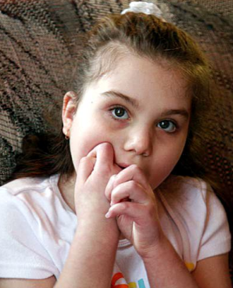
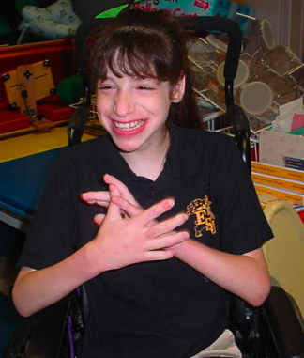
Rett’s Disorder
One in every 10,000 to 15,000 live female births
Normal growth for the first few months of life
Deceleration of head growth between 4-8 months
“Hand washing” stereotypies, Loss of purposeful hand movements
Truncal incoordination; gait problems; Seizures
Most are in wheelchair by their late teens and die before 30.
Disorder of females; in up to 80% due to mutation of MECP2 gene on X chromosome
Notes:
Normal growth for the first few months
Deceleration of head growth between 4-8 months
Truncal incoordination
Lack of purposeful hand movements
Disorder of females
Similar criteria as PDD

Slide 22


Childhood Disintegrative Disorder
Normal development for at least the first two years of life
Clinically significant loss of previously acquired skills (before age 10 years) in 2 or more of the following areas:
  Language
  Social skills or adoptive behavior
  Motor skills
  Play
  Bowel or bladder control

Slide 23
Important Educational Link ASD
http://www.youtube.com/watch?v=lbXjW-cX9kQ

Slide 24




Attention Deficit/Hyperactivity Disorder (ADHD)
Present before age 7
Persist for at least 6 months and be more frequent and severe than is typical for children at comparable developmental stages
Symptoms in two or more settings
Boys to girls 3 : 1
DSM-IV-TR distinguishes ADD WITH & WITHOUT hyperactivity, and recognizes a predominantly hyperactive subtype
Persists in some patients into adolescence and Adulthood
Normal IQ
Notes:
Symptoms for at least six months to a degree that is maladaptive and INCONSISTENT with developmental level
Some symptoms present prior to age 7
Symptoms in two or more settings
DSM-IV-TR distinguishes Attention deficit disorder WITH and WITHOUT hyperactivity, and recognizes a predominantly hyperactive subtype
ADHD is more difficult to reliably diagnose in early childhood (age 4-6)
Obtain developmental and medical history
Get standardized questionnaires from parents and teachers
Observation in clinic setting may or may not show symptoms described by parents
Psycho-educational testing useful if LD suspected

Slide 25
ADHD
(ADHD) is a neurocognitive behavioral developmental disorder most commonly seen in childhood and adolescence, which often extends to the adult years.
Minireview: Advances in understanding and treating ADHD. By: Kevin M Antshel, State University of New York, Upstate Medical University, Department of Psychiatry and Behavioral Sciences. BMC Medicine 2011

Slide 26
ADHD
prevalence :
The ADHD prevalence was once estimated to be 3 to 5% of school-age children, but more recent studies place the figure closer to 7 to 8% of school-age children (1)
and 4 to 5% of adults (2).
Prevalence clearly varies, with risk factors including age, male gender, chronic health problems, family dysfunction, low socioeconomic status, presence of a developmental impairment and urban living (3).
(1) Barbaresi WJ: How common is attention-deficit/hyperactivity disorder? Incidence in a population-based birth cohort in Rochester, Minn. Arch Pediatr Adolesc Med 2002
(2) Kessler RC, et al.: The prevalence and correlates of adult ADHD in the United States: results from the National Comorbidity Survey Replication. American Journal of Psychiatry 2006
(3) Lavigne JV, Gibbons RD, Christoffel KK, Arend R, Rosenbaum D, Binns H, Dawson N, Sobel H, Isaacs C: Prevalence rates and correlates of psychiatric disorders among preschool children.
J Am Acad Child Adolesc Psychiatry 1996

Slide 27
ADHD
Associated factors
Difficult temperament
Learning disabilities
Pregnancy and perinatal complications with soft neurological signs (brain impairment) (e.g., clumsiness)
Family conflict and parenting problems (may be a reaction)

Slide 28
ADHD
While stimulants clearly have abuse potential, the rate of lifetime nonmedical methylphenidate use has not significantly increased since methylphenidate was introduced as a treatment for ADHD, suggesting that abuse is not a major problem (Goldman et al., 1998).
Case reports describing abuse by children prescribed stimulants for ADHD are rare. (Hechtman, 1985).

Slide 29

INATTENTION
no attention to details
difficulty focusing
not listening
easily distracted
forgetful not following through
difficulty organizing
avoids effortful tasks
loses things
HYPERACTIVITY
IMPULSIVITY
fidgets
leaves seat
runs/climbs
loud
on the go
excessive talk
blurts
can't wait turn
interrupts/butts in

Slide 30
Academic
limitations
Children
Occupational/
vocational
Relationships
Adults
Legal
difficulties
ADHD
Low self
esteem
Motor vehicle
accidents
Injuries
Smoking and
substance abuse
Adolescents

Slide 31
ADHD Diagnosis
ADHD is more difficult to reliably diagnose in early childhood (age 4-6)
Obtain developmental and medical history
Get standardized questionnaires from parents and teachers
Observation in clinic setting may or may not show symptoms described by parents
Psycho-educational testing useful if LD suspected

Slide 32
اسم الطفل : ........................................ رقم المستشفى : ............................. العمر : ................
التعليمات :
الرجاء وضع دائرة حول الرقم الذي يناسب وصف الطفل أمام كل واحده من العبارات التالية :
كثيراً جداً
كثيراً
قليلاً
أبداً
وصف الطفل
تسلسل
3
2
1
0
غالباً ما يتململ أو يتحرك في مقعده .
( 1)
3
2
1
0
يجد صعوبة في البقاء جالساً .
( 2)
3
2
1
0
من السهل تشتيت انتباهه .
( 3)
3
2
1
0
يجد صعوبة في انتظار دوره وسط أقرانه .
( 4)
3
2
1
0
غالباً ما يندفع في الاجابة على الأسئلة دون تفكير .
( 5)

Slide 33
3
2
1
0
يجد صعوبة في اتباع التعليمات .
( 6)
3
2
1
0
يجد صعوبة في حصر انتباهه فيما يطلب منه عمله .
( 7)
3
2
1
0
غالباً ما ينتقل من نشاط قبل إكماله ، إلى نشاط آخر .
( 8)
3
2
1
0
يجد صعوبة في اللعب بهدوء .
( 9)
3
2
1
0
غالباًَ ما يتكلم بافراط .
(10)
3
2
1
0
غالباً ما يقاطع الآخرين يقحم نفسه عليهم .
(11)
3
2
1
0
غالباً ما يبدو عليه عدم الإنصات .
(12)
3
2
1
0
غالباً ما يضيع أشياءه الخاصة(الأدوات المدرسية مثلاً)
(13)
3
2
1
0
غالباً ما يقوم بأعمال خطرة بدنياً دون اكتراث لما ينتج عن ذلك .
(14)

Slide 34
ADHD
Etiology
Neuroanatomical
Neurochemical
Environmental
Genetic
CNS
insult

Slide 35
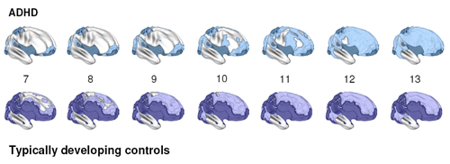
NIMH Press Release
NIMH Press Release November 12, 2007
Brain Matures a Few Years Late in ADHD, But Follows Normal Pattern
http://www.nimh.nih.gov/science-news/2007/brain-matures-a-few-years-late-in-adhd-but-follows-normal-pattern.shtml

Slide 36
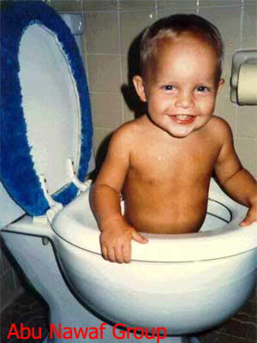

Slide 37
Child Psychiatry for Medical Students
Psychiatry Course 462 – Part (2)
Turki ALBatti, MB BS,
Assistant Professor
Child & Adolescent Psychiatrist
Department of Psychiatry
College of Medicine
King Saud University
1434H/2013G
Notes:
JES-2003
37

Slide 38
Treatment Modalities*
*(Usually 2 or more modalities are used simultaneously)
Medications aimed at reducing specific target symptoms or co morbidities
Psychotherapy of various types
  Individual psychotherapy (play, behavioral, cognitive, supportive, dynamic)
  Family Therapy & Parent Training
  Behavioral modification
  Problem solving skills training and social skills training
  Group Therapy - especially important for adolescents

Slide 39
Modules of Psychiatric Interventions
Places of psychiatric intervention
- Outpatient Treatment
- Partial Hospitalization
- Day Care Treatment
- Residential Treatment Center
- Inpatient Treatment
- Community Based approaches
Type of psychiatric intervention

Slide 40
Psychotropic medications in Child and Adolescent Psychiatry focusing on the following general classes of medication
Psychostimulants
Antidepressants:
- Selective serotonin reuptake inhibitors (SSRIs)
- TCA
Antipsychotic agents (Neuroleptics)
- Antimanic agents
Mood stabilizers
Other miscellaneous agents (Anxiolytics, Central alpha agonist. e.g. clonidine,
Notes:
Examples of Pharmacotherapy:
ADHD: Stimulants (e.g., Ritalin, Concerta) and Atomoxetine (Strattera)
MDD & Anxiety: SSRI's (recent Black Box warnings)
Bipolar Disorders: Valproate, Lithium
Psychosis: Antipsychotics

Slide 41

Treatment
Behavioural Therapy
ADHD Child
Home
Medication
School
Notes:
The components of a multidisciplinary approach to treating ADHD include:
Education for both parents and child or teen about diagnosis and treatment
ADHD medication
Behavior management therapy
School teacher involvement
School counselor involvement

Slide 42
ADHD Treatment
Psychoeducation essential; medication alone is usually not sufficient for the treatment of ADHD
Parent training in behavioral management and school-based behavioral interventions
FDA approved medications include stimulants and Atomoxetine
  Note: Stimulant medications improve attention in normal individuals as well as children with ADHD
Establish communication with teachers/school; potentially includes accommodations and IEP
Notes:
For most patients with ADHD, stimulants remain the first choice for medication management, as meta-analyses of existing research have shown that they are more efficacious than non-stimulant medications.
Faraone SV,: Comparing the efficacy of medications for ADHD using meta-analysis. MedGenMed 2006.

Slide 43
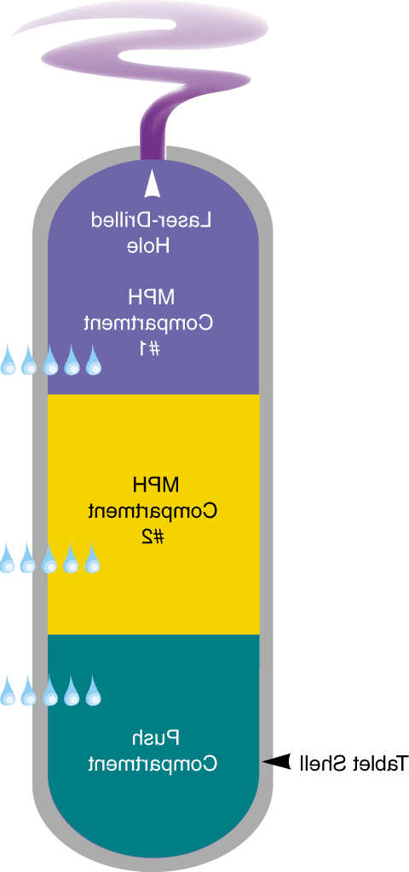
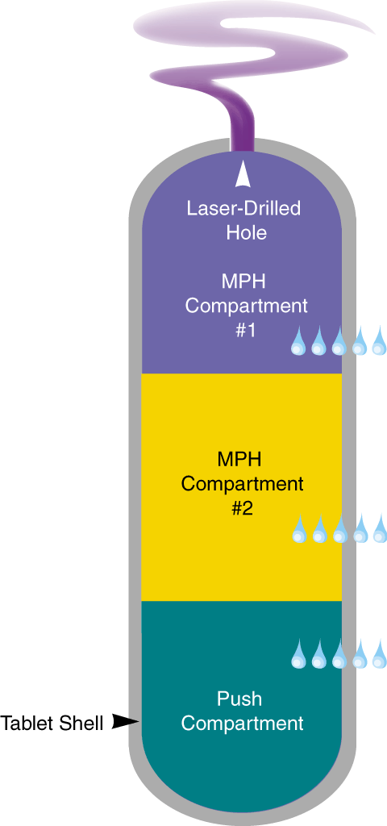

The Concerta ® Formulation
Laser-Drilled
Hole
MPH Compartment
#1
MPH Overcoat
MPH Compartment
#2
Tablet Shell
Push Compartment
Notes:
OROS® methylphenidate HCl (CONCERTA®) is a capsule-shaped tablet that contains drugs, excipients, osmotic agents and a cellulosic rate-controlling membrane with an orifice for drug release.
The tablet is covered by an MPH overcoat (4 mg in an 18-mg dose, 8 mg in a 36-mg dose) that is released quickly upon introduction into the gastro-intestinal tract.
The remaining drug is contained in the system core and is released by a membrane-controlled, osmotically-activated process over 12 hours.
Once the MPH overcoat dissolves, water permeates the exposed semi-permeable tablet shell, expanding the push compartment and releasing MPH from the first MPH compartment through a laser-drilled hole at a controlled rate.
As the push layer expands, MPH release continues through 10 hours after dosing, leaving minimal residual MPH, insoluble core components, and a tablet shell that are eliminated.
Dosing:
Available in 18 mg and 36 mg doses.
Dose should be tailored according to the needs and responses of the patient.
Dosage may be adjusted in 18 mg increments.

Slide 44
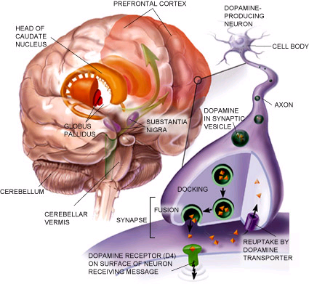

Slide 45
Medications and ADHD
Psychostimulants are highly effective for more than
75% -90% (!) of children with ADHD.
Has been used for childhood behavioral disorders since the 1930s
Administration of medications is timed:
- to meet the child’s school schedule,
- to help the child pay attention and meet his or her academic demands, and
- to mitigate side effects.

Slide 46
Medications and ADHD
These medications have their greatest effects on symptoms of:
hyperactivity,
impulsivity, and
inattention and
the associated features of:
( defiance, aggression, and oppositionality).
(Reviews by Barkley, 1990; Pelham, 1993; Swanson et al.,1993, 1995b; Greenhill et al., 1998; Cantwell, 1996a; Spencer et al., 1996.)

Slide 47
Medications and ADHD
The most common side effects of stimulants for ADHD include:
decreased appetite/weight loss
sleep problems
headaches
jitteriness
social withdrawal
Stomachaches
Rarely, stimulant medications for ADHA cause serious side effects.
Notes:
(They may exacerbate already existing psychiatric conditions, like psychosis, depression (!), or anxiety).
However, some studies suggest that treatment with stimulants can help to lessen the likelihood of other psychiatric comorbidities during adolescence, including cigarette use and substance abuse.
Minireview: Advances in understanding and treating ADHD. By: Kevin M Antshel, State University of New York, Upstate Medical University, Department of Psychiatry and Behavioral Sciences. BMC Medicine 2011

Slide 48
Medications and ADHD
Other non-stimulants FDA-approved drugs have also been found to be efficacious in treating ADHD in children and adolescents like:
Non-stimulants such as Atomoxetine (Strattera).
Is a Selective norepinephrine reuptake inhibitor (SNRI)
Minireview: Advances in understanding and treating ADHD. By: Kevin M Antshel, State University of New York, Upstate Medical University, Department of Psychiatry and Behavioral Sciences. BMC Medicine 2011

Slide 49
Medications and ADHD
Strattera
- Pose a much lower risk of abuse or dependence than stimulants
- Atomoxetine has been rarely associated with acute suicidality, it has been given a 'black box' warning.
Notes:
As with stimulant treatment, Atomoxetine rarely completely normalizes behavior, but symptom improvement is often reflected in gains in social and behavioral function.

Slide 50
Psychosocial Intervention
The main psychosocial intervention to help children with ADHD are:
Behavioral training for parent and teacher.
Systematic programs of contingency management:
systematic programs of intensive contingency management conducted in specialized (classrooms or summer camps) with the setting controlled by highly trained individuals is the most effective

Slide 51
Psychosocial Intervention
parent training or school-based behavioral modification with the use of stimulants.
Most of the training conducted in outpatient settings are behavioral therapy programs. In which parents meet in groups and are taught behavioral techniques such as time out, point systems, and contingent attention.
Teachers are taught similar classroom strategies, as well as the use of a daily report card for parents that evaluates the child’s in-school behavior.

Slide 52
Education
Educating parents about the disorder and its management is another important part of ADHD treatment. For parents, this may include learning Parenting Skills to help the child manage his or her behavior. That would involve skills such as giving positive feedback for desirable behaviors, ignoring undesirable behaviors, and giving time-outs when the child's behavior is out of control. In some cases, the child's entire family may be involved in this part of the treatment.

Slide 53
Can ADHD be treated with dietary changes or vitamins?
A well-balanced diet is most important for optimal health. But scientific studies do not support the idea that dietary factors or a vitamin deficiency actually causes ADHD.

Slide 54
ADHD Outcomes
ADHD can be a lifetime disorder, with nearly 2/3 of children continuing with symptoms as adults
Learning disabilities frequently comorbid in children with ADHD and not responsive to medications
Adult outcome studies show more relationship problems, lower educational and professional achievement, more traffic violations and higher health care costs for cohort members with ADHD compared to unaffected controls
Long term outcome strongly influenced by comorbid ODD, CD, and substance abuse
Notes:
Course and Prognosis:
Symptoms tend to persist, although adolescents usually become more goal-directed and less impulsive.
Channelling activity into sport or work if the opportunity is available.
The outcome is less favorable for those who have an associated conduct disorder.
In these cases, there is a significantly increased risk of continuing to have mental health, personality and social adjustment problems.
National Health and Medical Research Council Working Party. Report on attention deficit hyperactivity disorder. Canberra: NHMRC, 1997.

Slide 55
In Summary
Management
Parenting-skills training and home help
Educational program for learning disabilities
Environment modification to reduce distraction
Tasks in small steps to channel energy
Behavioural management of antisocial behaviour
Family therapy for conflict
Pharmacotherapy: stimulants (dextroamphetamine, methylphenidate), clonidine, imipramine, and thioridazine, etc.

Slide 56
Autism Spectrum Disorders

Slide 57
Interventions in ASD
Presently:
No curative treatment; early detection and symptomatic approaches
Mainstay:
Structured behavioral and educational programs; speech and language services
Medication:
To control seizures, hyperactivity, SIB, severe aggression, or mood disorders
Notes:
CARD – Centers for Autism http://card.ufl.edu
There is no curative treatment for autism, and psychotropic drugs have only a minimal role to play in its management.
As a rule, drugs should be used sparingly and only when other strategies to reduce maladaptive behaviors have been properly tried and have failed to bring about the desired changes.
Use of unnecessary drugs in autism might lower the seizure threshold, and increase incidence of epilepsy.

Slide 58
Summary
The researches had shown by evidence that outcomes for children with autism can be significantly enhanced by early intensive intervention
Our duty to provide:
Early detection, intervention, education, and psychopharmacological management.
We hope that:
The optimal outcomes will be achieved through the earliest intervention possible

Slide 59
Mental Retardation (MR)
Intellectual Disability

Slide 60
Mental Retardation
Treatment Consideration
The mainstay of treatment of MR/ID is:
Developing a comprehensive management plan for the condition.
The complex habilitation plan for the individual requires input from care providers from multiple disciplines, including:
Special educators, language therapists, behavioral therapists, occupational therapists, and community services that provide social support and respite care for families affected by MR/ID.
Article: Mental Retardation Treatment & Management
Author: Ari S Zeldin, MD. Updated: Jul 13, 2012

Slide 61
Mental Retardation
Treatment Consideration
Family is coping with loss of “ideal” child:
  Grief and loss issues
Appropriate placement and support:
School setting, day care, group homes, sheltered workshop and relief care
Specific problems responsive to medications:
  e.g. seizures; depression; hyperactivity ; aggression
May experience “independent” psychiatric disorders:
e.g. schizophrenia, bipolar disorder, etc.

Slide 62
Multidisciplinary Team (Consultations)
Psychiatrist
psychologist
Developmental pediatrician
Geneticist and counselor
Dentist
Podiatrist
Special education/educational therapist
Occupational, speech and/or physical therapist
Behaviorist
Pharmacist
Durable medical equipment providers
Social services agencies/social workers
Notes:
Podiatry or podiatric medicine is a branch of medicine devoted to the study of, diagnosis, and medical treatment of disorders of the foot, ankle, and lower extremity.

Slide 63
Communication
Written, verbal and pictoral forms of communication as well as gestures and demonstrations are helpful for those with MR/ID to ensure mutual understanding and improve treatment adherence

Slide 64
Mental Retardation
No specific pharmacologic treatment is available for cognitive impairment in the developing child or adult with MR/ID.
Medications, when prescribed, are targeted to specific comorbid psychiatric disease or behavioral disturbances.

Slide 65
Neuroleptic drugs (antipsychotics)
The most frequently prescribed agents for targeting behaviors such as:
(aggression, self-injury, and hyperactivity in people with MR/ID).
These indications are generally off-label for MR/ID and caution is advised.
Thus, they are more likely to be reserved for the older child or adult in whom intensive behavioral intervention has failed.
The prevalence of comorbid psychiatric disorders in MR/ID increases with age.
Notes:
M/A:
By antagonizing dopamine receptors. This has correlated with the efficacy of these drugs and imparts their antipsychotic properties.
Likewise, antidopaminergic activity evokes extrapyramidal symptoms. Rarely, neuroleptic malignant syndrome may occur.

Slide 66
Abuse/Sexuality
A significantly higher proportion of children and adults with MR/ID have experienced some form of abuse, with some estimates of up to 70%, which contributes to mental health issues. This should be addressed at each medical visit and especially in the setting of changes in behaviors, such as increased aggression*
Ignorance of sexual life/right of MR/ID individuals is another probability of potential core-conflict between those population and care providers.
* Article cited on MedScape: Mental Retardation Treatment & Management
Author: Ari S Zeldin, MD. Updated: Jul 13, 2012

Slide 67
Mental Retardation
Neurological/Orthopedic referrals; If patients have coexisting motor impairments,.
Pharmacologic management of spasticity and rigidity allows the clinician to refer the patient for botulinum toxin injections or baclofen pump insertion when appropriate.
Arthroplasty for progressive hip dislocation and/or tendon releases for progressive contractures due to spasticity may be required.

Slide 68
Mental Retardation
Ongoing vision and audiologic evaluation, thyroid function tests, and screening for atlantoaxial instability and obstructive sleep apnea are some important components.

Slide 69
Mental Retardation
Family Education and support around the issues of MR is very important

Slide 70
Mental Retardation-Prognosis
Individuals with MR/ID fare better today than at any other recorded time in world history.

Slide 71
Mental Retardation
Nutritional supplements are of no proven benefit.

Slide 72
Mental Retardation
Physical activity and obesity are another major challenges and contributors to disease in MR/ID.
Very few programs exist that target healthy lifestyles (nutrition/diet, exercise, self-care, stress reduction) in those with MR/ID.
Annual counseling and referral on these issues to community agencies and programs is recommended.
Medications (e.g, antipsychotics) should be titrated to reduce the risk of obesity and metabolic issues.

Slide 73
Mental Retardation
Because obesity is more prevalent in those with MR/ID, regular physical activity should be included in the management plan.
Adaptive exercise programs for those with concomitant physical disabilities should be recommended as needed

Slide 74
Questions after lecture?
Interested in learning more about child and adolescent psychiatry?
  Arrange to attend OPD
  Consider an elective rotation during internship or otherwise

