Slide 1
Mood disorders
Dr.Noor AL-Modihesh

Slide 2
Mood is the sustained and pervasive feeling tone that influences a person's behavior and perception of the world. It is internally experienced. Mood can be normal, depressed, or elevated.
Affect is the person's present transient emotional state. It represents the external expression of mood.
Subjective Vs Objective

Slide 3
1.Major depressive episode (MDE):
≥ 2 weeks of low mood/loss of interest + other features
2.Manic episode:
≥ 1 week of elevated, expansive, or irritable mood + other features
3.Mixed episode:
≥ 1 week of both depressed and manic mood + other features
4.Hypomanic episode:
≥ 4 days less severe elevated mood + other features
5.Dysthymic disorder: ≥ 2 year-history of chronic less severe low mood.
6.Cyclothymic disorder: Less severe bipolar mood disorder with continuous mood swings; alternating periods of hypomania and moderate depression.

Slide 4
Depressive disorders:
Mood disorders have a high prevalence.
For Major Depressive Episode:
least five of nine symptoms of depression
they must be present for at least 2 weeks to rule out transient mood fluctuations.
must cause distress or impairment.
Other conditions must be ruled out
Is it MDE or MDD ? Any significance ?

Slide 5
Lifetime risk is in the range of 10 - 15 %.
Lifetime prevalence is in the range of 15 – 25%.
The mean age of onset is about 40 years (25 - 50 years).

Slide 6
Major Depressive Episode | Grief
persistent depressed mood and the inability to anticipate happiness or pleasure. more persistent and not tied to specific thoughts or Preoccupations. self-critical or pessimistic ruminations. possibly about “joining” the deceased | Predominant feature is emptiness & sense of loss. dysphoria in grief decreases over days & weeks thoughts and memories of the deceased. self-esteem is generally preserved possibly about “joining” the deceased

Slide 7
DSM-5 depressive and related disorders
In DSM5 :
Disruptive mood dysregulation disorder
Major depressive disorder, single episode
Major depressive disorder, recurrent
Persistent depressive disorder (dysthymia)
Substance/medication-induced depressive disorder
Premenstrual dysphoric disorder
Depressive disorder due to another medical condition
Other specified depressive disorder
Unspecified depressive disorder

Slide 8
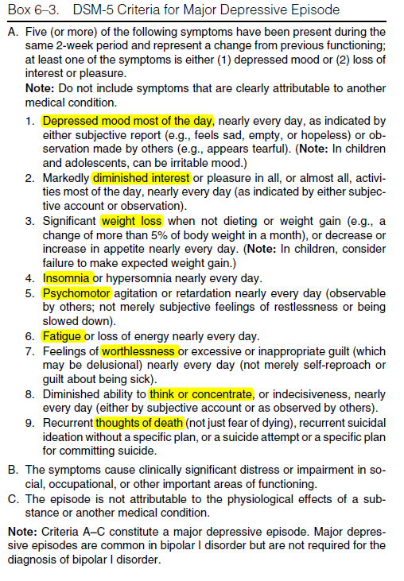

Slide 9
Appearance & Behavior:
Neglected dress and grooming.
Facial appearance of sadness:
- Turning downwards of corners of the mouth.
- Down cast gaze/tearful eyes/reduced rate of blinking.
- Head is inclined forwards.
Psychomotor retardation (in some patients agitation occurs):
- Lack of motivation and initiation.
- Slow movements/slow interactions.
Social isolation and withdrawal.
Delay of tasks and decisions.

Slide 10
Biological Features (Neuro-vegetative Signs)
Change in appetite (usually reduced but in some patients increased).
Change in sleep (usually reduced but in some patients increased). Early morning (terminal) insomnia; waking 2 - 3 hours before the usual time, this is usually associated with severe depression.
Change in weight (usually reduce but may be increased).
Fatigability, low energy level (simple task is an effort).
Low libido and /or impotence.
Change in bowel habit (usually constipation).
Change in menstrual cycle (amenorrhea).
Diurnal variation of mood (usually worse in the morning).
Several immunological abnormalities (e.g. low lymphocytes) increasing the risk to infection

Slide 11
Mood (Affective) Changes:
Feeling low (more severe than ordinary sadness).
Lack of enjoyment and inability to experience pleasure (anhedonia).
Irritability /Frustration/Tension

Slide 12
Cognitive Functions & Thinking:
Subjective poor attention, concentration and memory. In elderly this may be mistaken as dementia (pseudo dementia).

Slide 13
Psychotic Features Associated with Severe Depression
A. Hallucinations (mood-congruent)
1. Usually second person auditory hallucinations (addressing
derogatory repetitive phrases).
2. Visual hallucinations (e.g. scenes of death and destruction) may be experienced by a few patients.

Slide 14
B. Delusions (mood-congruent)
1. Delusion of guilt (patient believes that he deserves severe punishment).
2. Nihilistic delusion (patient believes that some part of his body ceased to exist or function, e.g. bowel, brain…).
3. Delusion of poverty and impoverishment.
4. Persecutory delusion (patient accepts the supposed persecution as something he deserves, in contrast to schizophrenic patient).

Slide 15
Course and Outcome
Depressive episode might be untreated for weeks or months
The prognosis for any single depressive episode is quite good
about 20% will develop a chronic form of depression
Suicide is the most serious complication of depression

Slide 16
Features associated with increase suicidal risk :
being divorced or living alone
having a history of alcohol or drug abuse.
being older than 40
having a history of a prior suicide attempt and expressing suicidal ideation

Slide 17
Differential Diagnosis of Major Depressive Disorder (MDD) :
Depression secondary to medical diseases:
- Hypothyroidism - Diabetes mellitus-Cushing’s disease - Parkinson’s disease.
- Stroke
- Carcinoma (especially of the pancreas and lungs).
- Autoimmune diseases; SLE, multiple sclerosis.

Slide 18
Depression secondary to medications:
- Antihypertensives (e.g. beta-blockers, methyldopa, reserpine & Ca-channel blockers).
- Steroids.
- Bromocriptine & L - dopa.
- Indomethacin.
- Isotretinoin (Roaccutane); treatment of acne.
- Progestin-containing contraceptives (compared to estrogen-containing contraceptives, which can reduce depression risk).
- Tamoxifen (estrogen-receptor antagonist used in breast cancer): it may induce depression that can be difficult to treat with antidepressants.
- Chemotherapy agents e.g. vincristine, interferon (may induce severe depression with suicidal ideas).
- Antipsychotics.
• Depression secondary to substance abuse ( upon discontinuation of stimulants / cannabis).

Slide 19
Psychiatric disorders:
− Dysthymic disorder (chronic& less severe depression- see later-).However, both may occur together; dysthymic disorder complicated by major depressive episodes (double depression).
− Adjustment disorder with depressed mood (see later).
− Schizophrenia, schizoaffective disorder.
− Somatization disorder
− Anxiety disorder.

Slide 20
Management of Major Depression
Hospitalization.
Electroconvulsive therapy ( ECT )
Psychosocial
Treatment:
Selective Serotonin Reuptake Inhibitors (SSRIs) e.g. fluoxetine, paroxetine
Selective serotonin – Norepinephrine Reuptake Inhibitors (SNRIs) e.g. venlafaxine, duloxetine.
Other new agents e.g. mirtazapine.
S\E profile
Duration for MDE , MDD

Slide 21
DYSTHYMIC DISORDER
Persistent Depressive Disorder =DSM5
is a chronic and persistent disturbance
in mood that has been present for at least 2 years.
is characterized by relatively typical depressive symptoms such as anorexia,
insomnia, decreased energy, low self-esteem, difficulty concentrating, and feelings of hopelessness.

Slide 22
DSM-5 Diagnostic Criteria for Persistent Depressive Disorder (Dysthymia)
This disorder represents a consolidation of DSM-IV-defined chronic major depressive disorder and dysthymic disorder.
A. Depressed mood for most of the day, for more days than not, as indicated by either subjective account or observation by others, for at least 2 years.
Note: In children and adolescents, mood can be irritable and duration must be at least 1 year.
B. Presence, while depressed, of two (or more) of the following:
1. Poor appetite or overeating.
2. Insomnia or hypersomnia.
3. Low energy or fatigue.
4. Low self-esteem.
5. Poor concentration or difficulty making decisions.
6. Feelings of hopelessness.

Slide 23
C. During the 2-year period (1 year for children or adolescents) of the disturbance,
the individual has never been without the symptoms in Criteria A
and B for more than 2 months at a time.
D. Criteria for a major depressive disorder may be continuously present for
2 years.
E. There has never been a manic episode or a hypomanic episode, and criteria
have never been met for cyclothymic disorder.
F. The disturbance is not better explained by a persistent schizoaffective
disorder, schizophrenia, delusional disorder, or other specified or unspecified
schizophrenia spectrum and other psychotic disorder.
G. The symptoms are not attributable to the physiological effects of a substance
(e.g., a drug of abuse, a medication) or another medical condition
(e.g. hypothyroidism).
H. The symptoms cause clinically significant distress or impairment in social,
occupational, or other important areas of functioning

Slide 24
Treatment: The most effective treatment is the combination of pharmacotherapy and cognitive or behavior therapy (CBT).
A. Pharmacological
SSRI, SNRI, MAOI, TRICYCLIC.
B. Psychological

Slide 25
Anti-depressant
Selective-Serotonin- Reuptake Inhibitors (SSRIs )
paroxetine (seroxat)
fluoxetine (prozac)
citalopram (cipram)
escitalopram (cipralex)
sertraline (lustral)
fluvoxamine (faverin).

Slide 26
Uses :
− Depressive disorders.
− Anxiety, phobia & panic disorders.
− Obsessive compulsive disorder.
− Trichotillomania.
− Tic disorders.
− Premature ejaculation

Slide 27
Side Effects:
Gastrointestinal upset, nausea, reduced appetite, diarrhea / constipation.
− Headache/ irritability/sweating/fine tremor.
− Sexual dysfunction (delayed orgasm).
− Insomnia (mainly with Fluoxetine).
− Sedation (mainly with Fluvoxamine).
− Withdrawal syndrome (mainly with paroxetine).

Slide 28
Serotonin syndrome
Rare but serious S/E.
It is due to combination of a number of drugs that potentiate brain serotonin function.
The most common combination is MOAIs (which inhibit the catabolism of serotonin) with SSRIs, clomipramine and fenfluramine.
Features; myoclonus, nystagmus, tremor, irritability, confusion, and hyperpyrexia.
Treatment; Stop Rx and support vital signs

Slide 29
Selective-Serotonin-Norepinephrine Reuptake Inhibitors (SNRIs )
Venlafaxine (Effexor-Efexor)
desvenlafaxine (Pristiq)
duloxetine (Cymbalta).
adverse reactions are dry mouth, nausea, anorexia, somnolence, dizziness, nervousness, constipation, asthenia, anxiety, blurred vision, abnormal ejaculation or orgasm, erectile disturbances, and impotence. Sweating is also more common with venlafaxine than the SSRIs. Venlafaxine can cause an increase in diastolic BP, but this was seen more often in patients treated with doses of venlafaxine > 225 mg /day

Slide 30
Mirtazapine (Remeron)
It increases both NE and 5HT
Effective in depression
Side effects: increased appetite, weight gain, and sedation

Slide 31
Tricyclic Antidepressants (TCAs)
Amitriptyline, imipramine, clomipramine.
Side Effects:
Anticholinergic: constipation, urinary retention, dry mouth , impaired visual accommodation, worsening of glaucoma central anticholinergic toxicity(delirium)
Antiadrenergic ( alpha-receptors ):Postural hypotension, delayed ejaculation and drowsiness
Others: sweating, weight gain, arrhythmia, tremor, precipitation of mania in susceptible patients.
Very risky in overdose

Slide 32
Bipolar disorder

Slide 33
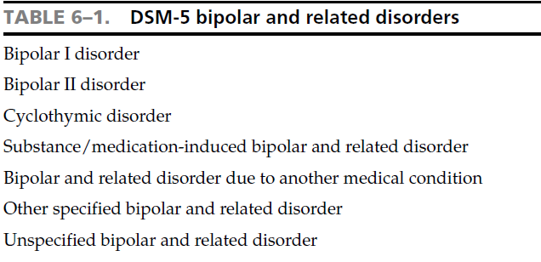

Slide 34
Manic episode
A. A distinct period of abnormally and persistently elevated, expansive, or irritable mood, lasting at least 1 week.
B. During the period of mood disturbance ≥ 3 of the following (4 if mood is irritable):
1. Inflated self-esteem or grandiosity.
2. Decreased need for sleep.
3. Pressured speech.
4. Racing thoughts or flight of ideas.
5. Distractibility (reduced concentration).
6. Increase in goal-directed activity (socially, at work, or sexually).
7. Excessive involvement in pleasurable activities that have a high potential for painful consequences (e.g., engaging in unrestrained buying sprees, sexual indiscretions, or foolish business investments).
C. The symptoms do not meet criteria for a mixed episode.
D. Significant distress or impairment in functioning.
E. Not due to substance abuse, a medication or a general medical condition (e.g., hyperthyroidism).
Note: Manic-like episodes that are clearly caused by antidepressant treatment should not count toward a diagnosis of bipolar I disorder.

Slide 35
Psychotic features may occur in severe cases of mania:
A.Mood - congruent hallucinations; e.g. voices talking to the patient about his special powers. Occasionally
visual hallucinations (e.g. seeing Angels).
B.Mood-congruent delusions; usually grandiose delusions (e.g. being a prophet, a prince …), Patients with

Slide 37
Mixed Episode
≥ 1 week of both manic and depressive symptoms occurring simultaneously nearly every day (e.g. overactive over talkative patient may have at the same time profound depressive thoughts including suicidal ideas)

Slide 38
Etiology of mood disorders
Genetic: one parent with bipolar I >25 % chance of mood disorder in child.
Two parents with bipolar I > 50 % chance of mood disorder in child.
Concordance rates for monozygotic twins are approximately 75%, and rates for dizygotic twins are 5 to 25%.
Some studies found some defects in chromosomes 5, 11 and X.
Neurochemical: disturbance in biogenic amines (norepinephrine, serotonin, and dopamine).
Psychosocial: psychosocial stresses may trigger manic or mixed episode in a vulnerable person

Slide 39
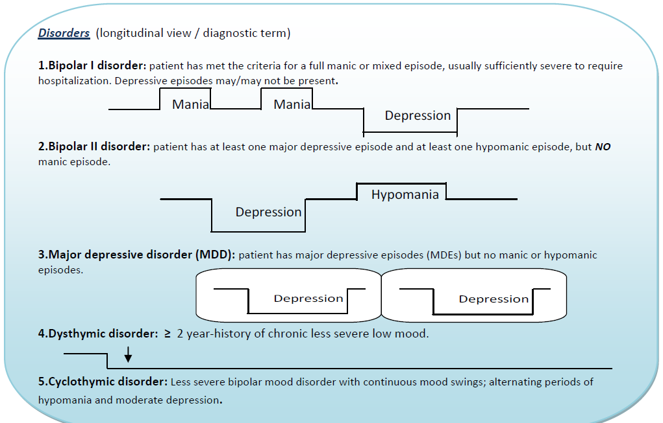
Bipolar I Disorder

Slide 40
Rapid Cycling Bipolar I or II Mood Disorders
≥ 4 alternating mood episodes (MDE, Manic, Hypomanic or Mixed ) in the previous 12 months, separated by intervals of 2-3 days.
Around 80 % are lithium-treatment failures. Carbamazepine and sodium valproate are usual agents of choice

Slide 41
Bipolar I Disorder
Single episode or recurrent
One manic episode to Dx
Can have major depressive episode or more
Patients who are having their first episode of bipolar I disorder MDE cannot be distinguished from patients with MDD. Till they have their 1st manic episode.
Manic episodes are considered distinct when they are separated by at least 2 months without significant symptoms of mania or hypomania

Slide 42
Bipolar II Disorder
Patient has at least one major depressive episode and at least one hypomanic episode, but no manic episode.
Epidemiology; onset usually 18- 30 years. Lifetime prevalence: 0.5%. Slightly more common in women

Slide 43
SEASONAL AFFECTIVE DISORDER
Recurrent major depressive episodes that come with shortened day light in winter and disappear during summer (may be followed by hypomania).
Characterized by atypical features of depression: hypersomnia, hyperphagia (carbohydrate craving), weight gain, increased fatigue.
Related to abnormal melatonin metabolism. Treated with exposure to light (artificial light for 2 – 6 hours a day).

Slide 44
Course and Prognosis of bipolar disorders
If left untreated, most manic episodes will resolve within 8 -12 weeks
The risk of recurrence is particularly high (50 %)
About 80 % of manic patients eventually experience a full depressive episode
About 50 % will have multiple relapses with good interepisodic functioning.

Slide 45
As the disorder progresses, the time between episodes often decreases
After about five episodes, however, the interepisodic interval often stabilizes at 6 - 9 months.

Slide 46
Treatment of Bipolar Mood Disorder
Short-term treatment
Hospitalization.
Agitation ==antipsychotic medication
typical (e.g. haloperidol 10 -20 mg or chlorpromazine 400-800 mg) or atypical (e.g. olanzapine 10-20 mg, or risperidone 4-8 mg)

Slide 47
Long-term treatment
Lithium has been found effective in preventing recurrence of manic-depressive episodes.
Carbamazepine appears to be as effective as lithium in the prophylaxis of bipolar mood disorder, and can be considered in patients who are intolerant of lithium or who respond poorly to lithium (e.g. rapid-cycling mood disorders).
Sodium valproate has been found effective in patients with refractory bipolar illness, even when there has been a poor response to lithium and carbamazepine

Slide 48
LITHIUM
Mechanism of action
Work up : renal,u&e,TFT,ECG if cardiac disease
s\e:
Fine tremor/ Gastric discomfort and diarrhea /Dry mouth, metallic taste /Fatigue /Weight gain
− Reversible hypothyroidism / Reversible nephrogenic diabetes insipidus (polyuria – polydepsia) due to blockade of ADH – sensitive adenylcyclase in distal tubules.
Toxicity (course tremor, ataxia, confusion, diarrhea, vomiting…).
Dosing
Drug interaction

Slide 49
Carbamazepine (Tegretol)
first-line agent for acute and maintenance treatment for bipolar I disorder
In acute & prophylaxis
Dose ( 200 mg po twice –1000 \day)
S\E :Mild GI (gastric discomfort, nausea, vomiting, constipation, diarrhea, and anorexia) and CNS (sedation, drowsiness, vertigo, blurred vision and ataxia).
Enzyme inducer …

Slide 50
Valproate (Depakine Depakene, Depakote )
For manic episode of bipolar dis. or even schizoaffective
usually 250 mg twice/day. It can be increased gradually to 2500 mg/day
Common side effects include Mild GI (gastric discomfort, nausea, vomiting, and anorexia) and CNS (sedation, drowsiness, dysarthria, and ataxia).

Slide 51
Other anticonvulsants used as mood-stabilizers:
Lamotrigine (Lamictal)
Topiramate (Topamax)
Gabapentin (Neurontin)
Pregabalin (Lyrica)
Levetiracetam (Keppra)
Tiagabine (Gabitril).

Slide 52
CYCLOTHYMIC DISORDER
Less severe bipolar mood disorder with continuous mood swings; alternating periods of hypomania and moderate depression. It is non-psychotic chronic disorder.

