Slide 1
Theme 4: Anxiety Disorders
Ahmad AlHadi, MD
Assistant Professor and Consultant
in Psychiatry and Psychotherapy

Slide 2
Introduction
Case
Hx
MSE
Types of Anxiety

Slide 3
Anxiety Disorders DSM-IV-TR
Panic Disorder
Agoraphobia
Specific Phobia
Social Phobia (Social Anx Dis).
Obsessive Compulsive Disorder (OCD)
Post Traumatic Stress Disorder (PTSD), Acute Stress Disorder
Generalized Anxiety Disorder (GAD)

Slide 4
Anxiety Disorders in DSM5
Anxiety Disorders
Separation Anxiety Disorder
Selective Mutism
Obsessive-Compulsive and Related Disorder
Obsessive-Compulsive Disorder
Body Dysmorphic Disorder
Trauma- and Stressor-Related Disorders
Reactive Attachment Disorder
Disinhibited Social Engagement Disorder
Specific Phobia
Social Anxiety Disorder
Panic Disorder
Agoraphobia
Generalized Anxiety Disorder
Substance/Medication-Induced Anxiety Disorder
Anxiety Disorder Due to Another Medical Condition
Hoarding Disorder
Trichotillomania (Hair-Pulling Disorder)
Excoriation (Skin-Picking) Disorder
Substance/Medication-Induced Obsessive-Compulsive and Related Disorder
Obsessive-Compulsive and Related Disorder Due to Another Medical Condition
Posttraumatic Stress Disorder
Acute Stress Disorder
Adjustment Disorders

Slide 5
Case Vignette:
Layla is 31 year old female. She came to your clinic complaining of fearfulness, palpitations, shortness of breath and impaired concentration. She is afraid that she will die. These symptoms come suddenly in episodes for the last two months.

Slide 6
Case Vignette:
Layla is 31 year old female. She came to your clinic complaining of fearfulness, palpitations, shortness of breath and impaired concentration. She is afraid that she will die. These symptoms come suddenly in episodes for the last two months.

Slide 7
Features of Anxiety
Physical | Psychological
Neuro: ENT: CVS & CHEST: GI: Genito-urin.: SKIN: MSS: | Excessive worries + anticipation Fear Apprehension + hypervigilance Difficulty concentrating Feeling of restlessness Sensitivity to noise Sleep disturbance

Slide 8
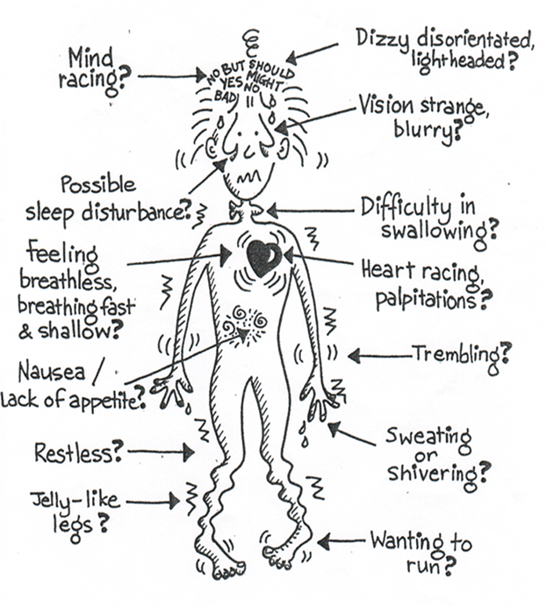

Slide 9
Imagine!!

Slide 10
Anxiety Disorders
Panic Disorder
Agoraphobia
Specific Phobia
Social Phobia.
Obsessive Compulsive Disorder (OCD)
Post Traumatic Stress Disorder (PTSD), Acute Stress Disorder
Generalized Anxiety Disorder (GAD)

Slide 11
Panic Disorder
Panic attack :
a symptom not a disorder.
Episodic sudden intense fear (of dying, going mad, or loosing self-control).
Can be part of many disorders: panic disorder, GAD, phobias, sub. Abuse, acute & PTSD.
2 types:
1- unexpected.
2- situationally bound.
Panic Disorder:
Disorder with specific criteria:
1- unexpected recurrent panic attacks
(+/- situationally bound).
2- one month period (or more) of persistent concerns about another attack or implications of the attack or changes in behavior.
3- Not due to other disorders
Notes:
Panic Attack:
A discrete period of sudden onset of intense fear or discomfort that builds up to a peak rapidly (usually in 5-15 minutes) and is often accompanied by a sense of imminent danger or impending doom and an urge to escape.
There are some somatic and cognitive symptoms that accompany fear. These include:
Palpitation ● Sensations of shortness of breath
Feeling of choking ● Chest pain
Shaking ● Tremor ● Chills or hot flushes ● Sweating
Paraesthesia
Feeling dizzy, unsteady or faint.
Fear of going mad, dying or losing control.
Derealization (feelings of unreality) or depersonalization (being detached from one self)

Slide 12
Panic Attacks
Unexpected
Situationally bound
Spontaneous.
Essential to diagnose
Panic Disorder
- Anticipation Or immediately on exposure to the trigger
e.g. specific phobia.
- can be ass./with
panic disorder

Slide 13
Panic Disorder Diagnostic Criteria 300.01 (F41.0)
A. Recurrent unexpected panic attacks. A panic attack is an abrupt surge of intense fear or intense discomfort that reaches a peak within minutes, and during which time four (or more) of the following symptoms occur;
Note: The abrupt surge can occur from a calm state or an anxious state.
1. Palpitations, pounding heart, or accelerated heart rate.
2. Sweating.
3. Trembling or shaking.
4. Sensations of shortness of breath or smothering.
5. Feelings of choking.
6. Chest pain or discomfort.

Slide 14
Panic Disorder Diagnostic Criteria 300.01 (F41.0)
7. Nausea or abdominal distress.
8. Feeling dizzy, unsteady, light-headed, or faint.
9. Chills or heat sensations.
10. Paresthesias (numbness or tingling sensations).
11. Derealization (feelings of unreality) or depersonalization (being detached from one­self).
12. Fear of losing control or “going crazy.”
13. Fear of dying.
Note: Culture-specific symptoms (e.g., tinnitus, neck soreness, headache, uncontrollable screaming or crying) may be seen. Such symptoms should not count as one of the four required symptoms.

Slide 15
Panic Disorder Diagnostic Criteria 300.01 (F41.0)
B. At least one of the attacks has been followed by 1 month (or more) of one or both of the following:
1. Persistent concern or worry about additional panic attacks or their consequences (e.g., losing control, having a heart attack, “going crazy”).
2. A significant maladaptive change in behavior related to the attacks (e.g., behaviors designed to avoid having panic attacks, such as avoidance of exercise or unfamiliar situations).

Slide 16
Panic Disorder Diagnostic Criteria 300.01 (F41.0)
C. The disturbance is not attributable to the physiological effects of a substance (e.g., a drug of abuse, a medication) or another medical condition (e.g., hyperthyroidism, cardiopulmonary disorders).
D. The disturbance is not better explained by another mental disorder (e.g., the panic attacks do not occur only in response to feared social situations, as in social anxiety disorder: in response to circumscribed phobic objects or situations, as in specific phobia: in response to obsessions, as in obsessive-compulsive disorder: in response to reminders of traumatic events, as in posttraumatic stress disorder: or in response to separation from attachment figures, as in separation anxiety disorder).

Slide 17
Epidemiology
Women > men
Prevalence : 1– 3 %
Age at onset :
20 --- 35 years
Etiology
Genetic predisposition
Disturbance of neurotransmitters
NE & 5 HT
in the locus ceruleus
(alarm system
in the brain )
Behavioral conditioning
Mitral valve prolapse 2x ?..% not increased in Echo. MVP
Notes:
Age at onset: bimodal distribution, with one peak in late adolescence and a second smaller peak in the mid 30s
Aetiology:
Genetic basis (panic disorder occurs more often among relatives).
The biochemical hypothesis (panic attacks can be induced by chemical agents like sodium lactate, and can be reduced by drugs like imipramine).
Panic disorder develops in a person with poorly regulated autonomic responses to stressors when he becomes afraid of the consequences of symptoms of autonomic arousal.
The neurotransmitters involved are noradrenaline and serotonin.
Locus coeruleus is essential for anxiety expression (alarm system in the body). Hyperactivity occurs in Locus Coeruleus.
Mitral Valve Prolapse (MVP) is more common in patients with panic disorder (40-50 %) than in general population (6 – 20 %). Whether this association has a causal relationship it is not clear.

Slide 18
Course & Prognosis
With treatment : good
Some pts recover within weeks even with no treatment.
Others have chronic fluctuating course.
Management
Rule out physical causes.
Support & reassurance
Bio-Psycho-Social
Medications:
BNZ
SSRIs
TCAs
CBT
Social

Slide 19
Phobia s
Any Qs So far?

Slide 20
Case Development 1:
Layla started to be fearful whenever she leaves her home and ask for company all the time. She anticipated these episodes.
10 years ago, when she was in the university, she developed same episodes only in social situations like parties and presentations.
She also has irrational fear from injections and she has the same episodes when she is exposed to them.

Slide 21
Anxiety Disorders
Panic Disorder
Agoraphobia
Specific Phobia
Social Phobia.
Obsessive Compulsive Disorder (OCD)
Post Traumatic Stress Disorder (PTSD), Acute Stress Disorder
Generalized Anxiety Disorder (GAD)

Slide 22
Phobia
FEAR
Avoidance
± panic attack
endured with +++ discomfort

Slide 23
Phobic Disorders Irrational excessive fear ± panic attack on exposure + avoidance or endured with +++ discomfort
Agoraphobia | Social | Specific
where it is difficult or embarrassing to escape or get help. 1) Away from home, 2) Crowded places, or 3) Confinement (in-closed spaces e.g. bridges or in-closed vehicles ( e.g. bus) *. *Anxiety about fainting and / or loss of control Functional impair. | Embarrassment when observed performing badly or showing anxiety features. e.g. speaking in public, leading prayer serving guests *Functional impair. | Objects or situations: blood ex. dental clinic hospital airplane (height) animals insects thunder storms closed spaces/lifts darkness clowns
Notes:
AGORAPHOBIA
ag·o·ra·pho·bi·a (gr--fb-)n.An abnormal fear of open or public places.
[Greek agor, marketplace;
Literally it means fear of open spaces (misleading term).
Common feared and avoided situations:
Overcrowding: a social situation (mass of people), shops and markets.
Distance from home: travelling away.
Confinement: closed spaces, e.g. elevators (claustrophobia) bridges, public transport.
Features:
Anxiety about fainting and / or loss of control when patient is away from home, in crowds, or in situations that he cannot leave easily.
Anxiety symptoms identical to those of any other anxiety state (see physical and psychological features of anxiety Table 11-2).
Anticipatory anxiety.
The person has anticipatory anxiety.
The most common feared situations
Gatherings (e.g. meetings, parties).
Speaking to authority figures or in public (e.g. leading prayers, lecturing).
Performing under scrutiny (e.g. serving coffee or tea to guests).
Local studies in Saudi Arabia suggested that social phobia is a notably common disorder among Saudis, (composes 80 % of phobic disorders).
Aetiology:
Genetic factors: some twins studies found genetic basis for social phobia.
Social factors: excessive demands for social conformity and concerns about impression a person is making on others, (high cultural superego increases shame feeling), some Arab cultures are judgmental and impressionistic.
Behavioural factors: sudden episode of anxiety in a social situation followed by avoidance, reinforces phobic behaviour.
Cognitive factors: exaggerated fear of negative evaluation based on thinking that other people will be critical, and one should be ideal person.
Treatment:
A. Psychological:
1. Cognitive-Behaviour Therapy:
Exposure to feared situations is combined with anxiety management (relaxation training with cognitive techniques designed to reduce the effects of anxiety-provoking thoughts).
It is the treatment of choice for social phobia.
2. Social Skill Training: e.g. how to initiate, maintain and end conversation.
3. Assertiveness Training: how to express feelings and thoughts directly and appropriately.
Literally it means fear of open spaces (misleading term). Although fear of open spaces is common, agoraphobic patients have anxiety about being in places from which escape seems difficult or help may not be available in case of sudden incapacitation (places cannot be left suddenly without attracting attention e.g. a place in the middle of a row in mosque).
Subtypes
The following subtypes may be specified to indicate the focus of fear or avoidance in Specific Phobia (e.g., Specific Phobia, Animal Type).
Animal Type. This subtype should be specified if the fear is cued by animals or insects. This subtype generally has a childhood onset. Natural Environment Type. This subtype should be specified if the fear is cued by objects in the natural environment, such as storms, heights, or water. This subtype generally has a childhood onset. Blood-Injection-Injury Type. This subtype should be specified if the fear is cued by seeing blood or an injury or by receiving an injection or other invasive medical procedure. This subtype is highly familial and is often characterized by a strong vasovagal response. Situational Type. This subtype should be specified if the fear is cued by a specific situation such as public transportation, tunnels, bridges, elevators, flying, driving, or enclosed places. This subtype has a bimodal age-at-onset distribution, with one peak in childhood and another peak in the mid-20s. This subtype appears to be similar to Panic Disorder With Agoraphobia in its characteristic sex ratios, familial aggregation pattern, and age at onset. Other Type. This subtype should be specified if the fear is cued by other stimuli. These stimuli might include the fear of choking, vomiting, or contracting an illness; "space" phobia (i.e., the individual is afraid of falling down if away from walls or other means of physical support); and children's fears of loud sounds or costumed characters.

Slide 24
^{Specific Phobia DSM5}
^{A.} Marked fear or anxiety about a specific object or situation (e.g., flying, heights, animals, receiving an injection, seeing blood). Note: In children, the fear or anxiety may be expressed by crying, tantrums, freezing, or clinging.
^{B.} The phobic object or situation almost always provokes immediate fear or anxiety.
^{C.} The phobic object or situation is actively avoided or endured with intense fear or anxiety.

Slide 25
^{Specific Phobia DSM5}
^{D.} The fear or anxiety is out of proportion to the actual danger posed by the specific object or situation and to the sociocultural context.
E. The fear, anxiety, or avoidance is persistent, typically lasting for 6 months or more.
F. The fear, anxiety, or avoidance causes clinically significant distress or impairment in social, occupational, or other important areas of functioning.
G. The disturbance is not better explained by the symptoms of another mental disorder, including fear, anxiety, and avoidance of situations associated with panic-like symptoms or other incapacitating symptoms (as in agoraphobia): objects or situations related to obsessions (as in obsessive-compulsive disorder); reminders of traumatic events (as in posttraumatic stress disorder); separation from home or attachment figures (as in separation anxiety disorder); or social situations (as in social anxiety disorder).

Slide 26
Social Anxiety Disorder (Social Phobia) DSM5
A. Marked fear or anxiety about one or more social situations in which the individual is exposed to possible scrutiny by others. Examples include social interactions (e.g., having a conversation, meeting unfamiliar people), being observed (e.g., eating or drinking), and performing in front of others (e.g., giving a speech).Note: In children, the anxiety must occur in peer settings and not just during interactions with adults.
B. The individual fears that he or she will act in a way or show anxiety symptoms that will be negatively evaluated (i.e., will be humiliating or embarrassing: will lead to rejection or offend others).

Slide 27
Social Anxiety Disorder (Social Phobia) DSM5
C. The social situations almost always provoke fear or anxiety. Note: In children, the fear or anxiety may be expressed by crying, tantrums, freezing, clinging, shrinking, or failing to speak in social situations.
D. The social situations are avoided or endured with intense fear or anxiety.
E. The fear or anxiety is out of proportion to the actual threat posed by the social situation and to the sociocultural context.
F. The fear, anxiety, or avoidance is persistent, typically lasting for 6 months or more.

Slide 28
Social Anxiety Disorder (Social Phobia) DSM5
G. The fear, anxiety, or avoidance causes clinically significant distress or impairment in social, occupational, or other important areas of functioning.
H. The fear, anxiety, or avoidance is not attributable to the physiological effects of a sub­stance (e.g., a drug of abuse, a medication) or another medical condition.
I. The fear, anxiety, or avoidance is not better explained by the symptoms of another mental disorder, such as panic disorder, body dysmorphic disorder, or autism spectrum disorder.
J. If another medical condition (e.g., Parkinson’s disease, obesity, disfigurement from burns or injury) is present, the fear, anxiety, or avoidance is clearly unrelated or is excessive.
Specify if: Performance only: If the fear is restricted to speaking or performing in public.

Slide 29
Agoraphobia Diagnostic Criteria 300.22 (F40.00) A.
A. Marked fear or anxiety about two (or more) of the following five situations:
Using public transportation (e.g., automobiles, buses, trains, ships, planes).
Being in open spaces (e.g., parking lots, marketplaces, bridges).
Being in enclosed places (e.g., shops, theaters, cinemas).
Standing in line or being in a crowd.
Being outside of the home alone.
B. The individual fears or avoids these situations because of thoughts that escape might be difficult or help might not be available in the event of developing panic-like symptoms or other incapacitating or embarrassing symptoms (e.g., fear of falling in the el­derly; fear of incontinence).

Slide 30
Agoraphobia Diagnostic Criteria 300.22 (F40.00) A.
C. The agoraphobic situations almost always provoke fear or anxiety.
D. The agoraphobic situations are actively avoided, require the presence of a companion, or are endured with intense fear or anxiety.
E. The fear or anxiety is out of proportion to the actual danger posed by the agoraphobic situations and to the sociocultural context.
F. The fear, anxiety, or avoidance is persistent, typically lasting for 6 months or more.

Slide 31
Agoraphobia Diagnostic Criteria 300.22 (F40.00) A.
G. The fear, anxiety, or avoidance causes clinically significant distress or impairment in social, occupational, or other important areas of functioning.
H. If another medical condition (e.g., inflammatory bowel disease, Parkinson’s disease)is present, the fear, anxiety, or avoidance is clearly excessive.
I. The fear, anxiety, or avoidance is not better explained by the symptoms of another men­tal disorder—for example, the symptoms are not confined to specific phobia, situational type; do not involve only social situations (as in social anxiety disorder): and are not related exclusively to obsessions (as in obsessive-compulsive disorder), perceived defects or flaws in physical appearance (as in body dysmorphic disorder), reminders of traumatic events (as in posttraumatic stress disorder), or fear of separation (as in separation anxiety disorder).Note: Agoraphobia is diagnosed irrespective of the presence of panic disorder. If an individual’s presentation meets criteria for panic disorder and agoraphobia, both diagnoses should be assigned.

Slide 32
Video

Slide 33
Summary
Def. of Phobia
Types
Specific Phobia
Social Phobia
Agoraphobia

Slide 34
Case Development 2:
Family History:
One of Layla's sisters has recurrent intrusive silly doubts regarding ablutions and praying that she cannot resist. This makes her repeat ablution and praying frequently.
Also, her brother Saad, has the same symptoms of Layla whenever he is exposed to cues that remind him with the car accident that he had 2 years ago. Saad had serious injuries in that accident and he was in coma for 3 weeks. His friend died in the same accident. He also has flashbacks related to that accident. Also, he refuses to talk about the accident and avoids drive in the street where the accident happened.
Her aunt is anxious for the last 8 years. She has excessive worries about daily events mainly toward safety of her kids.

Slide 35
Family History:
One of Layla's sisters has recurrent intrusive silly doubts regarding ablutions and praying that she cannot resist. This makes her repeat ablution and praying frequently.

Slide 36
Anxiety Disorders
Panic Disorder
Agoraphobia
Specific Phobia
Social Phobia.
Obsessive Compulsive Disorder (OCD)
Post Traumatic Stress Disorder (PTSD), Acute Stress Disorder
Generalized Anxiety Disorder (GAD)

Slide 37
OCD
Obsessions
Own: thoughts,
Impulses, images
Intrusive, Insisting, Unwanted
Repetitive
Irrational
uncontrollable
e.g. contaminated hands
Compulsions
Irresistible, Compelling Actions or mental acts
Done in response to obsessions or according to rules
to reduce anxiety or prevent dreaded events or situations
e.g. washing hands
repeatedly
Disorder
Time consuming
at least 1 hr/d
Functioning imp.

Slide 38
OCD DSM5
A. Presence of obsessions, compulsions, or both:
Obsessions are defined by (1) and (2):
1. Recurrent and persistent thoughts, urges, or images that are experienced, at some time during the disturbance, as intrusive and unwanted, and that in most individuals cause marked anxiety or distress.
2. The individual attempts to ignore or suppress such thoughts, urges, or images, or to neutralize them with some other thought or action (i.e., by performing a compulsion).
Compulsions are defined by (1) and (2):
1. Repetitive behaviors (e.g., hand washing, ordering, checking) or mental acts (e.g., praying, counting, repeating words silently) that the individual feels driven to perform in response to an obsession or according to rules that must be applied rigidly.
2. The behaviors or mental acts are aimed at preventing or reducing anxiety or distress, or preventing some dreaded event or situation; however, these behaviors or mental acts are not connected in a realistic way with what they are designed to neutralize or prevent, or are clearly excessive. Note: Young children may not be able to articulate the aims of these behaviors or mental acts.

Slide 39
OCD DSM5
B. The obsessions or compulsions are time-consuming (e.g., take more than 1 hour per day) or cause clinically significant distress or impairment in social, occupational, or other important areas of functioning.
C. The obsessive-compulsive symptoms are not attributable to the physiological effects of a substance (e.g., a drug of abuse, a medication) or another medical condition.
D. The disturbance is not better explained by the symptoms of another mental disorder (e.g., excessive worries, as in generalized anxiety disorder; preoccupation with appearance, as in body dysmorphic disorder; difficulty discarding or parting with possessions, as in hoarding disorder; hair pulling, as in trichotillomania [hair-pulling disorder]; skin picking, as in excoriation [skin-picking] disorder; stereotypies, as in stereotypic movement disorder; ritualized eating behavior, as in eating disorders; preoccupation with substances or gambling, as in substance-related and addictive disorders; preoccupation with having an illness, as in illness anxiety disorder; sexual urges or fantasies, as in paraphilic disorders; impulses, as in disruptive, impulse-control, and conduct disorders; guilty ruminations, as in major depressive disorder; thought insertion or delusional preoccupations, as in schizophrenia spectrum and other psychotic disorders; or repetitive patterns of behavior, as in autism spectrum disorder).
Specify if:
With good or fair insight: The individual recognizes that obsessive-compulsive disorder beliefs are definitely or probably not true or that they may or may not be true.
With poor insight: The individual thinks obsessive-compulsive disorder beliefs are probably true.
With absent insight/delusional beliefs: The individual is completely convinced that obsessive-compulsive disorder beliefs are true.
Specify if: Tic-related: The individual has a current or past history of a tic disorder.

Slide 41
video
Video 1
Video 2

Slide 42
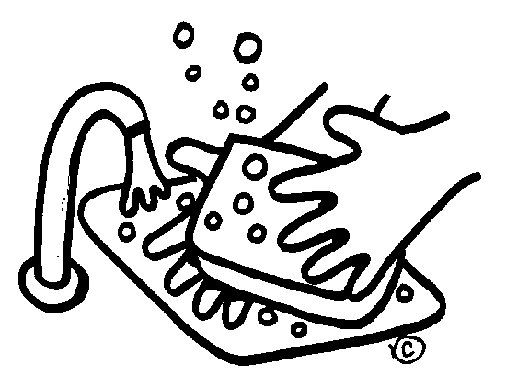
Main themes of OCD
**** sense of danger and/or responsibility.
Contamination ➔ washing.
Religious, e.g. repeating Ablution, prayers, divorce, Blasphemous.
Sexual
Aggression
Symmetry ➔ slowness
Hoarding
Notes:
Pattern of obsessive-compulsive disorder in eastern Saudi Arabia
OM Mahgoub and HB Abdel-Hafeiz Department of Psychiatry, College of Medicine, King Faisal University, Dammam, Kingdom of Saudi Arabia.
In 32 Muslim Saudis with obsessive-compulsive disorder, compulsive acts (78%) and doubts (66%) were the commonest forms. Religious themes predominated in both the obsessions and compulsions.
THE MAIN THEMES OF OCD
Contamination and washing (e.g. contaminated by one’s own excreta, shaking hands with others, etc.)
Repeated doubts concerning actions that may not have been completed adequately (e.g. ablutions, prayers, gas checking).
Insistence on symmetry: needs to have things in a particular order.
Aggressive or horrific impulses (e.g. fear of harming a child).
Sexual imagery (e.g. violent abnormal sexual practices).
Blasphemous thoughts: obsessions about religious matters.
Obsessional ruminations: internal debates in which arguments for and against even the simplest everyday actions are reviewed endlessly.
Obsessional phobias: obsessional thoughts with fearful content such as thoughts of a harmful use of knives.

Slide 43
video
Hoarding video

Slide 44
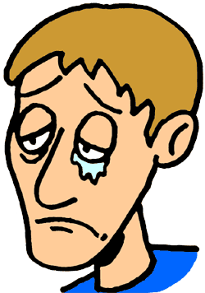
OCD
Excessive self blame & sense of responsibility
Feeling anxious
Depressive feeling
↑OCD
↑OCD

Slide 45
Course
Gradual > acute
Chronic
Waxing & waning
Notes:
Course and Prognosis:
In most cases onset is gradual but acute cases have been noted.
The majority have a chronic waxing and waning course with exacerbations related to stressful events.
Severe cases may become persistent and drug resistant.
Prognosis is worse when the patient has obsessive compulsive personality disorder.
Patient’s age, sex, age of onset and duration of OCD showed no significant correlation with outcome.
Good lasting outcome was found to be related to compliance with treatment (exposure and drugs), presence of mood component and family support.

Slide 47
Prognosis
Non – severe
No OCPD
Depressed / anxious mood
Compliance with Tx
Family support
Good p. Factors

Slide 48
video
Video: What is it like to be OCD

Slide 49
Case development
Also, her brother Saad, has the same symptoms of Layla whenever he is exposed to cues that remind him with the car accident that he had 2 years ago. Saad had serious injuries in that accident and he was in coma for 3 weeks. His friend died in the same accident. He also has flashbacks related to that accident. Also, he refuses to talk about the accident and avoids drive in the street where the accident happened.

Slide 50
Also, her brother Saad, has the same symptoms of Layla whenever he is exposed to cues that remind him with the car accident that he had 2 years ago. Saad had serious injuries in that accident and he was in coma for 3 weeks. His friend died in the same accident. He also has flashbacks related to that accident. Also, he refuses to talk about the accident and avoids drive in the street where the accident happened.

Slide 51
Anxiety Disorders
Panic Disorder
Agoraphobia
Specific Phobia
Social Phobia.
Obsessive Compulsive Disorder (OCD)
Post Traumatic Stress Disorder (PTSD), Acute Stress Disorder
Generalized Anxiety Disorder (GAD)

Slide 52
Re-experience
Flash-backs
Nightmares
Place, People
Conversations
Arousal
Sleep
Hallucinations
Cues ➔
Apathy
Detached
Hypervigilance
Irritability
Anger
Avoidance
Changes in Mood & Cognitions
Amnesia
negative beliefs
distorted cognitions ➔ blame
negative emotional state
diminished interest
Detachment
Persistent inability to experience positive emotions
TRAUMA

Slide 53
Acute stress disorder and PTSD
After exposure to traumatic life events.
Duration > a month after the event.
Acute stress disorder: occurs earlier than PTSD (within 4 weeks of the event) and remits within 2 days to 4 weeks.
Must significantly affect important areas of life (family and work)
ASD
PTSD
TRAUMA
1 month

Slide 54
Acute stress disorder and PTSD
The stressors are sufficiently overwhelming to affect almost anyone.
Arise from experiences in war, torture, natural catastrophes, assault, rape, and serious accidents, for example, in cars and in burning buildings.

Slide 55
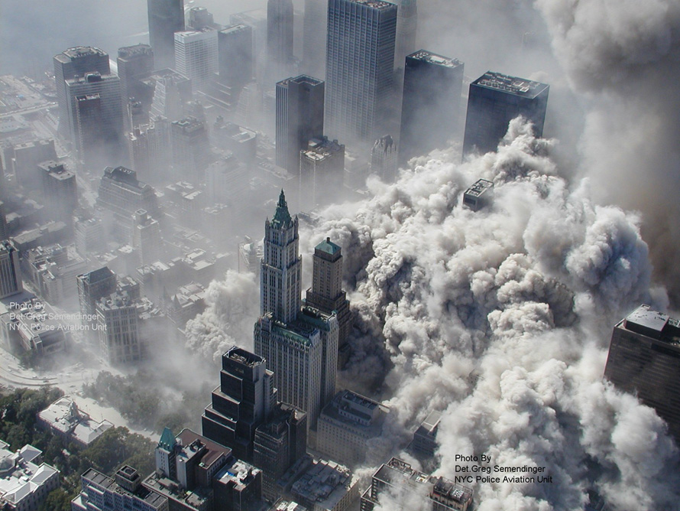
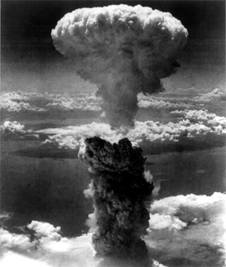
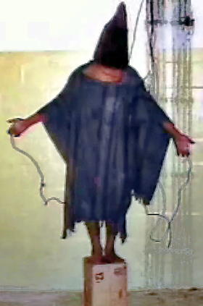
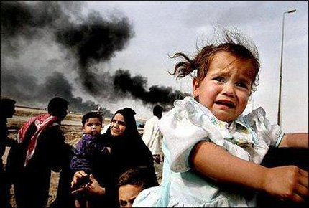
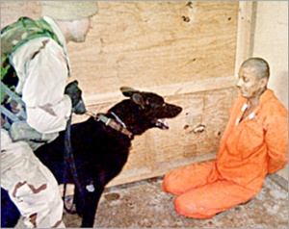

Slide 56
PTSD DSM5
Note: The following criteria apply to adults, adolescents, and children older than 6 years. For children 6 years and younger, see corresponding criteria below.
A. Exposure to actual or threatened death, serious injury, or sexual violence in one (or more) of the following ways:
1. Directly experiencing the traumatic event(s).
2. Witnessing, in person, the event(s) as it occurred to others.
3. Learning that the traumatic event(s) occurred to a close family member or close friend. In cases of actual or threatened death of a family member or friend, the event(s) must have been violent or accidental.
4. Experiencing repeated or extreme exposure to aversive details of the traumatic event(s) (e.g., first responders collecting human remains: police officers repeatedly exposed to details of child abuse). Note: Criterion A4 does not apply to exposure through electronic media, television, movies, or pictures, unless this exposure is work related.

Slide 57
PTSD DSM5
B. Presence of one (or more) of the following intrusion symptoms associated with the traumatic event(s), beginning after the traumatic event(s) occurred:
1. Recurrent, involuntary, and intrusive distressing memories of the traumatic event(s). Note: In children older than 6 years, repetitive play may occur in which themes or aspects of the traumatic event(s) are expressed.
2. Recurrent distressing dreams in which the content and/or affect of the dream are related to the traumatic event(s).Note: In children, there may be frightening dreams without recognizable content.
3. Dissociative reactions (e.g., flashbacks) in which the individual feels or acts as if the traumatic event(s) were recurring. (Such reactions may occur on a continuum, with the most extreme expression being a complete loss of awareness of present surroundings.)Note: In children, trauma-specific reenactment may occur in play.
4. Intense or prolonged psychological distress at exposure to internal or external cues that symbolize or resemble an aspect of the traumatic event(s).
5. Marked physiological reactions to internal or external cues that symbolize or resemble an aspect of the traumatic event(s).

Slide 58
PTSD DSM5
C. Persistent avoidance of stimuli associated with the traumatic event(s), beginning after the traumatic event(s) occurred, as evidenced by one or both of the following:
1. Avoidance of or efforts to avoid distressing memories, thoughts, or feelings about or closely associated with the traumatic event(s).
2. Avoidance of or efforts to avoid external reminders (people, places, conversations, activities, objects, situations) that arouse distressing memories, thoughts, or feelings about or closely associated with the traumatic event(s).

Slide 59
PTSD DSM5
D. Negative alterations in cognitions and mood associated with the traumatic event(s), beginning or worsening after the traumatic event(s) occurred, as evidenced by two (or more) of the following:
1. Inability to remember an important aspect of the traumatic event(s) (typically due to dissociative amnesia and not to other factors such as head injury, alcohol, or drugs).
2. Persistent and exaggerated negative beliefs or expectations about oneself, others, or the world (e.g., “I am bad,” “No one can be trusted,” ‘The world is completely dangerous,” “My whole nervous system is permanently ruined”).
3. Persistent, distorted cognitions about the cause or consequences of the traumatic event(s) that lead the individual to blame himself/herself or others.
4. Persistent negative emotional state (e.g., fear, horror, anger, guilt, or shame).
5. Markedly diminished interest or participation in significant activities.
6. Feelings of detachment or estrangement from others.
7. Persistent inability to experience positive emotions (e.g., inability to experience happiness, satisfaction, or loving feelings).

Slide 60
PTSD DSM5
E. Marked alterations in arousal and reactivity associated with the traumatic event(s), beginning or worsening after the traumatic event(s) occurred, as evidenced by two (or more) of the following:
1. Irritable behavior and angry outbursts (with little or no provocation) typically expressed as verbal or physical aggression toward people or objects.
2. Reckless or self-destructive behavior.
3. Hyper-vigilance.
4. Exaggerated startle response.
5. Problems with concentration.
6. Sleep disturbance (e.g., difficulty falling or staying asleep or restless sleep).

Slide 61
PTSD DSM5
F. Duration of the disturbance (Criteria B, C, D, and E) is more than 1 month.
G. The disturbance causes clinically significant distress or impairment in social, occupa­tional, or other important areas of functioning.
H. The disturbance is not attributable to the physiological effects of a substance (e.g., medication, alcohol) or another medical condition.
Specify whether:
With dissociative symptoms: The individual’s symptoms meet the criteria for post traumatic stress disorder, and in addition, in response to the stressor, the individual experiences persistent or recurrent symptoms of either of the following:
1. Depersonalization: Persistent or recurrent experiences of feeling detached from, and as if one were an outside observer of, one’s mental processes or body (e.g., feeling as though one were in a dream; feeling a sense of unreality of self or body or of time moving slowly).
2. Derealization: Persistent or recurrent experiences of unreality of surroundings (e.g., the world around the individual is experienced as unreal, dreamlike, distant, or distorted). Note: To use this subtype, the dissociative symptoms must not be attributable to the physiological effects of a substance (e.g., blackouts, behavior during alcohol intoxication) or another medical condition (e.g., complex partial seizures).
Specify if: With delayed expression: If the full diagnostic criteria are not met until at least 6 months after the event (although the onset and expression of some symptoms may be immediate).

Slide 62
PTSD epidemiology
The lifetime prevalence:
8 % of the general population.
up to 75 % in high-risk groups whose experienced traumatic events.
5 to 15 % may experience subclinical forms of the disorder.
The most important risk factors are the severity, duration, and proximity of a person's exposure to the actual trauma.
Risk Factors: single, divorced, widowed, socially withdrawn, or of low socioeconomic level.

Slide 63
Comorbidity
High rates
Two thirds (66%) having at least two other disorders.
Common:
depressive disorders
substance-related disorders
other anxiety disorders
bipolar disorders.

Slide 64
Prognosis
Fluctuate over time and may be most intense during periods of stress.
Untreated,
about 30 percent of patients recover completely,
40 percent continue to have mild symptoms,
20 percent continue to have moderate symptoms,
10 percent remain unchanged or become worse.
After 1 year, about 50 percent of patients will recover.
A good prognosis
rapid onset of the symptoms,
short duration of the symptoms (less than 6 months),
good pre-morbid functioning,
strong social supports
absence of other psychiatric, medical, or substance-related disorders or other risk factors.

Slide 65
Adjustment Disorders
The adjustment disorders: emotional response to a stressful event.
The stressor involves financial issues, a medical illness, or a relationship problem.
The symptoms must begin within 3 months of the stressor and must remit within 6 months of removal of the stressor.
3
6
9

Slide 66
DSM-IV-TR Diagnostic Criteria for Adjustment Disorders
Adjustment disorders are coded based on the subtype, which is selected according to the predominant symptoms. The specific stressor(s) can be specified on Axis IV. With depressed mood With anxiety With mixed anxiety and depressed mood With disturbance of conduct With mixed disturbance of emotions and conduct Unspecified

Slide 67
Adjustment Disorders DSM5
A. The development of emotional or behavioral symptoms in response to an identifiable stressor(s) occurring within 3 months of the onset of the stressor(s).
B. These symptoms or behaviors are clinically significant, as evidenced by one or both of the following:
1. Marked distress that is out of proportion to the severity or intensity of the stressor, taking into account the external context and the cultural factors that might influence symptom severity and presentation.
2. Significant impairment in social, occupational, or other important areas of functioning.
C. The stress-related disturbance does not meet the criteria for another mental disorder and is not merely an exacerbation of a preexisting mental disorder.

Slide 68
Adjustment Disorders DSM5
D. The symptoms do not represent normal bereavement.
E. Once the stressor or its consequences have terminated, the symptoms do not persist for more than an additional 6 months.
Specify whether:
With depressed mood: Low mood, tearfulness, or feelings of hopelessness are predominant.
With anxiety: Nervousness, worry, jitteriness, or separation anxiety is predominant.
With mixed anxiety and depressed mood: A combination of depression and anxiety is predominant.
With disturbance of conduct: Disturbance of conduct is predominant.
With mixed disturbance of emotions and conduct: Both emotional symptoms (e.g., depression, anxiety) and a disturbance of conduct are predominant.
Unspecified: For maladaptive reactions that are not classifiable as one of the specific subtypes of adjustment disorder.

Slide 69
Course and Prognosis
With appropriate treatment, the overall prognosis of an adjustment disorder is generally favorable.
Most patients return to their previous level of functioning within 3 months.
Some persons (particularly adolescents) who receive a diagnosis of an adjustment disorder later have mood disorders or substance-related disorders. Adolescents usually require a longer time to recover than adults.

Slide 70
Bereavement, Grief, and Mourning
Psychological reactions of those who survive a significant loss.
Mourning is the process by which grief is resolved.
Bereavement literally means the state of being deprived of someone by death and refers to being in the state of mourning.

Slide 71
Normal Bereavement Reactions
Stage 1: Shock and Denial
Stage 2: Anger
Stage 3: Bargaining
Stage 4: Depression
Stage 5: Acceptance

Slide 72
SUMMARY: Bereavement or depression ?
In bereavement :
NO morbid feelings of guilt and worthlessness, suicidal ideation, or psychomotor retardation.
Dysphoria often triggered by thoughts or reminders of the deceased.
Onset is within the first 2 months of bereavement.
Duration of depressive symptoms is less than 2 months.
Functional impairment is transient and mild.
No family or personal history of major depression.

Slide 73
Case Development
Her aunt is anxious for the last 8 years. She has excessive worries about daily events mainly toward safety of her kids.

Slide 74
Anxiety Disorders
Panic Disorder
Agoraphobia
Specific Phobia
Social Phobia.
Obsessive Compulsive Disorder (OCD)
Post Traumatic Stress Disorder (PTSD), Acute Stress Disorder
Generalized Anxiety Disorder (GAD)

Slide 75
Generalized Anxiety Disorder
Criteria:
Excessive worries about many events :
( routine themes “everyday events”, Difficult to control or relax, not productive).
Multiple physical & psychological features.
Significant impairment in function.
Not due to GMC , substance abuse or other
axis I psychiatric disorder.
6 months duration – most of the time
Notes:
Craske, Barlow and O'Leary recommend asking yourself the following questions to determine if you are worrying too much:
¨ Do you worry about things that you recognize most people do not worry about (such as little things around your home)?
¨ Do you find it very difficult to stop worrying, and cannot relax as a result?
¨ Does your worry rarely result in your reaching a possible solution for a particular problem?
¨ Do you believe that if you do not worry a terrible event will actually happen?
¨ Do you worry about not being worried, or worry when everything is going well in your life?
Generalized Anxiety Disorder (GAD)
If your worry is interfering with your daily life and you experience a high level of physical tension, you may fit the criteria for Generalized Anxiety Disorder (GAD). GAD is characterized by 6 months or more of chronic, exaggerated worry and tension that is unfounded or much more severe than the normal anxiety most people experience. People with this disorder usually expect the worst; they worry excessively about money, health, family, or work, even when there are no signs of trouble. People with GAD can't seem to shake their concerns, even though they usually realize that their anxiety is more intense than the situation warrants. People with GAD also seem unable to relax and often have trouble falling or staying asleep. Their worries are accompanied by physical symptoms, especially trembling, twitching, muscle tension, headaches, irritability, sweating, or hot flashes.

Slide 76
Generalized Anxiety Disorder DSM5
A. Excessive anxiety and worry (apprehensive expectation), occurring more days than not for at least 6 months, about a number of events or activities (such as work or school performance).
B. The individual finds it difficult to control the worry.
C. The anxiety and worry are associated with three (or more) of the following six symptoms (with at least some symptoms having been present for more days than not for the past 6 months); Note: Only one item is required in children.
1. Restlessness or feeling keyed up or on edge.
^{2. Being easily fatigued.}
3. Difficulty concentrating or mind going blank.
^{4. Irritability.}
^{5. Muscle tension.}
6.Sleep disturbance (difficulty falling or staying asleep, or restless, unsatisfying sleep).

Slide 77
Generalized Anxiety Disorder DSM5
^{D.} The anxiety, worry, or physical symptoms cause clinically significant distress or impairment in social, occupational, or other important areas of functioning.
E. The disturbance is not attributable to the physiological effects of a substance (e.g., a drug of abuse, a medication) or another medical condition (e.g., hyperthyroidism).
F. The disturbance is not better explained by another mental disorder (e.g., anxiety or worry about having panic attacks in panic disorder, negative evaluation in social anxiety disorder [social phobia], contamination or other obsessions in obsessive-compulsive disorder, separation from attachment figures in separation anxiety disorder, reminders of traumatic events in posttraumatic stress disorder, gaining weight in anorexia nervosa, physical complaints in somatic symptom disorder, perceived appearance flaws in body dysmorphic disorder, having a serious illness in illness anxiety disorder, or the content of delusional beliefs in schizophrenia or delusional ^{disorder).}

Slide 78
Generalized Anxiety Disorder
Associated features:
panic attacks (episodes of short severe anxiety).
Sadness +/- weeping
Overconcerned about body functions (heart, brain,...)
MSE :
Tense posture, excessive movement
e.g. hands (tremor) & head, excessive blinking
Sweating.
Difficulty in inhalation.

Slide 80
Generalized Anxiety Disorder
Course & Prognosis
If not properly treated :
chronic, fluctuating & worsens with stress.
Secondary depression .
Possible physical complications: e.g. HTN,DM,IHD
Poor Prognostic Factors:
Very severe symptoms
Personality problems
Uncooperative patient.
Derealization
Notes:
The course is often chronic, fluctuating and worsen during times of stress. Symptoms may diminish as patient gets older. Over time, patient may develop secondary depression (not uncommon if left untreated). When patient complains mainly of physical symptoms of anxiety and attributes these symptoms to physical causes, he generally seems more difficult to help. Poorer prognosis is associated with severe symptoms and with derealization, syncopal episodes, agitation and hysterical features.

Slide 81
Anxiety .. In general

Slide 82
ABNORMAL ANXIETY | NORMAL ANXIETY
Out of proportion body responses > External trigger Many – severe – prolonged & interfere with life. GAD-Panic-Phobias Acute &PTSD- …etc | Proportional to the trigger (time & severity). External trigger > body responses. few - not severe - not prolonged & minimal effect on life . Trait (character) State (situational) | 1-Apprehension 2- Attention 3- Features 4- Types

Slide 83
Anxiety Disorders
DANGER
COPING

Slide 84
Vicious cycle of panic attack

Slide 85
Mental Disorders among Adults (18 and older), in the past year (2001)

Slide 86
William R Yates, Anxiety Disorders: Multimedia 2010
Notes:
Anxiety Disorders: Multimedia
Author: William R Yates, MD, MS, Research Psychiatrist, Laureate Institute for Brain Research; Professor of Research, Department of Psychiatry, University of Oklahoma College of Medicine at Tulsa Contributor Information and Disclosures
Updated: Apr 20, 2010

Slide 87
William R Yates, Anxiety Disorders: Multimedia 2010
Notes:
Anxiety Disorders: Multimedia
Author: William R Yates, MD, MS, Research Psychiatrist, Laureate Institute for Brain Research; Professor of Research, Department of Psychiatry, University of Oklahoma College of Medicine at Tulsa Contributor Information and Disclosures
Updated: Apr 20, 2010

Slide 88
Fear network
Fear network centered in the Amygdala which has interaction with :
Hippocampus, hypothalamic and brainstem sites (observed signs of fear responses)
Neuroanatomical Hypothesis of Panic Disorder, Revised, Jack M,2004

Slide 89
Prognosis
Depends on:
Dx (Psychosis ➔ Mood ➔ Anxiety)
Severity
Duration
Support
Compliance

Slide 90
Summary
Case
Hx
MSE
Types of Anxiety

