Slide 1
Anesthesia for healthy patient
Group A:
Saeed Nassar
Talal Al Hoshan
Faisal Almojel
Hatim Alebdi
Moaz Al Battah

Slide 2
Case :3
A 52-year-old man has had progressive knee pain with swelling, His orthopedic surgeon has tentatively diagnosed a torn meniscus, and recommended an arthroscopy as an outpatient. The patient has had no major illnesses other than the typical childhood diseases. He has had no previous operations or anesthetics, nor a family history of problems with anesthesia. He has no allergies to medications, does not smoke, diabetics on oral medication blood sugar is controlled . His laboratory results and physical examination by an internist were all normal. He has had nothing to eat or drink since he went to bed last night.

Slide 3

- What is ASA status?

Slide 4
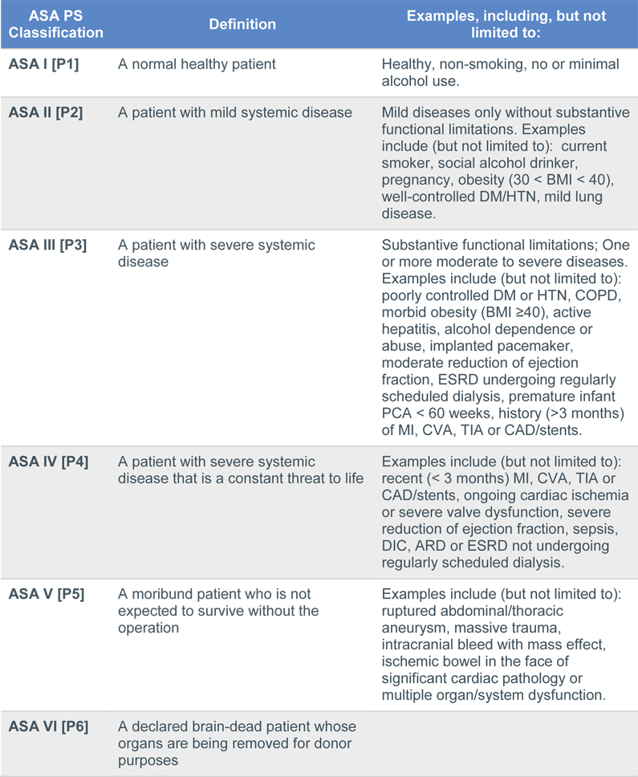

Slide 5
According to the previous ASA classification table this patient in which grade :
•He is on grade 2 of ASA Classification.

Slide 6
How will you prepare a diabetic patient for surgery ?
Determine the type of diabetes and its management .
it is important to confirm the form of diabetes present, as patients with type 1 diabetes must continue a basal rate insulin replacement preoperatively while patients on oral hypoglycemics should stop using them 1 day before surgery
Ensure that the patient’s diabetes is well controlled .
Ensure that the patient is capable of managing their diabetes after discharge from hospital .
Consider the presence of complications of diabetes that might be adversely affected by or that might adversely impact upon the outcome of the proposed procedure .

Slide 7
On examination, the patient weighs 75 Kg and is 182 cm tall. His neck appears to be flexible and mobile. He opens his mouth without difficulty, and with his head extended and tongue protruding, his uvula is completely visible.

Slide 8
Discuss the airway assessment for this patient?
History
Past anesthetic history
Surgery/radiotherapy to head and neck.
Obstructive sleep apnea (OSA)
Conditions affecting tongue size (e.g. acromegaly, infections, tumors(
Conditions affecting neck mobility (e.g. ankylosing spondylitis, infections, tumors.)
Conditions affecting mouth opening (e.g. temporomandibular joint dysfunction )

Slide 9

- Discuss the airway assessment for this patient?
LEMON criteria
L Look externally
E Examination
M Mallampati
O Obstruction
N Neck mobility

Slide 10
Mallampati Classification

Slide 11
preoperative assessment clinic
Anesthetic consent should be taken.
Discuss types of anesthesia
Explain the side effects
- Discuss anesthesia plan for this patient
1) Pre-Operative Management:

Slide 12
2) Intra-Operative Management:
Before moving into the operating theater
•To establish IV access.
•Apply monitors:
  ECG.
  Pulse Oximeter
  non- invasive blood pressure monitoring
At the OR
•Airway must be secured
  (e.g. with an LMA or
  endotracheal tube)
•Then further motoring/interventions are performed
  (e.g. nasogastric tube urinary catheter insertion occur, if indicated.)
Notes:
Laryngeal mask airway

Slide 13
3) Post Operative Management:
End Of
Operation
•Extubated in the operating theater (and an oropharyngeal airway inserted if needed.(
•Transferred to the recovery room with an LMA still in situ.
All patients receive supplemental oxygen during transfer .
In Recovery
Room
1. patient's name and age. 5. antiemetics given
2. operation details 6. Antibiotics
3. blood loss 7. thromboprophylaxis
4. analgesia given
Leave Recovery
Room?
Awake and in complete control of airway reflexes .
Pain free.
3. No/minimal nausea and vomiting.
4. No/minimal bleeding from surgical site.
5. Normothermic.

Slide 14
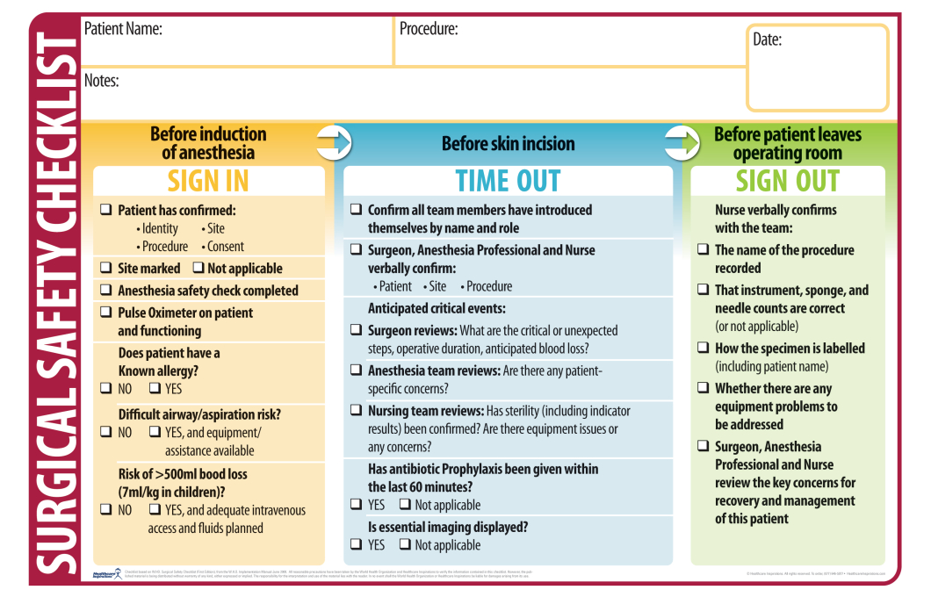
What is the check list for sign in and time out?

Slide 15
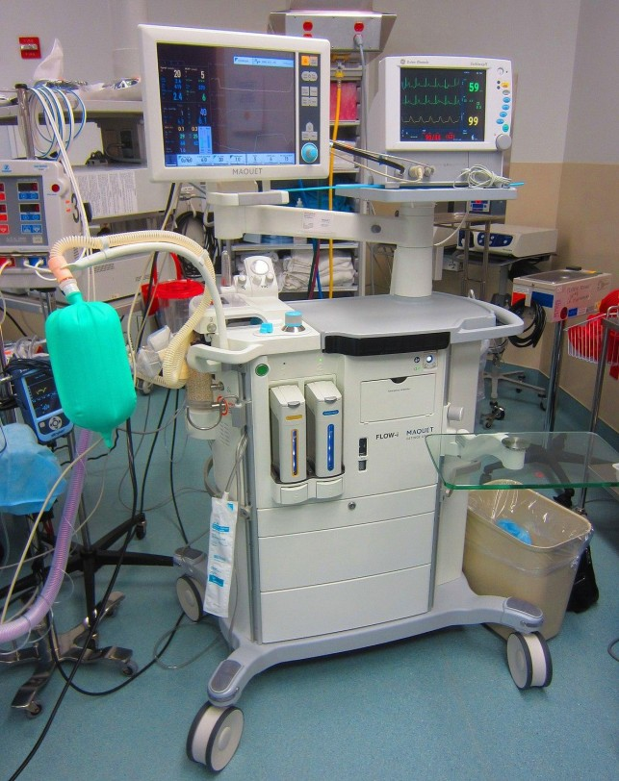
Discuss the safety features of anesthesia machine
•Non-interchangeable screw threads (NISTs) prevent the incorrect
pipeline gas being connected to the machine inlet
•A pin index system is used to prevent incorrect cylinder connection.
•Pressure reducing valves/regulators and flow restrictors to prevent barotrauma
•The oxygen failure warning alarm is pressure driven and alerts of imminent pipeline or cylinder failure
•Interlocking vaporizers on the back bar prevent two anesthetic vapors from being given simultaneously

Slide 16
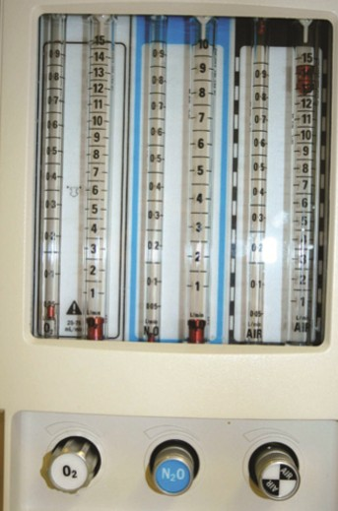
Discuss the safety features of anesthesia
machine
• Flow delivered through the anaesthetic machine is displayed by a bobbin within a rotameter to allow accurate gas delivery.
• Hypoxic guard: the O2 and N2O control knobs are linked, preventing <25% O2 being delivered when N2O is used.
• Emergency oxygen flush: when pressed, oxygen bypasses the back bar and is 35 < delivered to the CGO (common gas outlet) atL/min

Slide 17
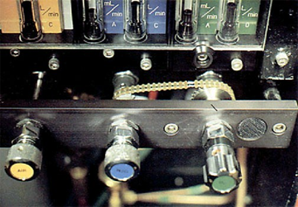
Discuss the safety features of anesthesia machine
Suction: generated suction is used to clear airway-pressure-adjustable negative secretions/vomit and must be available for all cases
Scavenged gases are usually vented to the atmosphere. Scavenging tubing has a 30 ) wider boremm), preventing accidental connection to breathing circuits.
Ventilator alarms warn of high and low pressure.

Slide 18
References :
https://www.asahq.org/resources/clinical-information/asa-physical-status-classification-system
PERI-OPERATIVE DIABETES MANAGEMENT GUIDELINES AUSTRALIAN DIABETES SOCIETY 2012
Anesthesia At a Glance , Julian Stones and William Fawcett. 2013

Slide 19
THANK YOU

