Slide 1
UNDER GRADUATE ANESTHESIA COURSE (ORIENTATION AND OUTLINE)
Dr. Jumana. M. Baaj
Ass. professor , Anesthesia consultant
Dept. of Anesthesia
KKUH- KSU
Riyadh, Saudi Arabia

Slide 2
TABLE OF CONTENTS:
Welcome
Introduction
The roles of the Anesthesiologist
Orientation
Code of conduct
Learning Resources
Objectives

Slide 3
Welcome
Welcome to this two week introduction to Clinical Anesthesiology.
You will learn to use technical and analytical skills , how to look after patients in many situations – some are routine and others very challenging.

Slide 4
Introduction
This is a guide for the Undergraduate Electives Course in Anesthesia.
Its purpose is to provide a course outline for 4th year medical students.
By creating a structured approach we hope to provide a consistent experience for students learning the basics of anesthesia.

Slide 5
course aim
To graduate medical students having the basic knowledge & clinical skills to deal with the peri-anaesthetic measures for simple surgical procedures.

Slide 6
Goals and learning objectives
Academic and Clinical skills:
Preoperative evaluation and clinical skills
Airway and ventilation
Fluid and volume resuscitation, electrolyte balance and acid-base
Pharmacology of anesthetic drugs
Principles of general anesthesia
Principles of regional anesthesia
Pain management
Monitoring in anesthesia
Anesthesia emergencies (intraoperative , Post operative period)
Patient safety , surgical safety check list

Slide 7
Role of anaesthetist in the preoperative care Lecture (1.30 hours)
student will learn pre-anesthetic patient evaluation and risk stratification.
Obtain a full history and physical examination including allergies, current medications, past anesthetic history, family anesthetic history
Understand how patient co-morbidities can affect the anesthetic plan.
Understand potential anesthetic options for a given surgical procedure.
Understand the basics of an anesthetic plan and how it relates to the clinical work-up ASA classification of pre-operative physical status.
Understand risk stratification of a patient undergoing anesthesia.

Slide 8
Patient safety
Discuss major and minor anesthesia complication
Causes of Mortality in anesthesia
What make anesthesia safe
Factors influence the anesthesia safety and patient outcome
Mandatory standard for anestehsia
Post crisis recommendation

Slide 9
General anaesthesia technique
Definition of general Anaesthesia
Learn about several agents used on induction methods of general anaesthesia including intravenous agents, Understand the principles of general anesthesia and the delivery of volatile anesthetics
stages of general anesthesia .
Role of anesthesit in intraoperative period.
Complications commonly encountered intra-operatively
Have a basic understanding of the structure, function and safety features of the anesthesia machine.
general anaesthesia

Slide 10
Pharmacology of general anesthetics
Intravenous Anesthetics , Inhaled anesthetic agents (The minimum alveolar concentration (MAC) , Learning The opioids most commonly used
Learn Pharmacokinetics, Pharmacodynamics
Know Main uses
Know Advantages and disadvantages
How to deal with Adverse reactions
Neuromuscular blockade
Know Types
Depolarizing neuromuscular blockade, Nondepolarizing blockade
Reversal of muscle relaxants and recuraization
Malignant hyperthermia (MH) syndrome diagnosis and managements

Slide 11
Airway Management and equipment
Learn about basic airway anatomy
Conduct a preoperative airway assessment
Identify a potentially difficult airway
Understand the issues around aspiration and its prevention
Learn about the management of airway obstruction
Become familiar with airway equipment
Practice airway management skills including bag and mask ventilation, laryngeal mask insertion, endotracheal intubation
Learn about controlled ventilation and become familiar with ventilatory parameters
Appreciate the different ways of monitoring oxygenation and ventilation

Slide 12
Regional Anaesthesia Techniques (2 hours)
What are the risks and benefits of regional (epidural/spinal) anesthesia/analgesia?
What are the indication ,contraindications to regional anesthesia ,complication of regional anesthesia
How do you prevent hypotension following epidural/spinal anesthesia?
Post dural puncture headache management

Slide 13
Regional anesthesia and Pain management
Be familiar with the concept of local and regional anesthesia and commonly used local anesthetic agents.
Be familiar with perioperative pain management techniques and drugs.
Local anesthesia toxicity

Slide 14
Fluid Requirements and Fluid Therapy 6-Intravenous Fluid Resuscitation and Blood Transfusion (2 hours)
What perioperative factors affect the patient’s fluid requirements?
How do you estimate maintenance fluid requirements?
What are some common conditions associated with preoperative fluid deficits?
List the potential physical and laboratory findings seen in a patient with a volume deficit.
How do you calculate the patient’s preoperative requirements .
Electrolyte and acid-base balance management .
fluid deficits?

Slide 15
Intravenous Fluids and blood Transfusion
Crystalloids
What is the difference between normal saline, and Ringer's lactate?
What are the advantages and disadvantages of crystalloids?
Colloids
What colloid preparations are available for clinical use?
What are some advantages and potential side effects of hetastarch?
When to use 5% or 25% albumin preparation in volume resuscitation?
When is plasma indicated?
Electrolyte and acid base palance

Slide 16
Blood Transfusion
Blood And Blood Product Tranfusion
Indication , Contraindication
Complication , Managment

Slide 17
Monitoring In anesthesia
Monitors :
non-invasive blood pressure
ECG
pulse oximetry capnography (CO2 monitor) and oxygen analyzer
Temperature , nerve stimulator
Specialized monitors :
arterial line (invasive blood pressure)
central venous line (cvp monitoring)
pulmonary artery flotation catheter ( monitors function of right and left side of the heart)
BIS monitor (depth of anesthesia)

Slide 18
Vascular Access
Examine the construction of the commonly used venous catheters.
Anatomical considerations regarding peripheral and central venous access.
Discuss the choice of catheter size.
Prepare and set-up an IV infusion set. Why do you need a gas-fluid level in the drip chamber?
Discuss the choice of sites for placement of IV catheters.
What are the different sites suitable for central venous catheter placement?
Discuss universal precautions.
Indications and complications of central venous access

Slide 19
Post operative pain management
Goal Of Pain Treatment
Pain Physiology
Classification Of Pain
Systemic Response To The Pain
Pain assessment including different scores of pain assessment
Post operative pain management including WHO ladder step with patient control analgesia and epidural analgesia , PCA .

Slide 20
Objectives in the operative room
General Anesthesia
Anesthetic Machine: Identify the sources of oxygen, nitrous oxide and volatile agents; safety features
Options for airway management in the anesthetized patient, Rapid Sequence Induction, and monitoring:
Recognize and be able to list a differential diagnosis of hypoxaemia and hypercarbia and the basic management of these problems.

Slide 21
Orientation with anesthesia equipment in O.R
Anesthesia machine
Anesthesia circuits
Laryngoscopes – tubes – LMA – Airways
Epidural set &Spinal set
Monitors- Anesthesia Record
Anesthetics Drugs- I.V. Inhalational & Muscle Relaxants
Resuscitation Drugs During Anesthesia
fluids (Crystalloids & Colloids Fluids)

Slide 22
Objectives for the Airway Skills
Bag & Mask Ventilation
Practice bag and mask ventilation
What are some common problems encountered when trying to ventilate patients using a bag and mask?
Laryngoscopy & Endotracheal Intubation
Describe the appropriate patient position for laryngoscopy and intubation.
Practice the skill of laryngoscopy during your rotation.
Why do we administer oxygen prior to laryngoscopy and endotracheal intubation?
Discuss the laryngeal grading system.
How can the correct placement of the endotracheal tube be confirmed?
List the indications for an endotracheal intubation.
What are some potential complications of endotracheal intubation.
Understand criteria for endotracheal extubation.

Slide 23
Objectives for the Airway
Laryngeal Mask (LMA) Insertion
Which patients are suitable for a general anesthetic with an LMA?
What are the advantages of the LMA over an endotracheal tube?
Does the LMA protect against aspiration?
Learn how to insert an LMA.

Slide 24
Objective for RR
Receiving the patient from operating theatre from anesthesia doctor and OR nurse to recovery room staff
Connection of standard ASA monitor in RR
Check All Vital Signs Urine out put
Evaluate pain score
Identify methods of post-operative analgesia used (IV opioids. PCA, epidural peripheral nerve block )
Complication Management ( vomiting , hypoxia , hypotension , shivering …..)

Slide 25
Objective for pre-operative assessment
Obtain a full history and physical examination including allergies, current medications, past anesthetic history, family anesthetic history
Understand how patient co-morbidities can affect the anesthetic plan
Able to plan an anesthetic for a basic surgical procedure
Understand risk stratification of a patient undergoing anesthesia

Slide 26
Intra and post operative complication management
Learn basic management of common intra-operative problems such as:
Hypoxia, hypercarbia,
Hyper/hypotension, cardiac arrhythmias,
High and low airway pressure alarm.
Understanding of the requirements for safe emergence from general anesthesia and common problems and complications in the PACU
Post –op nausea and vomiting, pain hypertension , hypotension , shivering etc ….

Slide 27
Code of conduct
Professionalism and Respectful Workplace
All students are expected to demonstrate respect for the patients and staff encountered during the rotation.
We also expect all students to be treated with respect during their rotation.
Health has clear policies regarding:
Maintenance of patient confidentiality.
Mutual respect in the workplace.

Slide 28
Code of conduct
Professionalism
Attendance and punctuality are mandatory.
Students are expected to be aware of the limitations of their role in the operating room and to be diligent in the OR environment.

Slide 29
Code of conduct
Dress code
When in the OR, students must respect the rules of the sterile environment and wear greens, mask, gloves and bootes.
If you have not previously been in the OR, please notify us so we can make you aware of appropriate protocol.
You are expected to bring your stethoscope to the OR. Other medical instruments are not mandatory.

Slide 30
LEARNING RESOURCES Anesthesia course
Exposure to anesthesia learning in the following areas:
Adult OR
Pediatric OR
Teaching at the bedside in the OR:
Clinical teaching modules to cover basic anesthesia knowledge.
Enabling objectives for technical skills.
Case based clinical teaching
Independent learning:
Reference material- texts and web-based
Simulator based learning:
Low and high fidelity simulation to facilitate technical skills, crisis resource management, and critical anesthesia events.

Slide 31
Intra and post operative management
Learn basic management of common intra-operative problems such as:
Hypoxia, hypercarbia,
Hyper/hypotension, cardiac arrhythmias,
High and low airway pressure alarm.
Understanding of the requirements for safe emergence from general anesthesia and common problems and complications in the PACU
Post –op nausea and vomiting, pain etc

Slide 32
The anesthetic plan

Slide 33
The anesthetic plan
Type of anesthesia
General
Induction
Airway management
Maintenance and analgesia
Muscle relaxation
Sedation
Supplemental oxygen
Agents
Local or regional anesthesia
Technique
Agents

Slide 34
The anesthetic plan
Intraoperative management
Monitoring
Positioning
Fluid management
Special techniques
Postoperative
Oxygen therapy
Pain control
Complication management
Intensive care
Postoperative ventilation
Hemodynamic monitoring

Slide 35
Stages of the Peri-Operative Period
Pre-Operative
From time of decision to have surgery until admitted into the OR theatre.

Slide 38
Stages of the Peri-Operative Period
Intra-Operative
Time from entering the OR theatre to entering the Recovering Room or Post Anesthetic Care Unit (PACU)

Slide 39
Post anesthesia care units (recovery room )

Slide 40
Stages of the Peri-Operative Period
Post-Operative
Time from leaving the PACU until time of follow-up evaluation (often as out-patient)

Slide 42
Key Success Factors
Attendance
Realistic Expectations
Maintains communication with the faculty member
Good organizational skills
Expect to work beyond the classroom
Stay on track/understand commitment required
Ask questions

Slide 43
Books recommended
Anaesthesiaat a Glance
Julian Stone
Consultant Anaesthetist
Great Western Hospital NHS Foundation Trust
Swindon, UK;
Senior Clinical Lecturer University of Bristol, Bristol UK
William Fawcett
Consultant Anaesthetist
Royal Surrey County Hospital NHS Foundation Trust;
Senior Fellow
Postgraduate Medical School, University of Surrey
Guildford, UK

Slide 44
Books recommended as a Text
Morgan and Mekhails clinical anesthesiology 5th Edition . John Butterworth, G. Morgan, John Wasnick, Mikhail Maged, David C. Mackey, Hans-Joachim Priebe

Slide 45
End of the course ASSESMENT
LOG BOOK SUBMISSION
OSCE EXAMINATION
WRITTEN EXAMINATION

Slide 46
ANESTHESIA DEPARTMENT 4692019
Dr Jumana 46921865 BLEEP 0320
Dr.Mueen 4692190 BLEEP 0821
Dr Waleed 4692356 BLEEP 2032 Mobile No.0547874681
Mr.Waleed Alzuhiri 4692356

Slide 47
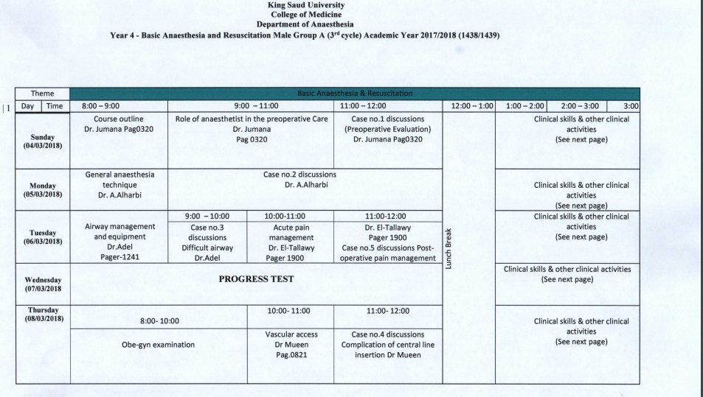

Slide 48
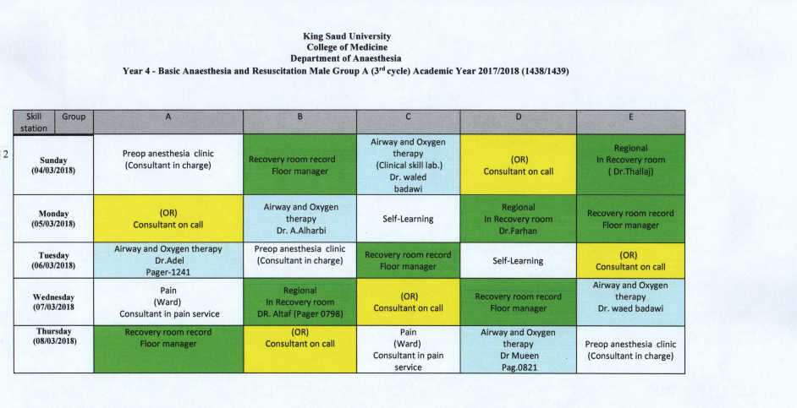

Slide 49
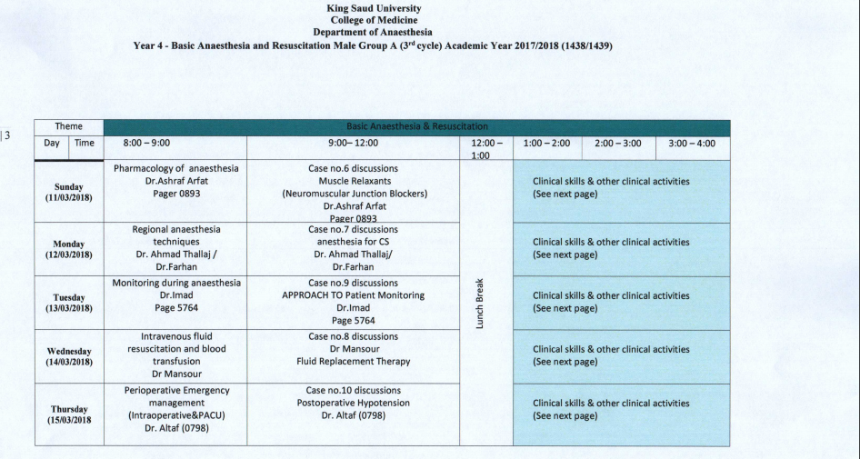

Slide 50
