Slide 1
VASCULAR ACCESS
ESSAM M. MANAA
Assisstant Professor and Consultant
Department of Anesthesia
KKUH, KSU, RIYADH

Slide 2
Lecture Objectives..
Examine the construction of the commonly used venous catheters.
Anatomical considerations regarding peripheral and central venous access.
Prepare and set-up an IV infusion set.
What are the different sites suitable for central venous catheter and arterial catheter placement?
Universal precautions.
Indications and complications of central venous access
Indications and complications of arterial access

Slide 3
Medical Asepsis
Removal or destruction of disease-causing organisms or infected material
Sterile technique (surgical asepsis)
Clean technique

Slide 4
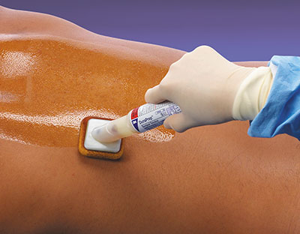
Disinfectants & Antiseptics
Chemical agents used to kill specific microorganisms
Disinfectants
Used on nonliving objects
Toxic to living tissue
(Chlorine boiling,
filtration and ultraviolet irradiation)
Antiseptics
Applied to living tissue
More dilute to prevent cell damage (Chlorhexidine polyvidone-iodine Ethanol)

Slide 5
Universal Precautions
Universal standard precautions on every patient
Observe hand washing and gloving procedures
Face shields indicated during clean procedures
Sterile gowns plus above all for sterile procedures.

Slide 6
Types of IV Catheters
Hollow needles
Butterfly type
Indwelling plastic catheter over hollow needle
Indwelling plastic catheter inserted through a hollow needle
Intracath

Slide 7
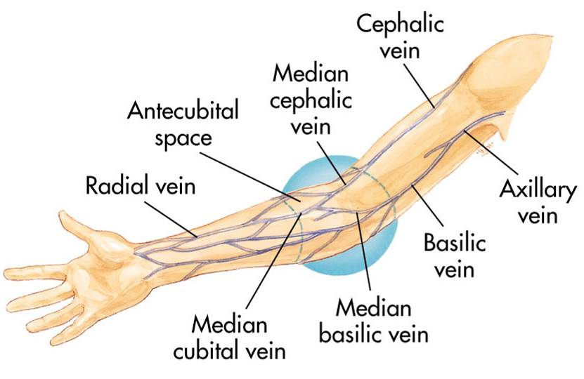
Peripheral IV Insertion
Common sites:
Hands and arms
Antecubital fossa (AC space)

Slide 8
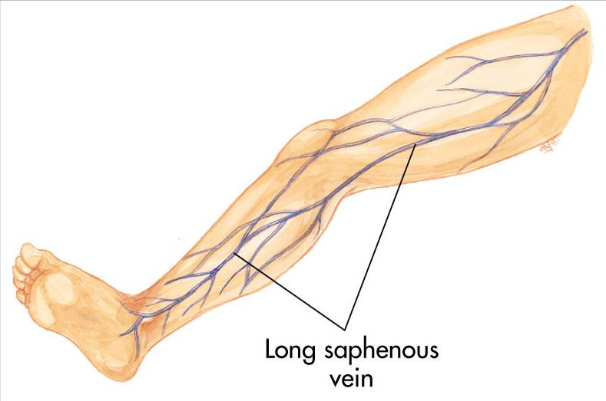
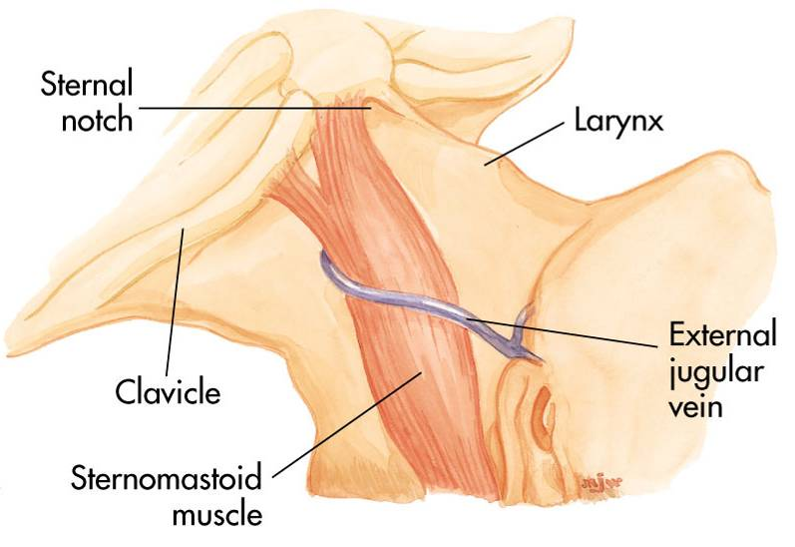
Peripheral IV Insertion
Alternate sites:
Long saphenous veins
External jugular veins
Embolism and infection rates higher

Slide 9
Peripheral IV Insertion
Avoid sites that have injury or disease:
Trauma
Dialysis fistula
History of mastectomy

Slide 10
Peripheral IV Procedure
Explain procedure
Assemble equipment
Inspect fluid for contamination, appearance, and expiration date
Prepare infusion set
Attach infusion set to bag of solution

Slide 11
Peripheral IV Procedure
Clamp tubing and squeeze reservoir on infusion set until it fills half way
Open clamp and flush air from tubing
Close clamp
Maintain aseptic technique

Slide 12
Peripheral IV Procedure
Put on gloves
Select site
Apply tourniquet
Prepare site
Cleanse area

Slide 13
Peripheral IV Procedure
Stabilize vein
Apply pressure and tension to point of entry

Slide 14
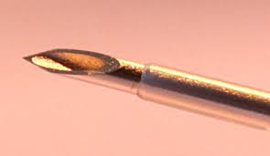
Peripheral IV Insertion
Bevel of the needle up
Pass needle through skin into vein from side or directly on top

Slide 15
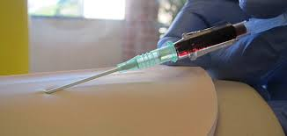
Peripheral IV Procedure
Advance needle and catheter about 2 mm past point where blood return is seen in hub of needle
Slide catheter over needle and into vein

Slide 16
Peripheral IV Procedure
Withdraw needle while stabilizing catheter
Lock in protective sheath if present
Apply pressure on proximal end of catheter to stop escaping blood
Obtain blood samples if needed

Slide 17
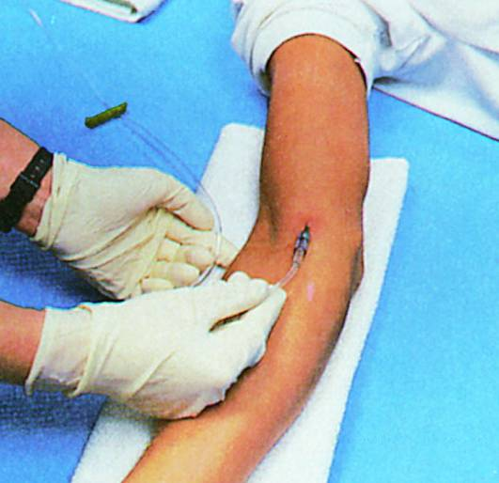
Peripheral IV Procedure
Release tourniquet
Attach IV tubing

Slide 18
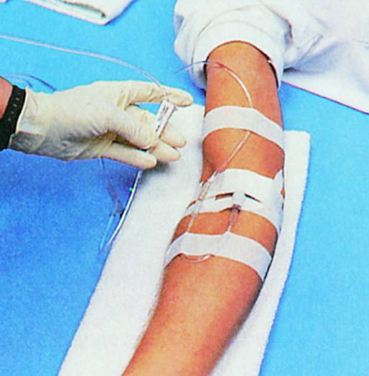
Peripheral IV Procedure
Open tubing clamp and allow fluid infusion to begin at prescribed flow rate

Slide 19
Peripheral IV Procedure
Cover puncture site dressing
Antibiotic ointment if indicated by protocol
Anchor tubing
Secure catheter
Document procedure
Monitor flow

Slide 20
Local Complications
Pain and irritation
Extravasation and Infiltration
Phlebitis
Thrombophlebitis
Hematoma
Venous spasm
Cellulitis

Slide 21
Infiltration
Dislodgement of catheter or needle cannula during venipuncture
Puncture of vein wall during venipuncture
Leakage of solution into surrounding tissue from insertion site
Poorly secured IV
Poor vein or site selection
Irritating solution inflames vein’s intima
Improper cannula size
High delivery rate or pressure

Slide 22
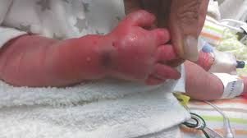

Slide 23
Infiltration—Management
Lower fluid reservoir to check for presence of backflow of blood into the tubing
Absence of backflow suggests infiltration
Discontinue IV infusion
Remove needle or catheter
Apply a pressure dressing to the site
Choose new site
Initiate IV therapy with new equipment
Document

Slide 24
Central Venous Access
Requires special training
Authorization from medical direction
Not for rapid fluid replacement in pre-hospital setting
Within scope of paramedic practice in some EMS systems

Slide 25
Central Venous Access
Common Sites include:
Femoral vein
Internal jugular vein
Subclavian vein

Slide 26
Central Venous Access
Prepare as for peripheral veins
Sterile procedure
Success depends on:
Patient's body position
Knowledge of anatomy
Familiarity with the procedure and equipment

Slide 27
Femoral Vein Anatomy

Slide 28
Femoral Vein Cannulation

Slide 29
Internal Jugular Vein Anatomy

Slide 30
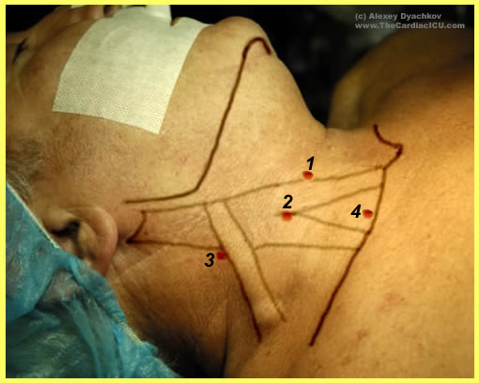
Internal Jugular Vein Cannulation

Slide 31
Subclavian Vein Anatomy

Slide 32
Subclavian Vein Cannulation

Slide 33
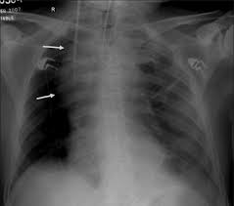
Central Venous Access

Slide 34
Central Venous Access
Indications
Available when peripheral vessels collapse
Access to central pressure measurements
In-hospital procedure
Safer vasopressor administration

Slide 35
Central Venous Access
Disadvantages
Excessive time for placement
Sterile technique
Special equipment
Skill deterioration
High complication rate
Pneumothorax, arterial injury, abnormal placement
Chest x-ray should be obtained immediately

Slide 36
Systemic Complications
Contamination and infection
Hypersensitivity reactions
Sepsis
Emboli (blood clot, air, and catheter)

Slide 37
Air Embolism
Uncommon but can be fatal (coronary –cerebral – systemic)
Air enters bloodstream through catheter tubing
Risk greatest with catheter in central circulation
Negative pressure may pull air in

Slide 38
Air Embolism
Air can enter circulation
During catheter insertion
If tubing is disconnected
If enough air enters the heart chamber:
Blood flow is impeded
Shock develops

Slide 39
Air Embolism
Signs and symptoms
Hypotension
Cyanosis
Weak and rapid pulse
Loss of consciousness

Slide 40
Air Embolism
Management
Close the tubing
Turn patient on left side with head down
Check tubing for leaks
Administer100% Oxygen
Notify medical direction

Slide 41
Complications—Central Veins
Femoral vein
Local complications
Systemic complications
Internal jugular and subclavian veins
Local complications
Systemic complications

Slide 42
Indwelling Vascular Devices
Heparin or saline lock

Slide 43
Indwelling Vascular Devices
Single-, dual-, and triple-lumen catheters

Slide 44
Ultrasound guided IV insertion

Slide 45
Ultrasound guided CVC insertion

Slide 46
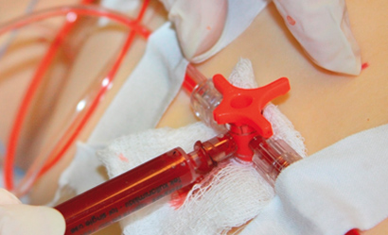
Arterial Line Placement
Provide continuous blood pressure (BP) monitoring
Arterial blood sampling

Slide 47
Arterial line placement Indications
Continuous arterial BP monitoring - more accurate than NIBP
Inability to use indirect BP monitoring (eg, in patients with severe burns or morbid obesity)
Frequent blood sampling
Frequent arterial blood gas sampling

Slide 48
Contraindications for arterial line placement
Absolute
Relative
Absent pulse
Thromboangiitis obliterans (Buerger disease)
Inadequate circulation to the extremity
Raynaud syndrome
Anticoagulation
Atherosclerosis
Coagulopathy
Inadequate collateral flow
Infection at the cannulation site
Partial-thickness burn at the cannulation site
Previous surgery in the area
Synthetic vascular graft

Slide 49
Technical Considerations
Requires appropriate knowledge of the anatomy and procedural skills.
Arterial line placement is considered a safe.
Major complications that is below 1%.
Common site of cannulation :
radial, ulnar, brachial, axillary, posterior tibial, femoral, and dorsalis pedis arteries.

Slide 50
Allen test
The Allen test is a worldwide used test to determine whether the patency of the radial or ulnar artery is normal.
It is performed prior to radial cannulation or catheterization.
The test is used to reduce the risk of ischemia to the hand.

Slide 51
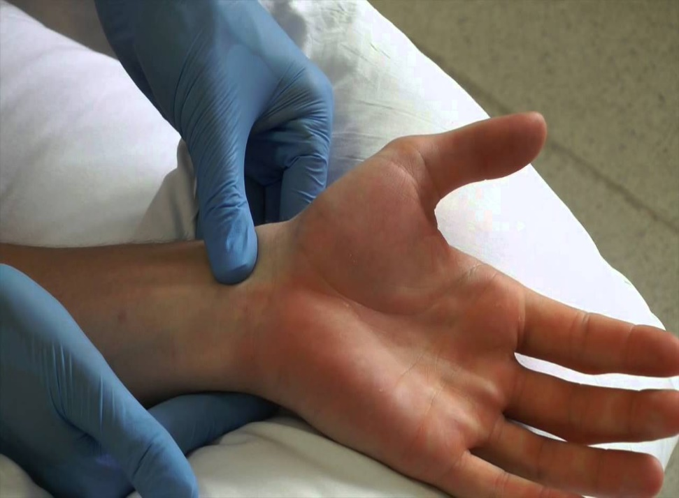
Allen test

Slide 52
Allen Test
Positive modified Allen test – hand flushes within 5-15 seconds it indicates that the ulnar artery has good blood flow; this normal flushing of the hand is considered to be a positive test.
Negative modified Allen test – If the hand does not flush within 5-15 seconds, it indicates that ulnar circulation is inadequate or nonexistent; in this situation, the radial artery supplying arterial blood to that hand should not be punctured.

Slide 53
Radial Artery Aatomic consideration
Originates in the cubital fossa from the brachial artery
At the wrist, the radial artery sits proximal and medial to the radial styloid process and just lateral to the flexor carpi radialis tendon.

Slide 54
Femoral Artery Anatomic consideration
Originates at the inguinal ligament from the external iliac artery
Medial to the femoral nerve and lateral to the femoral vein and lymphatics.

Slide 55
Arterial Line Placement Equipment
Sterile gloves
Sterile gauze
Sterile towels
Chlorhexidine or povidone-iodine skin preparation solution
1% Lidocaine needle
5-mL syringe
Appropriate-sized cannula for artery
Nonabsorbable suture (3-0 to 4-0)
Adhesive tape or strips
Sterile nonabsorbable dressing
Three-way stopcock
Pressure transducer kit
Pressure tubing
Arm board of appropriate size for the patient (eg, neonate, pediatric, adult)

Slide 56
Arterial Line Placement Patient Preparation
UNCOSCIOS PATIENT
Anesthesia/ Sedation is not required.
CONSCIOUS PATIENT
Provide LA -lidocaine 1%
UNCOPERATIVE PATIENT
Sedation or general anesthesia may be required.

Slide 57
Arterial Line Placement Positioning
The patient is placed in the supine position.
The arm is placed up on a flat surface in neutral position, with the palm up and the wrist adequately exposed.
The wrist is dorsiflexed to 30-45° and supported in this position with a towel or gauze under its dorsal aspect

Slide 58
Arterial Line Placement
The most commonly used methods
Catheter over needle
Catheter over wire (including Seldinger technique)

Slide 59
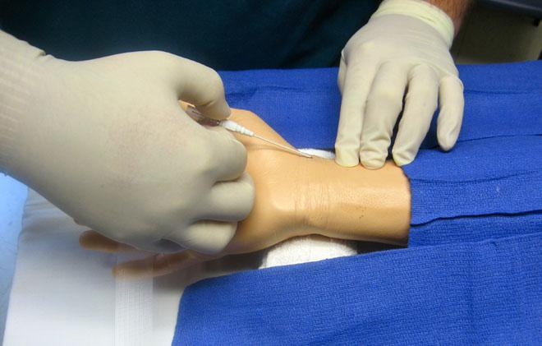
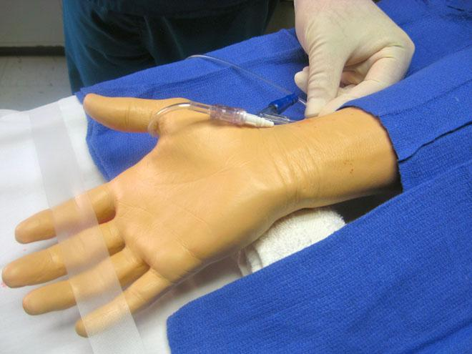
Catheter over needle technique

Slide 60
Radial artery cannulation (Seldinger) catheter over guide wire

Slide 61
Complications of arterial line placement
Common
Less common
Temporary radial artery occlusion (19.7%)
Hematoma/bleeding (14.4%)
Localized catheter site infection (0.72%) - The risk increases with the length of time the catheter is in place
Hemorrhage (0.53%)
Sepsis (0.13%)
Permanent ischemic damage (0.09%)
Pseudoaneurysm formation (0.09%)

