Slide 1

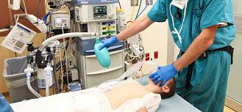
Lecture Title : General Anesthesia
Lecturer name: Dr Mohamed Bilal Delvi
Lecture Date:25 Sept 2017

Slide 2
Lecture Objectives..
Students at the end of the lecture will be able to:
Define General Anesthesia
Learn about several equipment, adjuncts and agents used for induction of general anesthesia including intravenous agents, inhalation agents, neuromuscular blocking agents and reversal agents.
Understand basic advantages and disadvantages of these agents.
Complications commonly encountered during general anesthesia

Slide 3
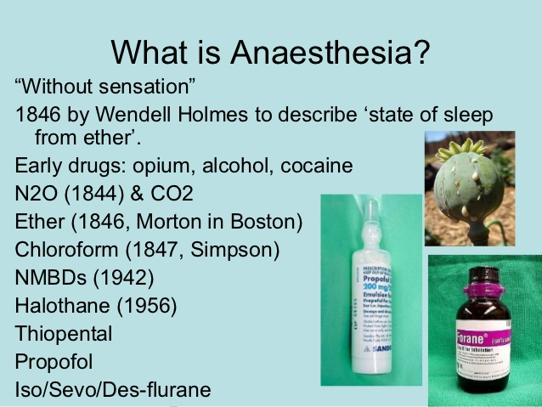

Slide 4
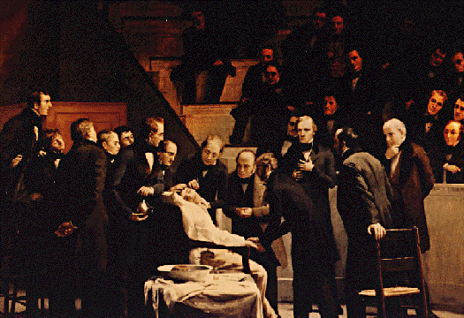
General anesthetics have been used since 1846 when Morton demonstrated the first anesthetic (using ether) on 16th of Oct 1846 in Boston, USA.
Local anesthetics arrived later, the first being scientifically described in1884.

Slide 5
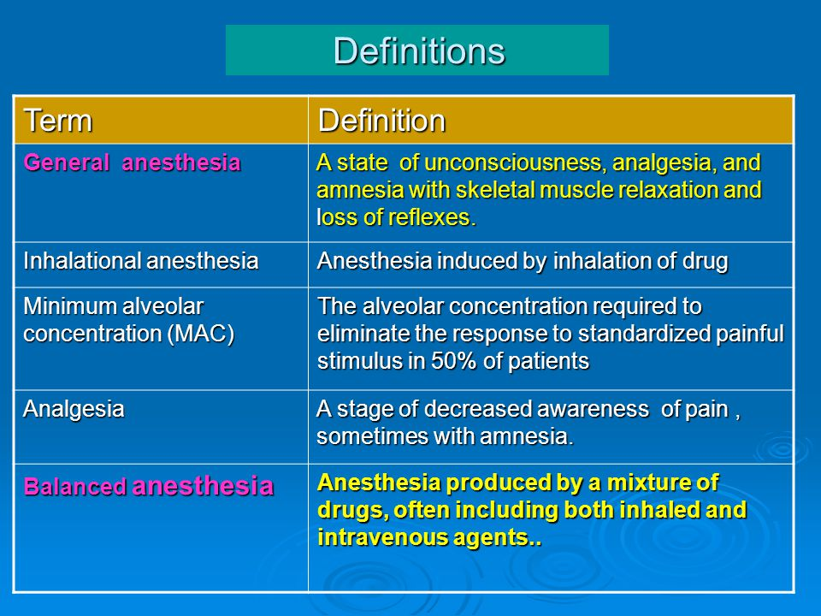

Slide 6
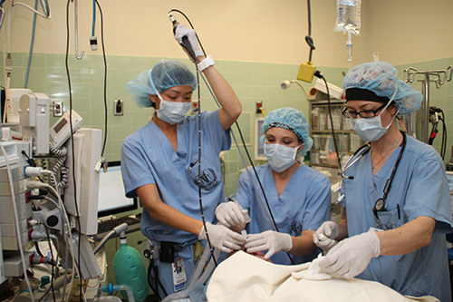
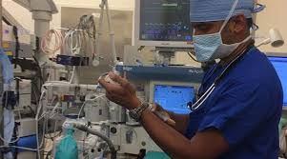
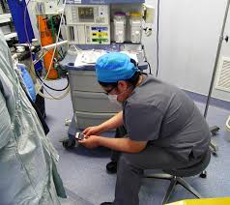
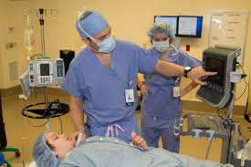
Role of Anesthetists

Slide 7
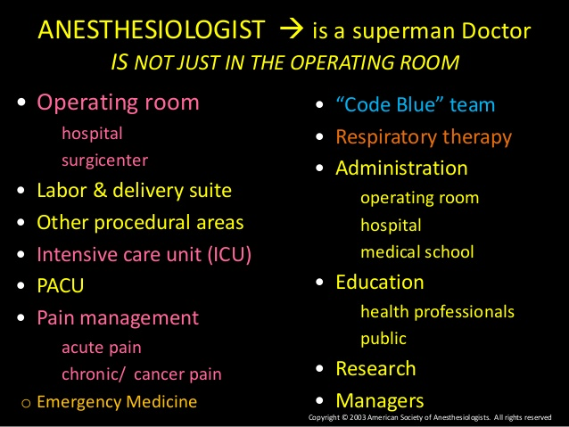

Slide 8
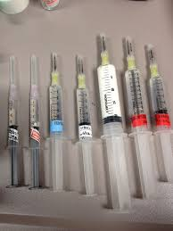
General Anesthesia Goals
Primary goal:
Oxygenation
Ventilation
Monitoring
Amnesia: patient should forget any unpleasant feeling.
Hypnosis: Unconscious state
Analgesia: No pain sensation
Autonomic Block: Reflexes blocked
Optimal conditions: all the above along with good muscle relaxation.
SAFETY AND PATIENT CARE IS THE PRIORITY

Slide 9
General Anesthesia
Assessment
Planning I: Monitors
Planning II: Drugs
Planning III: Fluids
Planning IV: Airway
Management
Process of Anesthesia
Premedication
Induction
Maintenance
Emergence
Postoperative care

Slide 10
Preoperative anesthetic evaluation
Risks of Anesthesia

Slide 11
Physical status classification
Class I: A normal healthy patient.
Class II: A patient with mild systemic disease (no functional limitation)
Class III: A patient with severe systemic disease (some functional limitation)
Class IV: A patient with severe systemic disease that is a constant threat to life (functionality incapacitated)
Class V: A moribund patient who is not expected to survive with or without the operation.
Class VI: A brain-dead patient whose organs are being removed for donor purposes
Class E: Emergent procedure

Slide 12
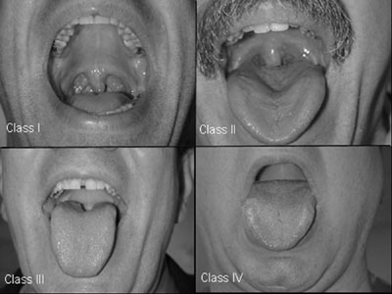
Airway examination
Mallampati classification
Class I:
uvula, faucial pillars, soft and hard palate visible
Class II:
faucial pillars, soft and hard palate visible
Class III:
soft and hard palate visible
Class IV:
hard palate visible

Slide 13
NPO status
NPO, Nil Per Os, means nothing by mouth
Solid food: 8 hrs before induction
Liquid: 4 hrs before induction
Clear water: 2 hrs before induction
Pediatrics: stop breast milk feeding 4 hrs before induction

Slide 14
Anesthetic plan
Premed
Intraop. management Postop. management
General Monitoring Pain control
PONV
Airway Management Positioning Complications Induction Fluid management postop.ventilation Maintenance Special techniques Hemodynamic mont.
Muscle relaxation

Slide 15
General Anesthesia
Monitor
Pre-oxygenation
Induction ( including RSI & cricoid pressure)
Mask ventilation
Muscle relaxants
Intubation & ETT position confirmation
Maintenance
Emergence

Slide 16
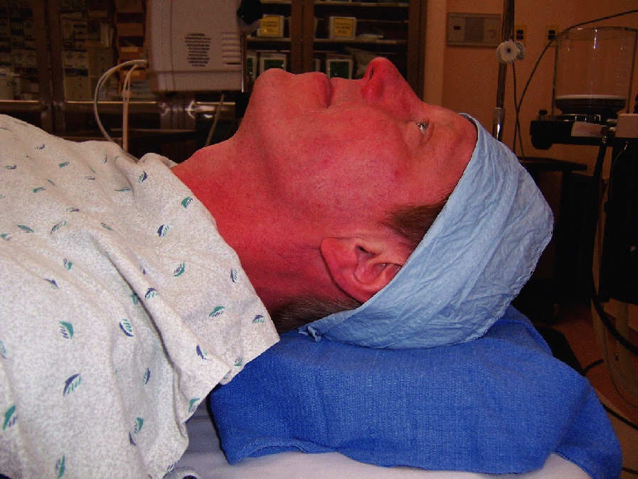
Sniffing position

Slide 17
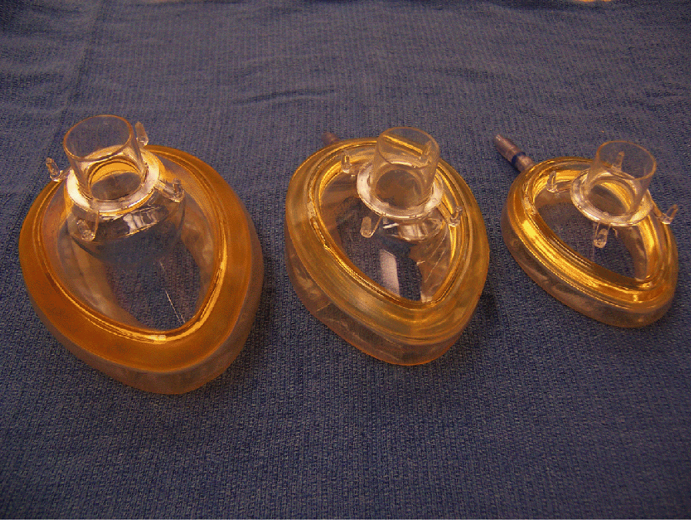
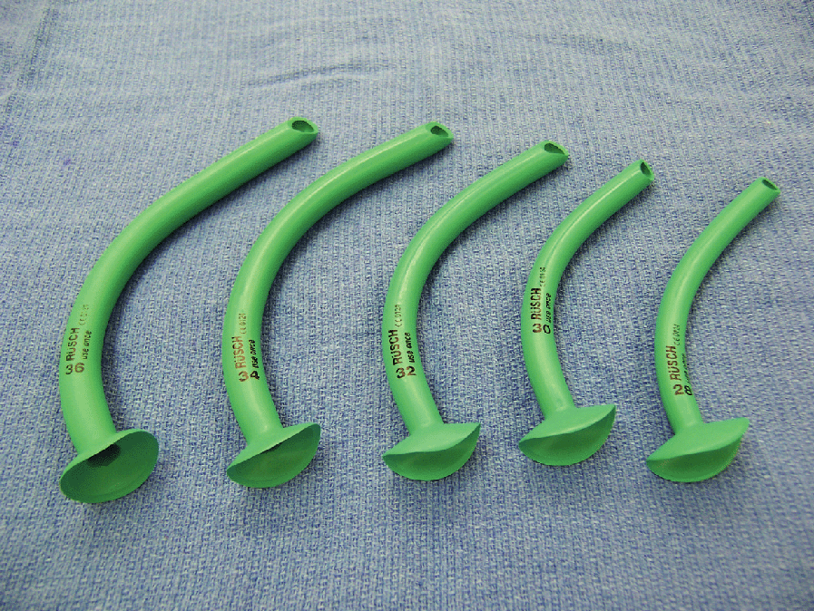
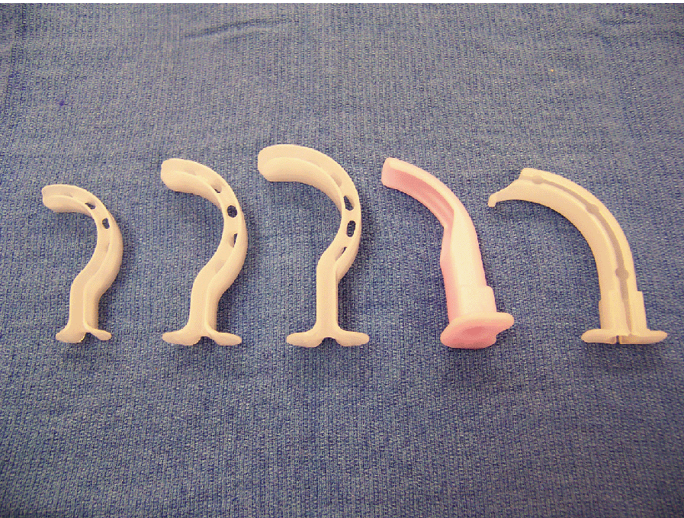
Mask and airway tools

Slide 18
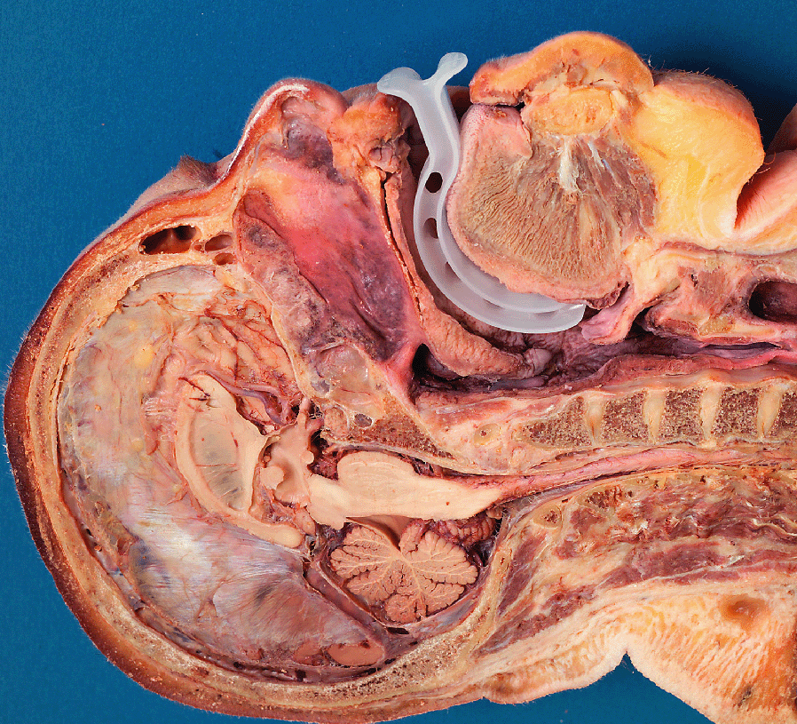
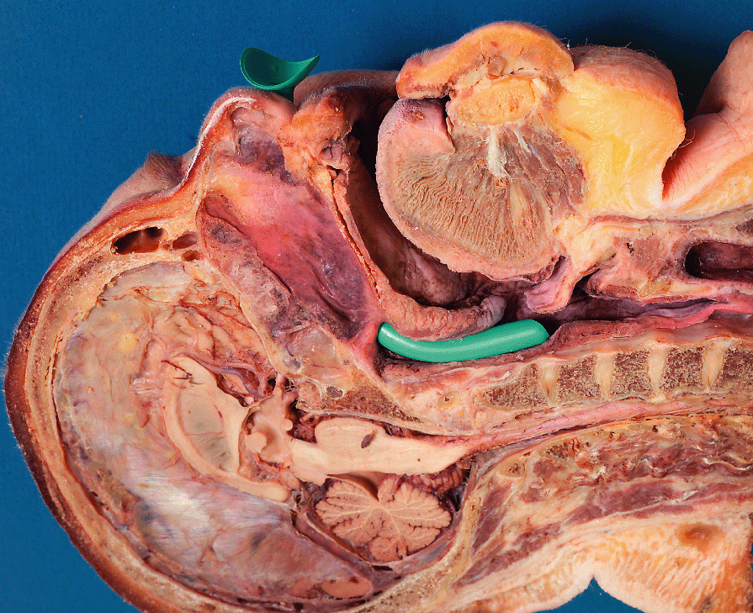
Oral and nasal airway

Slide 19
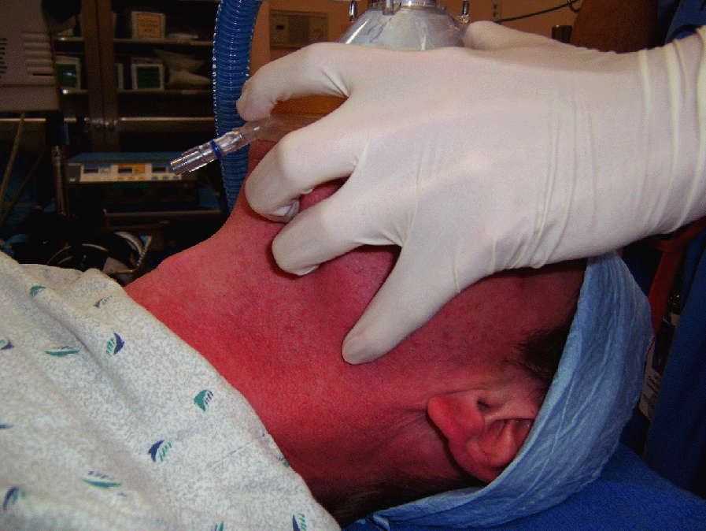
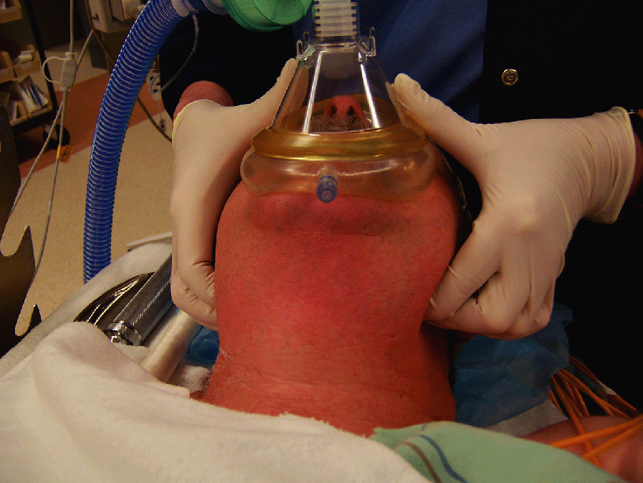
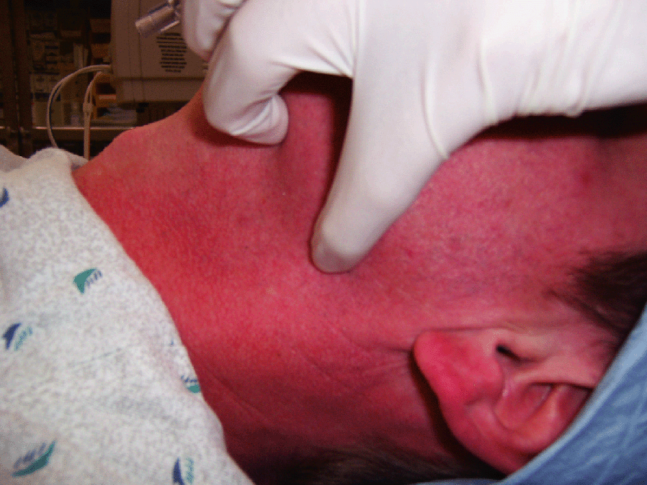
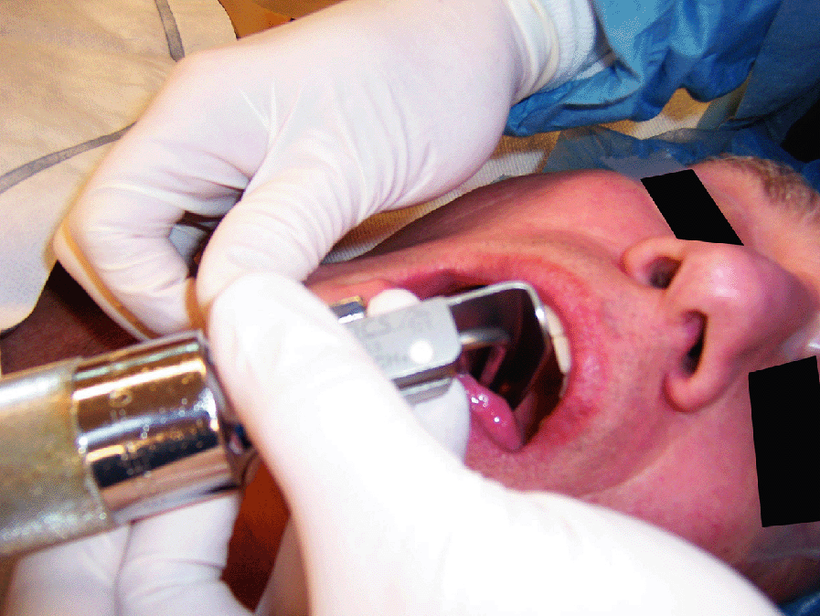
Mask ventilation and intubation

Slide 20
Difficult BMV- MOANS
MASK SEAL: mask seal requires normal anatomy, absence of facial hair, lack of interfering substances like vomitus or bleeding & ability of apply mask with pressure.
OBSTRUCTION/ OBESITY: Obstruction of upper airway, obesity (BMI greater than 26) is an independent marker. Redundant upper airway tissue, chest wall weight & resistance from abdominal contents impede airflow.
AGE: General loss of elasticity & increased incidence of restrictive /obstructive lung disease with increasing age.
NO THEETH: Edentulous creates difficulty.
STIFFNESS: Resistance to ventilation with COPD, Asthma, Pulmonary edema.

Slide 21
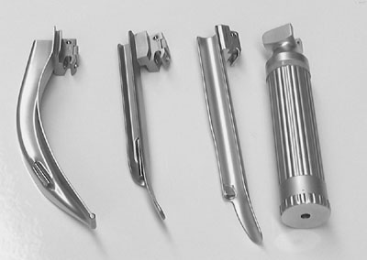
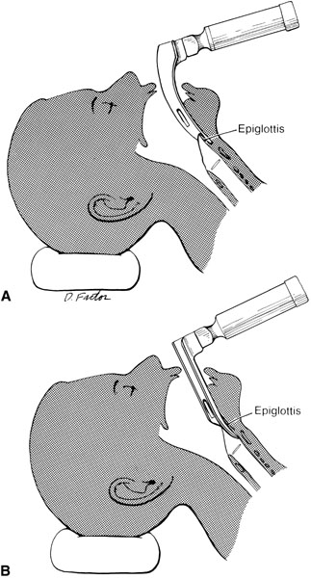
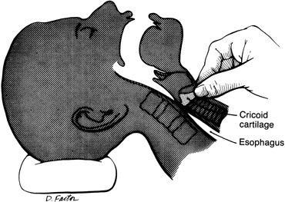
Intubation

Slide 22
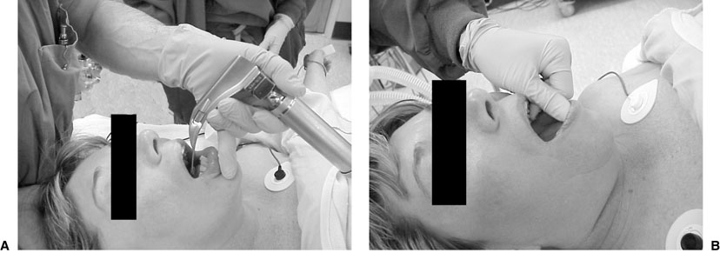
Intubation

Slide 23
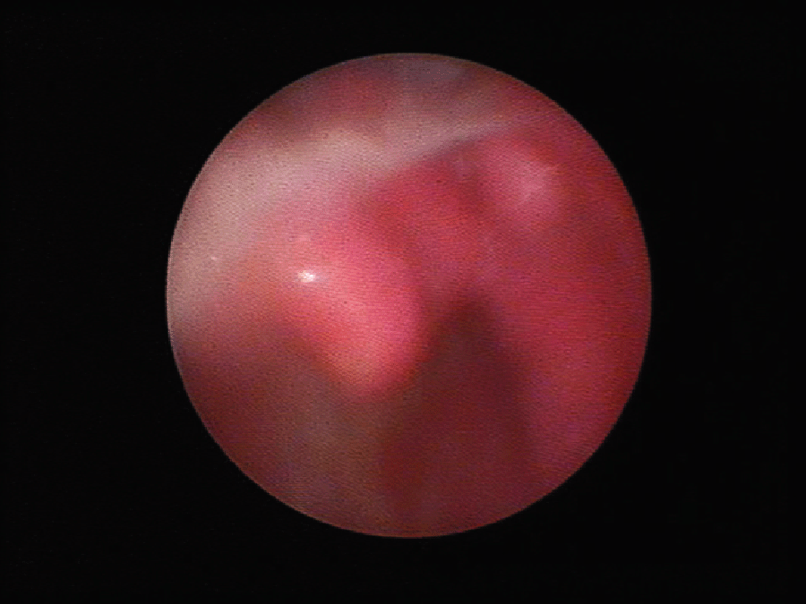
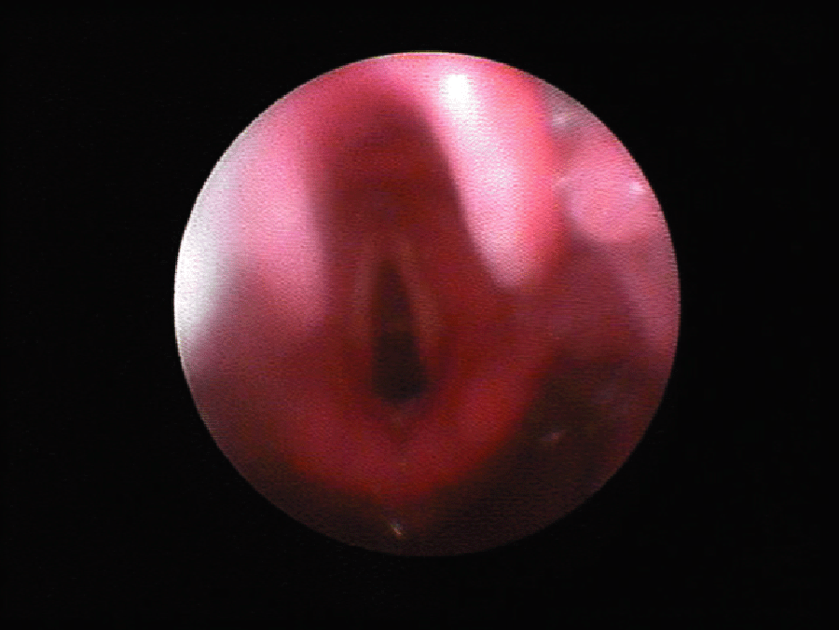
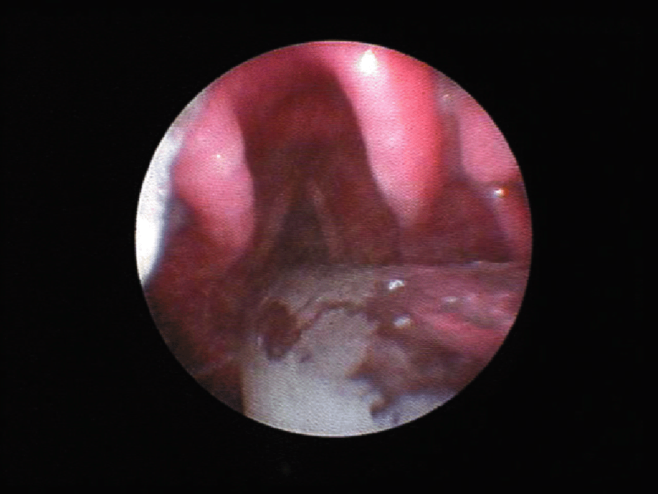
Laryngeal view

Slide 24
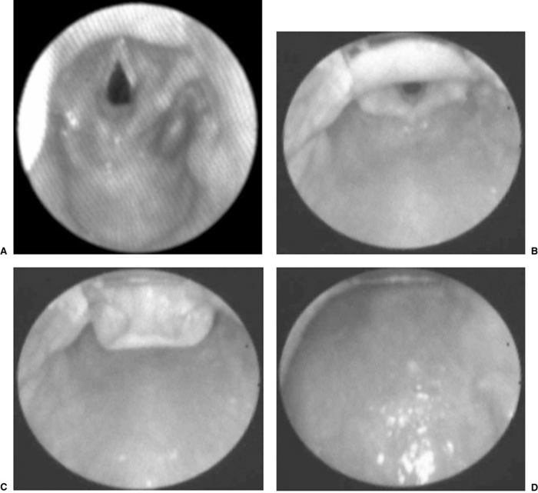
Laryngeal view scoring system

Slide 25
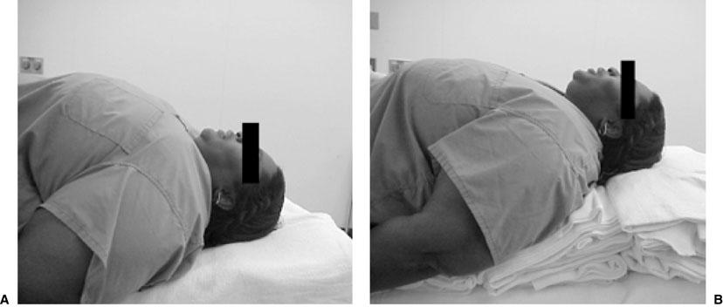
Difficult airway

Slide 26
The LEMON Approach
LOOK EXTERNALLY: Abnormal facies, unusual anatomy or facial Trauma.
EVALUATE (3-3-2 rule):3 fingers between the incisors, 3 fingers along the floor of the mandible b/w the mentum and the neck mandible junction & 2 fingers in the superior laryngeal notch. This predicts difficulty in visualizing the glottis.
MALLAMPATTI SCORE:III predicts difficulty and IV predicts extreme difficulty.
OBSTRUCTION/ OBESITY.
NECK MOBILITY.

Slide 27
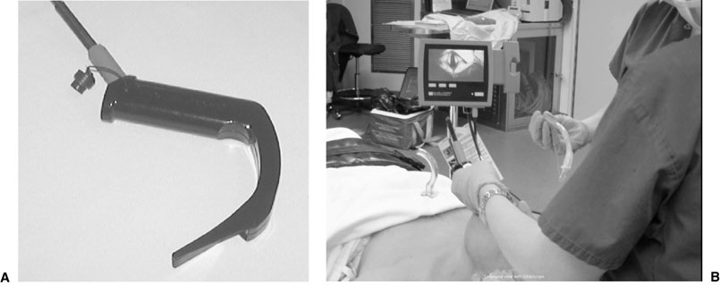
Glidescope

Slide 28
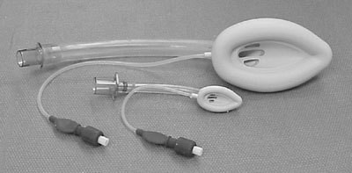
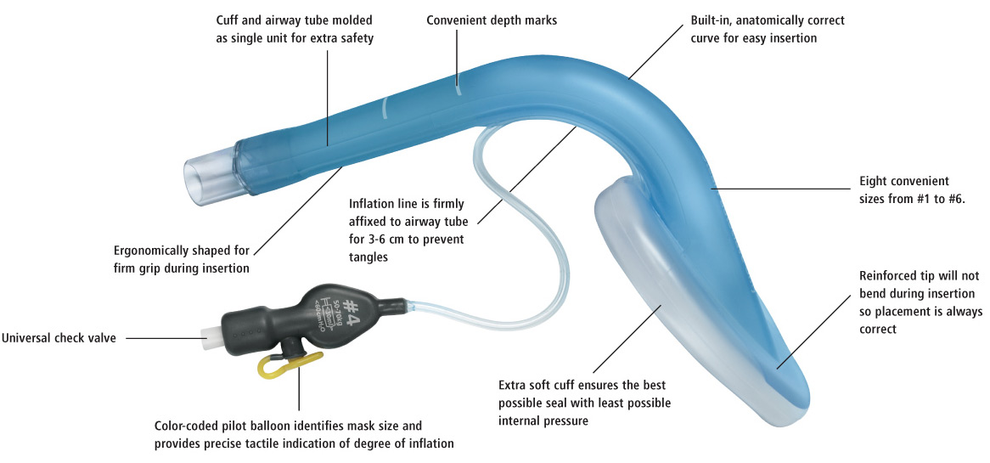
LMA

Slide 29
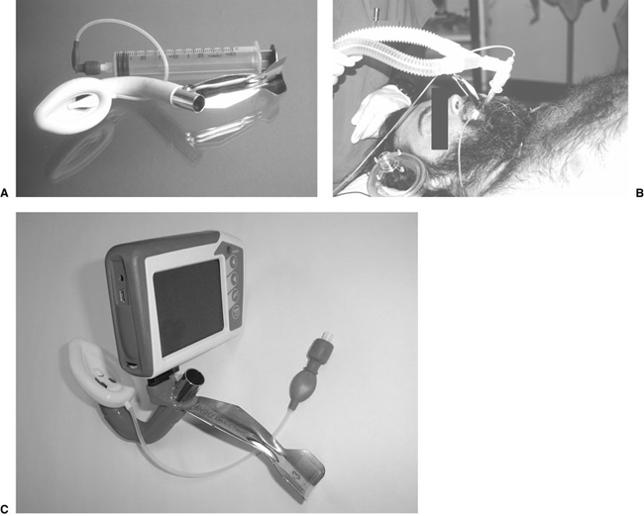
Fast track LMA

Slide 30
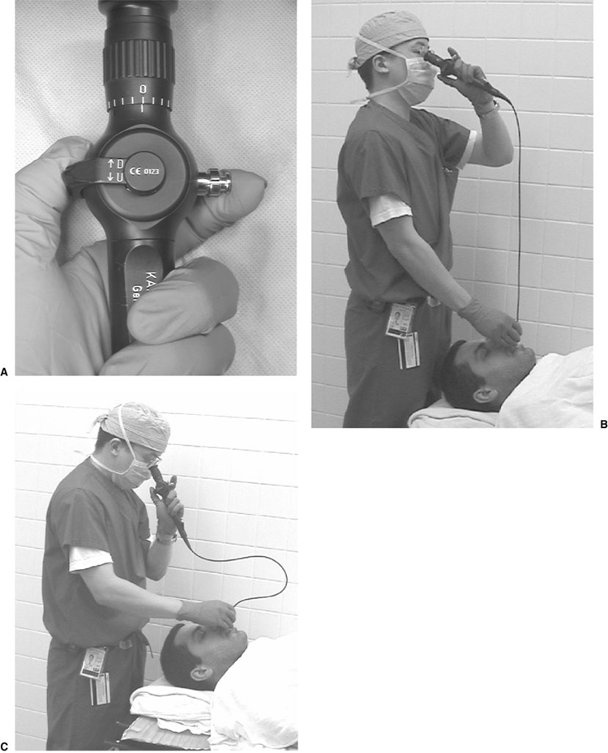
Fiberoptic intubation

Slide 31
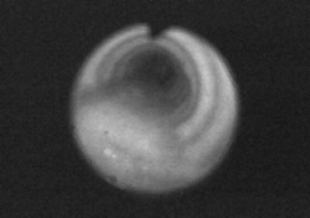
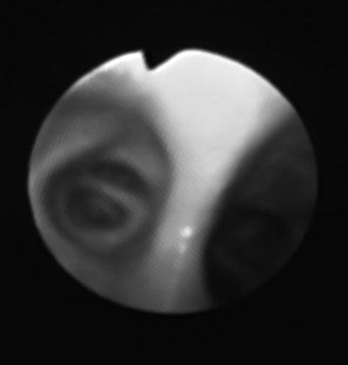
Trachea view Carina view

Slide 32
Anesthesia Machine
Anesthesia is delivered via a machine from the main gas supply to the patient.

Slide 33
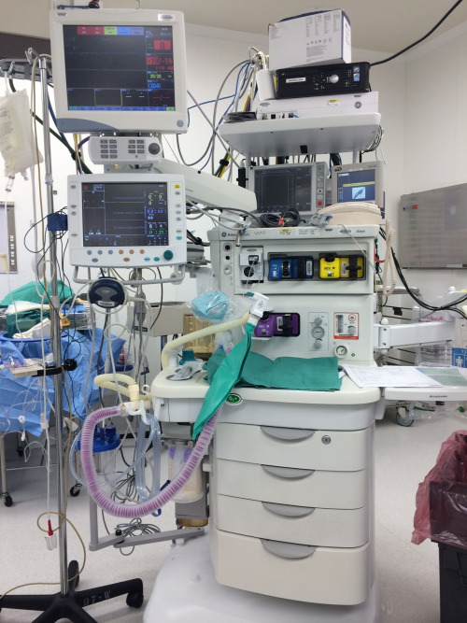
Anesthesia Machine
Anesthesia Workstation

Slide 34
Anesthesia Machine
FUNCTIONS OF ANAESTHESIA MACHINE
The machine performs four essential functions:
1.Provides O2,
2.Accurately mixes anaesthetic gases and vapours,
3.Enables patient ventilation and
4.Minimises anaesthesia related risks to patients and staff.

Slide 35
Anesthesia Machine
Gas supplies: From the central pipeline to the machine as well as cylinders.
Flow meters.
Vaporizers.
Fresh gas delivery: Breathing systems and ventilators.
Scavenging.
Monitoring.

Slide 36
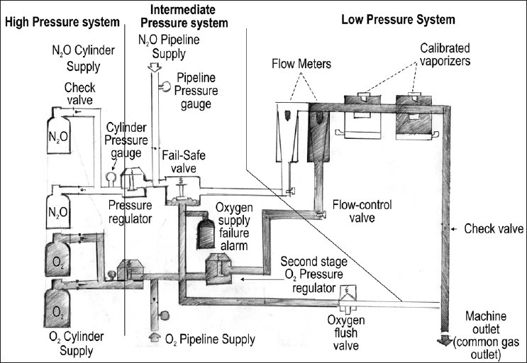
Diagram of Anesthesia Machine

Slide 37
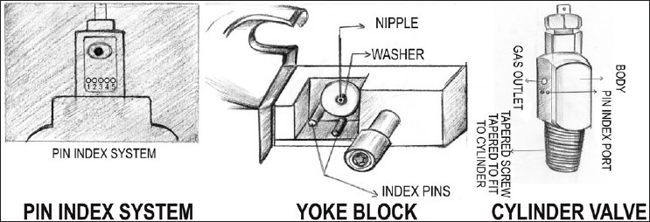
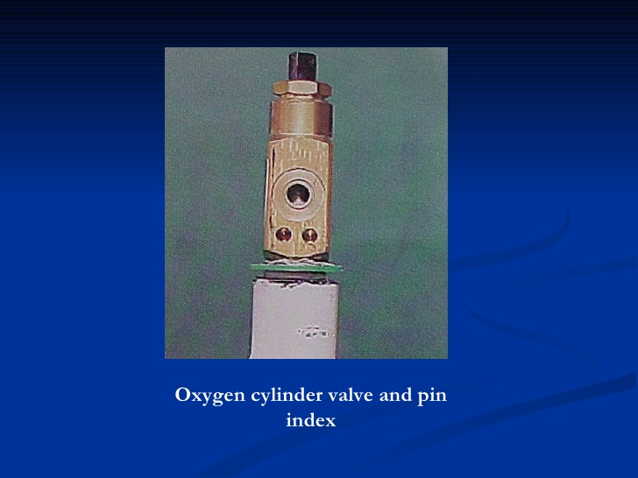
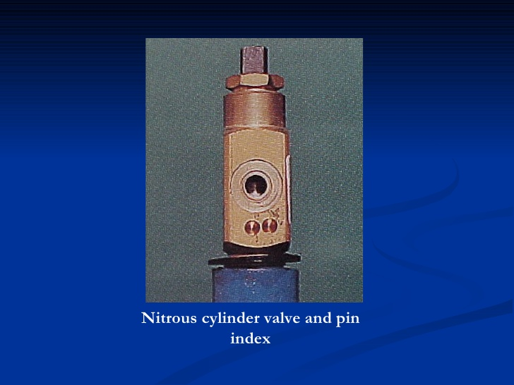
Safety Features
Pin Index safety system

Slide 38
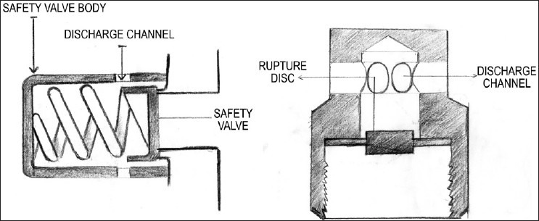
Safety Features
Pressure Regulators

Slide 39
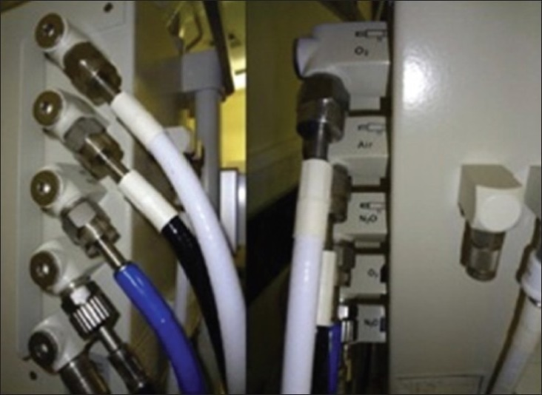
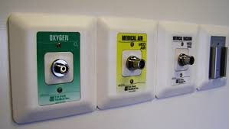
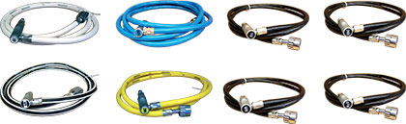
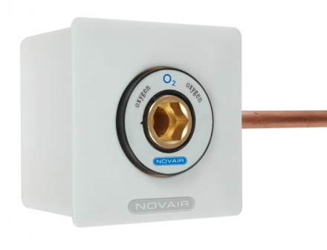
Safety Features
DISS safety connections
Non-interchangeable screw thread

Slide 40
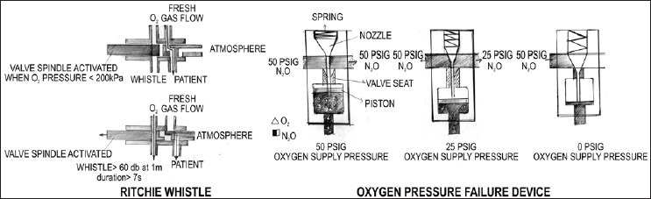
Safety Features
Oxygen Failures device

Slide 41
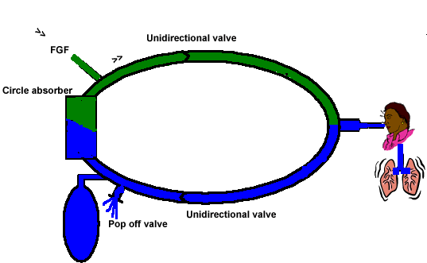
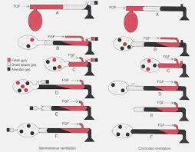


Breathing Circuits

Slide 42
Induction agents
Analgesics:
Opioids – Fentanyl,Sufentanyl, Remifentanil
Induction of unconscious:
Propofol,Thiopental and Etomidate, Benzodiazepines
Muscle relaxants:
Depolarizing
Non-depolarizing

Slide 43
Induction
IV induction
Inhalation induction

Slide 44
Intraoperative management
Maintenance
Inhalation agents: N2O, Sevo, Deso, Iso.
Total IV agents: Propofol
Opioids: Fentanyl, Morphine
Muscle relaxants
Balance anesthesia

Slide 45
Intraoperative management
Monitoring
Position –supine, lateral, prone, sitting, lithotomy
Fluid management
- Crystalloid vs colloid
- NPO fluid replacement:
1st 10kg weight-4ml/kg/hr,
2nd 10kg weight-2ml/kg/hr and 1ml/kg/hr thereafter
- Intraoperative fluid replacement:
minor procedures 1-3ml/kg/hr,
major procedures 4-6ml/kg/hr,
major abdominal procedures 7-10ml/kg/hr

Slide 46
Intraoperative Management and Recovery
Waking up is a crucial time where there is short period when the patient is aware of emergence without a full return to consciousness.
Turn off the agent (inhalation or IV agents)
Reverse the muscle relaxants
Return to spontaneous ventilation with adequate ventilation and oxygenation
Suction upper airway
Wait for patient to wake up and follow command
Hemodynamically stable

Slide 47
Postoperative management
Post-anesthesia care unit (PACU)
- Oxygen supplement
- Pain control
- Nausea and vomiting
- Hypertension and hypotension
- Agitation
Surgical intensive care unit (SICU)
- Mechanical ventilation
- Hemodynamic monitoring

Slide 48
General Anesthesia
Complications
Respiratory complications
- Aspiration – airway obstruction and pneumonia
- Bronchospasm
- Atelectasis
- Hypoventilation
Cardiovascular complications
- Hypertension and hypotension
- Arrhythmia
- Myocardial ischemia and infarction
- Cardiac arrest

Slide 49
General Anesthesia
Complication and Management
Neurological complications
- Slow recovery from anesthesia.
- Stroke
Malignant hyperthermia

Slide 50
Case Report
Arterial oxygen desaturation following PCNL

Slide 51
The Patient
Patient :
73 y/o Female BW 68 kg, BH 145 cm (BMI 32)
Chief complaint :
Right flank pain (stabbing, frequent attacks)
General malaise and fatigue

Slide 52
The Patient
History :
Hypertension under regular control.
Senile dementia.
Preoperative diagnosis :
Right renal stone (3.2 cm in size)
Operation planned :
Right PCNL (percutaneous nephrolithotomy)

Slide 53

Kidney stone

Slide 54
Pre-anesthetic Assessment
Lab data :
Hb 10.5 / Hct 33.2
BUN 24 / Creatinine 1.1
SGOT 14
PT, aPTT normal
EKG : Normal sinus rhythm
CXR : Borderline cardiomegaly & tortuous aorta

Slide 55

A
B
A+B=>C
C
Preop

Slide 56
Anesthetic Technique
General anesthesia with endotracheal intubation
Standard monitoring.
Induction : Fentanyl 2mcg/kg
Propofol 2mg/kg
Succinylcholine 100mg
Endotracheal tube (ID 7.0-mm) @ 19cm
Cisatracurium 12mg
Maintenance: Sevoflurane 2~3% in O₂ 1.5 L/min
Position: prone
Blood loss : 500 mL → Transfused- 2 units pRBC

Slide 57
Intra-operative Events
To begin with patient had stable hemodynamics
30 minutes into intra-operative period
Sudden Increase in airway pressure 35~40 mmHg
SpO₂ dropped from 100% to 95% and then kept falling till it reached 90%
Bilateral breathing sounds equal and audible.
Likely Diagnosis? Differential Diagnosis?
Management :100% Oxygen, increasing the depth of anesthesia . Hydrocartisone 100 mg IV stat.
Aminophylline 250 mg IV drip.
Bricanyl 5 mg inhalation as nebulization.

Slide 58
Intra-operative Events
pH | 7.2
PaO₂ | 90.5
PaCO₂ | 66.8
HCO₃⁻ | 26.0
BE | -2.4
Na⁺ | 143.0
K ⁺ | 4.0
Ca² ⁺ | 1.1
Hb/Hct | 11.4/36.1
ABG data

Slide 59
Post-operative Course
The patient was managed with stable hemodynamics but SpO2 at 85-94%.
After the patient was placed in the supine position auscultation revealed diminished breath sounds over right lower lung area
SpO2 90~92%
Decided by team to transfer patient intubated ventilated to SICU for further care (*)
Chest X-ray taken as soon as patient arrived in SICU

Slide 60

In SICU
? Differential Diagnosis

Slide 61


Before
In SICU

Slide 62
Postoperative Course
Surgeon decided to insert a Pigtail catheter in SICU
On insertion of pigtail fluid was drained about 1 litre sent for analysis the following was the result :
Bloody
RBC numerous
WBC 7800 (Seg 94%)
Gram stain (-)
Impression : Right hydrothorax /hemothorax.

Slide 63

Post fluid drainage by pigtail catheter

Slide 64


Immed. Postop
s/p pigtail

Slide 65
Postoperative Course
Extubation and transfer to the floor.
Pigtail removed after X ray repeated in the ward .

Slide 66
Thank You

