Slide 1
Eczema
DR.MOHAMMED ALSHAHWAN

Slide 2
OBJECTIVES
To know the definition & classification of Dermatitis/Eczema
To recognize the primary presentation of different types of eczema
To understand the possible pathogenesis of each type of eczema
To know the scheme of managements lines

Slide 3
A spectrum of related disorders with pruritus being the hallmark of the disease.
Acute
chronic

Slide 4
Atopic
Seborrheic
Contact
  Allergic
  Irritant
Dyshidrotiform
Asteatotic
Stasis
Neurodermatitis (Lichen Simplex Chronicus)

Slide 5
ATOPIC DERMATITIS
Very common disease affect 10% of children
More than 40% will remit completely during childhood
Cause :
Genetic factors
skin barrier defect
Immune dysregulation
Triggers
Autoallergen
Microbes
Food

Slide 6
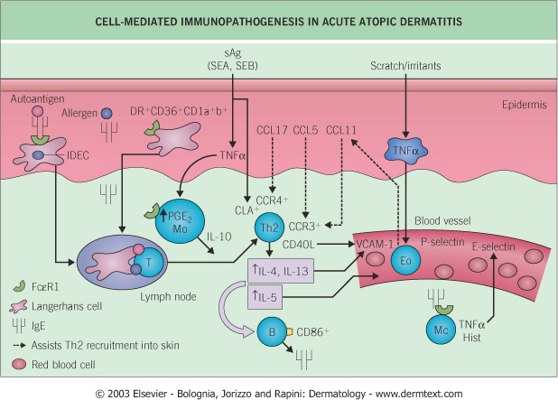

Slide 7
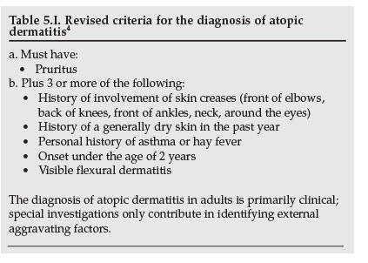

Slide 8
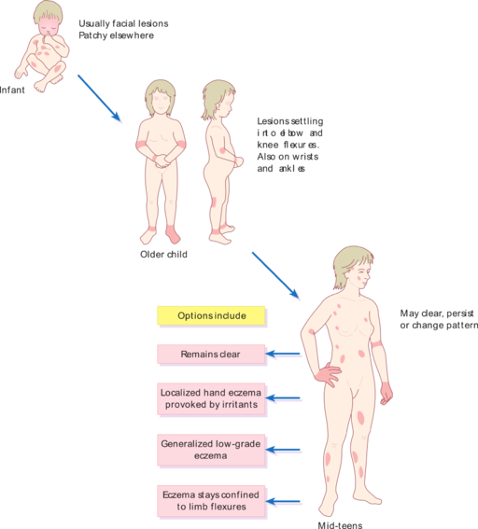

Slide 9
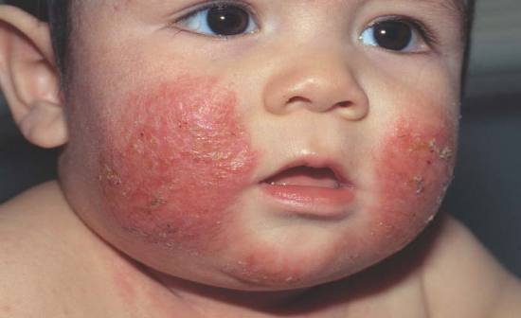

Slide 10
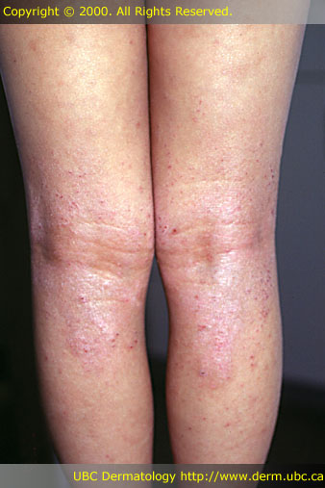

Slide 11
Adult AD
Regional dermatitis
Discoid eczema
Childhood AD
juvenile planter dermatosis

Slide 12
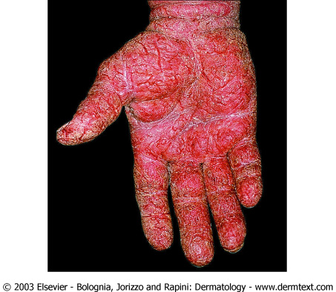

Slide 13
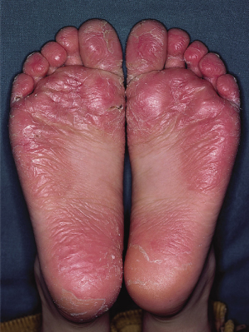

Slide 14
Complications
Infections
Impetigo
Eczema herpeticum
Immunological abnormalities
urticaria
contact dermatitis
Ocular complication
cataract
Keratoconus
Keratoconjunctivitis
Growth retardation

Slide 15
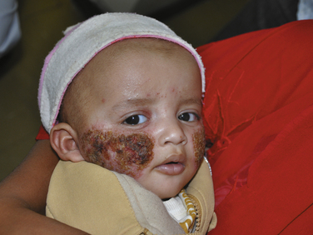

Slide 16
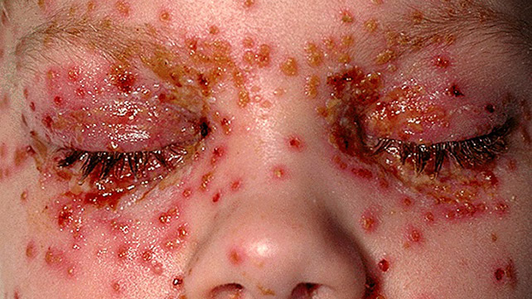

Slide 17
Management
Hydrate the skin
Avoid triggers

Slide 18
Active treatment
Topical corticosteroids
Topical calcineurin inhibitor
Oral H1 antihistamine
Systemic Corticosteroids
Phototherapy – NBUVB, PUVA
Immunosuppressive therapy

Slide 19
SEBORRHEIC DERMATITIS
Chronic dermatitis that affect male more between the age of 20-50 years.
Causes
hereditary Seborrheic status
M. furfur
Nutritional def. (SD-like rash)
Common associated with
Parkinson disease
Facial paralysis
HIV and immune suppression

Slide 20
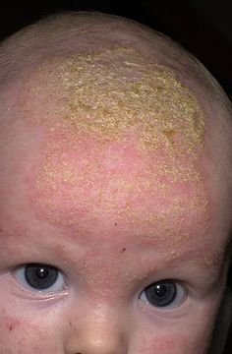

Slide 21
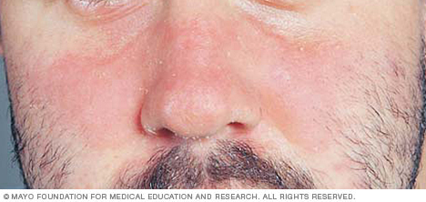

Slide 22
Treatment
Anti-dandruff shampoo
2% ketoconazole
2% selenium sulfide
Topical corticosteroids
Topical calcineurin inhibitor
Oral Isotretinoin
Oral H1 antihistamine
Systemic Corticosteroids
Immunosuppressive therapy

Slide 23
CONTACT DERMATITIS
Contact irritant dermatitis
It account for 80% of occupational skin diseases
It result of direct cytotoxic damage to keratinocytes in any person.
Contact allergic dermatitis
It account for 7% of occupation related diseases
It is caused by allergen that trigger type IV hypersensitivity reaction in a sensitized person.

Slide 26
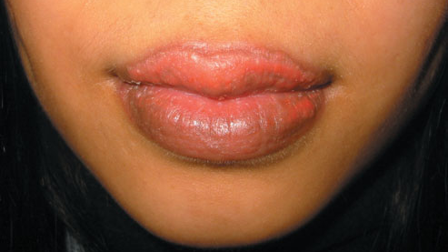

Slide 27
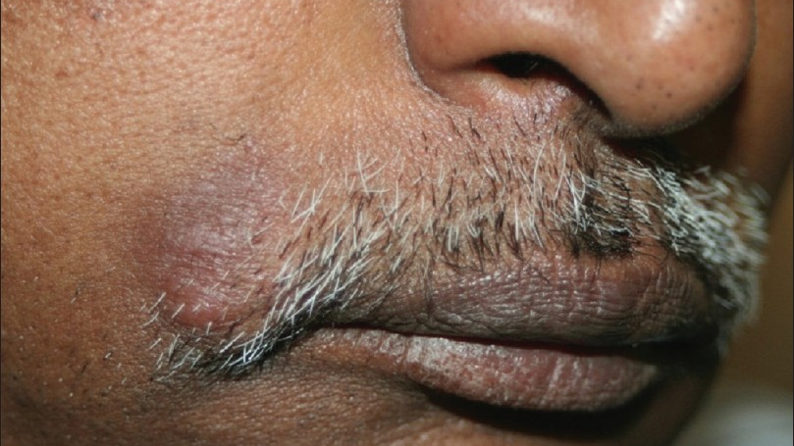

Slide 28
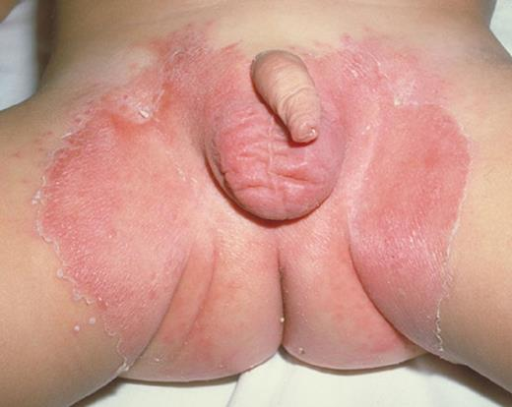

Slide 29
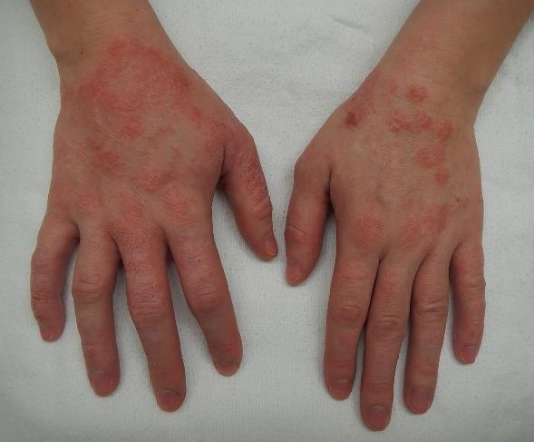

Slide 31
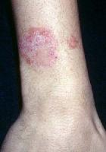
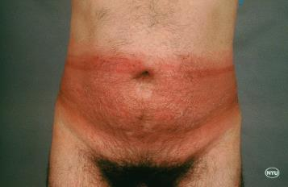
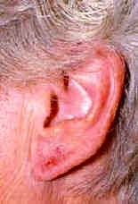
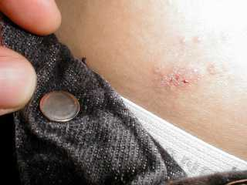
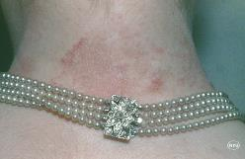

Slide 32
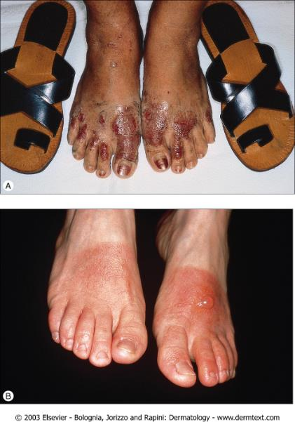
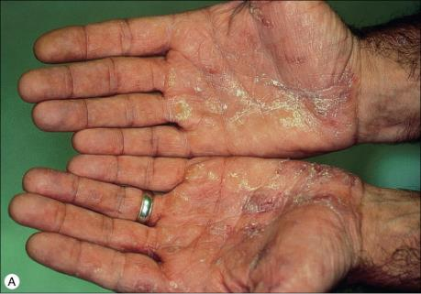

Slide 33
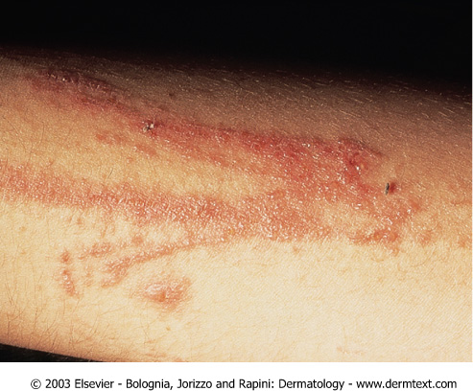
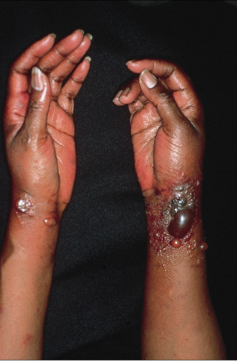
Patch test ?

Slide 34
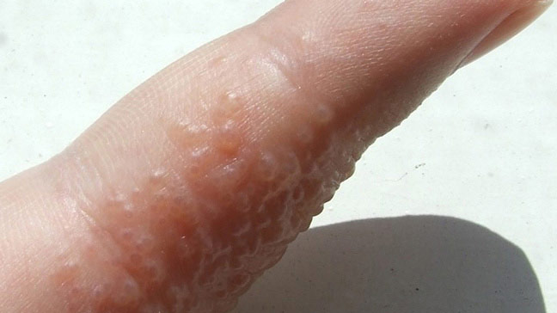
Dyshidrotiform eczema

Slide 35
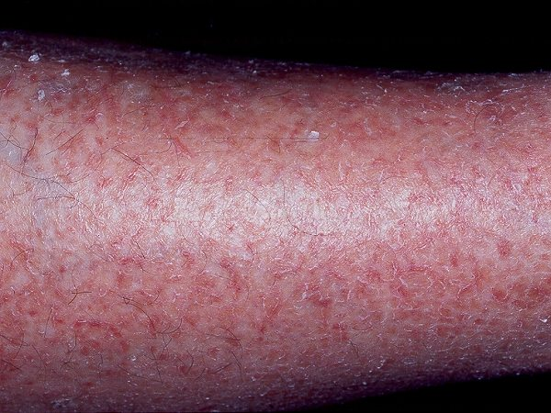
Asteatotic eczema

Slide 36
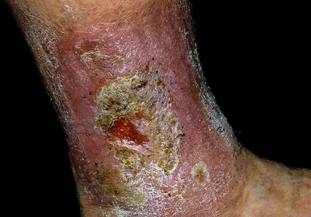
Stasis eczema

Slide 37
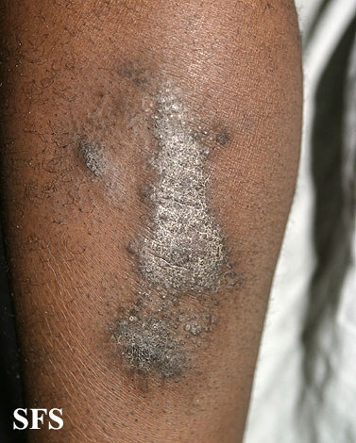
Lichen simplex Chronicus

