Slide 1
Autoimmune Bullous Diseases
Dr. Abdullah ALAKEEL
Assistant Professor & Consultant
Department of Dermatology
KKUH

Slide 3
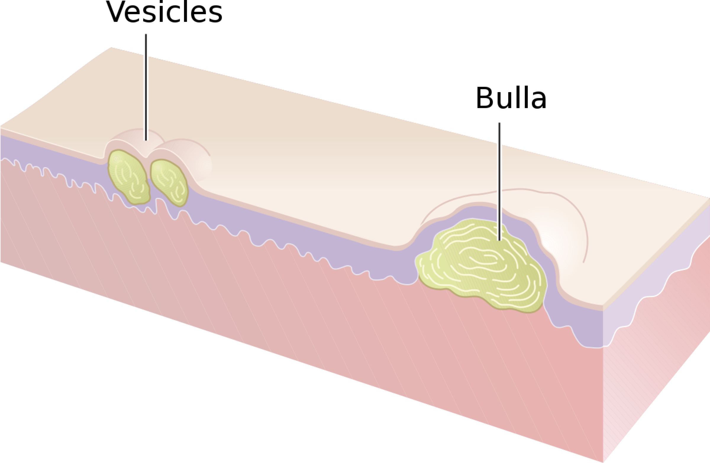
Circumscribed skin lesions containing fluid (If the size ≤ 5mm = vesicle If the size > 5mm = bulla)

Slide 4
Classification Of Vesiculobullous Diseases:

Slide 5
Autoimmune bullous diseases
A- Loss of intraepidermal adhesion: Pemphigus group :
1- Pemphigus vulgaris (PV) with subtypes
a- Classic
b- Pemphigus vegetans
2- Pemphigus foliaceus with subtypes:
a- Classic
- Fogo selvagum
- Pemphigus erythematosus ( Senear-Usher)
b- Paraneoplastic pemphigus
c- Drug induced pemphigus
d- IgA pemphigus

Slide 6
Autoimmune bullous diseases
B- Loss of subepidermal adhesion :
1- Pemphigoid
a- Bullous pemphigoid
b- Pemphigoid gestationis
c- Cicatricial pemphigoid
2- Linear IgA disease
- of childhood
- Adult form
3- Epidermolysis bullosa acquisita
4- Dermatitis herpetiformis

Slide 10
Autoimmune bullous diseases
Pemphigus Group :
A group of disorders with loss of intraepidermal adhesion due to autoantibodies directed against proteins of the desmosomal complex that hold keratinocytes together. The desmosome is a complex structure, with many of its components targets for autoantibodies.

Slide 11
PV
Pemphigus vulgaris (PV):
Definition : severe, potentially fatal disease with intraepidermal blister formation on skin and mucosa caused by autoantibodies against desmogleins.
Epidemiology : 0.1-0.5/ 100000 yearly, most patients middle aged.

Slide 12
PV
Pathogenesis:
- Genetic predisposition: HLA-DRQ402- DQ0505
- Antibodies against desmoglein 3 (Dsg 3) and later desmoglein 1 (Dsg 1 ). The bound antibodies activate proteases that damage the desmosome, leading to acantholysis.
- Serum antibody titer usually correlates with severity of disease and course.

Slide 13
PV
- Agents containing sulfhydryl groups (penicillamine, captopril, piroxicam) are more likely to cause PV.
- Those without sulfhydryl groups tend to cause PV ( beta-blockers, cephalosporins, penicillins, & rifampicin) .
Note : drugs from either group can cause either type of pemphigus.

Slide 14
PV
Clinical features:
Sites: oral mucosa, scalp , face, mechanically stressed areas,nail fold, intertriginous areas.
Bliters are NOT stable, epidermis falls apart, erosions & crusts are common
Oral involvement: 70%, anti-Dsg3 (Dsg 3 is the main desmoglein on mucosa)
Additional localized disease; scalp
Note: always check scalp when confronted with unexplained oral erosions.

Slide 15
PV
Generalized disease due to development of antibodies against Dsg1 which is present in skin along with Dsg3.
Pruritus is uncommon.
Histology: acantholysis, retention of basal layer keratinocytes (tombstone effect), mild dermal perivascular infiltrates.

Slide 17
PV
Diagnostic approach:
Clinical evaluation
Nikolsky sign
Pseudo-Nikolsky sign (Asboe-Hansen sign), less specific

Slide 18
PV
Histology:
DIF: perilesional shows a net-like intracellular deposition of IgG (100%), C3 (80%)
Indirect IF (IIF) performed using monkey esophagus
ELISA: to identify anti-Dsg3,1

Slide 19
PV
Differential diagnosis:
When skin is involved:
Bullous impetigo, dyskeratotic acanthoytic disorders ( Hailey-Hailey, Grover disease)
When oral mucosa is involved:
Denture intolerance
Erosive candidiasis
Chronic recurrent aphthae
Erythema multiforme
Erosive lichen planus
Herpetic ginigivitis

Slide 20
PV
Therapy :
1- Systemic corticoisteroids
The main cause of morbidity & mortality in patients is CS side effects, have to combine with steroid-sparing agent, check for osteoporosis and latent TB
A- combination pulse therapy : prednisolone 1g + cyclophosphamide 7.5-10 mg/kg every 3-4 weeks
With cyclophosphamide in interval 1-2mg/kg daily.

Slide 21
PV
Prednisolone- azathioprine therapy
Alternative immunosuppressive agents: cyclosporine, mycophenolate mofetil, chlorambucil
Topical measures: local anesthetic gels
Therapy resistant course: IVIG

Slide 24
Pemphigus vegetans
Unusual variant of PV with hyperkeratotic verruciform reaction (vegetans)
Clinical features :
Originally typical PV, then development of white macerated plaques in involved areas
(pyodermite végétante) : limited to intertriginous areas, starts as pustules that evolve into vegetating lesions.

Slide 25
Pemphigus vegetans
Diagnostic approach : as for PV
DDx: if mild and localized can be confused with Hailey-Hailey
Therapy : see PV

Slide 28
Pemphigus Foliaceus
Form of pemphigus with superficial blisters caused by anti-Dsg1
Pathogenesis:
Anti-Dsg1, the main desmoglein on the upper epidermis.
More often drug induced than PV,usually sulfhydryl groups : captopril, penicillamine, peroxicam
Maybe caused by sunburn or paraneoplastic sign

Slide 29
PF
Clinical features:
Scalp, face, chest and back, can progress to involve large areas with diffuse scale and erosions.
Diagnostic approach:
Clinical
Biopsy ? Not helpful
DIF: superficial deposition of IgG
ELISA: reveals IgG antibodies against Dsg1
Medication history
Therapy: same approach as PV, but usually more responsive to therapy. Dapsone maybe helpful

Slide 31
Pemphigus eryhthematosus
Uncommon feature of pemphigus foliaceus with additional features of lupus erythematosus.
More likely to be triggered by sunlight or medications than other forms of PF

Slide 34
IgA Pemphigus
Pustular acantholytic dermatosis with intercellular IgA deposition in epidermis.
Can be associated with gammopathy
Clinical features:
Subcorneal pustular dermatosis (Sneddon-Wilkinson disease): broad, annular erythematous patches with peripheral flaccid pustules and central crusting, favours flexures and trunk, never mouth, pruritic

Slide 35
IgA Pemphigus
Intradermal neutrophilic dermatosis (Huff syndrome): clinically similar, sunflower lesions
Diagnostic approach:
DIF; showing IgA directed against keratinocytes
Therapy : most cases are responsive to dapsone, if not , corticosteroids & other immunosuppressive agents

Slide 36
Paraneoplastic Pemphigus
Most often associated with lymphoma, leukemia, thymoma, Castleman tumor.
Not with SCC or adenocarcinoms
Clinical: severe persistent painful stomatitis extending from lips to pharynx, larynx and esophagus, conjunctival involvement may lead to blindness.
Cutaneous changes are polymorphic

Slide 37
Paraneoplastic Pemphigus
Note: if patient is sick and has lesions resembling erythema multiforme, lichen planus and a blistering disease , be highly suspicious of paraneoplastic pemphigus.
Histology is rarely helpful.
Therapy : treat the underlying tumour , prognosis correlates with the response
No consensus on what immunosuppressive regimen. Good success with ant-CD20 (rituximab)

Slide 42
Pemphigoid Group
Bullous pemphigoid (BP):
Subepidermal blistering disease caused by autoantibodies to components of hemidesmosomes in the basement membrane zone (BMZ).
Most common autoiummune bullous disease, 1/100000, favours elderly male<female.

Slide 43
BP
Pathogenesis :
Autoantibodies directed against 2 hemidesmosomal proteins:
- BP 230
- BP 180
BP 180 is most likely to be more involved in the initial immune response, since it is transmembranous.

Slide 44
BP
Less common causes include drugs ( benzodiazepine, furosemide, penicillin, sulfasalazine), sunlight, and ionizing radiation.
Clinical :
before blisters develop, pruritus, urticarial lesions may be present, blisters tend to develop in these areas.
Note: always keep BP in mind when confronted with an elderly patient with persistent « urticaria ».
Blisters are stable and tense.
Oral mucosal involvement in <20%.

Slide 45
BP
Histology :
Prebullous lesions: presence of unexpected eosinophils is a good clue.
Later subepidermal blister formation.
Diagnostic approach:
Labs: elevated ESR, eosinophils, and increased IgE in 60%.
DIF: best taken from erythematous area at periphery, not blister itself; band of IgG & C3 along BMZ.
Indirect IF: using NaCL split skin
ELISA: identifies ab against both BP 230 & 180 in 60-80% of pts.

Slide 46
BP
Therapy:
Steroids ?
Methotrexate 15-20 mg weekly
Mostly widely used steroid-sparing agents, azathiporine & mycophenolate mofetil.

Slide 47
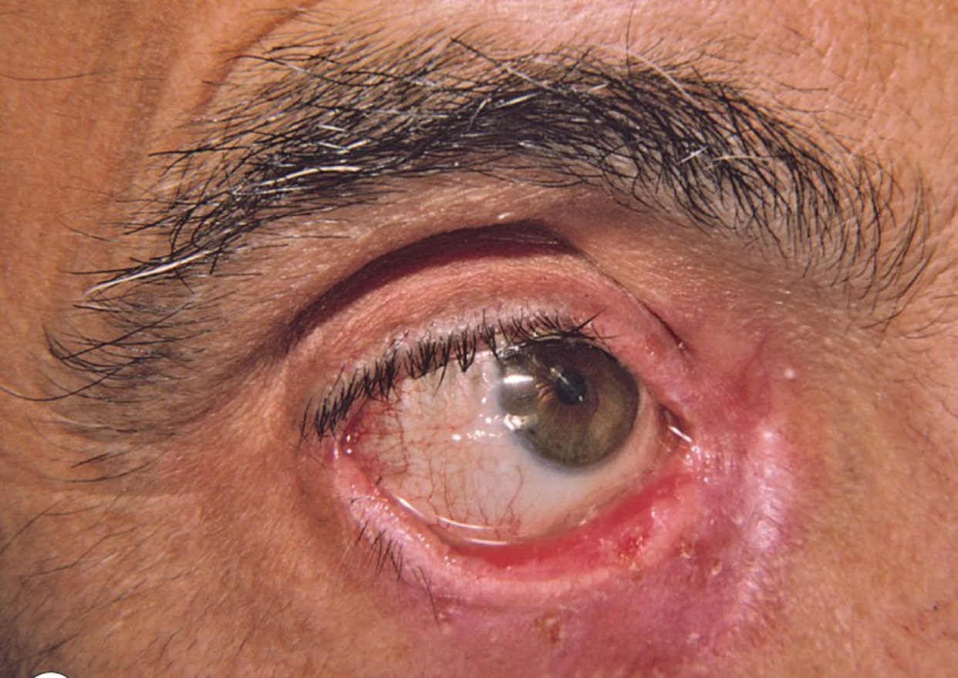

Slide 48
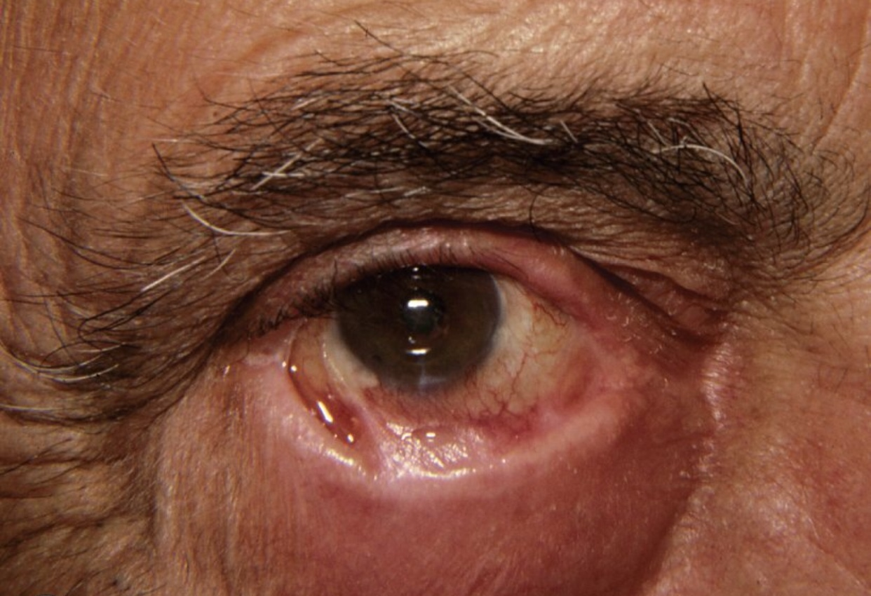

Slide 50
Cicatricial Pemphigoid
Chronic subepidermal blistering disease favoring mucus membrane especially mouth and eyes.
Patients > 65 years. Women > men

Slide 51
Cicatricial Pemphigoid
Clinical features:
Conjunctiva affected in 75% of cases. Starts unilaterally , within 2 years usually bilateral. Adhesions, ectropion, corneal damage
Oral mucosa: much less painful than PV.
Esophagus and larynx can develop strictures, requiring surgery.
Genitalia: narrowing of vaginal orifice; adhesions between glans & foreskin.
Skin: only involved in 25%

Slide 52
Cicatricial Pemphigoid
Diagnostic approach :
DIF
Indirect IF
Therapy:
Ocular: topical or systemic corticosteroids, OPH consultation
Mucosal: topicals
Widespread: Pred + azathoiprine or pred+ cyclophosphamide pulse therapy
IVIG

Slide 53
Pemohigoid Gestationis
Synonym : herpes gestationis
Form of BP occuring during pregnancy.
Occur in 1/10000-40000 pregnancies.
No maternal risk, no increase in birth defects
Infants born to affected mothers may develop lesions as well (10% of cases).
Pathogenesis:
mothers often HLA-88, -DR3, -DR4, father often HLA-DR2. possible that mothers are sensitized against placental antigens. Target antigens are BP 180

Slide 54
Pemohigoid Gestationis
Erythematous urticarial plaques, alone or with papules, vesicles, blisters in sub-epidermal area, erosions.
Intense pruritus.
Sites: abdomen, proximal extremities.
Rarely appears postpartum, resolve within 3 months. Occasionally recur with menses or ingestion of OCP, tends to be worse in next pregnancy.
The ab cross the placenta, the newborn can have blisters for a few weeks.

Slide 55
Pemohigoid Gestationis
Diagnostic approach: Labs : eosinophilia, DIF, Indirect IF
Management:
Systemic Potent steroids: For blisters, avoid the systemic in the 1st trimester (topicals)
Skin care : to prevent infections
Anti-histamines: For pruritis .

Slide 56
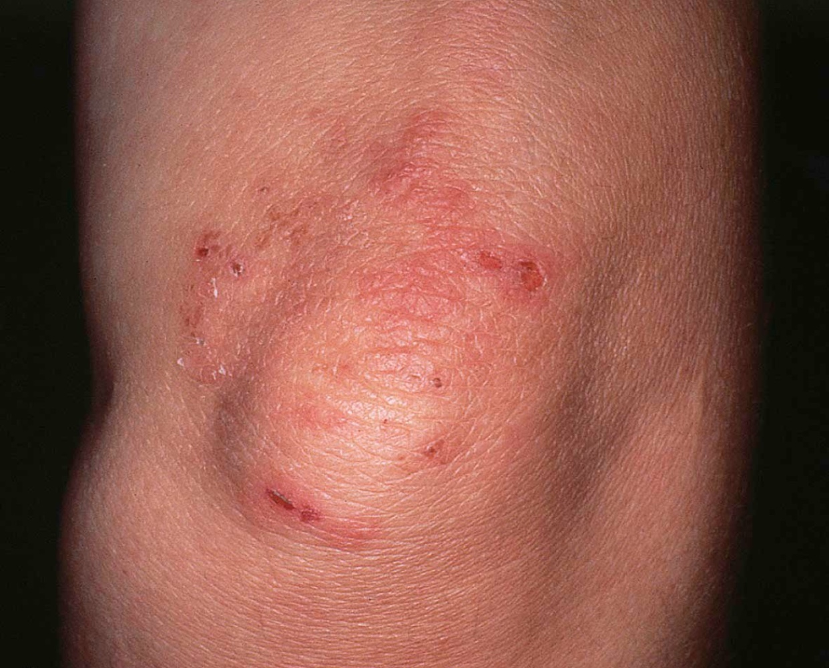

Slide 57
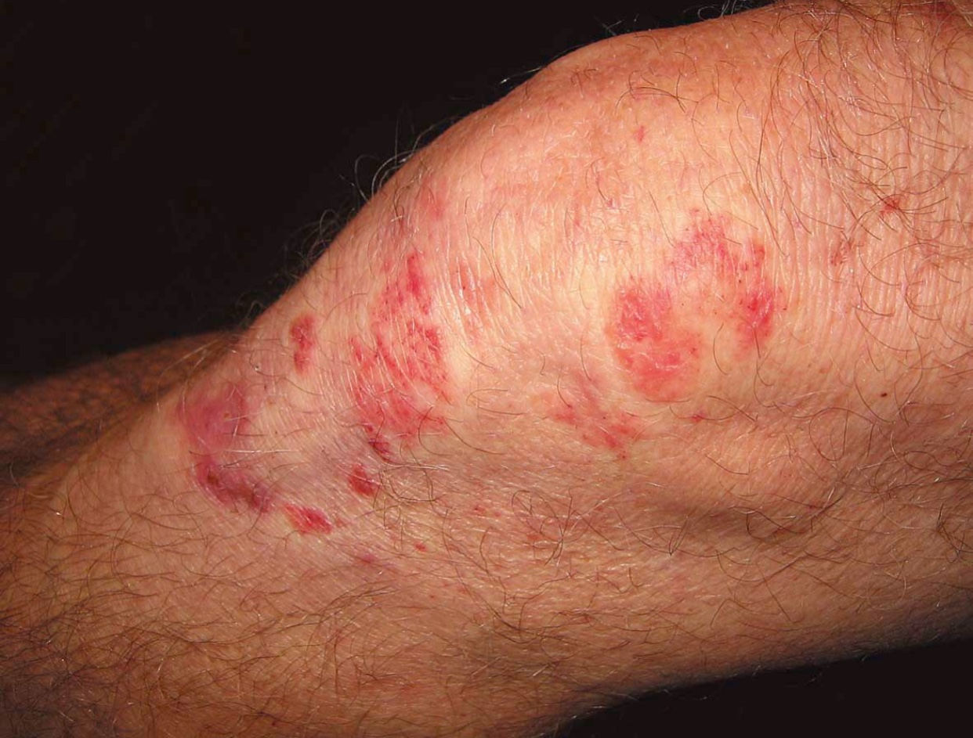

Slide 58
Dermatitis Herpetiformis
Pruritic vesicular disease caused by IgA ab directed against epidermal transglutaminase & presenting with granular pattern in papillary dermis.
M>F 1:2, disease of young adults.
DH & gluten-sensitive enteropathy are closely related (i.e. celiac disease).

Slide 59
Dermatitis Herpetiformis
Grouped papules/vesicles/urticarial wheals on an erythematous base, associated with intense pruritus, burning, stinging, excoriations.
sites: extensor surfaces of elbows/knees, sacrum, buttocks, scalp .
Spontaneous remissions may occur, but disease often lifelong.

Slide 60
Dermatitis Herpetiformis
Histology:
Neutrophilic microabcesses in the papillary dermis are the hallmark
Approach:
Skin biopsy
DIF: granular deposits of IgA in dermal papillae
Indirect IF:
ELISA: identifies IgA ab against transglutaminase in at least 80%
Jejunal biopsy: flattening of villi

Slide 61
Dermatitis Herpetiformis
Therapy:
Gluten free diet.
Dapsone: amazingly effective

Slide 64
Linear IgA disease
Subepidermal blistering disease caused by deposits of IgA along BMZ.
Maybe identical to DH but without GI involvement , or resemble BP.
Over 50% have mucosal involvement
Approach:
DIF
OPH, and to exclude celiac (jejunal biopsy..)
Therapy: CS, Dapsone

Slide 65
Linear IgA disease
Childhood type:
Before 5 years of age and resolves spontaneously
Large tense blisters arranged in a rosette fashion, predilection of abdomen, groin , axillae and face mucosal disease very common 90% approx. GI disease extremely rare.

Slide 66
Linear IgA disease
Diagnostic approach:
DIF: IgA deposits
IIF: IgA
Therapy:
Dapsone , sulfapyridine
If CI or failure: CS

Slide 67
Summary

Slide 68
Summary

Slide 69
Summary

Slide 70
Thank you !

