Slide 1
CUTANEOUS
MANIFESTATIONS OF SYSTEMIC DISEASES
Dr. Saleem Alkeraye
Consultant in Dermatology and Cutaneous Laser Surgery
Assistant Professor - Dermatology Department
College of Medicine
KSU , Riyadh.
PDF created with FinePrint pdfFactory trial version http://www.fineprint.com

Slide 2
Contents:
Introduction:
u ConnectiveTissue Diseases
v Lupus
v Dermatomyositis v Scleroderma
u Endocrinological Diseases
v Diabetes Mellitus
v Hyperthyrodism
v Hypothyeodism
v Cushing’s Syndrome v Addison’s disease
PDF created with FinePrint pdfFactory trial version http://www.fineprint.com

Slide 3
GIT:
u Chronic Liver Disease (CLD) u Acrodermatitis entropathica u Peutz Jeghers Syndrome u Pyoderma Gangrenosum
u Hereditary hemaorrghic Telangectasia Metabolic:
u Hyperlipidemia
PDF created with FinePrint pdfFactory trial version http://www.fineprint.com

Slide 4
Neurocutaneous diseases
1. Neurofibromatosis
2. Tuberous Sclerosis Behcet’s Syndrome
u Nutritional deficiency disorders
v Scurvy
v Pellagra
Causes of Generalized pruritus without skin lesions
PDF created with FinePrint pdfFactory trial version http://www.fineprint.com

Slide 5
Cutaneous manifestations of internal malignancy.
u Acanthosis Nigricans
u Dermatomyositis Nails:
u Clubbing
u Koilonychia
u Splinter haemorrhages
When to do HIV testing for skin Disease ?
PDF created with FinePrint pdfFactory trial version http://www.fineprint.com

Slide 6
Introduction:
u Skin is the “Gate of the Body”
u Detection of Systemic disease or internal malignancy through skin presentation.
u Systemic diseases associated with skin diseases
PDF created with FinePrint pdfFactory trial version http://www.fineprint.com

Slide 7
SLE:
u Facial Photosensitivity u Butterfly Erythema
u Multisystem disease (Renal, CNS, Cardic, Blood, etc….)
u Positive ANA and anti-ds DNA
PDF created with FinePrint pdfFactory trial version http://www.fineprint.com

Slide 8
Discoid Lupus (DLE)
u round scarring lesions on light exposed areas u No Systemic involvement
PDF created with FinePrint pdfFactory trial version http://www.fineprint.com

Slide 9
Subacute Cutaneous Lupus (SCLE)
u papulosqamous or annular presentation u Photosensitivity
u Dose not cause scarring
u Usually ANA negative but anti Ro positive.
PDF created with FinePrint pdfFactory trial version http://www.fineprint.com

Slide 10
Neonatal Lupus:
uAppears in the first month in a photo-distribution uPatterns : Papulosqamous and annular
uCongenital heart block (complete & permanent) usually needs pacemaker u anti Ro positive
PDF created with FinePrint pdfFactory trial version http://www.fineprint.com

Slide 11
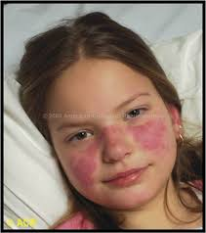
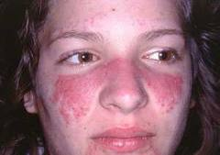
PDF created with FinePrint pdfFactory trial version http://www.fineprint.com

Slide 12
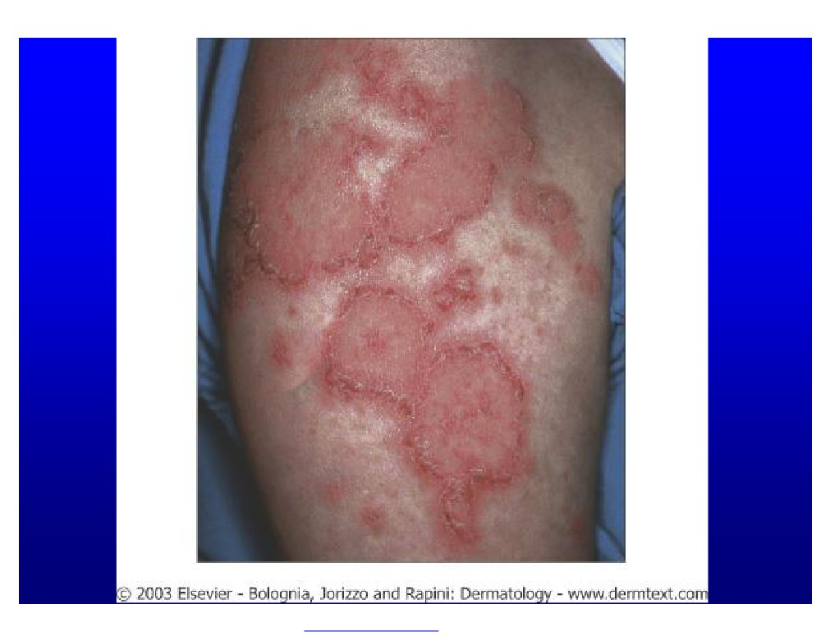
PDF created with FinePrint pdfFactory trial version http://www.fineprint.com

Slide 13
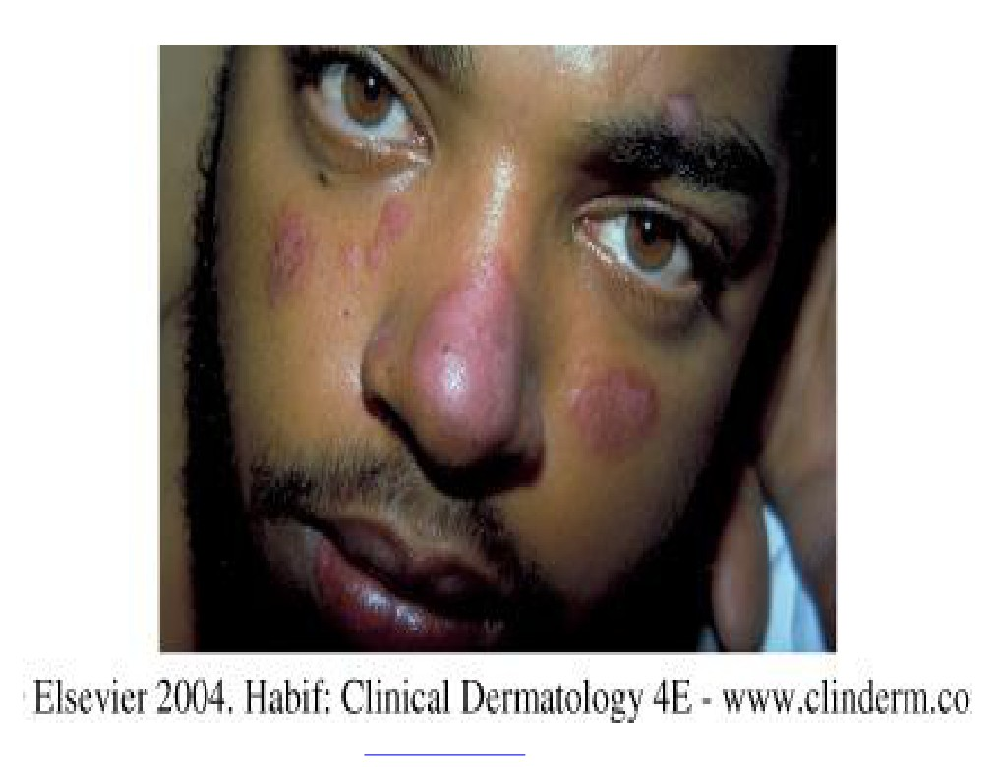
PDF created with FinePrint pdfFactory trial version http://www.fineprint.com

Slide 14
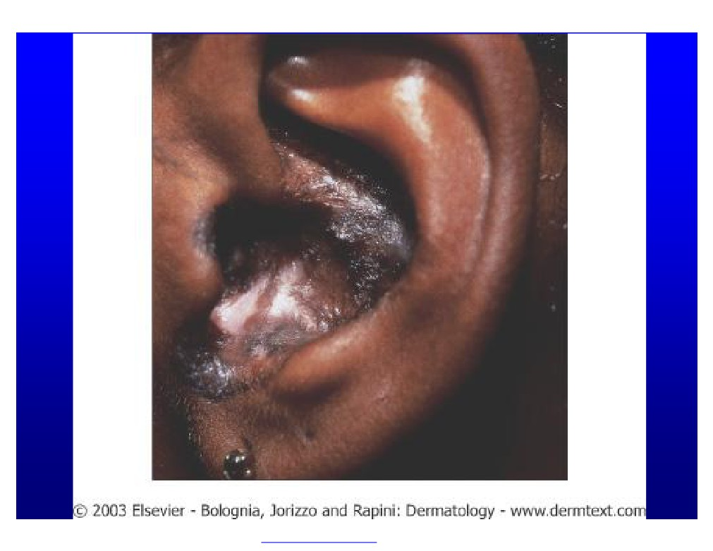
PDF created with FinePrint pdfFactory trial version http://www.fineprint.com

Slide 15
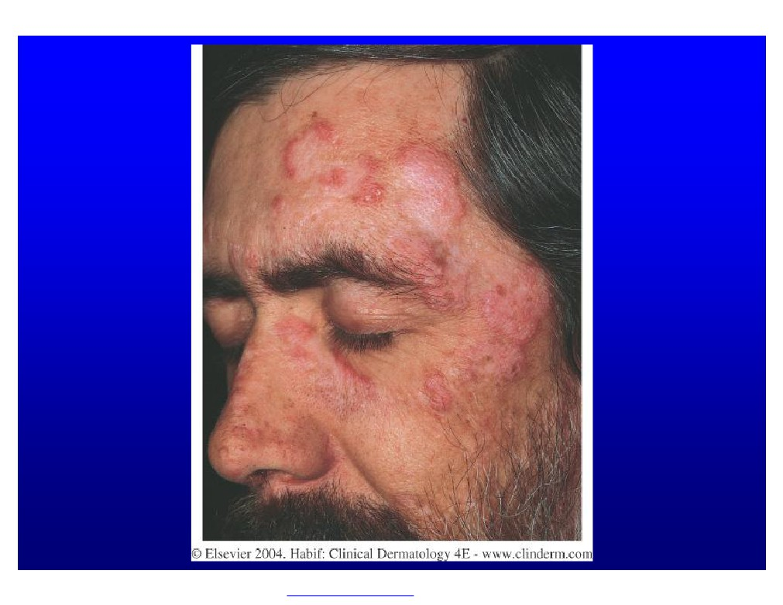
PDF created with FinePrint pdfFactory trial version http://www.fineprint.com

Slide 16
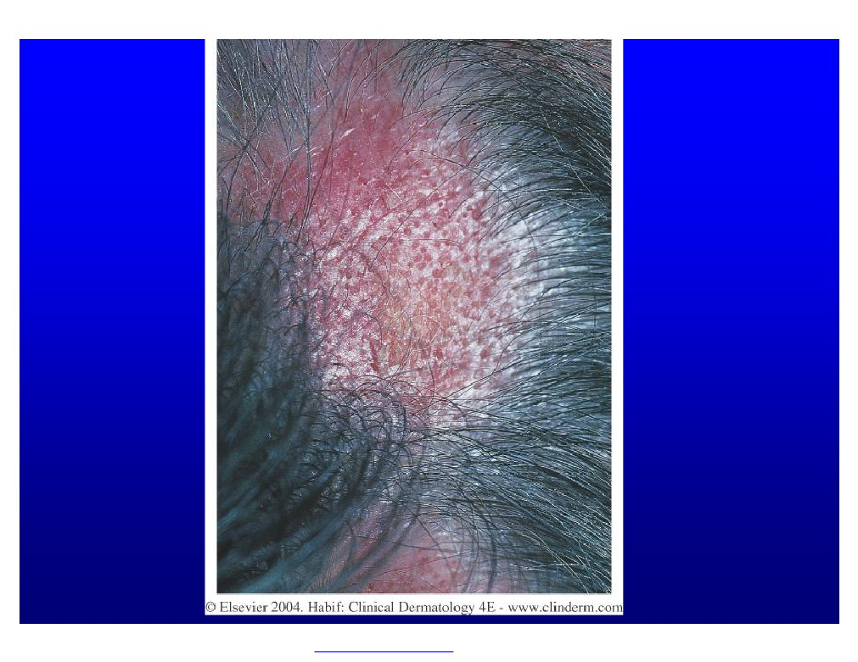
PDF created with FinePrint pdfFactory trial version http://www.fineprint.com

Slide 17
PDF created with FinePrint pdfFactory trial version http://www.fineprint.com

Slide 18
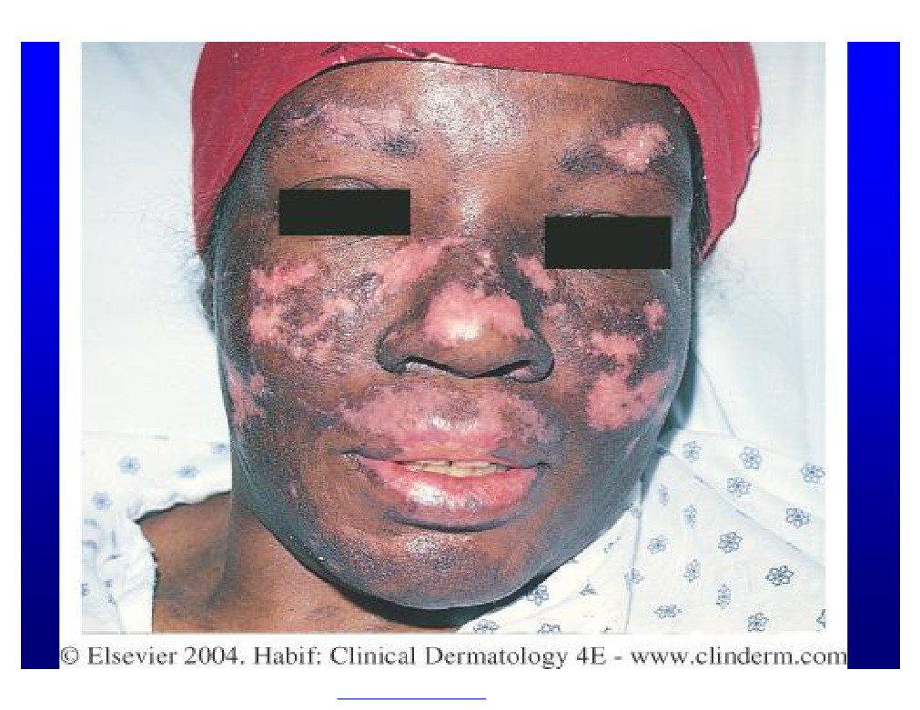
PDF created with FinePrint pdfFactory trial version http://www.fineprint.com

Slide 19
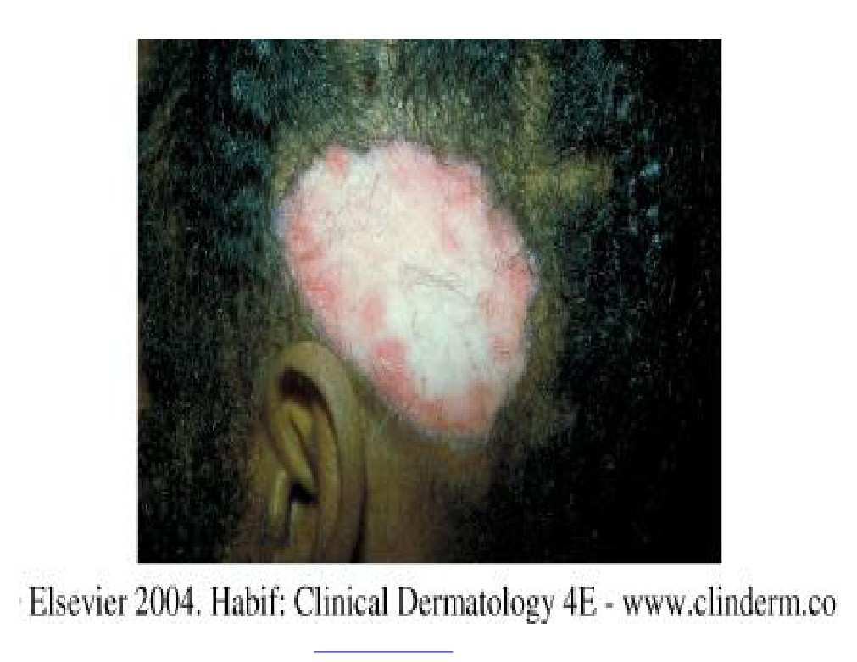
PDF created with FinePrint pdfFactory trial version http://www.fineprint.com

Slide 20
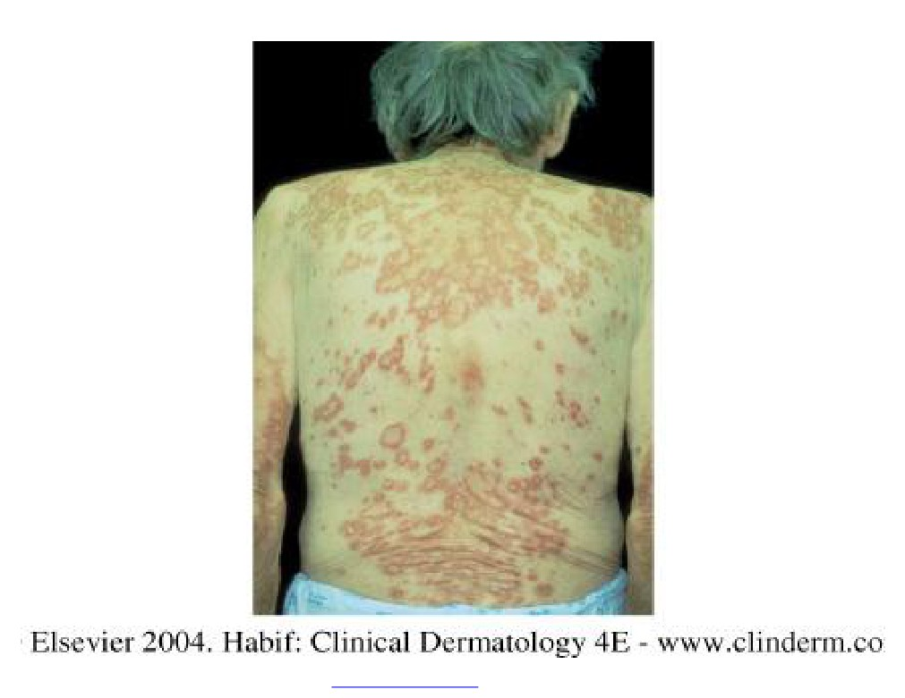
PDF created with FinePrint pdfFactory trial version http://www.fineprint.com

Slide 21
PDF created with FinePrint pdfFactory trial version http://www.fineprint.com

Slide 22
PDF created with FinePrint pdfFactory trial version http://www.fineprint.com

Slide 23
Drug - Induced Lupus:
u Cause:
v Procainamide v Hydralazine v Others
u Antihistone positive
PDF created with FinePrint pdfFactory trial version http://www.fineprint.com

Slide 24
Dermatomyositis (Skin Rash + Muscle Weakness):
u Heliotrope : Violeceous color over the upper eyelids
u Gottoron’s papules: Flat- topped violaceous papules over knuckles of hands
u Calcifications especially in kids
u Bilateral proximal muscle weakness (with high CPK, Positive EMG and Muscle biopsy)
u In adults (especially over 50 yrs)
associated with internal malignancy (e.g. GI, Prostrate, ovary & breast)
PDF created with FinePrint pdfFactory trial version http://www.fineprint.com

Slide 25
PDF created with FinePrint pdfFactory trial version http://www.fineprint.com

Slide 26
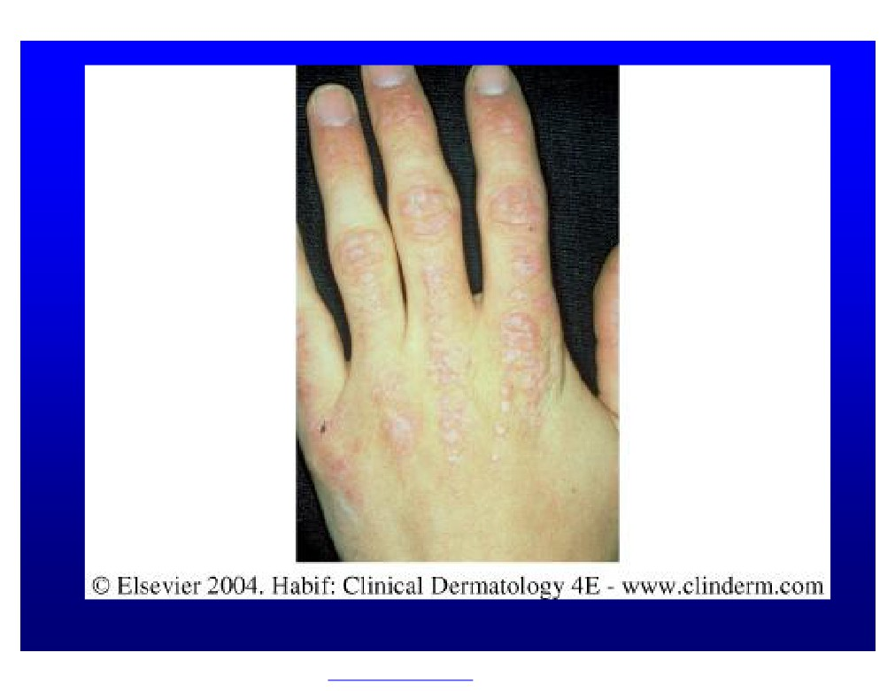
PDF created with FinePrint pdfFactory trial version http://www.fineprint.com

Slide 27
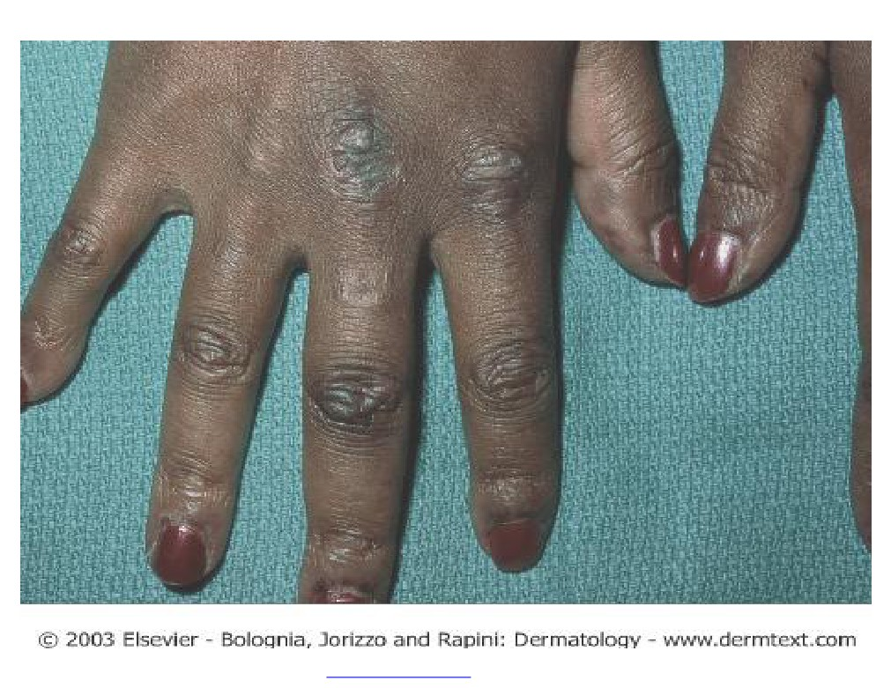
PDF created with FinePrint pdfFactory trial version http://www.fineprint.com

Slide 28
PDF created with FinePrint pdfFactory trial version http://www.fineprint.com

Slide 29
Scleroderma (Systemic Sclerosis)
u Thickened & tight skin
u Sclerodactyly
u Face: loss of forehead lines
u beaked nose, small mouth, radial furrowing around the mouth) u Telangectasia and calcification
u Systemic involvement:
v Lung, GI, Kidneys
v Positive anti scl-70
PDF created with FinePrint pdfFactory trial version http://www.fineprint.com

Slide 30
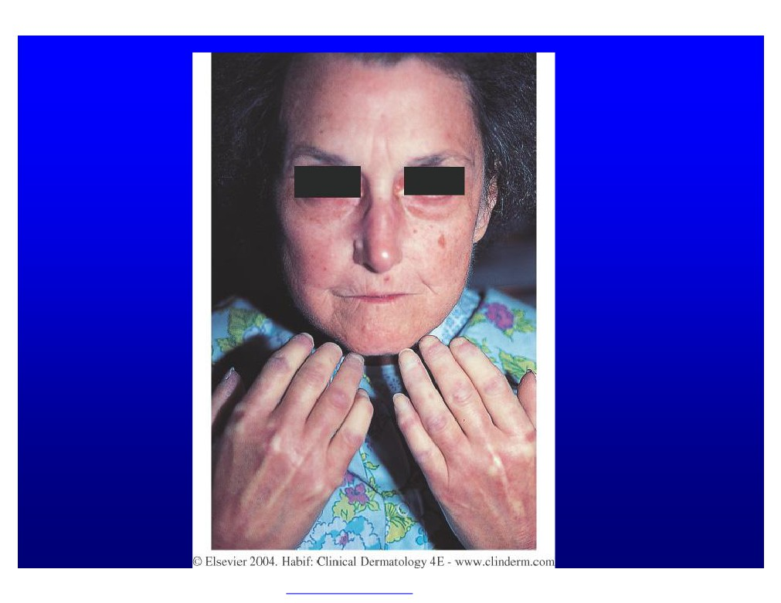
PDF created with FinePrint pdfFactory trial version http://www.fineprint.com

Slide 31
PDF created with FinePrint pdfFactory trial version http://www.fineprint.com

Slide 32
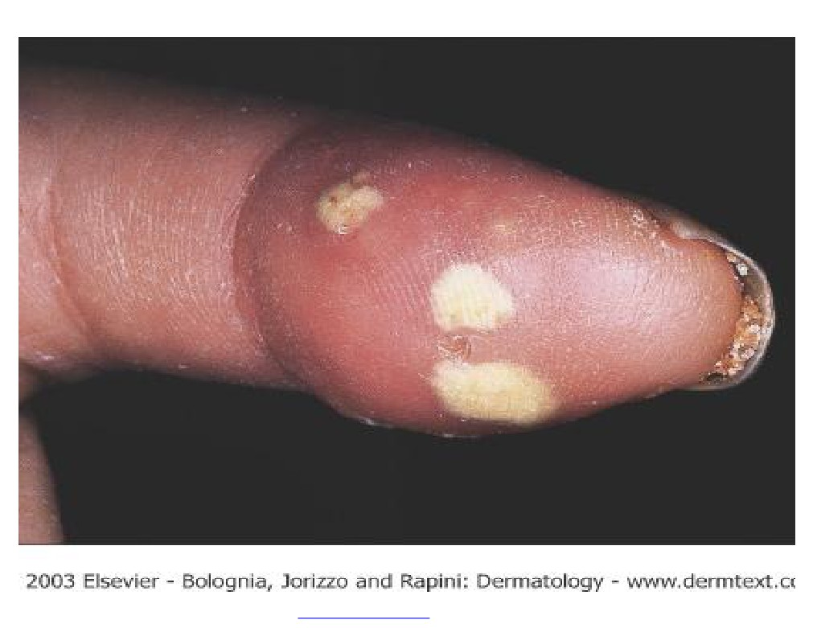
PDF created with FinePrint pdfFactory trial version http://www.fineprint.com

Slide 33
CREST (milder variant of scleroderma)
u C=Calcification
u R =Raynand’s
u E =Eosopheagal dysfunction u S= Sclerodactasia
u T=Telangectasia
u Positive anti- centromere
u Less systemic involvement.
PDF created with FinePrint pdfFactory trial version http://www.fineprint.com

Slide 34
Morphea:
u Localized scleroderma without systemic involvement.
v Firm,white patch of skin surrounded by violaceous ring En coup de sabre
u Linear scleroderma on the scalp and face which may give scarring alopecia + it may affect muscle or even bone
PDF created with FinePrint pdfFactory trial version http://www.fineprint.com

Slide 35
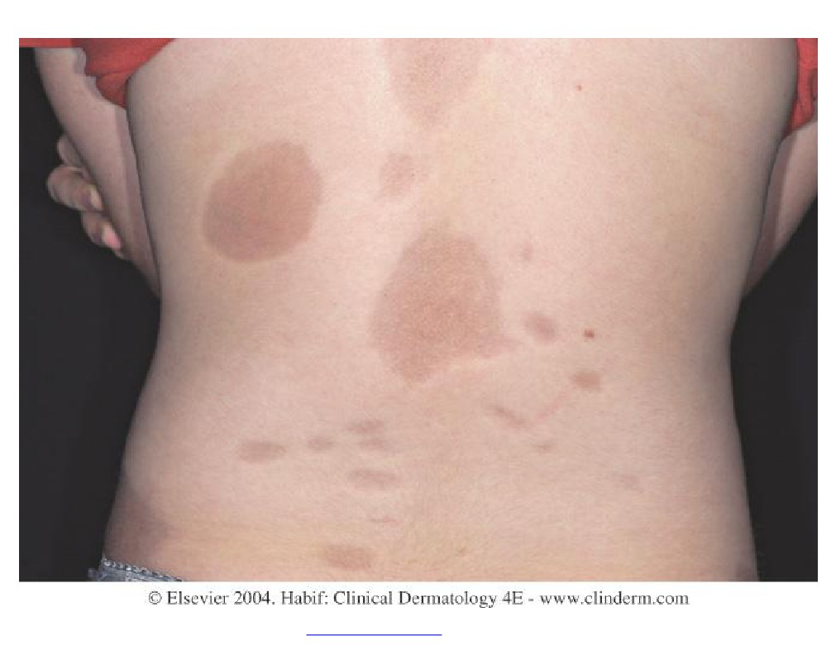
PDF created with FinePrint pdfFactory trial version http://www.fineprint.com

Slide 36
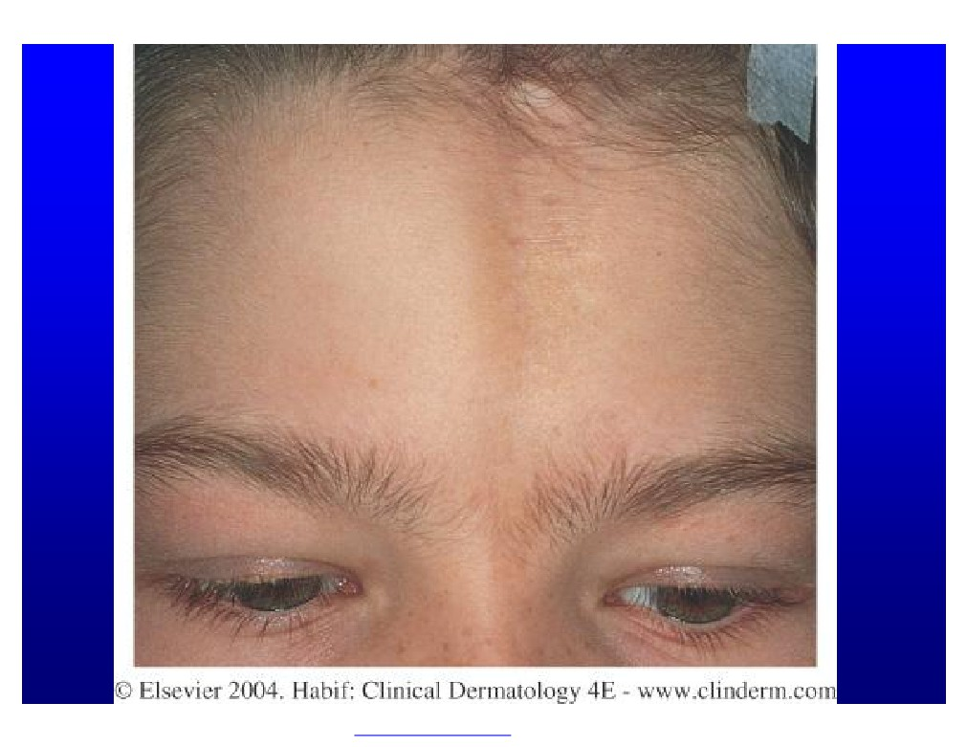
PDF created with FinePrint pdfFactory trial version http://www.fineprint.com

Slide 37
PDF created with FinePrint pdfFactory trial version http://www.fineprint.com

Slide 38
Antibody testing for CTD (table)
Antibody
Clinical significance
ANA
Screening for SLE and other CTD
Anti-Centromere
Marker for CREST
Anti-histone
Marker for Drug-Induced Lupus
Anti-Smith
Specific for SLE
Anti - RNP
For MCTD
Anti - Ro
Neonatal Lupus, SCLE
Scl - 70 antibody
For Scleroderma
Anti ds- DNA
For SLE
PDF created with FinePrint pdfFactory trial version http://www.fineprint.com

Slide 39
Endocrine :
u Diabetes
v Necrobiosis Lipoidica diabeticorum (NLD) :Asymptomatic v Usually seen on the shins
v May predate frank development of diabetes by several years v Shiny atrophic red or yellowish plaques with telangectasia over their surface + ulceration
v Severity of NLD is not directly related to severity of diabetes.
*Increased risk of fungal and bacterial infection
PDF created with FinePrint pdfFactory trial version http://www.fineprint.com

Slide 40
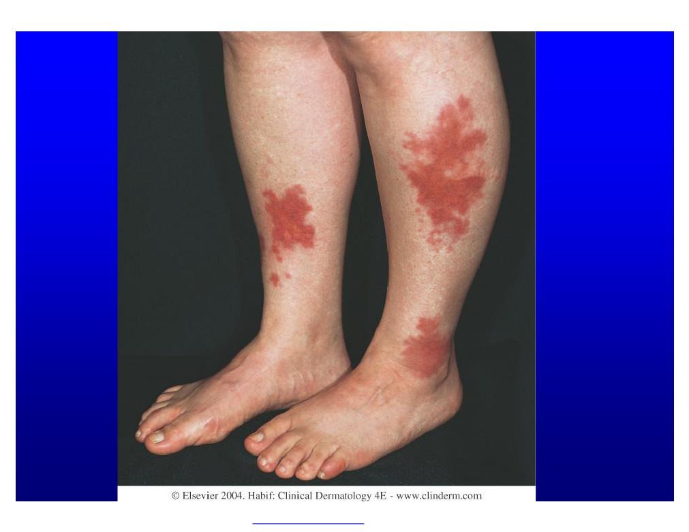
PDF created with FinePrint pdfFactory trial version http://www.fineprint.com

Slide 41
PDF created with FinePrint pdfFactory trial version http://www.fineprint.com

Slide 42
PDF created with FinePrint pdfFactory trial version http://www.fineprint.com

Slide 43
Hyperthyrodism:
u Smooth, warm, moist (due to increase sweating) skin u Peritibial myxedema (asymptomatic red plaques over shins)
u Thin & fine hair u Onycholysis u Clubbing.
Hypothyrodism
u Dry, cold, skin
u Edematous skin (myxedema)
u Hair loss of lateral third of eyebrows u Brittle hair or nails
PDF created with FinePrint pdfFactory trial version http://www.fineprint.com

Slide 44
Cushing’s Syndrome:
u Rounded face with fullness of cheeks (Moon face) u Buffalo hump (fat deposit over upper back)
u Central obesity with thin arms & legs & “lemon with sticks” u Atrophy of skin
u Striae
u Purpura u Hirsutism u Acne
PDF created with FinePrint pdfFactory trial version http://www.fineprint.com

Slide 45
PDF created with FinePrint pdfFactory trial version http://www.fineprint.com

Slide 46
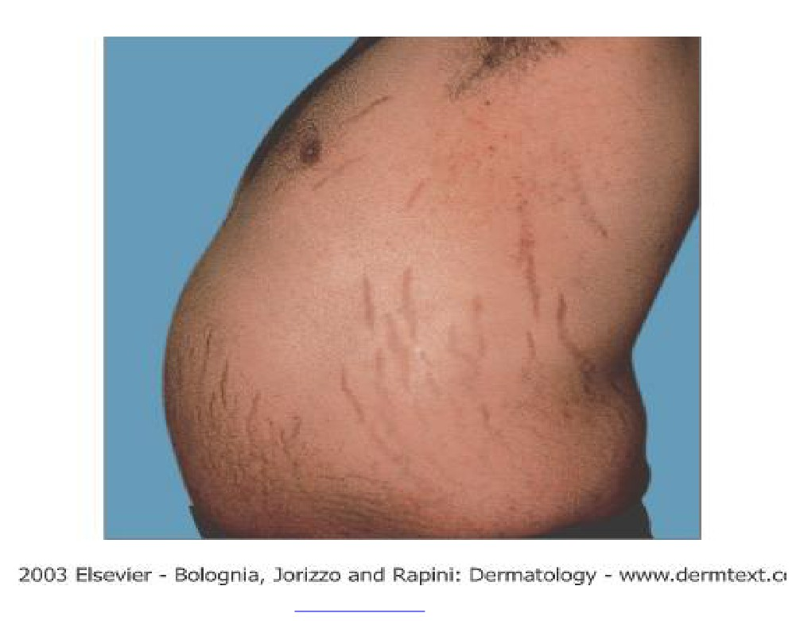
PDF created with FinePrint pdfFactory trial version http://www.fineprint.com

Slide 47
Addison’s disease:
u Hyperpigmentation:
v at Sun exposed skin, sites of trauma, axillae, palmar creases, old scars ,nevi and mucous membranes
PDF created with FinePrint pdfFactory trial version http://www.fineprint.com

Slide 48
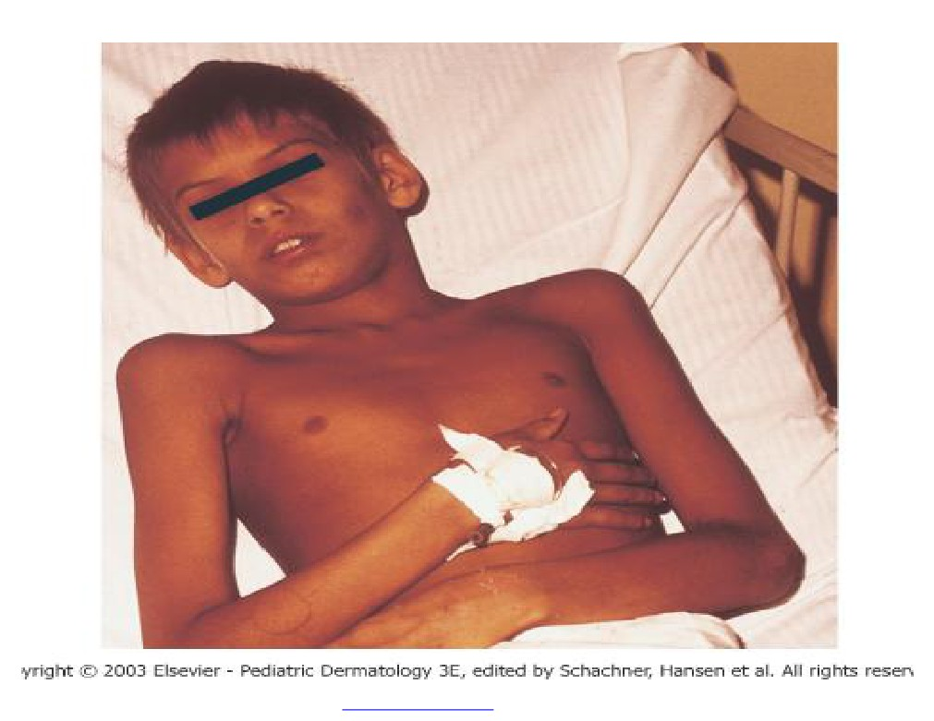
PDF created with FinePrint pdfFactory trial version http://www.fineprint.com

Slide 49
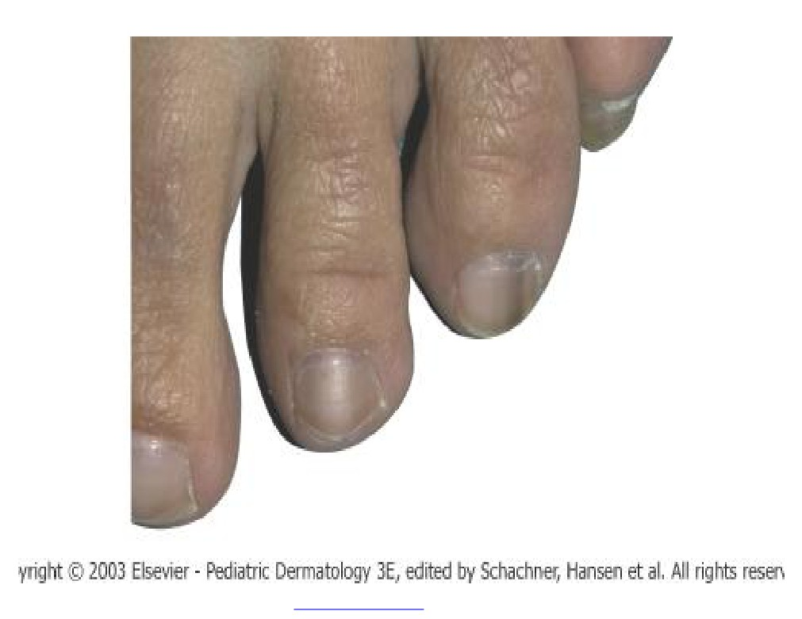
PDF created with FinePrint pdfFactory trial version http://www.fineprint.com

Slide 50
GIT
Chronic Liver Disease
u Jaundice
u Spider telangectasia u Acne
u Gyneacomastia u Purpura
u Collateral viens u Striae
u Palmer erythema
u Dupuytren’s contracture u White nails.
PDF created with FinePrint pdfFactory trial version http://www.fineprint.com

Slide 51
Acrodermatitis enteropathica (genetic disease)
u Due to zinc deficiency
u Seen in infants as erythematous erosive rash around orifices (mouth, ears, anus)also on hands & feet.
u Alopecia and nail dystrophy
u Diarrhea or abdominal pain.
PDF created with FinePrint pdfFactory trial version http://www.fineprint.com

Slide 52
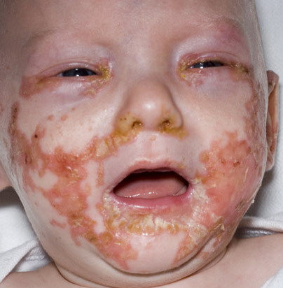
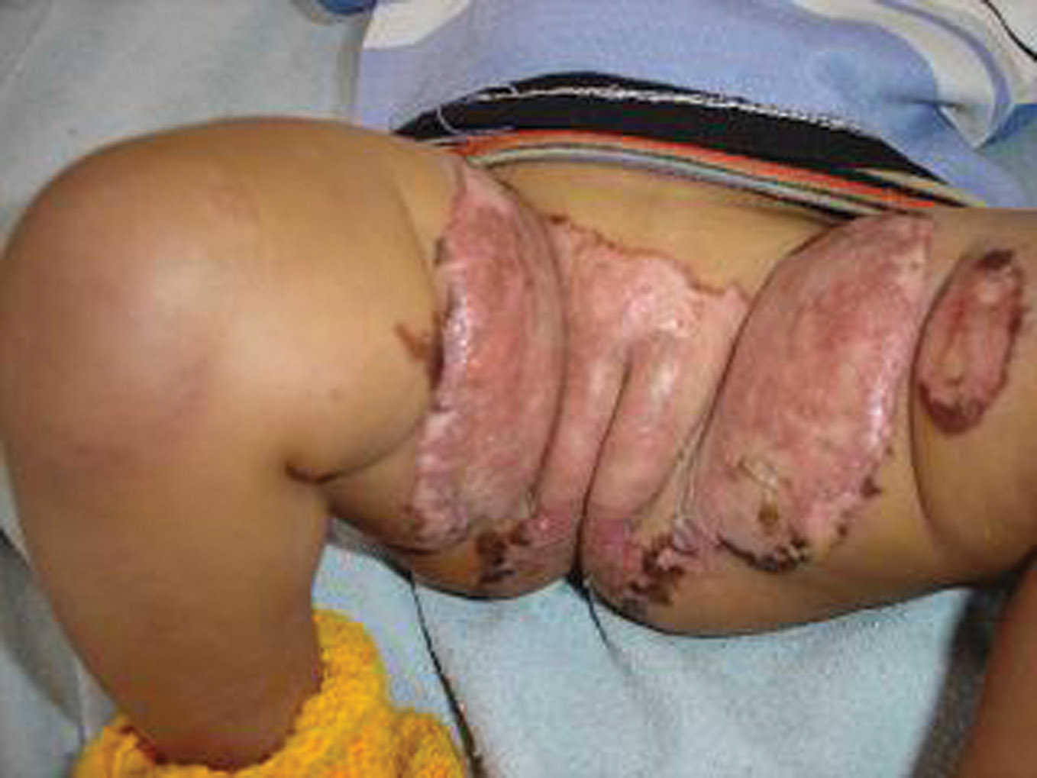

Slide 53
Peutz-Jeghers Syndrome
u Small brown macules on lips,
buccal mucosa and small intestinal polyps
u rarely polyps can be premalignant.
PDF created with FinePrint pdfFactory trial version http://www.fineprint.com

Slide 54
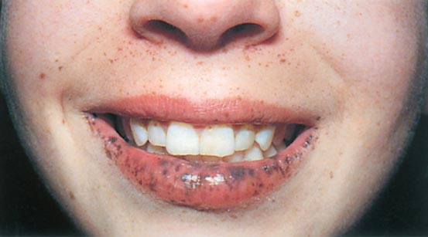

Slide 55
Pyoderma Gangrenosum:
uAcute painful leg ulceration, surrounded by violaceous border uAssociated with inflammatory bowel disease
uOther associations; Rheumatoid Artharitis and leukemia
PDF created with FinePrint pdfFactory trial version http://www.fineprint.com

Slide 56
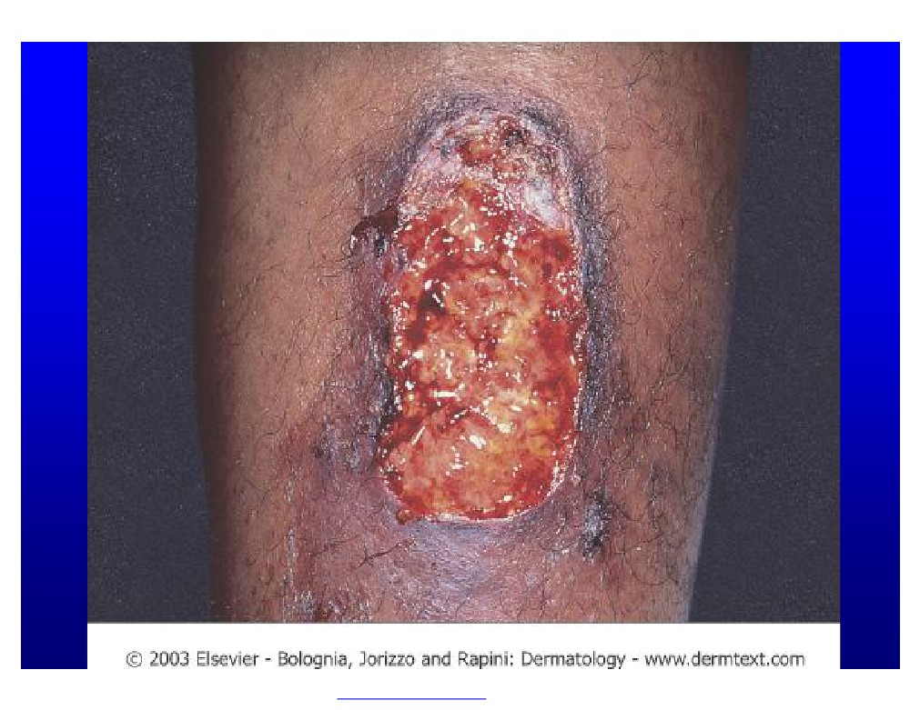
PDF created with FinePrint pdfFactory trial version http://www.fineprint.com

Slide 57
Hereditary haemorrghic Telangectasia
u Telangectasia (dilated capillaries) over lip,nose, tongue, fingers and toes.
u Hx of recurrent epistaxis
u Associated with recurrent upper GI bleed
PDF created with FinePrint pdfFactory trial version http://www.fineprint.com

Slide 58
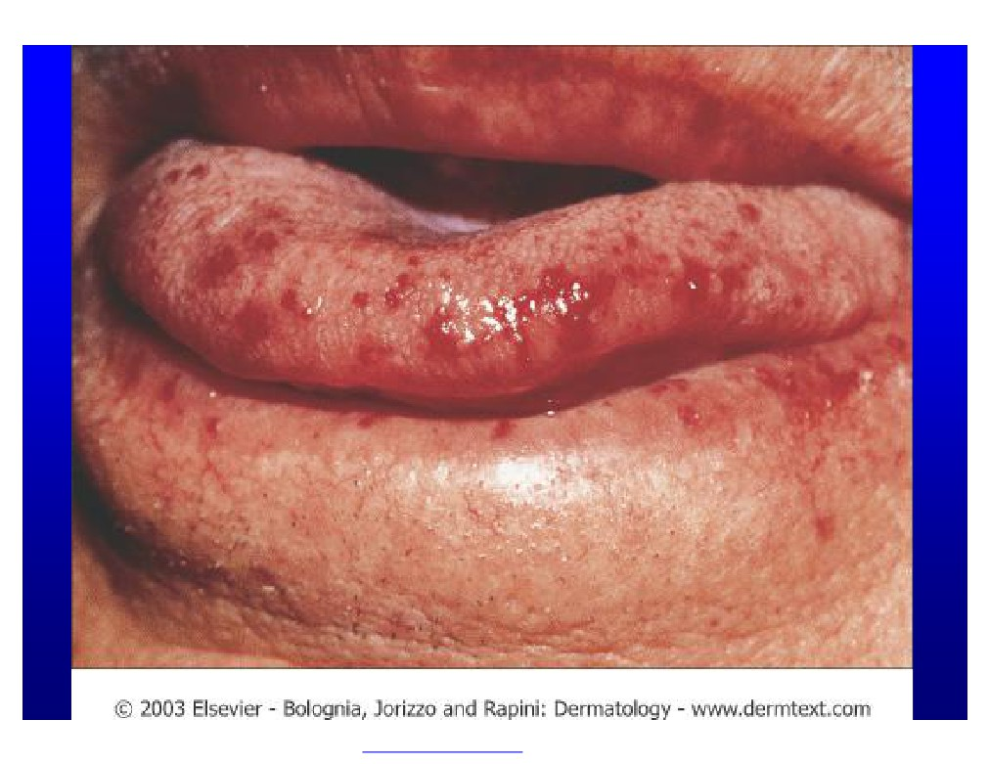
PDF created with FinePrint pdfFactory trial version http://www.fineprint.com

Slide 59
Hyperlipidemia:
uPresent with different types of xanthomas uYellow color is characteristic
PDF created with FinePrint pdfFactory trial version http://www.fineprint.com

Slide 60
Types of Xanthomas
u Eruptive: small papules appear in crops over buttocks & extensors
u Tendinous: Nodules over tendons e.g. extensor tendons of hands & feet and Achilles tendon.
u Palmar crease xanthoma: on palms
u Tuberous: Papules & nodules over knees and elbows u Xanthelasma: Bilateral symmetrical over both eyelids.
PDF created with FinePrint pdfFactory trial version http://www.fineprint.com

Slide 61
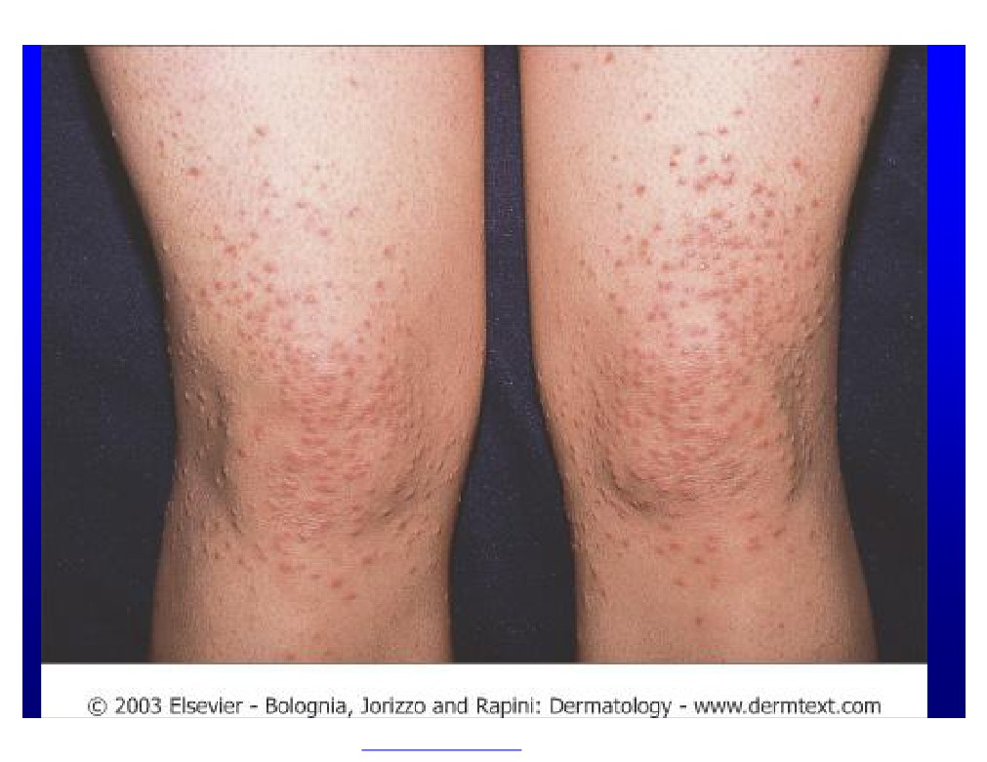
PDF created with FinePrint pdfFactory trial version http://www.fineprint.com

Slide 62
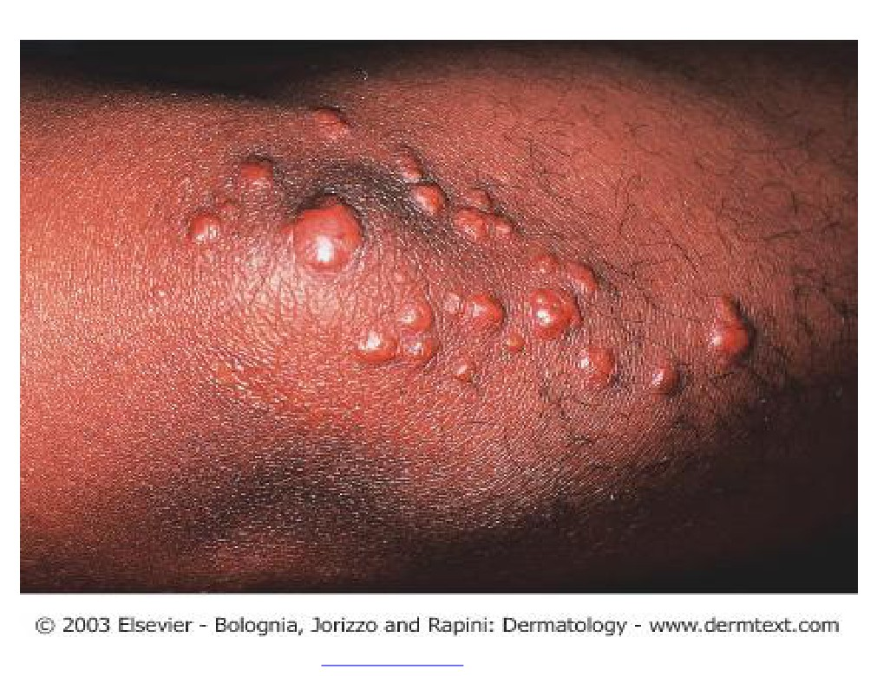
PDF created with FinePrint pdfFactory trial version http://www.fineprint.com

Slide 63
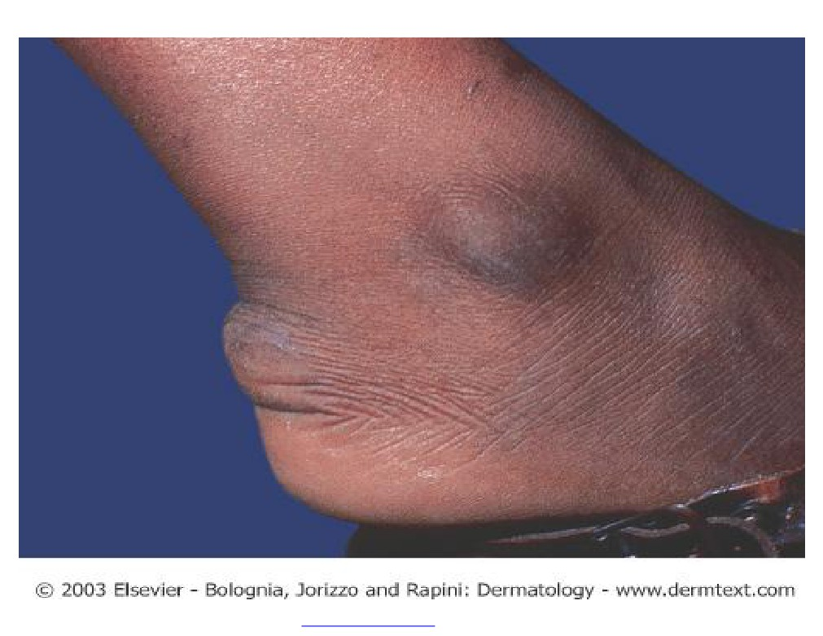
PDF created with FinePrint pdfFactory trial version http://www.fineprint.com

Slide 64
PDF created with FinePrint pdfFactory trial version http://www.fineprint.com

Slide 65
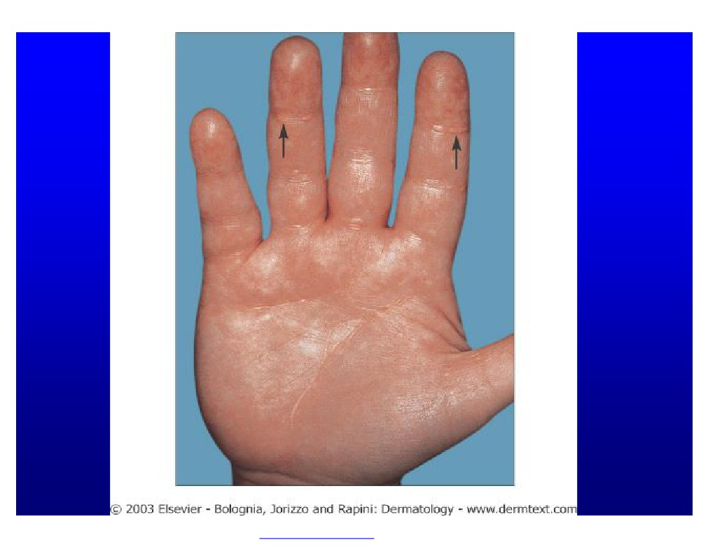
PDF created with FinePrint pdfFactory trial version http://www.fineprint.com

Slide 66
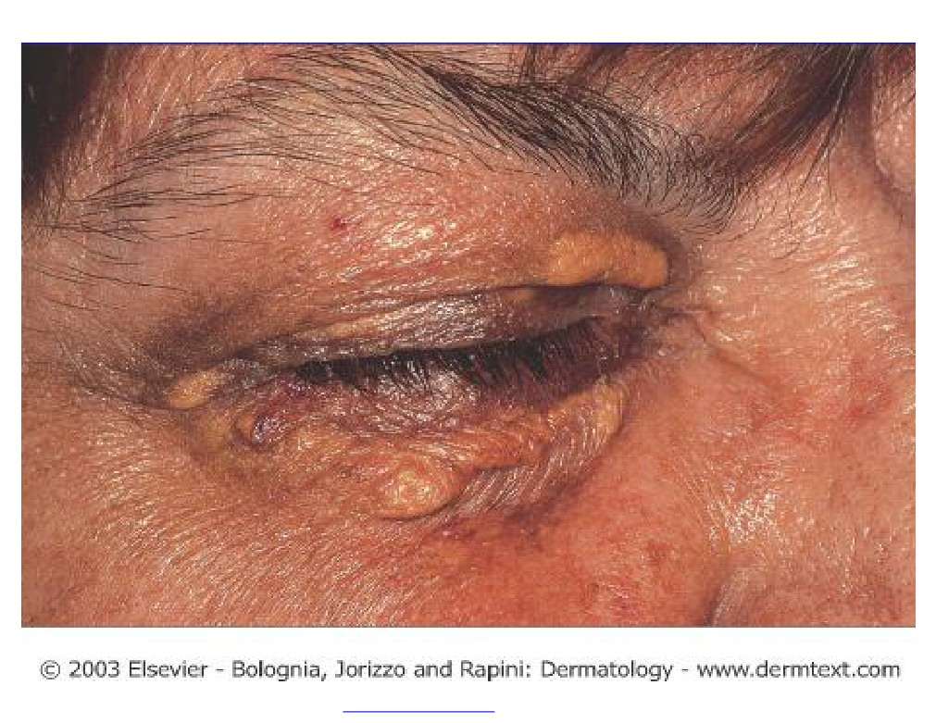
PDF created with FinePrint pdfFactory trial version http://www.fineprint.com

Slide 67
Xanthoma may be a pointer to:
u Primary hyperlipemic status due to genetic abnormality
u Secondary hyperlipemic status due to renal, hepatic, endocrine or pancreatic disease
u Normo-lipemic status.
PDF created with FinePrint pdfFactory trial version http://www.fineprint.com

Slide 68
Neurocutaneous Disorders
Neurofibromatosis:
u Autosomal dominant
u Café-au-lait macules(light brown)
u Neurofibromas(soft pink or skin- colored papules and nodules) u Axillary freckling
u Optic glioma
u Lisch nodules (iris hamartoma, seen by slit-lamp examination)
u Associated with Neurological complications e.g. tumors, seizures and mental retardation.
PDF created with FinePrint pdfFactory trial version http://www.fineprint.com

Slide 69
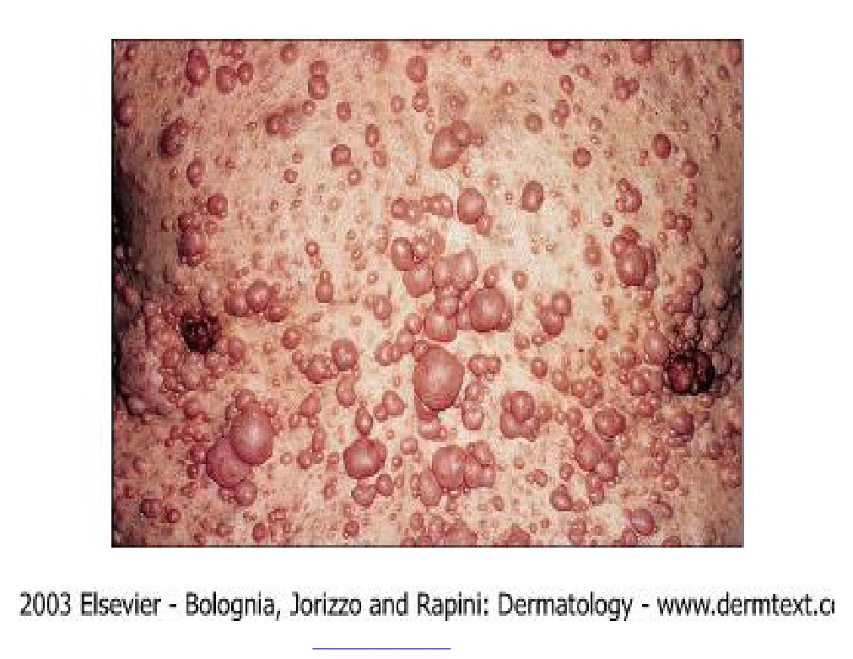
PDF created with FinePrint pdfFactory trial version http://www.fineprint.com

Slide 70
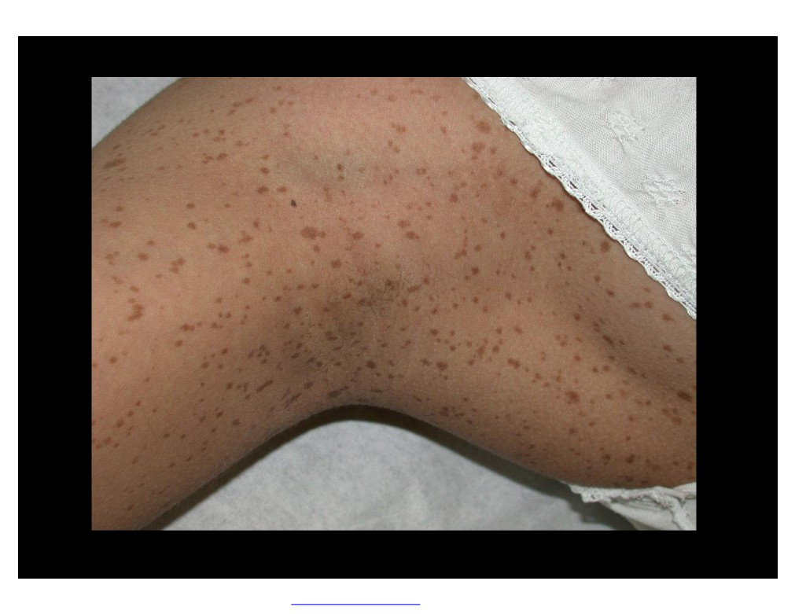
PDF created with FinePrint pdfFactory trial version http://www.fineprint.com

Slide 71
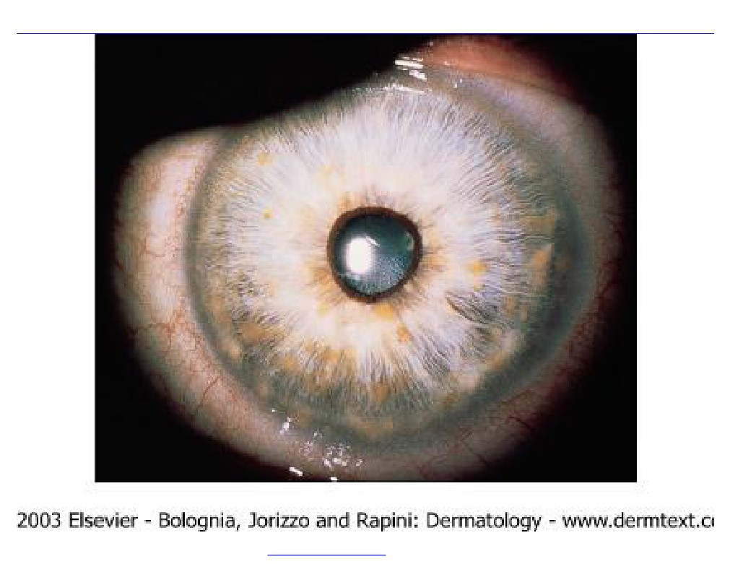
PDF created with FinePrint pdfFactory trial version http://www.fineprint.com

Slide 72
PDF created with FinePrint pdfFactory trial version http://www.fineprint.com

Slide 73
Tuberous Sclerosis (Epiloia) :
v Epi = Epilepsy
v Loi = Low intellegence
v a
= adenoma sebaceoum
Skin features
1. Adenoma sebaceoum (anigofibroma): red papules around the nose and on chin
2. Ash-leaf hypopigmention: oval area of hypopigmention This is the earliest sign of TS
3. Periungal fibroma: multiple papules & nodules around the nail
4. Shagreen patch: skin colored plaque on the trunk with “orange- peel” surface
PDF created with FinePrint pdfFactory trial version http://www.fineprint.com

Slide 74
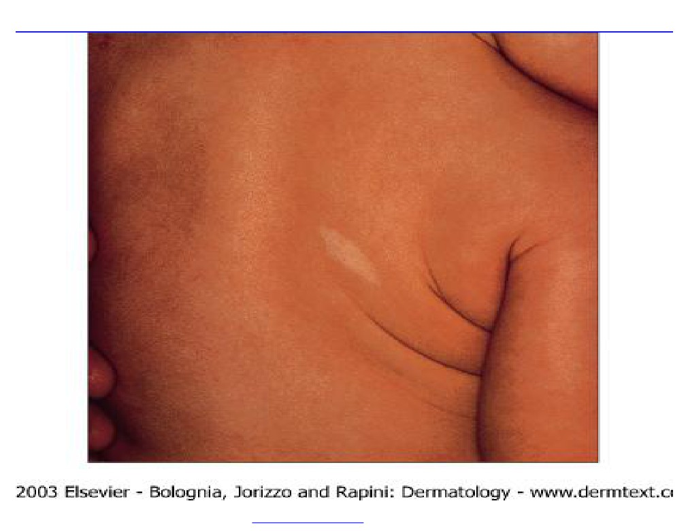
PDF created with FinePrint pdfFactory trial version http://www.fineprint.com

Slide 75
PDF created with FinePrint pdfFactory trial version http://www.fineprint.com

Slide 76
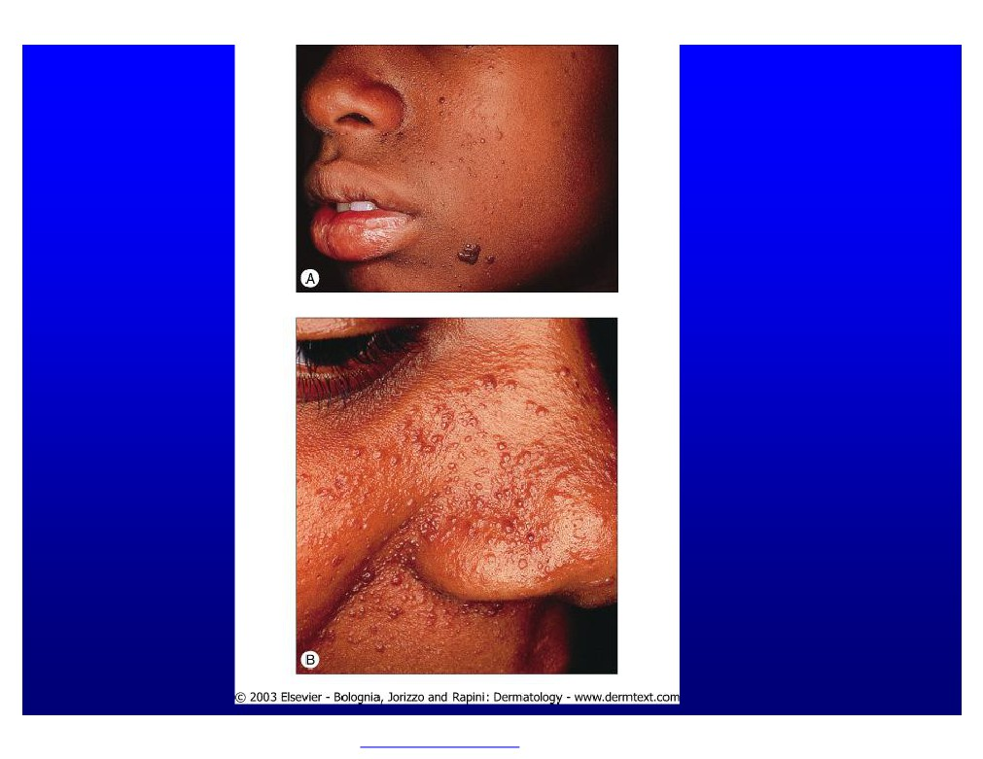
PDF created with FinePrint pdfFactory trial version http://www.fineprint.com

Slide 77
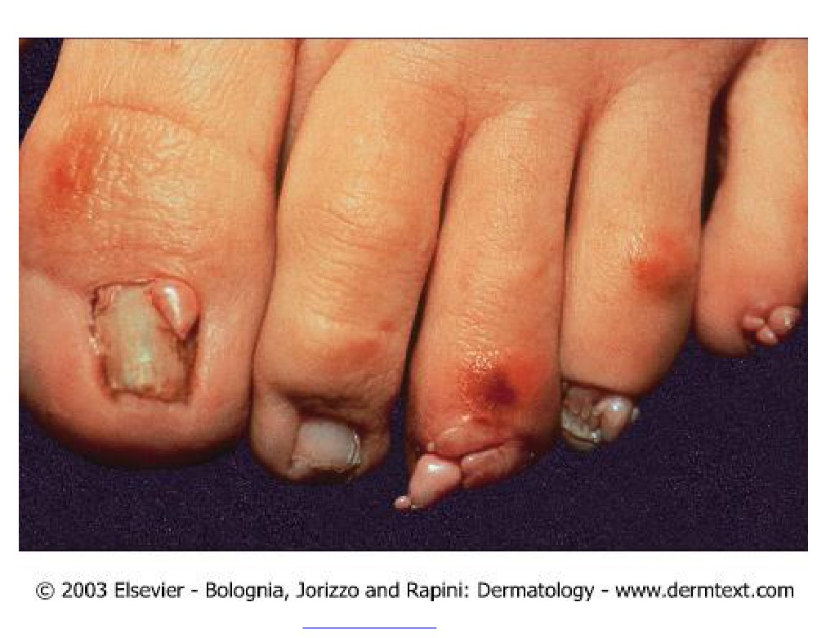
PDF created with FinePrint pdfFactory trial version http://www.fineprint.com

Slide 78
Behcet’s Syndrome:
u Oral ulcer (the most common) u Genital ulcers (mainly scrotal) u Iritis and arthoropathy
u May have CNS involvement Scurvy :
u Vitamin C deficiency u Bleeding gums
u Can cause teeth loss (permanent complication)
PDF created with FinePrint pdfFactory trial version http://www.fineprint.com

Slide 79
Scurvy(cont’d)
u Easy bruishing
u Diagnosis : Low ascorbic acid (Vit-C) level in Leukocyte Pellagra:
u Nictonic acid deficiency u 4 “D”s
Dermatitis (Photodermatitis)
Diarrhea
Dementia
Death (if not treated)
PDF created with FinePrint pdfFactory trial version http://www.fineprint.com

Slide 80
PDF created with FinePrint pdfFactory trial version http://www.fineprint.com

Slide 81
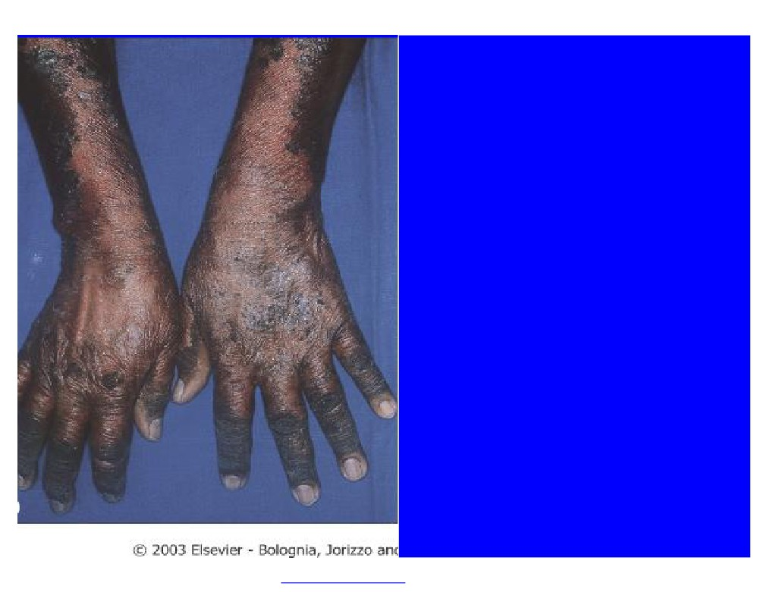
Pellagra
PDF created with FinePrint pdfFactory trial version http://www.fineprint.com

Slide 82
Causes of generalized pruritus without skin lesions:
1.
Endocrine: DM, hypo& hyperthyroidsm
2.
Haematological: polycythemia rubra vera, iron def anemia Malignancy; e.g. Lymphoma
3.
4.
Hepatic: primary biliary cirrhosis Renal: CRF
5.
The commonest manifestation of CRF is pruritus
6.
Neurological : e.g. Tabes dorialis Others:
7.
v Psychognic v Drugs
v Idiopthaic
PDF created with FinePrint pdfFactory trial version http://www.fineprint.com

Slide 83
Erythema Nodosum
u Multiple bilateral tender erythematous subcutaneous nodules Over shins
u More common in females u Causes:
v Infectious: Streptococus, Tuberculosis, Hepatitis ,Chlamydia v Sarcoidosis
v Drugs : Oral contraceptive pills, sulfonamides v Lymphoma & leukemia
v Pregnancy
v Behcet’s disease v Idiopathic
PDF created with FinePrint pdfFactory trial version http://www.fineprint.com

Slide 84
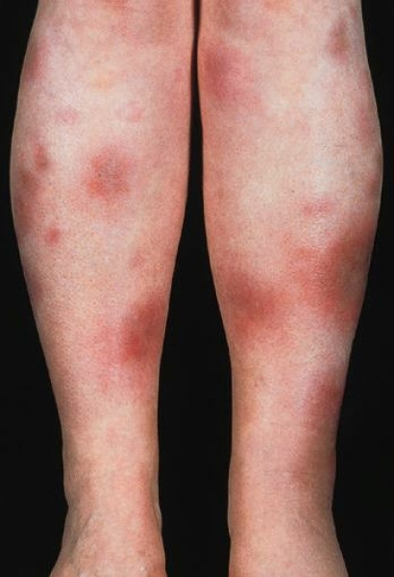
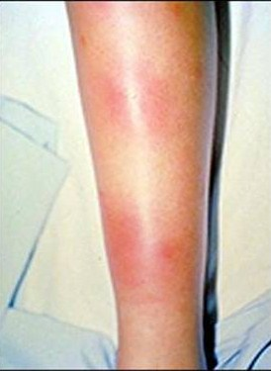
PDF created with FinePrint pdfFactory trial version http://www.fineprint.com

Slide 85
Acanthosis Nigricans:
u Brown hyperpigmentation & increased thickening of skin with velvety texture at neck, axillae and groin
Causes:
Obesity
Endocrinopathy : Diabetes, Thyroid disease, Insulin resistance
Internal malignancy: the most common is adenocarcinoma of stomach Drugs: Nicotinic acid
Familial
Idiopathic
PDF created with FinePrint pdfFactory trial version http://www.fineprint.com

Slide 86
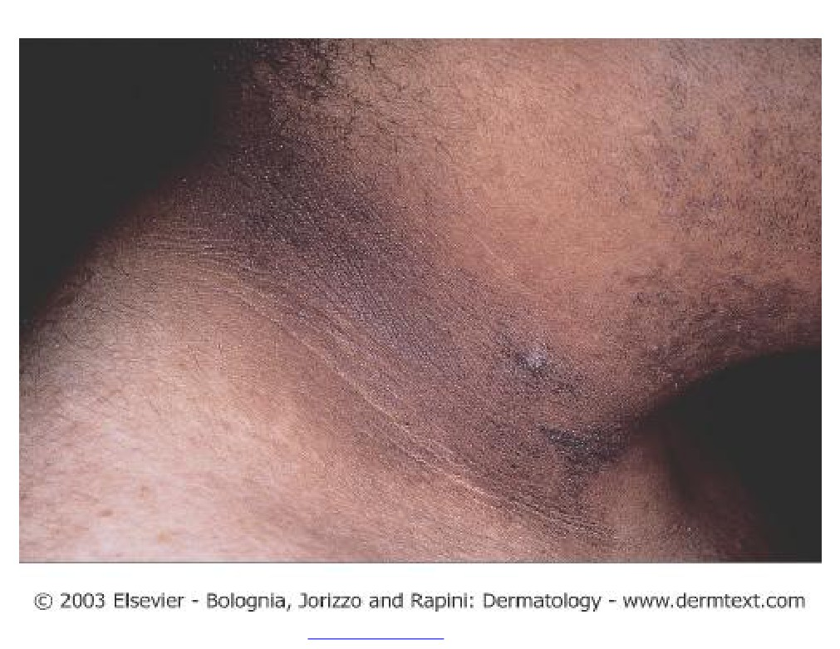
PDF created with FinePrint pdfFactory trial version http://www.fineprint.com

Slide 87
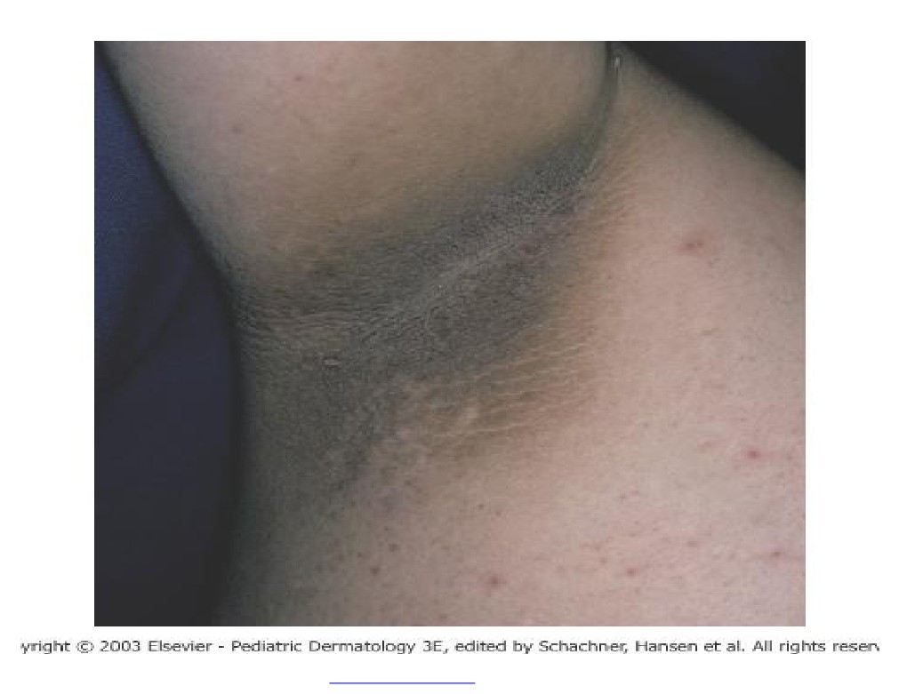
PDF created with FinePrint pdfFactory trial version http://www.fineprint.com

Slide 88
Nails
Clubbing :
v Exaggeration of the normal nail curve associated with loss of the normal angle between nail and posterior nail fold
v Causes:
1. Thoracic: Lung abscess, Lung CA
2. CVS: Congenital cyanotic heart disease
3. GIT:GI carcinoma, Inflammatory bowel disease
4. Endocrine: Thyroid disease
5. Idiopathic:
PDF created with FinePrint pdfFactory trial version http://www.fineprint.com

Slide 89
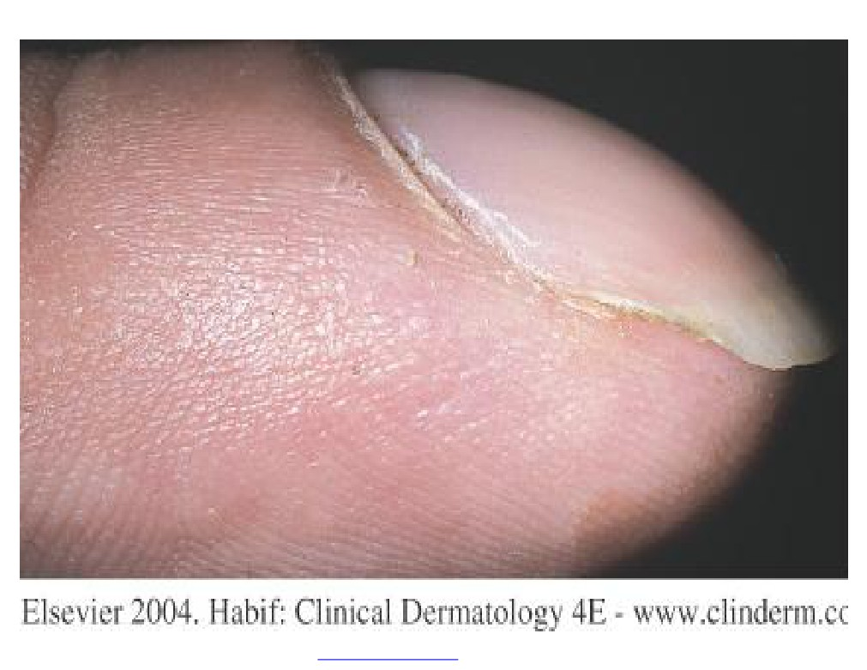
PDF created with FinePrint pdfFactory trial version http://www.fineprint.com

Slide 90
Splinter Haemorrhages :
u Causes :
1. Bacterial endocarditis
2. Septic emboli
3. CTD
4. Trauma
5. Idiopathic
PDF created with FinePrint pdfFactory trial version http://www.fineprint.com

Slide 91
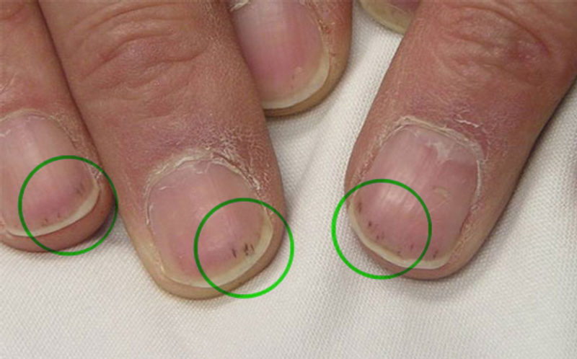

Slide 92
Koilonychia :
u Spoon- shaped appearance u Causes:
1. Iron deficiency anemia
2. Thyroid disease
3. Physological; early childhood
4. Dermatoses: Lichen planus
Alopecia Areata and others
PDF created with FinePrint pdfFactory trial version http://www.fineprint.com

Slide 93
Some mucocutaneous disorders in which you need to do HIV testing?
u Oral hairy leukoplakia:
v Corragated white plaques on the lateral aspect of the tongue. u Kaposi Sarcoma:
v Caused by HHV -8
v Blue macules ,patches or nodules which is in essence a vascular tumor v Associated with low CD4 count
v May resolve or diminish if CD4 count rises
v Types of Kaposi sarcoma :Classic type (in elderly),Immunosupperssion associated ,HIV associated ,and African endemic type
v Metastasis to Lymph nodes , and Viscera
PDF created with FinePrint pdfFactory trial version http://www.fineprint.com

Slide 94
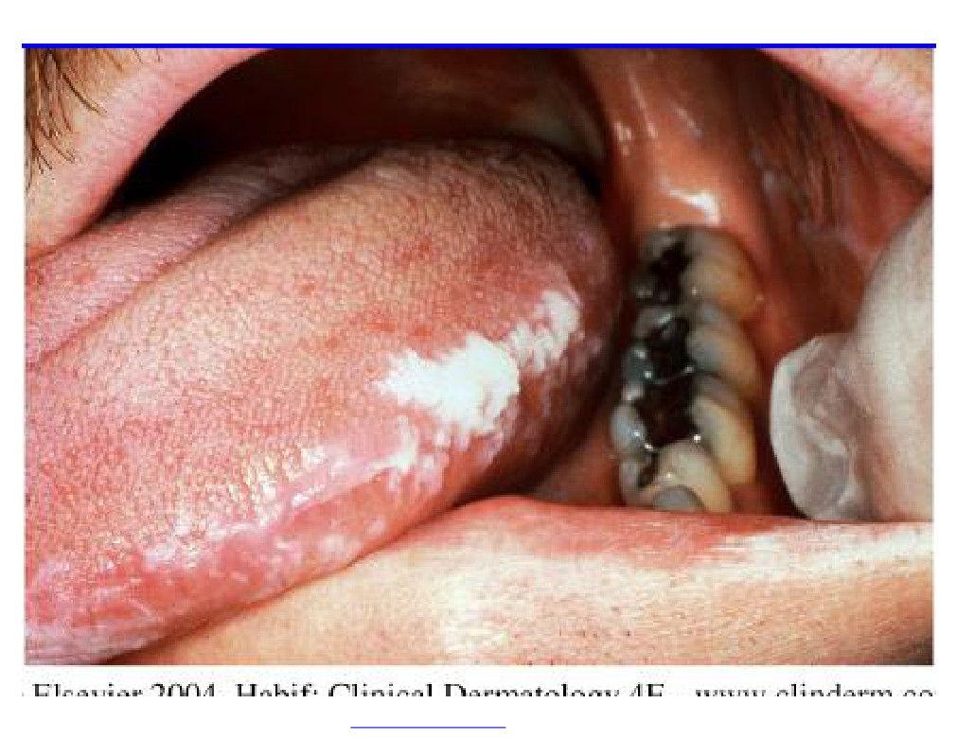
PDF created with FinePrint pdfFactory trial version http://www.fineprint.com

Slide 95
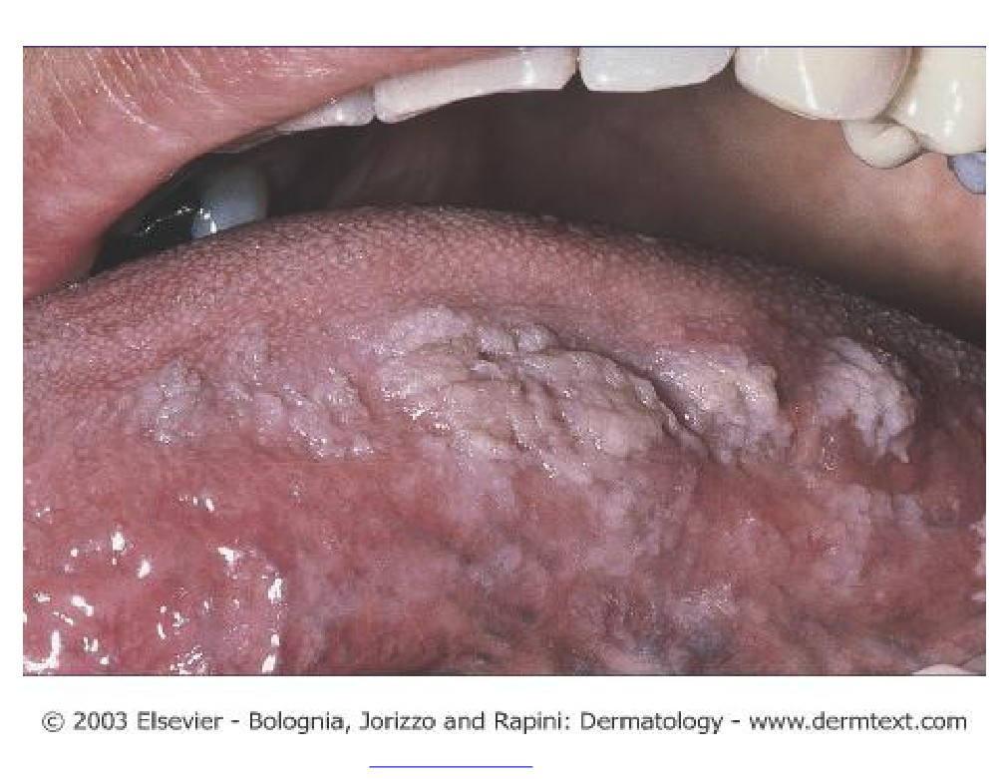
PDF created with FinePrint pdfFactory trial version http://www.fineprint.com

Slide 96
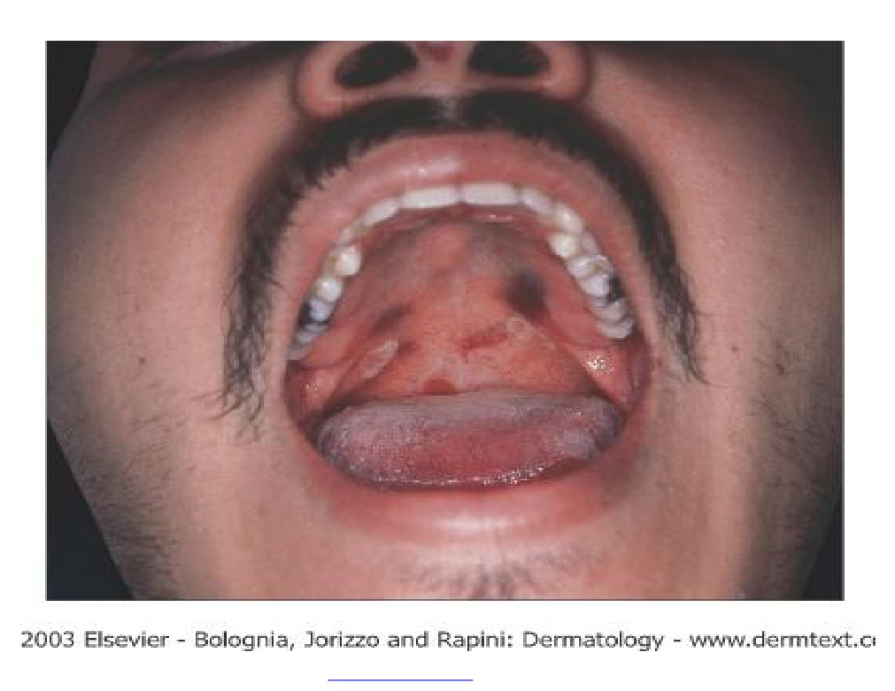
PDF created with FinePrint pdfFactory trial version http://www.fineprint.com

Slide 97
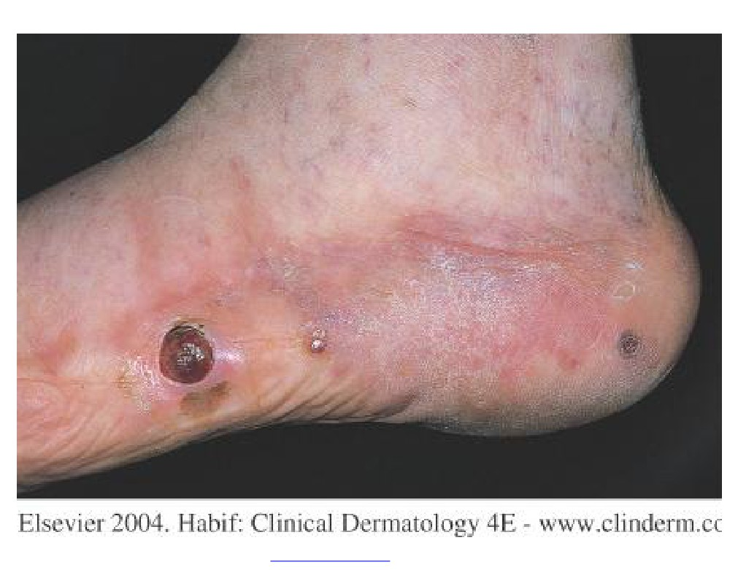
PDF created with FinePrint pdfFactory trial version http://www.fineprint.com

Slide 98
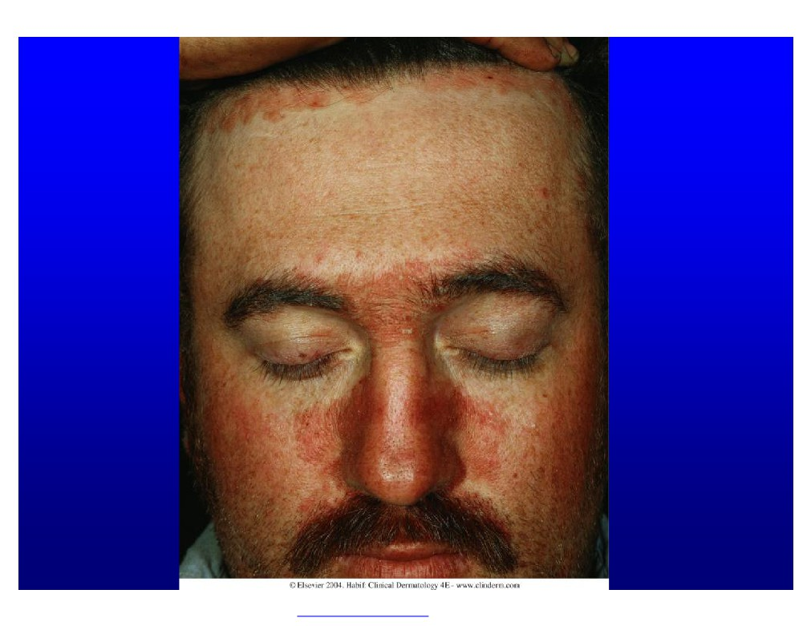
PDF created with FinePrint pdfFactory trial version http://www.fineprint.com

Slide 99
*Multiple mollsucum contagiosum in adult (on face)
*Any STD
*Seborrheic Dermatitis (extensive & refractory to therapy )
*Severe extensive relacitrant apthous ulceration
PDF created with FinePrint pdfFactory trial version http://www.fineprint.com

Slide 100
Examples of some skin diseases where you may find systemic s associations:
1.Lichen planus;associated with Hepatitis B and C
2.Vitiligo and
3.Alopecia Areata :
both associated with autoimmune diseases like: Autoimmune
Thyroid dis,Diabetes mellitus ,Prenicious anemia,Mysthina gravis etc
PDF created with FinePrint pdfFactory trial version http://www.fineprint.com

Slide 101
PDF created with FinePrint pdfFactory trial version http://www.fineprint.com

Slide 102
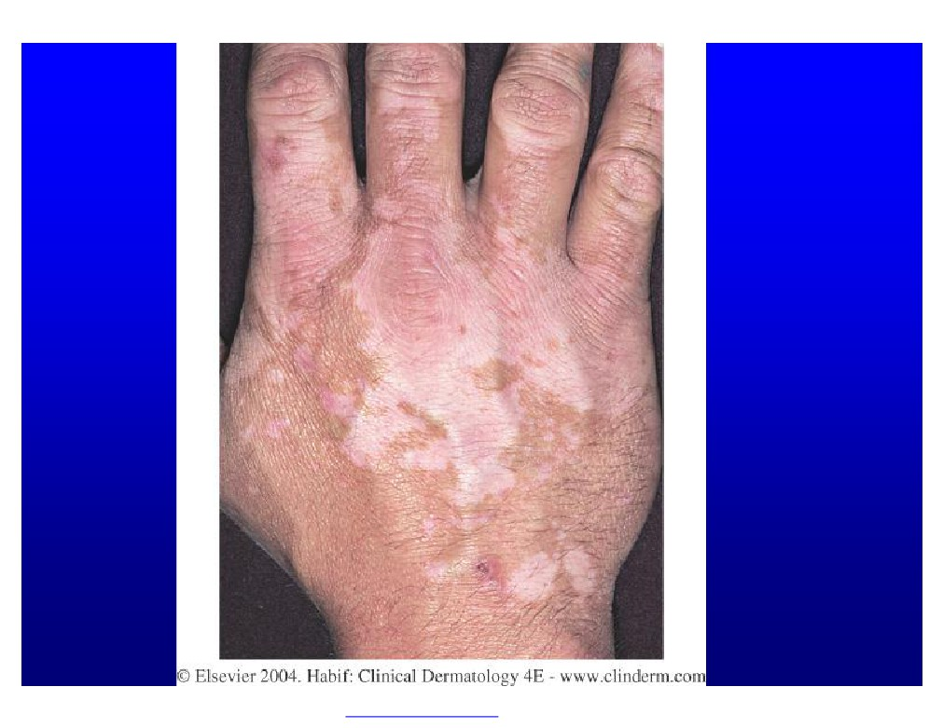
PDF created with FinePrint pdfFactory trial version http://www.fineprint.com

Slide 103
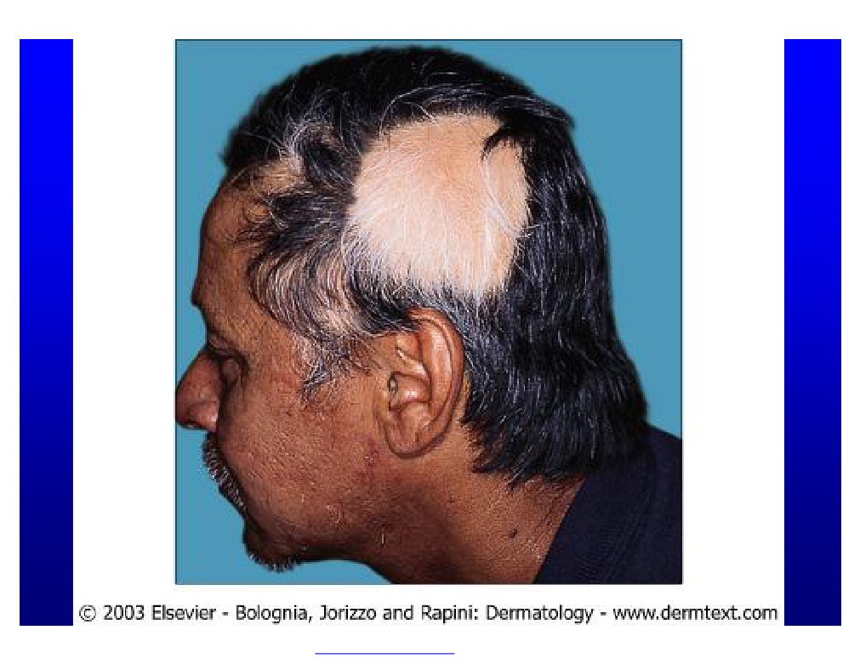
PDF created with FinePrint pdfFactory trial version http://www.fineprint.com

Slide 104
PDF created with FinePrint pdfFactory trial version http://www.fineprint.com

Slide 105
Purpura and vasculitis

Slide 106
Definition
Visible hemorrhage into the skin or mucous membrane subdivided as a follow:
-Petechiae less than or equal 4 mm
-Purpura (>4mm - < 1cm)
which can be either Palpable or non-palpable(macular)
-Ecchymoses > or equal to 1 cm

Slide 107
Purpura
Causes
Platelet disease
Coagulation defect
Blood vessel wall pathology

Slide 108
Causes
1-Platelet Disorders
Thrombocytopenia
Platelet Dysfunction
2-Coagulation Factor Deficiency
Congenital
Factor VIII Deficiency
Factor IX Deficiency
Von Willebrands disease
Acquired
Disseminated Intravascular Coagulopathy
Liver disease
Uremia
Vitamin K deficincy
3-Vascular Factors
Congenital
Hereditary Hemorrhagic Telangectasia
Ehlers-Danlos Syndrome (Type IV)
Acquired:
Inflammation(Vasculitis)
Trauma
Vitamin c deficiency (scurvy)

Slide 110
vasculitis

Slide 111
Definition
A clinicopathologic process characterized by inflammatory destruction of blood vessels that results in occlusion or destruction of the vessel and ischemia of the tissues supplied by that vessel.

Slide 112
classification

Slide 114
Classification
-Large-vessel vasculitis
Aorta and the great vessels (subclavian, carotid)
Claudication, blindness, stroke
-Medium-vessel vasculitis
Arteries with muscular wall
Mononeuritis multiplex (wrist/foot drop), mesenteric ischemia, cutaneous ulcers
-Small-vessel vasculitis
Capillaries, arterioles, venules
Palpable purpura, glomerulonephritis, pulmonary hemorrhage

Slide 115
Cutaneous small vessel vasculitis
-Is the most common type of vasculitits and it primarily affect post-capillary venules

Slide 116
Cutaneous small vessel vasculitis
Pathogenesis:
-Many forms of small-vessel vasculitis are felt to be caused by circulating immune complexes
-These lodge in vessel walls and activate compliment

Slide 117
Cutaneous small vessel vasculitis

Slide 118
Cutaneous small vessel vasculitis
Palpable purpura is the hallmark
-Pinpoint to several centimeters
-Early on lesion may not be palpable,Papulonodular, vascular, bullous, pustular or ulcerated forms may develop
-Predominate on the ankles and lower legs i.e dependent areas

Slide 119
-may be localized to the skin or may manifest in other organs.
-The internal organs affected most commonly include the joints, GIT, and the kidneys.
-Renal involvement present as glomerulonephritis
- The prognosis is good in the absence of internal involvement

Slide 120
Histology
Agiocentric segmental inflammation, endothelial cell swelling, fibrinoid necrosis of blood vessel walls and a cellular infiltrate composed of neutrophil with RBC extravasation.

Slide 121
Work up
-Detailed history and physical examination
-History should focus on possible infectious disorders, prior associated diseases, drugs ingested, and a thorough review of systems
-CBC, strep throat culture or ASO titer, Hep B & C serologies and ANA are a reasonable initial screen,renal profile
-URINALYSIS FOR RBC , PROTIEN & CAST

Slide 123
Treatment
treatment of cause.
-Symptomatic treatment (if skin is only involved): rest ,NSAIDS ,Antihistamine
-severe visceral involvement may require high doses of corticosteroids with or without an immunosuppressive agent
-Immunosuppressive agents for rapidly progressive course and severe systemic involvement

Slide 124
Henoch-Schönlein purpura HSP
-Primarily occurs in male children
-peak age 4-8 years
-Adults may be affected
-A viral infection or streptococcal pharyngitis are the usual triggering event
-In about 40 % of the cases the cutaneous manifestations are preceded by mild fever, headache, joint symptoms, and abdominal pain for up to 2 weeks

Slide 126
-Characterized by intermittent purpura, arthralgia, abdominal pain, and renal disease
-Typically purpura appears on the extensor surfaces of the extremities
-Become hemorrhagic within a day and fades in 5 days
-New crops appear over a few weeks

Slide 127
May be associated with:
pulmonary hemorrhage
Abdominal pain and GI bleeding
-GI radiographs may show “cobblestone” appearance
-Renal manifestations may occur in 25% or more but only 5% end up with ESRD

Slide 128
Thank you ………….
-The long-term prognosis in children with gross hematuria is very good; however, progressive glomerular disease and renal failure may develop in a small percentage
-IgA, C3 and fibrin depositions have been demonstrated in biopsies of both involved and uninvolved skin by immunofluorescence techniques

