Slide 1
Cutaneous Manifestations Of Connective Tissue Disease (Lupus, Dermatomyositis and Scleroderma)
Prof. Fahad AlSaif Professor, Department of Dermatology, College of Medicine, King Saud University

Slide 2
Objectives
Differentiate between the various types of CLE
How to diagnose and investigate CLE
Identify all of the current treatment options available for CLE
To learn how to diagnose and investigate dermatomyositis.
How to manage dermatomyositis.
To learn the presentation of morphea and systemic sclerosis and ways to manage them

Slide 3
Cutaneous Lupus Erythematosus (CLE)
1

Slide 4
Cutaneous Lupus Erythematosus (CLE)
Lupus Erythematosus (LE): is a chronic, autoimmune disease that includes a broad spectrum of signs and symptoms.
LE is divided into:
systemic form (SLE) and cutaneous form (CLE).
They can occur both together or separately

Slide 5
Cutaneous Lupus Erythematosus (CLE)
CLE has various subsets and wide-ranging of clinical manifestations
The cutaneous manifestations of LE can be divided based on histopathological findings into :
1- Histopathologically specific CLE:
Acute cutaneous LE (ACLE)
Subacute cutaneous LE (SCLE)
Chronic cutaneous LE (DLE)
2- Histopathologically non-specific LE-skin manifestations which are not exclusive to LE disease

Slide 6
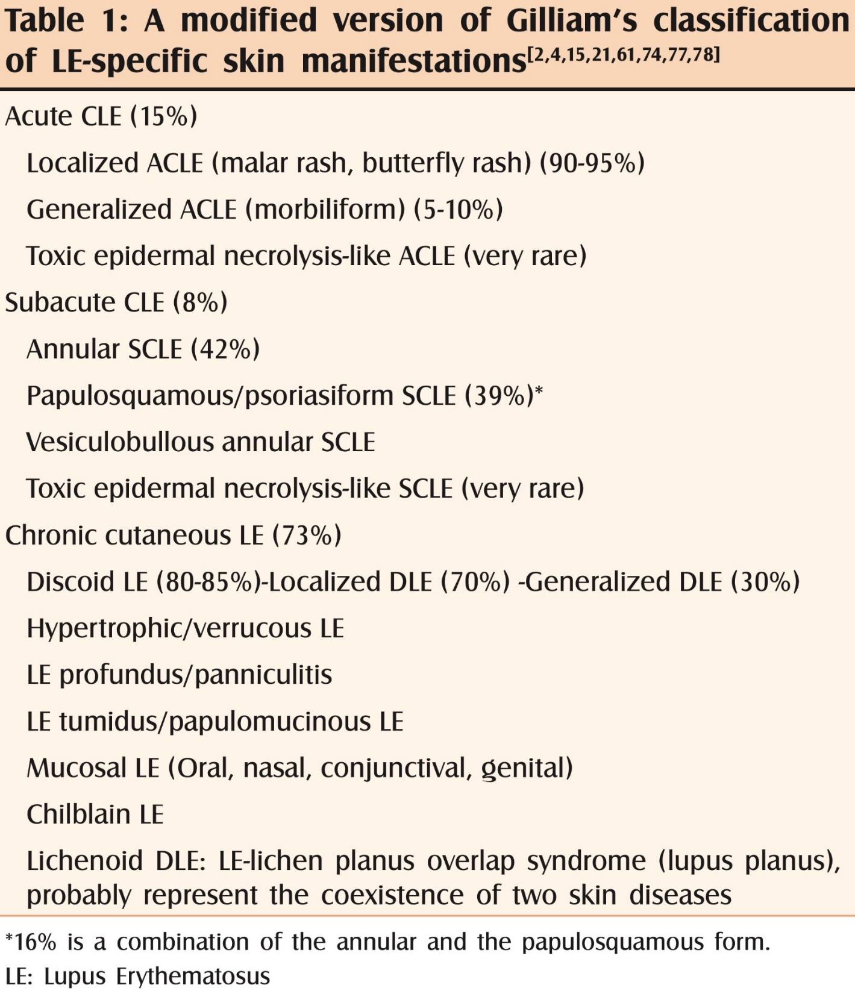

Slide 7
Cutaneous Lupus Erythematosus (CLE) EPIDEMIOLOGY
Incidence of CLE in Sweden and USA is 4/100,000.
The female to male ratio 3:1 for both DLE and SCLE
DLE is more common among African Americans and SCLE is more common among Caucasians.
DLE is the most common subset (80%).

Slide 8
Cutaneous Lupus Erythematosus (CLE) PATHOGENESIS
CLE is multifactorial and polygenic.
Complex interactions between genetics, environment, and cells.
More than 25 risk loci have been identified.
Ultraviolet radiation(appears to initiate CLE lesion formation by inducing apoptosis, precipitating autoantigen presentation, and promoting cellular production of specific cytokines).

Slide 9
Cutaneous Lupus Erythematosus (CLE) PATHOGENESIS
Autoantibodies are a well-known entity in CLE, but their exact role remains unclear.
Native skin cells implicated in CLE include keratinocytes and endothelial cells.
Smoking
Drug-induced subacute CLE and DLE: hydrochlorothiazide, terbinafine, TNF-α inhibitors, antiepileptic and proton-pump inhibitors.
30% of SCLE are secondary to drugs.

Slide 10
Cutaneous Lupus Erythematosus (CLE) Histopathology
Focal or continuous epidermal atrophy (in CDLE alternating acanthotic areas)
Follicular keratin plugs
Vacuolar degeneration along the dermoepidermal junction zone
Individual necrotic keratinocytes
Thickening of basement membrane
Abundant interstitial mucin deposits in the reticular dermis
Moderate to dense superficial and deep perivascular and periadnexal lymphocytic infiltrate

Slide 11
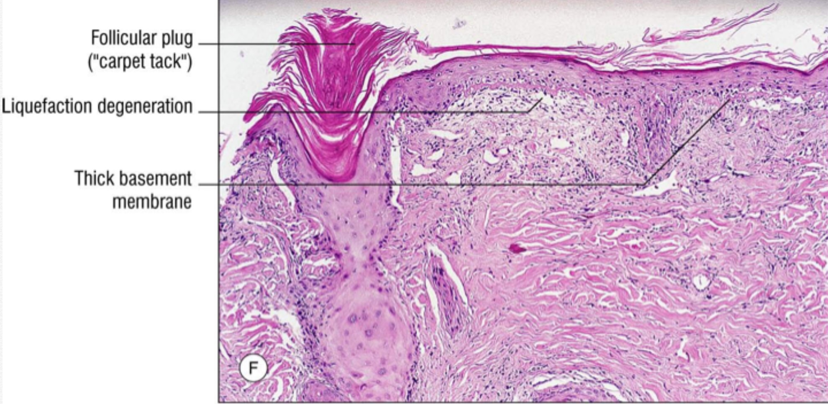

Slide 12
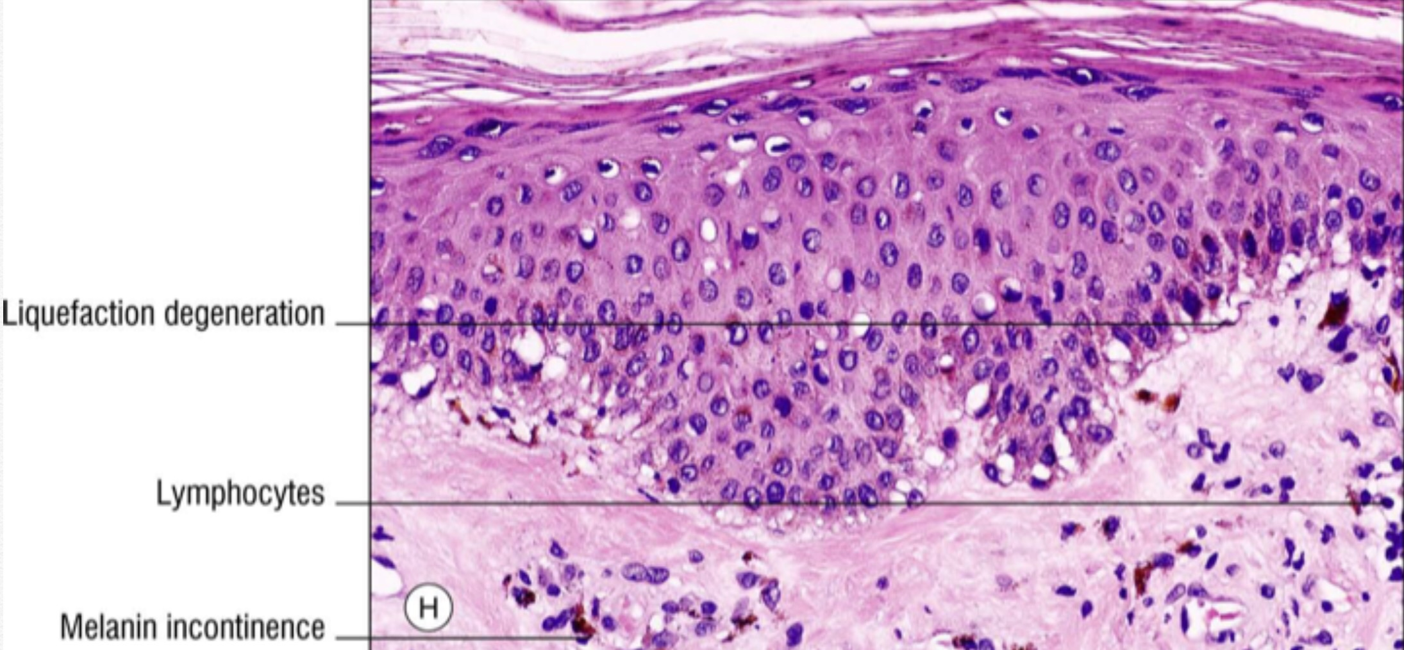

Slide 13
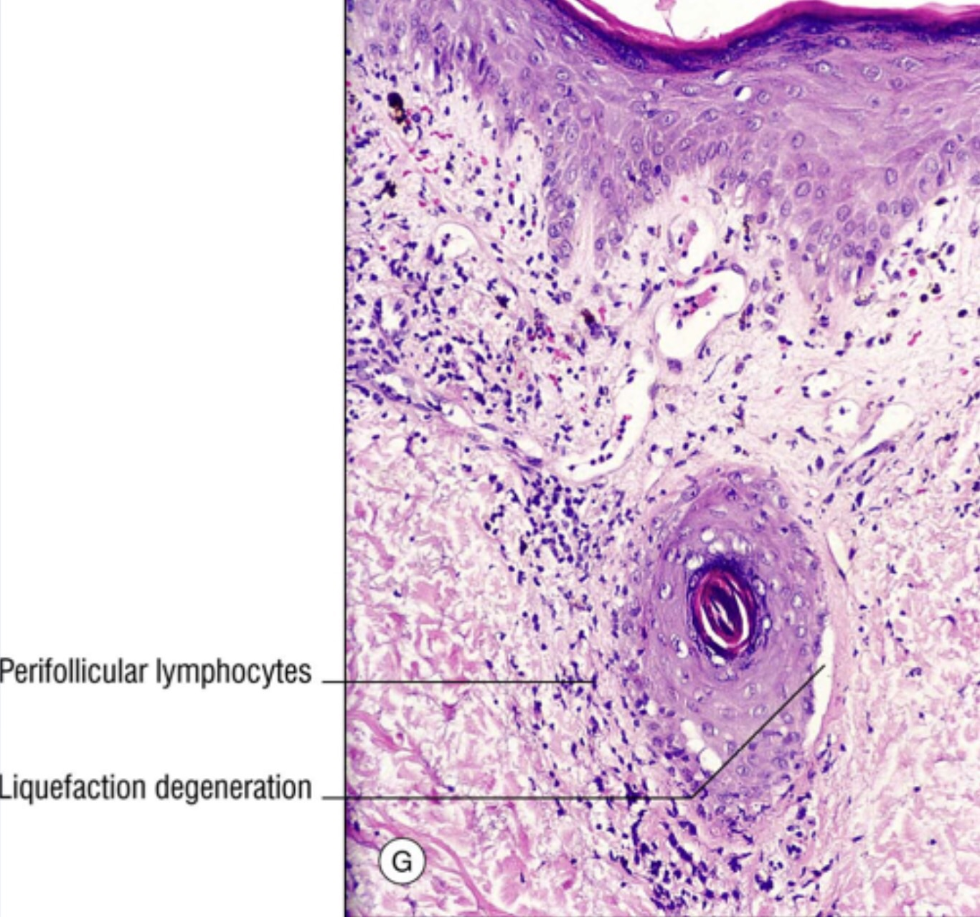

Slide 14
LE-specific skin manifestations

Slide 15
1- Acute CLE :
Almost always associated with systemic disease
Localized (concentrated above the neck) or generalized
Malar rash or butterfly erythema is the most typical localized lesion, an erythema (and/or oedema) over the malar eminence with a tendency to spare the nasolabial folds

Slide 16
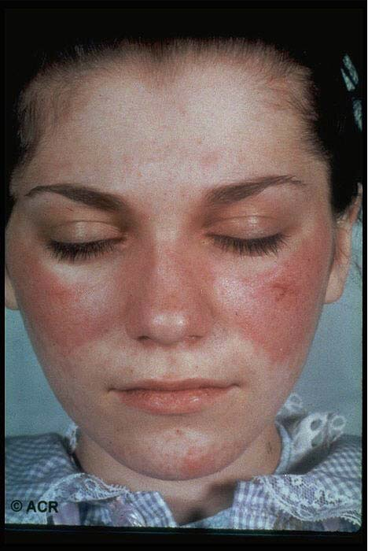

Slide 17
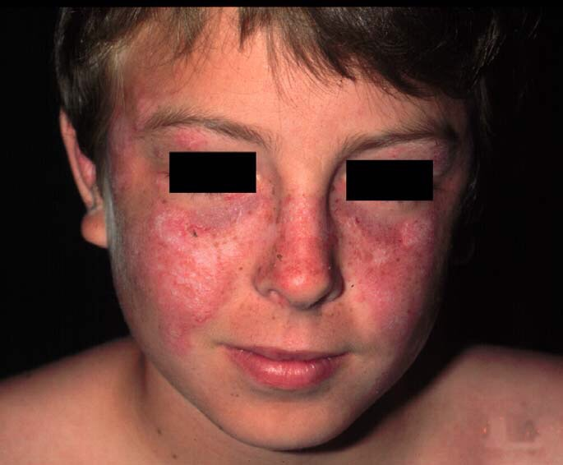

Slide 18
1- Acute CLE :
The generalized form of acute CLE is uncommon
Associated with a previous sun exposure
Preferably located to sun-exposed areas
Maculopapular rash of lupus
Photosensitive lupus dermatitis
Bullous lupus

Slide 19
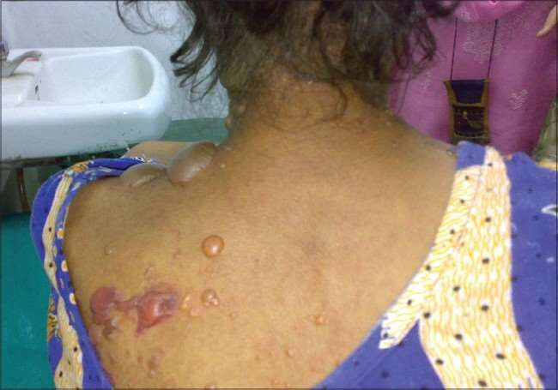

Slide 20
2-Subacute CLE :
Photosensitivity
There are two morphologic variants of SCLE:
1- Psoriasiform type
2- Annular, polycyclic type
Subacute CLE is strongly associated with the anti- Ro/SSA
15-20% of SCLE patients also have other types of CLE lesions
50% of SCLE patients fulfill the American College of Rheumatology (ACR) criteria for SLE

Slide 21
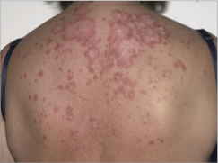

Slide 22
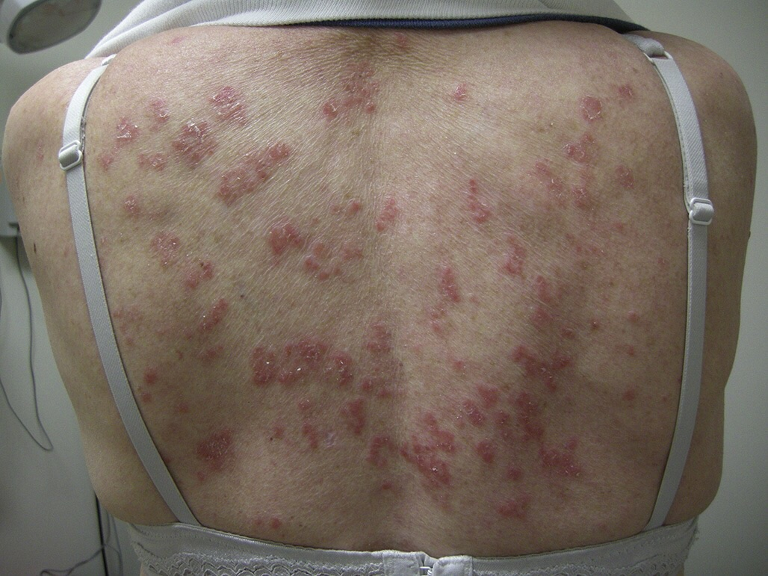

Slide 23
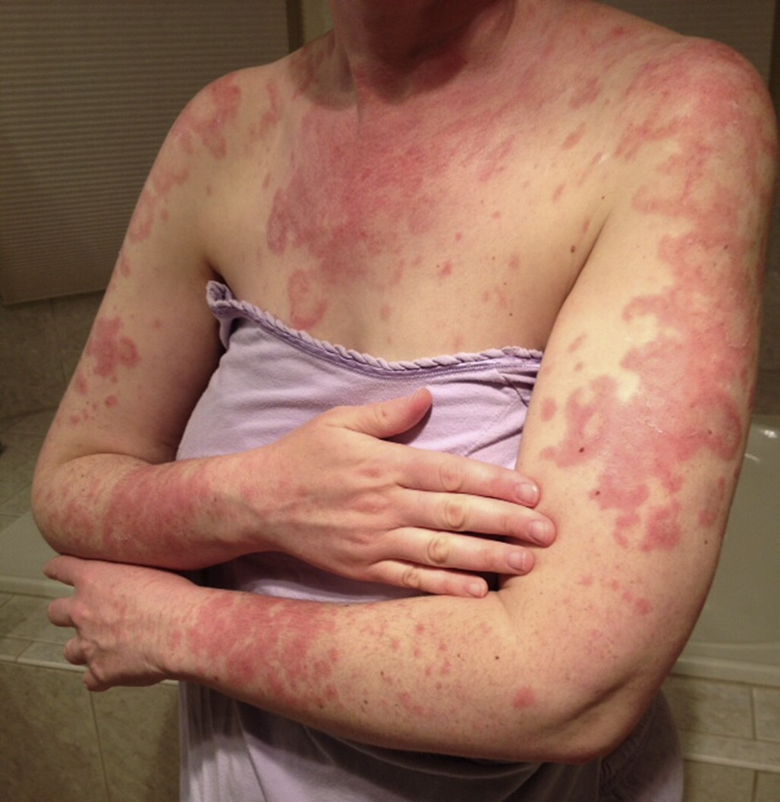

Slide 24
NEONATAL LE :
Develops in fetuses whose mothers have anti-Ro/SSA and/or anti-La/SSB antibodies and more rarely Ribonucleoprotein (RNP) antibodies
Transmission of antibodies over the placenta which can cause congenital heart block and cutaneous manifestations
Resolve spontaneously as the titers of maternal antibodies degrade within the first 6 months

Slide 25
NEONATAL LE :
Photosensitivity, hepatobiliary disease, hemolytic anemia and thrombocytopenia or leucopenia
Cutaneous symptoms include a SCLE-like rash, erythematosus, non-scarring annular plaques most typical occurrence in the face and especially peri-orbital (“raccoon or owl eye”)

Slide 26
NEONATAL LE :
Annular plaques with fine scale – “Owl” eyes – Crusted papules with petechiae
DLE lesions
Facial involvement is most common
Photosensitivity
Angiomatous papules or telangiectatic mats

Slide 27
NEONATAL LE :
Complete Heart block – 90%
May result in congestive heart failure in early childhood and the need for pacemaker placement
Associated congenital heart defects – 30%

Slide 28
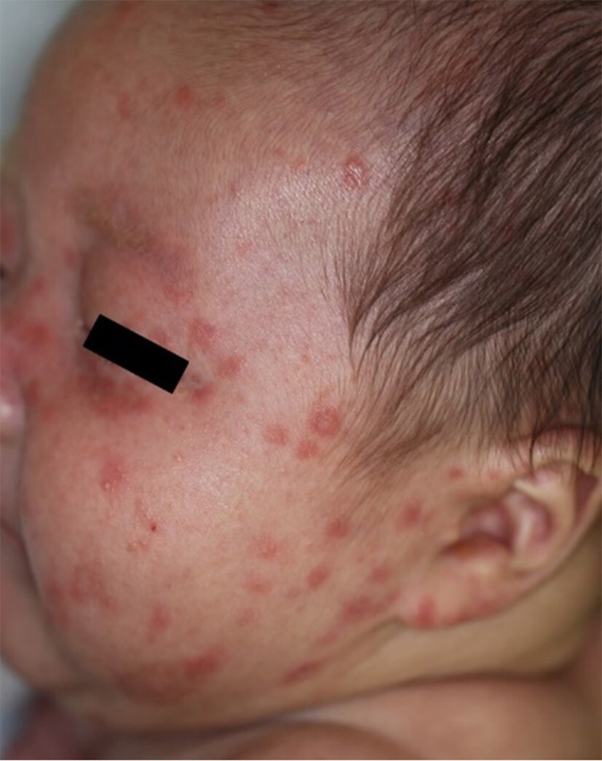

Slide 29
3-Chronic CLE:
A- Discoid LE is the most common subtype of CCLE
60-80% is localized above the neck and 20-40% is generalized (lesions both above and below the neck)
Scalp, ears and cheeks are the most commonly involved areas
Have a chronic course, less chance of remission
More difficult to control

Slide 30
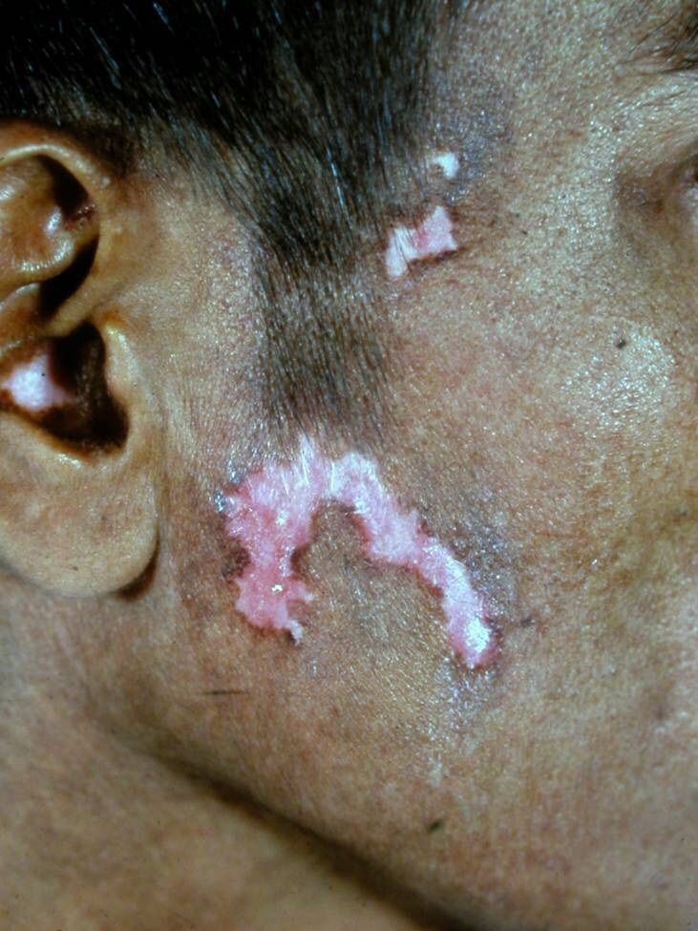

Slide 31
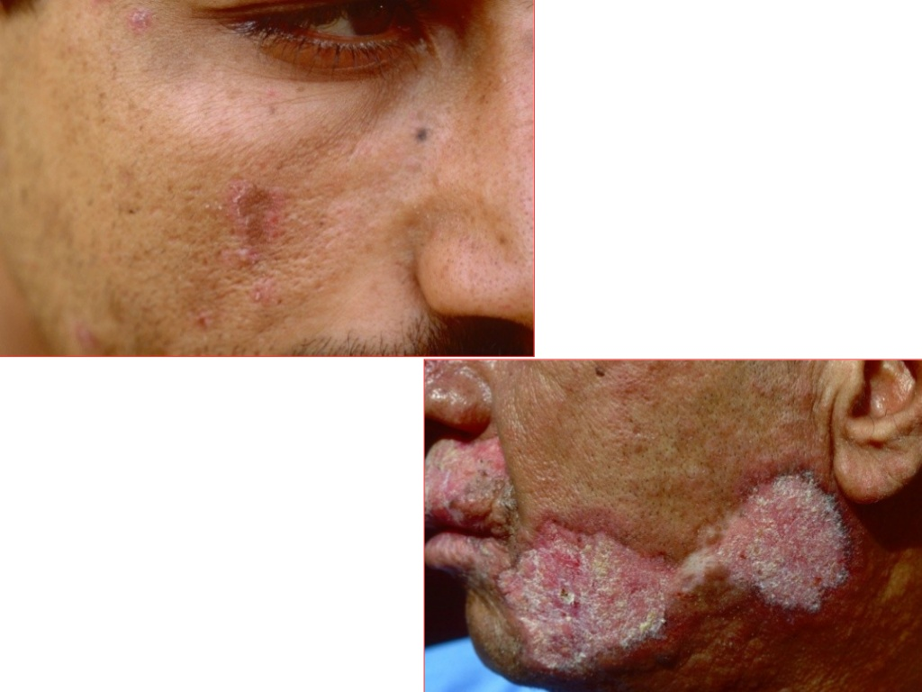

Slide 32
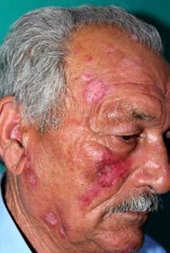

Slide 33
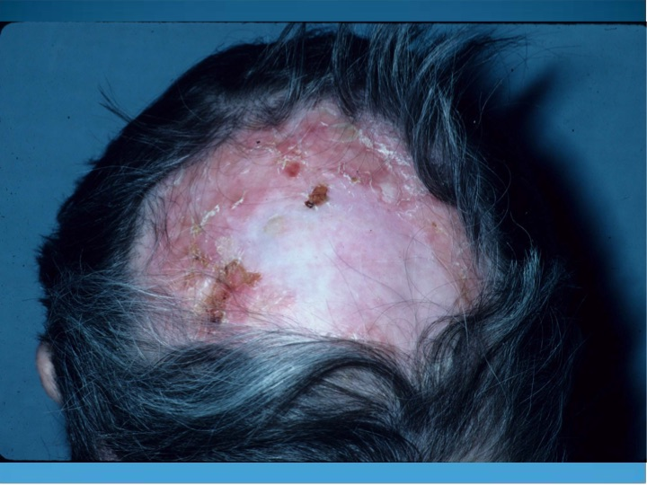

Slide 34
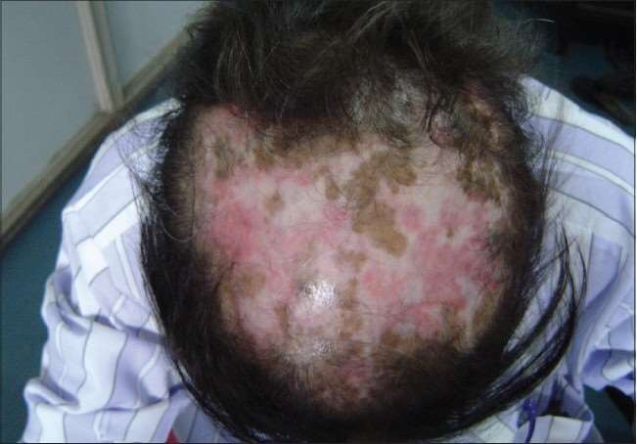

Slide 35
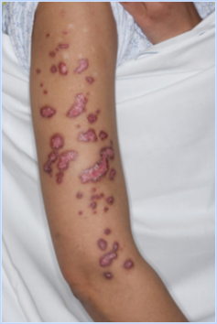

Slide 36
3-Chronic CLE:
B-Verrucous or hypertrophic LE
Wart-like lesions most often on the arms and/or hands
Typical DLE lesions elsewhere
Differential diagnosis – warts, KA, SCC

Slide 37
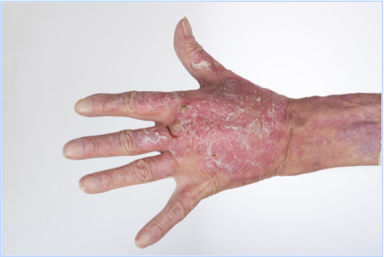

Slide 38
3-Chronic CLE:
C- LE profundus (panniculitis):
Rare presentation of CCLE
Multiple subcutaneous nodules or plaques
Upper arms, shoulders, buttocks, or face.
DDx: Morphea profunda, erythema nodosum and subcutaneous panniculitis-like T-cell lymphoma

Slide 39
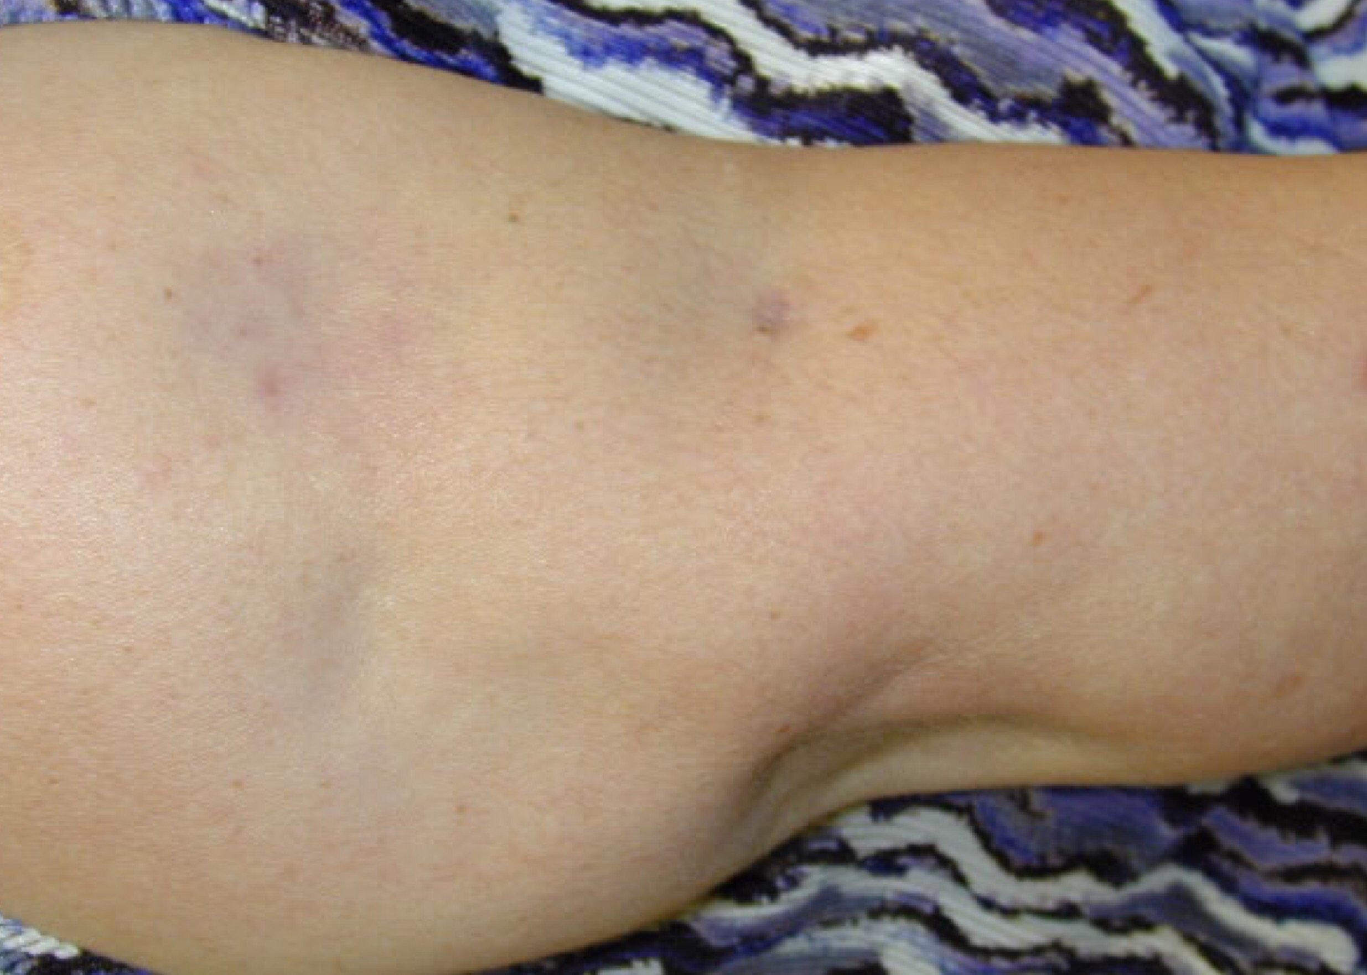

Slide 40
3-Chronic CLE:
D- Chilblain Lupus
Rare form of CCLE
Predominantly in women
Occurs commonly on the digits, calves and heels
Microvascular injury secondary to exposure to cold and possibly hyperviscosity from immunological abnormalities.
Characterized by symmetrically erythematous to violaceous painful plaques over dorsal and lateral aspects of hands and feet, appearing during cold.

Slide 41
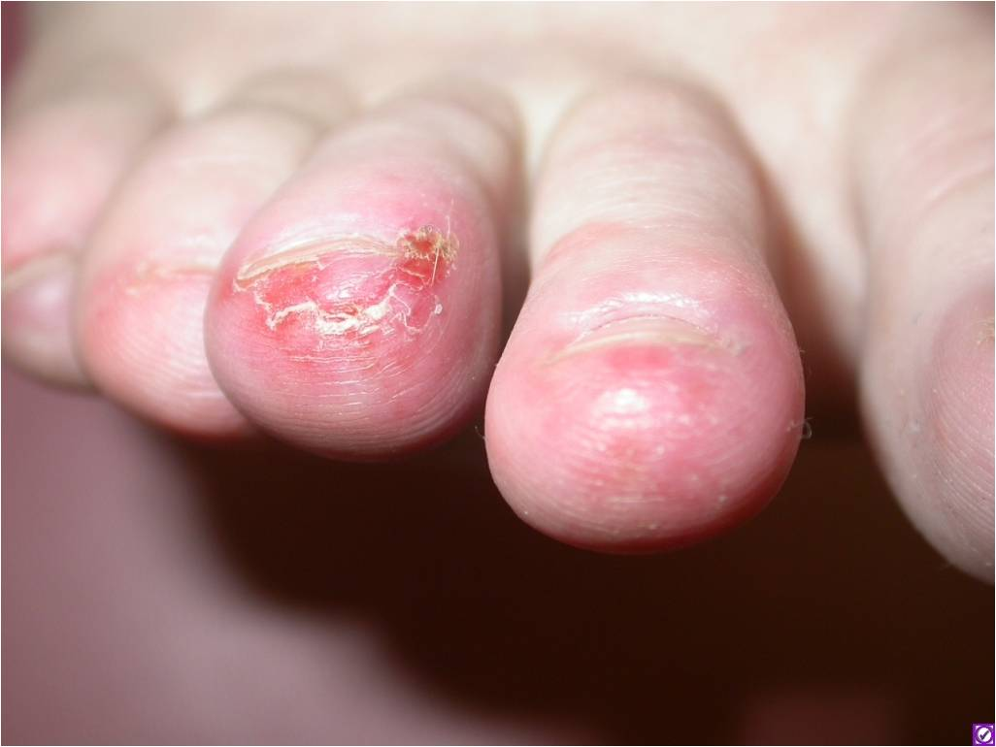

Slide 42
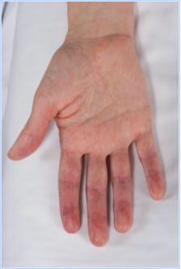

Slide 43
3-Chronic CLE:
Lupus Erythematosus Tumidus
Onset in summer
Photosensitivity > 70%
Histopathology – periadnexal, perivascular lymphocytic infiltrate with increased mucin
ANA < 10%
Systemic disease – 0

Slide 44
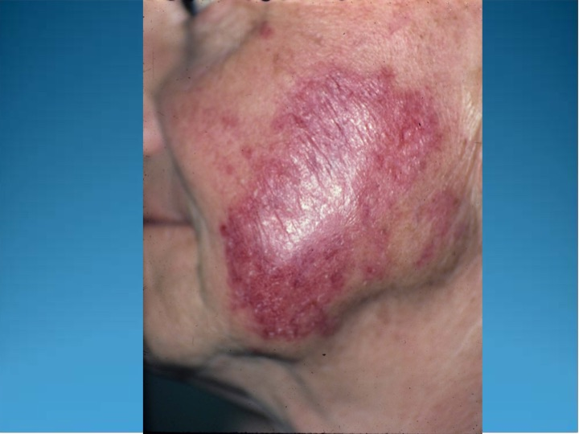

Slide 45
Histopathologically non-specific LE-skin manifestations
photosensitivity
Vasculitis: Palpable and nonpalpable purpura Urticarial-like vasculitis Hypocomplementemic urticarial vasculitis
Vasculopathy: Livedo reticularis , Erythromelalgia
Urticaria
Non-scarring alopecia:
Oral lesions
Bullous lesions
Acanthosis nigricans

Slide 46
Mucinous infiltration
Porphyria cutanea tarda
Psoriasis
Other “autoimmune” disorders

Slide 47
Differential diagnosis:
CCLE: PS, sarcoidosis,LP
SCLE : PMLE, rosacea, PS diseases, EAC, other figurate erythemas, DM
Tumid LE : Sarcoid, BLI, PMLE, REM
SLE : rosacea, drug-induced photosensitivity, DM

Slide 48
Cutaneous Lupus Erythematosus (CLE) Workup
Goal: confirm diagnosis and assess for systemic involvement
Thorough review of history and examination
Skin biopsy: H&E and lesional DIF
Basic labs: CBC, LFT’s, creatinine, inflammatory markers (ESR, CRP), urinalysis
Autoimmune serologies,: ANA, dsDNA, complement (C3, C4, total), anti-phospholipid Abs
If considering systemic therapy: Eye exam (antimalarials), hepatitis serologies (methotrexate), thiopurine methyltransferase (TPMT; azathioprine

Slide 49
Cutaneous Lupus Erythematosus (CLE) Management
Goal
Reassure the patient
Improve the patient’s appearance
Prevent the formation of scars, dyspigmentation and atrophy
Stop the formation of new lesions

Slide 50
Cutaneous Lupus Erythematosus (CLE) Management
TREATMENT
A. Prevention
Patient education.
Heat, sun, and drug avoidance is standard
Strict sunscreen adherence is a critical component of therapy, as UVA and UVB irradiation has been shown to induce CLE lesions
B. Topical Therapies
-steroids
-calcineurin inhibitors

Slide 51
Cutaneous Lupus Erythematosus (CLE) Management
C. Systemic Therapies
First-line Systemic Therapies
1- Antimalarial Drugs :
-considered first-line systemic therapy
-Hydroxychloroquine sulfate
-6.5 mg/kg/day

Slide 52
Cutaneous Lupus Erythematosus (CLE) Management
Side effects of antimalarials include xerosis, exanthematous or lichenoid drug eruptions, urticaria, blue-gray skin hyperpigmentation, ocular toxicity, gastrointestinal upset, myopathy, cardiomyopathy, and rare central nervous system side effects (dizziness, headache, insomnia, psychosis).
2- Systemic Corticosteroids:
prednisone of 0.5 to 1.0mg/kg/da
Second-line Systemic Therapies
1- Immunosuppressants:Azathioprine, Methotrexate, Mycophenolate mofetil
2- Biologics : Rituximab
3- Immunomodulators: Thalidomide

Slide 53
Dermatomyositis (DM)
2

Slide 54
Dermatomyositis (DM)
A subtype of idiopathic inflammatory myopathies (IIMs)
Characterized by skin rash, proximal muscle weakness, and inflammatory infiltrates in the muscle tissue.

Slide 55
Dermatomyositis (DM) EPIDEMIOLOGY
Rare disease
11 /100,000
Adult F:M is 2:1
Two peaks of onset: ages 10-15, 45-55
14% present during childbearing ages

Slide 56
Dermatomyositis (DM) Clinical presentation
1- Pathognomonic Cutaneous manifestations :
A- heliotrope rash : violaceous to dusky erythematous rash with or without edema in a symmetrical distribution involving periorbital skin
B- Gottron’s papules : slightly elevated, violaceous papules and plaques over bony prominences: metacarpophalangeal joints and the proximal interphalangeal joints
C- Gottron’s sign: symmetric, nonscaling, violaceous to erythematous macules or plaques, often atrophic, in the same distribution as Gottron’s papules

Slide 57
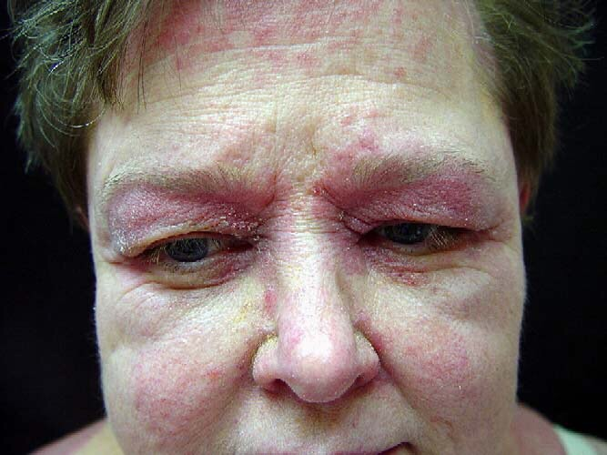

Slide 58
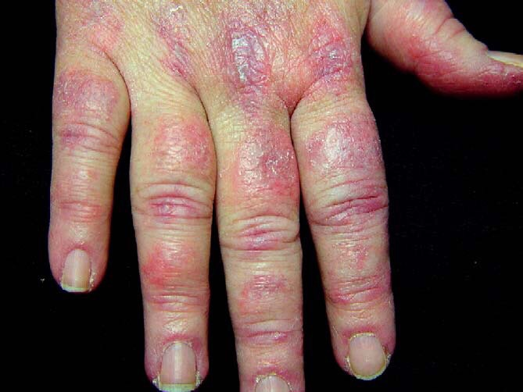

Slide 59
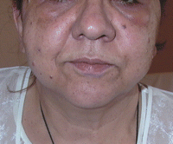
Dermatomyositis (DM) Clinical presentation
2- Cutaneous features are characteristic of the disease but not pathognomonic:
A- Facial erythema and edeama

Slide 60
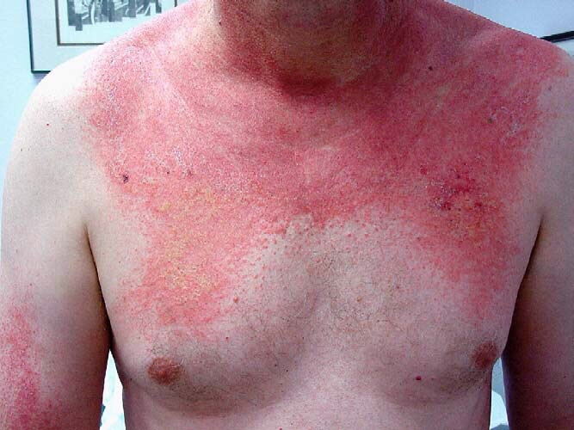
Dermatomyositis (DM) Clinical presentation
B- Poikiloderma in a photosensitive distribution:V-sign

Slide 61
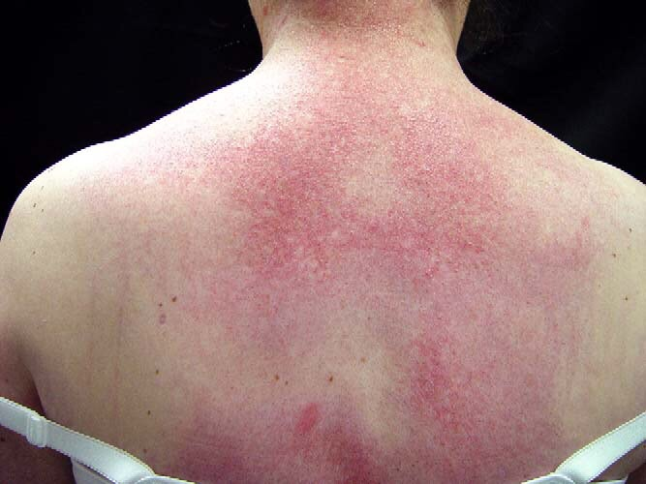
Dermatomyositis (DM) Clinical presentation
C-Poikiloderma over the upper back (shawl sign):

Slide 62
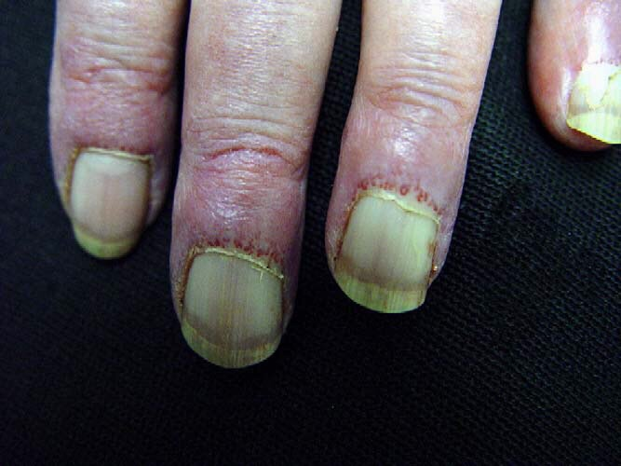
Dermatomyositis (DM) Clinical presentation
D- Periungual and cuticular changes

Slide 63
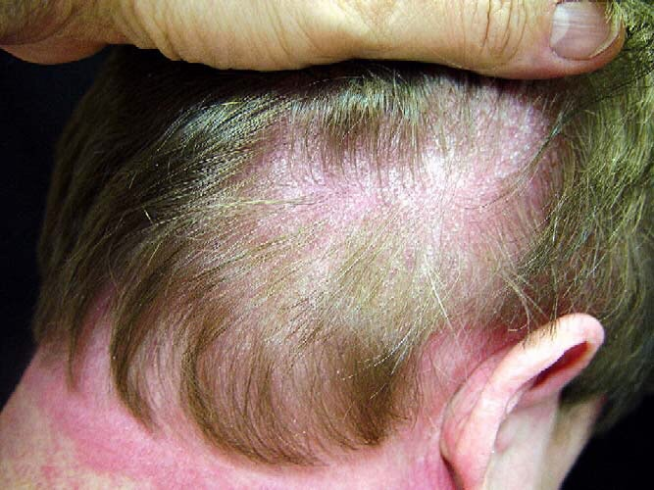
Dermatomyositis (DM) Clinical presentation
E-Scalp : Eythematous to violaceous, psoriasiform dermatitis

Slide 64
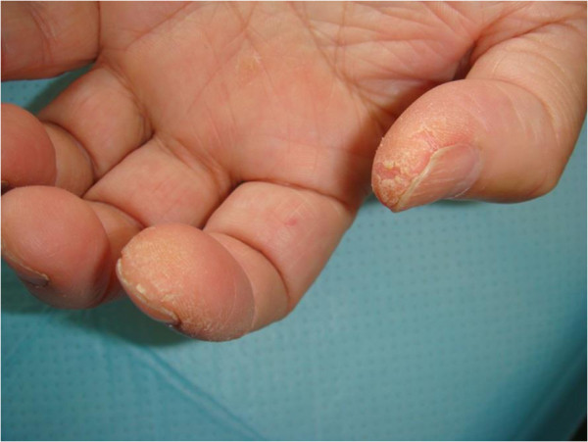
Dermatomyositis (DM) Clinical presentation
F. Mechanic’s hand : - Cracking and fissuring of the skin of the fingerpads.

Slide 65
Dermatomyositis (DM) Clinical presentation
Other skin manifestations:
Photosensitivity
Vasculitis
Nonscarring alopecia
Calcinosis cutis
Vesiculobullous

Slide 66
Dermatomyositis (DM) Clinical presentation
3- Non-cutaneous DM manifestations:
High temperature
elevated serum C-reactive protein level and ESR
Muscle pain on grasping or spontaneous pain
Proximal muscle weakness (upper or lower extremity and trunk)
Nondestructive arthritis or arthralgias
Elevated serum creatine kinase or aldolase level
Myogenic changes on electromyography
Positive anti-Jo-1 antibody test (histidyl-tRNA synthetase)
Pathologic findings compatible with inflammatory myositis

Slide 67
Juvenile (childhood) DM

Slide 68
Drug-induced DM
Quinidine, NSIND, d-penicillamine, isoniazid and TNF antagonists
Dermatomyositis and malignancy
Older patients
Ovarian carcinoma,lungs, pancreas, breasts and gastrointestinal tract.
Occur before the onset of DM, concurrently with DM, or after the onset of DM.

Slide 69
Dermatomyositis (DM) Systemic complications/associations
Cardiomyopathy and Cardiac conduction defects
Aspiration pneumonia secondary to respiratory muscle weakness
Diffuse interstitial pneumonitis/fibrosis
Muscle calcification
Ocular complications including iritis, nystagmus, cotton-wool spots, optic atrophy, conjunctival edema and pseudopolyposis
Internal malignancy

Slide 70
Dermatomyositis (DM) Investigations
Muscle enzyme elevation: Serum aldolase, ALT, LDH, CK
CK is useful to monitor the treatment of DM
Autoantibodies: ANA levels,Jo-1: most common antisynthetase
Magnetic resonance imaging (MRI)
Electromyography
Muscle biopsy
skin biopsy

Slide 71
Dermatomyositis (DM) Diagnostic Criteria
1. Symmetric proximal muscle weakness
2. Biopsy evidence of myositis (MRI can subst)
3. Increased serum skeletal muscle enzymes
4. Characteristic EMG pattern
5. Typical DM rash
DM possible (#5 + any two of 1-4), probable (#5 + any 3), definite (all 1-5)

Slide 72
Dermatomyositis (DM) Treatment
Oral prednisone: 0.5 to 1.5 mg per kg daily until serum creatine kinase normalizes, then slowly taper over 12 months
Methotrexate: Oral: 7.5 to 10 mg per week, increased by 2.5 mg per week to total of 25 mg per week
Azathioprine: 2 to 3 mg per kg per day tapered to 1 mg per kg per day once steroid is tapered to 15 mg per day. Reduce dosage monthly by 25-mg intervals. Maintenance dosage is 50 mg per day.
Cyclosporine
Hydroxychloroquine
Topical steroids

Slide 73
Scleroderma (Hard skin )
3

Slide 74
Scleroderma
Chronic systemic autoimmune disease
characterized by fibrosis of the skin as well as internal organs, e.g., lung, heart, gastrointestinal tract, and kidneys.

Slide 75
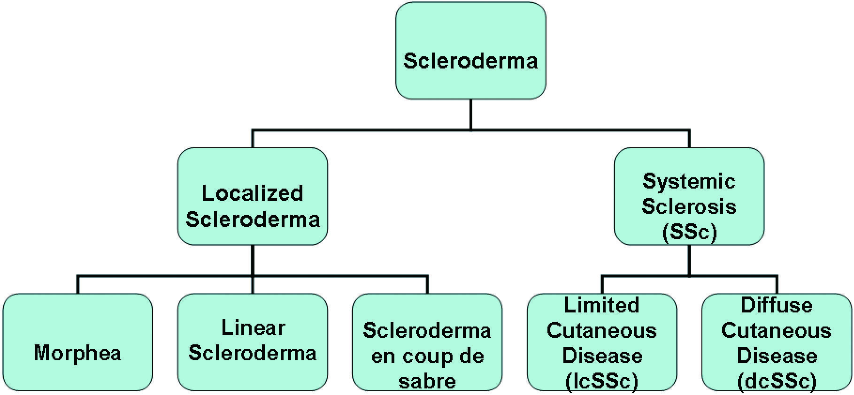
Scleroderma Classification

Slide 76
Scleroderma
Systemic scleroderma:
is a chronic autoimmune disease
characterised by tissue fibrosis and immune abnormalities
three cardinal pathogenetic features:
a-microvascular involvement
b-activation of the immune system
c-increase of extracellular matrix deposition in the skin and internal organs

Slide 77
Scleroderma EPIDEMIOLOGY
Rare disease
150 to 300 cases per million.
Peak occurrence in the 30-40 years age group
F: M 4:1
Very rare in childhood

Slide 78
Scleroderma Pathogenesis
Unknown
Individual genetic background
Exposure to environmental triggers( virus, drugs, vinyl chloride, silica and nanoparticles from traffic-derived pollution ).
Inducing vascular damage and fibroblast
Several subsets of circulating progenitor cells have been described in patients with SSc, all have a monocytic origin but may or may not express CD14.

Slide 79
Scleroderma Pathogenesis
These cells have the ability to give origin to endothelial cells, or collagen producing cells.
These cells will migrate into SSc injury tissues to differentiate into both endothelial cells and fibroblasts, to cause defective vasculogenesis or fibrosis or both), and to have immunomodulatory effects.
The B cells in SSc are activated and produced anti-topoisomerase I and anti-centromere antibodies

Slide 80
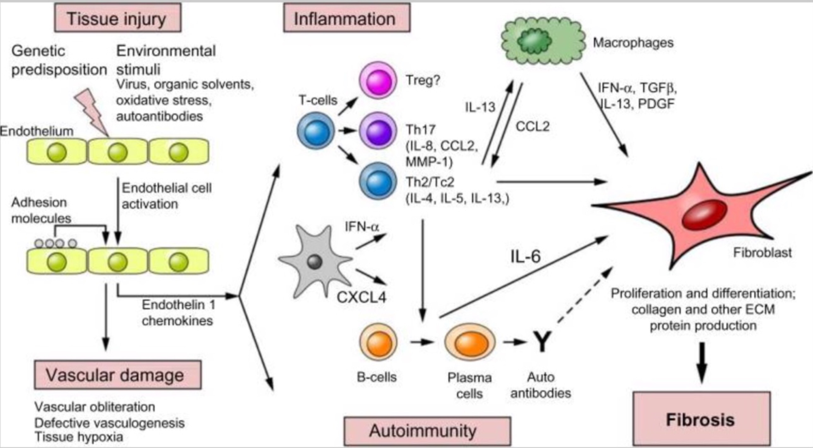
Scleroderma Classification

Slide 81
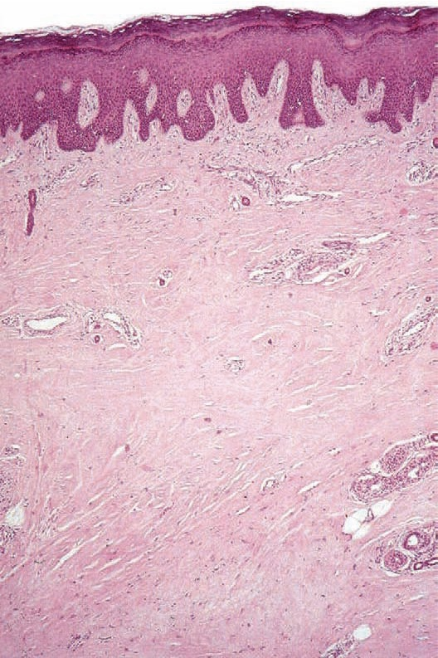
Scleroderma Histopathology

Slide 82
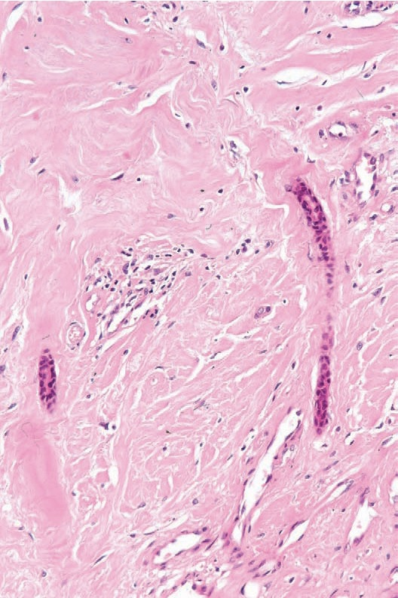
Scleroderma Histopathology

Slide 83
Scleroderma

Slide 84
Scleroderma Clinical features
Cutaneous manifestations:
Raynaud’s phenomenon :
Early manifestation of disease in more than 90%
Vasospasm of the digital microvasculature resulting in:
- digital ischemia (pallor)
- digital hypoxia (cyanosis)
- digital reactive hypermedia (erythema)

Slide 85
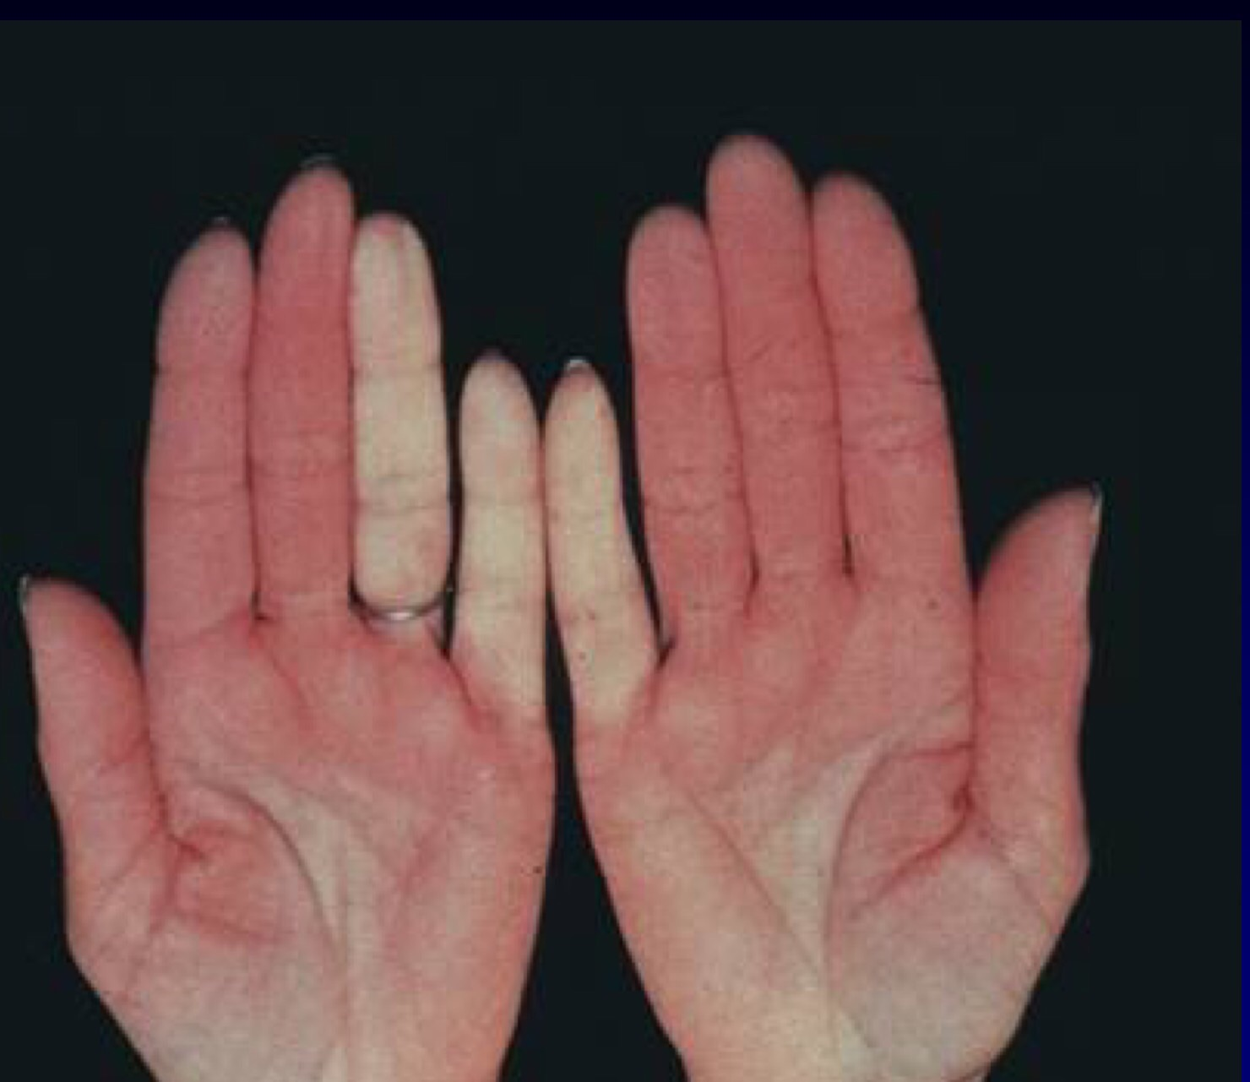
Scleroderma

Slide 86
Scleroderma Clinical features
Swelling (non-pitting oedema) of fingers and toes - a common early sign and hand movement may be limited.
Sclerodactyly
Swelling and sclerosis reduce hand movements, so patients may be unable to make a fist, or to place the palmar surfaces together - the 'prayer sign'.
Fingertips may have pitting, ulcers or loss of bulk from finger pads

Slide 87
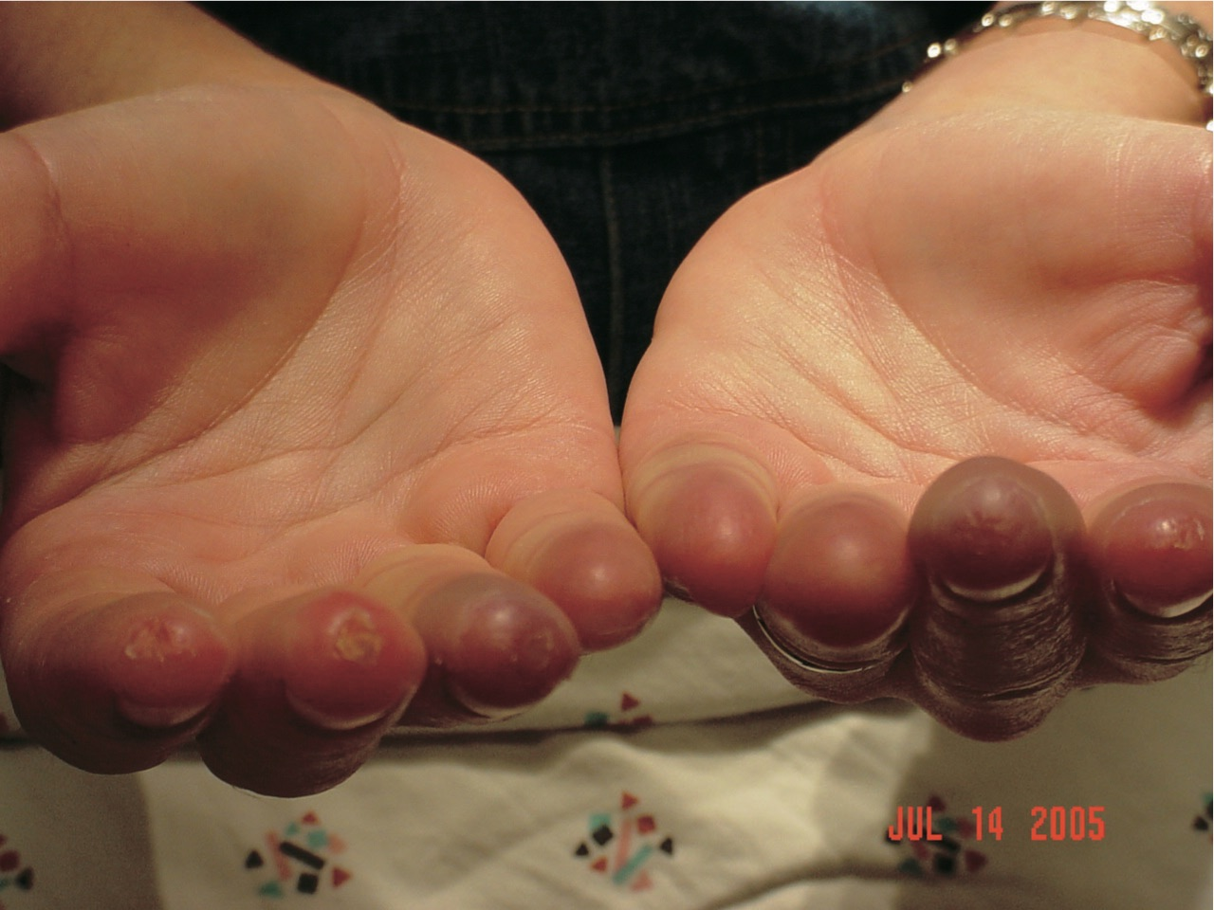
Scleroderma

Slide 88
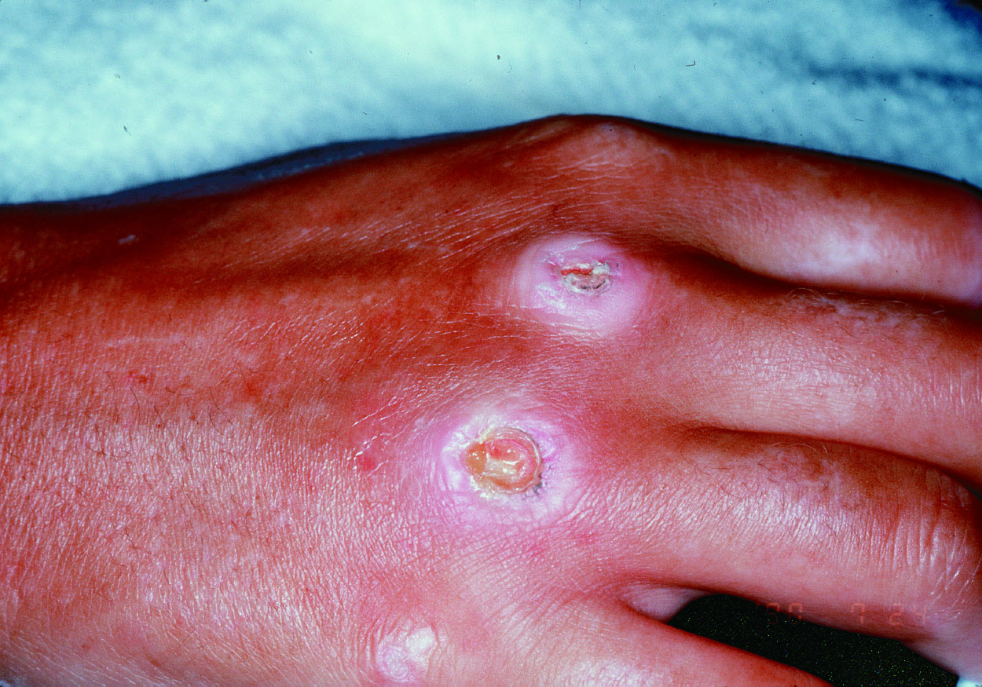
Scleroderma Clinical features
Painful ulcerations

Slide 89
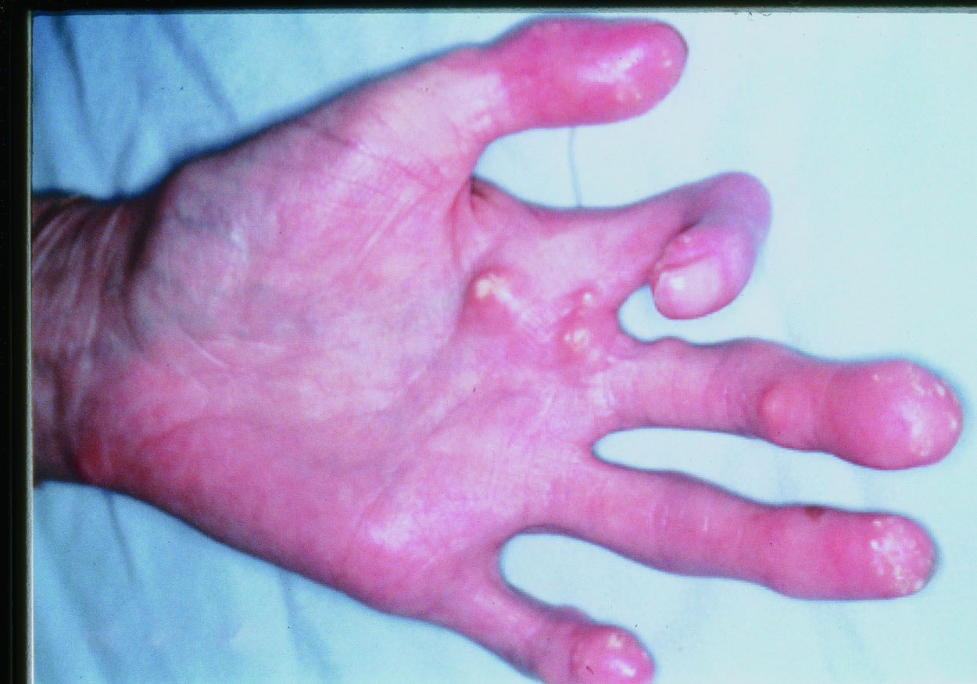
Scleroderma Clinical features
In limited form of the disease calcium deposits may form under the skin and cause white spots or ulcerations and may be quite painful.

Slide 90
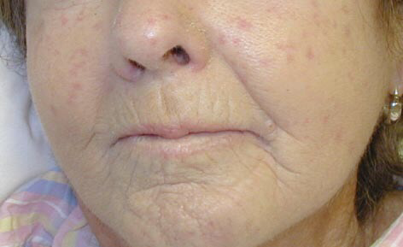
Scleroderma Clinical features
Spider veins (telangiectasia) often appear on the fingers, chest, face, lips, and tongue.
Tightening of facial skin.
Tight lips (microstomia) - can make dental hygiene difficult.

Slide 91
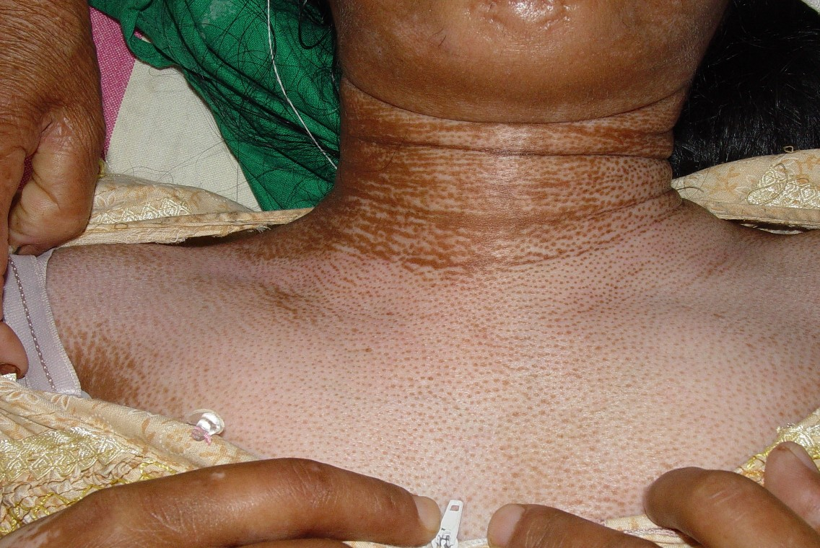
Scleroderma Clinical features
Salt and pepper' appearance of skin, due to areas of hypopigmentation and hyperpigmentation.
Dry or itchy skin; reduced hair over affected skin areas

Slide 92
Scleroderma Clinical features
Systemic manifestations:
Limited vs. Diffuse Scleroderma:
Cutaneous criteria:
Limited: involves skin distal to elbows and knees, as well as face
Diffuse: involves skin of proximal extremities and face, as well as trun

Slide 93
Limited Scleroderma :
Pulmonary: Pulmonary Hypertension
Kidney disease: uncommon
Heart disease : uncommon
Gastrointestinal: Esophageal dysmotility and gastroesophageal reflux disease

Slide 94
Diffuse Scleroderma:
Kidney: Acute renal failure 2° renovascular hypertension
Pulmonary: pulmonary Hypertension, pulmonary Fibrosis
Heart:Myocardial Fibrosis
Gastrointestinal : Esophageal dysmotility and gastroesophageal reflux

Slide 95
Localized scleroderma
CLASSIFICATION
Plaque morphe

Slide 96
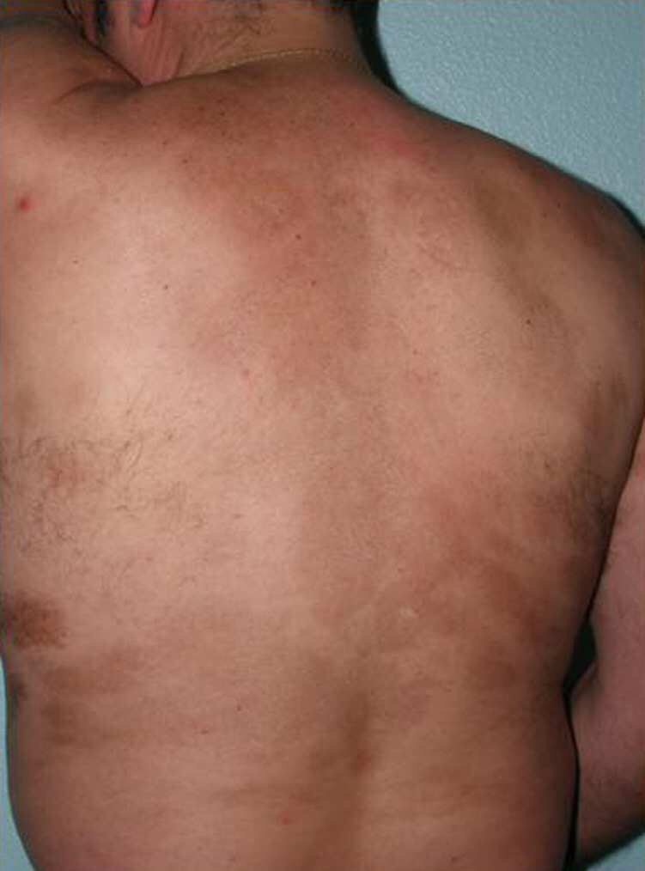
Localized scleroderma
CLASSIFICATION
Generalized morphea: is more severe, characterized by extension of skin damage and its association with muscle damage.

Slide 97
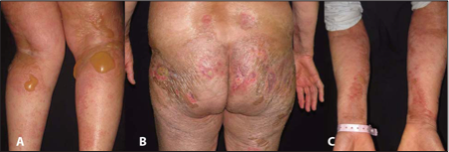
Localized scleroderma
3. Bullous morphea: is characterized by tense subepidermal bullae in the presence of typical morphea or deep morphea.

Slide 98
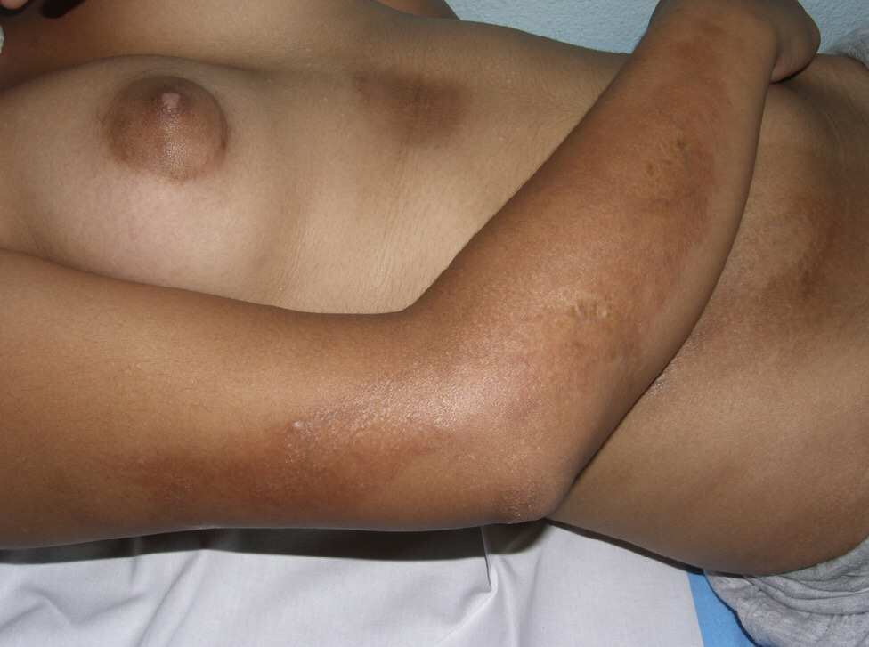
Localized scleroderma
4. Linear scleroderma: is characterized by one or more linear streaks and induration that can involve dermis, subcutaneous tissue, muscle, and bone. It occurs on the extremities, face, or scalp of children and adolescents.

Slide 99
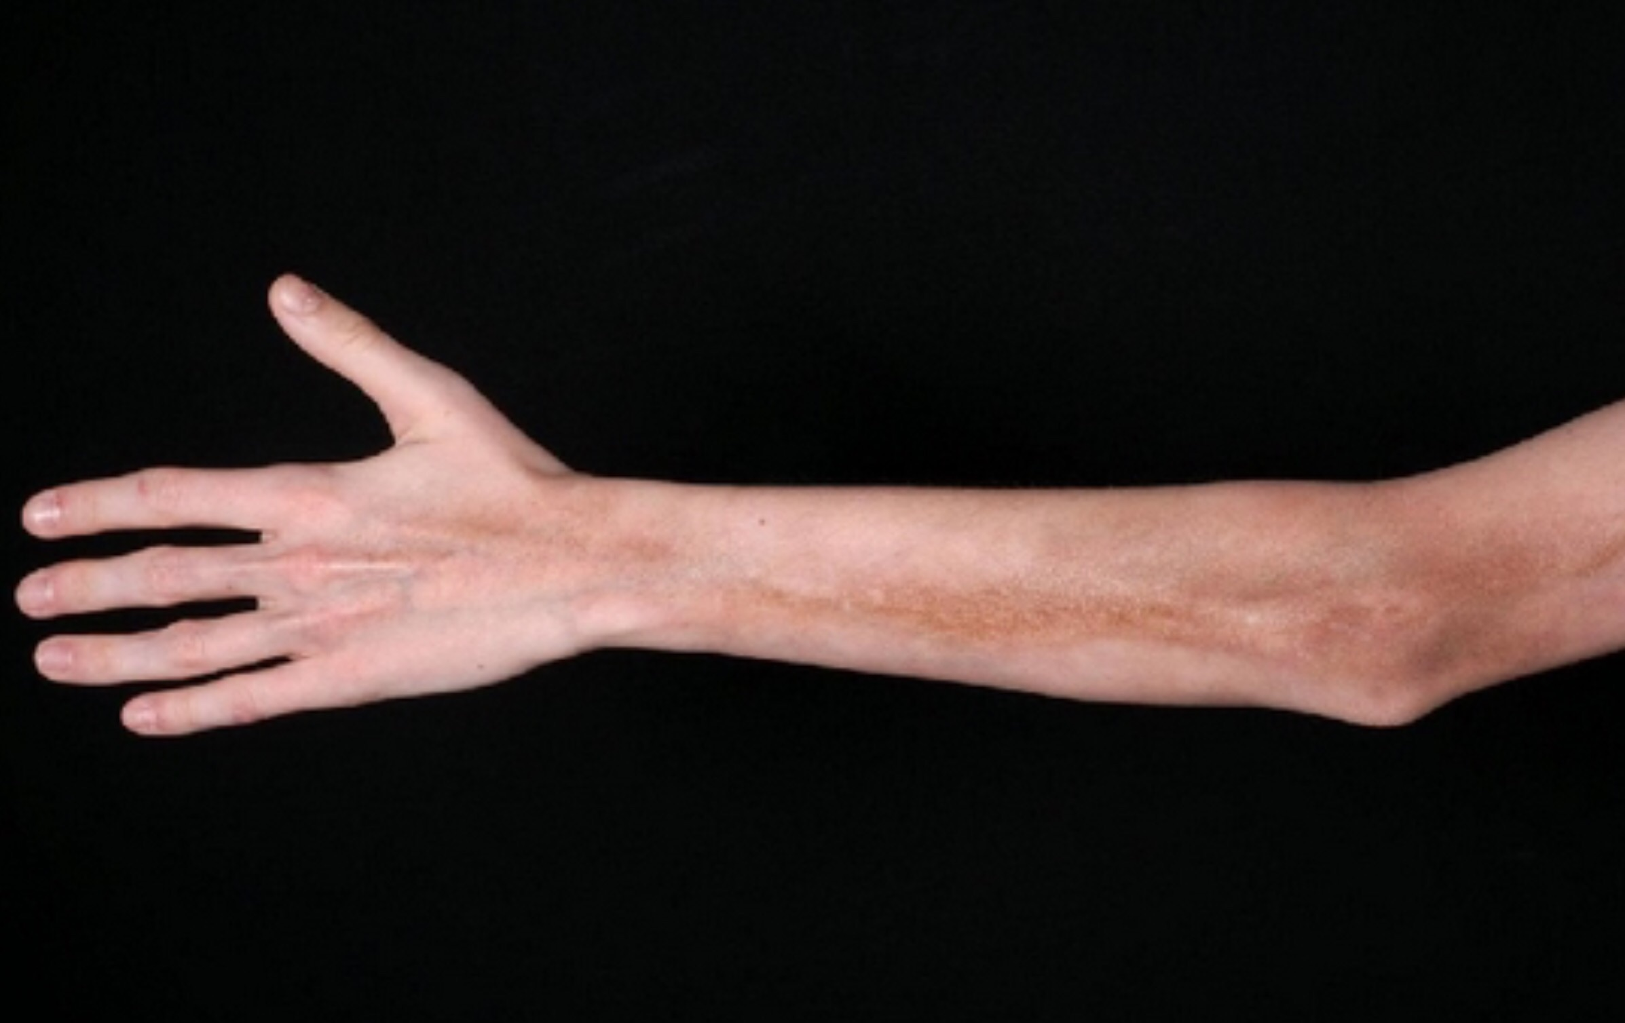
Scleroderma

Slide 100
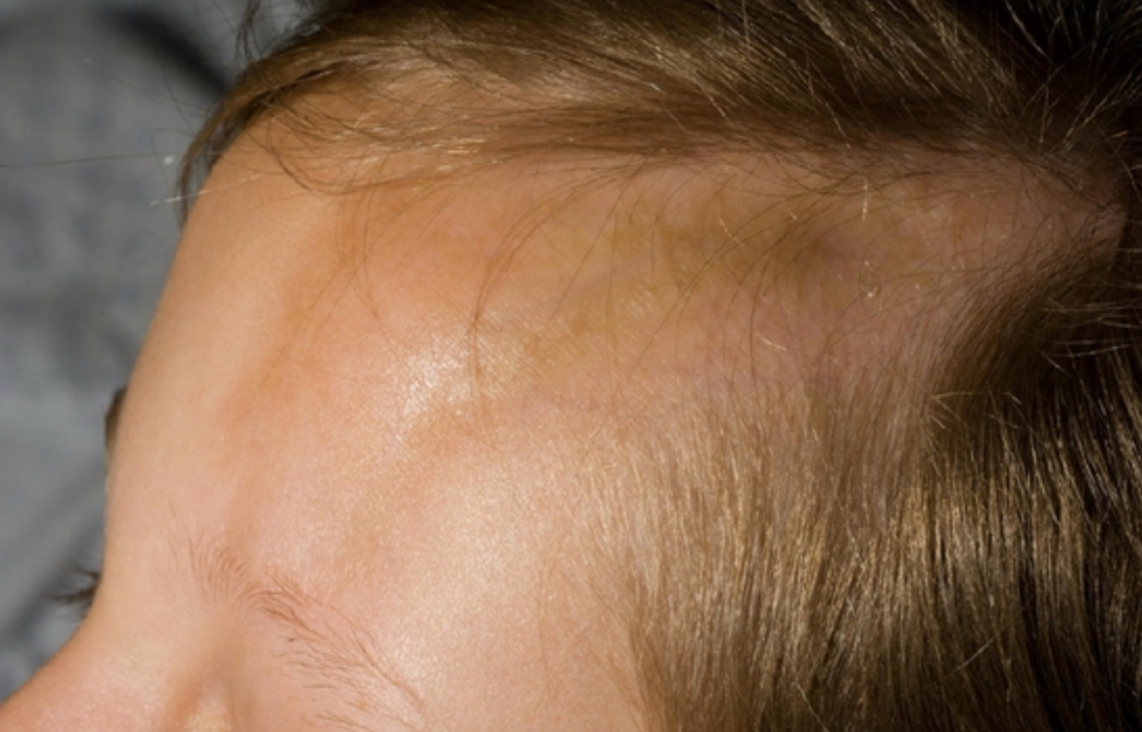
Scleroderma

Slide 101
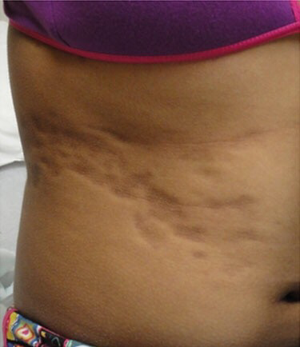
Localized scleroderma
5. Deep morphea: subcutaneous morphea, morphea profunda, disabling pansclerotic morphea of childhood

Slide 102
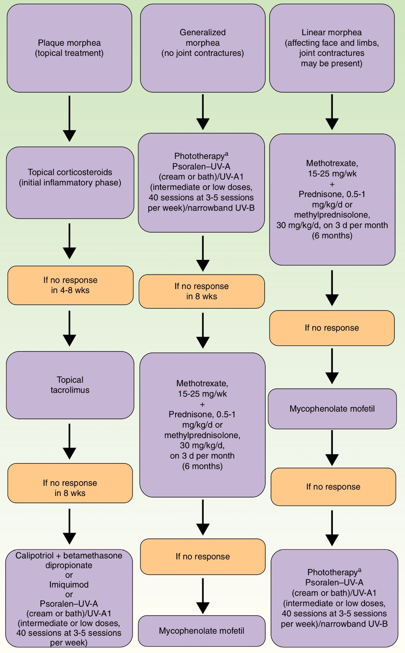
Scleroderma Treatment

Slide 103
THE END

