Slide 1
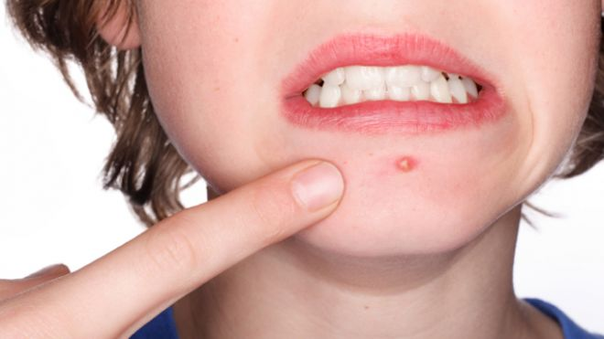
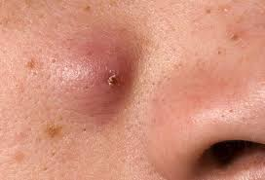
What is this ?

Slide 2
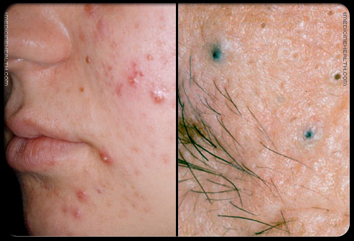
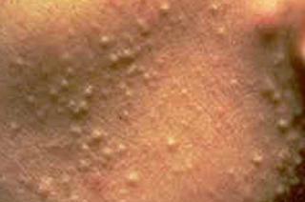
What are these ?

Slide 3

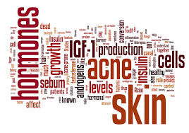
Acne and Acneiform Eruptions

Slide 4
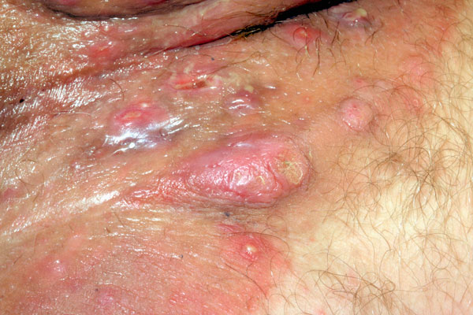
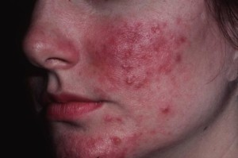
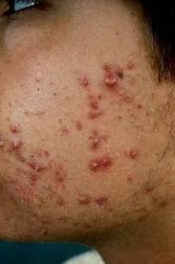
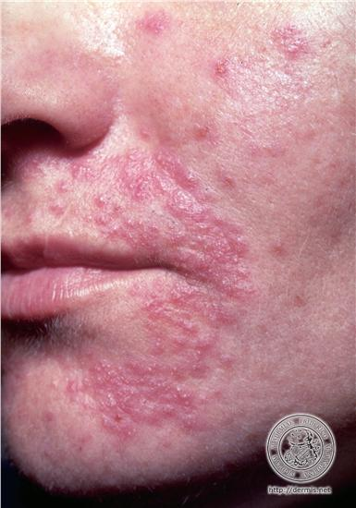
Hidradenitis
supprative
Rosacea
Perioral dermatitis
Acne

Slide 5
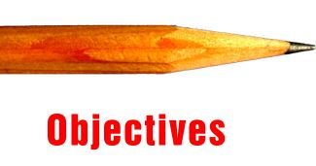
Objective of the lecture
To know the multiple pathogenetic mechanisms causing acne
To recognize the clinical features of acne.
To differentiate acne from other acniform eruptions such as rosacea.
To prevent acne scars and treat acne efficiently.
To recognize the clinical features of rosacea, it’s variable types, differential diagnosis and treatment.
To recognize the features of perioral dermatititis, differential diagnosis and treatment.
To recognize the features of hidradenitis supprativa and treatment.

Slide 6
Acne Vulgaris
Multifactorial disease of pilosebaceous unit.
Affects both males and females.
The most common dermatological disease.
Mostly prevalent between 12-24 yrs.
Affects 8% between 25-34, 4% between 35-44.

Slide 7
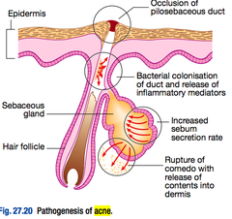
Pathogenesis:
Ductal cornification and occlusion
(micro-comedo).
Increased sebum secretion (Seborrhoea).
Ductal colonization with propioni
bacterium acnes.
Rupture of sebaceous gland and
inflammation.

Slide 8
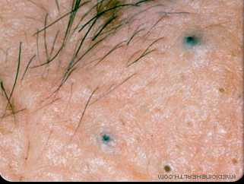
Specialized terms
Microcomedone:
Hyperkeratotic plug made of sebum and keratin in follicular canal.
Closed comedo ( whitehead):
Closed follicular orifice, accumulation of sebum and keratin
Open comedo ( blackhead):
Opened follicular orifice packed with melanin and oxidized lipids

Slide 9
Clinical Features
Acne lesions are divided into:
Inflammatory (papules,pustules,nodules,cyst)
Non inflammatory (open, closed comedons).
The comedons are the pathognomonic lesion
Seborrhoea.
Post inflammatory hyper pigmentation .
Scarring (Atrophic or Hypertrophic).

Slide 10
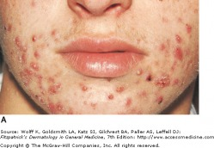
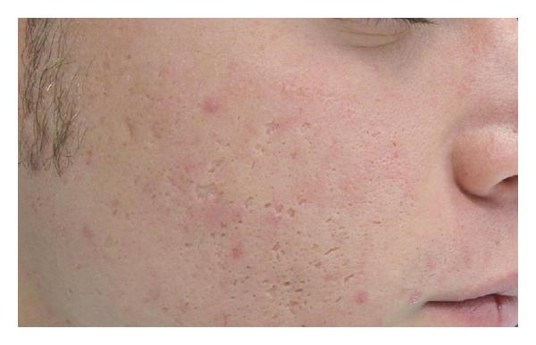
Clinical features

Slide 11
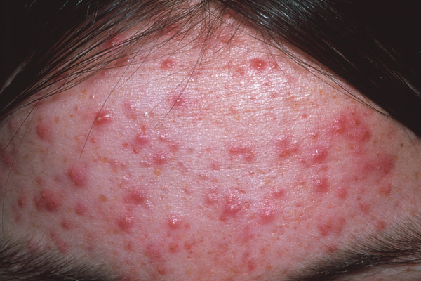
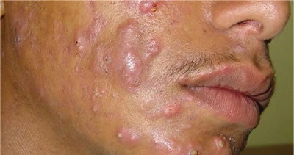
Clinical features
When follicles rupture into surrounding tissues they result in:
Papules.
Pustules.
Nodules.
Cysts.

Slide 12
Clinical Features
Lesions predominate in sebaceous gland rich
regions (face, upper back, chest & upper arms).
The severity of acne ranges from mild, moderate ,
severe according to the predominant lesion.
Comedon predominance is considered to be mild,
while extensive papulopustules and nodules or cysts are considered severe.

Slide 13
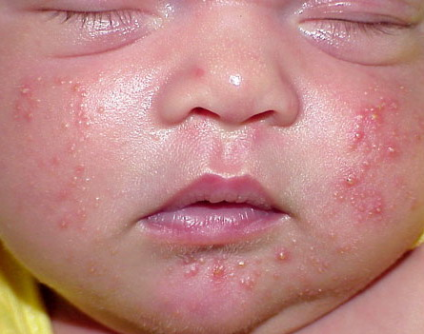
Acne Subtypes
1- Neonatal acne:
  Onset between 0-6 w of age.
  Characterized by closed comedons.
  Resolve spontaneously within 1-3 months.
  No relation with later development of acne.

Slide 14
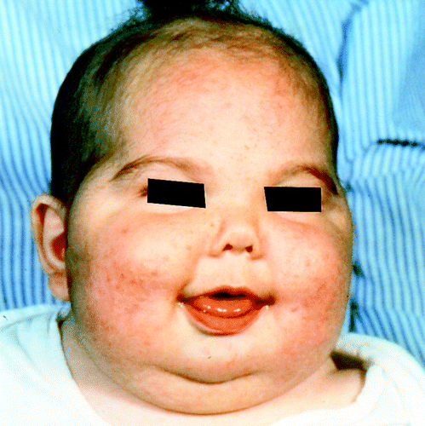
Acne Subtypes
2- Infantile Acne:
Onset between 3-6 m.
  Characterized by inflammatory lesions.
  Can be associated with precocious androgen secretion secondary to brain hamartoma and astrocytoma.

Slide 15
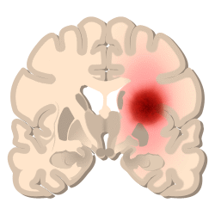
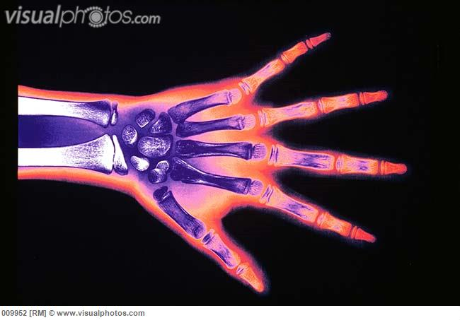
Acne Subtypes
  Endocrinology examination (LH) and bone age is important.
  There is increased risk of development of severe acne later in life.

Slide 16
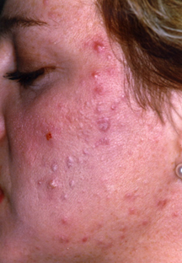
Acne Subtypes
  3-Teenage Acne:
  More in boys.
  Mainly comedonal.
  May be the first sign of puberty.

Slide 17
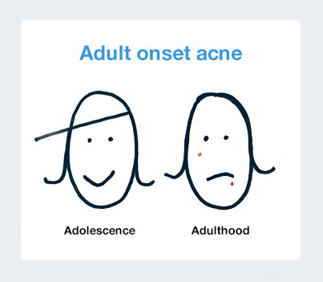
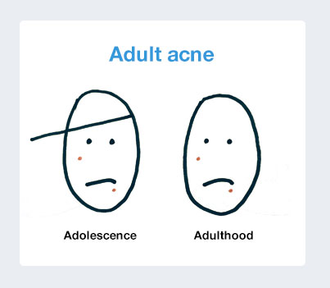
Acne Subtypes
  4- Adult Acne:
  Affects adults above 25 years.
  Can be continuation of teenage acne or start denovo.
  IF associated with hirsutism, irregular periods evaluate for hyper secretion of ovarian androgens (e.g. Polycystic ovary syndrome).

Slide 18
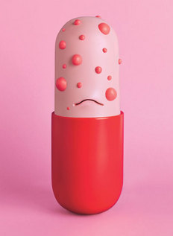
Acne Subtypes
5- Drug induced Acne:
Steroids, Iodides, Bromides, INH, Lithium, Phenytoin, epidermal growth factor inhibitors (cetuximab) cause acniform eruption.
The characteristic feature of steroids acne is the absence of comedons and monomorphic lesions as small pustules and papules all looking alike

Slide 19
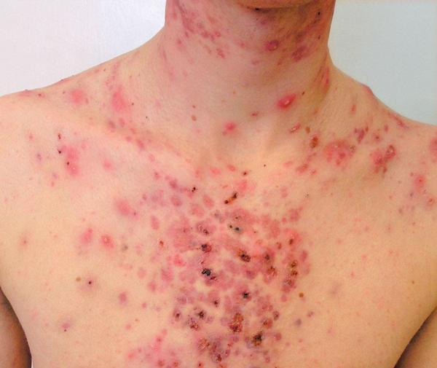
Acne Subtypes
6- Acne Conglobata:
  Highly inflammatory; with comedons, nodules abscesses, draining sinuses, over the back and chest .
  Often persist for long periods.

Slide 20
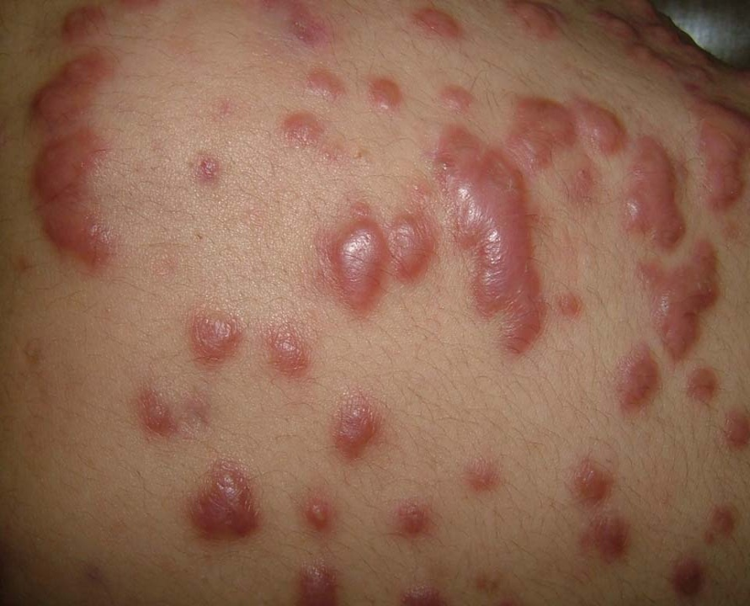
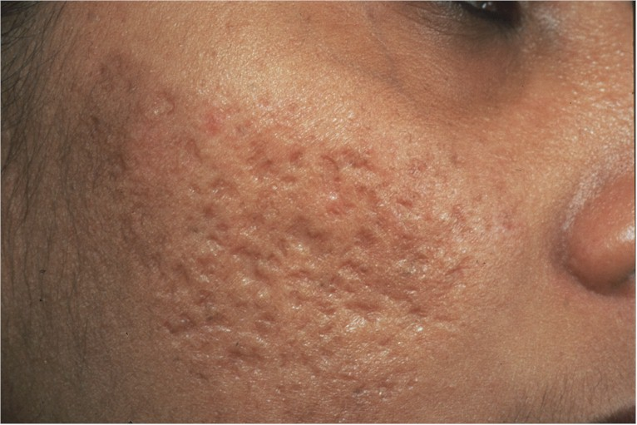
Acne Subtypes
  Affect males in adult life (18-30 years).
  Heals with scars (Depressed or Keloidal).

Slide 21
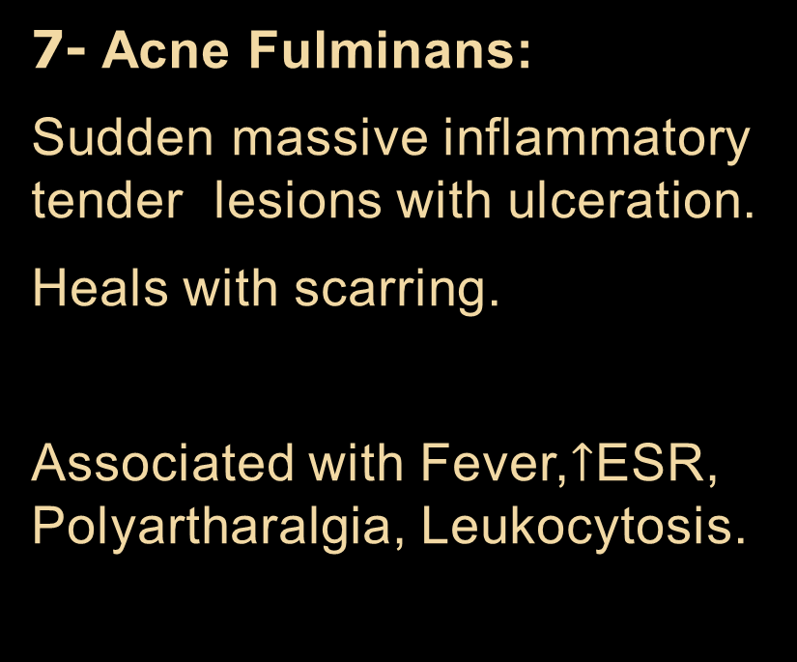
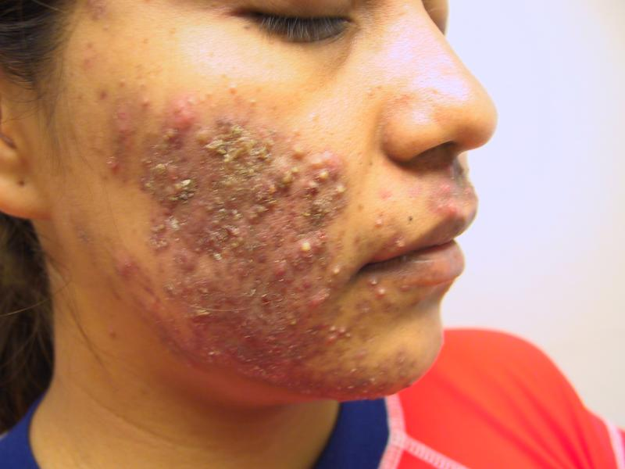
Acne Subtypes

Slide 22
Acne Subtypes
8- Occupational Acne:
Due to contact with oils – tars –chlorinated hydrocarbons used in the synthesis of insecticides and solvents.
Lesions appear at site of contact including large comedons, papules, pustules, nodules.
The most serious form is the chloracne due to systemic effect (liver damage –CNS involvement, decrease lung vital capacity).

Slide 23
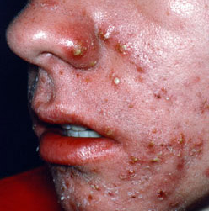
Acne Subtypes
9- Gram NegativeFolliculitis:
Infection with G –ve organisms (Klebsiella, proteus, E.coli).
Seen in patients under chronic antibiotic acne treatments.
Superficial pustules without comedons or even cysts involving from intranasal area to chin and cheeks.
Response to ampicillin, Isotretenoin, TMP-SM.

Slide 24
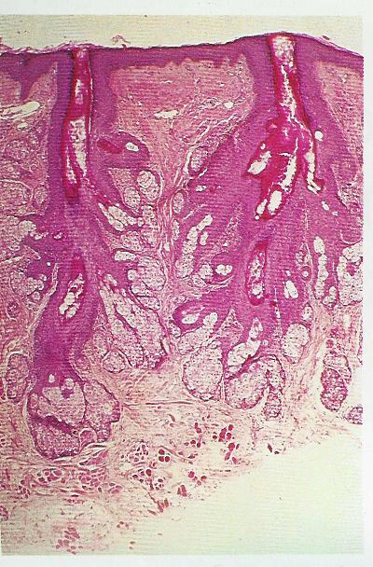
Obstructed duct
Sebaceous gland
Obstructed sebaceous duct

Slide 25
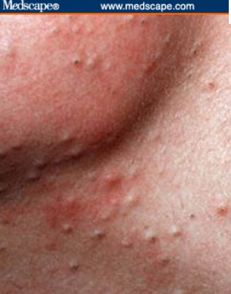
Closed and open comedones

Slide 26
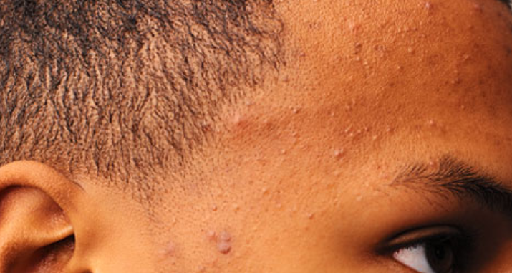
Closed and open comedones

Slide 27
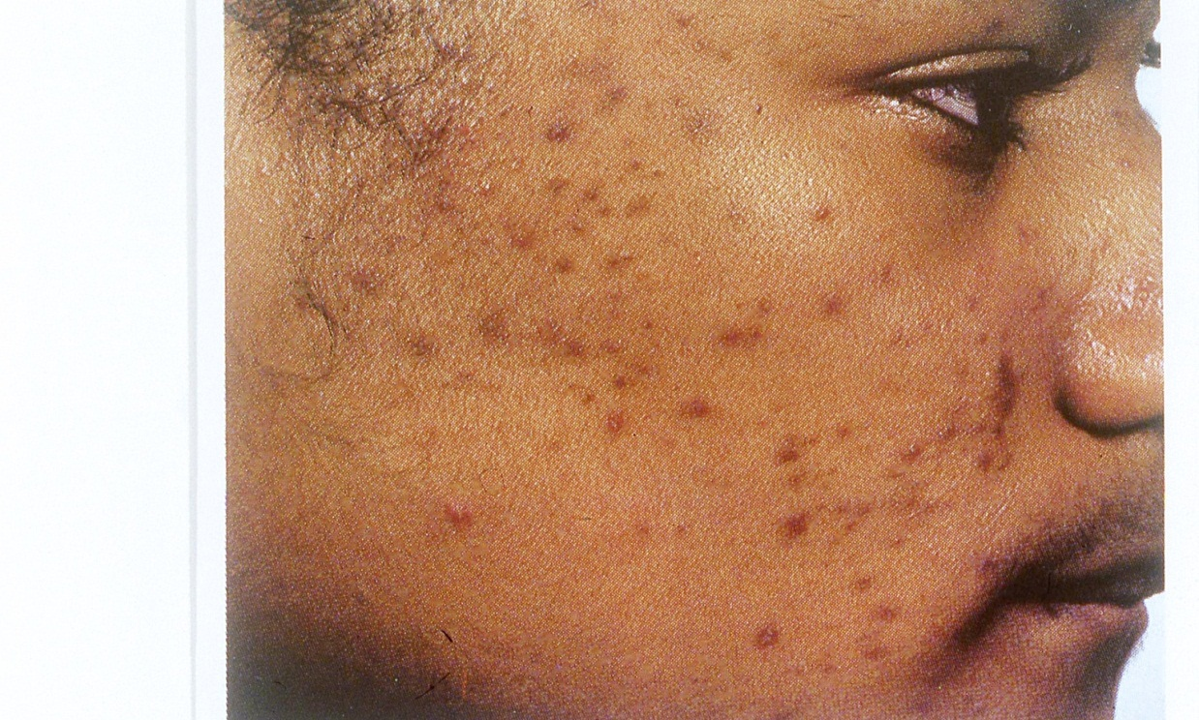
Marked post inflammatory hyperpigmentation

Slide 28
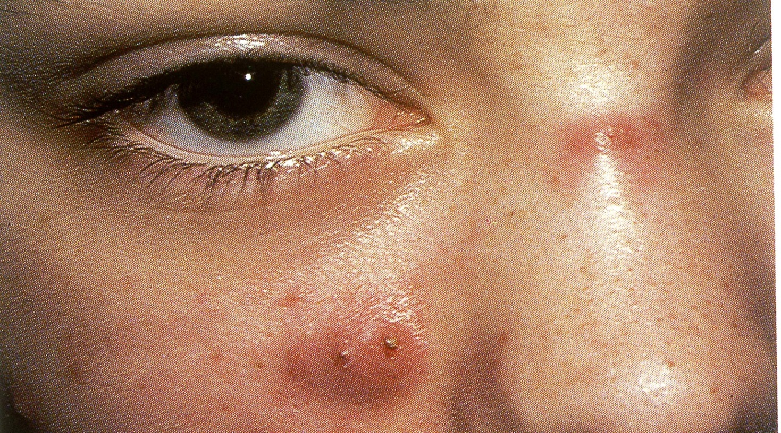
Nodules

Slide 29
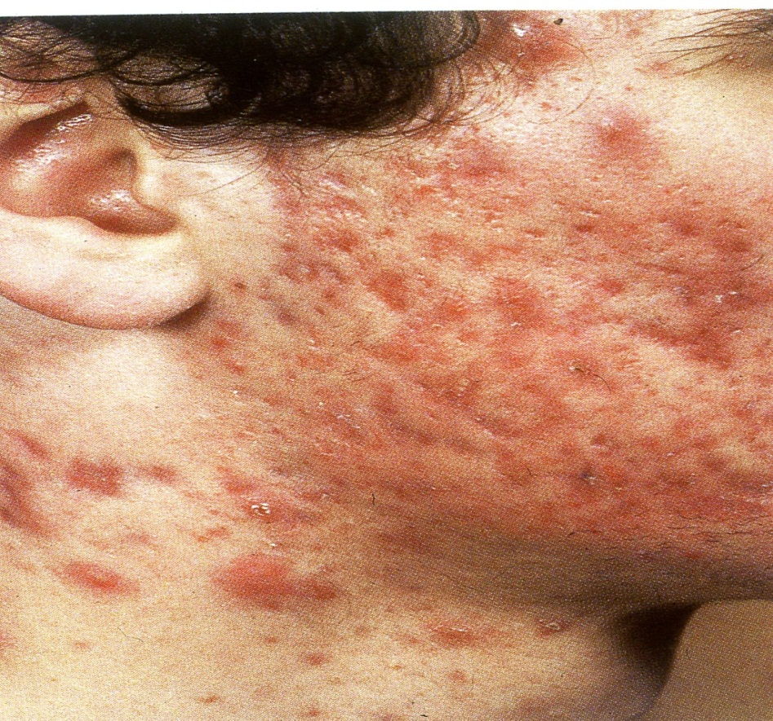
Acne conglobata with nodules and scars

Slide 30
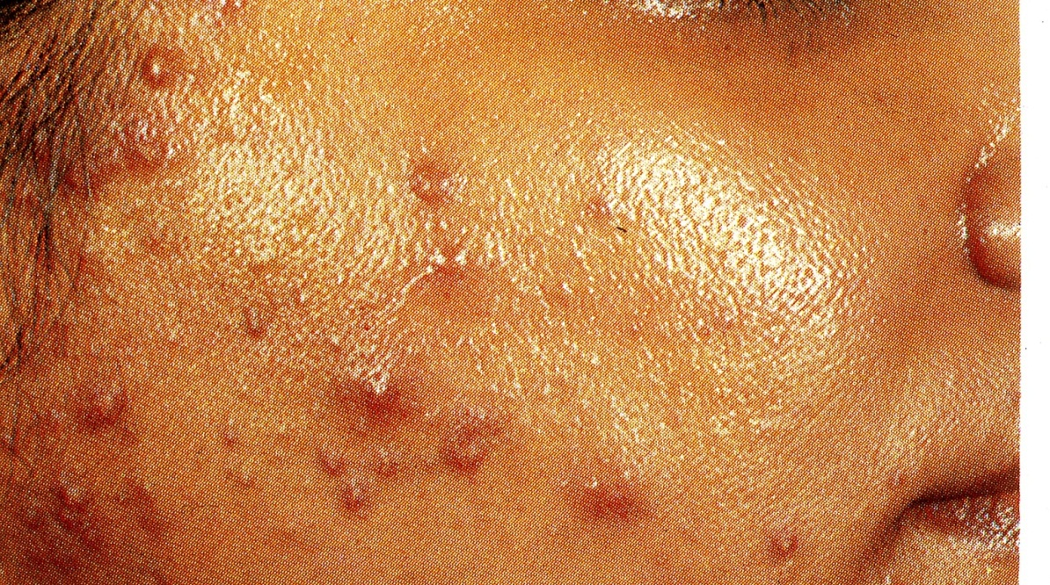
Seborrohea and papules , pustules

Slide 31
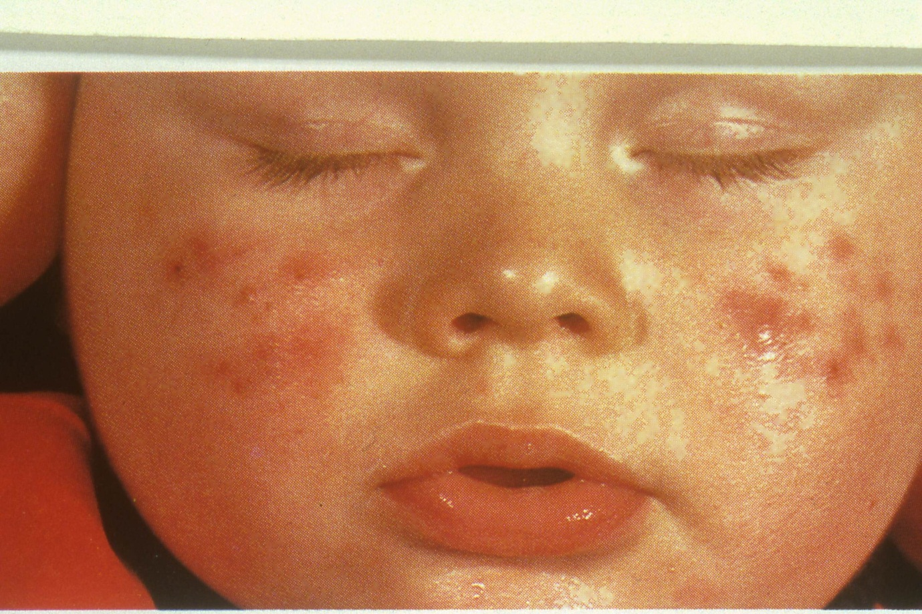
Neonatal acne

Slide 32
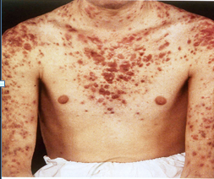
Nodules , Keloides

Slide 33
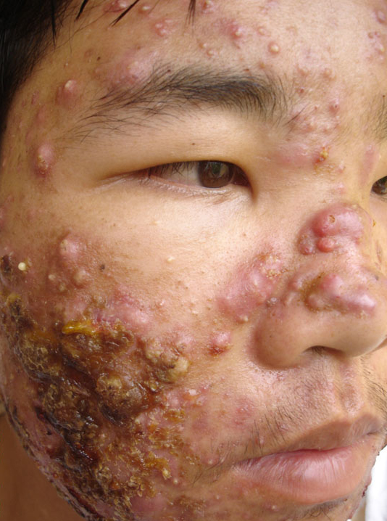
Acne fulminans
Nodules, pustules closed comedones,papules, pus .

Slide 34
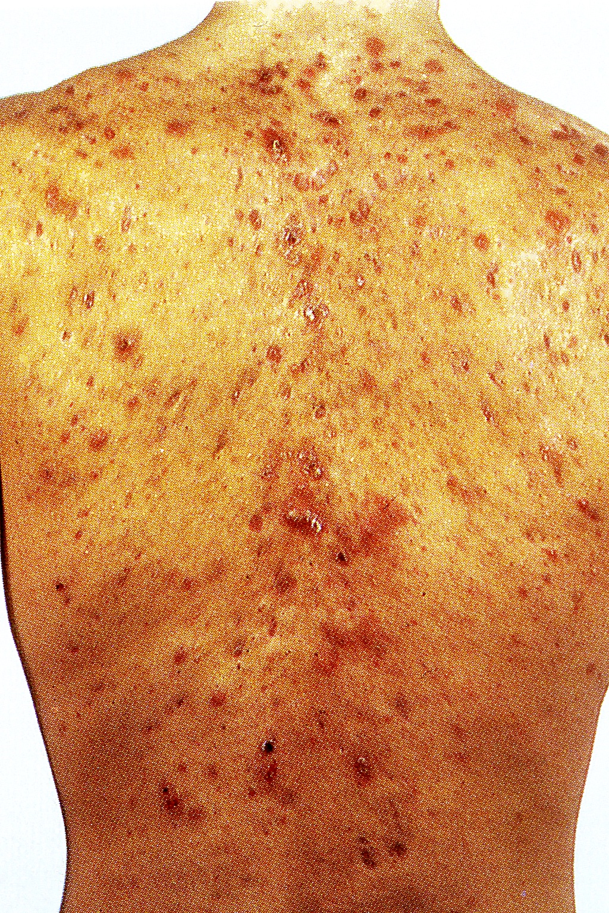
Acne conglobata
Scars, Nodules, Keloides, Sinuses

Slide 35
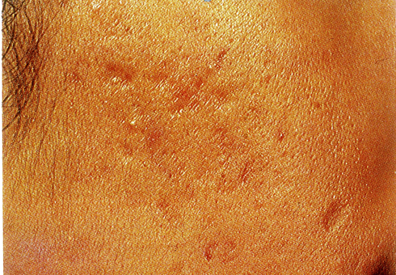
Acne rolling and boxcar scars

Slide 36
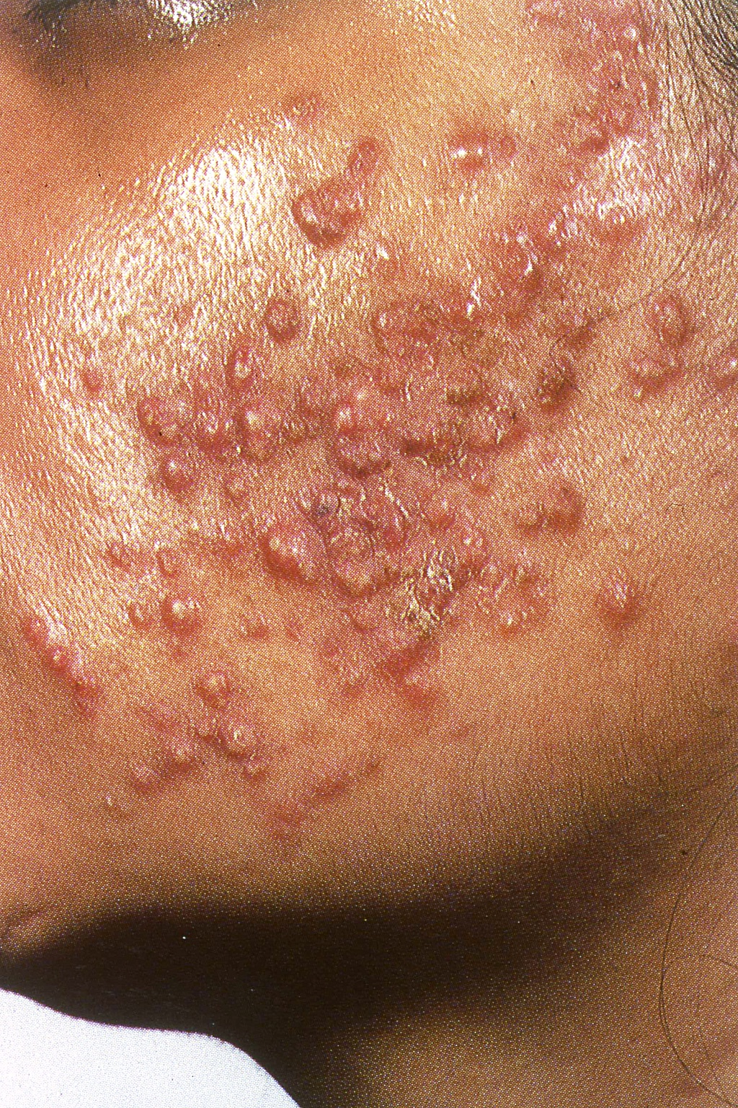
Monomorphic steroid acne

Slide 37
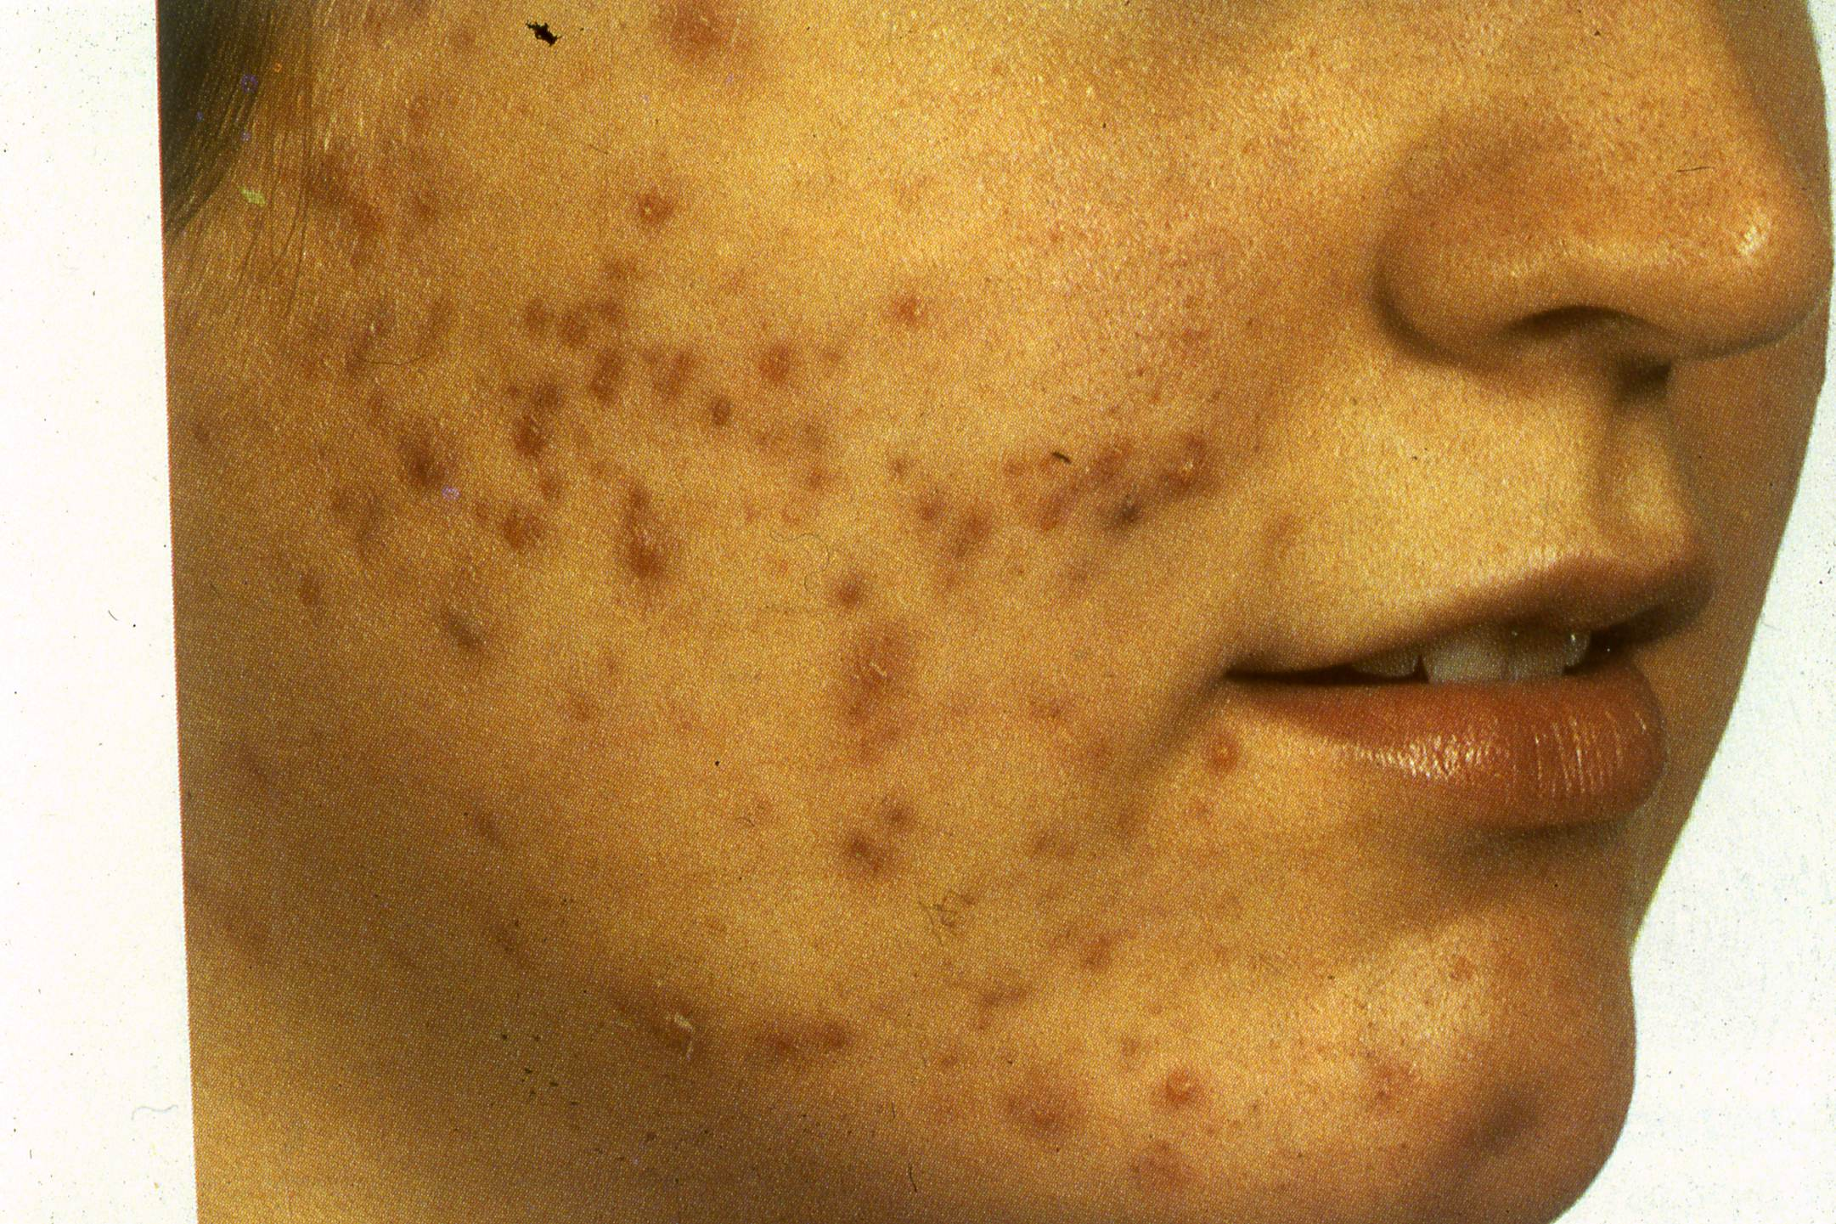
Postinfammatory hyperpigmentation, papules , pustules

Slide 38
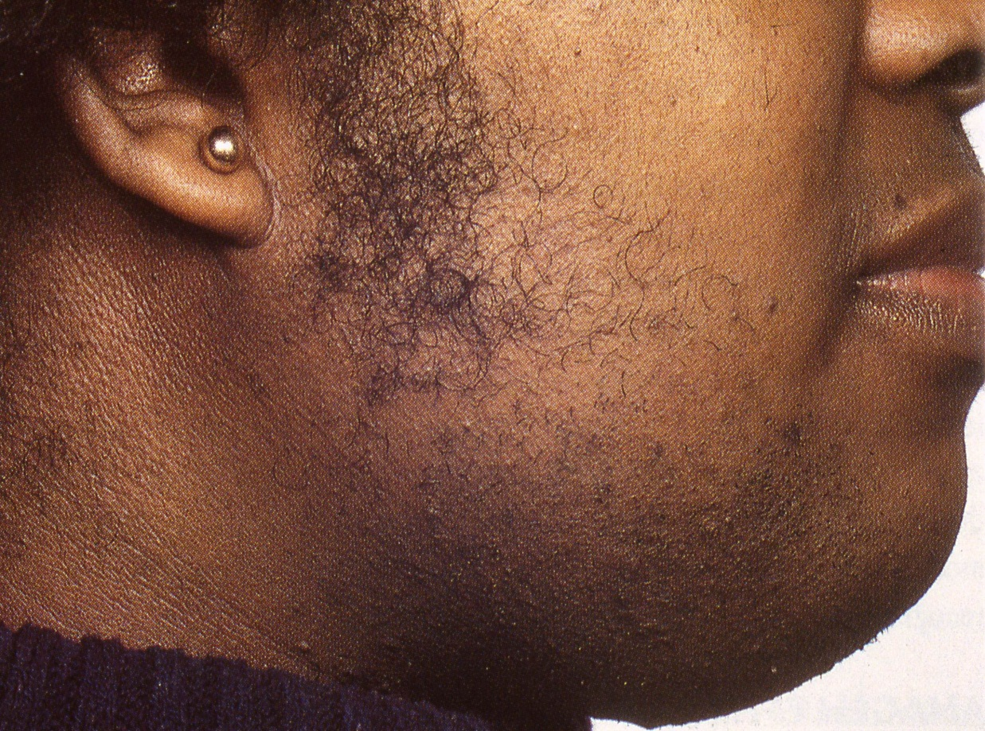
Hirsutism and closed comedones

Slide 39
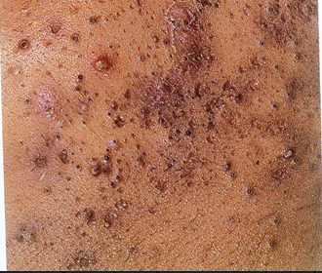
Open comedones, papules ,pustules

Slide 40
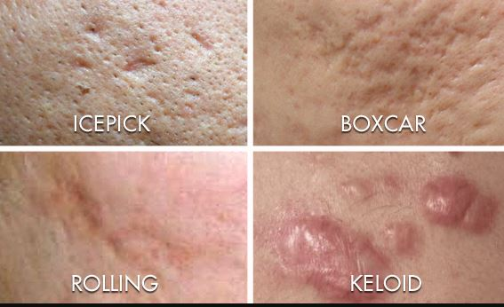
ACNE SCARS

Slide 41


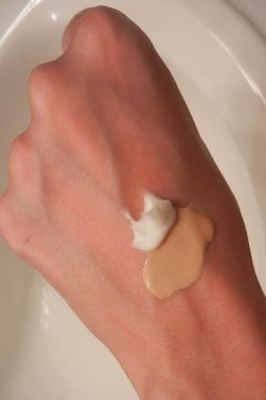
:
Aggravating Factors
Diet has no relation to acne.
Pre menstrual flare.
Sweating.
UV radiation.
Stress.
Friction.
Cosmetics.

Slide 42
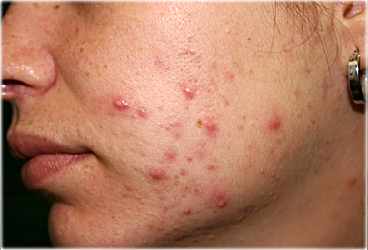
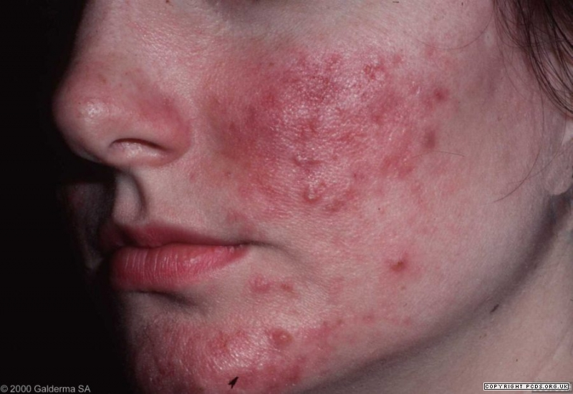

Differential Diagnosis
Rosacea
Folliculitis

Slide 43
ACNE TREATMENT - Goals
Decrease scarring.
Decrease unsightly appearance.
Decrease psychological stress.
Explain length of treatment, may be several months and initial response may be slow but must persevere .

Slide 44

Principles in treating acne:
Reverse the altered keratinization.
Decrease the intra-follicular P.acnes.
Decrease sebaceous gland activity.
Decrease inflammation.

Slide 45
Treatment
Miscellaneous | Oral | Topical
Laser resurfacing | Antibiotics: | Benzoyl peroxide
Chemical peel | Doxycycline | Retinoic acid
Comedo extraction | Minocycline | Adaplene Tazarotene ,
Dermaberasion | Erythromycin | Resorcinol,Sulfer
Intralesional steroid | Retinoids: | Azeliac acid
CROSS | Isotretinoin | Antibiotics:
 | Hormones: | Clindamycin
 | Antiandrogens | Erythromycin
 | OCP

Slide 46


Topical Therapy
Benzoyl peroxide:
High antibacterial activity.
Drying effect.
Could cause irritation and contact dermatitis.
Retinoic Acid:
Comedolytic activity.
Advice patient not to expose to sun as it may lead to burn.
Salicylic Acid:
Comedolytic, less potent than retinoic acid.

Slide 47

Topical Therapy:
Resorcinol and sulfur: are keratolytic.
Azeliac acid: antibacterial and bleaching.
Topical treatment result is noticed within 2 months.

Slide 48
Treatment
Drug | Dose | Recommendation and Duration
Tetracycline | 0.5 BD | Taken on empty stomach to promote absorption Not to be taken with milk or antacid Not to be given to pregnant women “Why”?
Erythromycin | 0.5 g BD | For pregnant women with bad acne
azithromycin | 250mg | 3 consecutive days/w for pregnant women
Doxycycline | 100 mg/day | Can be taken with food, photosensitivity.
Minocycline | 100 mg/day | Drug could cause blue – black pigmentation in scars, lupus, hepatitis, photosensitive drug rash
Clindamycin |  | Could cause pseudo membranous colitis
Trimethoprim Sulphamethoxazole |  | Used only in resistant cases .
Isotretinoin | 0.5-1mg/kg | Give long term remission Given in resistant acne

Slide 49
Acne treatment
Systemic Antibiotic:
have to be used for 3months to avoid resistance.
Hormonal:
OCP consider less androgenic progestogen eg marvelon/cilest, but increased risk of DVT.
Consider cyproterone acetate (antiandrogen) with oestrogen(dianette) . flutamide (antiandrogen).
Isotretinoin [Accutane]:
Vitamin A analogue

Slide 50

Treatment
Side Effects of Isotretinoin:
Dryness of mucous membranes [Chelitis, Conjunctivitis].
Headache and increased intracranial pressure [Pseudotumor cerebri].
Isotretinoin should not be given with tetracycline.

Slide 51

Treatment
Bone and joint pains.
Increases triglycerides and cholesterol or LFT.
Patients should avoid pregnancy 4 w after discontinuation of drug because of teratogenicity.

Slide 52


Treatment
CROSS
Comedo extraction

Slide 53


treatment

Slide 54


Slide 55
Take home massage
A avoid squeezing and manipulation.
C comply with medication.
N no cosmetics and moisturizers.
E early treatment to avoid scaring.

Slide 56


Slide 57

Rosacea
Definition:
Papules and Papulo- pustules in the center of the face against vivid erythematous background with telangi-ectasia.
Incidence:
Common in 3rd and 4th decade
Peaks between 40-50.

Slide 58

Rosacea
Common in fair skin.
Women are affected more than men but rhinophyma is more in men.

Slide 59


Rosacea Pathogenesis:
Unknown.
Genetic predisposition (38% have a relative).
Sunlight and heat.
Constitutional predispostion to flushing & blushing.
Demodex folliculorum mite.
H. Pylori infection.

Slide 60

Clinical Findings
The hall mark is:
Episodes of flushing and erythema in butterfly distribution.
Papules and pustules.
Erythema and telangiectasia.
Absent comedons.
Granulomas [firm papules].

Slide 61

Clinical Findings
Localization:
The nose, cheeks, chin, forehead, glabella.
May involve ears, chest.

Slide 62


CLINICAL FINDINGS
Types of Rosacea:
Erythematotelangictatic.
Papulopustular.
Ocular.
Phymatous.

Slide 63

Complications
Phymatous complication:
Rhinophyma:Swelling of the nose due to sebaceous gland hyperplasia.
Other phymatous complications include gnathophyma, otophyma, blepharophyma and metophyma.

Slide 64


Complications
Eye complications:
Occurs in 50% of cases including:
Blepharitis.
Conjunctivitis.
Keratitis.
Iritis.
Eyelid telangi-ectasia.

Slide 65

Associated diseases
MARSH syndrome =
Melasma.
Acne.
Rosacea.
Seborrheic dermatitis.
Hirsutism.

Slide 66
triggers
Hot or cold temperatures, Wind.
Hot drinks, Caffeine, Spicy food, Alcohol.
Exercise.
Emotions.
Topical products that irritate the skin and decrease the barrier.
Medications that cause flushing (nicotinamide).

Slide 67



Differential Diagnosis
  SLE (erythema only).
  Acne (comedons).
  Seborrheic dermatitis no pustules.
  Perioral dermatitis.
SLE
SEB DERM
Perioral Derm

Slide 68

Malar erythema

Slide 69

Malar erythema and scales

Slide 70

Telangictasia, papules , blepharitis , conjunctivites

Slide 71

Papules on erythematous background

Slide 72

Rhinophyma

Slide 73

Rhinophyma

Slide 74

Papules on erythematous background , telangictasia

Slide 75
Treatment
Schedules are determined by stage & severity.
General measures:
The skin of rosacea patients is delicate to physical insults.
Patient should use mild soaps or diluted detergents.
Protection against sunlight by sunscreen
Avoid hot drinks and heat.

Slide 76
Treatment
Topical | Systemic
1.Topical antibiotics Clindamycin. Erythromycin. | Tetracycline reduces erythema.
2. Metronidazole –affects papules or pustules but no effect on erythema | Oxy-tetracycline.
3. Imidazoles e.g. Ketoconazole cream – has anti-inflammatory action | Minocycline
4. 2-5% sulfur lotion,sulfacetamide | Doxycycline
5. Isotretinoin 0.1% in cream | Isotretinoin in resistant phymas cases (0.1 -0.2 mg/kg)
Antiparasitic : Lindane, permethrin Benzyl benzoate, Crotamiton ,ivermectin | Metronidazole 500 mg for 20-60 days
Sunscreen, Vascular laser, ,brimonidine α adrenergic blocker | Azithromycin

Slide 77
Treatment
Topical:
Metronidazole gel 0.75%.
Erythromycin 2% gel bid.
Systemic:
Minocycline 100 mg bid till clear then taper.
Doxycycline 100 mg bid then taper.
Tetracycline 500 mg bid till clear and tapered.
Anti H. pylori therapy.

Slide 78
Take home massage
R recognize triggers.
O ocular hygiene.
S sunblock.
A avoid hot food.
C comply with instructions.
E early treatment.
A avoid scrubs and harsh cleansers.

Slide 79


Slide 80

Perioral dermatitis
Occurs mainly in young women.
Discrete & confluent papulo- pustules over the perioral or periorbital skin sparing the vermilion border of lips.
No comedons.

Slide 81

Perioral dermatitis
Predominant in females at 20- 30 years of age.
Aggravated by topical steroids, dentifrice and moisturizers.
Occasionally itchy or burning or feeling of tightness.

Slide 82

Female with papules over chin

Slide 83

Papules , pustules, no comedones

Slide 84


Differential Diagnosis
Acne.
Rosacea.
Seborrheic Dermatitis.
Atopic Dermatitis.
Allergic Contact Dermatitis.
Atopic dermatitis
Allergic contact dermatitis

Slide 85
Treatment
Wean patients of topical steroid.
Stop any moisturizers.
In pregnant mild cases use topical antimicrobial therapy with metronidazole gel and erythromycin solution.
Pimecrolimus cream in steroid induced perioral dermatitis.
Topical anti acne medication like adaplene and azelaic acid.
In severe cases oral doxycycline or minocycline .
Isotretinoin for resistant cases.

Slide 86


Slide 87

Hidradenitis Supprativa
Chronic recurrent supprative scarring disease of apocrine gland bearing skin (axillae, anogenital region, under female breast).
Associated with obesity.
Develops in 2nd and 3rd decades.

Slide 88

Pathogenesis:
Unknown
Apocrine duct occlusion.
Dilatation and rupture of apocrine gland.
Secondary bacterial infection and draining sinuses.
Genetic predisposition[38% have a relative affected].

Slide 89


Clinical Presentation
Intermittent pain and tenderness.
Pus drainage.
Double headed comedons [characteristic lesion].
Nodules, abscess, sinus tracts, scarring.
Submammary, axillary , inguinal regions are common in females.
Perineal involvement occurs more in males.

Slide 90


Slide 91





Slide 92



Associated findings:
The follicular occlusion tetrad including:
Extensive acne vulgaris (conglobata variety).
Perifolliculitis of the scalp.
Pilonidal sinus.
Acne conglobata
Perifolliculitis
Hidradenitis supprativa

Slide 93
Associated findings
Crohn’s disease in 39% of patients.
Irritable bowel syndrome.
Sjogren syndrome.

Slide 94

Sinuses, nodules, connecting tracts

Slide 95

Double headed comedones

Slide 96

Tracts , sinuses

Slide 97
treatment
General measures:
Practicing proper hygiene.
Using soaps and antiseptic and antiperspirant agents.
Using warm compresses.
Wearing loose-fitting clothing.
Smoking cessation.
Weight reduction.

Slide 98

treatment
Medical :
Intralesional triamcinolone acetonide for acute lesions
Antibiotics (minocycline erythromycin)
Retinoids (Acitretin better than isotretinoin
Antiandrogens.
Biological therapy (infliximab, adalimumab)

Slide 99

treatment
Surgical:
Incision and drainage of abscess better avoided
Excision of sinus tracts and chronic nodules
Complete excision of the area and grafting.
CO2 laser.
graft

Slide 100



