Slide 1
HAIR AND PIGMENTARY DISORDERS
DR.AMAL AL BALBEESI
2018

Slide 2
OBJECTIVES OF THE LECTURE
To know the structure of the hair.
To know the hair growth cycle.
To know the approach and bed side tests to diagnose hair disorders.
To know the clinical presentations and treatment of scarring and non scarring alopecias like DLE, Lichen planopilaris, Alopecia areata, Androgenetic alopecia (male and female pattern), telogen effluvum, traction alopecia, trichotellomania and anagen effluvum.
To know the different clinical presentations of vitiligo, associated diseases, differential diagnoses and therapy.
To know the pathogenesis of melasma, freckels and treatment.

Slide 3
FUNCTION OF THE HAIR
1. Protects body surface from external injury.
2. Helps in sensory function.
Psycho – social importance.
Forensic importance.
i. Identification of race, sex, age.
ii. Cause of death- can be determined.
iii. Time of death- can be determined.
5. Assist thermo- regulation: mainly in lower animals.

Slide 4
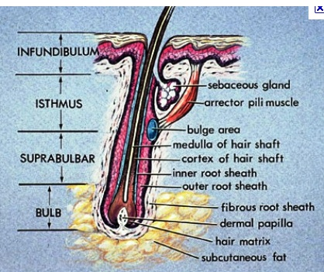
HAIR STRUCTURE
Hair follicle anatomy:
The hair follicle has many parts:
The Infundibulum
The Isthmus
Lower follicle
Bulb

Slide 5
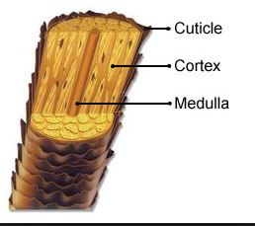
HAIR SHAFT
The cross section of hair shaft has 3 components:
The cuticle (6-8 layers of cells).
The cortex (strength & elasticity).
The medulla(absent in most terminal hair except gray hair).

Slide 6
HAIR CONSTITUENTS
Sulfur rich protein containing cysteine residues
Water
Lipids
Trace elements
Melanin ( 2 types):
eumelanin in black, brown hair.
pheomelanin in red hair.

Slide 7
HAIR MORPHOLOGY
There are 5,000,000 hair follicles in the body.
100-150,000 over scalp.
11100-350 follicle/cm2.
Hair grows at 0.4 mm/day.
Tow types of hair:
Terminal.
Vellus.
Normal scalp averages 7 Terminal hair :1 Vellus.

Slide 8
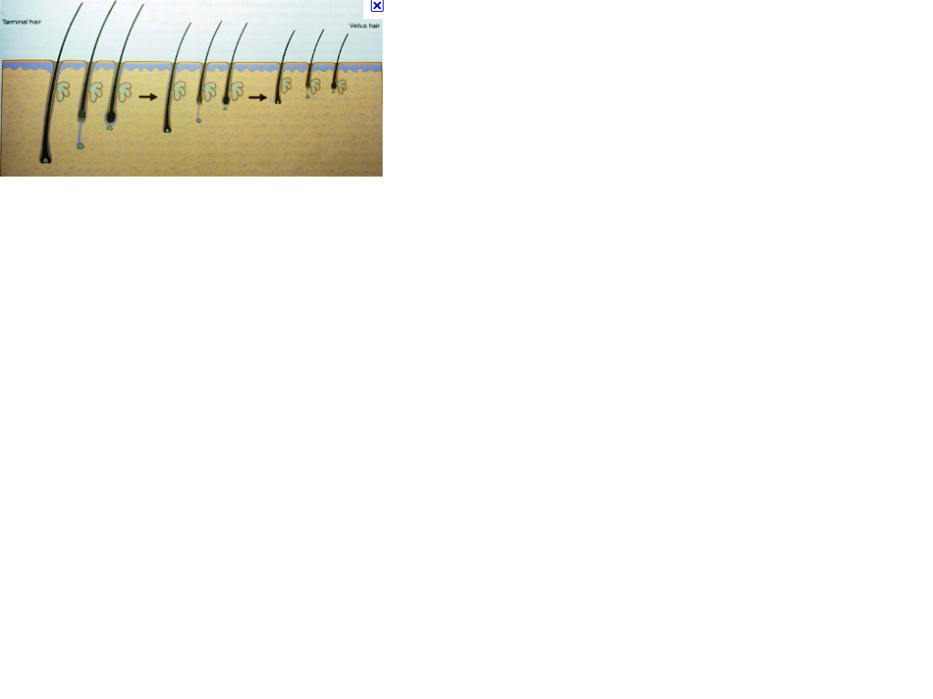
DIFFERENCES BETWEEN TERMINAL AND VELLUS HAIR
Terminal hair:
Large , pigmented.
0.03mm diameter.
Medullated.
The terminal hair is deeper in the subcutaneous tissue.
Vellus hair
Small, non pigmented .
Less 0.03mm diameter.
Non medullated.
Vellus hair is in the upper dermis.

Slide 9
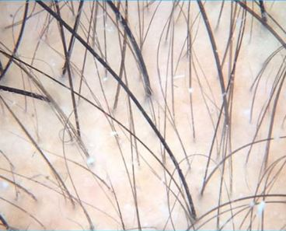
DIFFERENCES BETWEEN TERMINAL AND VELLUS HAIR

Slide 10
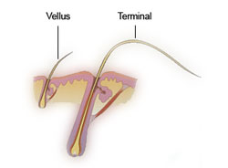
Comparison of terminal and vellus hair
Notice the size difference, the depth

Slide 11
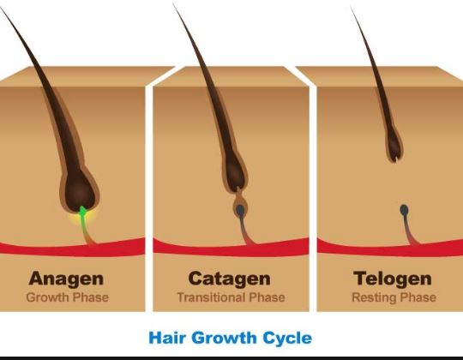
HAIR GROWTH CYCLE
Has three PHASES :
ANAGEN (GROWING PHASE) duration depends on the body region.
CATAGEN (REGRESSION PHASE) lasts 2 weeks.
TELOGEN (RESTING PHASE) lasts up to 3 months.
5-10% of scalp hair is in TELOGEN (50-100 hairs daily
lost ).
90-95% of scalp hair is in ANAGEN phase .

Slide 12
ANAGEN DURATION OF DIFFERENT REGIONS
REGION
DURATION
scalp.
Eye brow
Legs
Arm hairs
Upper lips
Lasts 1-7 years
Lasts 4-8 weeks
19-26 weeks
6-12weeks
4-14 weeks

Slide 13
HAIR SHINE
Hair luster is the result of light reflection from the cuticle cells.
Cuticle cells act like mirrors reflecting light.

Slide 14
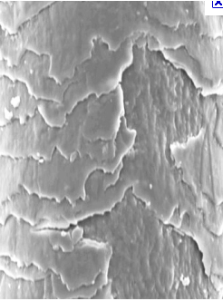
HAIR SHINE
Damage to cuticular cells induced by weathering result in dull hair.

Slide 15
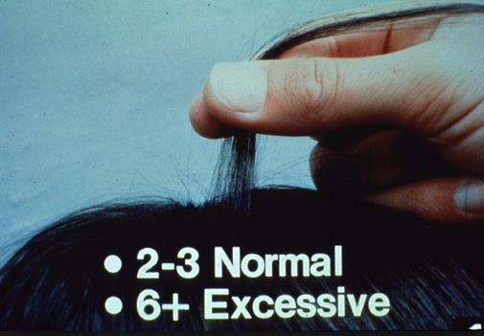
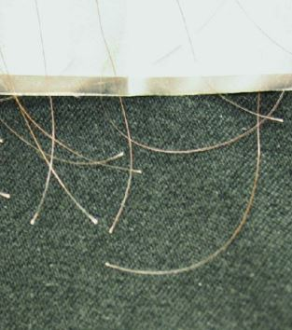
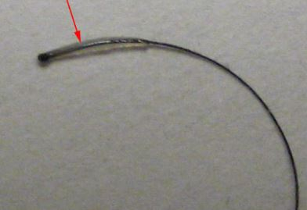
BED SIDE TESTS
1. Pull test:
Small amount of hair is grasped between 2 fingers close to the scalp and pulled along the entire length.
Under normal conditions few hairs are shed .
Look at the proximal end to see if telogen, anagen , or tapered
anagen
telogen

Slide 16
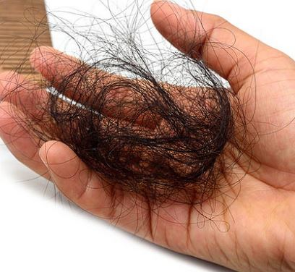
BED SIDE TESTS
IF positive ( $≥6)$ and the proximal end is clubbed (telogen )consider :
Telogen effluvum.
IF miniaturized short telogen consider:
Female pattern hair loss (androgenic alopecia ).

Slide 17
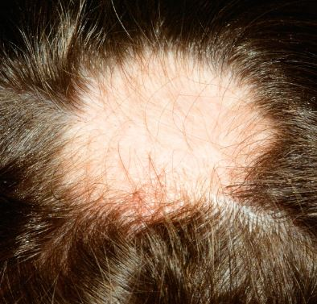
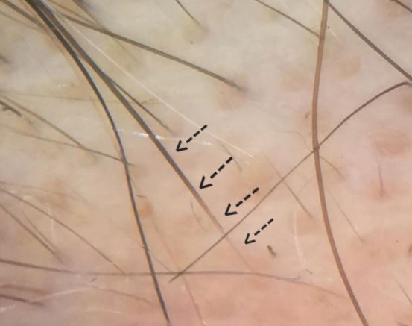
BED SIDE TESTS
IF positive and the proximal end is tapered consider
Active alopecia areata.

Slide 18
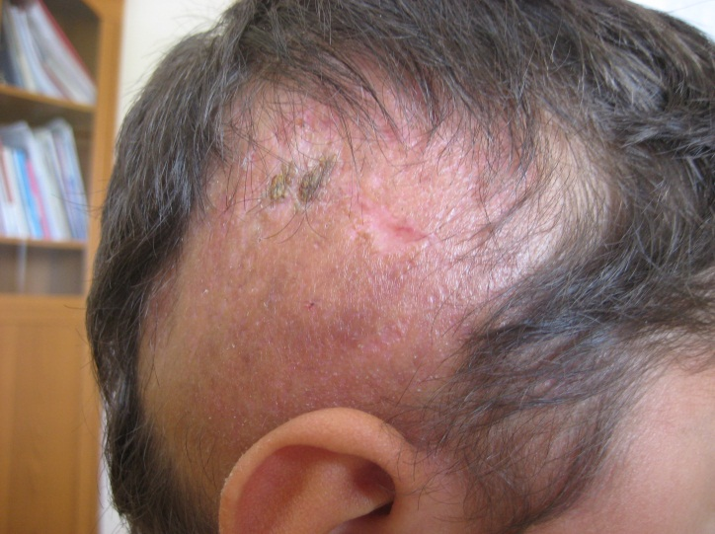
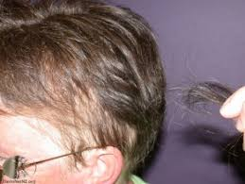
BED SIDE TESTS
IF positive and the proximal end is anagen consider:
Scarring alopecia
Anagen effluvum

Slide 19
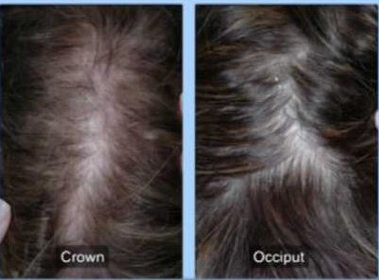
BED SIDE TEST
2. Part –width test
Part the patient hair in the midline
Note the width of the part
Compare the part width over the occipital and crown area
IF the part is wide over the crown, it’s likely that the patient has FPHL (female pattern hair loss).

Slide 20
BED SIDE TEST:
3. Trichogram:
Take 50-100 hairs from different parts of scalp (crown, occiput ).
Pluck the hair by using rubber tipped clamp in the hair direction.
Mount hair on a slide.
Examine the root under the microscope.
Determine the % of anagen, catagen, telogen.
Notes:
N hair loss more telogen on the crown

Slide 21
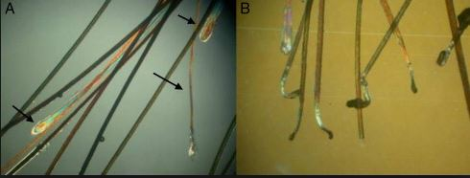
TRICHOGRAM MOUNT
Anagen have sheath on the lower end.
Catagen have tapered end.
Telogen have club end and no sheath
10% telogen is excellent.
With female pattern hair loss the telogen is more on the crown than occiput.
IF telogen % is equal on different parts of the scalp consider telogen effluvium

Slide 22
ANAGEN HAIR
Note the sheath.

Slide 23
CATAGEN HAIR
Note the tapered end.

Slide 24
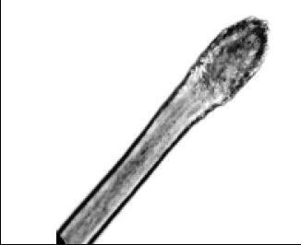
TELOGEN HAIR
Note the club end.
Club end

Slide 25
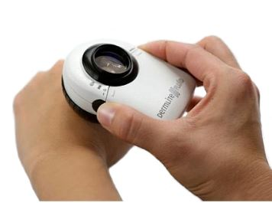
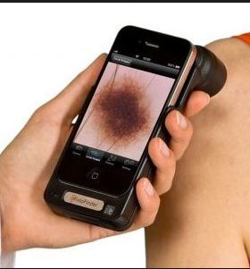
TRICHOSCOPY
Trichoscopy involves using a dermoscope to examine the surface of the scalp and the hair shaft to identify signs of scalp disorders and different types of alopecia.

Slide 26
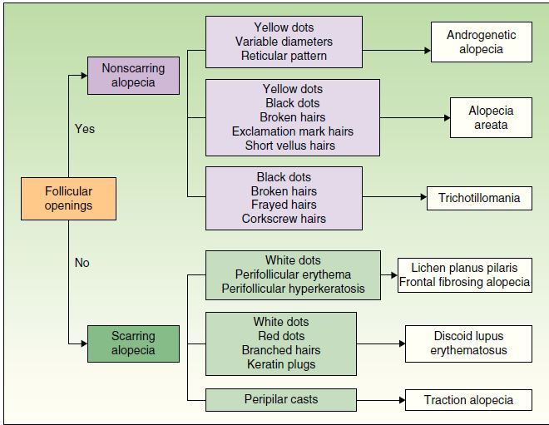
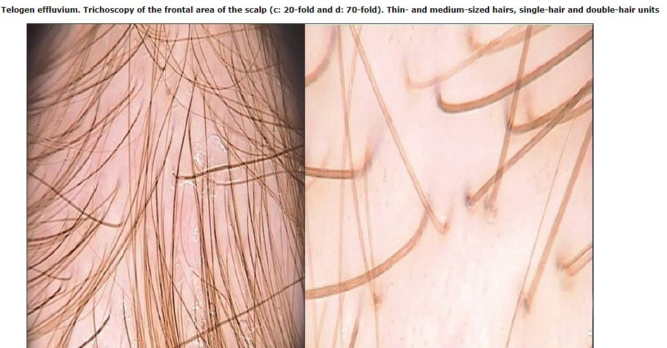
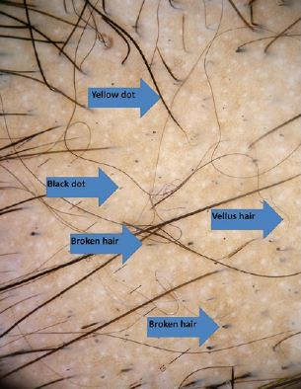
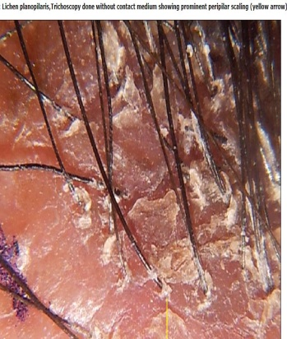
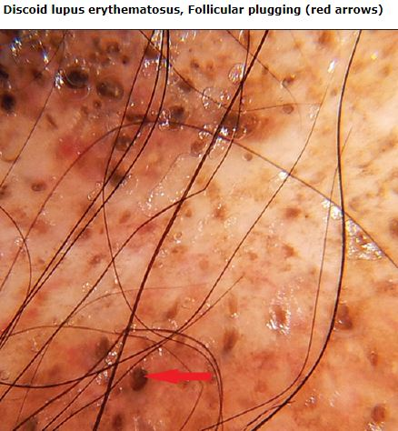
TRICHOSCOPY

Slide 27
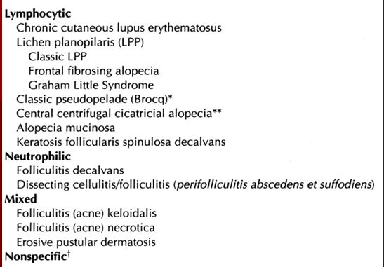
ALOPECIA
Primary scarring alopecia
Alopecia is hair loss.
There are 2 types of alopecia :
Scaring (irreversible) includes :
Chronic discoid lupus
Lichen planopilaris
Dissecting cellulitis of the scalp.

Slide 28
ALOPECIA
Non scaring ( reversible) includes:
Alopecia areata.
Androgenetic alopecia.
Telogen effluvum.
Anagen effluvum.
Trichotellomania .
Traction alopecia.

Slide 29
HAIR TIPS
Healthy-appearing hair is a sign of excellent general health, as well as good hair care practices.

Slide 30
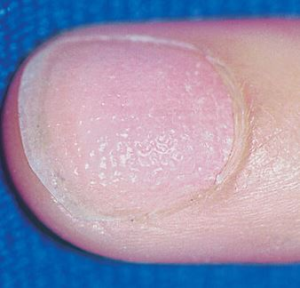
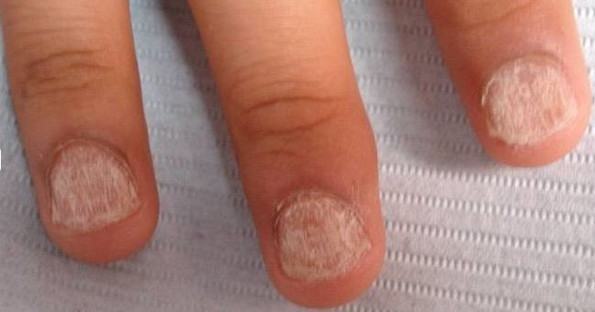
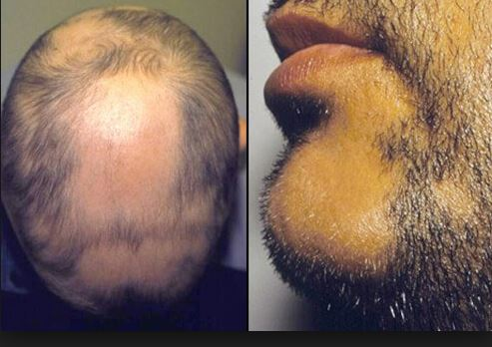
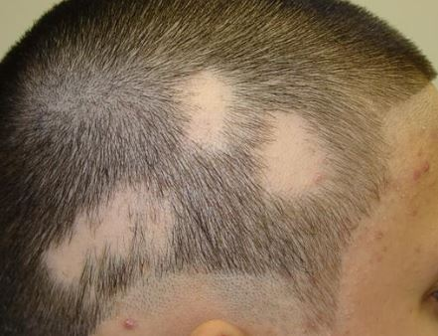
ALOPECIA AREATA

Slide 31
ALOPECIA AREATA
Immune mediated non scarring disease targeting anagen follicle.
Peak incidence 15-29.
Typically present as one of 5 major patterns:
Round or oval patches .
Loss of all scalp hair (alopecia totalis).
Loss of all body hair (alopecia universalis).
Ophiasis/ sisaipho.
Diffuse pattern AA.
Spontaneous resolution occurs in most patients.
Familial incidence is seen in 10-50%.

Slide 32
ETIOPATHOGENESIS
Trauma | Neurogenic inflammation | Infectious agents
Release of cytokines
Aberrant expression of adhesion molecules
Haematopoietic cell migration (T-cell)
Follicular damage in anagen and rapid premature transformation to telogen

Slide 33
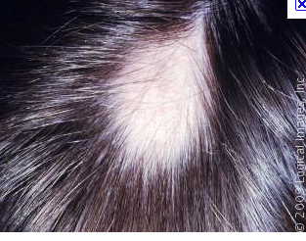
ALOPECIA AREATA
Round or oval patches.

Slide 34
ALOPECIA AREATA
Loss of all scalp hair (alopecia totalis).

Slide 35
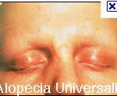
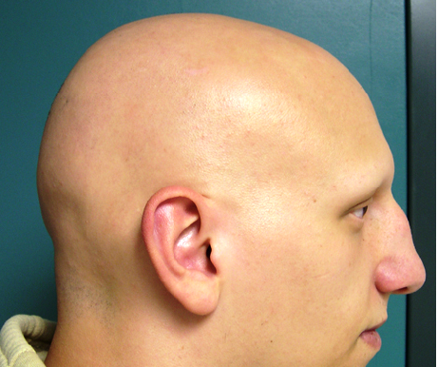
ALOPECIA AREATA
Loss of all body hair (alopecia universalis ).

Slide 36
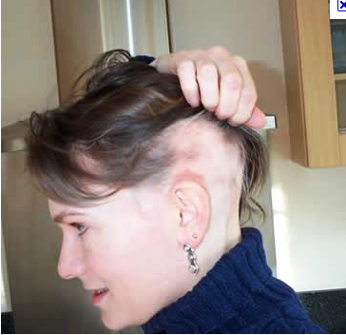
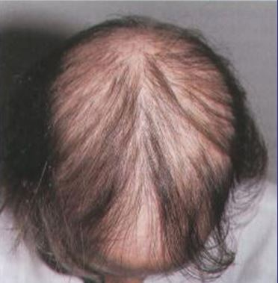
ALOPECIA AREATA
Ophiasis (loss of the occipital hair).
Sisaipho( scalp hair loss sparing the temporal and occipital areas, just the opposite than ophiasis).
Diffuse pattern alopecia areata.

Slide 37
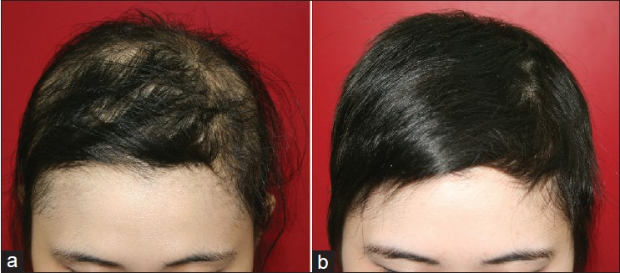
ALOPECIA AREATA
Diffuse pattern alopecia areata:
Affects women mostly
Hair shedding after psychological stress or systemic illness.
Nail changes are uncommon.
Abrupt and intense hair loss, no patches.

Slide 38
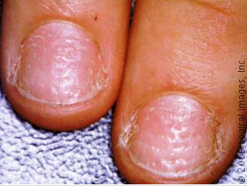
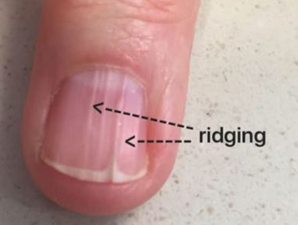
ALOPECIA AREATA
Nail abnormality include :
Nail pitting (most common).
Koilonychia.
Longitudinal ridging.

Slide 39
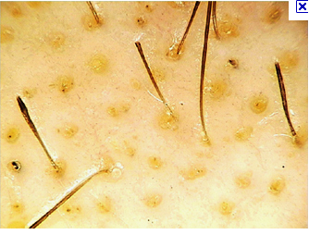
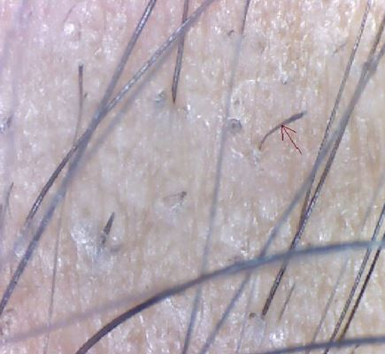
ALOPECIA AREATA
When alopecia areata is active hair pull test is positive and exclamation mark !!! hair is found.
Trichoscopy: Exclamation mark hair have broader distal segment than the proximal part (tapered hair).

Slide 40
ALOPECIA AREATA
ASSOCIATED DISEASES:
Atopy (allergic rhinitis, asthma, atopic dermatitis).
Autoimmune disease –Thyroiditis and Vitiligo.
Down syndrome.
Psychiatric diseases.

Slide 41
ALOPECIA AREATA
Bad prognostic factors:
The age of onset (the earlier the worse).
Positive family history of alopecia.
Extensive involvement.
Prolong duration >5 years.
Ophiasis.

Slide 42
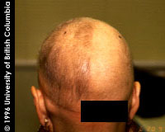
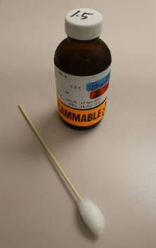
ALOPECIA AREATA
Treatment:
Topical sensitizers like diphenycyprone.
Weekly application to induce mild eczematous reaction and retro-auricular lymph-adenopathy.
Steroids: Topical, intra-lesional, oral ±methotrexate.

Slide 43
ALOPECIA AREATA
Minoxidil 2-5%.
Anthralin at concentrations ranging from 0.2-1% short contact of half hour and increased gradually to overnight.
NBUVB
3 times per week.
Increased risk of melanoma with more than 250 treatments.

Slide 44
ANDROGENETIC ALOPECIA
It is a form of hair loss in which there is decline in hair production that leads to balding.
There is gradual reduction of the anagen duration.
Affects both sexes.
Male androgenetic alopecia is dominantly determind.
The same is true in females, and also as a manifestation of androgen excess.
The pattern of hair loss is different in both sexes .

Slide 45
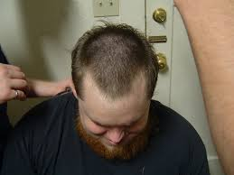
CLINICAL PICTURE
Male pattern androgenetic alopecia:
Can start after puberty.
Has 2 coponents:
Frontotemporal ressecion(M shaped)
Hair loss over vertex.
Hairs become short.
Total loss of hair except the occipital region.

Slide 46
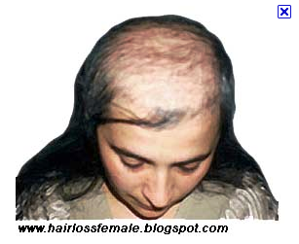
CLINICAL PICTURE
Female patterned hair loss:
Start after puberty.
Gradual hair thinning over several years .
Sometimes there is history of increased hair shedding.
Widening of the parting width .
Reduction of hair density over frontal scalp and crown.
Frontal hair line is preserved.

Slide 47
TRICHOSCOPY

Slide 48
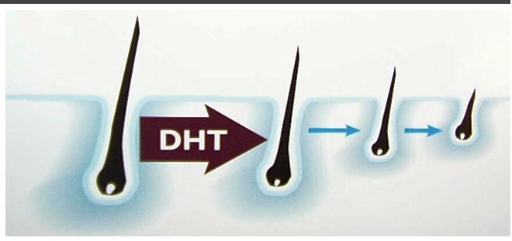
ANDROGENETIC ALOPECIA
Etiology
There is progressive miniaturization and eventual deletion of hair follicle.
Testosterone is converted to dihydro-testosterone by the enzyme 5 alpha reductase (5AR) causing miniaturization.
T
5αR

Slide 49
ANDROGENETIC ALOPECIA
Etiology
5 αR has 2 isoforms (1&2).
Type 1 is widely distributed over skin.
Type 2 is limited to androgen target tissues like prostate, epididymis, and hair follicles in certain regions of skin
Female patterned alopecia might be associated with poly cystic ovary, acne, hirsutism.

Slide 50
DIFFERENTIAL DIAGNOSIS
Diffuse alopecia areata.
Look for hair loss involving other sites and nail changes.
Chronic telogen effluvium.
Ask about causes of telogen effluvium.

Slide 51
TREATMENT
MEN:
Minoxidil 2% or 5%, twice daily.
Side effects: Scalp irritation, hypertrichosis on the face and other remote sites.
Finastride is an inhibitor of type 2 (5αR)
It decrease the level of DHT in serum and scalp up to 70%.
25% reduction in the incidence of prostate cancer .
In females a risk of abnormal genitalia in male fetus.

Slide 52
TREATMENT
Surgery (hair transplant).
Women:
Minoxidil 2% and 5% (unlicensed).
Antiandrogens such as:
Cyproterone acetate: Blocks androgen receptors and also has Progestational activity, so it has to be combined with contraceptive pills in a cyclical regimen, causes Weight gain, Fatigue, Mastodynia and Reduced libido.

Slide 53
TREATMENT
Spironolactone :Blocks androgen receptors and increase the clearance of testosterone,causes Breast sorness, Menstrual irrigularity, but the safest.
Flutamide androgen receptor blocker, ineffective in post menopausal women, and is Hepatotoxic.

Slide 54
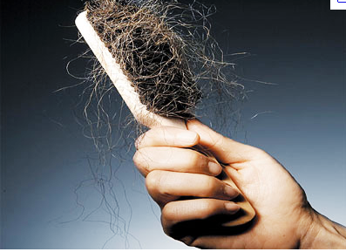
TELOGEN EFFLUVIUM
The most common hair loss.
Patient complain of hair shedding and associated alopecia.
Results from premature conversion of Anagen into Telogen.
TE is a medical sign induced by many triggers.

Slide 55
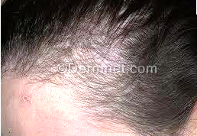
CLINICAL PICTURE
Telogen effluvium has 3 different senarios:
Acute (< 6 months).
Chronic (> 6 months).
Chronic repetitive.
In chronic TE (CTE) the anagen cycle shortens and the hair fiber becomes thinner and shorter.

Slide 56
CLINICAL PICTURE
Hair shedding starts 2 weeks after the trigger and peaks between 6-8w, and tapers in about 6-8 w.
Pull test is positive IF patient uses no shampoo or comb.
Follicular regeneration is common within 4-6 months.

Slide 57
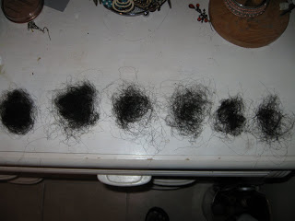
CLINICAL PICTURE
Daily collection of shed hairs for 2 weeks may confirm the diagnoses if more than 100 hairs are collected with club ends.
Trichogram will show that anagen:telogen ratio is 70:30 instead of 90:10.

Slide 58
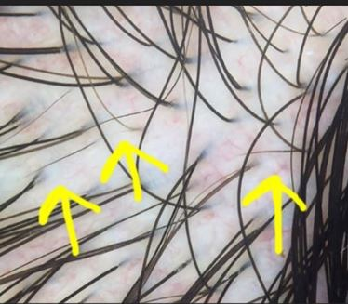
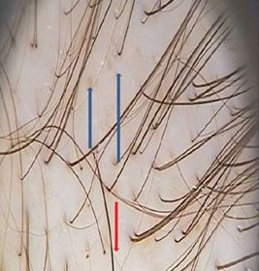
TRICHOSCOPY
AGA, Miniaturized hairs
CT
CTE showing Empty hair follicles, minimal Miniaturized hairs

Slide 59
DIFFERENTIAL DIAGNOSIS
Androgenetic alopecia (pattern, pull test shows club end telogen hair , miniaturized and less than 3 cm length).
Diffuse alopecia areata (exclamation hair).

Slide 60
TRIGGERING FACTORS
Stress.
Nutritional deficiencies (iron, VIT D).
Endocrine disorders(thyroid disease).
Crash diet.
Surgery.
Drugs (Heparin, Retinoid, Propranalol, Captopril) .
Fever.
Child birth.

Slide 61
TREATMENT
Identify the triggering factor and treat it.
Minoxidil topically 2%.
Biotin 3-5mg daily.
L- cystine supplement.
Iron and vitamin D supplement.

Slide 62
ANAGEN EFFLUVIUM
Results from severe insult to the dermal papilla producing 80% hair loss .
Cytotoxic drugs causing anagen effluvium:
Doxorubicin (Adriamycin),
Cyclophosphamide
Paclitaxel (Taxol)
Etoposide.
No treatment is available.

Slide 63
TRICHOTELLOMANIA
Persistent and excessive pulling of one’s own hair, resulting in noticeable hair loss.
7 times as prevalent in children as in adults.
Peak prevalence between the ages of 4 and 17 years.
The scalp is the most common area of hair pulling, followed by the eyebrows, eyelashes.
Can be associated with nail biting and skin picking.
Trichophagia (ingesting hair) is common in persons who pull out their hair.

Slide 64
TRICHOTELLOMANIA
In very young children, the prognosis is excellent, In adult patients, the prognosis is poor.
Friar Tuck sign - This common presentation consists of areas of hair loss with broken hairs of varying lengths arranged in a circular pattern, with unaffected hairs surrounding the area of hair loss.

Slide 65
TRICHOSCOPY
Bleeding , different hair length, black dots

Slide 66
TRICHOTELLOMANIA
Trichobezoars (ingestion of hair) result in intestinal obstruction, MRI and US required for diagnosis.
The first line of treatment for trichotillomania is behavioral treatment and intervention.
A psychiatrist should be consulted.
Drug therapy includes SSRI like fluoxetine.

Slide 67
Traction alopecia
Traction alopecia is caused by persistent, pulling forces on the hair follicles from traction-inducing hairstyles.
it is non scaring in early stages and scarring in late stages.
Traction alopecia typically affects the frontotemporal margins of the scalp.
Fringe sign: short terminal hairs bordering areas of marginal hair loss

Slide 68
Traction alopecia
Dermoscopy shows peripilar whitish hair casts.
Treatment includes changing hair style and 2% minoxidil.
No hair relaxers.

Slide 69
HAIR TIPS
Clarifying shampoos, are typically used to remove retained styling products, such as hair spray, gel, and mousse.
Styling products build up on the hair shaft after seven days use and leave the hair feeling harsh and appearing dull.
Everyday shampoos and dry hair shampoos are not good at removing the polymer film.
Once weekly use of clarifying shampoo removes the polymer.

Slide 70
SCARRING ALOPECIA
Hair follicles are destroyed and replaced by scar tissue and permanent hair loss.
The diagnostic hallmark of all scaring alopecia is visible loss of follicular ostia.
Another characteristic finding is positive pull test with anagen hairs.
May be acute or chronic.
May be associated with itching, pain, redness , drainage .

Slide 71
SCARRING ALOPECIA
Compound follicles are also seen.
Sebaceous gland may be central to the pathogenesis of scaring alopecia.
Sebaceous gland involvement is noted in lichen planopilaris and dissecting cellulitis in follicular occlusion triad.

Slide 72
SCARRING ALOPECIA
Discoid lupus
Onset typically between 20 and 40 years.
The inflammation is in the center of the lesion not as other causes of scaring alopecia where inflammation is in the periphery.
Presents with scaly erythematus plaques, follicular plugs, pigmentation and scarring alopecia

Slide 73
SCARRING ALOPECIA
Discoid lupus
Trichoscopy shows the presence of erythema , scales , pigmentary changes and follicular plugs.
Look for signs of systemic lupus.

Slide 74
SCARRING ALOPECIA
This condition is treated by corticosteroids topically or by intralesional injection.
Antimalarials .

Slide 75
SCARRING ALOPECIA
Lichen planopilaris
Seen in middle aged women.
There is itching , pain and burning.
Trichoscopy shows characteristic perifollicular erythema and perifollicular scales at the margin of the lesion.
50% of patients lack evidence of lichen planus at other sites.
Treated by antimalarials, dapsone, retinoids.

Slide 76
SCARING ALOPECIA
Dissecting cellulitis of scalp
It occurs predominantly in black males, in their second to fourth decade of life.
The condition also has been reported in other races and in women.
Clinically, patients develop perifollicular pustules, nodules, and abscesses, with interconnecting sinus tracts that drain pus or blood.
Usually runs a chronic course.

Slide 77
SCARING ALOPECIA
Dissecting cellulitis of scalp
The disease is thought to result from occlusion of the pilosebaceous unit.
Acne conglobata, hidradenitis suppurativa, and pilonidal cysts are frequent concomitant diseases.
Oral isotretinoin is the treatment of choice.
Intralesional corticosteroids (eg, triamcinolone acetonide).
Antibiotics such as doxycycline, ciprofloxacin, rifampicin, and dapsone.
Biologic agents such as adalimumab and infliximab

Slide 78
VITILIGO
Vitiligo is an acquired pigmentary disorder of the skin and mucous membranes, and it is characterized by circumscribed depigmented macules and patches secondary to absence of functional melanocytes in vitiligo skin

Slide 79
VITILIGO
Vitiligo affects 0.5-2% of the world population.
Multifactorial polygenic disorder with a complex pathogenesis.

Slide 80
VITILIGO
Theories regarding destruction of melanocytes include:
Autoimmune mechanisms.
Cytotoxic mechanisms .
An intrinsic defect of melanocytes.
Oxidant-antioxidant mechanisms.
Neural mechanisms.

Slide 81
VITILIGO
Autoimmune mechanisms:
Humoral and cellular immunity is involved in the destruction of melanocytes .
Associated autoimmune diseases include:
Thyroid disorders, particularly Hashimoto thyroiditis and Graves disease
Other Endocrinopathies, such as Addison disease and Diabetes Mellitus.
Alopecia Areata; Pernicious anemia; Inflammatory bowel disease; Psoriasis.
Autoimmune Polyglandular syndrome.

Slide 82
VITILIGO
An intrinsic defect of melanocytes:
Abnormal rough endoplasmic reticulum.
Oxidant-antioxidant mechanisms:
Accumulation of free radicals toxic to melanocytes leads to their destruction.
Neural mechanisms:
Patients with nerve injuries have hypopigmentation or depigmentation in denervated areas.
Segmental vitiligo occurs in a dermatomal pattern.

Slide 83
CLINICAL PICTURE
30% occur with a familial clustering of cases.
The onset is in persons aged 10-30 years.
Manifests as acquired white or hypopigmented macules or patches.
Usually well demarcated, round, oval, or linear in shape.
Koebner phenomenon is the development of vitiligo in trauma sites, such as a cut, burn, or abrasion.

Slide 84
CLINICAL PICTURE
The most common sites of occurrence are areas subjected to trauma, including the following:
Bony prominences.
Extensor forearm.
Ventral wrists.
Dorsal hands.
Digital phalanges.
Vitiligo occurs around body orifices such as the lips, genitals, gingiva, areolas, and nipples.
Woods light shows milky white depigmentation.

Slide 85
CLINICAL PICTURE
Body hair depigmentation is (leukotrichia).
Leukotrichia may indicate a poor prognosis in regards to repigmentation.
Spontaneous repigmentation of hair does not occur.
Trichrome vitiligo has an intermediate zone of hypochromia located between achromic center and peripheral unaffected skin. 3 shades of color—brown, tan, and white.

Slide 86
CLASSIFICATION
Vitiligo is classified based on the distribution into localized, generalized, and universal types
Localized vitiligo:
Focal: This type is characterized by one or more macules in one area, most commonly in the distribution of the trigeminal nerve.

Slide 87
CLASSIFICATION
Segmental: Manifests as one or more macules in a dermatomal pattern.
It occurs most commonly in children.
More than half the patients with segmental vitiligo have poliosis (white hair).
Is not associated with thyroid or other autoimmune disorders.
Mucosal: Mucous membranes alone are affected.
poliosis

Slide 88
CLASSIFICATION
Generalized vitiligo:
Acrofacial: Depigmentation occurs on the distal fingers and periorificial areas.
Vulgaris: This is characterized by scattered patches that are widely distributed.
Mixed: Acrofacial and vulgaris vitiligo occur in combination, or segmental and acrofacial

Slide 89
CLASSIFICATION
Universal vitiligo:
Complete or nearly complete depigmentation.
Often associated with multiple endocrinopathy syndrome.

Slide 90
EXTRACUTANEOUS MANIFESTATION
Choroidal abnormalities in up to 30% of patients.
Iritis reported in 5% of patients.
Uveitis is the most significant ocular abnormality.
The most severe form of uveitis is seen in the Vogt-Koyanagi-Harada syndrome.
This syndrome is characterized by:
Vitiligo.
Uveitis.
Aseptic meningitis.
Dysacusis.
Tinnitus.
Poliosis.
Alopecia.

Slide 91
DIFFERENTIAL DIAGNOSIS
Pityriasis Alba.
Chemical leukoderma.
Postinflammatory depigmentation.
Halo Nevus.
Prior treatment with corticosteroids.
Idiopathic Guttate Hypomelanosis.
Leprosy.
Tinea Versicolor.
Nevus Anemicus.
Vogt-Koyanagi-Harada Syndrome.

Slide 92
INVESTIGATIONS
Thyrotropin (TSH) testing for thyroid disease.
Antinuclear antibody screening.
CBC count with indices helps rule out anemia.
Serum antithyroglobulin and antithyroid peroxidase antibodies.
Antithyroid peroxidase antibodies are sensitive and specific marker of autoimmune thyroid antibodies.
Fasting blood glucose or glycosylated hemoglobin testing (HbA1c).

Slide 93
TREATMENT
Pigmentation arise from the following 3 sources:
The pilosebaceous unit.
Spared epidermal melanocytes not affected during depigmentation.
The border of lesions, migrating up to 2-4 mm from the edge.
Repigmentation occurs in a perifollicular pattern.

Slide 94
TREATMENT
Narrow-band UV-B phototherapy (311nm)
Frequency is 2-3 times weekly, never on consecutive days.
Safely used in children, pregnant women, and lactating women.
Short-term adverse effects include pruritus and xerosis.

Slide 95
TREATMENT
Psoralen photochemotherapy (PUVA):
Treatment with 8-methoxypsoralen+ UV-A (PUVA) patients who have widespread vitiligo.
Psoralens can be applied either topically or orally, followed 2 hours by exposure to artificial UV light or natural sunlight.
2-3 treatments per week for many months.
The total number of PUVA treatments required is 50-300.

Slide 96
TREATMENT
The advantages of narrow-band UV-B over PUVA include:
Shorter treatment times.
No drug costs.
No adverse GI effects (eg, nausea).
No need for subsequent photoprotection.

Slide 97
TREATMENT
Excimer laser:
Produces monochromatic rays at 308 nm to treat limited, stable patches.
It is an efficacious, safe, and well-tolerated for vitiligo limited to less than 30% of the body surface.
Expensive.
Treated twice weekly for an average of 24-48 sessions.

Slide 98
TREATMENT
Biologic therapy (JAK inhibitors):
Tofacitinib + light.
Topical therapy:
Topical Steroid preparation to treat localized vitiligo
Topical Tacrolimus ointment (0.03% or 0.1%) is an effective alternative therapy particularly when the disease involves the head and neck.
Combination treatment with topical Tacrolimus 0.1% plus the 308-nm Excimer laser.
Vitamin D analogs, particularly Calcipotriol and Tacalcitol.

Slide 99
TREATMENT
Depigmentation:
IF vitiligo is widespread depigmentation may be attempted (more than 40% of surface area).
A 20% cream of monobenzylether of hydroquinone is applied twice daily for 3-12 months.
Burning or itching may occur.
Allergic contact dermatitis may be seen.
Surgery:
In cases that are stable suggested by:
No progression of lesions for at least 2 years
Spontaneous repigmentation indicates vitiligo inactivity.
Unilateral vitiligo most stable form of vitiligo.

Slide 100
Segmental vitiligo/vogt koyanagi

Slide 101
acral vitiligo /perifollicular pigmentation

Slide 102
Vitiligo universalis/symmetrical vitiligo

Slide 103
Pityriasis alba/idiopathic guttate hypomelanosis

Slide 104
Leprosy /Halo nevus

Slide 105
Chemical leukoderma/post inflammatory Hypopigmentation

Slide 106
Nevus anemicus/ T. versicolor

Slide 107
MELASMA
Melasma is an acquired hypermelanosis of sun-exposed areas.
Presents symmetrically as hyperpigmented macules, Areas that receive excessive sun exposure, including the cheeks, the upper lip, the chin, and the forehead, are the most common locations.
Genetic predisposition (48% reported a positive family history)

Slide 108
PATHOPHYSIOLOGY
Female hormonal activity evidenced by:
Melasma occurs more frequently in females than in males
Develops or worsens during pregnancy (half of melasma cases)
Use of oral contraceptive pills.
Estrogen receptors over expresion.
Exposure to sunlight. Ultraviolet (UV) radiation resulting in increased plasminogen activator , α-melanocyte–stimulating hormone arachidonic acid and corticotropin, contributing to increased melanin production
Photosensitizing medications(antiseizure)
Cosmetics.

Slide 109
CLINICAL PRESENTATION
Tan to brown macular hyperpigmentation
Blue or black may be evident in patients with dermal melasma.
The distribution is one of three patterns. Centrofacial involves the forehead, cheeks, nose, upper lip, and chin.
Malar involves solely the nose and the cheeks.
Mandibular affects the ramus of the mandible.
.
Woods light examination showed accentuation of the pigmentation implying epidermal rather than dermal type of pigmentation.

Slide 110
ochronosis

Slide 111
Associated diseases
A four-fold increase in thyroid disease
An association between the development of melasma and the presence of melanocytic nevi

Slide 112
TREATMENT
Avoidance of sun exposure and use of high-SPF sunscreens (50+)
Topical depigmenting agents like:
Hydroxyquinone (HQ) 2-4% cream first-line agent, both alone or combined with other agents
HQ is a hydroxyphenolic chemical that inhibits tyrosinase
Side effects of hydroquinone :
skin irritation.
Phototoxic reactions with secondary postinflammatory hyperpigmentation
Irreversible exogenous ochronosis
Combination treatment including hydroquinon, retinoic acid. steroid and Vit.C
Azelaic acid,
Other depigmenting agents are, kojic acid, and ascorbic acid.

Slide 113
TREATMENT
Oral proanthocyanidin (flavonoide)
Tranexamic acid tablets (antifibrinolytic) at a dosage of 250 mg twice daily for 6 months.
Chemical peels, lasers) yield unpredictable results and are associated with a number of potential adverse effects:
Epidermal necrosis.
Hypertrophic scars.
Postinflammatory hyperpigmentation.

Slide 114
FRECKLES
Multiple, tanned macules, ranging from 1-5 mm in diameter, with uniform pigmentation.
Associated with fair skin and red or blonde hair.
Benign, but may be seen in association with systemic disease such as :
Xeroderma pigmentosum XP ( autosomal recessive disease),
Neurofibromatosis:Freckles can be found in the folded regions (autosomal dominant ).
In contrast to solar lentigines, freckles are not strongly associated with age.
Neurofibromatosis
XP
solar lentigines

Slide 115
FRECKLES
Most commonly found on sun-exposed areas, such as the nose, cheeks, shoulders, and upper part of the back.
The macules may be discrete or confluent.
Sunscreens may be used to prevent enhancement of the freckling caused by sun exposure.
Chemical peels, cryotherapy, and laser.
Q-switched alexandrite laser and intense pulsed light.

