Slide 1
Psoriasis and Papulosquamous diseases
By:
Dr. Eman Almukhadeb
Consultant Dermatologist , Assistant professor

Slide 2
Objectives
- Understand the pathogenesis of papulosquamous diseases
- Recognize the clinical features of papulosquamous diseases
- To know the outlines of management of papulosquamous diseases

Slide 3
Papulosquamous
The term squamous refers to scaling that represents thick stratum corneum and thus implies an abnormal keratinization process

Slide 4
Papulosquamous Diseases
- Psoriasis
- Pityriasis rosea
- Lichen planus
- Pityriasis rubra pilaris
- Miscellaneous : Secondary syphilis, mycosis fungoides, discoid lupus erythematosus, ichthyoses

Slide 5
Psoriasis
- Psoriasis is a common, chronic, non-infectious inflammatory skin disease.
- It affects the skin , nails and joints
- It causes rapid skin cell reproduction resulting in red, dry patches of thickened skin

Slide 6
Psoriasis
- 1-3% (under-estimated)
- F=M
- Any age (two peak of onset)
- Race:-any race; higher prevalence in western European and Scandinavian populations

Slide 7
Psoriasis
-Epidermal cell kinetics : -The growth fraction of basal cells is increased to almost 100% compared with 30% in normal skin -The epidermal turnover time is shortened to less than 10 days compared with 30 to 60 days in normal skin

Slide 8
Pathogenesis
Multifactorial includes :
1- Genetic factor:-
There are two types:-
type I psoriasis: more likely to be familial, have a early clinical course and is associated with HLA-Cw6
Late onset, or type II psoriasis: ages 50 to 60 and lack the expression of HLA-CW6

Slide 9
Pathogenesis
2-Environmental factors:-
- Infection (streptococcal infection)
- Physical agents (eg, stress, alcoholism, smoking)
Koebner phenomenon
Hypocalcemia
- Drugs (lithium, anti-malarials , NSAID , beta-blockers)

Slide 10
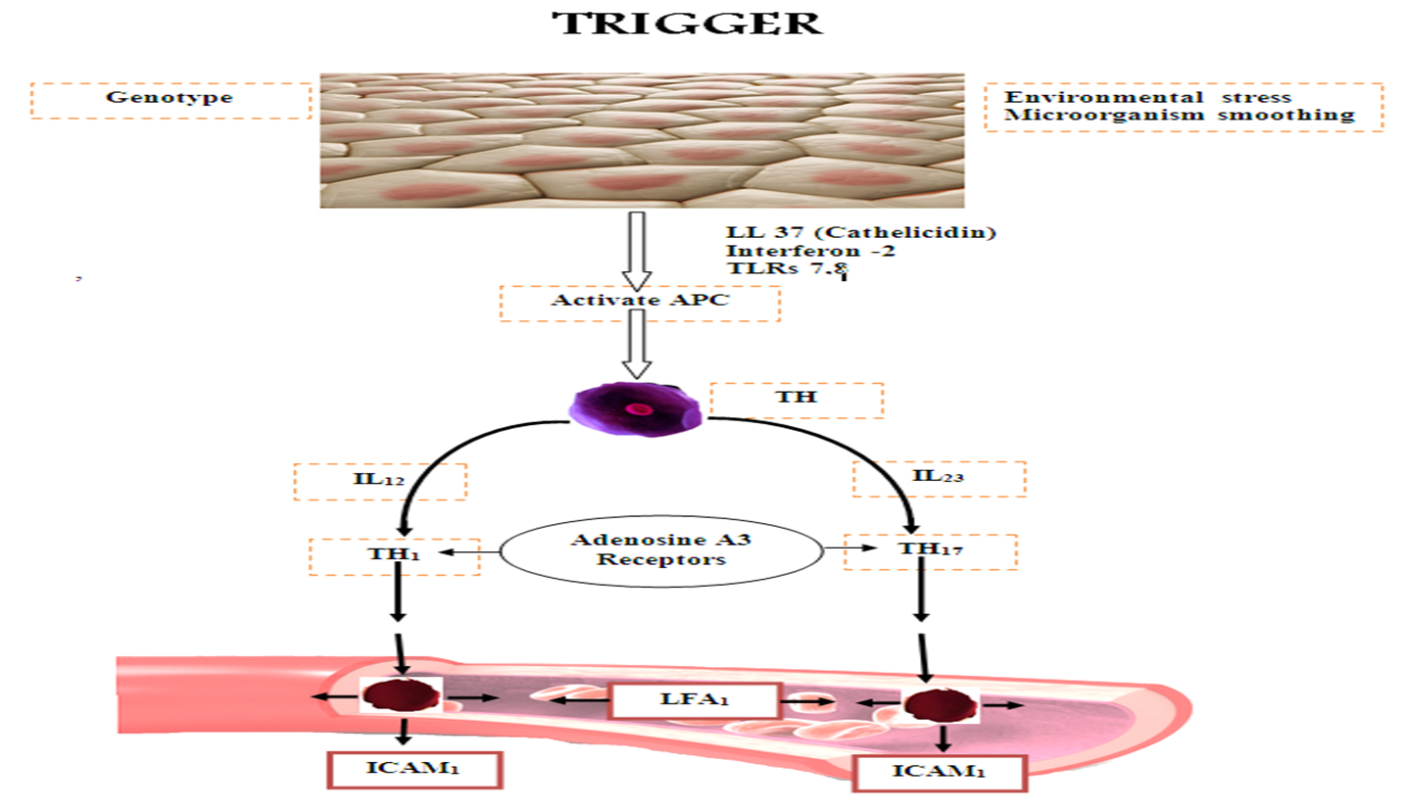
Pathogenesis
3- Immunopathogenesis

Slide 11
Psoriasis
There are many clinical types of psoriasis:-
1-Plaque :- Most common form of the disease
2-Guttate :- Appears as small red spots on the skin
3-Inverse :- Occurs in skin folds
4-Pustular :- sterile small pustules, surrounded by red skin
5-Erythrodermic:- Intense redness over large areas
6-Psoriatic arthritis

Slide 12
Psoriasis
Psoriasis can occur on any part of the body:-
- Scalp psoriasis
- Genital psoriasis
- Around eyes, ears, mouth and nose
- On the hands and feet
- Psoriasis of the nails

Slide 13
Plaque Psoriasis ( Psoriasis vulgaris )
- the most common
- characterized by round-to-oval scaly erythematous plaques and distributed over extensor body surfaces and the scalp
- Up to 10-20% of patients with plaque psoriasis may evolve into more severe disease, such as pustular or erythrodermic psoriasis

Slide 16
Guttate Psoriasis
- Small, droplike, 1-10 mm in diameter, salmon-pink papules, usually with a fine scale
- Younger than 30 years
- Upper respiratory infection secondary to group A beta hemolytic streptococci
- On the trunk and the proximal extremities
- Resolution within few months

Slide 17
Guttate Psoriasis

Slide 18
ERYTHRODERMIC PSORIASIS
- Scaly erythematous lesions, involving 90% or more of the cutaneous surface
- Few typical psoriatic plaques
- Unwell, fever, leucocytosis
- Hypothermia
- Increase cutaneous blood flow
- Increase percutaneous loss of water, protein and iron

Slide 19
Pustular Psoriasis
- uncommon form of psoriasis
- pustules on an erythematous background
- psoriasis vulgaris may be present before, during, or after
- pustular psoriasis may be classified into several types:
1-generalized type(von Zumbusch variant):
- generalized erythema studded with interfollicular pustules
- fever, tachypneic , tachycardic
2-Localized form (palms and soles)

Slide 20
Pustular Psoriasis

Slide 21
Pustular Psoriasis

Slide 22
Pustular Psoriasis
Causes :
Withdrawal of systemic steroids
Drugs, including salicylates, lithium, phenylbutazone,, hydroxychloroquine, interferon
Strong, irritating topicals, including tar, anthralin, steroids under occlusion, and zinc pyrithione in shampoo
Infections
Sunlight or phototherapy
Cholestatic jaundice
Hypocalcemia
Idiopathic in many patients

Slide 23
Inverse psoriasis
- Over body folds
- The erythema and scales are very similar to that seen in seborrhoeic dermatitis

Slide 24
Psoriatic Arthritis
-5% of patients with psoriasis develop psoriatic arthritis
-Most commonly a seronegative oligoarthritis
-Asymmetric oligoarthritis occurs in as many as 70% of patients with psoriatic arthritis
-DIP joint involvement occurs in approximately 5-10 of patients with psoriatic arthritis
-Arthritis mutilans is a rare form of psoriatic arthritis occurring in 5% of patients with psoriatic arthritis

Slide 26
Nail Psoriasis
-Psoriatic nail disease occurs in 10-55% of all patients with psoriasis
Less than 5% of psoriatic nail disease cases occur in patients without other cutaneous findings
The following nail changes may be seen:
Oil drop or salmon patch
Nail plate Pitting
Subungual hyperkeratosis
Onycholysis
- Beaus lines

Slide 29
Histology
-parakeratosis (nuclei retained in the horny layer) -irregular thickening of the epidermis over the rete ridges but thinning over dermal papillae -epidermal polymorphonuclear leucocyte infiltrates (munro microabscesses) -dilated capillary loops in the dermal papillae -T-lymphocytes infiltrate in the upper dermis

Slide 31
Treatment

Slide 32
Phototherapy

Slide 33
Psoriasis

Slide 34
Methotrexate

Slide 35
Acitretin (Oral retinoids)

Slide 36
Cyclosporine

Slide 37
Biologics

Slide 38
Lichen Planus ( LP)
Lichen planus is a disease with altered cell-mediated immune response of unknown origin.
-Drugs , Metals (gold or Mercury) or infections like hepatitis C virus , can alter cell mediated immunity, therefore are possible inducers of LP in genetically susceptible people.

Slide 39
LP
Epidemiology:-
-Approximately 1% of all new patients derma clinic.
-Rare in children
-F=M
-No racial predispositions.
-LP can occur at any age but two thirds of patients are aged 30-60 years

Slide 40
LP
Pathophysiology:-
- The cause of LP is unknown
- LP may be a cell-mediated immune response
- LP may be associated with: ulcerative colitis, alopecia areata, vitiligo, dermatomyositis
- An association is noted between LP and hepatitis C virus infection ,chronic active hepatitis, and primary biliary cirrhosis
- Familial cases
- Drug may induce lichenoid reaction like: thiazide,antimalarials,propranolol

Slide 41
Lichen planus
Clinical features :
-Shiny flat topped violaceous papules ,with white lines (Wickham’s striae).
-Polygonal or oval ,grouped or scattered, linear or annular.
-Sites of Predilection: flexor surfaces of the upper extremities, on the genitalia, and on the mucous membranes.

Slide 42
LP

Slide 45
Clinical types of LP
Actinic LP.
Annular LP.
Bullous LP.
Eruptive LP.
Hypertrophic LP.
Palmoplantar LP.
Inverse LP.
Lichen Planus Pigmentosus.
Lichenplanopilaris (scarring alopecia of scalp).
Ulcerative LP.
Oral LP (Erosive or reticular).
Nail involvement ( pterygium formation).

Slide 46
LP
1-Hypertrophic LP:-
These extremely pruritic lesions are most often found on the extensor surfaces of the lower extremities, especially around the ankles
2-Atrophic LP:-
-is characterized by a few lesions, which are often the resolution of annular or hypertrophic lesions
3-Erosive LP
4-Follicular LP:-
-keratotic papules that may coalesce into plaques
-A scarring alopecia may result

Slide 47
LP
5-Annular LP:-
-Annular lesions with an atrophic center can be found on the buccal mucosa and the male genitalia
6-Vesicular and bullous LP
-develop on the lower limbs or in the mouth from preexisting LP lesions
7-Actinic LP:-
-Africa, the Middle East, and India
-mildly pruritic eruption
-characterized by nummular patches with a hypopigmented zone surrounding a hyperpigmented center
8-LP pigmentosus :
-common in persons with darker-pigmented skin
-usually appears on face and neck

Slide 48
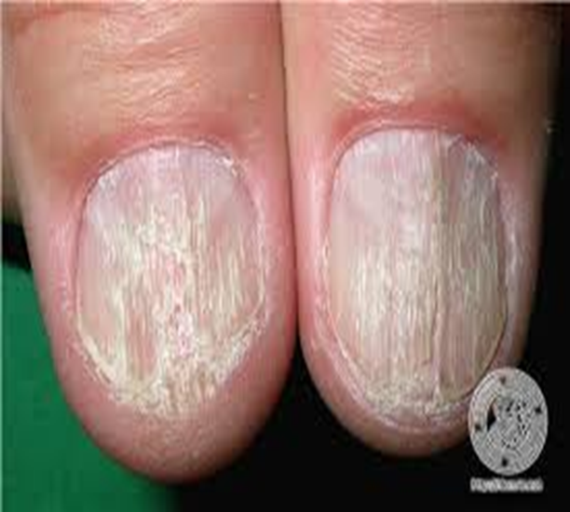
Nail LP
- In 10% of patients
-nail plate thinning causes longitudinal grooving and ridging
-subungual hyperkeratosis,
-onycholysis
-Rarely, the matrix can be permanently destroyed with prominent pterygium formation
-twenty-nail dystrophy

Slide 49
Oral LP

Slide 50
Hair LP (lichen planopilaris )

Slide 51
Actinic LP

Slide 52
Histopathology

Slide 53
Treatment
- Self-limited disease that usually resolves within 8-12 months
Topical steroids, particularly class I or II ointments
Topical Tacrolimus.
Intralesional steroids(hypertrophic/Nail or hair involvement)
- Systemic steroids for symptom control and possibly more rapid resolution
- Oral acitretin
- Phototherapy
- Other: Cyclosporine, Mycophenolate mofetil

Slide 54
Pityriasis Rosea (PR)
-Acute mild self-limited inflammatory exanthema
Epidemiology:-
-In children and young adult
-Increased incidence in spring and autumn
-PR is more common in women than in men (2:1)

Slide 55
PR
Pathophysiology:-
-Immunologic data suggest a viral etiology
- Families and close contacts
-A single outbreak tends to elicit lifelong immunity
-Human herpesvirus (HHV)–7and HHV-6 , ? HHV8 ,? H1N1

Slide 56
PR
Clinical features :
- Approximately 5% of patients may experience a mild prodrome with headache, fever, arthralgias, or general malaise
Begins with a solitary macule that heralds the eruption(herald spot/patch )
Usually a salmon-colored macule
Over a few days it become a patch with a collarette of fine scale just inside the well-demarcated border , within the next 1-2 weeks, a generalized exanthem usually appears
- Bilateral and symmetric macules with a collarette scale oriented with their long axes along cleavage lines
Tends to resolve over 6 weeks
Pruritus is common, usually of mild-to-moderate severity
Over trunk and proximal limbs

Slide 57
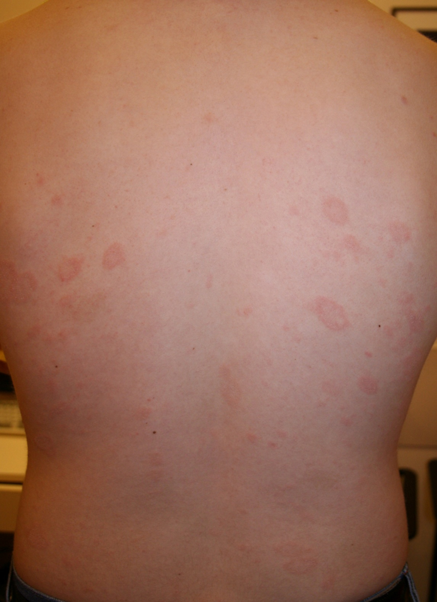

Slide 58
PR
Atypical form of PR:-
Occurs in 20% of patients
Inverse PR
Unilateral variant
Papular PR
Erythema multiforme–like
Purpuric PR

Slide 59
PR
- No treatment is needed with mild disease.
Gentle bathing, mild lubricants
Topical steroids
Antihistamines, taken by mouth, may be used to reduce itching
- Ultraviolet light treatment

Slide 60
Pityriasis rubra pilaris (PRP)
- A disease with unknown etiology.
- Has a familial form and an acquired form
- Classified by “GRIFFITH” into 6 Subtypes:
Type I : Classic adult PRP (most common )
Type II : Atypical adult PRP
Type III : Classic juvenile PRP
Type IV : circumscribed juvenile PRP
Type V : atypical juvenile PRP
Type VI : HIV associated PRP

Slide 61
PRP
Clinical features :
- Orange-red or salmon-colored scaly plaques.
- Characteristic feature is presence of islands of sparing(unaffected skin within the plaques).
- Follicular hyperkeratosis on dorsal aspects of proximal phalanges, elbows and wrists.
- Palmoplantar keratoderma occurs in most patients and tends to have an orange hue.

Slide 62
PRP

Slide 63
PRP

Slide 65
PRP
- Nail changes: distal yellow-brown discoloration, subungual hyperkeratosis, longitudinal ridging, nail plate thickening, and splinter hemorrhages
- Mucous membranes: Patients may complain of pain and irritation in the mouth

Slide 66
PRP
Treatment :
The classic types (adult and juvenile) typically resolve within 3–5
years
Topical steroids
Vit D analogue.
Topical retinoids.
Phototherapy (NBUVB).
Oral retinoids.
Methotrexate.

