Slide 1
ATOPIC DERMATITIS AND ECZEMATOUS DISORDERS
Dr. Hend Alotaibi Assistant professor & Consultant College of Medicine, King Saud University Dermatology Department /KKUH
Email: halotaibi1@ksu.edu.sa
To know the definition & classification of Dermatitis/Eczema
To recognize the primary presentation of different types of eczema
To understand the possible pathogenesis of each type of eczema
To know the scheme of managements lines

Slide 2
Eczema - dermatitis
Inflammation of the skin
Acute eczema:
erosion )superficial while ulcer is deep), oozing and vesicles (bullea is bigger)
Subacute eczama:
Redness + swelling
Crust (dry layer from ruptures vesicle حاجة خارجية)
Scale: is a secondary change + infection
Chronic eczema: lichenification (THICK), drak pigmentation and thick papules and plaques
Eczema is a general term with classification
Same patient can have different phases of eczema in the same time

Slide 4
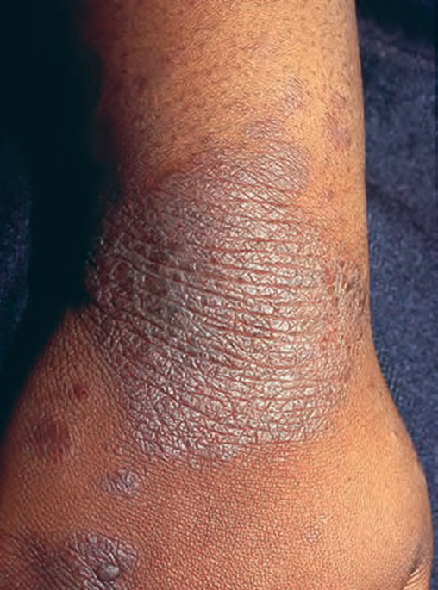
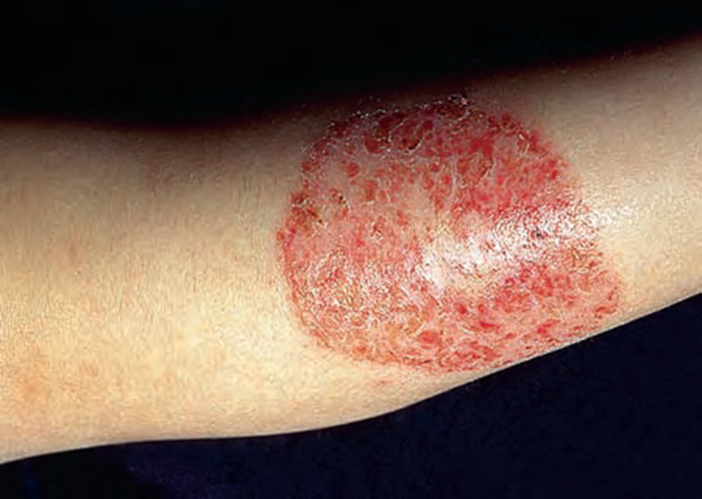
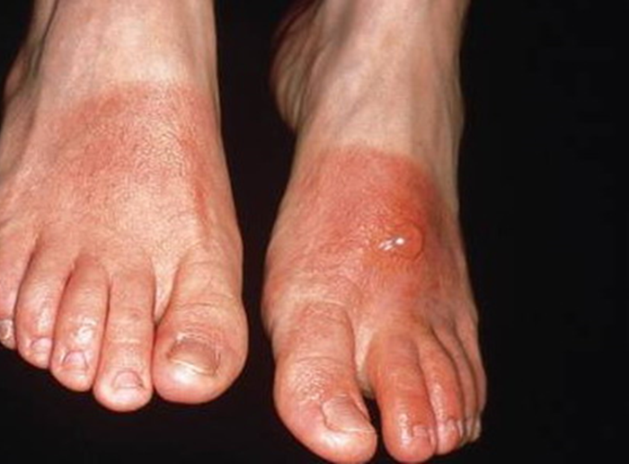
Subacute?
Acute,
Background erythema with vesicles
Liquification with pigmentation (chronic)

Slide 5
Atopic Dermatitis
Definition: chronic relapsing itchy skin disease in genetically predisposed patients.
Associated diseases: bronchial asthma, allergic rhinitis, allergic conjunctivitis
Incidence: up to 15% in developed countries
Grow out tendency! يعني ممكن يروح مع الوقت او يخف

Slide 6
Pathogenesis:
Atopy: genetic predisposition
Dry skin (decrease production of moisturizing lipids; sebum)
Theories:
IgE? (Epiphenomenon): is higher in their blood but it is not type I hypersensitivity
T-Cell: is higher in their blood but it is not type IV hypersensitivity
Allergy, increased tendency to certain allergens
AD and Food! minor role

Slide 7
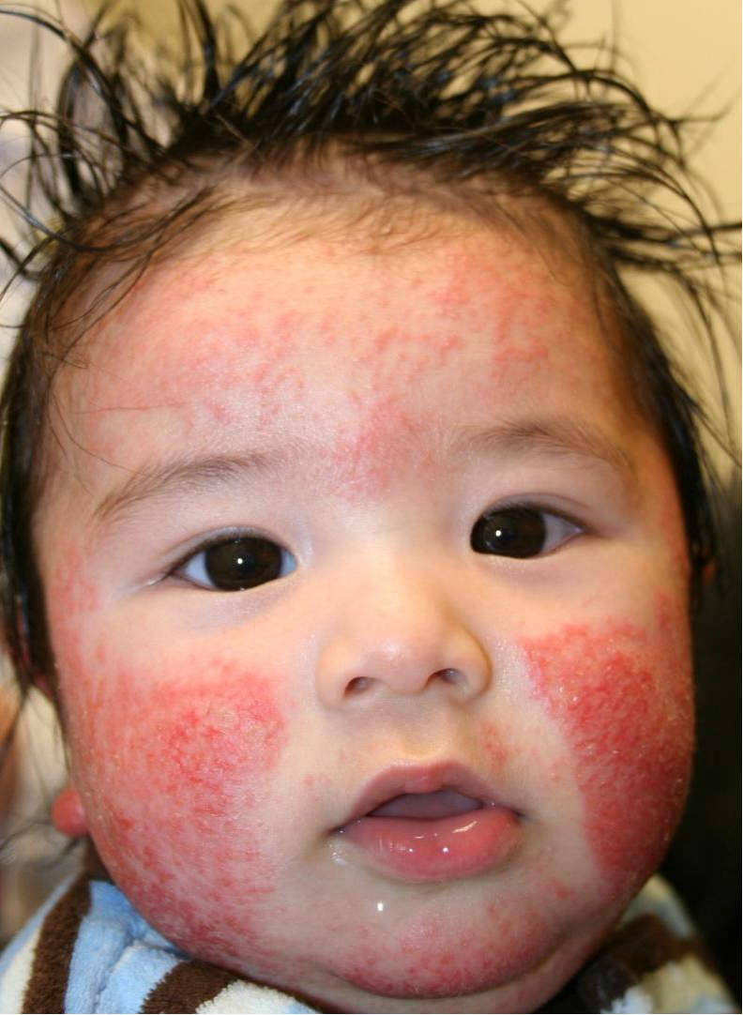
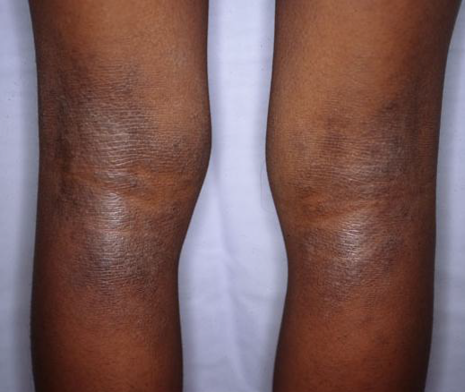
Clinical Variants
 | Infentile | Childhood | Adult
Distribution | Forhead and cheeks | In extensor surfaces | Behind the knee (popliteal)
Presentation | The infant may be not able to sleep well because of itchiness |  | More localized than children
Behavior | Excoriation sign علامات حك
Notes | Food may has an association but it’s not a cause |  | Hand dermatitis is a sign of atopic dermatitis in adults May be in breast areola, be careful if it’s unilateral may indicate pages disease of the breast
Discribtion | Bilateral ill-defined erythmatous elevated lesions

Slide 8
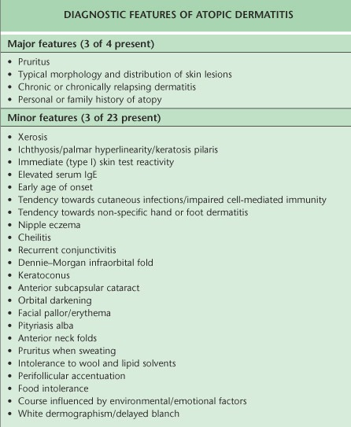
Atopy in family:
Allergic rhinitis
Allergic conjunctivitis
Asthma
Eczema

Slide 9
Keratosis pillars
باليدين والفخوذ من فوق
ممكن يجي الناس الي ماعندهم اكزيما
Xerosis
Ichthyosis جلد السمك
dennie morgan infraorbital fold
Caused by edema in atopic dermatitis
Pityriasis alba is a common skin condition mostly occurring in children and usually seen as dry, fine-scaled, pale patches on the face. It is self-limiting and usually only requires use of moisturizer creams.
perifollicular accentuation

Slide 10
Complications:
Secondary infections
Eczema herpeticum
Growth retardation (from cortisone Rx)
psychological

Slide 11
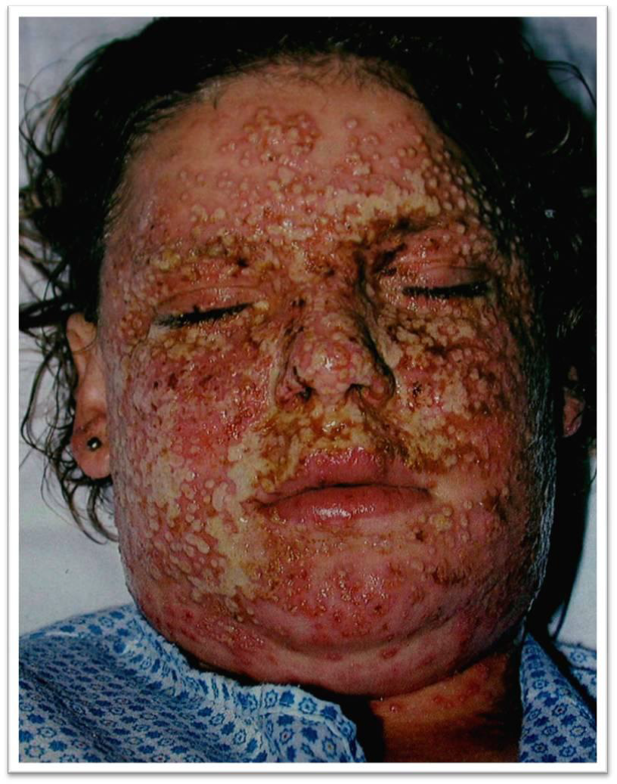
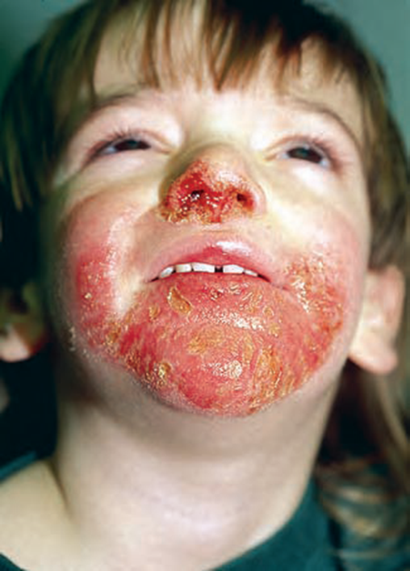
Secondary infection caused by S. Aureus
fluid coming out
Fever
Yellow crusts
If in doubt treat as infection
Eczema herpeticum is a rare but severe disseminated infection by Herpes Virus that generally occurs at sites of skin damage produced by, for example, atopic dermatitis, burns, long term usage of topical steroids or eczema.

Slide 12
Prognosis
Half of the cases improve by 2 years of age
Most improve by teenage years
<10% of patients have lifelong problems

Slide 13
Management
Education! Education! Education!
Psychological support!
Skin care: moisturizing the skin
Avoid irritant like soaps
Topical therapy:
Immunosupprssive:
Topical Immune regulator to avoid side effects of steroids (systemic side effects, dependence, thinning of skin), you should calculate the dose, it’s not approved for children <2 years , it is used for maintenance because of the burning sensation: Tacrolimus, Pimecrolimus
Antibiotics: Anti-staphylococcal drugs
Sedative antihistamine to control itching and help sleep (Histop)
Phototherapy علاج ضوئي: immune regulator. Ask the patient if they have transportation so they can come regularly to the sessions. Not applied to patients with SLE.
Systemic therapy: steroids, Cyclosporin, Methotrexate, Azathioprine. For: severe cases, unresponsive. Used for short duration. Then shifter to topical.

Slide 14
Seborrhoeic Dermatits
Definition:
Pathogenesis:
Increased Sebum!
Tendency
Pityrosporum ovale over growth
Severe in immune compromised patients (HIV, bed ridden in hospitals)
It can’t be treated but rather you control the disease
With antifungals and steroids

Slide 15
Clinical features
Presentation
Distribution

Slide 16
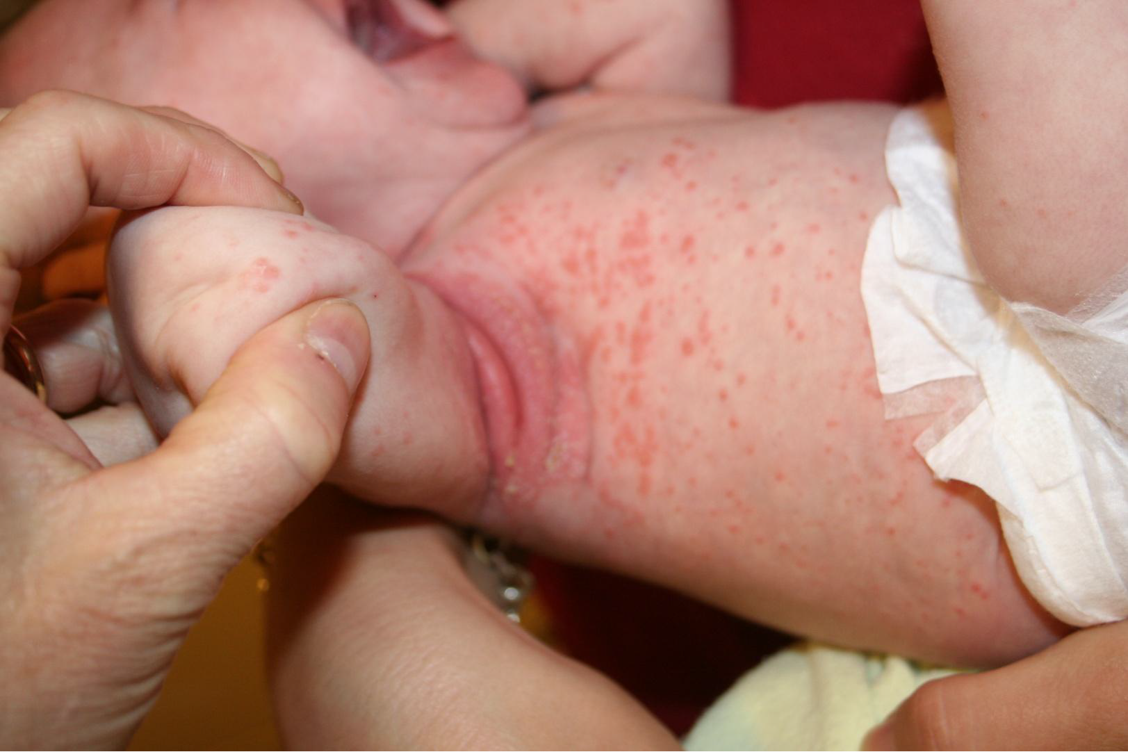
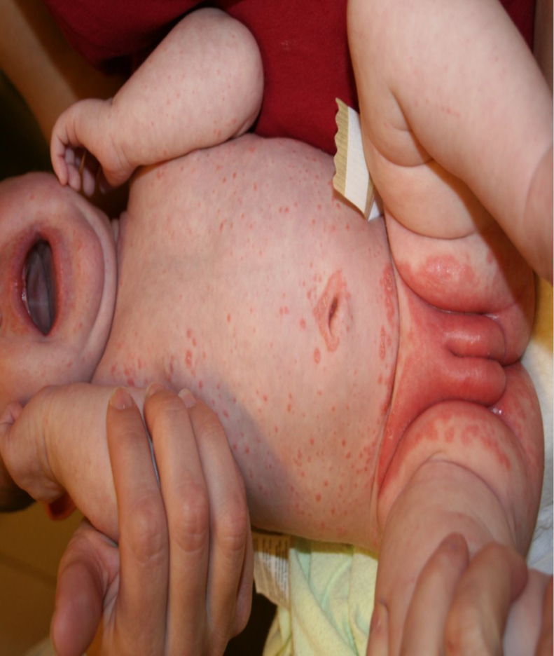
Ill defined erythematous patches, oily skin with yellow grease over trunk, axilla and groin areas, ( caused by increase in sebum and normal flora fungus called Pityrosporum ovale) = seborrheic dermatitis الاكزيما الدهنية
Difference from atopic eczema: in diaper area, oily, yellow scales

Slide 17
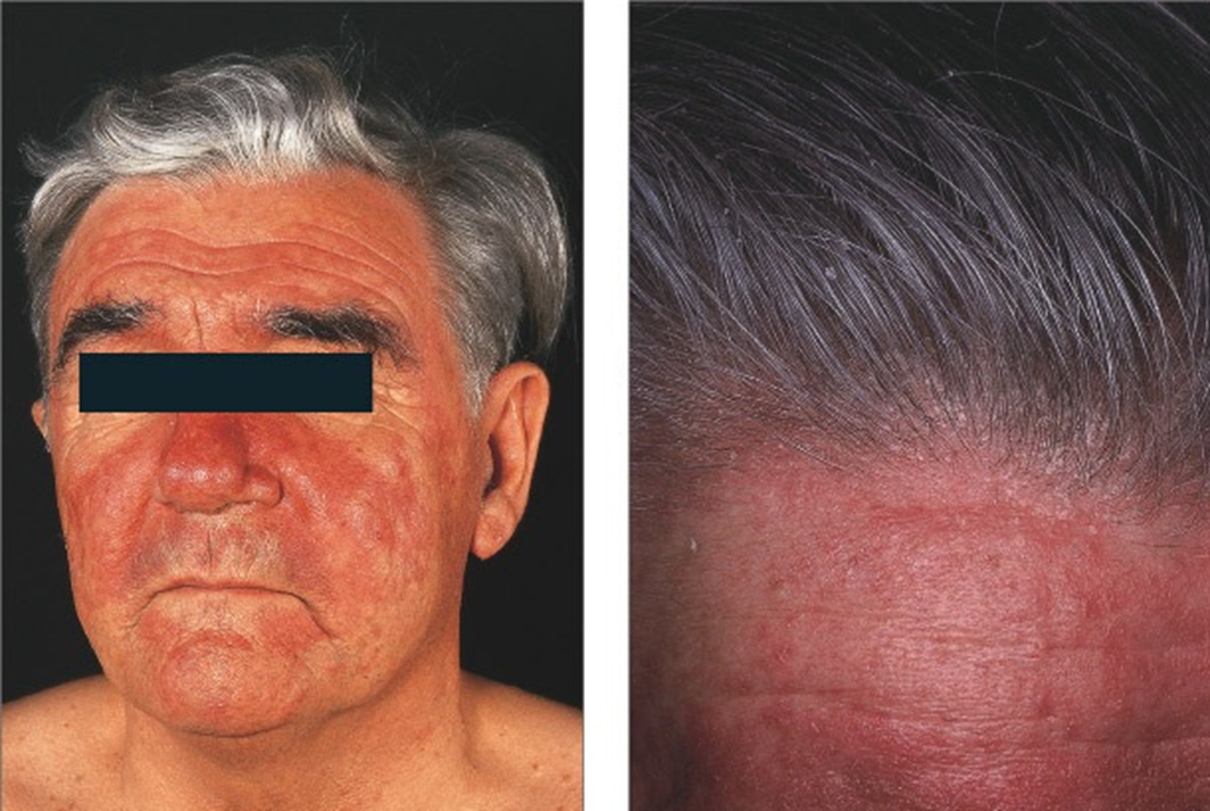

Slide 18
Management:
Shampoo:
Zinc pyrithione
Selenium sulfide 2.5% shampoo
2% ketoconazole shampoo
Antifungals
Topicals
Combined therapy (antifungal & steroids)
Maintenance & recurrence

Slide 19
Contact Dermatitis
Definition: dermatitis results from contact with external materials.
Pathogenesis:
Irritant vs. allergic : (cytotoxic vs type IV)
Common irritants: detergent, acids, dust, burning chemicals, etc
Common allergens: perfumes, hair dyes, nickels, leathers, metals, rubbers, latex, cosmetics, etc

Slide 20
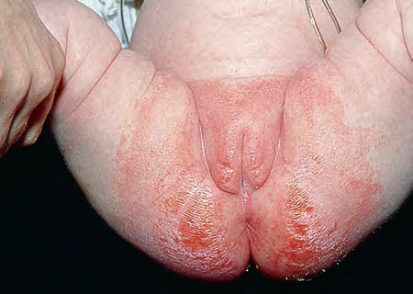
Irritant | Allergic
All people will react to an irritant if applied in a high enough concentration At 1st exposure | First exposure does not cause a reaction Begins 24 h after subsequent exposure if already allergic May be very severe that it may cause anaphylactic shock
Common causes: Hands repeatedly exposed to water, cleansers Lip-licking habit – wetting and drying caused by saliva (enzymes from saliva) Napkin dermatitis: from urine & stool | chromates, rubber, preservatives, topical Abx, topical cs, Nickel accessories, hair dyes, perfumes, latex in gloves
Cytotoxic to all people | Type 4 hypersensitivity to some people
Patch skin test is used for type 4 hypersensitivity (read after 48,96 h)
Type 4 may turns to type 1 and can cause anaphylactic shock
Napkin dermatitis

Slide 21
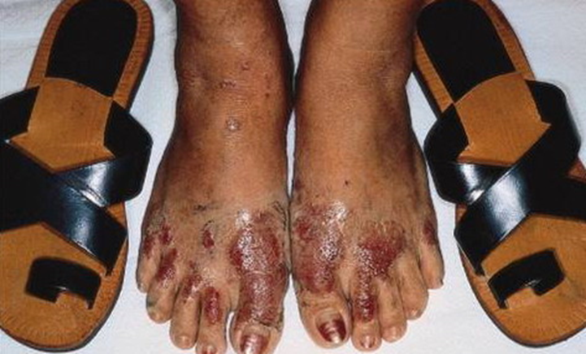
Shoe dermatitis
Causes:
a. Rubber (most common)
b. Chromates (in leather)
c. Glutaraldehyde (in leather)
d. Adhesives
e. Dyes

Slide 22
Clinical features
Prediliction sites: site of contact
Distribution & configuration

Slide 23
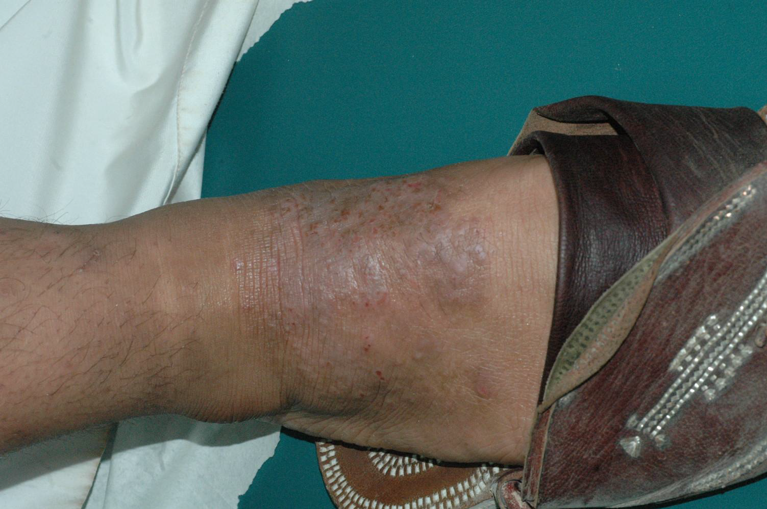
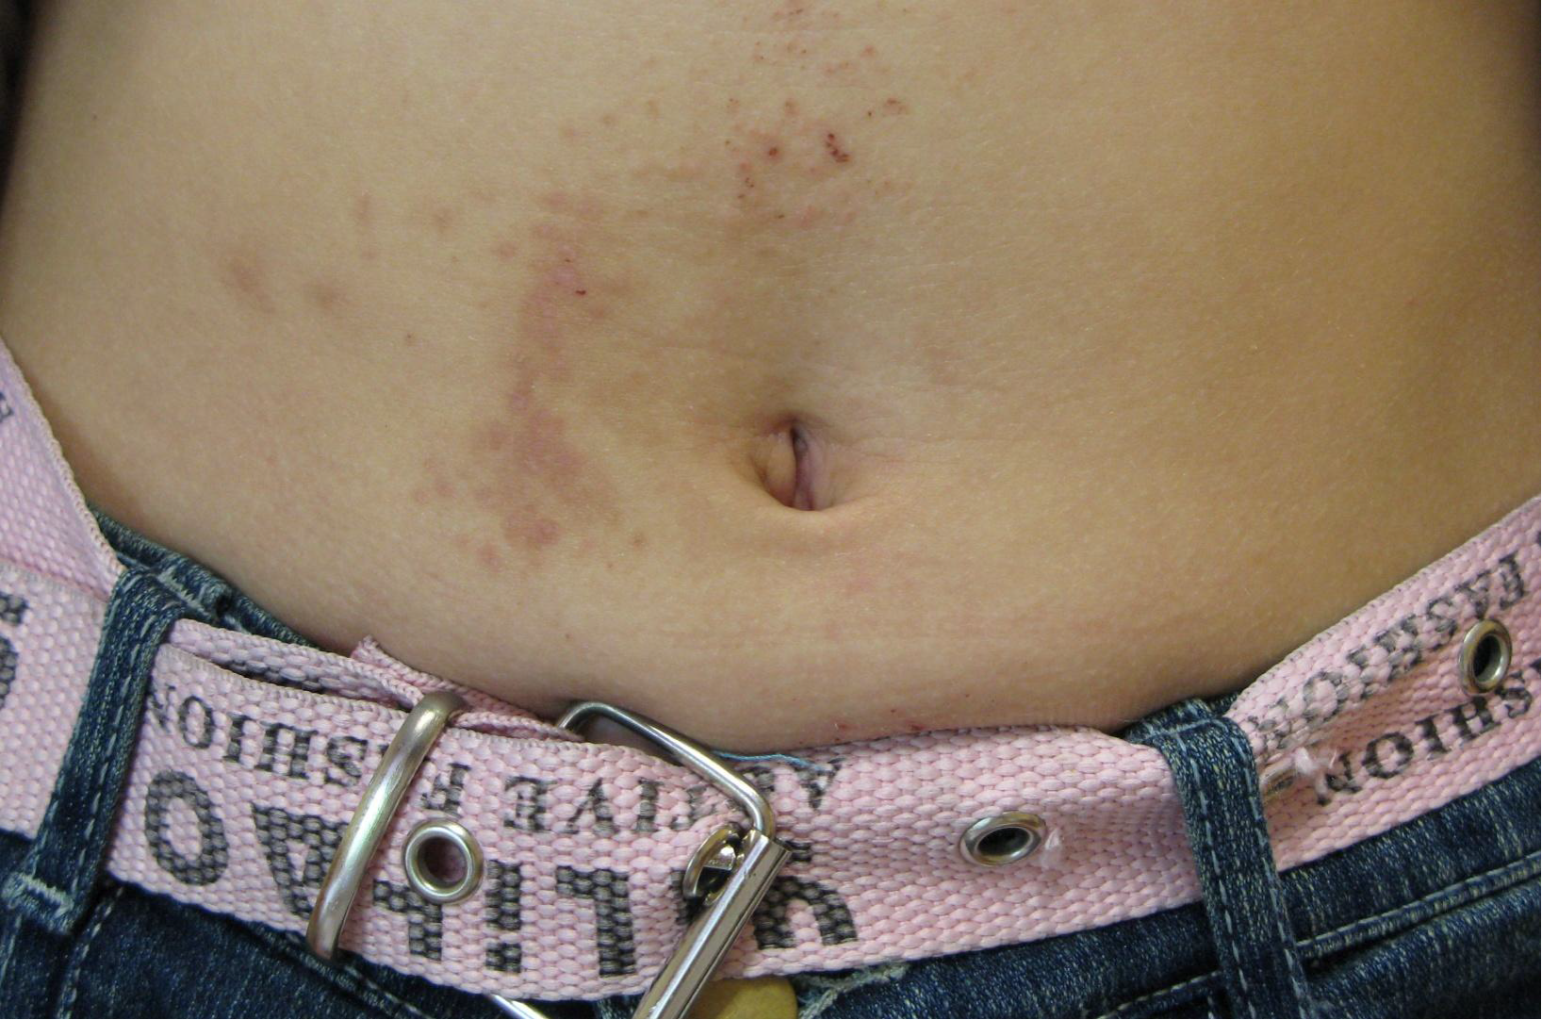

Slide 24
Management:
Identification
Patch testing: for allergic contact dermatitis not for irritant
Avoidance allergens
Topical corticosteroids

