Slide 1
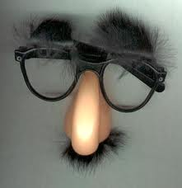
NASAL SEPTAL DISEASES
Dr.Mohammad Aloulah
Assistant Professor
Consultant ORL

Slide 2
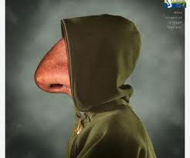
ANATOMY OF NASAL SEPTUM
Consists of three parts
1. Columellar septum
2. Membranous septum
3. Septum proper

Slide 3
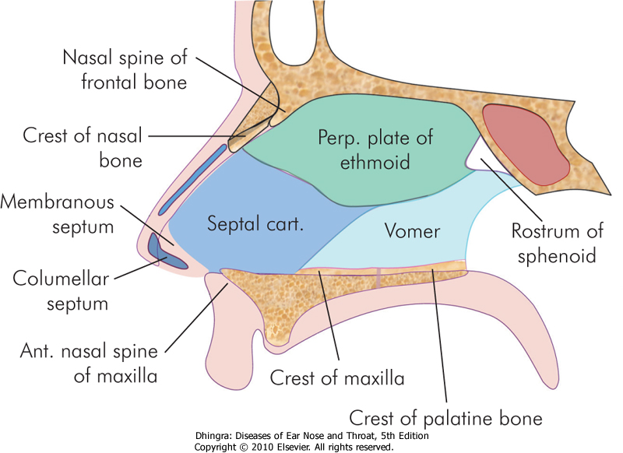

Slide 4
BLOOD SUPPLY OF NASAL SEPTUM

Slide 5
NASAL SEPTAL DISEASES
Fracture of nasal septum
Deviated nasal septum
Septal haematoma
Septal abcess
Nasal synechia
Septal perforation

Slide 6
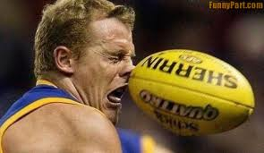
1.FRACTURES OF NASAL SEPTUM
Aetiopathogenesis
Trauma
Fate of septum - buckling
vertical or horizontal fracture
crushed into pieces
Septal injuries with mucosal tear profuse epistaxis
Septal injuries without mucosal tear septal hematoma
Types- 1.Jarjaway fracture
2.Chevallet fracture

Slide 8
Treatment
Early recognition and treatment of septal injuries is essential.
Haematoma is drained

Slide 9
Complications
deviation of cartilaginous nose
asymmetry of nasal tip, columella or the nostril

Slide 10
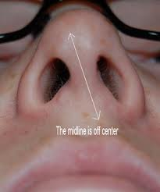
2.DEVIATED NASAL SEPTUM
Aetiology
1. Trauma
2. Developmental errors
3. Racial factors
4. Hereditary factors

Slide 11
1. TRAUMA
A lateral blow on the nose may cause displacement of septal cartilage from the maxillary crest
A crushing blow from the front may cause buckling , twisting ,fractures and crushing of nasal septum
Trauma during delivery

Slide 12
2 . DEVELOPMENTAL ERRORS
Nasal septum is formed by the tectoseptal process which descends to meet the two halves of developing palate in the midline
During primary and secondary dentition further developments takes place in palate
Unequal growth between palate and base of skull may cause buckling of nasal septum
In mouth breathers-high arched palate and DNS
In cleft palate,cleft lip,dental abnormalities

Slide 14
3. RACIAL FACTORS
Caucasians are more affected than African
4. HEREDITARY FACTORS
Members of same family may have deviated
septum

Slide 16
Sites of DNS
Cartilagenous/bony/both
Anterior/posterior
High/low

Slide 17
Types of DNS

Slide 19
ANTERIOR DISLOCATION

Slide 20
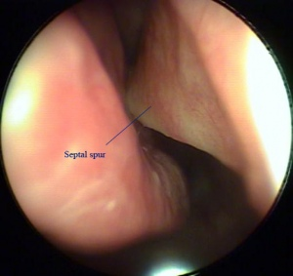
SEPTAL SPUR

Slide 21
Effects of DNS
Compensatory hypertrophy of turbinates of opposite side
External deformity
Impairment of drainage to sinus
Secondary atrophic rhinits

Slide 22
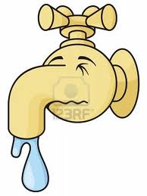
Clinical features
1 . NASAL OBSTRUCTION
Sites
1. Vestibular
2. At the nasal valve
3. Turbinal
4. Choanal
Bilateral/unilateral obstruction

Slide 23
COTTLE TEST
Used in nasal obstruction due to abnormality of nasal valve
In this test ,cheek is drawn laterally while patient breathes quietly.If the nasal airway improves on test side,the test is positive and indicates abnormality of vestibular component of nasal valve

Slide 25
2. HEADACHE
3. SINUSITIS
4. EPISTAXIS
5. ANOSMIA
6. EXTERNAL DEFORMITY
7. MIDDLE EAR INFECTION

Slide 26
TREATMENT
Minor degrees of septal deviation require no treatment
If produces mechanical nasal obstruction or other symptoms, an operation is indicated

Slide 27
1.SUBMUCOUS RESECTION OPERATION
Generally done in adults under local anaesthesia
Elevating the mucoperichondrial and mucoperiosteal flaps on either side of the septal framework by a single incision made on one side of the septum
Removing the deflected parts of bony and cartilaginous septum
Repositioning the flaps

Slide 29
2.SEPTOPLASTY
Conservative surgery
Only most deviated parts are removed
Rest of the septal framework is corrected and repositioned by plastic means.
Mucoperichondrial or mucoperiosteal flap is generally raised only in one side of the septum retaining the attachment and blood supply of the other

Slide 31
SEPTAL HAEMATOMA
Definition
Collection of blood under the perichondrium or periosteum of nasal septum
Aetiology
nasal trauma
septal surgery
bleeding disorders

Slide 32
Clinical features
Bilateral nasal obstruction and mouth breathing
Frontal headache
Sense of pressure over nasal bridge
Smooth rounded swelling of the septum in both nasal fossae
Soft and fluctuant mass felt

Slide 33
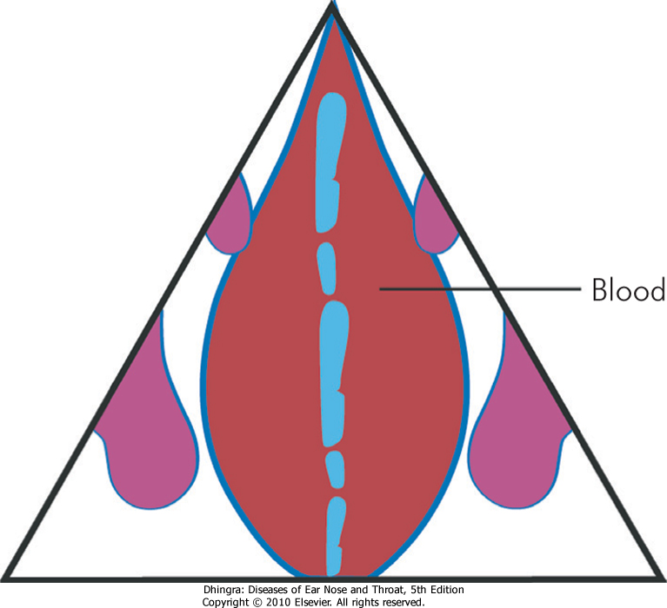

Slide 34
Treatment
Small haematoma- Aspiration with a wide bore sterile needle
Large haematoma-Incised and drained by a small anteroposterior incision parallel to the nasal floor
Nose is packed on both sides to prevent reaccumulation
Antibiotics

Slide 35
Complications
Permanently thickened septum
Septal abscess with necrosis of cartilage and depression of nasal dorsum

Slide 36
SEPTAL ABSCESS
Aetiology
Secondary infection from septal haematoma
Furuncle of the nose or upper lip
Acute infection such as typhoid or measles

Slide 38
Clinical features
Severe bilateral nasal obstruction with pain and tenderness over the bridge of nose
fever with chills and frontal headache
Skin over the nose -- red and swollen
smooth bilateral swelling of nasal septum
Fluctuation elicited
Septal mucosa -- congested
Submandibular lymph nodes -- enlarged and tender

Slide 40
Treatment
Early drainage
Incision made in the most dependent parts of the abscess
A piece of septal mucosa is excised
Pus and necrosed pieces of cartilages are removed by suction
Incision reopened daily for 2-3 days
Systemic antibiotics

Slide 41
Complications
Depression of the cartilaginous dorsum in the supratip area
Septal perforation
Meningitis and cavernous sinus thrombosis

Slide 42
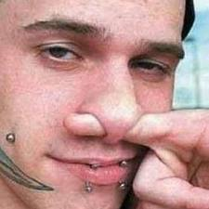
PERFORATION OF NASAL SEPTUM
Aetiology
Traumatic perforation
Injury to mucosal flaps during SMR
cauterization of septum with chemicals
Habitual nose- picking

Slide 43
2 . Pathologic perforations
Septal abscess
Rhinolith or neglected foreign body
Chronic granulomatous conditions like Lupus,
tuberculosis, leprosy, syphilis
Wegener’s granuloma

Slide 44
3 . Drugs and chemicals
Prolonged use of steroids in nasal allergy
Cocaine addicts
Workers in certain occupations. Eg .chromium
plating
4.Idiopathic

Slide 46
Clinical features
Small anterior perforation cause whistling
sound during inspiration or expiration
Large perforations develop crusts which
obstruct the nose or cause epistaxis when
removed

Slide 47
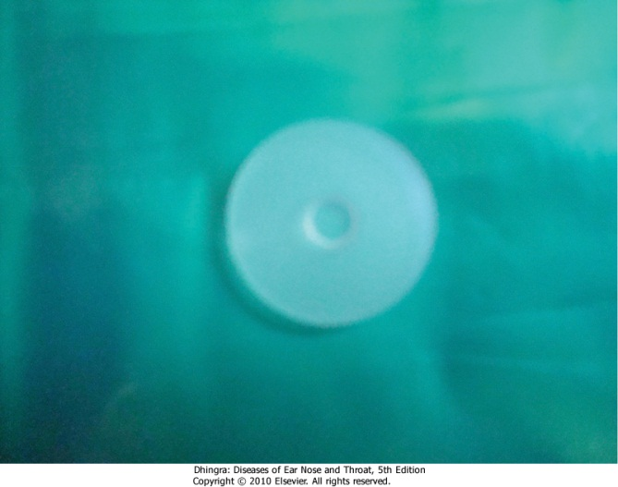
Treatment
Based on cause and size of perforation
Small perforation--closed by plastic flaps, nasal mucosal flap
Larger perforations
treatment aim -- to keep the nose--crust free
By alkaline nasal douches and application of a
bland ointment
A thin silastic button can be worn

Slide 48
NASAL SYNECHIA
Aetiology
Adhesions between septum and lateral wall
Adhesions between middle turbinate and lateral wall
Following nasal surgery and nasal packing
Clinical features
Nasal obstruction
Sinusitis and headache

Slide 50
Treatment
Excision and release of adhesion
sialistic sheets between 2 surfaces
Prevention
Proper perioperative cleaning
Lubrication of nasal pack before insertion
Use of septal splints following surgery
Notes:
1-using diathermy.bipolar cautery,laser
2-for 1 wk-prevent further adhesions

