Slide 1
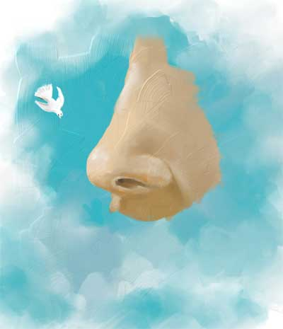
Anatomy of Nose and Paranasal Sinus
By:
د. أحمد الروقي

Slide 2
The Nose
The nose consists of the external nose and the nasal cavity,
Both are divided by a septum into right and left halves.

Slide 3
External Nose
The external nose has two elliptical orifices called the naris (nostrils), which are separated from each other by the nasal septum.
The lateral margin, the ala nasi, is rounded and mobile.

Slide 4
External Nose

Slide 5
External Nose
The framework of the external nose is made up above by the nasal bones, the frontal processes of the maxillae, and the nasal part of the frontal bone.
Below, the framework is formed of plates of hyaline cartilage

Slide 6
External Nose

Slide 7
Blood Supply of the External Nose
The skin of the external nose is supplied by branches of the ophthalmic and the maxillary arteries.
The skin of the ala and the lower part of the septum are supplied by branches from the facial artery.

Slide 8
Nerve Supply of the External Nose
The infratrochlear and external nasal branches of the ophthalmic nerve (CN V) and the infraorbital branch of the maxillary nerve (CN V).

Slide 9
Nasal Cavity
The nasal cavity has
a floor,
a roof,
a lateral wall,
a medial or septal wall.

Slide 10
The Floor of Nasal Cavity
Palatine process maxilla
Horizontal plate palatine bone

Slide 11
The Roof of Nasal Cavity
Narrow
It is formed
anteriorly beneath the bridge of the nose by the nasal and frontal bones,
in the middle by the cribriform plate of the ethmoid,
located beneath the anterior cranial fossa,
posteriorly by the downward sloping body of the sphenoid

Slide 12
The Medial Wall of Nasal Cavity
The Nasal Septum
Divides the nasal cavity into right and left halves
It has osseous and cartilaginous parts
Nasal septum consists of the perpendicular plate of the ethmoid bone (superior), the vomer (inferior) and septial cartilage (anterior)
Perpendicular Plate (ethmoid)
Septal Cartilage
Vomer

Slide 13
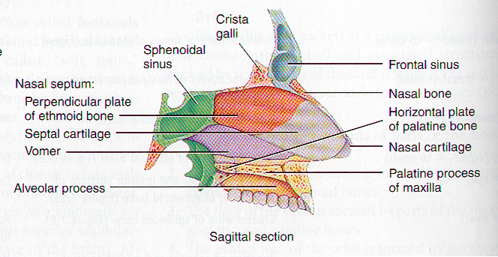
The Nasal Septum

Slide 14
The Lateral Walls of Nasal Cavity
Marked by 3 projections:
Superior concha
Middle concha
Inferior concha
The space below each concha is called a meatus.

Slide 15
The Lateral Walls of Nasal Cavity

Slide 16
The Lateral Walls of Nasal Cavity
Inferior meatus: nasolacrimal duct
Middle meatus:
Maxillary sinus
Frontal sinus
Anterior ethmoid sinuses
Superior meatus: posterior ethmoid sinuses
Sphenoethmoidal recess: sphenoid sinus

Slide 17
Openings Into the Nasal Cavity
Sphenoid sinus opens into sphenoethmoidal recess
Anterior & middle ethmoid air cells, maxillary and frontal sinuses open into middle meatus
Posterior ethmoidal air cells open into superior meatus
Nasolacrimal Canal drains into Inferior Meatus

Slide 18
Blood Supply to the Nasal Cavity
From branches of the maxillary artery, one of the terminal branches of the external carotid artery.
The most important branch is the sphenopalatine artery.
The sphenopalatine artery anastomoses with the septal branch of the superior labial branch of the facial artery in the region of the vestibule.
The submucous venous plexus is drained by veins that accompany the arteries.

Slide 19
Blood Supply to the Nasal Cavity
Sphenopalatine a.
Maxillary a.
Netter, Frank H., Atlas of Human Anatomy. Ciba-Geigy Corporation, Summit, N.J. 1993. Plate 35.

Slide 20
Nerve Supply of the Nasal Cavity
The olfactory nerves from the olfactory mucous membrane ascend through the cribriform plate of the ethmoid bone to the olfactory bulbs .
The nerves of ordinary sensation are branches of the ophthalmic division (V1) and the maxillary division (V2) of the trigeminal nerve.

Slide 21
Nerve Supply of the Nasal Cavity
CN I – Olfactory Nerves (SVA)
Anterior ethmoidal branch of V₁
Posterior nasal branches of V₂
Cut nasopalatine branch of V₂ to septum

Slide 22
Lymph Drainage of the Nasal Cavity
The lymph vessels draining the vestibule end in the submandibular nodes.
The remainder of the nasal cavity is drained by vessels that pass to the upper deep cervical nodes.

Slide 23
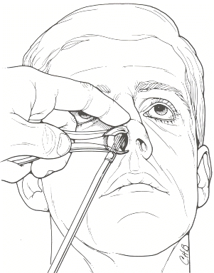
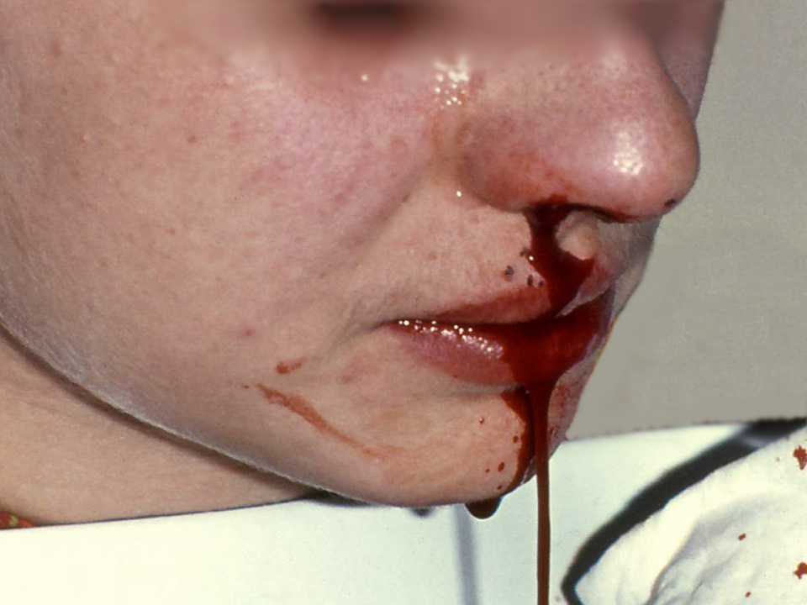
Clinical Notes
Examination of the Nasal Cavity
Trauma to the Nose
Infection of the Nasal Cavity
Foreign Bodies in the Nose
Nose Bleeding (Epistaxis)

Slide 24
The Paranasal Sinuses

Slide 25
The Paranasal Sinuses
The paranasal sinuses are cavities found in the interior of the maxilla, frontal, sphenoid, and ethmoid bones .
They are lined with mucoperiosteum and filled with air.
They communicate with the nasal cavity through relatively small apertures.

Slide 26
Drainage of Mucus and Function of Paranasal Sinuses
The mucus produced by the mucous membrane is moved into the nose by ciliary action of the columnar cells.
Drainage of the mucus is also achieved by the siphon action created during the blowing of the nose.
Functions:
Resonators of the voice
They also reduce the skulls weight
Help wam and moisten inhaled air
Act as shock absorbers in trauma

Slide 27
Maxillary Sinus
Pyramidal in shape
Paired & symmetric
Located within the body of the maxilla behind the skin of the cheek.
The roof is formed by the floor of the orbit, and the floor is related to the roots of the 2nd premolars and 1st molar teeth.
The maxillary sinus opens into the middle meatus of the nose

Slide 28
Frontal Sinuses
Rarely symmetrical
Contained within the frontal bone .
Separated from each other by a bony septum.
Each sinus is roughly triangular
Extending upward above the medial end of the eyebrow and backward into the medial part of the roof of the orbit.
Opens into the middle meatus

Slide 29
Sphenoidal Sinuses
Lie within the body of the sphenoid bone
Below sella turcica
Extends between dorsum sellae and post clinoid processes
Opens into the sphenoethmoidal recess above the superior concha

Slide 30
Ethmoid Sinuses
They are anterior, middle, and posterior
They are contained within the ethmoid bone, between the nose and the orbit
Anterior & middle
Drains into middle nasal meatus
Posterior
Drain into superior nasal meatus
Separated from the orbit by a thin plate of bone so that infection can readily spread from the sinuses into the orbit

Slide 31
Sinus Drainage Schema

Slide 32
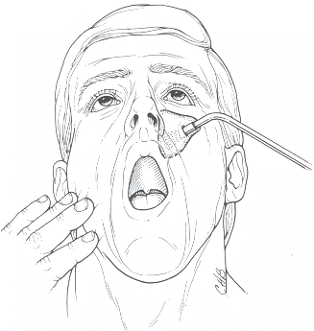
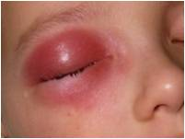
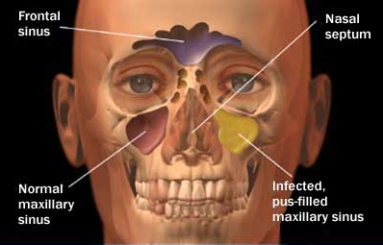
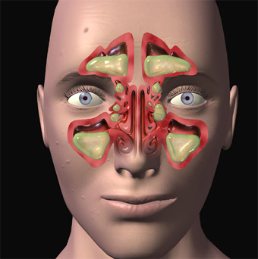
Clinical Notes
Examination of the Paranasal Sinuses
Sinusitis
Basal skull fracture

Slide 33
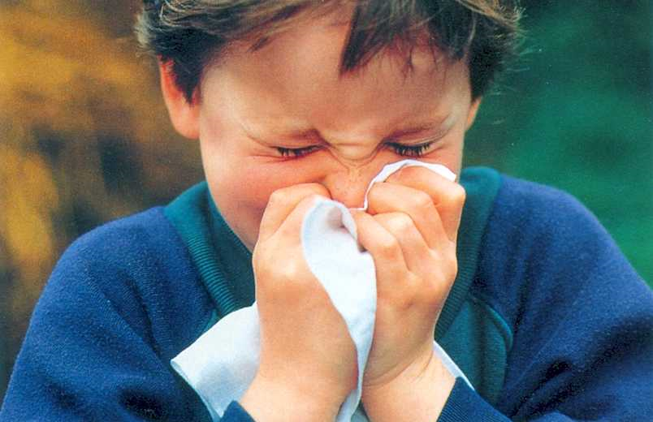
Thank you

