Slide 1
Nasal polypi
د. أحمد الروقي

Slide 2
Definition
The term polyp derived from Latin word “Polypous” Many footed
Defined as simple oedematous hypertrophic nasal mucosa
Can be unilateral / bilateral

Slide 3
Classification
1
2
Fungal polyp
3
Malignant polyp
Simple nasal polyp
Notes:
This is another option for an Overview slide.

Slide 4
Simple nasal polypi
Also known as inflammatory polyp
Ethmoidal polyp
Antrochoanal polyp

Slide 5
AC polyp / Ethmoidal polypi
Ethmoidal polypi | Antrochoanal polyp
Seen in adults | Seen in children and adolescents
Allergy is the common cause | Infection is the common cause
Multiple (bunch of grapes) | Unilateral
 | Arises from maxillary antrum
Seen easily on anterior rhinoscopy | Seen commonly in post nasal exam
X ray PNS may show hazy ethmoids and normal maxillary sinuses | X ray PNS shows hazy maxillary antrum
Mostly bilateral | Usually unilateral
Recurrence is common | Recurrence is uncommon
Polypectomy | Caldwel luc surgery in recurrent cases

Slide 6
Fungal polyp
5 Different types
Acute fulminant
Chronic invasive
Granulomatous invasive
Fungal ball
AFRS
Notes:
What will the audience be able to do after this training is complete? Briefly describe each objective how the audience will benefit from this presentation.

Slide 7
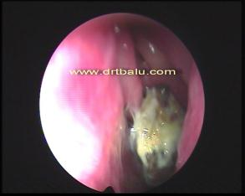
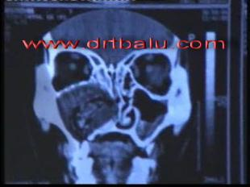
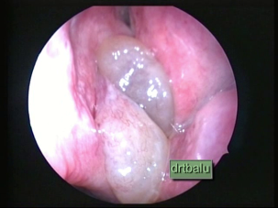
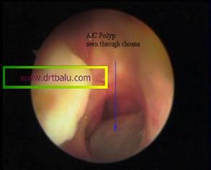

Slide 8
Fungal ball
Features
Immunocompetent
Fungal ball is tightly packed hyphae of aspergillus (common)
Antifungal trt is not necessary

Slide 9
AFRS
Bent’s criteria
Type I hypersensitivity (demonstrable)
Nasal polyposis
Heterodense mass lesion seen in CT scans
Presence of eosinophilic mucin mixed with non invasive fungus
+ Fungal stain / culture

Slide 10
Clinical Features
Notes:
Keep it brief. Make your text as brief as possible to maintain a larger font size.

Slide 11
Clinical features
Nasal obstruction – Unilateral / bilateral
Anosmia
Loss of taste
Rhinorrhoea – watery / mucoid / mucopurulent
Head ache
Broadening of nose (Frog face)

Slide 12
Examination
Smooth glossy multiple mass seen in anterior rhinoscopy
Insensitive on probing. Probe can be passed around the polyp
Soft and mobile
Notes:
If there is relevant video content, such as a case study video, demo of a product, or other training materials, include it in the presentation as well.

Slide 13
Posterior rhinoscopy
Polyp can be seen at the level of choana
Antrochoanal polyp can be seen exiting out of accessory ostium
Notes:
Add a case study or class simulation to encourage discussion and apply lessons.

Slide 14
Differential diagnosis
Meningocele
Angiofibroma
Sq cell carcinoma
Enlarged turbinates
Inverted papilloma

Slide 15
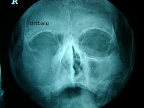
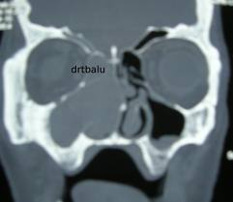
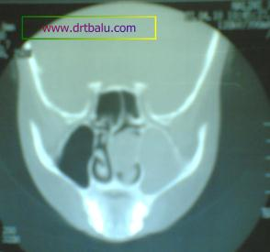
Radiology

Slide 16
Medical Management
Antihistamines ?
Nasal decongestant
Steroids
Antibiotics ?

Slide 17
Surgery
FESS
Endoscopic polypectomy
Caldwel Luc procedure

Slide 18
Thank you

