Slide 1
Laryngology
AHMED ALARFAJ

Slide 2
Objectives
To know the basic larynx anatomy and physiology.
To recognize assessment and management of common laryngeal diseases, include ability to obtain patients’ history, perform comprehensive physical assessment, interprets findings
To know how to handle common laryngeal emergencies.
To be aware of common laryngeal operations.

Slide 3
dysphonia: is a descriptive medical term meaning disorder of voice.
Hoarseness: is a subjective term, and usually refers to a weak or altered voice.
voice change are: breathy, harsh, tremulous, weak, reduced to a whisper, or vocal fatigue (voice deteriorates with use).

Slide 5
ANATOMY
Laryngeal Neuromuscular Anatomy
Extrinsic Depressors:
Extrinsic Elevators:
Posterior Cricoarytenoid
Lateral Cricoarytenoid:
Thyroarytenoid:
Cricothyroid:
Interarytenoid

Slide 7
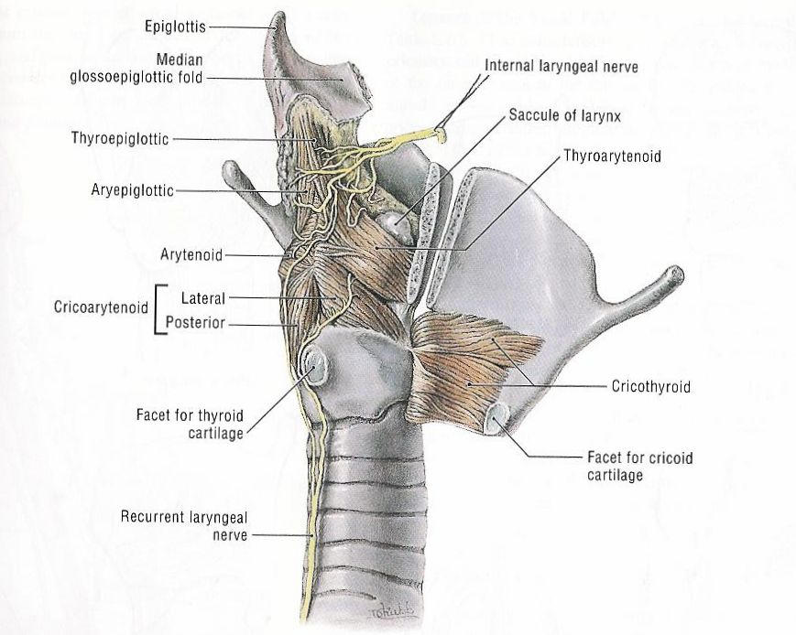
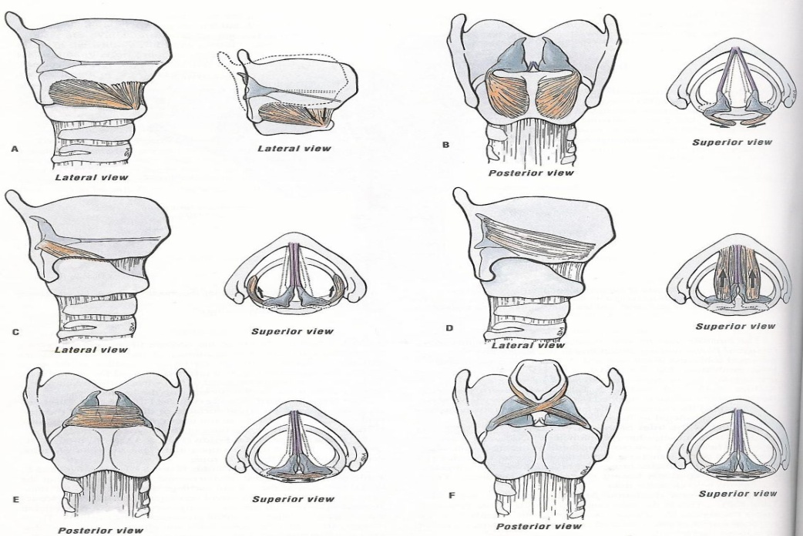
Intrinsic musculature
Abductors :
posterior cricoarytenoid (PCA)
Adductors:
thyroarytenoid (TA) ,lateral cricoarytenoid (LCA) ,cricothyroid, interarytenoid

Slide 8
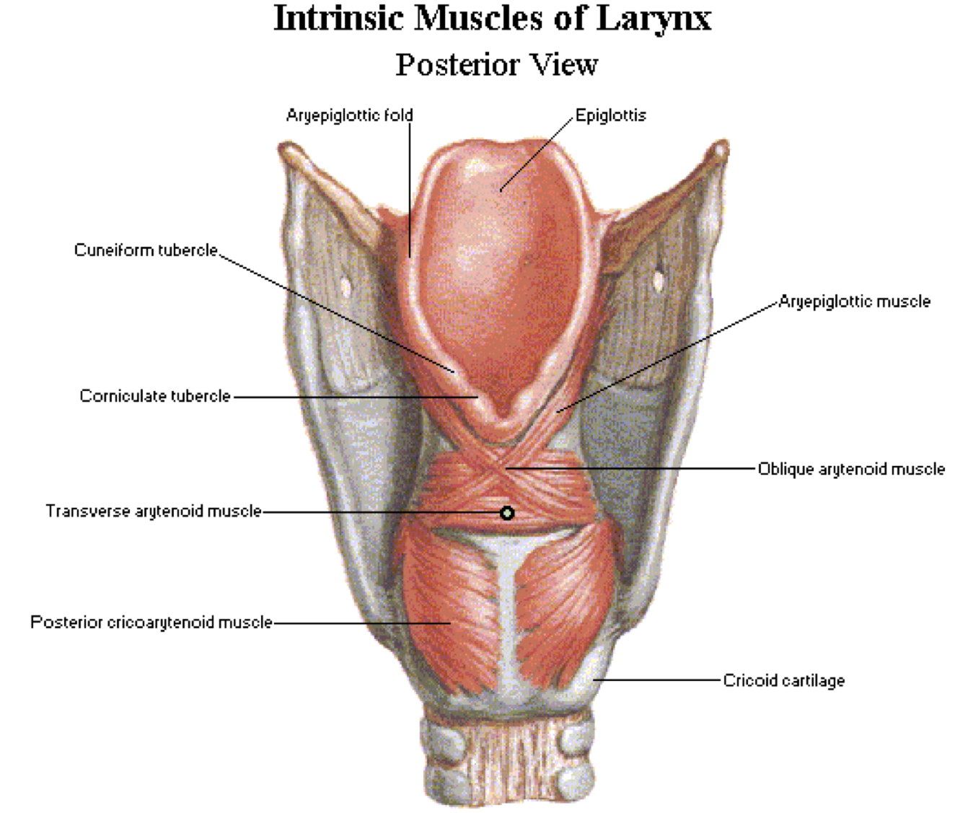

Slide 12
ANATOMY
Laryngeal Innervation
Internal Branch of the SLN
RLN

Slide 14
Nerve supply:
Superior laryngeal nerve
Internal branch (sensory) .
External branch ►cricothyroid muscle
Recurrent laryngeal nerve
RT side: crosses the subclavian artery
LT side: arises on the arch of the aorta deep to ligamentum arteriosum
it is divided behind the cricothyroid joint
Motor ►all the intrinsic muscles except ?
Sensory

Slide 16
ANATOMY
Laryngeal Cartilage
Thyroid, Cricoid and Arytenoids
Epiglottis
Corniculate Cartilage
Trieceous Cartilage

Slide 17
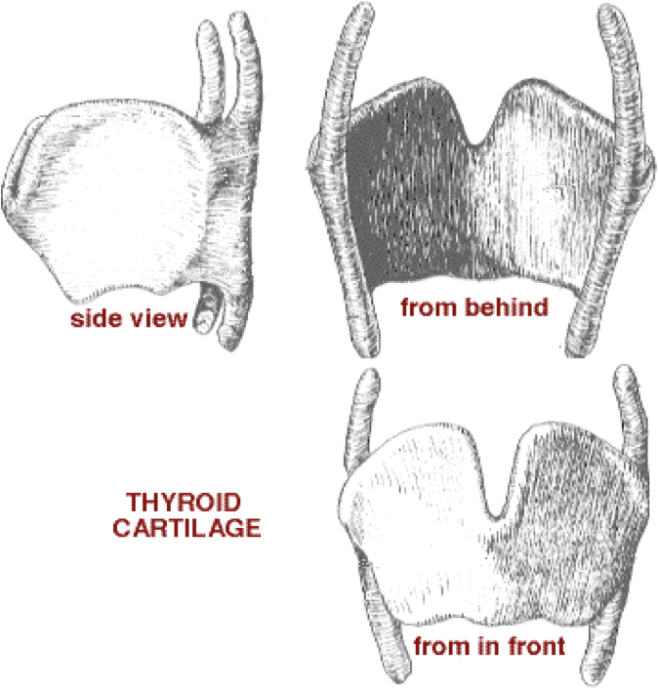
Thyroid cartilage :
Shield like

Slide 18
Cricoid cartilage :
Signet ring shaped.
the only complete skeletal ring for the airway.
♦Both thyroid and cricoid cartilage ► hyaline ► calcification
Cricothyroid joint
Synovial joint ► hinge motion

Slide 19
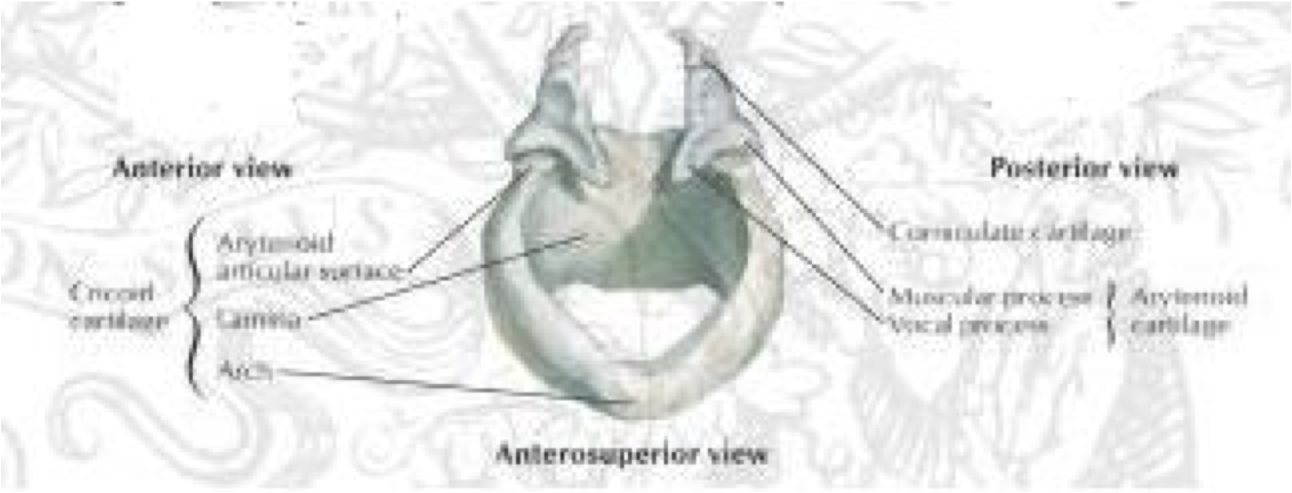
Arytenoid cartilage :
Pyramidal shaped
Apex ,vocal & muscular process.
Cricoarytenoid joint
Synovial
rocking motion
Corniculate and cuneiform cartilage:

Slide 20
ANATOMY
Laryngeal Joints
Cricothyroid Joints
Cricoarytenoid Joints

Slide 22
Laryngeal mucosa :
All mucosa from trachea to aryepiglottic fold ►ciliated columnar epithelium.
☼ except vocal cord and aryepiglottic fold ►squamous epithelium

Slide 23
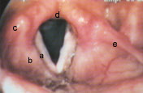

Slide 24
Histopathology

Slide 25
ANATOMY
Vocal Fold Layers (from superficial to deep)
Squamous Epithelium
Superficial Lamina Propria (SLP. Reinke’s Space)
Intermediate Lamina Propria
Deep Lamina Propria
Thyroarytenoid Muscle Complex

Slide 26
ANATOMY SPECIAL CONSIDERATION
Pediatric Airway Anatomy
1mm of laryngeal edema in the neonate can be reduce airway by 60%

Slide 27
PHYSIOLOGY
Components of Speech
Phonation
Resonation
Articulation
Respiration

Slide 28
Applied physiology of the larynx
Protection of the lower air passages
Closure of the laryngeal inlet
Closure of the glottis
Cessation of respiration
Cough reflex (forced expiration is made against a closed larynx

Slide 29
Phonation :
Voice is produced by vibration of the vocal cord
Source of energy is the airflow
Normal vocal fold vibration occurs vertically from inferior to superior
The mouth ,pharynx ,nose ,chest (resonating chambers)
Respiration:
Vocal cord in abduction position

Slide 30
PHYSIOLOGY
Voice Parameters
Pitch (Hz)
Fundamental Frequency
Loudness (decibels)
Quality

Slide 31
Laryngeal sphincters
True vocal cord
false vocal cord
Aryepiglottic sphincter

Slide 32
EVALUATION OF THE DYSPHONIC PATIENT History and Physical Exam
History
Character of Dysphonia
Associated Symptoms
“KITTNES” for differential diagnosis

Slide 33
EVALUATION OF THE DYSPHONIC PATIENT
Physical Exam
Quality of Voice
Indirect and Direct Laryngosocopy
(Mirror, Flexible Nasopharyngoscopy,
Videostroboscopy):
H &N Exam:

Slide 34
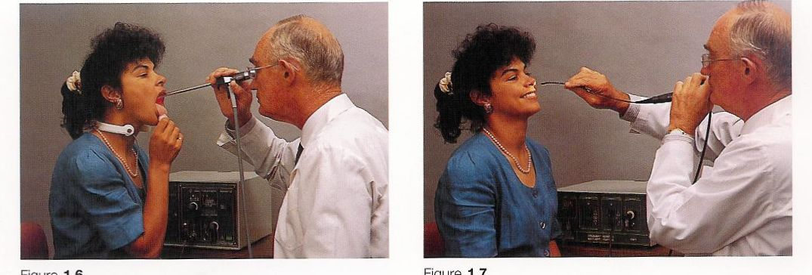

Slide 35
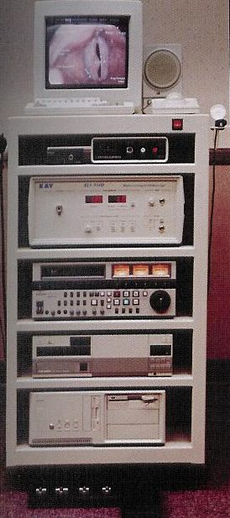

Slide 38
Differential Diagnosis of Dysphonia : KITTENS Method
Congenital Infectious & Trauma & Tumor Endocrine Neurologic Systemic
Congenital Laryngitis Laryngeal cysts, Recurrent Hypothyroidism Cerebral GERD
(Viral, bacteria, nodules, polyps laryngeal (laryngeal palsy
& fungal) & ulcers papillomatosis myxedema)
Under- vocal fold voice laryngeal adrenal, extra- connective
Developed paralysis abuse cancer pituitary, pyramidal tissue
Larynx gonadic lesions disorders disorders (parkinson’s) (rheumatoid
arthritis, SLE)
Adductor Reinker’s Benign
Spasmodic edema laryngeal
Dysphonia neoplasms
arytenoid (hemangiomas, Pubescence stroke Psychogenic
dislocation cystic hygromas Guillain Barre’
muscle-tension vocal fold Myasthenia gravis
disorders granulomas Other
Caustic neurological
inhalation disorders
injuries

Slide 39
ANCILLARY TESTS
Videostroboscopy:
Laryngeal EMG:

Slide 40
BENIGN LARYNGEAL PATHOLOGY Congenital Laryngeal Defects
Congenital Webs
Most commonly anteriorly based
Pathophysiology : incomplete recanalization
Types: supraglottic (2%) glottic (75%), subglottic (7%)
Symptom: aphonia, stridor
Management:

Slide 41
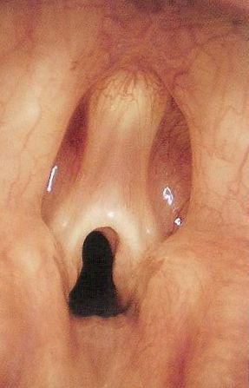

Slide 43
CONGENITAL SUBGLOTTIC
STENOSIS
< 4 mm in newborn
Pathophysiology: incomplete recanalization
Types
1. Membranous
2. Cartilaginous
3. Mixed
Grades: I. <50% obstruction, II 50-70%, III- 70-90% IV.> 90-Complete obstruction
Symptom: stridor

Slide 45
CONGENITAL SUBGLOTTIC STENOSIS
Management
Secure Airway
Medical Management
Grade I-II: Endoscopic management
Grade III-IV: Open Procedures:
Anterior Cricoid Split
Posterior Cricoid Split
Laryngofissure
Segmental Resection with End to End Anastomosis

Slide 46
LARYNGOMALACIA
Most common laryngeal anomally
Most common cause of stridor in
neonate and chronic pediatric stridor
Pathophysiology : immature
cartilage
Symptom: inspiratory stridor
Diagnosis:
Management: observation , epiglottoplasty , correct GERD if present.

Slide 48
TRACHEOMALACIA
Less common
Pathophysiology
Symptom: expiratory stridor
Diagnosis:
Management: observation.

Slide 49
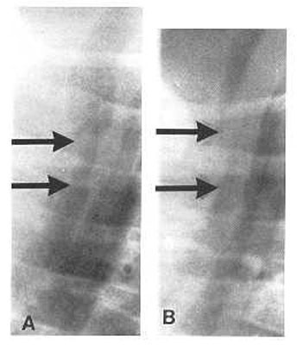
TRACHEOMALACIA

Slide 50
LARYNGITIS
Acute Viral Laryngitis
Pathogens: rhinovirus (most
common)
Symptom:
Management : conservative

Slide 51
ADULT SUPRAGLOTTITIS
Common Pathogens: H. influenza (most common) S. pneumoniae. S.aureus, β hemolytic Streptococcus
Symptom:
Management:
1. Evaluate airway
2. Humidification
3. Parenteral antibiotics

Slide 52
Reflux – Induced Laryngitis
Pathophysiology
Clinical feature
Laryngeal Findings
Management

Slide 54
CROUP (Acute Laryngotracheobronchitis, LTB)
Most common cause of stridor in children
Subglottic region
Pathogen: parainfluenza 1 (most common cause)
Risks: 1-5 years old during fall and winter seasons
Sign&symptom:
Diagnosis: plain neck films (“Steeple”)

Slide 56
CROUP (Acute Laryngotracheobronchitis, LTB)
Management
Assess Airway
Medical Management
Endoscopy

Slide 57
Epiglottitis
Pathogen
Risks
Clinical feature
Diagnosis: plain neck films (“thumbprint sign’)
Complications

Slide 60
Epiglottitis
Management
Establish Emergent Airway
Endoscopy
Postoperative care parenteral antibiotics and corticosteroids

Slide 61
Contrasting Acute Laryngotracheobronchitis (Croup) and Epiglottitis
 | Acute Laryngotracheo bronchitis Epiglottitis | Acute Epiglottitis
Pathogen | Parainfluenza virus 1 | Haemophilis influenze B
Age | <5 years old | 2-6 years old
Location | subglottic | supraglottic
Onset | gradual (days) | sudden onset (hours)
Cough | barky | normal
Posture | supine | upright
Drooling | no | yes
Fever | low grade | high fevers
Radiographs | steeple sign | thumb printing
Treatment | supportive | airway management

Slide 62
Examples of Specific Chronic Laryngitis
TB Laryngitis
Syphilitic Laryngitis
Scleroma of the Larynx/ Rhinoscleroma
Leprosy (Hansen’s Disease)
Perichondritis of the Larynx/Polychondritis
Fungal Laryngitis

Slide 63
Common Benign Laryngeal Neoplasms Recurrent Respiratory Papillomatosis
Pathophysiology
Lesion: wart-like, irregular exophytic
Types:
1. Juvenile
2. Senile
Clinical feature
Complications

Slide 67
Common Benign Laryngeal Neoplasms Recurrent Respiratory Papillomatosis
Management
Microlaryngoscopy with Laser
Excision:
Avoid tracheotomy
Adjunctive Therapy: αINF…….

Slide 68
Systemic Disease Affecting the Larynx
Sarcoidosis
Wegener’s Granulomatosis
Amyloidosis
Arthritis of Cricoarytenoid Joint

Slide 69
Other Common Laryngeal Lesion
Acquired Stenosis - Subglottic
Edema - Reink’s edema
Cysts - laryngeal cyst
laryngocele

Slide 70
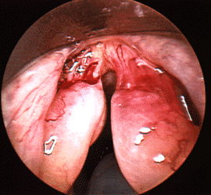

Slide 71
Subglottic haemangioma
Most common in subglottic space
- 50% of subglottic hemangiomas associated
with cutaneous involvement
Typically presents by 6 months old then involutes by 2 years of age
Types:
- capillary (typically resolve)
- cavernous
SSX: biphasic stridor
DX :endoscope
RX: - observation
- Crticosteroid
- CO2 Laser

Slide 72
Hemangioma
Management
May observe if asymptomatic and non progressive
Embolization
Corticosteroids or interferon.
Endoscopic CO2 or argon laser excision (YAG lasers).
Radiation therapy may be considered although increases risk of malignant degeneration.

Slide 74
Traumatic Conditions of the Larynx
Direct injuries (blows)
Penetration (open)
Burns (inhalation , corrosive fluids)
Inhalation foreign bodies
Intubations injuries :
Prolonged intubation
Blind intubation
too large tube
pathology :
Abrasion ► granulomatous formation… subglottic stenosis
SSX; hoarsness , dyspnoea
RX:
voice rest
endoscopic removal
prevention

Slide 76
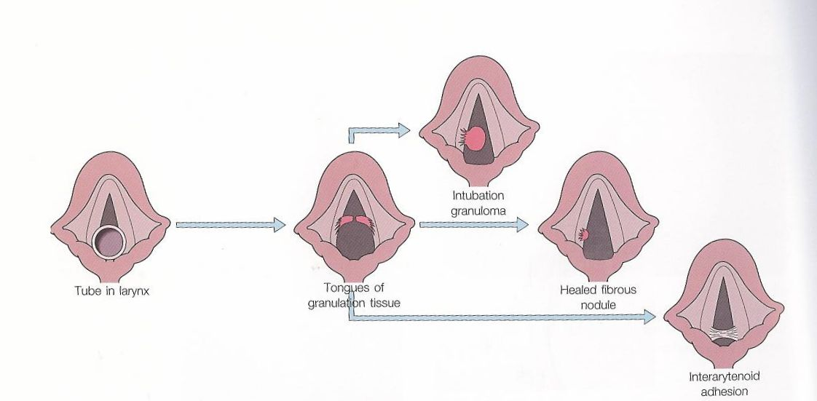
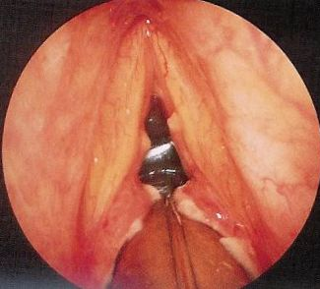
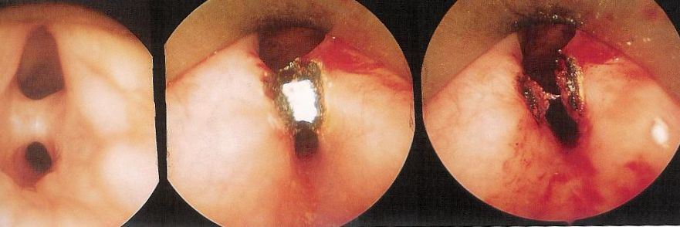
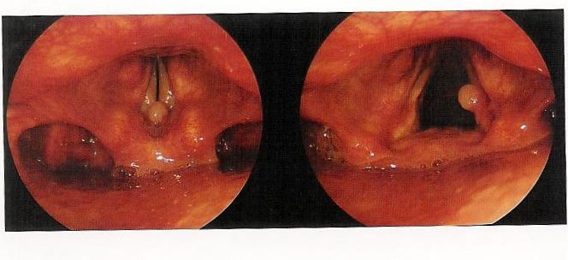

Slide 77
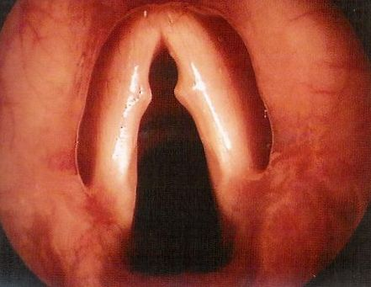
Vocal fold lesions secondary to vocal abuse and trauma
Vocal nodules (singer’s nodules)
At junction of ant 1/3 and mid 1/3
RX :
- voice therapy
- surgical excision (microlaryngoscopy)

Slide 78
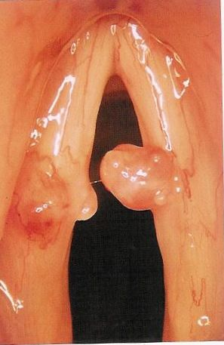
Vocal fold polyp :
Middle and ant 1/3 , free edge , unilateral
Mucoid , hemorrhagic
RX :
- surgical excision

Slide 80
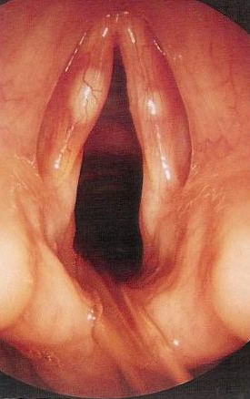
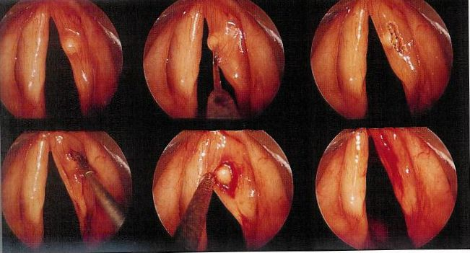
Vocal fold cyst
congenital dermoid cyst
mucus retention cyst
RX:
- surgical excision

Slide 81
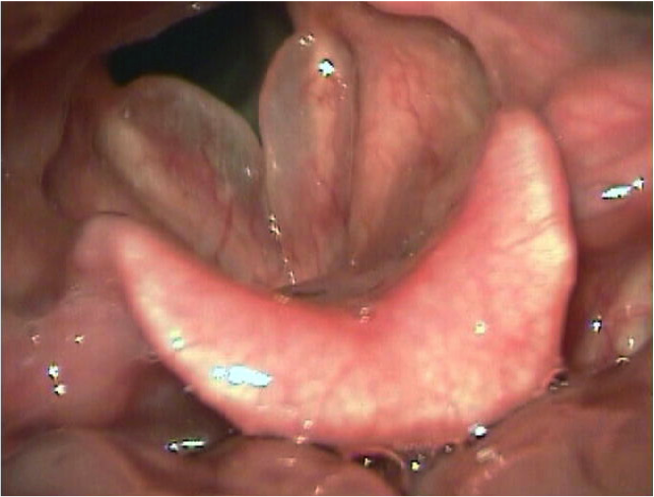
Reinke’s edema
RX:
- voice rest ,stop smoking, anti reflux therapy
- surgical excision

Slide 82
Laryngocele
Air filled dilation of the appendix of the ventricle, communicates with laryngeal lumen
congenital or acquired
types :
External : through thyrohyoid membrane
Internal :
Combined
Rx :marsupialization

Slide 83
Neurogenic Vocal Pathologies

Slide 84
Vocal Fold Paralysis Evaluation of Vocal Fold Paralysis
History and Physical
Vocal Fold Positioning

Slide 85
Vocal Fold Paralysis Evaluation of Vocal Fold Paralysis
Causes of Vocal Fold Paralysis in Adults
Neoplastic
Iatrogenic Injury
Idiopathic
Trauma
Neurological
Infectious
Systemic Diseases
Toxins

Slide 86
Vocal Fold Paralysis Evaluation of Vocal Fold Paralysis
Causes of Vocal Fold Paralysis in Pediatrics
Idiopathic
Birth Trauma
Iatrogenic Injury
Infection
Vascular Abnormalities

Slide 87
Vocal Fold Paralysis Evaluation of Vocal Fold Paralysis
Unilateral Vocal Paralysis Management
Must determine if self limiting or permanent paralysis
May not require surgical management
Goal of unilateral surgical procedures is to medialize vocal fold

Slide 88
Vocal Fold Paralysis Evaluation of Vocal Fold Paralysis
Surgical Management of Unilateral Vocal Fold Paralysis
Vocal Fold Injections
Thyroplasty

Slide 91
Vocal Fold Paralysis Evaluation of Vocal Fold Paralysis
Bilateral Vocal Fold Paralysis Management
Goal is lateralize vocal fold
Tracheotomy: gold standard treatment
Cordotomy (Laser)
Arytenoidectomy

Slide 92
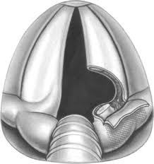
Arytenoidectomy

Slide 93
Thanks!!!

