Slide 1
ميحرلا نمحرلا الله مسب

Slide 2
TRAUMA and FBs in ENT

Slide 3
Objectives of the lecture
Discuss the presentation of patients with trauma to the nose, ear or the larynx and patients with ingested or inhaled FBs or with FBS in the nose or the ear.
Discuss the management of those patient with
emphasis on the emergency treatment.

Slide 4
Nasal Trauma

Slide 5
Manifestations of nasal trauma
Fracture nasal bone
Septal injury
  Displacement
  Hematoma
  Perforation
Synechia
CSF rhinorrhea
Epistaxis

Slide 6
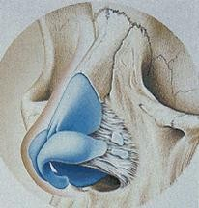
Fracture Nasal Bone

Slide 7
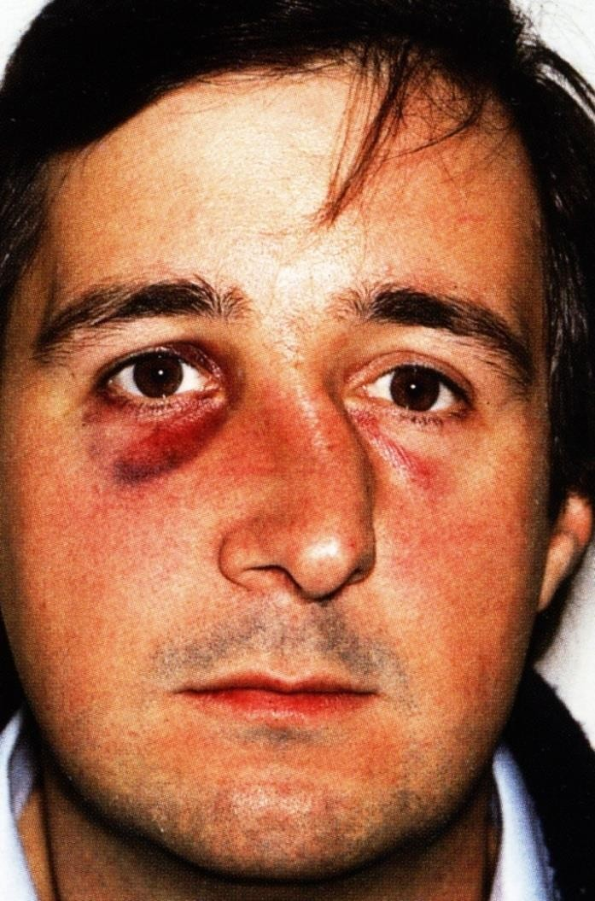
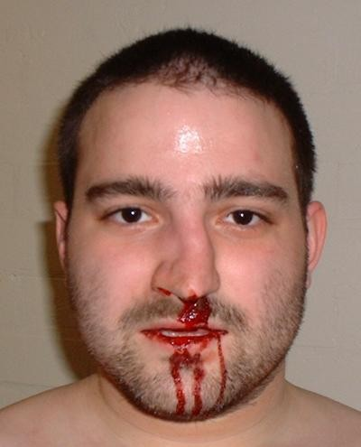
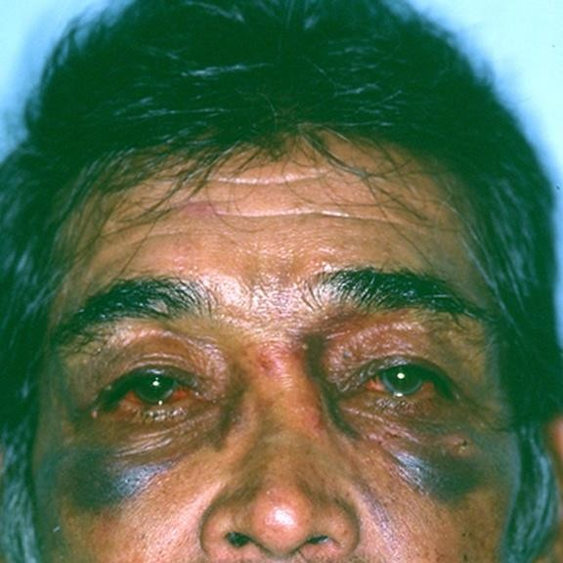
Physical Examination

Slide 8
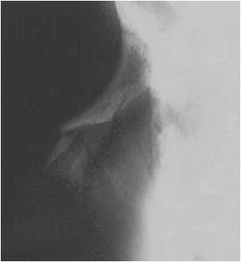
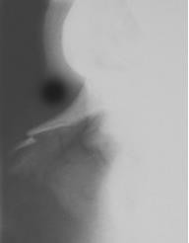
Radiology
Usually is not necessary because treatment
depends on the clinical findings

Slide 9
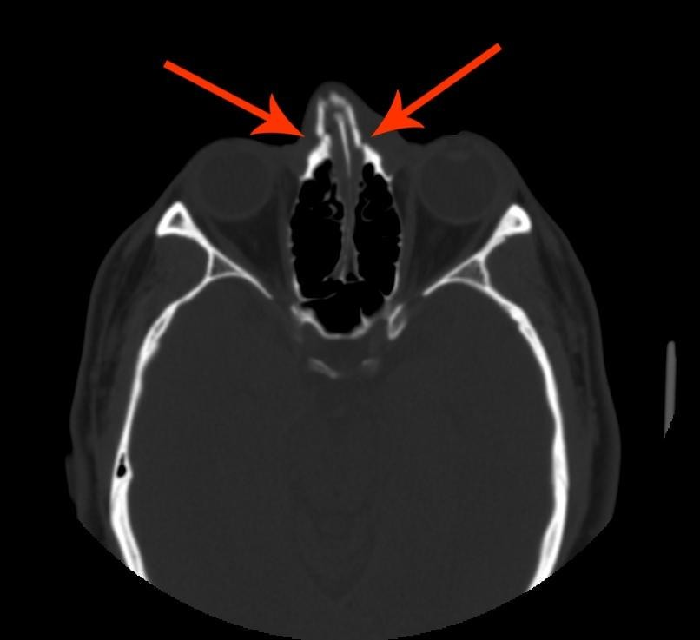

Slide 10
Management of fractured nasal
bone
Depends upon the presence or the absence of nasal deformity (for proper assessment of the “shape” of the nose you may wait “few” days for the edema to subside)
No deformity
Deformity
•Reduction if presented early
No treatment
•Rhinoplasty if presented late

Slide 11
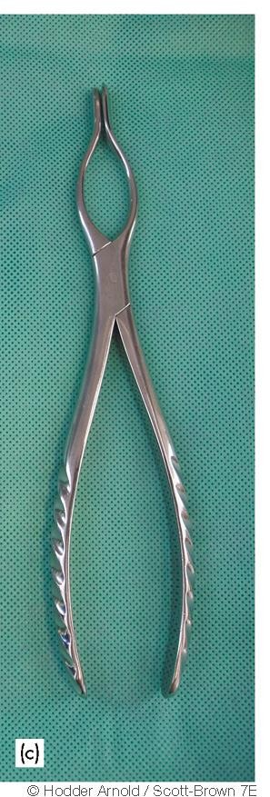
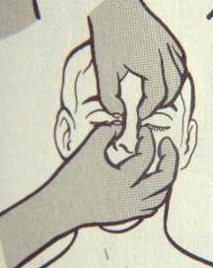
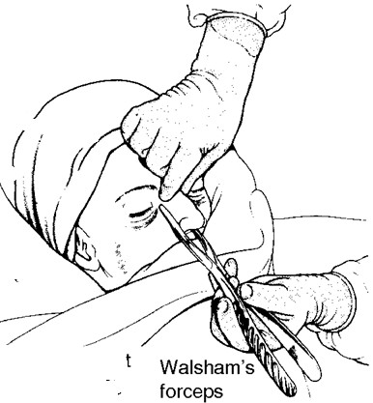
Reduction

Slide 12
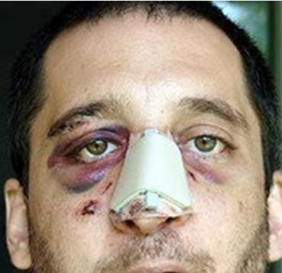

Slide 13
Rhinoplasty
To correct “old” fractures

Slide 14
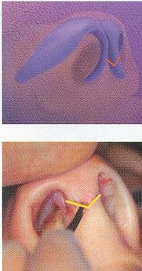
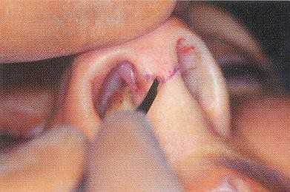
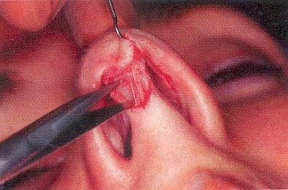

Slide 15
Nasal Septum Injury

Slide 16
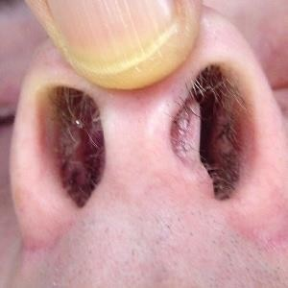
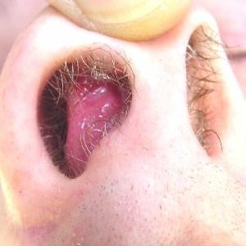
Displacement of nasal septum

Slide 17
Presentation
May be asymptomatic
Nasal obstruction
Cosmetic deformity

Slide 18
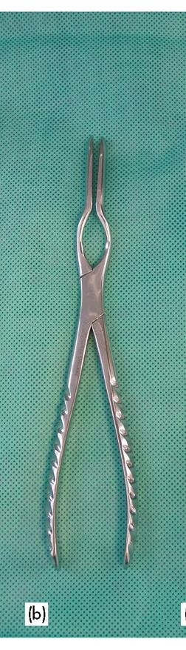
Treatment of displacement of nasal
septum
No symptoms: no treatment
Symptomatic
  Early presentation: Reposition
  Late presentation: Septoplasty

Slide 19
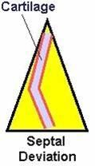
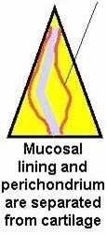
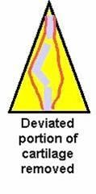
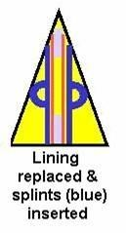
Septoplasty

Slide 20
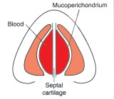
Septal hematoma

Slide 21
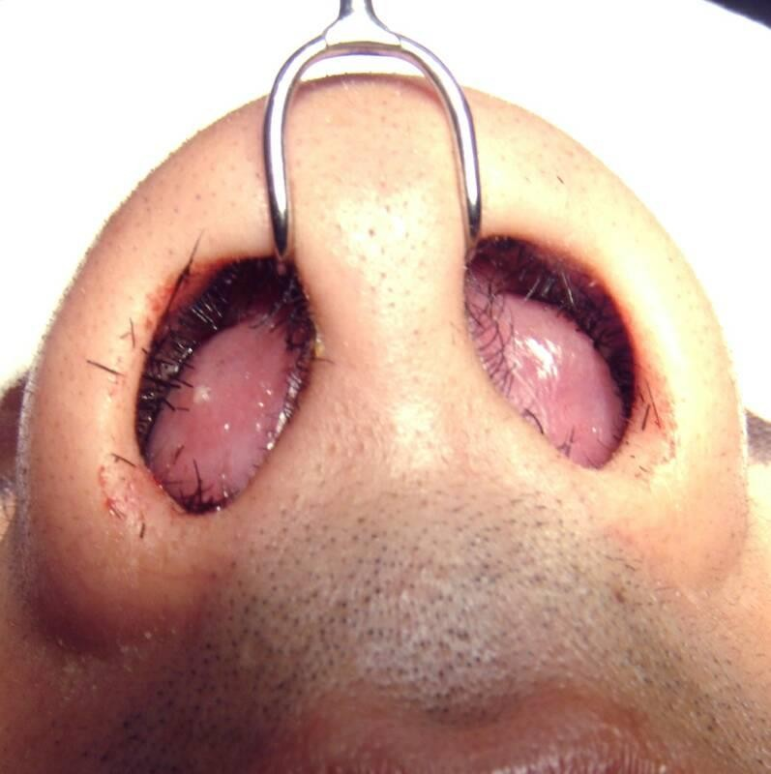
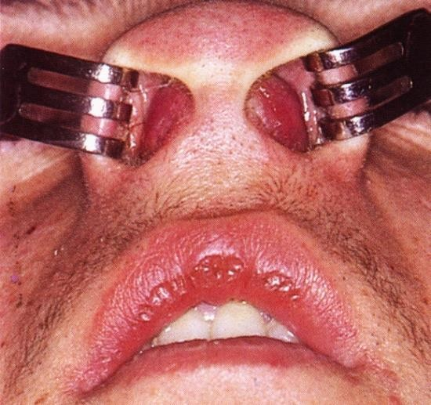
Septal hematoma

Slide 22
Presentation
Nasal obstruction

Slide 23
Complications of Septal hematoma
Necrosis of the cartilage
– Deformity

Slide 24
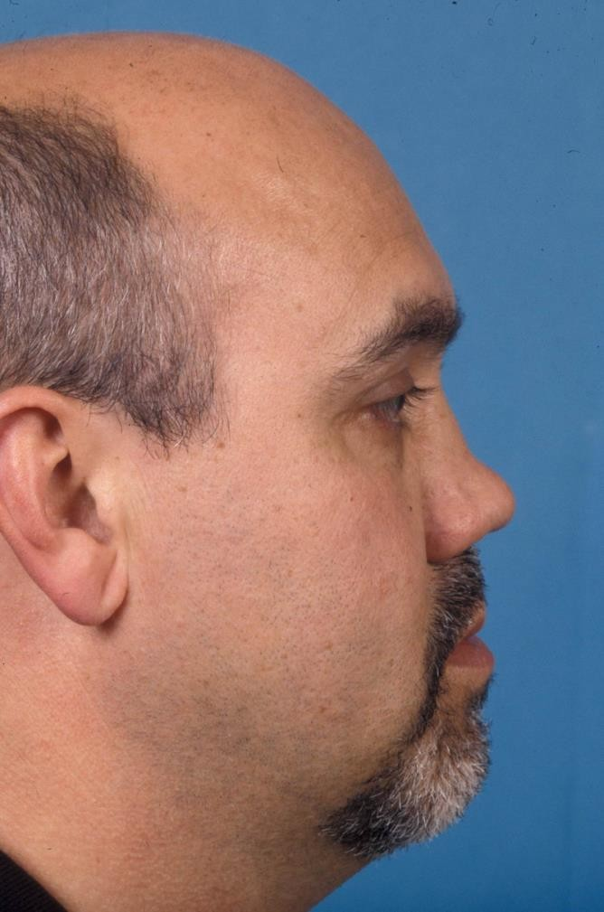
Complications of Septal hematoma
Necrosis of the cartilage
– Deformity

Slide 25
Complications of Septal hematoma
Necrosis of the cartilage
  Deformity
Infection
  Septal abscess
  Spread to the intracranium

Slide 26
Treatment of septal hematoma
Immediate incision & drainage

Slide 27
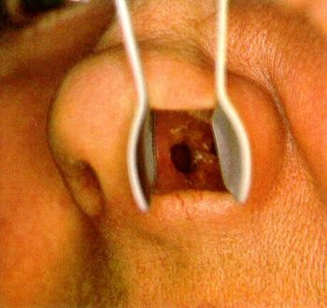
Traumatic septal perforation
Mostly due to
surgical trauma
May be due to self
inflicted trauma

Slide 28
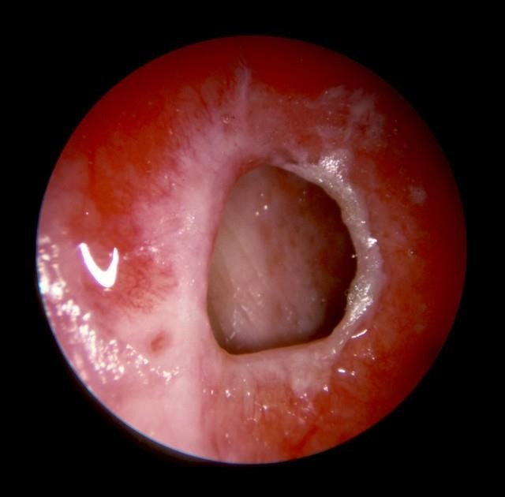
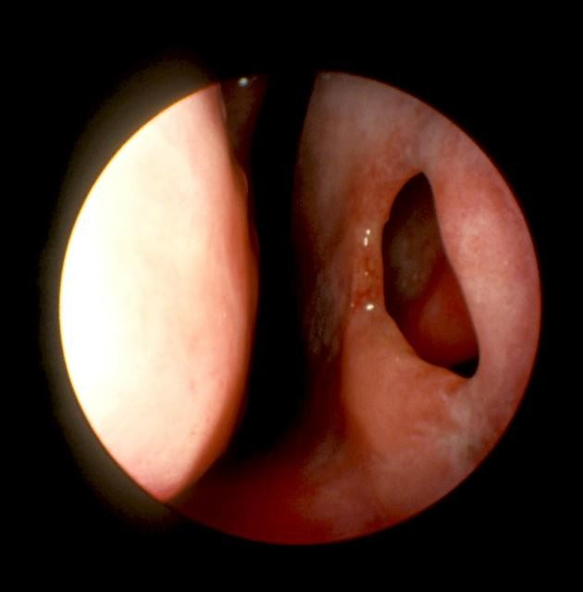

Slide 29
Symptoms
No symptoms
Whistling sound during breathing
Crusting and epistaxia

Slide 30
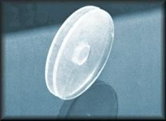
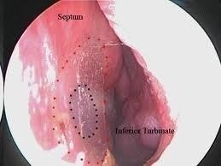
Treatment
No treatment
Nasal wash
Surgical repair
Insertion of silicon “button”

Slide 31
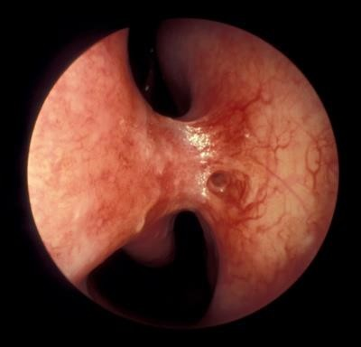
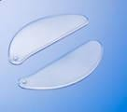
Synechia
Usually follow surgery
May be asymptomatic
May cause nasal obstruction
If symptomatic, treatment is by division and insertion of silastic sheets (for 10 days)

Slide 32
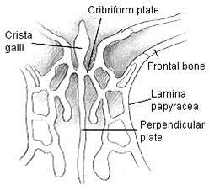
CSF Rhinorrhea
Due to injury of the roof of the nos and the dura
e
33

Slide 33
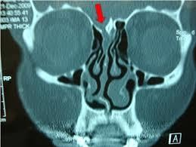
CSF Rhinorrhea
Due to injury of the roof of the nose and the dura
34

Slide 34
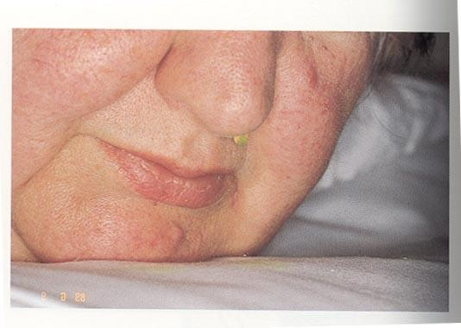
CSF Rhinorrhea
Due to injury of the roof of the nose and the dura
Unilateral watery rhinorrhea increases by bending forward, exertion and coughing
35

Slide 35
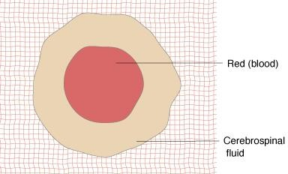
CSF Rhinorrhea
Due to injury of the roof of the nose and the dura
Unilateral watery rhinorrhea increases by bending forward, exertion and coughing
Halo sign
Diagnosis is confirmed by biochemical analysis (Beta-2-transferrin) and by radiology
Most cases resolve with conservative treatment
Surgical repair may be needed in
minority of cases
36

Slide 36
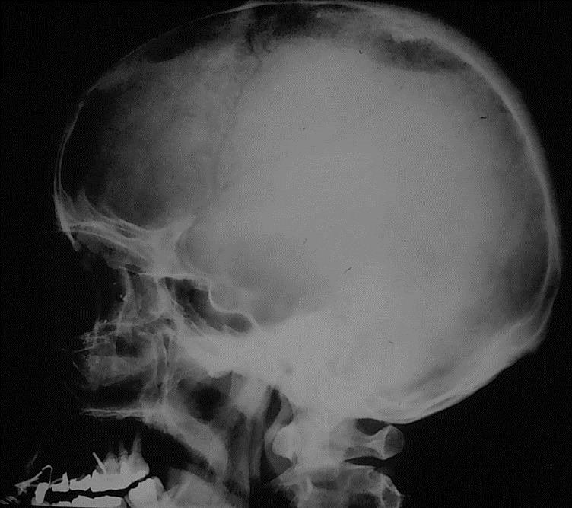
Complications of CSF Rhinorrhea
Meningitis
Tension pneumocephalus

Slide 37
Sinus Trauma

Slide 38
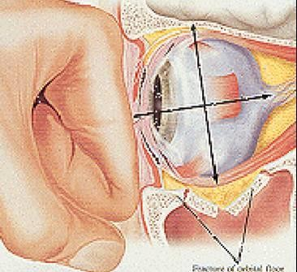
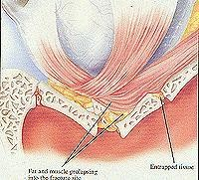
Blow-out fracture
Injury of the orbital floor (maxillary sinus roof)
due to blunt trauma to the orbit

Slide 39
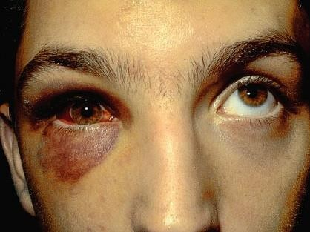
Physical examination
Enophthalmos
Subconjuctival hge
Diplopia and restriction of upward gaze

Slide 40
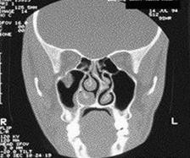
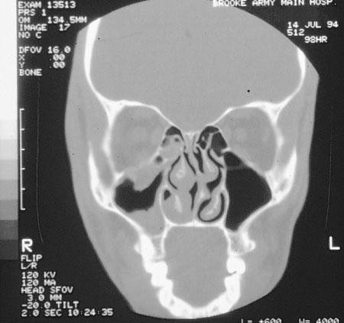
Radiology
Tear-drop sign

Slide 41
Treatment
Repair

Slide 42
Nasal Foreign Bodies
May be asymptomatic
Unilateral nasal obstruction
Bad odor blood stained unilateral nasal
discharge

Slide 43
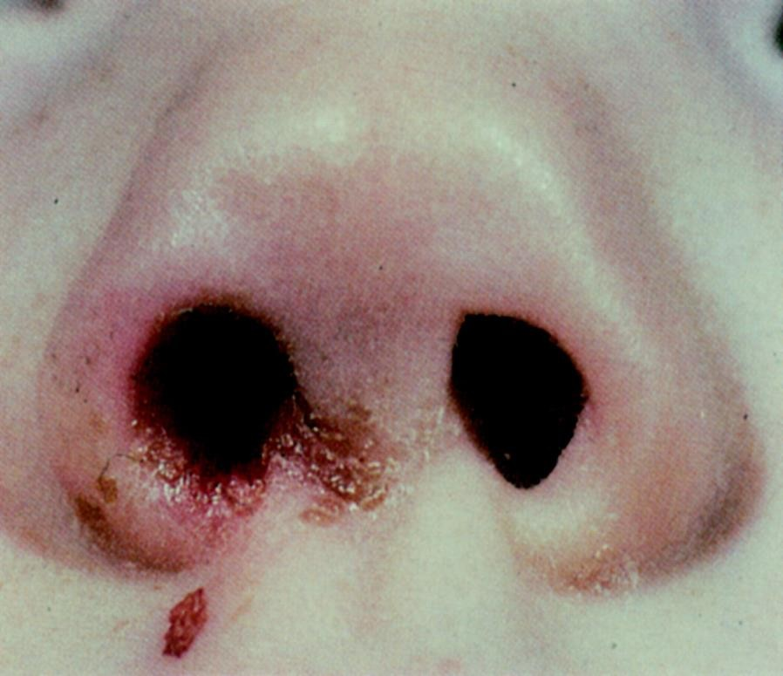
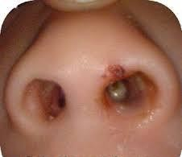
Examination

Slide 44
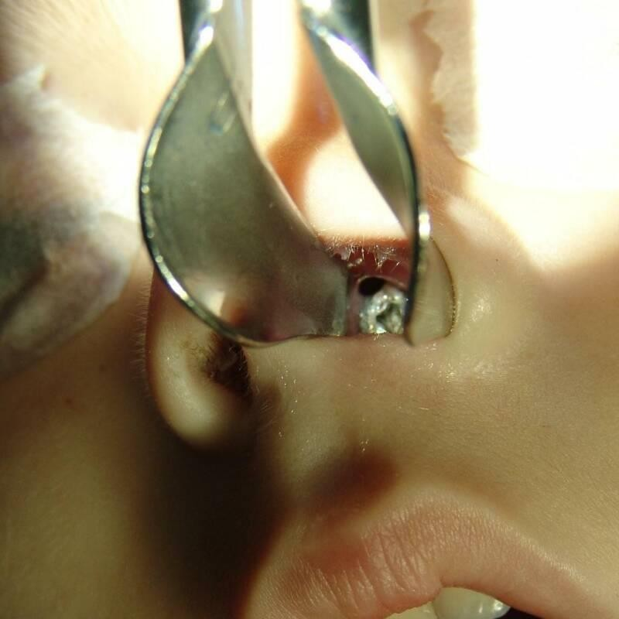
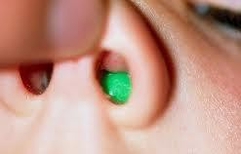

Slide 45
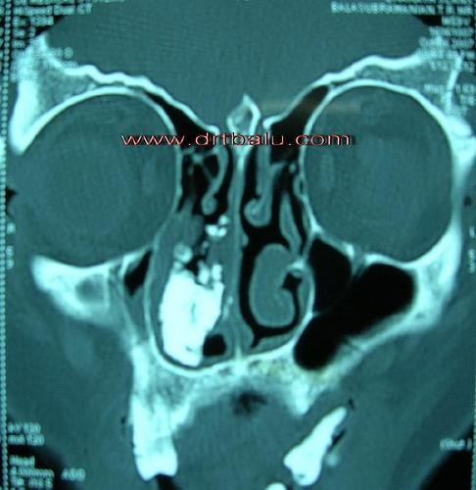
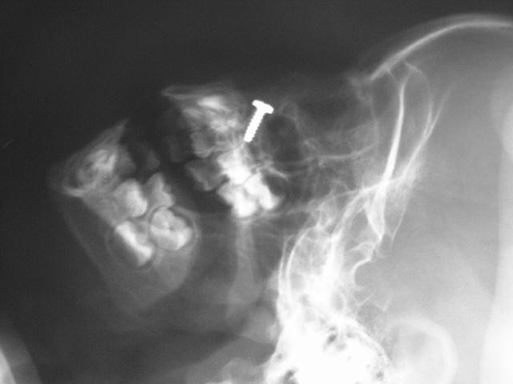
Radiology
Rhinolith

Slide 46
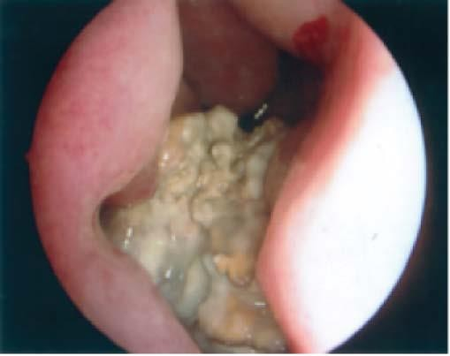

Slide 47
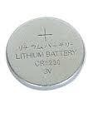
Treatment
Removal (general anesthesia may be needed)
Disc batteries removal is an emergency because of sever necrosis due to release of NaOH, KOH, & mercury

Slide 48



Slide 49


Slide 50
Ear Trauma

Slide 51


Trauma to the Auricle
Laceration

Slide 52


Slide 53


Slide 54


Trauma to the auricle
Hematoma auris

Slide 55


Complication
Cauliflower ear

Slide 56


Treatment

Slide 57
F Bs external ear

Slide 58
Presentation
No symptoms
Earache
Deafness

Slide 59




FBs external canal

Slide 60


Removal FBs ear
Full cooperation from the patient; otherwise
go to general anesthesia
Disc batteries are emergency
Live insects to be killed or floa
Removal by : syringing and/or by instrumentation
t out

Slide 61



Slide 62




Slide 63



Slide 64
Traumatic TM Perforation
Presentation
History of trauma
Earache
Deafness
Bloody otorhea

Slide 65


Traumatic TM Perforation

Slide 66


Slide 67
Treatment of traumatic TM perforation
Observation
  Most cases heel spontaneously
  No suction, no drops & no water
Elective myringoplasty

Slide 68
Middle ear trauma

Slide 69

Hemotympanum
Usually is asymptomatic
May cause conductive hearing loss
Treated by observation because most cases resolve spontaneously

Slide 70

Traumatic Ossicular disruption
Suspected if trauma followed by
CHL with intact TM
Diagnosis is confirmed by CT and/or by surgical exploration (tympanotomy)
Treatment is by surgical repair

Slide 71
Otitic barotrauma
Pathological conditions of the ear induced by pressure
changes .
Middle ear otitic barotrauma results from failure of the Eustachian tube to equalize an increasing atmospheric pressure
Occurs most commonly during descent from high altitudes in aircraft or during descent in underwater diving
Pathology: the negative middle ear pressures causes transudate in the middle ear, rupture of superficial vessels, retraction of TM, and may cause perforation
Symptoms: discomfort, pain & deafness.

Slide 72




Examination

Slide 73
Treatment
Prophylactic

Slide 74

Treatment
Prophylactic
Decongestant, analgesic and auto inflation
(Valsalva maneuver)

Slide 75



Treatment
Prophylactic
Decongestant, analgesic and auto inflation
(Valsalva maneuver)
Myringotomy ± VT insertion

Slide 76



Fracture temporal bone
Longitudinal #
Transverse #

Slide 77
Temporal bone fractures
Longitudinal fracture | Transverse fracture

Slide 78
Temporal bone fractures
Longitudinal fracture | Transverse fracture
70% | 20%

Slide 79
Temporal bone fractures
Longitudinal fracture | Transverse fracture
70% | 20%
Conductive hearing loss (rupture drum, hemotympanum or ossicular disruption)

Slide 80
Temporal bone fractures
Longitudinal fracture | Transverse fracture
70% | 20%
Conductive hearing loss (rupture drum, hemotympanum or ossicular disruption) | SNHL & vertigo (Labyrinthine injury)

Slide 81
Temporal bone fractures
Longitudinal fracture | Transverse fracture
70% | 20%
Conductive hearing loss (rupture drum, hemotympanum or ossicular disruption) | SNHL & vertigo (Labyrinthine injury)
Facial nerve paresis is not common

Slide 82
Temporal bone fractures
Longitudinal fracture | Transverse fracture
70% | 20%
Conductive hearing loss (rupture drum, hemotympanum or ossicular disruption) | SNHL & vertigo (Labyrinthine injury)
Facial nerve paresis is not common | Facial nerve paralysis is common

Slide 83

Manifestation
Battle sign

Slide 84

Manifestations
Battle sign
TM perforation
Hemotympanum
CSF otorrhea or rhinorrhea
Ossicular disruption
SNHL
Vertigo
Facial nerve paralysis

Slide 85


FB pharynx
Usually sharp FB
Fish bone is the most common
Common sites: tonsils, base of tongue and vallecula
Diagnosis is by physical examination
Treatment is by removal

Slide 86
FB esophagus
Coins – 75%
Meat, dentures, disc batteries etc

Slide 87

FB esophagus
Common locations
  Cricopharyngeus
  Aorta/left mainstem bronchus
  Gastroesophageal junction

Slide 88
Diagnosis
Symptoms
  Dysphagia, odynophagia, choking & cough
Physical exam
  Drooling, refuses oral intake
Radiolgy

Slide 89



Plain X ray

Slide 90



Slide 91



Slide 92
Diagnosis
Symptoms
  Choking, coughing, dysphagia, odynophagia
Physical exam
  Drooling, refuses oral intake
Radiolgy
Esophogoscopy

Slide 93


Treatment
Removal via esophagoscopy
Disc batteries and sharp objects removal is an
emergency because of the risk of perforation

Slide 94
Laryngeal Trauma

Slide 95



Presentation

Slide 96
Presentation
Stridor
Hoarseness
Subcutaneous emphysema
Hemoptysis
Laryngeal tenderness, swelling and edema

Slide 97


Laryngoscopic Exam

Slide 98
Treatment
Tracheostomy if there is respiratory distress or
bleeding
Explore and repair

Slide 99

Foreign bodies of the larynx
Dyspnea
Cough
Hoarseness or aphonia

Slide 100
Treatment
Heimlich Maneuver

Slide 101


Slide 102
Treatment
Heimlich Maneuver
Slapping the back with the patient’s head
down

Slide 103


Slide 104
TREATMENT
Heimlich Maneuver
Slapping the back with the patient’s head
down
Manual removal
Removal by laryngoscopy
Tracheostomy or laryngostomy (cricothyrotomy)

Slide 105


Foreign bodies in the tracheobronchial tree
Usually in infants and
children
Most FB’s are organic material (mostly food derivatives)
Location: Mostly in the right side ( 60%)

Slide 106
CLINICAL PRESENTATION
Choking, cough, gagging & cyanosis
  Caused by laryngeal reflexes
Asymptomatic phase
  Due to fatigue of cough reflex
Wheeze, intractable cough, persistent or recurrent chest infection.
  Due to emphysema, atelectasis or infection

Slide 107


Slide 108
Radiology of tracheobronchial
F.Bs

Slide 109
1 Normal

Slide 110

2 Radio-opaque FB

Slide 111



Slide 112


Slide 113


3 Emphysema
Inspiration
Expiration

Slide 114

4 Collapse

Slide 115

5. Bronchopneumonia

Slide 116

Treatment
To be initiated on clinical suspicion
Bronchoscopy: in most cases
Bronchotomy
Pulmonary resection

Slide 117


Slide 118


Slide 119


Slide 120
THANK YOU

