Slide 1
Audiology presentation
Murad Almomani, Ph.D., CCC-A, FAAA
American Board of Audiology

Slide 2
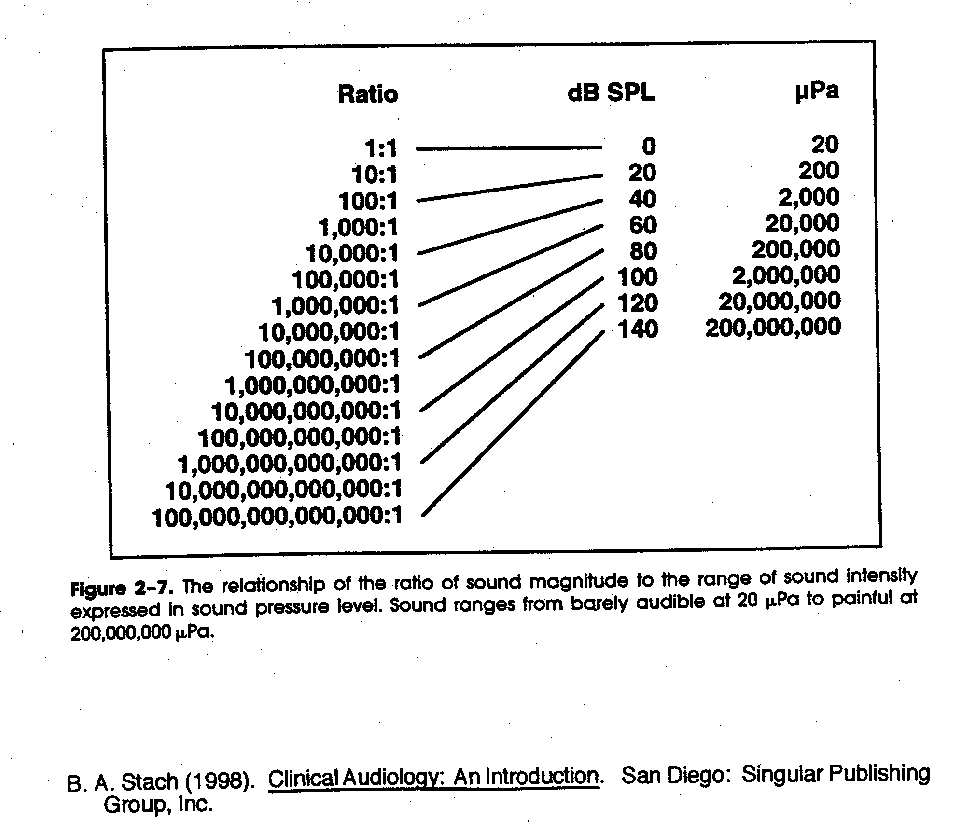

Slide 3
The Minimal Audible Pressure Curve (dB SPL)
Indicates the minimum average sound pressure levels by frequency for a group of people with normal hearing

Slide 4
Age based hearing assessment
BEHAVIOURAL
OBJECTIVE
SCHOOL-AGED +
PURE TONE AUDIOMETRY
Request responses
Measure responses
PLAY AUDIOMETRY
TODDLER
Condition responses
VROA
BIRTH
Need to consider individual’s functional age

Slide 5
Behavioural Observation Audiometry (BOA)
Observing changes in behaviour in response to sounds
Who?
Very young babies (under 6mths corrected) or with similar functional age.
Test sounds & materials
Calibrated (known frequency and intensity) noisemakers
Audiologist records sound level (from sound level meter), sound type & observed response- observer determines whether response is present/absent

Slide 6
Infants 7 months-3 years
Aim: to detect hearing impairment greater than 20-30 dB HL
Typically use behavioral techniques
  Visual Reinforcement Orientation Audiometry (VROA) for 6-18 months
  Play audiometry
May incorporate objective testing if non-compliant or very difficult to test

Slide 7
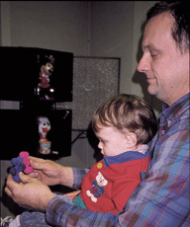
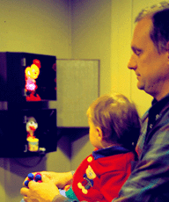
Visual Reinforcement Orientation Audiometry (VROA)
  Uses operant conditioned response and visual reinforcement
    Response typically head turn. Eye turn also possible
    Complex visual reinforcement usually lighted puppet theatre- color movement and light are important

Slide 8
Play audiometry 3-9 years
Before testing
  Subjective check of audiometer
  Check test environment, audibility of tones
  Avoid visual clues
  Instruct client, demonstrate procedure
  Position headphones
  Present orienting tone (40dBHL) and check client’s response. Re-instruct if necessary

Slide 9
Pure tone audiometry
Murad Al-momani, Ph.D., CCC-A, FAAA, American Board in Audiology

Slide 10
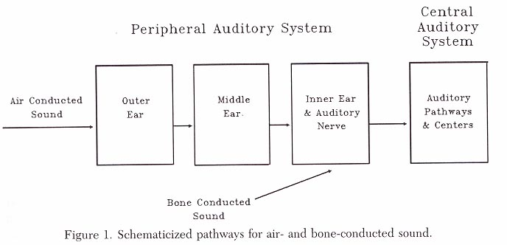
Pure Tone Audiometry
Most common test
Threshold of audibility
Activation of auditory system
Energy formatted into neural code
Air conduction assesses entire system
Bone conduction assesses cochlea onwards

Slide 11
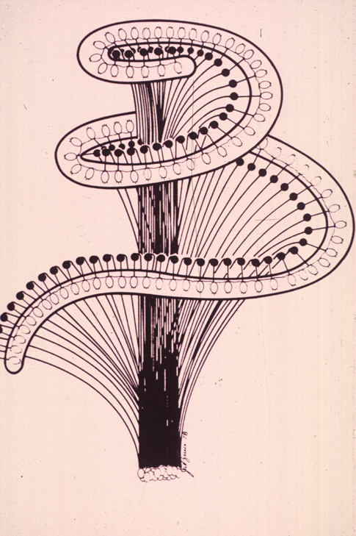
Pure Tones
Auditory acuity
Spectrally specific
High frequency tones stimulate basal turn of the cochlea
Low frequency tones stimulate apical turn of the cochlea

Slide 12
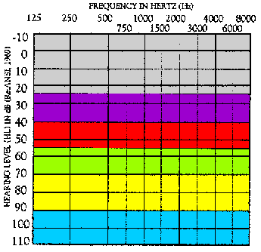
Ranges of Hearing Loss
-10 – 25 dB HL = Normal range
26 – 40 dB HL = Mild hearing loss
41 – 55 dB HL = Moderate
56 – 70 dB HL = Moderately Severe
71 – 90 dB HL= Severe
Greater than 90 dB HL = Profound

Slide 13
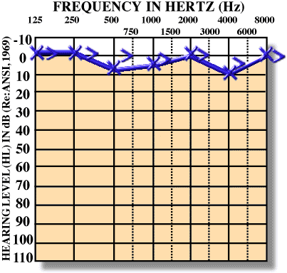
Normal Hearing

Slide 14
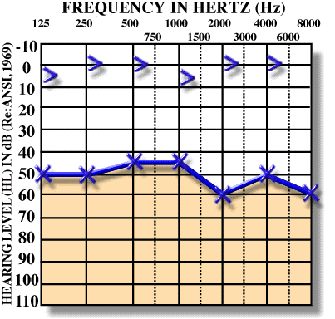
Conductive Hearing Loss

Slide 15
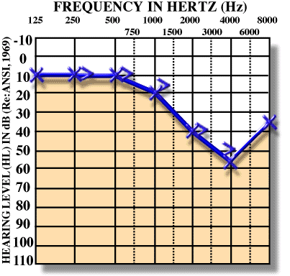
Sensorineural Hearing Loss

Slide 16
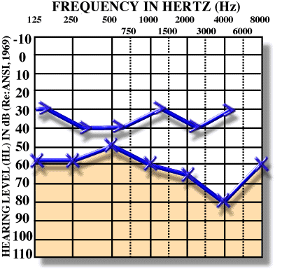
Mixed Hearing Loss

Slide 17
Procedures for conventional pure-tone audiometry
After history taking and otoscopy we must choose how to test the hearing thresholds.
Before we do pure tone audiometry (PTA), we usually perform middle ear immitance testing
PTA will be almost done to all pts visiting us in the clinic because it is the basic test and give us a lot of information about the problem.

Slide 18
Air conduction testing
When measuring behavioral air conduction thresholds, we are measuring a response to sound passed through the entire auditory pathway.
Thus if the patient responds to pure tones at normal levels, we can be sure that the auditory system is reasonably intact from the outer ear to the auditory cortex.
But that does not imply that there is no damage some where in the auditory system.
For example in some retrocochlear lesions, the pt responds normally to pure tones but he has difficulty recognizing speech.

Slide 19
PTA
With PTA we can determine whether the pt has peripheral hearing loss (that is at the level of outer, middle, inner ear or the auditory nerve).
PTA is administered both by air (air conduction PTA) or by bone (bone conduction PTA).
Air conduction tests are administered by loudspeakers or ear phones.

Slide 20
Pure tones
Pure tones are composed of sine waves that repeats itself at regular intervals.
Pure tones may differ in either amplitude or frequency.
The pure tones that the human ear can detect is between 20 Hz to 20,000 Hz.
But we are most interested infrequencies 125 Hz to 8,000 Hz.

Slide 21
PTA
Testing should be done in a room that is quiet enough to avoid masking by the noise.
The maximum SPL that may exist in the room in order to obtain thresholds near 0 dB HL are determined by ANSI, 1991.
We usually begin at 1000 Hz because some studies found that test-retest reliability is highest at this frequency.

Slide 22
PTA
After establishing threshold at 1 KHz, we move to the frequencies (2000, 4000, and 8000Hz).
If the difference between any two adjacent frequencies is 20 dB or more, we must measure the threshold at the inter octave frequencies.
After we are done from the high frequencies, we return back and check the 1 KHz again to check for test-retest reliability.
Then we test (500, 250 and 125 Hz).

Slide 23
PTA
If we test in the sound field, we must use warble tones instead of pure tones to avoid the production of standing waves.
When using ear phones make sure that there is no excessive wax in EAC and that the earphone is snugly inserted in the canal.
All equipment (audiometer, earphones, and testing room should be calibrated according the standards (will teach you how to do that in the instrumentation course).

Slide 24
PTA-BONE CONDUCTION
The most commonly used procedure for bone-conduction testing is mastoid placement because it is more convenient.
Frontal bone can be used as the place for the bone vibrator.

Slide 25
PTA.BONE CONDUCTION
We should do bone conduction if the air conduction thresholds are above the normal range otherwise we do not need to do bone conduction testing.
Some exceptions?
We first do unmasked thresholds and then we should apply masking to the contralateral ear in order to get precise threshold measurement in this ear (will talk about masking next lecture).

Slide 26
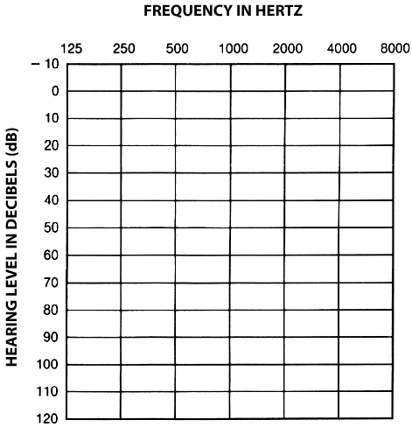
AUDIOGRAM

Slide 27
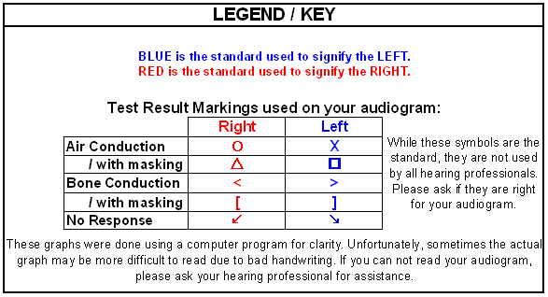

Slide 28
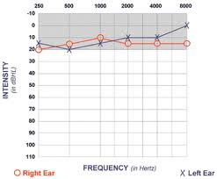

Slide 29
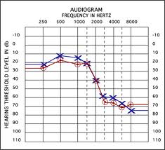

Slide 30
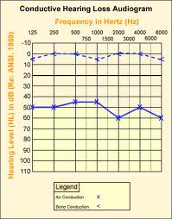

Slide 31
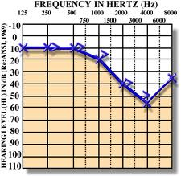

Slide 32
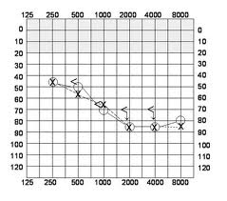

Slide 33
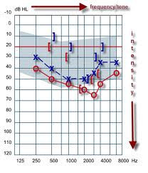

Slide 34
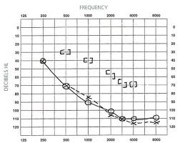

Slide 35
Information we get from audiogram
Degree of hearing loss.
Type of hearing loss.
Configuration of hearing loss.

Slide 36
Clinical Masking
Nontest ear can influence thresholds of test ear
Interaural attenuation varies from 40 to 80 dB with air conduction
Interaural attenuation is about 0 dB with bone conduction.
How we determine need for masking?

Slide 37
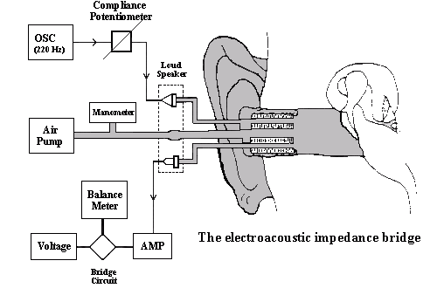

Slide 38
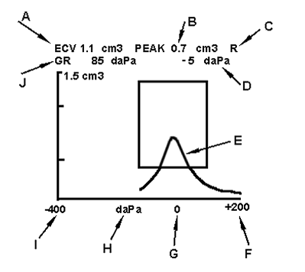

Slide 39
TYMPANOMETRIC FEATURES
Tympanometric shapes.
Static acoustic admittance.
Tympanometric width (gradient).
Tympanometric peak pressure.
Equivalent ear canal volume.

Slide 40
Tympanometric shapes
According to Jerger classification (1970).
Tympanograms are classifieds according to the height and location of the tympanometric peak.
  Type A: has normal peak height and location of the peak.
  Type B: is flat.
  Type C: the peak is displaced to the negative tail.
  Type D: double peak.
  A_{s} : normal but shallow peak admittance.
  A_{d} : normal with excessive admittance.

Slide 41
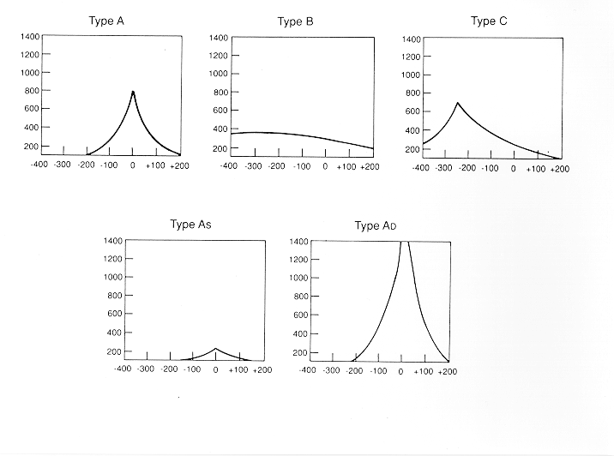

Slide 42
admittance
It is the most important feature.
It is sensitive to middle ear conditions including MEE, chronic otitis media, cholesteatoma and ossicular adhesion, ossicular discontinuity, TM perforation, glomus tumor.

Slide 43
Tympanometric width
The sharpness of the peak is an indicator of middle ear pathology.
Determined by bisecting the distance from the peak to the positive tail of the tympanogram.
The width of the tympanogram at that point is determined in daPa.
Abnormally narrow tympanograms might be related to otosclerosis but this has not been confirmed.
But abnormally wide peak has been found to be related to middle ear effusion.

Slide 44
Tympanometric peak pressure
The pressure at which the peak occurred.
Is an indicator of the pressure in the middle ear space.
Negative pressure is thought to happen because the gases of the bacteria resulted from infection is absorbed by the middle ear mucosa and then a negative middle ear pressure occur.
Studies however found that, without other tympanometric, audiometric or otoscopic abnormalities; negative pressure probably does not indicate a significant middle ear disorder.
Positive middle ear pressure has been reported in acute otitis media.

Slide 45
Equivalent ear canal volume
In the presence of a flat tympanogram, an estimate of the air in the canal can provide valuable information.
Like detecting perforations in the TM. Or patency of the myringetomy tube.
Usually high volume with flat tymps represents either perforations or patent vent tubes.

Slide 46
Sensitivity and specificity
Sensitivity has been found to be around 82% for MEE.
Normal type A has 100% specificity.
Overall sensitivity of around 80% and specificity of around 90%.
That is good but means we need to interpret results with caution.

Slide 47

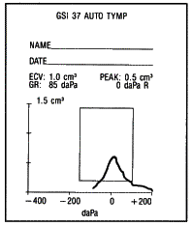
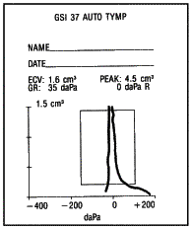
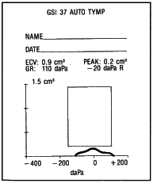
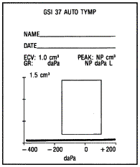
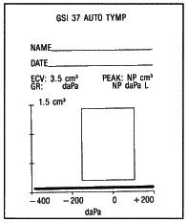
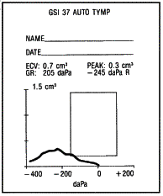
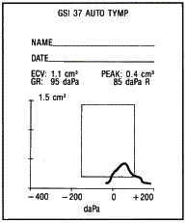
Tympanogram Types

Slide 48
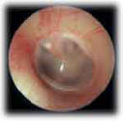
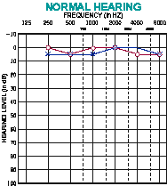
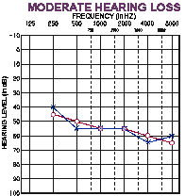
Type A Tympanogram
OE | ME | IE | AN | CNS
AC
A
BC
Normal or SN

Slide 49
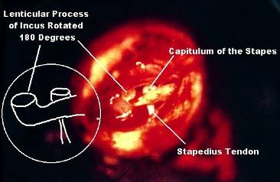
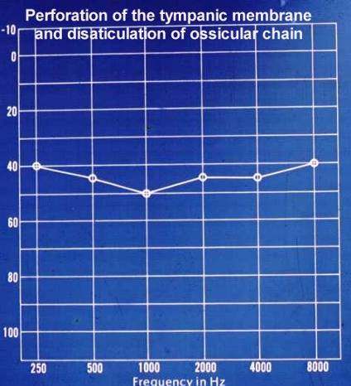
Type AD Tympanogram
OE | ME | IE | AN | CNS
AC
A
D
BC
Disarticulation

Slide 50
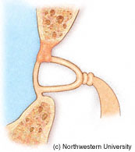
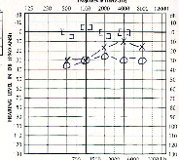
Type AS Tympanogram
OE | ME | IE | AN | CNS
AC
A
S
BC
Otosclerosis

Slide 51
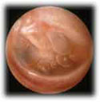
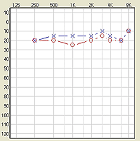
Type BLow Tympanogram
OE | ME | IE | AN | CNS
AC
B
Low
BC
OME

Slide 52
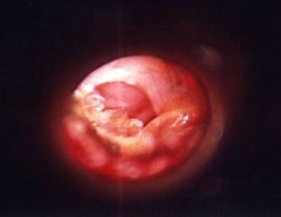

Type BHi Tympanogram
OE | ME | IE | AN | CNS
AC
B
Hi
BC
Perforation

Slide 53
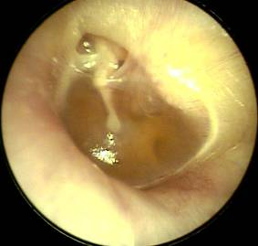
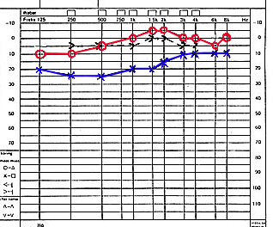
Type C Tympanogram
OE | ME | IE | AN | CNS
AC
C
BC
Eustachian Tube Dysfunction

Slide 54
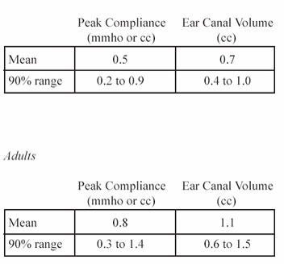
Static Compliance
(Peak Compliance)
Acceptable Range by Age
Flaccid: disarticulation, flaccid TM, etc.
0.9
1.4
Normal mobility
0.2
0.3
Stiff: otosclerosis fluid, tympanosclerosis, etc.
Child
Adult

Slide 55
Tympanometry in infants
Studies has found frequent occurrence of double peaked tymps.
Usually we use higher probe frequency when testing infants like 1000 Hz.

Slide 56
Principles of Acoustic Reflex
Murad Al-momani, Ph.D., CCC-A, FAAA, American Board in Audiology

Slide 57
Introduction
The stapedius muscle contracts reflexively as a result to sufficiently loud acoustic stimulation.
The contraction occurs bilaterally, even when one ear is stimulated only.
The necessary sound level that is necessary to stimulate acoustic reflex is between 70 to 100 dB HL for PT and around 65 dB HL for the white noise.

Slide 58
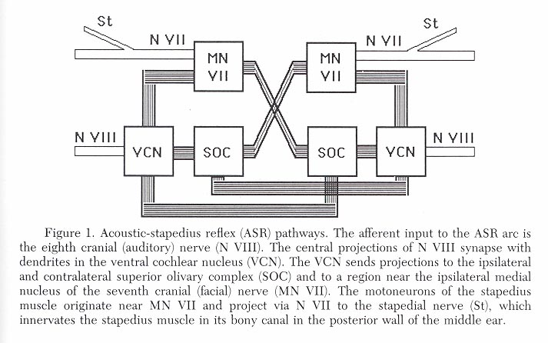
Acoustic Reflex Threshold
Stapedial muscle contraction
Temporary increase in middle impedance
Bilateral Stimulation
Adaptation
Neural network in lower brainstem

Slide 59
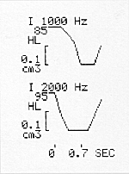
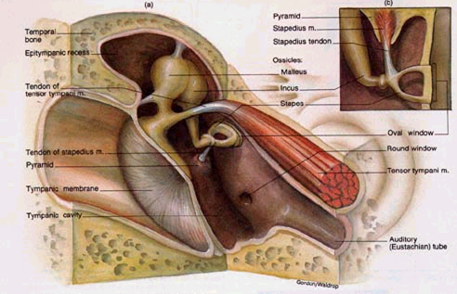
AR

Slide 60
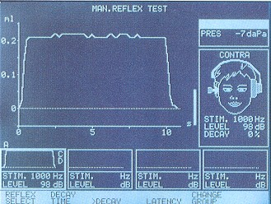
Reflex Decay

Slide 61
Mechanism of acoustic reflex
The acoustic reflex actually contracts both the stapedius and the tensor Tympani muscles.
Stapedius muscles attaches to the neck of the stapes. Contraction of this muscle causes the ossicular chain to be pushed laterally (away from the oval window).
Tensor tympani muscle attaches to the malleous and causes the ossicular chain to be pushed medially when contracted.
So the two muscles contract in opposite direction and this causes the ossicular chain to be stiffened as a result of that.
This stiffened ossicular chain will be reflected in stiffening TM as well, which is reflected in increasing the impedance of the middle ear to the transfer of energy from the outer ear to the middle ear.

Slide 62
STAPEDIUS vs. TENSOR TYMPANI
6 mm in length
25 mm in length
Arises in bony canal
adjoining the facial canal
and inserts on the head
of the stapes
Arises from wall of
Eustachian tube and
inserts on the upper
margin of the
manubrium of malleus
Cranial Nerve VII
Cranial Nerve V
Activates by acoustic
(acoustic reflex) and
nonacoustic means
Activates by startle
response and/or tactile
stimulation of the
orbital area

Slide 63
Functions of acoustic reflex
1- protection of the inner ear from extremely loud noise: AR increases the impedance and this will decrease the amount of acoustic energy reaching the inner ear. Attenuation mainly occurs for the low frequency sounds.
2- enhancing S/N ratio: since AR attenuates low frequency noise (such that of external noise or the internal noise such as the pumping of the heart or the breathing sounds) that might compete with speech signal.

Slide 64
How do we measure AR
AR causes increase in the impedance, this causes more SPL of the stimulus to be reflected. The measuring microphone will measure the reflected SPL and record it.
So, during AR more or less SPL will be measured by the microphone?

Slide 66
Parameters of interest of AR
1- AR threshold: the minimum SPL that produces AR.
2- AR decay. With sustained stimulation the auditory nerve caused to have adaptation (decrease in firing rate).
AR threshold: normally is 70 to 100 dB above the audiometric threshold.
So when we can measure AR, then we can be sure that audiometric threshold is at least better than 40-50 dB HL.
AR decay: abnormal decay happens when shorter duration of stimulation causes significant decay. This happen especially when lesions like tumors (Acoustic neuroma) affected the auditory nerve.

Slide 67
Clinical application of ASR
Middle Ear Disease
Otosclerosis
Cochlear hearing loss and loudness recruitment
Retrocochlear lesions may abolish the ASR
Brainstem lesions may abolish the contralateral reflexes
Determination of site of a seventh nerve lesion
Acoustic Reflex Decay

Slide 68
Clinical applications of AR
When there is any degree of conductive HL, AR can not be measured.
When the AR can be measured that means hearing thresholds are better than 50 dB HL. This can give you a hint about PTA thresholds well in advance before testing and can help you determining the level of stimulation that you need to start with. This also can alarm you when the pt is faking HL.

Slide 69
Clinical applications of AR
AR decay: positive decay can be an indication to retrocochlear lesions.
Positive decay is defined as having AR amplitude decreased 50% or more during the first 5 seconds of a 10 seconds stimulation at 500 Hz and 1000 Hz tones in ipsilateral or contralateral stimulation.
Questionable decay: when decay is positive at only one frequency and negative at the other.

Slide 70
Clinical applications of AR
The best benefits can be obtained when comparing ipsilateral and contralateral AR.
If AR is not present in ipsilateral and present in contralateral stimulation, hearing loss in the ipsilateral ear might be the cause.
If AR is present in the ipsilateral but not present in the contralateral, then we can deduce that the lesion must be some where either in the contralateral facial nerve, in the brainstem or a contralateral hearing loss.
When AR is present ipsilaterally, we can deduce that hearing threshold in that ear is better than 40-50 dB HL, the ipsilateral facial nerve is intact, and that ear does not have conductive HL.
Will contralateral conductive HL impede the contralateral AR if there is no ipsilateral conductive hearing loss or lesions in the ipsilateral facial nerve?
If there is profound SNHL in the ipsilateral ear, can we ever get a l AR from the other ear?
Can we have AR in the side that is affected by facial palsy (Bell’s palsy)?

Slide 71
Clinical applications of AR
Do you think AR measurement is
Beneficial and why?
Necessary and why?
In the battery of audiological testing, when/where, in your opinion, should we conduct AR testing?
Do you know how to conduct AR testing?
Do you consider AR testing as an immitance testing?
What variables can prevent you from recording AR?

Slide 72
otoacoustic emissions

Slide 73
Origin of OAE
Initially reported by Kemp in 1978.
OAE are considered a by-product of sensory OHCs transduction and represent cochlear amplifier that thought to be as a result of the contraction of OHCs in synchrony with BM displacement.
The contraction of the OHCs (movement) is then propagated outward toward the middle ear and moves the TM.
This in turn creates acoustic energy that is picked by the OAE probe.

Slide 74
Recording OAE’s
OAEs are measured by presenting a series of very brief acoustic stimuli, clicks, to the ear through a probe that is inserted in the outer third of the ear canal. The probe contains a loudspeaker that generates clicks and a microphone that measures the resulting OAE’s that are produced in the cochlea and are then reflected back through the middle ear into the outer ear canal.
The resulting sound that is picked up by the microphone is digitized and processed by specially designed hardware and software. The very low-level OAEs are separated by the software from both the background noise and from the contamination of the evoking clicks.

Slide 75
OAE
So in order to record OAE in EAC we need to have normal middle ear function.
Conductive pathologies can prevent the recording of OAE but this does not mean that OAE is not present.

Slide 76
Types of OAE’s
Types
Spontaneous OAE’s
(SPOAE’s)
Distortion Product
OAE’s (DPOAE’s)
Transient Evoked
OAE’s (TEOAE’s)

Slide 77
Spontaneous OAE’s
Occurs in the absence of any intentional stimulation of the ear.
Prevalence is in about 40-60% of normal hearing people.
When you record SOAE’s, you average the number of samples of sounds in the ear and perform a spectral analysis.
The presence of SOAE’s is usually considered to be a sign of cochlear health, but the absence of SOAE’s is not necessarily a sign of abnormality.

Slide 78
Distortion Product OAE’s
Result from the interaction of two simultaneously presented pure tones.
Stimuli consist of 2 pure tones at 2 frequencies (ie, f1, f2 [f2>f1]) and 2 intensity levels (ie, L1, L2). The relationship between L1-L2 and f1-f2 dictates the frequency response.
DPOAEs allow for a greater frequency specificity and can be used to record at higher frequencies than TOAE’s. Therefore, DPOAE’s may be useful for early detection of cochlear damage as they are for ototoxicity and noise-induced damage.

Slide 79
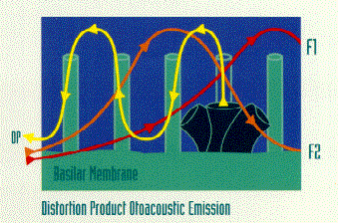
DPOAEs
2 tone stimuli (F1 and F2)
Cochlea hair cells generate a resonance

Slide 80
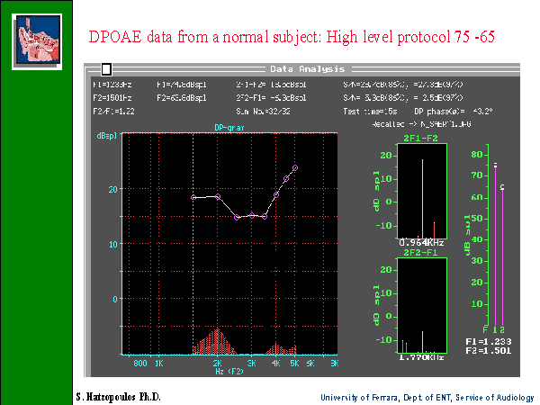
RESPONSE
NOISE

Slide 81
Transient Evoked OAE
TEOAE’s are frequency responses that follow
a brief acoustic stimulus, such as a click or tone burst.
The evoked response from this type of stimulus covers the frequency range up to around 4 kHz.
In normal adult ears, the click-elicited TEOAE typically falls off for frequencies more than 2 kHz, and is rarely present over 4 kHz, because of both technical limitations in the ear-speaker at higher frequencies and the physical features of adult ear canals so that is why DPOAE’s would be more efficacious.
For newborns and older infants, the TEOAE is much more robust by about 10 dB and typically can be measured out to about 6 kHz indicating that smaller ear canals influence the acoustic characteristics of standard click stimuli much differently than do adult ears.
TEOAE’s do not occur in people with a hearing loss greater than 30dB.

Slide 82
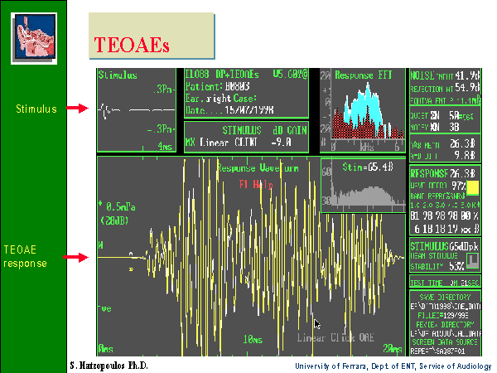

Slide 83
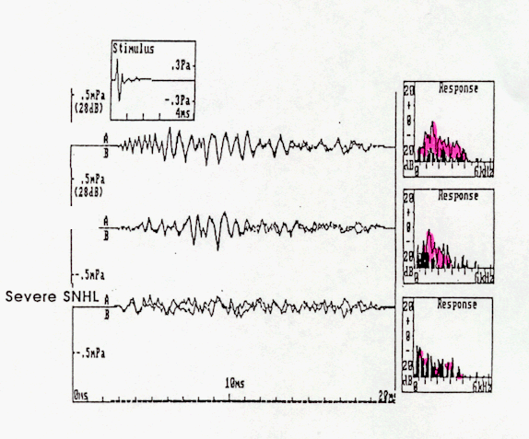
TEOAE results
Normal hearing
High frequency HL
Severe SN HL

Slide 84


TEOAE & DPOAE

Slide 85
Acquisition
Not affected by sleep but needs test subject to be still and compliant
Very quick

Slide 86
Clinical applications of EOAE
1- can be used in newborn hearing screening. The results will indicate either fail or pass. Fail means that hearing thresholds are worse than 30 dB HL. Pass results means hearing thresholds are 30 dB HL or better.
  So, we can not use this tool to measure threshold of hearing.

Slide 87
Applications of OAE
TEOAE can be recorded in all non-pathologic ears that do not display hearing loss of greater than 30 dB.
OAE can be recorded in both adults and infants.
Accordingly TEOAE and DPOAE can be used to screen for hearing loss in infants.
DPOAE provide more frequency specific evaluation that TEOAE.

Slide 88
Clinical applications of EOAE
2- in differential diagnosis of hearing loss (site of lesion). This can help in differentiating sensory from neural hearing loss.
3- monitoring of the effect of ototoxicity or noise exposure.
4- although still under research: DPOAE can be used to screen for the carriers of the recessive hearing loss genes: many studies found that DPOAE is larger (especially at high frequencies) in carriers than in non carriers when using f2/f1 of 1.3 and low stimulus levels of 50-60 dB.

Slide 89
clinical limitations
Problems because of middle ear disease
Not sensitive for neonates within 24 hours of birth
Results affected by test conditions
  Noise
Not a test of hearing- limited application

Slide 90
Clinical applications of ABR
Murad Almomani, Ph.D., CCC-A, FAAA

Slide 91
The normal ABR waveform
Is characterized by 5-7 peaks.
Occurs in a latency epoch of 1.4 – 8.0 ms.
Responses are usually displayed with positive peaks reflecting neural activity toward the vertex.
These peaks are labeled with the roman numerals I through XII.
The most prominent waves are I, III, and V.

Slide 92


Slide 93


Slide 94
Generators of the ABR
VI
V
IV
III
II
I

Slide 95
Latency, ms

Slide 96
Characteristics of normal ABR
Information to determine normal ABR waveform depends on:
  Waves absolute latency.
  Waves interpeak intervals.
  Latency-intensity function.
  Wave V/I amplitude ratio.
  Interaural wave V latency difference.
Research established normal ranges of the above parameters.

Slide 97
Characteristics of normal ABR
Normal ranges for the above parameters are not universal.
There are some variation among different research findings.
Many factors affects normal values including age, sex, temp and other factors.
It is always better for each practice to establish its own norms.

Slide 98
Characteristics of normal ABR
Absolute latency of ABR waves in adults:
  Wave I: at around 1.6 ms +/- 0.2 ms.
  Wave III: at around 3.7 ms +/- 0.2 ms.
  Wave V: at around 5.6 ms +/- 0.2 ms.
Interwave latency intervals:
  I-III: 2.0 ms+/- 0.4 ms.
  III-V: 1.8 ms +/- 0.4 ms.
  I-V: 3.8 ms +/- 0.4 ms.

Slide 99
Characteristics of normal ABR
Wave V latency-intensity function: increases by around 0.3 ms per 10 dB decrease of the stimulus level.
V/I amplitude ratio: greater than 1.0.
Wave V latency difference: less than 0.4 ms.

Slide 100

Example Normal Hearing
18 Month-Old – 2000 Hz Tone-Burst
70 dBnHL
10 dBnHL

Slide 101
Effects of age on waves latency and amplitude
Age: age affects considerably on ABR.
ABR changes as a function of age especially in the first 18 months of life.
ABR in infants
  Can first be recorded at approximately 28 weeks of conceptional age.
  Wave I is more prominent than later waves.
  Wave I is usually larger in amplitude than in adults (so V/I is less than 1.0).
  Wave I latency may be delayed of around 0.3 ms.
  Wave I is usually larger in amplitude than wave V.
  Wave V is generally prolonged more than wave I or wave III.
  So interpeak intervals in neonates are longer than in adults.
  Maturation occurs peripheral to central. So earlier waves mature first.

Slide 102
Effects of age on waves latency and amplitude
In neonates the I-V interpeak intervals changes as a function of intensity (longer at high intensity levels) while in adults interpeak intervals are stable regardless of stimulus intensity.
Increasing rate of stimulus produces a more pronounced increase in ABR latency with infants than adults.
  Usually no ABR can be recorded in newborns if a stimulus rate more than 40 is used.

Slide 103
Effects of age on waves latency and amplitude
ABR changes with age are nonlinear.
  Decrease in latencies are greatest in premature infants and then slows down after conceptional age of 40 weeks.
  Usually reaches adults norms by the age of 18 months.
It is important to distinguish between conceptional and gestational age
  Conceptional is calculated from the last menstrual period.
  Gestational is calculated based upon clinical assessment of physical findings.

Slide 104
Effects of age on waves latency and amplitude
There should be separate norms created for premature and mature infants.
When building the norms other factors also should be considered like
  Sex.
  Stimulus and response parameters (try to adhere to the parameters used to create norms).
  Electrode montage.

Slide 105
Effects of gender on waves latency and amplitude
Adult females showed shorter latencies and larger amplitudes of the different ABR waves.
Gender effect is smaller for wave I as compared for other waves.
  This produce smaller interpeak intervals in females by around 0.12-0.3 ms.
There are no significant gender difference in infants and very young ages.

Slide 106
Effects of gender on waves latency and amplitude
Some explanation offered for these differences in adults include:
  Females tend to have higher average body temperature.
  Females have smaller head size.
  Hormonal effects of estrogen and other hormones and its fluctuation during menstruation has found to have effects on ABR.

Slide 107
Effects of body temperature on waves latency and amplitude
Body temperature varies between people due to many factors including infection (hyperthermia), conscious state and anesthesia (hypothermia).
Low body temperature increases waves’ latencies and decreases waves’ amplitude.
Some authors recommend to make corrections to the norms in extreme cases of hypothermia or hyperthermia.
  Those with CNS pathology of around 0.5 ms to the I-V interval for every degree increase above 37 (98.6).
  Those with CNS pathology and hyperthermia of around 0.15 ms for every degree above 37 (98.6).

Slide 108
Other factors affecting ABR
Drugs:
  Ototoxic drugs seems to delays ABR waves.
  Sedatives and hypnotics: delays ABR waveforms.
  Neuromuscular blockers: may enhance waveforms because of less artifact.
  Anticonvulsants: delays ABR waves.
  Anesthesia like Propofol, which is used for light sedation for some procedures includes sedated ABR has shown some latency shift in ABR waves’ absolute latencies.

Slide 109
Other factors affecting ABR
Hypoxia: may lead to increase ABR waves’ latencies.
Cell phones: some studies found that wave V latency increased.
Alcohol intake: increases waves’ latency.

Slide 110
Clinical applications of ABR
There are two main applications for ABR in the clinical settings:
  Neurodiagnosis: to assess the auditory pathway. This feature is specially used in adult populations.
    Waves absolute latency.
    Interpeak intervals.
    Interaural wave V latency difference.
    Absence of waves.
  Hearing thresholds estimation: mainly used in infants and children population.
    Wave V threshold.
    Wave V latency-intensity function.

Slide 111
Standard ABR Measures for Acoustic Tumor Detection
IT5 = Interaural time delay for wave V
6.4
Non-Tumor Side
L1
IT5 = L2 - L1 = 0.9 ms
L2
7.3
Tumor Side
0
2
4
6
8
10
12
14
ms
I. Background: Standard ABR Tumor Detection

Slide 112
Standard ABR Measures for Acoustic Tumor Detection:
I-V Delay = Latency Difference Between Wave I and V
I. Background: Standard ABR Tumor Detection

Slide 113
Standard ABR Measures for Acoustic Tumor Detection:
I-V Delay = Latency Difference Between Wave I and V
I. Background: Standard ABR Tumor Detection

Slide 114
Neurodiagnosis
Who should be tested? Patients with:
  Dizziness.
  Unilateral tinnitus.
  Asymmetrical hearing loss.
  Sudden onset of hearing loss.
  Progressive hearing loss.

Slide 115
Neurodiagnosis
Procedure:
  Click stimuli.
  70-90 ndBHL.
  Rate: 11.1 to 23.1.
  Polarity: alternating.
  Window: 10-15 ms.
  Filters: 50-3000 Hz.
  Number of waves replications: at least twice.

Slide 116
Using ABR to estimate hearing thresholds
Can be obtained by progressively decreasing intensity of the stimulus (click or toneburst) and observing wave V.
The last intensity that wave V appears at is considered its threshold.
ABR threshold is within 10-20 dB from the subjective threshold.

Slide 117


Slide 118
Using ABR to estimate hearing thresholds
Suggested test protocol:
  Threshold to click stimuli.
  500 and 1000 Hz tonebursts thresholds.
  May also use 6000 Hz toneburst.
  Bone conduction ABR may be obtained to distinguish sensori from neural hearing loss.
  Present the stimulus at high level may be at 80 ndBHL, decrease in 20 dB steps until wave V is no longer exist. Then increase in 10 dB steps until wave V reappears.

Slide 119
Effects of degree and configuration of HL on ABR
Conducive hearing loss:
  All ABR waves latencies are usually increased.
  Interpeak intervals are stable.
  Wave V latency-intensity function is shifted from the normal at all stimulus levels.

Slide 120


Slide 121
Effects of degree and configuration of HL on ABR
Effects of cochlear hearing loss:
  ABR wave V is usually present for hearing losses up to 60 dBHL.
  When hearing loss at high frequencies exceeds 50 dB, wave I is usually absent.
  Sharply sloping audiograms may also delay wave V indicating that the response is coming from more apical end.
  Rising audiograms usually yields normal ABR.
  Wave V Latency-intensity function is steeper than that seen in normal, conductive or retrocochlear hearing loss.

Slide 122
Effects of degree and configuration of HL on ABR
Retrocochlear disorders:
    Prolong absolute latencies.
    Increases interpeak intervals.
    Poor waveform.
    Absence of some waves.
    Wave V interaural latency difference.
    Decreased V/I amplitude ratio for less than 1.0.
    PTA audiogram may be normal with abnormal ABR (may also be seen in auditory neuropathy).

Slide 123
Specific clinical application of ABR in pediatric populations
Newborn hearing screening:
  Usually screen at 30-35 dBHL.
  It can be automated.
  If fail refer for a diagnostic ABR.
  Many studies revealed that automated ABR (AABR) is efficient in newborn hearing screening.
  Some new technologies combined OAE and AABR in one equipment and used both in the screening process resulted in less refer rate and less false positives.

Slide 124
Specific clinical application of ABR in pediatric populations
Otitis media:
  Studies has found that ABR wave V latency-intensity function shift to the right in a proportion equivalent to the conductive hearing loss.
  Wave I is abnormally prolonged in Patients with effusion.
Congenital aural atresia:
  Can use both circumaural headphones for air conduction ABR and bone vibrator for bone conduction ABR.

Slide 125
Specific clinical application of ABR in pediatric populations
Auditory neuropathy:
  No single definition.
  No data about its prevalence, although it has been found to be around 10% in NICU who have hearing loss.
  Rare in healthy babies.
  Lesions can be in IHCs, synapses, or auditory nerve.
  Can have normal or mild to moderate PTA.
  Usually poor speech discrimination especially in noise.
  Many causes like hypoxia, hyperbillirubinemia, genetic.
  Present OAE and/or CM with absent ABR or abnormal ABR (may have only wave I).
  Or present CM, absent SP and absent or abnormal ABR.

Slide 126
Specific clinical application of ABR in pediatric populations
Neoplasms and tumors:
  Neurofibromatosis type I and II: genetically autosomal dominant inherited progressive disorders. Usually tumors involving auditory nerve bilaterally.
  Brainstem gliomas: tumors in children and adolescent and tends to grow slowly.
  These disorders may show increase in ABR absolute latencies and interpeak intervals.

Slide 127
Specific clinical application of ABR in pediatric populations
Epilepsy:
  ABR may show prolongation of waves III and V.
  Increase in interpeak intervals.
Demyelinating diseases:
  Multiple sclerosis (MS): is the most common type in adults and is characterized by vertigo, unsteadiness and fluctuating SNHL.
  Schilder’s disease: a progressive childhood disease. Some consider it a variant of MS.
  ABR usually reveals an absence of waves III and V.

Slide 128
Specific clinical application of ABR in pediatric populations
Fragile X syndrome: the most common hereditary type of mental retardation:
  Long absolute latencies.
  Increase in interpeaks intervals.
Meningitis:
  Increase in interpeaks intervals and absolute latencies.
Hydrocephalus:
  Increase in absolute latencies of waves III and V.
  Increase in interpeaks intervals.

Slide 129
Specific clinical application of ABR in adult populations
Retrocochlear lesions:
  Vestibular schwannoma: mostly found in the VIII nerve. But may also involve V, VII, and XII.
  It is also used interchangeably with acoustic neuroma.
  Increase in absolute latency of wave III or V.
  Interaural Wave V latency difference.
  Increase in I-III, III-V, and I-V interpeak intervals (some or all depending on the location).
  may be absence of waves III or V.
  Stacked ABR findings.

