Slide 1
Management of Epistaxis
Prof. Surayie Al Dousary
Rhinology research Chair Director
www.profseraye.com

Slide 2
At Glance
Nose Blood Supply
Causes of Epistaxis
History, Examination and Investigation
Management
Blood loss management
Avoidance

Slide 3
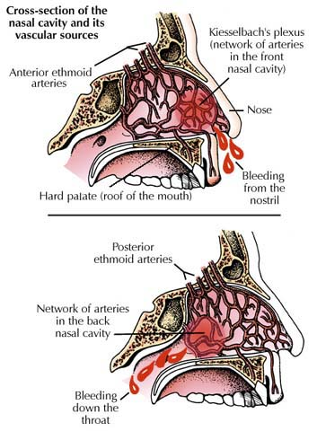
Vascular anatomy of the medial and lateral nasal walls

Slide 4

Local Causes of Epistaxis
Nasal trauma (nose picking, foreign bodies, forceful nose blowing)
Allergic, chronic or infectious rhinitis
Chemical irritants
Medications (topical)
Drying of the nasal mucosa from low humidity
Deviation of nasal septum or septal perforation
Bleeding polyp of the septum or lateral nasal wall (inverted papilloma)
Neoplasms of the nose or sinuses
Tumors of the nasopharynx especially Nasopharyngeal Angiofibroma
Vascular malformation
www.Rhinology.ksu.edu.sa
Rhinology Chair انفية

Slide 5
Systemic Causes of Epistaxis
Systemic arterial hypertension
Endocrine Causes: pregnancy, pheochromocytoma
Hereditary hemorrhagic telangectasias
Anticoagulants (ASA, NSAIDS)
Hepatic disease
Blood diseases and coagulopathies such as Thrombocytopenia, ITP, Leukemia, Hemophilia
www.Rhinology.ksu.edu.sa
Rhinology Chair انفية

Slide 6
Most Common Causes of Epistaxis
Disruption of the nasal mucosa - local trauma, dry environment, forceful blowing, etc.
Facial trauma
Scars and damage from previous nosebleeds that reopen and bleed
Intranasal medications
Hypertension and/or arteriosclerosis
Anticoagulant medications

Slide 7
Nasal Blood Supply
Internal and external carotid arteries
Many arterial and venous anastomoses
Kiesselbach’s plexus (Little’s area) in anterior septum
Woodruff’s plexus in posterior septum

Slide 8
Patient History
Previous bleeding episodes
Nasal trauma
Family history of bleeding
Hypertension - current medications and how tightly controlled
Hepatic diseases
Use of anticoagulants
Other medical conditions - DM, CAD, etc.

Slide 9
Physical Exam - Equipment
Protective equipment - gloves, safety goggles
Headlight if available
Nasal Speculum
Suction
forceps
Tongue depressor
Vasoconstricting agent
Topical anesthetic

Slide 10
Therapeutic Equipment to be Available
Variety of nasal packing materials
Silver nitrate cautery sticks
10cc syringe with 18G needle
Local anesthetic for prn injection
Gelfoam, Collagen absorbable hemostat, Surgicel or other hemostatic materials.

Slide 11
Physical Exam
Measure blood pressure and vital signs
Apply direct pressure to external nose to decrease bleeding
Use vasoconstricting spray mixed with tetracaine in a 1:1 ratio for topical anesthesia
Identify the bleeding source

Slide 12
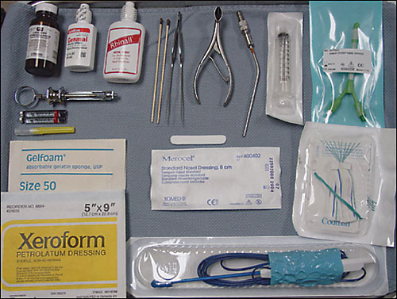
General Epistaxis Supplies

Slide 13
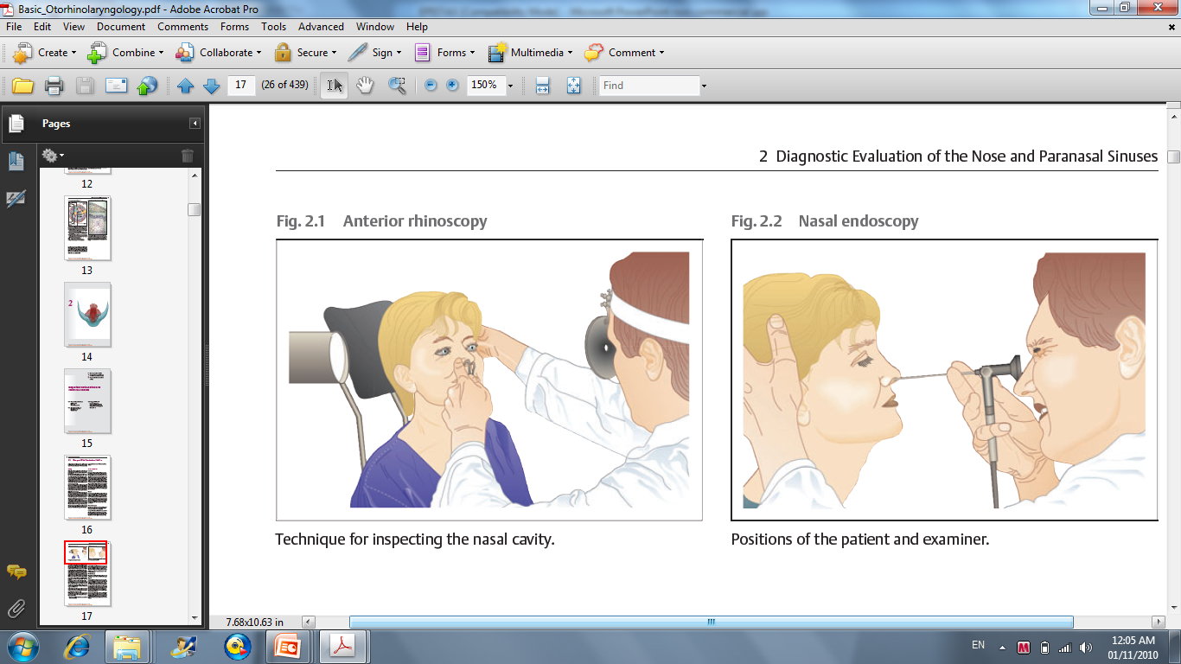
Nasal Exam

Slide 14
Types of Nosebleeds
ANTERIOR
  Most common in younger population
  Usually due to nasal mucosal dryness
  Usually controlled with conservative measures
POSTERIOR
  Usually occurs in older population
  HTN and SYS diseases are common contributing factors
  Significant bleeding in posterior pharynx
  More challenging to control

Slide 15
Treatment of Anterior Epistaxis
Localized digital pressure for minimum of 5-10 minutes,
Silver nitrate cautery
Collagen Absorbable Hemostat or other topical coagulant
Anterior nasal packing for refractory epistaxis
www.Rhinology.ksu.edu.sa
Rhinology Chair انفية

Slide 16
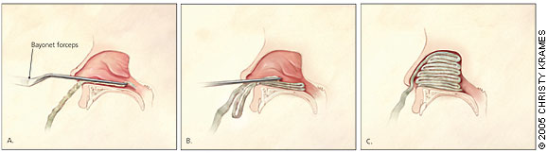


Anterior Nasal Packs
Formed expandable sponges are very effective
Available in many shapes, sizes and some are impregnated with antibacterial agents

Slide 17
Treatment of Posterior Epistaxis
IV pain medication and antiemetics may be helpful
Use topical anesthetic and vasoconstrictive spray for improved visualization and patient comfort
Balloon-type episaxis devices often easiest
Foley catheter or other traditional posterior packs may be necessary

Slide 18
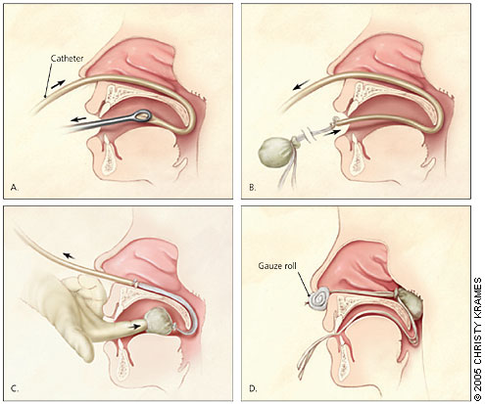
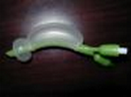
Posterior Pack

Slide 19
Duration of Packing Placement
Actual duration will vary according to the patient’s particular needs.
Typically, anterior pack at least 24-48 hours, sometimes longer.
Posterior pack may need to remain for 48-72 hours. If a balloon pack is used, advised tapered deflation of balloons - most successful when volume is documented.

Slide 20
Patients with Nasal Packing
Best to place patient on a p.o. antibiotic to decrease risk of sinusitis and Toxic Shock Syndrome
Advise pt to avoid straining, bending forward or removing packing early

Slide 21
Patients with Nasal Packing
Most patients may be treated as outpatients but hospital admission and observation should be strongly considered when a posterior pack is used. SaO2 should be monitored as well.
Admission may also be prudent for those with CAD, severe HTN or significant anemia. Give supplemental oxygen via humidified face tent.

Slide 22
Other Treatments for Refractory Epistaxis
Greater palatine foramen block
Septoplasty
Endoscopic cauterization
Selective embolization by interventional radiologist
Internal maxillary artery ligation
Transantral sphenopalatine artery ligation
Intraoral ligation of the maxillary artery
Anterior and posterior ethmoid artery ligation
External carotid artery ligation

Slide 23
Preventive Measures
Keep allergic rhinitis under control. Use saline nasal spray frequently to cleanse and moisturize the nose.
Avoid forceful nose blowing
Avoid digital manipulation of the nose with fingers or other objects
Use saline-based gel intranasally for mucosal dryness
Consider using a humidifier in the bedroom
Keep vasoconstricting spray at home to use only prn epistaxis

Slide 24
Blood Loss Management
Blood loss Estimate
  Vital sign
  Blood workup
Blood Expansion
Blood Transportation
  Blood Component

