Slide 1
بسم الله الرحمن الرحيم
Prof .Fatma Alanazy
ENT consultant

Slide 2
ANATOMY OF THE EAR

Slide 3
EXTERNAL EAR
Auricle
External Canal

Slide 4
THE AURICLE

Slide 5
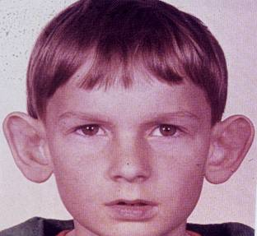
Absence of antihelix
(protruding ear)
Normal

Slide 6
Blood Supply
Richly supplied by branches from the external carotid

Slide 7
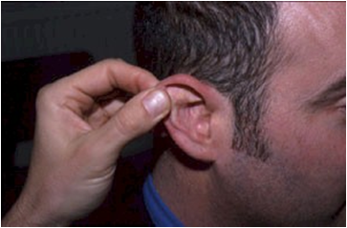
The External Auditory Canal

Slide 8
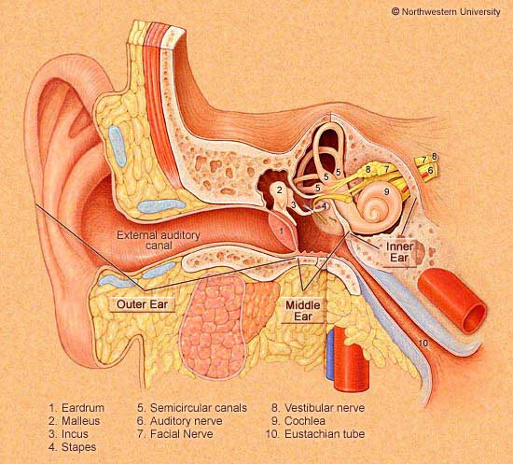
The External Auditory Canal
Length:2.5 cm
Lateral Third:
lateral 1/3
Medial Two Thirds:
Cartilagenous
Present at birth
Hair follicles
Sebacous glands
Ceruminous glands
Bony
Develops after birth

Slide 9
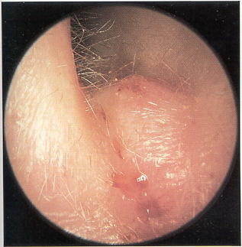
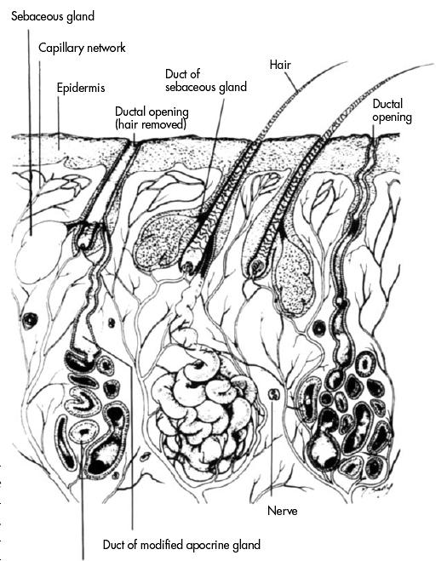
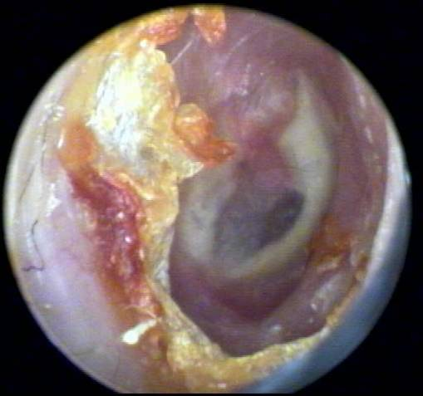
Skin of outer third of the external canal
Furunclosis
Wax

Slide 10
ANATOMY OF THE EAR
External Ear
Middle Ear Cleft
Inner Ear

Slide 11
MIDDLE EAR CLEFT
Eustachian Tube
Tympanum (Middle Ear Cavity)
Mastoid Antrum and Air Cells

Slide 12
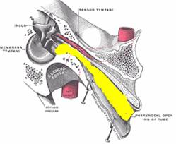
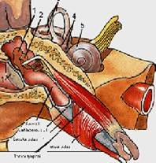
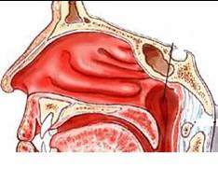
MIDDLE EAR CLEFT
The Eustachian Tube

Slide 13
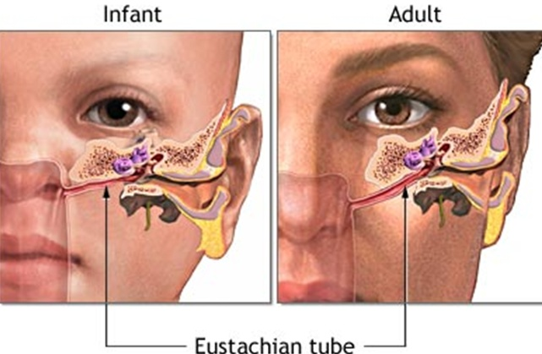

Slide 14
MIDDLE EAR CLEFT
Eustachian tube
Tympanic cavity (Middle ear cavity)

Slide 15
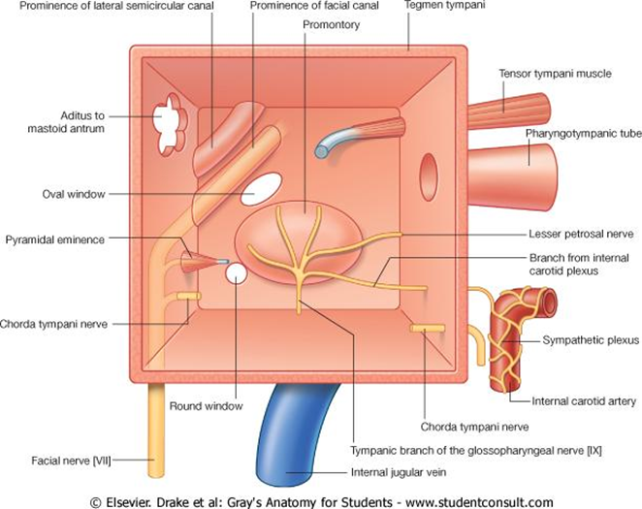
Tympanum (Middle Ear Cavity)
Tympanic cavity:
Bioconcave disc shaped cavity 13mm ant post ,15 mm in height .

Slide 16
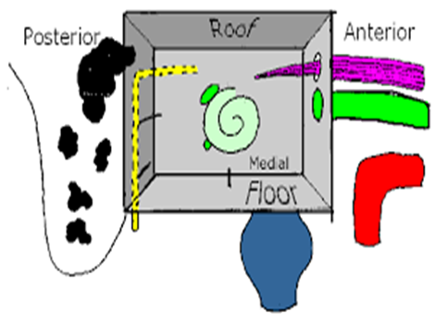
Roof (tegmen tympani)
Separate the cavity from middle cranial fossa
Floor
jugular bulb

Slide 17
Anterior wall
Canal Huguier ,chorda tympani
Canal of tensor tympani ms
Tympanic orifice of ET
Canal of carotid artery
Posterior wall
Aditus :which lead backwards from the epitympanum into mastoid antrum
Pyramid (stapedius tendon)
vertical portion of facial nerve

Slide 18
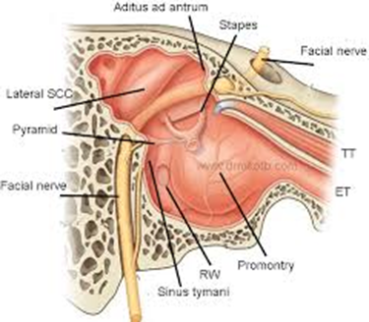
Medial wall:
The promontory :
bony projection covering the basal turn of the cochlea.
Oval window :
occupied by the footplate of the stapes ,closes the middle ear from the scala vestibuli
Round window :
separates the middle ear from scala tympani
Facial nerve :
the horizontal portion lies above the oval window .
The horizontal semicircular canal :
above the second genu of the facial nerve.

Slide 19
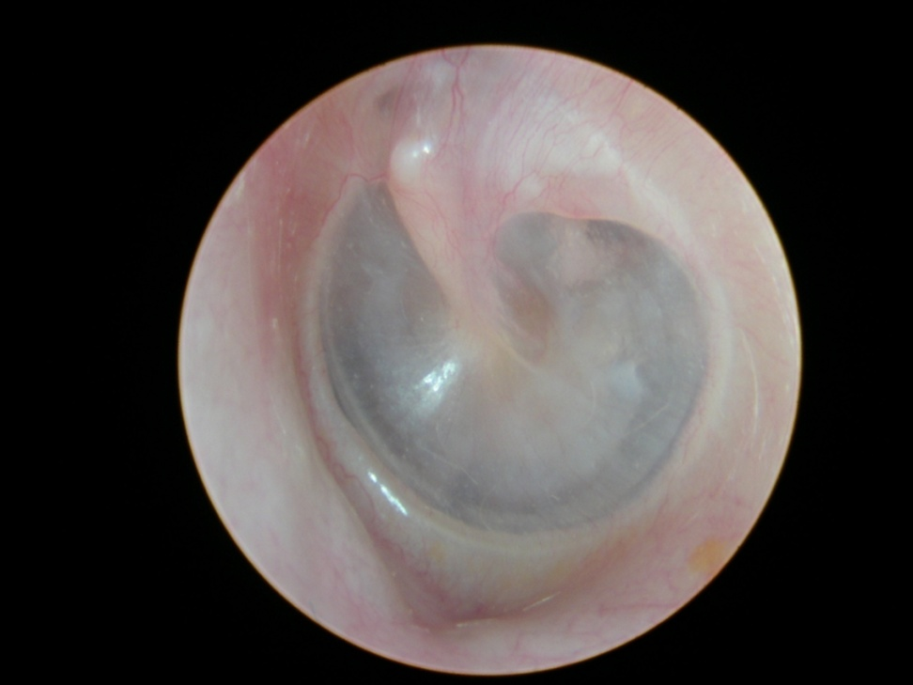
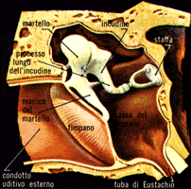
Membrana flaccida
Membrana Tensa
Epitympanum(attic)
Mesotympanum
Hypotympanum

Slide 20
MIDDLE EAR CLEFT
Eustachian (Pharyngo-tympanic) Tube
Tympanic (Middle Ear) Cavity
Mastoid antrum and air cells

Slide 21
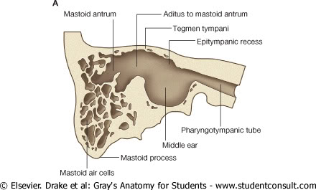
Mastoid antrum:
Situated in the post portion of petrous temporal bone
Ant :opening of the aditus
Medial :post and horizontal semicircular mcanals
Roof (tegmen antri)
Lat :squama and macewen’s triangle

Slide 22
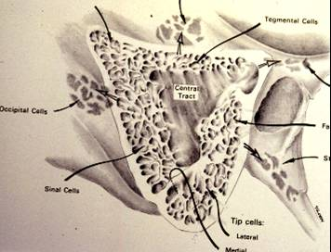
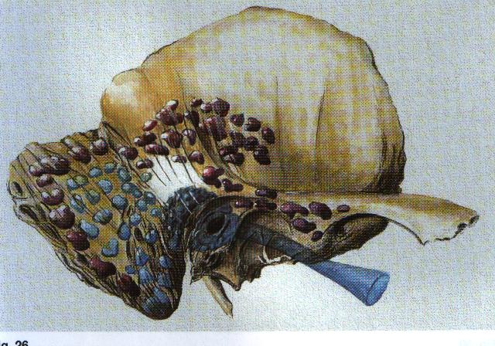
Mastoid Antrum & Air cells

Slide 23
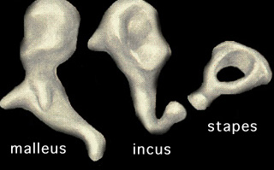
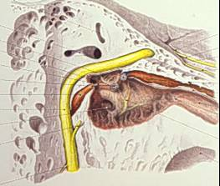
CONTENTS OF MIDDLE EAR CAVITY
Air
Ossicles
Malleus, Incus, & Stapes
Muscles
Tensor Tympani & Stapedius
Nerves
Tympanic Plexus & Chorda Tympani

Slide 24
LINING OF MIDDLE EAR
Mucous membrane : ciliated columnar anteriorly and cuboidal or flat elsewhere

Slide 25
SENSARY SUPPLY OF MIDDLE AND EXTERNAL EAR
Cervical II & III ( great auricular and lessor occipital)
V cranial nerve ( auriculotemporal)
IX cranial nerve (tympanic or Jacobson’s)
X cranial nerve ( auricular or Arnold’s)
VII cranial nerve

Slide 26
Referred Earache
Pain in the ear due to a disease in an area supplied by a nerve that also supply the ear.

Slide 27
Referred Earache
Cervical II & III
Cervical spondylosis, neck injury etc.
V cranial nerve
Dental infections, sinonasal diseases etc.
IX cranial nerve
Tonsillitis, post-tonsillectomy, carcinoma etc.
X cranial nerve
Tumors of hpopharynx, larynx & esophagus

Slide 28
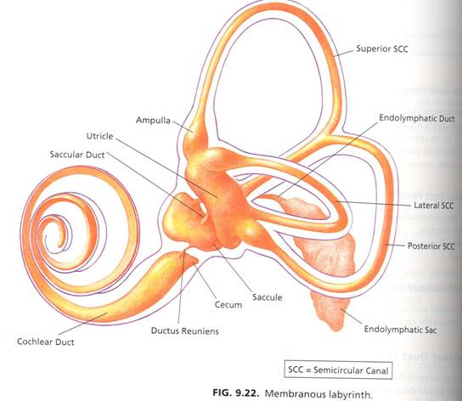
ANATOMY OF INNER EAR
Osseous Labyrinth
Perilymph
Membranous labyrinth

Slide 29
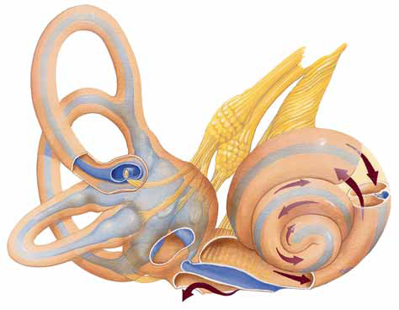

Slide 30
The Bony Labyrinth
Bony Cochlea
Vestibule
Bony semicircular canals

Slide 31
CONTENTS OF THE BONY LABYRINTH
Perilymph
Membranous labyrinth
Cochlear duct
Saccule and utricle
Membranous semicircular ducts

Slide 32
CONTENTS OF MEMBRANOUS LABYRINTH
Endolymph
Sensory epithelium
Cochlea: organ of Corti
Utricle & saccule: maculae
Semicircular canals: cristae

Slide 33
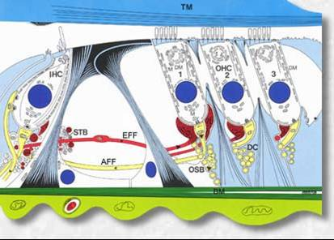
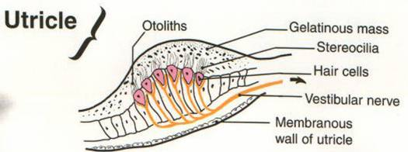
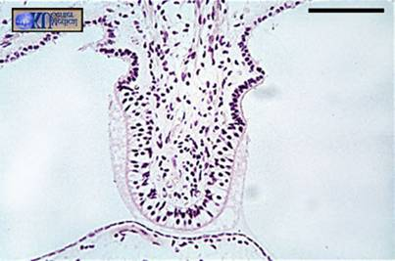
INNER EAR SENSORY EPITHELIUM
Cochlea: organ of Corti
Utricle & saccule: maculae
Semicircular canals: cristae

Slide 34
THE VESTIBULO-COCHLEAR NERVE

Slide 36
CENTRAL CONNECTIONS OF COCHLEAR NERVE

Slide 37
CENTRAL CONNECTIONS OF VESTIBULAR NERVE

Slide 38
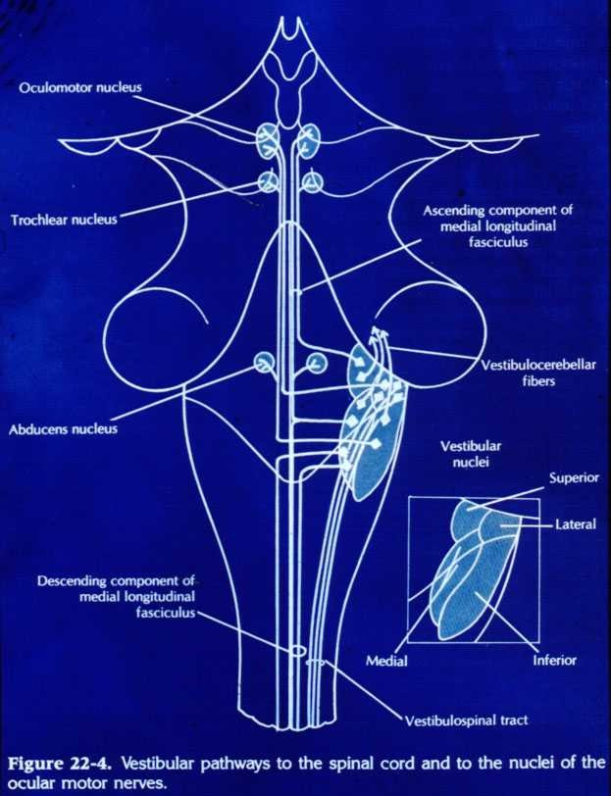

Slide 39
PHYSIOLOGY OF THE EAR

Slide 40
FUNCIONS OF THE EXTERNAL EAR
Auditory functions:
Sound conduction
Increase sound pressure by the resonance function
Protection of the middle ear
Curvature
Cerumen

Slide 41
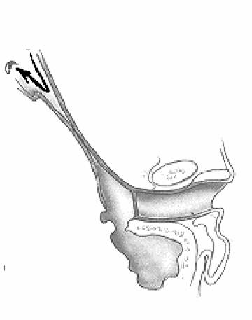
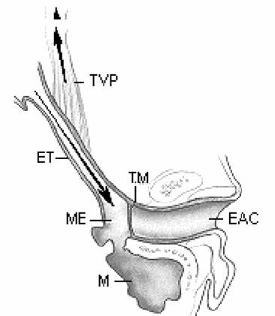
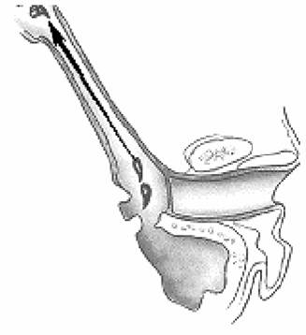
FUNCTIONS OF THE EUSTACHIAN TUBE
Protection
Ventilation
Drainage

Slide 42
Role of ET Dysfunction
Main route of infection in AOM (from the nasopharynx)
Obstruction
Negative middle ear pressure
Formation of non purulent fluid in the middle ear (Otitis Media with Effusion)

Slide 43
FUNCIONS OF THE MIDDLE EAR
Conduction of sound
Transformer mechanism
Hydraulic action
Ossicular leverage

Slide 44
FUNCIONS OF THE MIDDLE EAR
Conduction of sound
Transformer mechanism
Hydraulic action
Ossicular leverage
Protection to the inner ear
stapedial reflex

Slide 45
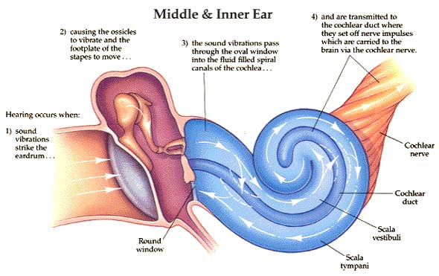
FUNCIONS OF THE INNER EAR
Hearing Function:
Transduction of sound to action potentials

Slide 46
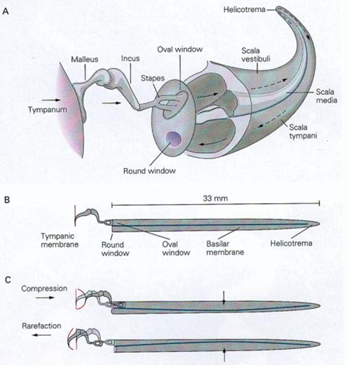

Slide 47
FUNCIONS OF THE INNER EAR
Hearing Function:
Transduction of sound to action potentials
Vestibular Function:
Participate in maintaining body balance

Slide 48
THE BALANCE SYSTEM

Slide 49
THE BALANCE SYSTEM
C. Cortex
Cerebellum
BRAIN-STEM

Slide 50
THE BALANCE SYSTEM
Vestibular
Proprioceptive
Visual
INPUT
C. Cortex
Cerebellum
BRAIN-STEM

Slide 51
THE BALANCE SYSTEM
Vestibular
Proprioceptive
Visual
INPUT
C. Cortex
Cerebellum
BRAIN-STEM
OUTPUT
Ocular muscles
Postural muscles

Slide 52
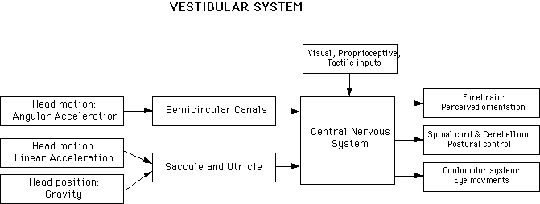

Slide 54
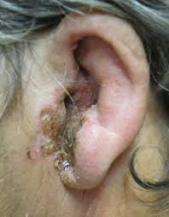
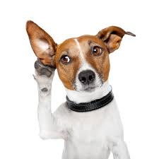
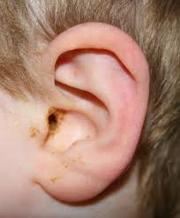
Disease of external ear and acute otitis media

Slide 55
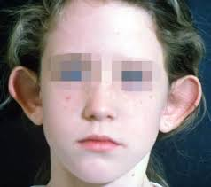
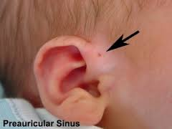
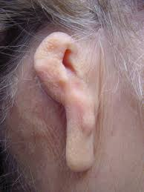
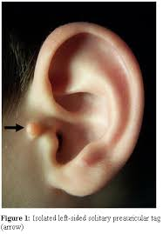
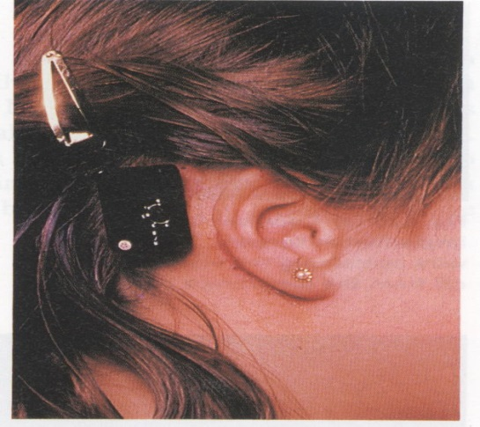
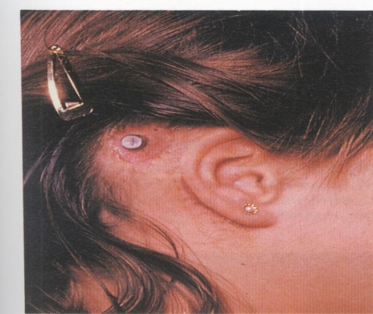
Congenital anomalies of external ear
Protruding ear (bat ear): otoplasty
Preauricular sinus: surgical excision
Microtia :
Atrasia
Accessory auricles
RX:
plastic reconstruction
Bone anchored hearing aid

Slide 56
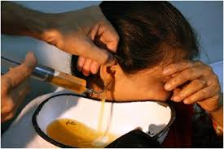
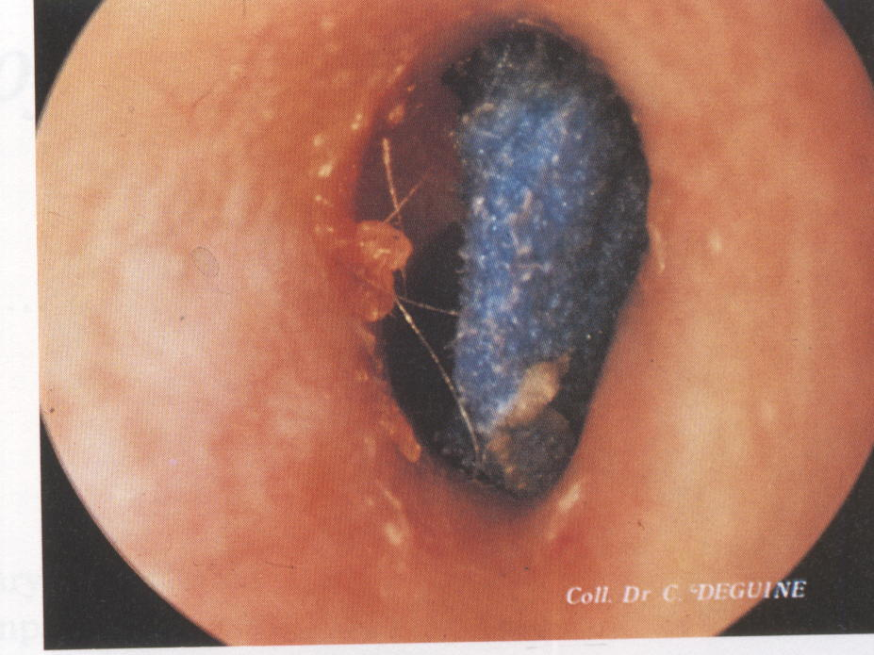
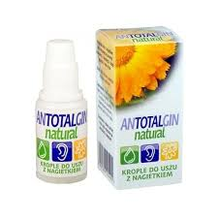
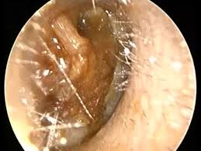
wax

Slide 57
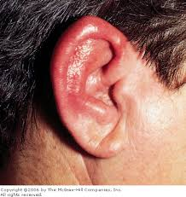
Perichondritis of pinna:
infection of the auricular cartilage-----necrosis ----deformity.
it may follow:
Haematoma
Surgery
RX:
ABX
Incision & drainage
Removal of necrotic tissue

Slide 58
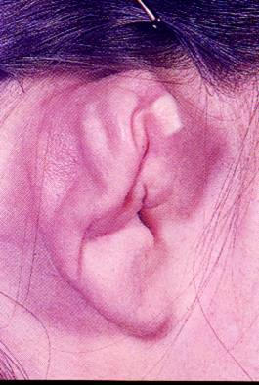
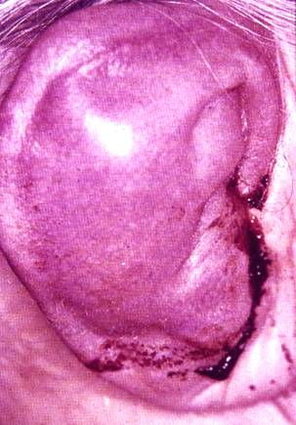
Hematoma Auris
Cauliflower ear

Slide 59
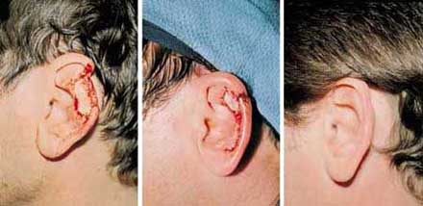

Slide 60
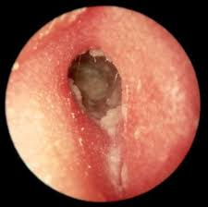
Otitis externa
Acute otitis externa:
Bacterial infection involving the skin of the external canal
Pathophysiology:
aggressive washing the wax or retention water
Microtruma (cotton swabs,fingernails )
Pathogens;
pseudomonas aeruginosa, staphlococcus (furuncle)
SSx:
pain ,tragal tendreness otalgia ,pruritus, edematous erythematous EAC, conductive hearing loss.
RX:
suction cleaning
Ear drop
Analgesia
Antibiotic

Slide 61
Eczematous otitis externa:
Allergic dermatitis
SSx;
pruritis ,redness oedema , mild pain,dry scaly skin
RX:
recognize the allergen
Hydrocortisone cream
Antihistamin
Coal tar ointment ,silver nitrate ,canalplasty (chronic stage)

Slide 62
Seborrhoeic otitis externa :
Greasy, scaling and crusting condition
Cause:
abn sebum and wax
SSx:
Greasy yellow scales
itching
RX:
Shampoo selenium sulphide and ketoconazole
Ointment; salicylic acid and sulpher 2%

Slide 63
Herpetic lesions:
Herpes simplex (acyclovir in severe cases)
herpes zoster oticus
Sever pain
Vesication
Cranial nerve lesion deafness SNHL
Vertigo
Facial nerve palsies
Ramsay hunt syndrome
RX:
oral and topical acyclovir early

Slide 64
Otomycosis :
Aspergillus ,candida
SSX:
moist tissue –paper dotted gray membrane, pruritic
RX
: suction cleaning
Fungicides :
nystatin ,econazol

Slide 65
Otitis externa malignans (osteomyelitis of skull base):
Pseudomonas infection occurring in elderly diabetic patients .
SSX:
Granulation tissue in EAC at the bony cartilaginous junction
Persist otalgia, otorrhea
Cranial nerve involvement
VII, IX ,X XI ,XII,V,VI
DX ;
CT scan, bone scan ,culture
RX:
diabetic control
Prolonged parenteral anti- pseudomonas abx
Ear drop
Debridement
Hyperbaric oxygen

Slide 66
A cute otitis media
Inflammation of the middle ear cavity (<3 weeks)
Pathophysiology :
ET dysfunction ,spread of the infection via submucosal lymphatic or direct spread
Pathogens;
S,pneumonia, H, influnza.Moraxella
Risks:
Craniofacial abn
Rec URTI
Day care
Bottle feeding
smoking
immunological disorders IgA ,IgG deficiencies
Ciliary dysfunction
Adenoid hypertrophy
GERD
NGT
SSX:
Otalgia,aural fullness, hearing loss, tinnitus ,fever
Hyperemic TM ,non mobile bulgingTM ,air fluid level
RX; oral ABX for 10 days
Antipyretics , analgsia oral and nasal decongestants
Myringotomy ►sever otalgia

Slide 67
Acute mastoiditis

Slide 68
Management of recurrent acute otitis media :
Myringotomy with pressure equalization tube;

Slide 69
Secretory otitis media (otitis media with effusion)
Persistence of fluid in the middle ear space without evidence of infection.
SSX:
nonmobile TM, airfluid levels, aural fullness, hearing loss,
DX:
tympanometry
RX:
ABx,
Myringotomy with pressure equalization tube.

Slide 70
Thank you

