Slide 1
The Nasal Septum
Prof. Surayie Al Dousarey
Rhinology Chair Director
www.rhinologychair.org
www.profseraye.com

Slide 2
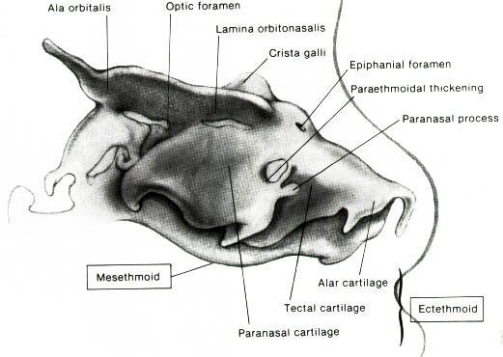
The Nasal Septum Development
I. Cartilaginous Vault
II. Bony Vault

Slide 3
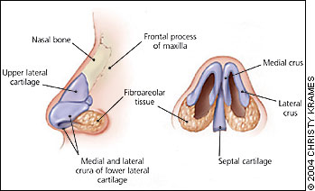
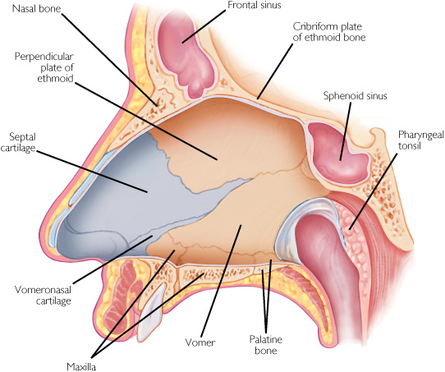
Cartilaginous Septum
  Septal (quadrilateral) cartilage
  The vomeronasal cartilages
  Medial crura of the alar (lower lateral) cartilages

Slide 4
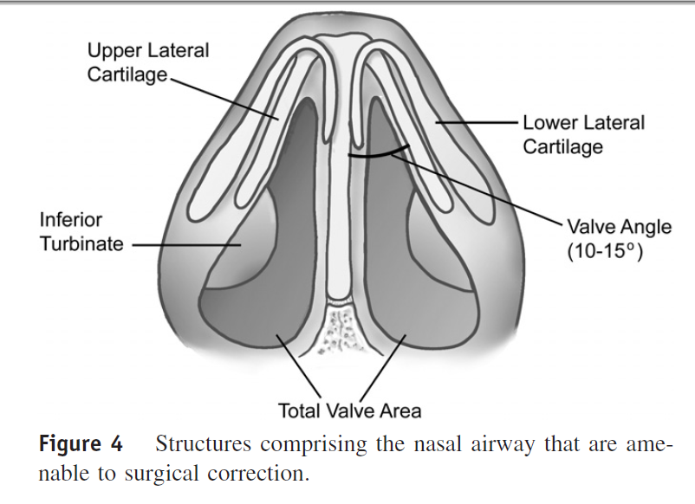
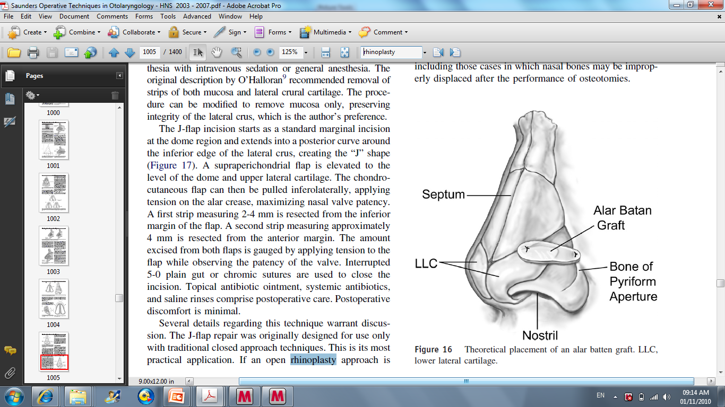
Cartilaginous Septum
Crura

Slide 5
The Membranous Septum
(Mobile Septum)
Anterior to the end of the septal cartilage.
It is formed by skin and subcutaneous tissue of the nasal columella.

Slide 6
Bony Septum
Composed of two major elements:
  The Vomer
  The Perpendicular plate of the Ethmoid

Slide 7
Septum Articulating Points
Nasal spine of the frontal bone.
Rostrum of the sphenoid.
Crests of the nasal, maxillary, and palate bones.

Slide 8

The perpendicular Plate of the Ethmoid (Mesoethmoid)
The ossified upper to midline portion of the primitive nasal capsule.
Ossification completed by 17th year of age.
Replacement of cartilaginous septum with thin bone.
At the nasal roof it articulates with the
cribriform plate and extends as the crista galli

Slide 9
Cribriform Plate
Fibrous structure until it becomes ossified in the third year.
Firm union between the lateral and medial ethmoidal elements.

Slide 10
The Vomer
Develops from connective tissue membrane on each side of the septal cartilage.
For the opposing lamellae of the vomer to fuse, the intervening cartilage must be absorbed completed by mid adult hood.

Slide 11
Inequality of Growth
Buckle laterally, creating the posterior septal spur.
Even on the normal, fully matured septum, elevations and ridgelike protuberances interrupt the smooth surface.

Slide 12
Tuberculum Septi
The most constant thickened mucosa appearing opposite the anterior end of the middle nasal turbinate.
Occasionally, oblique mucosal ridges are notable on the Posteroinferior septum.
These are Septal Plicae, remnants of mucosal folds prominent up to eight months of fetal age, which generally regress and disappear in infancy.
They may persist and may even hypertrophy into Tumorlike obstructing masses.

Slide 13
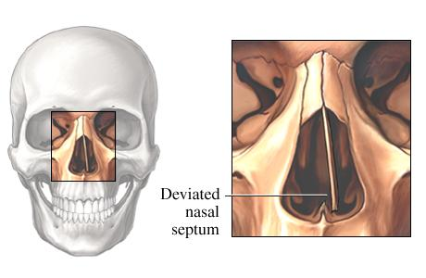
Septal Positions
Septum bows entirely into one nasal cavity
Double buckling occurs with an S‑shaped deformity affecting both cavities.
The septal cartilage is often dislocated out of the midline groove of the maxillary crest .

Slide 14
Asymmetry of the Nasal Septum
Approximately 80 % of humans have some deformity of the nasal septum.
Any or all parts of the septum except for the posterior free border at the choanae, where it is always midline.
A common area of deflection is along the articulation between the vomer and the perpendicular plate of the ethmoid
  Especially when these two bones are separated for a considerable distance by the sphenoidal process of the septal cartilage.

Slide 15
Septal Deviations
• Types: traumatic and congenital
• Common Defects: spurs, crests, dislocation of quadrangular septal cartilage, buckling
• SSx: unilateral nasal obstruction (may be bilateral), hyposmia, epistaxis, recurrent sinusitis
• Dx: anterior rhinoscopy

Slide 16
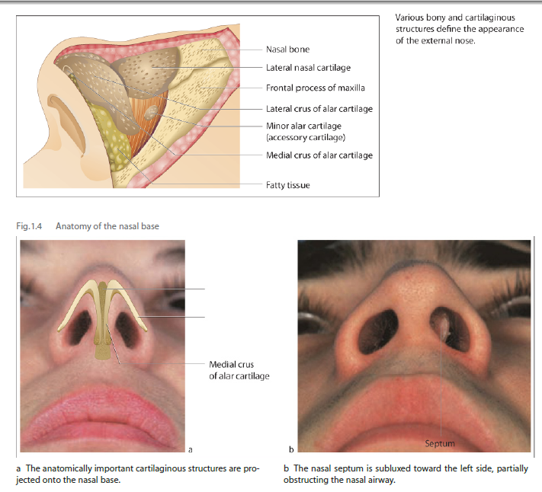
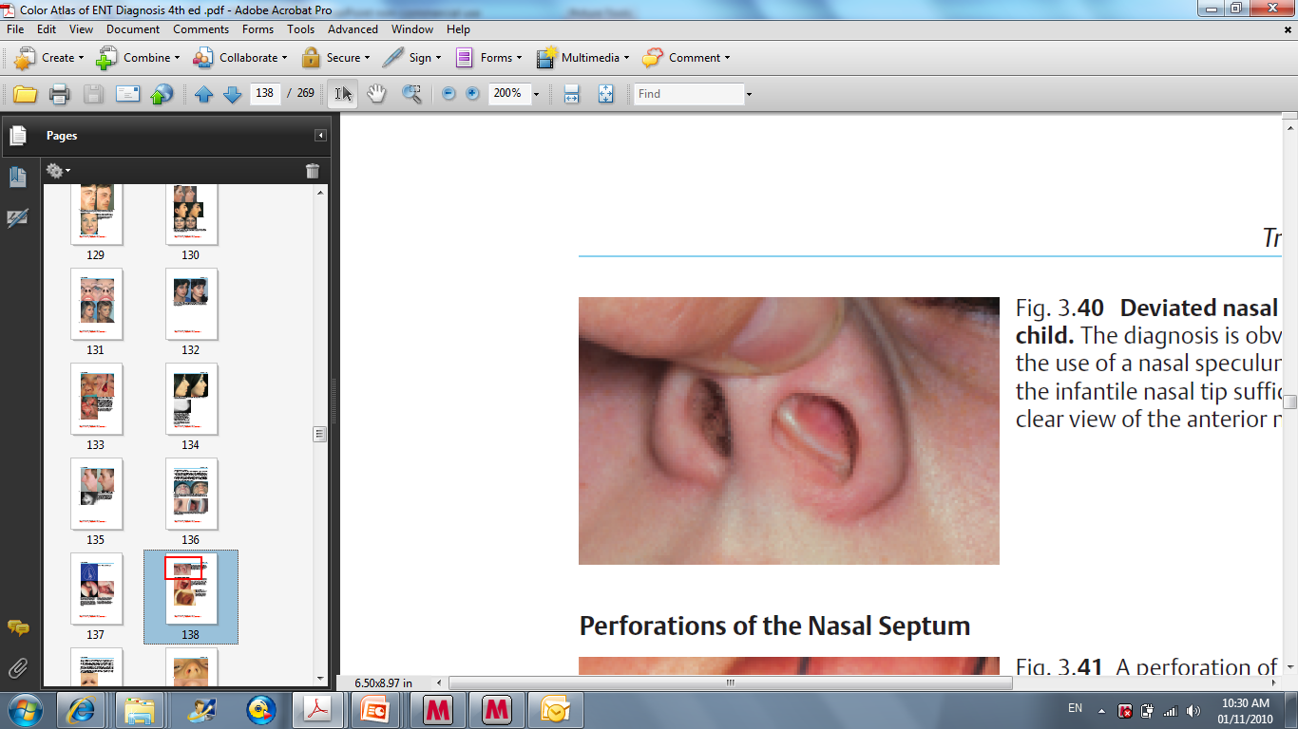
Caudal End Dislocation

Slide 17
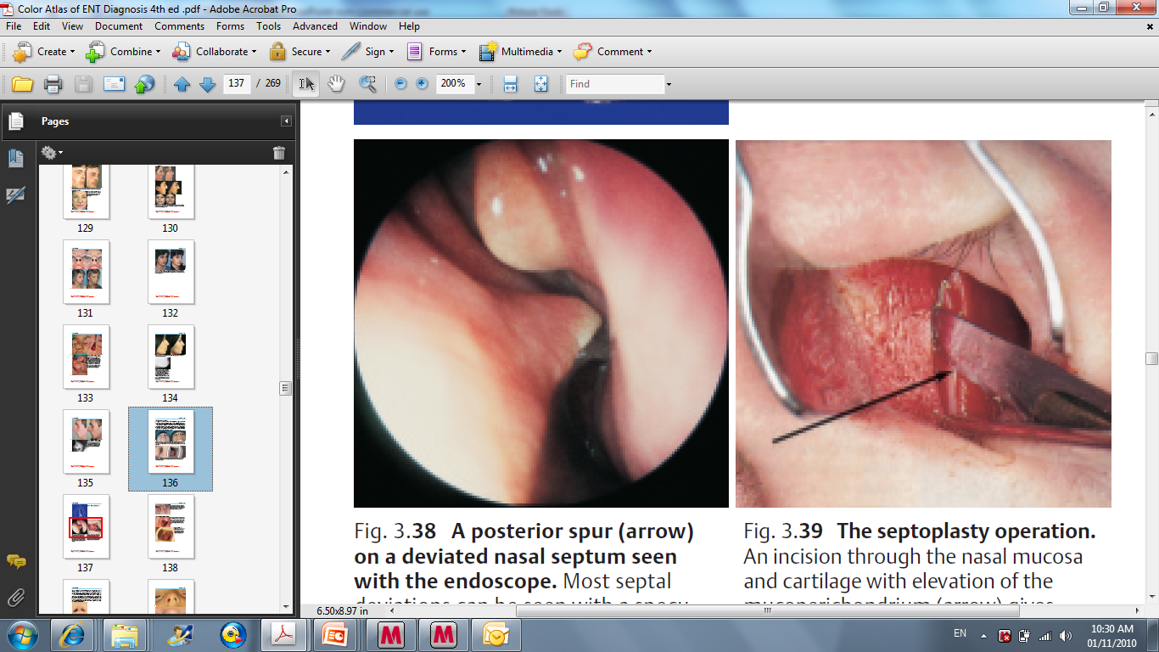
Spurs
  Ridge like deflections and spurs may occur there, even if the rest of the septum is straight.

Slide 18
Surgical Management
• Submucous Resection: obstructing cartilaginous and bony portion of the nasal septum is removed
• Septoplasty: removal of deviated cartilaginous and bony septum with reinsertion after remodeling and repositioning (preserves support system, less risk of perforation)

Slide 19
INDICATIONS
• nasal obstruction (deviated nasal septum),
epistaxis, chronic sinusitis (when septum is obstructing),
access for transseptal sphenoidotomy,
headache from an impacted spur
septal neoplasia (rare)

Slide 20
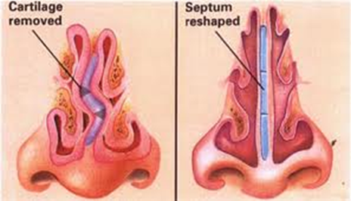
Goals

Slide 21
EMERGENCIES NASAL OBSTRUCTION
Diagnosis | Emergency | Complications
Septal hematoma | Elevation of mucosal perichondrium with cartilage devascularization | Septal cartilage necrosis, development of a saddle-nose deformity
Septal abscess | Intracranial extension of infection | Septal cartilage necrosis, development of a saddle-nose deformity, cavernous sinus thrombosis, intracranial infection
Mucormycosis | Tissue destruction | Extension to brain or orbit

Slide 22
Septoplasty

Slide 24
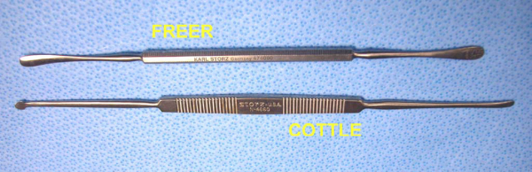
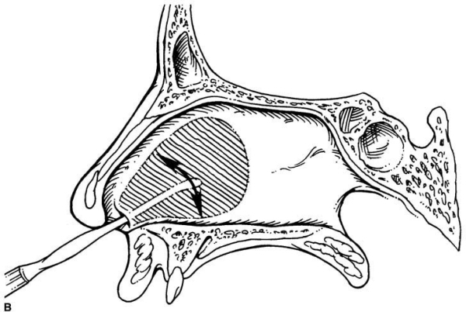

Slide 25
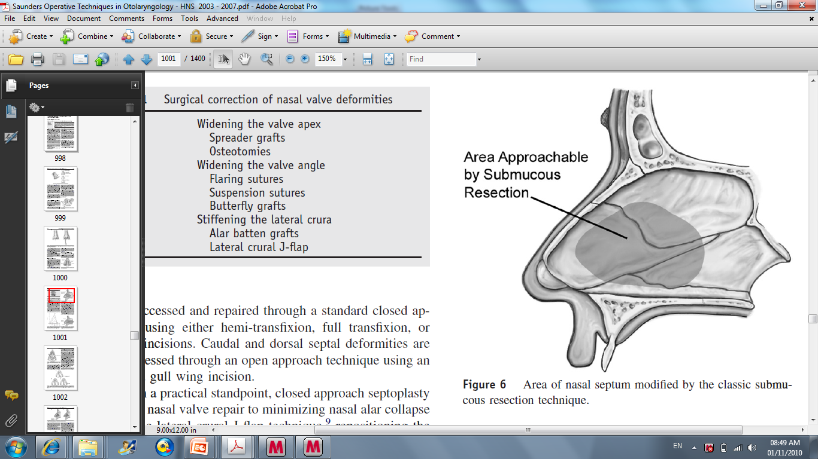
Submucous Resection

Slide 26
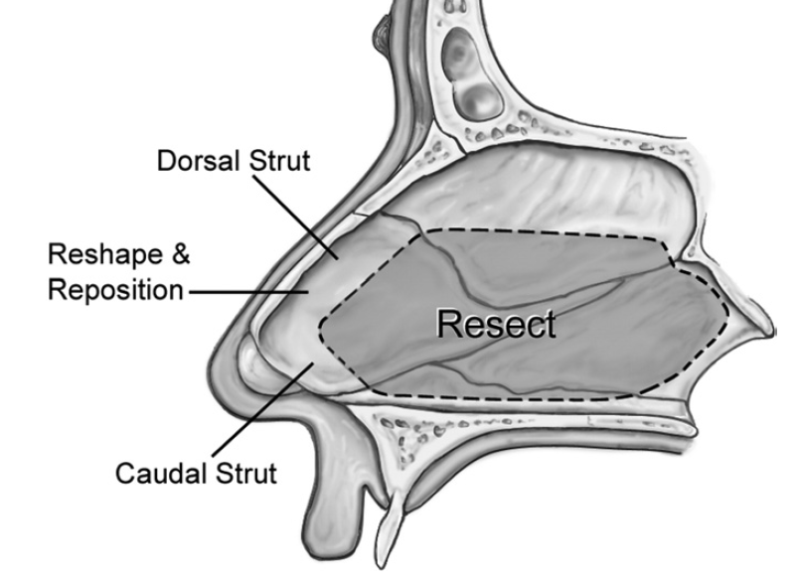

Slide 27
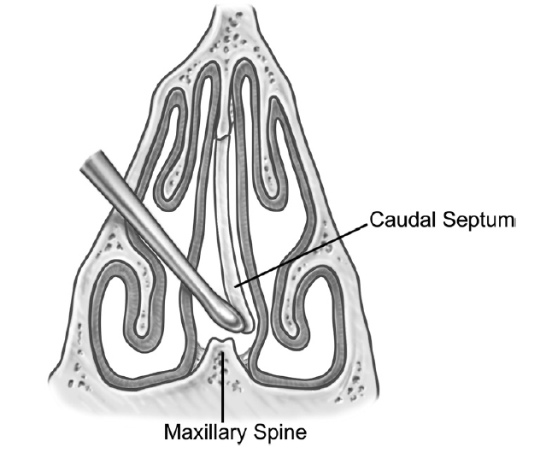
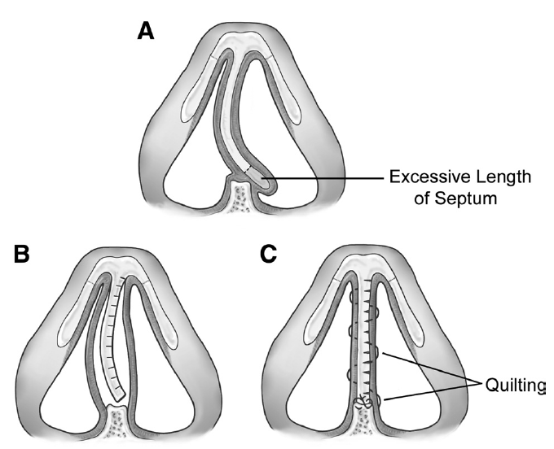

Slide 28
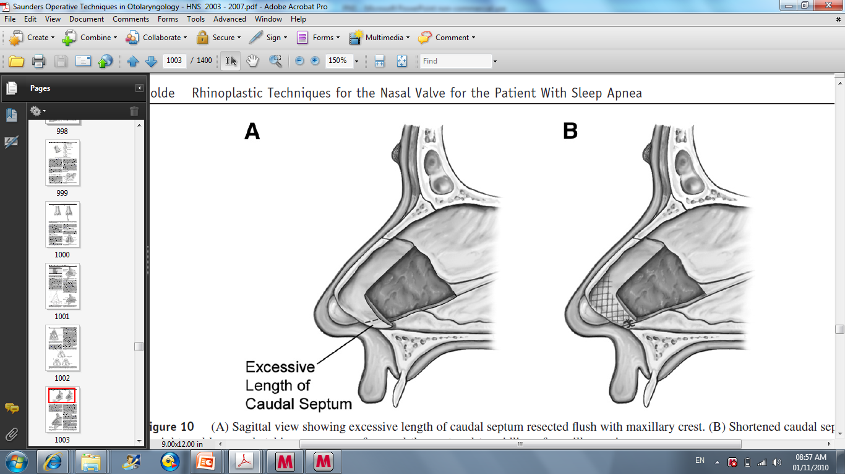

Slide 29
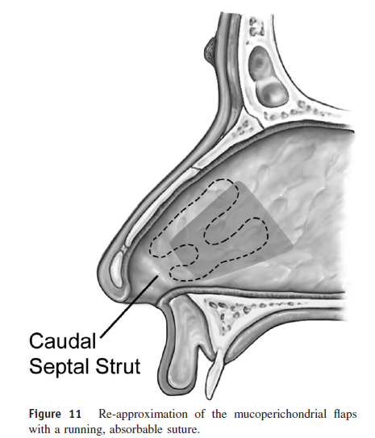

Slide 30
Complications
Psynechia
perforation,
saddle nose deformity (over resecting cartilage anteriorly),
cribriform plate fracture,
septal hematomas,
anosmia,
septal abscess,
bleeding

Slide 31
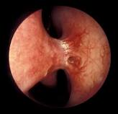
Psynechia
Cause
Manifestation
Treatment

Slide 32
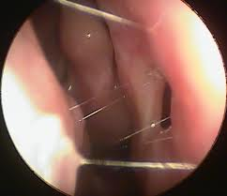
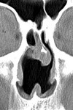
Septal Perforation
Cause
  Septoplasties (Most Common Cause, >50%),
  Infections
  (Tertiary Syphilis),
  Trauma (Nose Picking),
  Neoplasms,
  Granulomatous
  Disease,
  Vasculitis,
  Cocaine Abuse,
  Corticosteroid nasal spray
Manifestation
  Obstructive Sensation From Turbulent Flow, May Be Asymptomatic
  Crusting,
  Epistaxis,
  Whistling,
Treatment
Diagnosis :
Anterior rhinoscopy
Biopsy of granulation tissue or abnormal mucosa
  1. Saline irrigation, emollients
  2. Consider sliding or rotating mucoperichondrial flaps with or
  without a fascial graft; contraindicated for large perforations
  (approximately >2 cm of vertical height), cocaine abusers,
  malignancy, granulomatous or vascular diseases
  3. Silastic Button

Slide 33
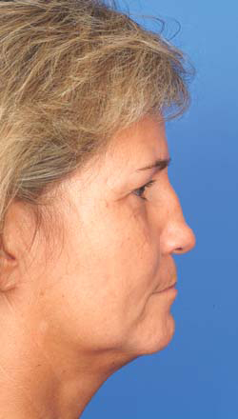
Sadel nasal deformity
Cause
Manifestation
Treatment

Slide 34
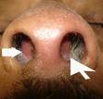
Septal Hematoma

Slide 35
Symptoms and Signs
Unilateral obstruction (may be bilateral),
septal swelling
•

Slide 36
Complications
septal abscess,
cavernous sinus thrombosis,
saddle nose deformity

Slide 37
Treatment
Immediate evacuation of hematoma
Nasal packing
Antibiotic prophylaxis

Slide 38
Functional Endoscopic Sinus Surgery

Slide 39
Functional Endoscopic Sinus Surgery
Medialize middle turbinate
Excise uncinate process
Anterior then posterior ethmoidectomies
Sphenoidotomy
Frontal recess sinusectomy
Create maxillary antrostomy

Slide 40
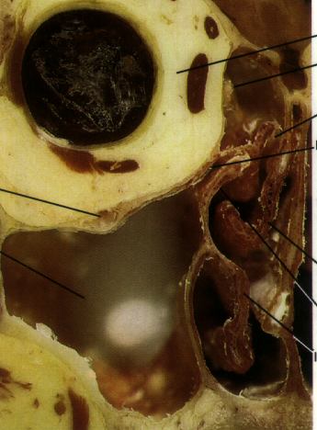
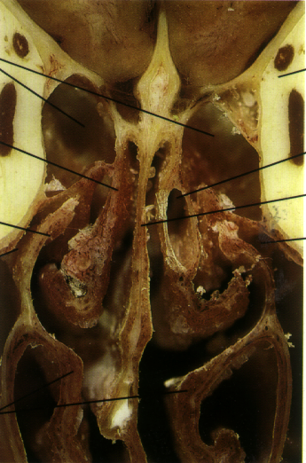
FESS Land Marks

Slide 41
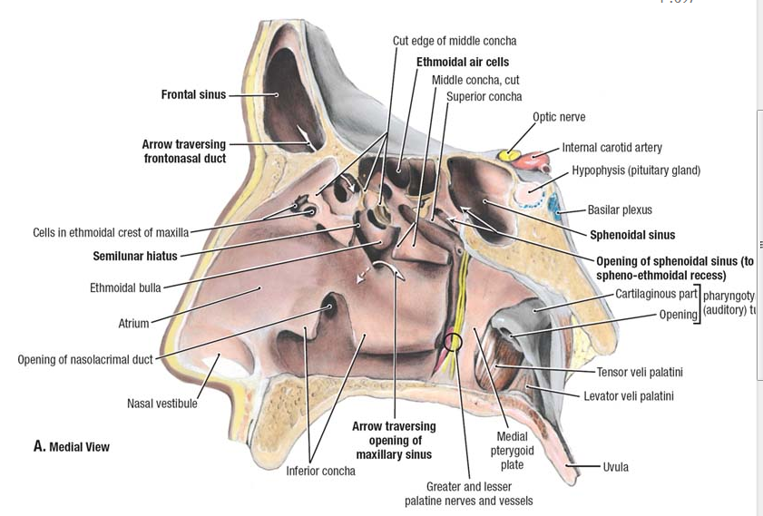
FESS Land Marks

Slide 42
Indications for ESS
Chronic sinusitis,
Complicated sinusitis,
Rrecurrent acute sinusitis,
Failed medical management of acute sinusitis,
Fungal sinusitis
Obstructive nasal polyposis
Sinus mucoceles
Remove foreign bodies
Tumor excision,
Transsphenoidal hypophysectomy
Orbital decompression,
Dacryocystorhinotomy,
Orbital nerve decompression,
Grave’s ophthalmopathy
Choanal atresia repair
CSF leak repair
Control epistaxis
Septoplasty,
Turbinectomy

Slide 43
FESS Goals
Complete extirpation of all the disase
Permanent drainage and ventilation of the affected sinuses
Postoperative access to the previously diseased areas.

Slide 44
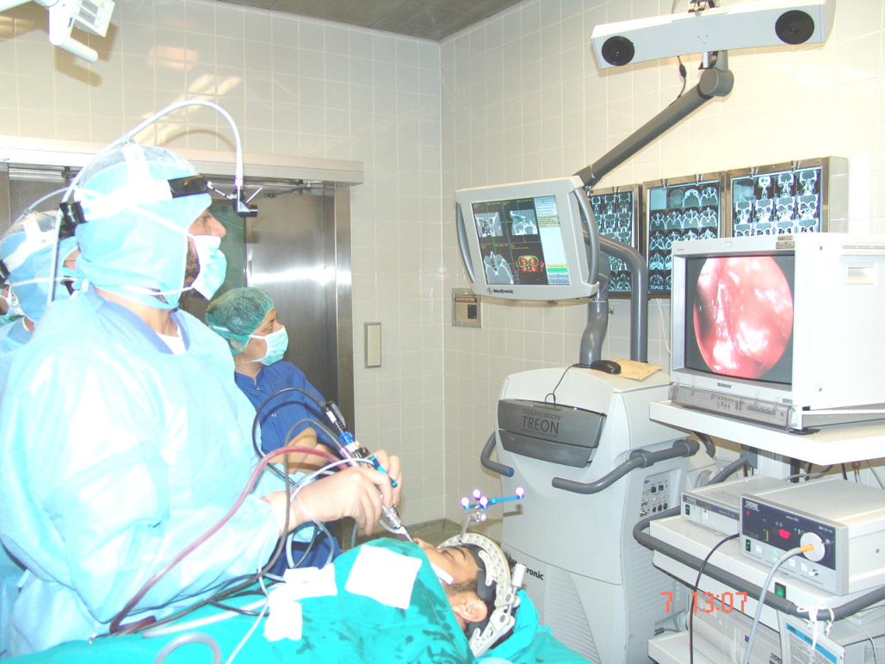
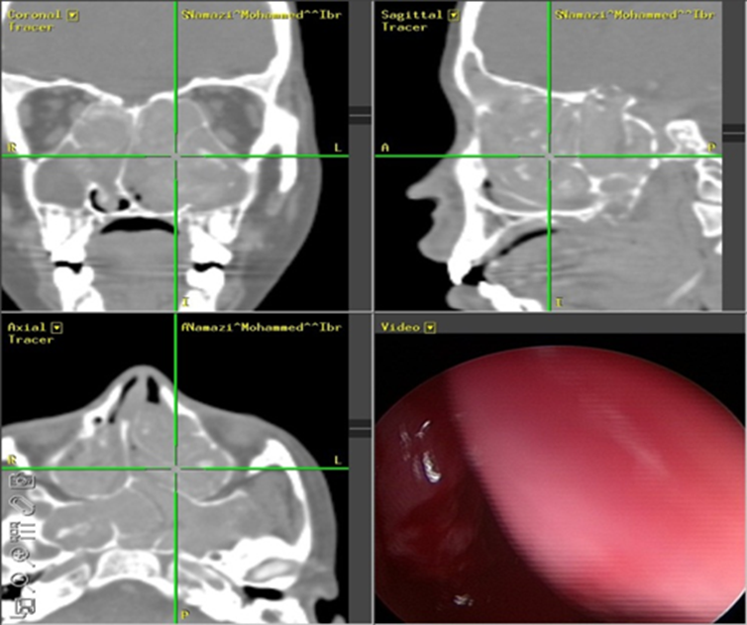
Extended FESS
CT Guided FESS
Power Instrument
Mini FESS

Slide 45
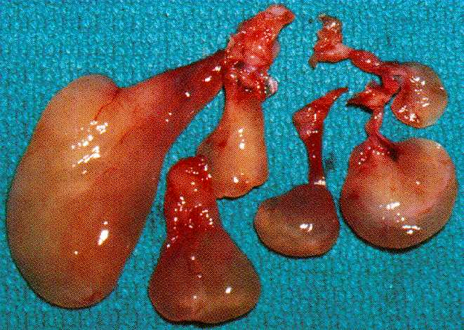
Polypectomy

Slide 46
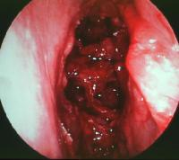
Ethemoidectomy

Slide 47
• Postoperative Care:
Sinus Packing
Oral Antibiotics for a minimum of 2 weeks
Aggressive nasal hygiene to prevent adhesions (saline irrigations)
Nasal steroids
Nasal debridement at 1, 3, and 6 weeks

Slide 48
Excellent results
71% normal at one year
Meta analysis 89% success
  with 0.6% complications

Slide 49
FESS Orbital Complications
• Blindness
Indirect injury (retrobulbar Hematoma)
Direct injury to the optic nerve
Orbital Fat Penetration:
increases risk of retrobulbar hematoma
Rx: recognize orbital fat (orbital fat floats);
avoid further trauma; may complete the FESS;
avoid tight nasal packing;
Observe for vision changes, proptosis, or restricted ocular gaze

Slide 50
• Diplopia: orbital muscle injury, most commonly from medial rectus
and superior oblique muscles
• Epiphora: injury to lacrimal duct system, avoid operating anterior to the attachment of the uncinate;
Rx: observation initially, if no resolution then dacryocystorhinostomy

Slide 51
Retrobulbar Hematoma
• Pathophysiology: most commonly from retraction injury of the anterior ethmoid artery which causes increased orbital pressure that compresses the vascular supply to the optic nerve, also may occur from venous injury near the lamina papyracea
• Avoidance: maintain orientation and operate under direct vision, examine CT for dehiscence, correct coagulopathies

Slide 52
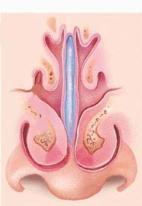
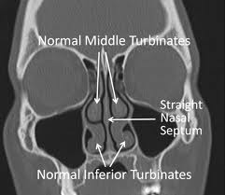
Turbinate Hypertrophy

Slide 53
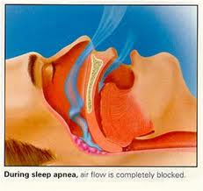
Turbinate Hypertrophy
Causes
  Infection
  Compensation
  Dysfunctional
  Allergies
Manifestation
  Nasal obstrauction
  Mouth Breathing
  Cause manifestation

Slide 54
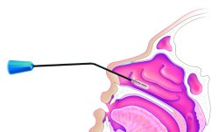
Turbinate Traetment
Treat underlaying cause
Surgical treatment
  SMR
  Turbinoplasty
  SMD
  Somnoplasty RF
  Turbenectomy
  Ultrasonic reduction

Slide 55
TURBINATE REDUCTION GOALS
Mucosal preservation
Controlled reduction
Submucous scarring to reduce the erectile nature of the mucosa
Bony reduction when necessary
Minimal complications

Slide 56
Preoperative
Postoperative

