Slide 1
Facial Nerve
Dr. Badi ALDOSARI
Assistant Professor
Facial Plastic Surgery Consultant
ENT Consultant
King Abdulaziz University Hospital

Slide 2
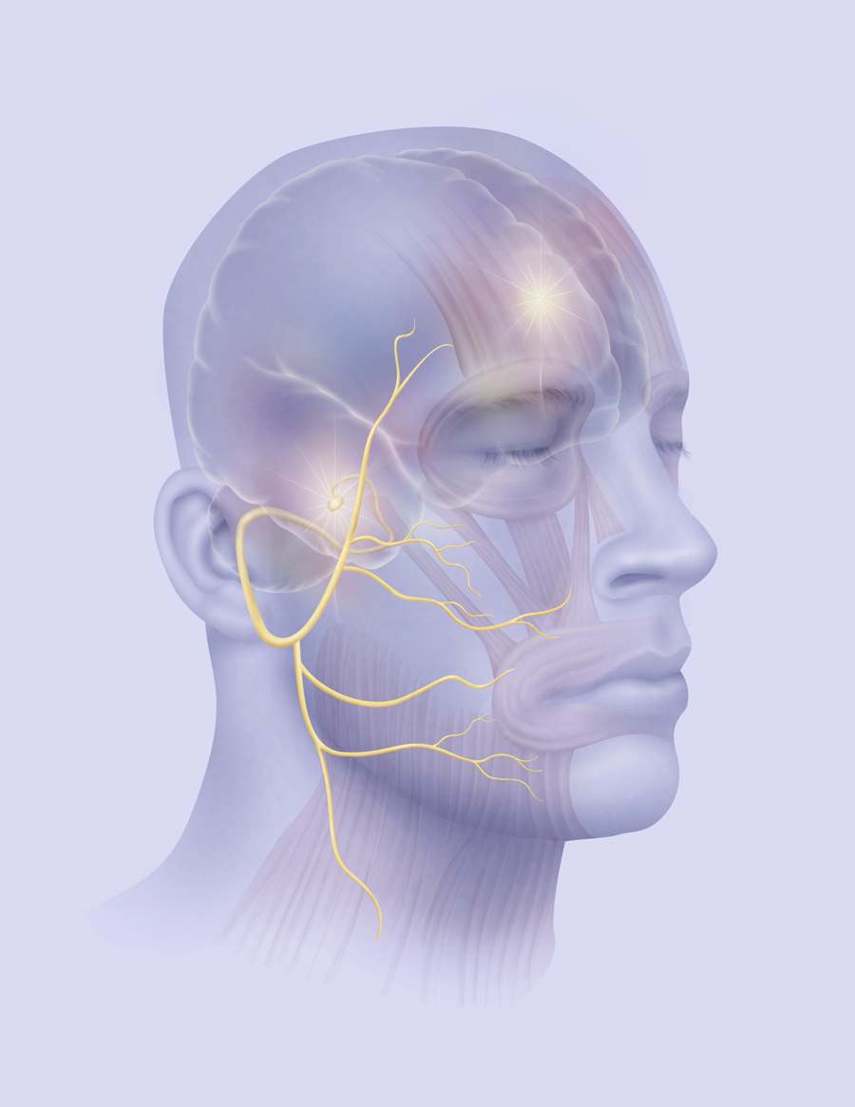

Slide 3
Facial Nerve
Embryology
Anatomy
Physiology
Pathology
Pathophysiology
Evaluation
Causes
Treatment

Slide 4
Embryology
The facial nerve is developmentally derived from the hyoid arch , which is the second branchial arch
It arises as 2 main divisions- motor and sensory
The motor division of facial nerve is derived from the basal plate of the embryonic pons
The sensory division originates from the cranial neural crest.

Slide 5
Facial Nerve
Embryology
Anatomy
Physiology
Pathology
Pathophysiology
Evaluation
Causes
Treatment

Slide 6
Facial Nerve
10,000 neurons
7,000 myelinated facial expression.
Superiorly along the roof of the IAC (7UP)
The course 7segments

Slide 8
Facial Nerve Anatomy
Facial nerve segments:
Pons
Cerebulo-pontine angle (CPA)
Internal Auditory Canal (IAC)
Labyrinthine
Tympanic
Mastoid
External
Fallopian canal (FC)

Slide 9
Pons
4 Ss Nuclei
Solitarius (Taste)
Superior salivatory nucleus
Spinal nucleus of the trigeminal nerve
Seventh motor

Slide 11
Solitarius

Slide 12
Superior salivatory nucleus

Slide 13
Motor part
Precentral gyrus (frontal lobe)
Upper face corticobulbar cross
Contralateral predominance
Motor fiber bend around the abducens ( CN VIth) nucleus

Slide 15
Fallopian canal
The labyrinthine segment
shortest & narrowest part susceptible to compression
Only segment that lacks arterial anastomosis
embolic phenomena
vascular compression
Geniculate ganglion
1st genu (bend or knee)
Common trunk (nervus intermedius and VII nerve)
Greater superficial petrosal nerve  lacrimal gland
Tympanic segment
50% dehiscent
_{– 1}st _{ 2}nd
genu

Slide 16
Fallopian canal
Mastoid segment
_{– 2}nd
genu  vertically  stylomastoid foramen
longest part of the intratemporal course
Branchs
Stapedius muscle
Chorda tympani nerve
 submaxillary and sublingual
 Taste anterior 2/3 tongue
 pain, temperature, and touch EAC.
Auricular nerve

Slide 17
Extracranial
Postauricular muscles
Stylohyoid muscle
Posterior belly of the digastric muscle
Pes anserinus (goose's foot ) separates parotid  deep and superficial lobes
5 major branches T,Z,B,M,C
Highest risk during surgical T&M

Slide 19
Pes anserinus (goose's foot )

Slide 22
Facial Nerve
Embryology
Anatomy
Physiology
Pathology
Pathophysiology
Evaluation
Causes
Treatment

Slide 23
Physiology
Lacrimation
Expression
Mastication
Salivation
Speech
Hearing

Slide 24
Facial Nerve
Embryology
Anatomy
Physiology
Pathology
–Pathophysiology
Evaluation
Causes
Treatment

Slide 25
Facial Nerve Palsy
Degeneration
Metabolic source (cell body)
Wallerian degeneration
Begins within 24 hours
Degeneration distal axon & myelin sheath
Distal to the site of an injury
Without local Inflammation
Macrophages degrade myelin and axons

Slide 26
Facial Nerve Palsy
Regeneration
Axonal stumps swell and proliferating neurofilaments
Misdirected regrowth of nerve fibers
Facial muscle contractures  Synkinesia
Salivation crocodile tears

Slide 27
Pathophysiology
Neuropraxia– no axonal discontinuity
Axonotmesis
Wallerian degeneration (distal to lesion)
Endoneural sheaths intact
Neurotmesis
Wallerian degeneration (distal to lesion)
Axon disrupted, loss of tubules, support cells destroyed

Slide 29
House-Brackmann
Grade 1
– = Neurapraxia
Spontaneous recovery
Grade 2-3
– =Axonotmesis
Flow interruption
Wallerian anterograde degeneration.
Incomplete degeneration

Slide 30
House-Brackmann
Grade 4
– =Neurotmesis ( permanent loss of axons)
Demyelinization
Moderate-to-severe facial musculature dysfunction
Regenerative  synkinetic movements
Grade 5 and 6
Partial or complete transection of the nerve
Minimal/complete loss of function

Slide 31
Facial Nerve
Embryology
Anatomy
Physiology
Pathology
Pathophysiology
–Evaluation
Causes
Treatment

Slide 32
Evaluation
Careful history
Physical exam
Audiometry
CT/MRI/other
Topographic
Electrophysiology

Slide 33
History
Timing
Associated symptoms
SNHL
Vesicles
Severe pain
Trauma
OM acute or chronic
Past medical history

Slide 34
Physical exam
Complete head and neck exam
Wide smile
Whistling
Blowing
LMNL
Forehead wrinkling
Eye closure
Bell’s phenomenon

Slide 36
Topognostic Tests
Schirmer’s Test
Stapedial reflex
Taste
Salivary Flow
Imaging

Slide 38
Evaluation Facial Nerve Palsy
Electro-Physiology
Electroneurography (ENoG)
Electromyography (EMG)
Nerve excitability test (NET)
Maximum stimulation test (MST)
ACUTE=Acute+Complete+Unilateral+ThreedaysEvaluate

Slide 41
Facial Nerve
Embryology
Anatomy
Physiology
Pathology
Pathophysiology
Evaluation
–Causes
Treatment

Slide 42
Facial Nerve Palsy
Causes:
Congenital
Trauma
Iatrogenic
Idiopathic
Infection
Toxic
Neurologic
Neoplastic

Slide 43
Facial Nerve Palsy
Trauma
Forceps delivery
Basal skull/temporal bone fractures
Facial injury
Penetrating to middle ear
Barotrauma
Lightning

Slide 44
Racoon eyes sign

Slide 45
Battle’s sign

Slide 47
Fractures
Longitudinal
80% of Temporal Bone Fractures
15-20% Facial Nerve involvement
Transverse
20% of Temporal Bone Fractures
50% Facial Nerve Involvement

Slide 49
R

Slide 50
Facial Nerve Palsy
Iatrogenic
Parotid surgery
Mastoid surgery
local anesthesia
Acoustic neuroma

Slide 51
Iatrogenic Facial Nerve Palsy

Slide 52
Iatrogenic Facial Nerve Palsy

Slide 53
Facial Nerve Palsy
Idiopathic
Bell’s
Melkersson-Rosenthal
Guillian-Barre
MS
Myasthenia gravis
Sarcoidosis (Heerfordt’s)

Slide 54
Bell's Palsy
Commonest cause of acute VII paralysis
Diagnosis of exclusion
Unilateral facial paralysis
Sudden onset
Unknown cause
LMNL

Slide 55
Bell's Palsy
Limited duration
Minimal symptoms
Spontaneous recovery
No sensory loss

Slide 56
Bell's Palsy
? Immune or viral
 Swelling of the nerve
 Compression and ischemia
 Complete paralysis

Slide 57
Diagnosis
Weakness of the entire half of the face
In doubt  CT and MRI scans
MRI may show contrast enhancement of the facial nerve

Slide 58
Prognosis and Treatment
Complete recovery
90% Complete recovery
Several months
Prevent corneal drying
Natural tears
Isotonic saline
Strips of skin tape to close the eye

Slide 59
Medical Management
Corticosteroids
80 mg/day po
Within 24 to 48 h of onset for 1 wk
Decreased gradually over the 2nd wk
Antivirals (Acyclovir )
Less degrees of facial weakness

Slide 60
Melkersson-Rosenthal
4 Fs
Facial nerve palsy
(Recurrent )
Furrowed tongue
Faciolabial edema
FHx + ve

Slide 61
Melkersson-Rosenthal

Slide 62
Sarcoidosis (Heerfordt’s)

Slide 63
Facial Nerve Palsy
Infection
Malignant otitis externa
Otitis media
Mastoiditis
Ramsey Hunt (Herpes zoster)
Encephalitis
Polio
Syphilis

Slide 64
Malignant Otitis Externa
4 Ds
Diabetes mellitus
Discharge (Purulent )
Discomfort
Dysfunction Cranial nerve
Granulation obscured TM


Slide 65
Otitis media

Slide 67
Mastoiditis

Slide 68
Ramsay Hunt
Herpetiform vesicular eruptions (VZV)
Painful
vestibulocochlear dysfunction
Treatment is equivalent to Bell palsy
Poor outcome

Slide 69
Facial Nerve Palsy
Neoplastic
Malignant parotid lesion
Cholesteatoma
Acoustic neuroma
CN VII tumor
Meningioma

Slide 70
Neoplastic
SPORT Neoplasm
Slowly progressive
Persistent >4 months
Other C.N. Ex SNHL
Recurrent
Tumor History

Slide 72
Cholesteatoma

Slide 73
Neoplastic Facial Nerve Palsy
Acoustic neuroma

Slide 74
Facial Nerve
Embryology
Anatomy
Physiology
Pathology
Pathophysiology
Evaluation
Causes
Treatment

Slide 75
Facial Nerve Palsy
Functional deficits
Lagopthalmos and ectropion
Oral incompetence
Nasal obstruction
Mastication difficulties
Articulation difficulties
Often severe psychological distress

Slide 76
Goals of restoration
Corneal protection
Facial symmetry at rest
Symmetric smile
Oral competence

Slide 77
Facial Nerve Palsy
Dynamic Reanimation
Primary repair
Interposition nerve grafts
Crossover reinnervation procedures
Ansahypoglossi Hypoglossal& Cross-facial
Regional muscle transfer
Temporalis, Masseter & Digastric
Microneurovascular free-flap
Gracilis, Latissimus dorsi & Rectus abdominis

Slide 78
Facial Nerve Palsy
Static Reanimation
Brow and forehead lift
Eyelid procedures
Gold weight, Spring & Lower lid tightening
Correction of midfacial deformity
Fascia lata, Alloplastic sheets & Facelift
Lower lip wedge resection
Botulinum toxin

Slide 79
Restore Neural input
Primary nerve repair
Preformed immediately
Small gap (<17mm)
Epineural or perineural
Magnification
No tension
Best outcome
Expect HB III

Slide 80
Restore Neural input
Interposition graft
HB III
Variable synkinesis
Improvement over 6 to 18 months

Slide 81
Hypoglossal-facial crossover

Slide 82
Muscle transposition
Masseter transfer

Slide 83
Muscle transposition
Temporalis transfer

Slide 84
Temporalis Muscle transposition

Slide 85
Non-functional facial muscles
Free gracilis

Slide 86
Non-functional facial muscles
Free gracilis trigeminal innervation

Slide 87
Static reanimation

Slide 88
Botulinum Toxin
Synkinesis and hypertonia
Advantages
Ease of use
Selective
•Disadvantages
Temporary
Repeated every 3 months

Slide 89
Conclusions
Facial paralysis sequlae (significant)
Functional
Cosmetic
Psychological
The primary goals of facial reanimation
Corneal protection
Symmetry at rest
Smile restoration

Slide 90
Conclusions
Primary repair
Cable rafting
CN XII-CN VII anastamosis Static Reanimation Microneurovascular Hyperkinetic  Botulinum toxin

Slide 91
Facial Nerve
Embryology
Anatomy
Physiology
Pathology
Pathophysiology
Evaluation
Causes
Treatment

