Slide 1
Audiological Evaluation
A to Z
Dr.Osama Hamed
Audio-Vestibular Medicine Specialist
KAUH

Slide 2
AUDIOLOGY
The study of sound and hearing
Sound=physical stimulus that evoke
sensation of hearing.
Audiometry=the measurement of
hearing sensitivity.

Slide 3
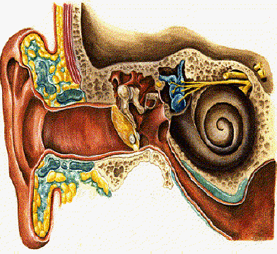
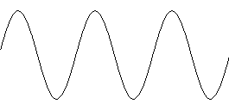
The nature of sound and hearing
Stimulus: sound
(sine wave)

Slide 4
MECHANICAL
ELECTRICAL/SENSORY

Slide 5
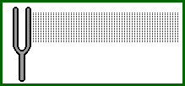
SOUND
Sound is a form of vibration
Vibration is the to-and-fro motion of an object (guitar string, vocal folds, diaphragm on an earphone or loudspeaker, tuning fork)

Slide 6
SOUND
For sound to occur, must have a
SOURCE: Something has to be disturbed.
FORCE: Something has to disturb it.
MEDIUM (e.g. air): Something has to carry the disturbances.

Slide 7
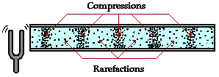
When air molecules are displaced, pressure waves occur
http://www.glenbrook.k12.il.us/gbssci/phys/Class/sound/u11l1c.html

Slide 8
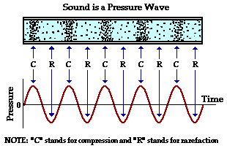
SOUND: PRESSURE WAVE

Slide 9
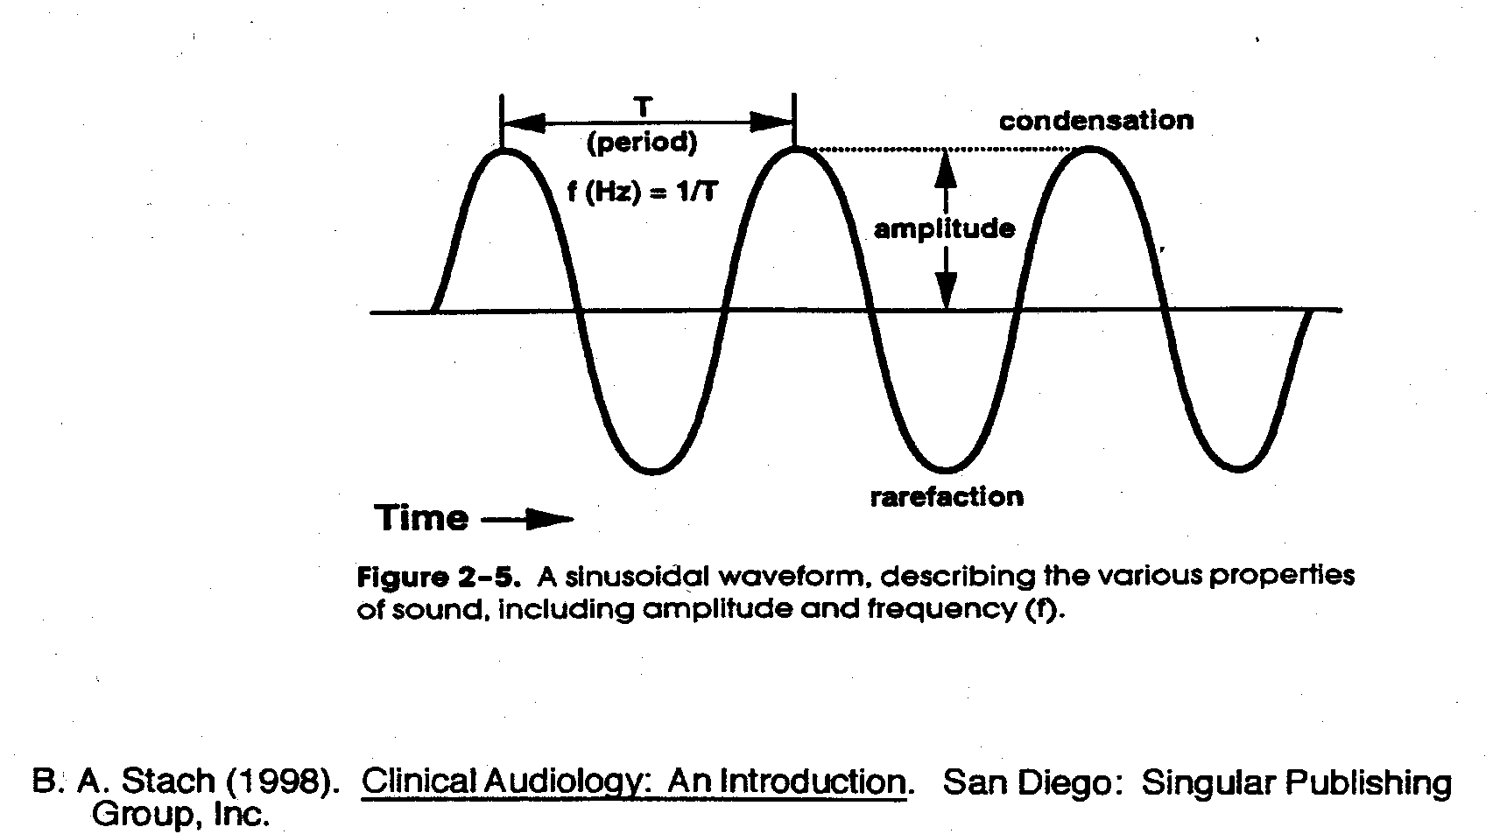
Characteristics of the waveform (amplitude x time)
CYCLE: One complete period of compression and rarefaction of a sound wave

Slide 10
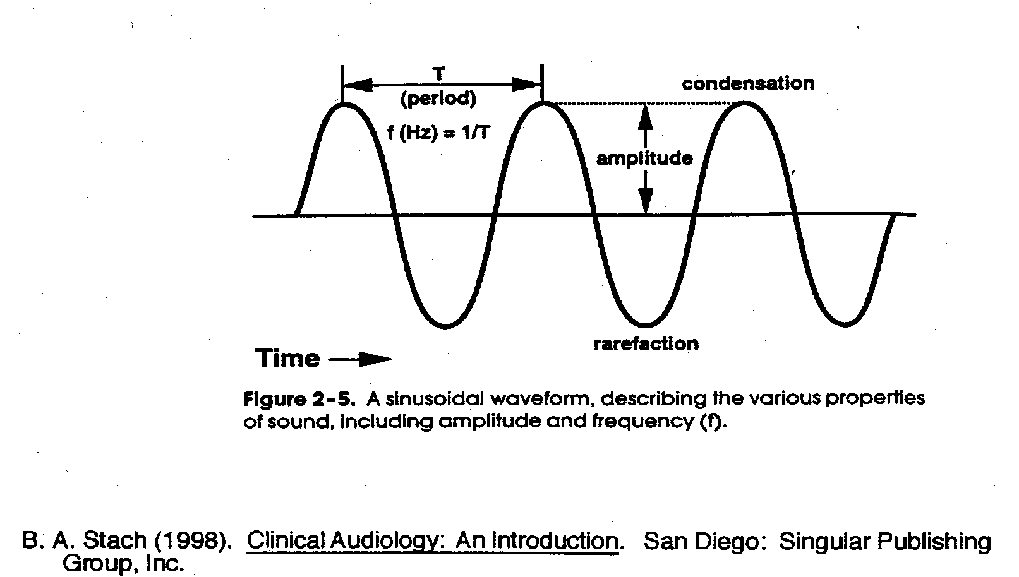
Characteristics of the waveform (amplitude x time)
PERIOD: The amount of time that it takes to complete one vibratory cycle.

Slide 11
FREQUENCY: The number of cycles that occur in one second.

Slide 12
FREQUENCY
Hertz (Hz): Unit of measurement of frequency
100 cycles per second = 100 Hz
Pitch: Psychological percept of frequency.
e.g., low frequency sounds = low pitch

Slide 13
Frequency Range of Hearing Sensitivity
Humans: 20 Hz to 20 kHz.
  Below 20 Hz, we feel a vibration rather than hear a sound.
  Most people have very diminished sensitivity for frequencies > 8000-10, 000 Hz.
Bats (auditory specialists) : 2 kHz-100 kHz.

Slide 14
The Minimal Audible Pressure Curve (dB SPL)
Indicates the minimum average sound pressure levels by frequency for a group of people with normal hearing

Slide 15
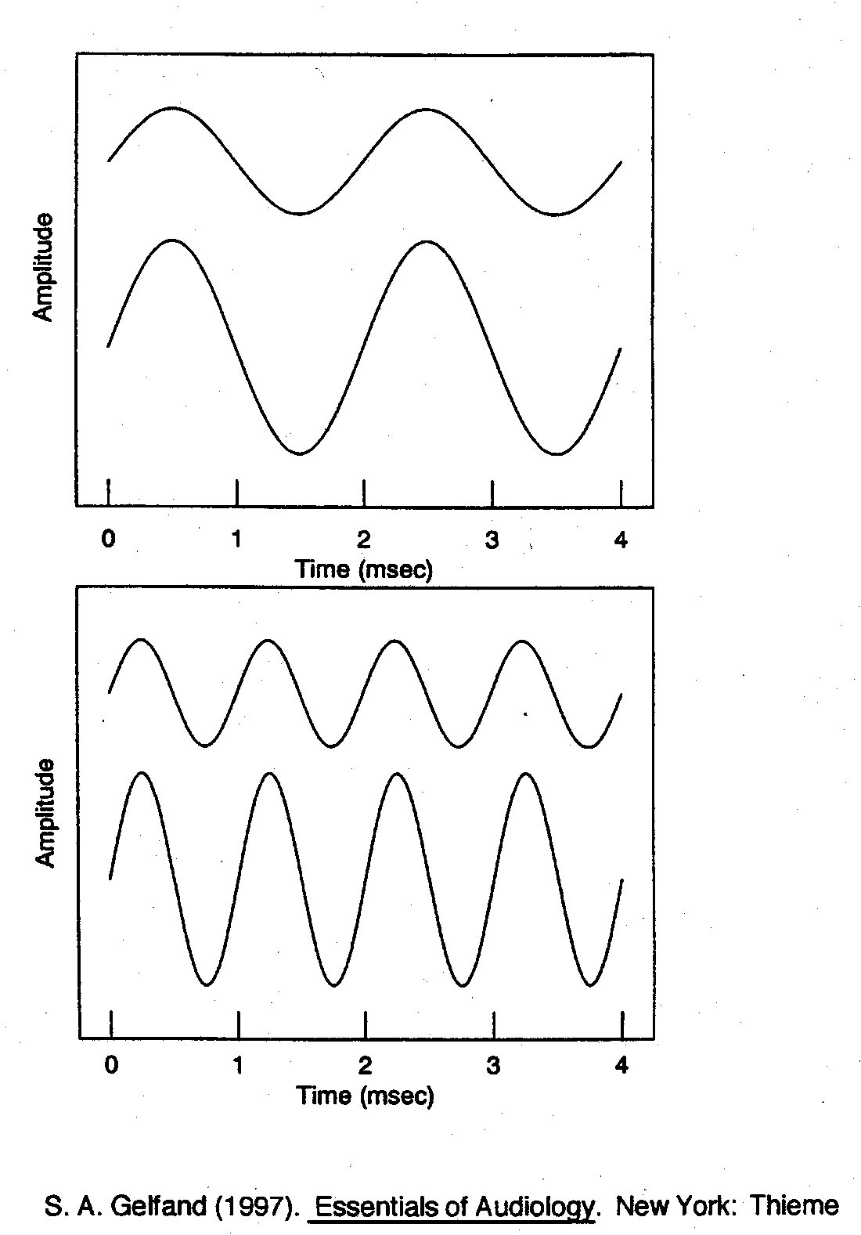
Amplitude
Intensity
The quantity or magnitude of sound.

Slide 16
AMPLITUDE/INTENSITY
Decibel (dB): Unit of amplitude used most frequently in clinical audiology.
Loudness: The psychological correlate of amplitude (measured in sones, phons).

Slide 17
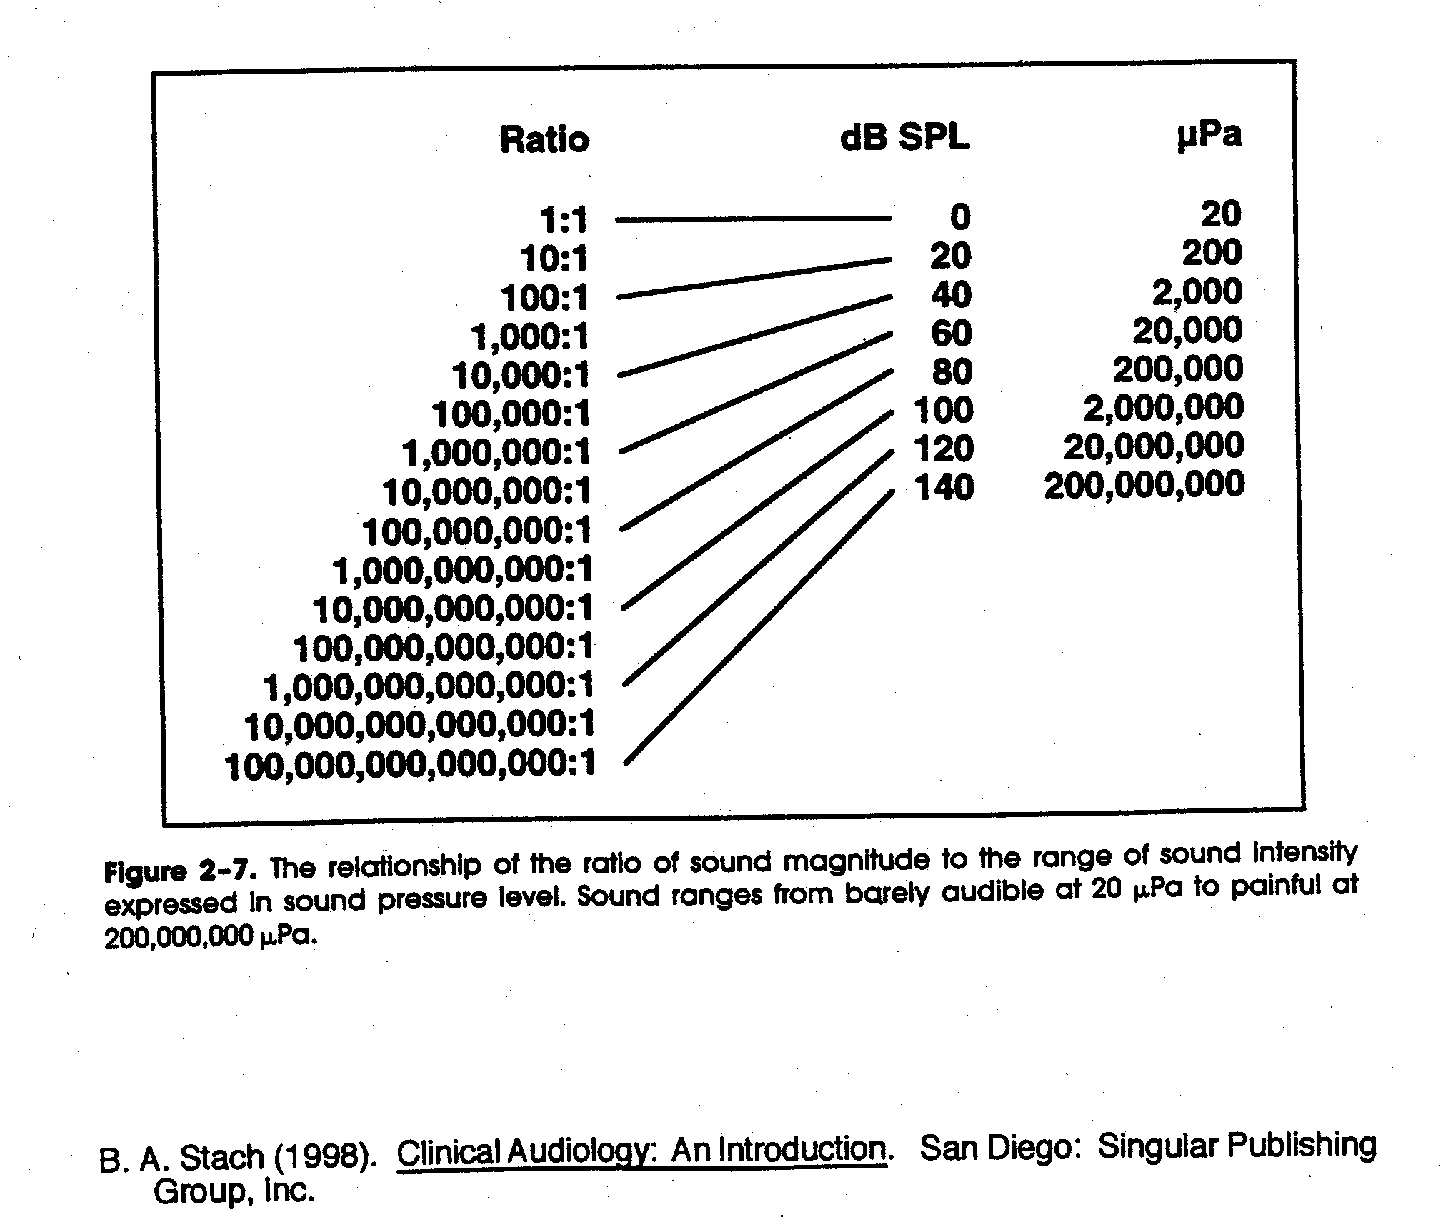

Slide 18
Hearing loss prevention
Noise controls, hearing protectors
  Primary prevention ➔ reduction or elimination of HL
Screening neonates, school age, elderly, industrial
  Secondary prevention ➔ early identification to reduce negative effect of HL
Audiology services (hearing aids, rehab)
  Tertiary prevention ➔ services to deal with adverse effects of HL

Slide 19
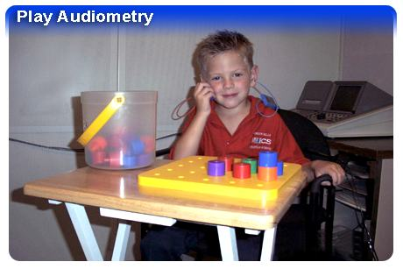
Types of Tests
BEHAVIOURAL
  reliable & consistent response to sound
  Developmental age
  not used in newborn screening
OBJECTIVE
  no voluntary response
  infants and young children
  non compliant subjects
  people with developmental level that doesn’t allow other testing.

Slide 20
Age based hearing assessment
BEHAVIOURAL
OBJECTIVE
SCHOOL-AGED +
PURE TONE AUDIOMETRY
Request responses
Measure responses
PLAY AUDIOMETRY
TODDLER
Condition responses
VROA
Observe responses
BIRTH
BOA
Need to consider individual’s functional age

Slide 21
Overview
Behavioral audiometry
Tympanometry
Acoustic reflex measurements
ECochG
Auditory Brainstem Response (ABR)
Otoacoustic Emissions

Slide 22
Behavioural Observation Audiometry (BOA)
Observing changes in behaviour in response to sounds
Who?
Very young babies (under 6mths corrected) or with similar functional age.
Test sounds & materials
Calibrated (known frequency and intensity) noisemakers
Audiologist records sound level (from sound level meter), sound type & observed response- observer determines whether response is present/absent

Slide 23
Infants 7 months-3 years
Aim: to detect hearing impairment greater than 20-30 dB HL
Typically use behavioural techiques
  Visual Reinforcement Orientation Audiometry (VROA) for 6-18 months
  Play audiometry
May incorporate objective testing if non-compliant or very difficult to test

Slide 24
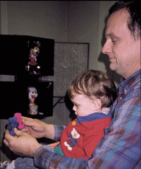
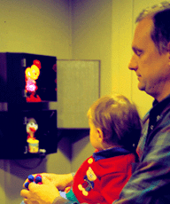
Visual Reinforcement Oreintation Audiometry (VROA)
  Uses operant conditioned response and visual reinforcement
    Response typically head turn. Eye turn also possible
    Complex visual reinforcement usually lighted puppet theatre- colour movement and light are important

Slide 25
Play audiometry 3-9 years
Before testing
  Subjective check of audiometer
  Check test environment, audibility of tones
  Avoid visual clues
  Instruct client, demonstrate procedure
  Position headphones
  Present orienting tone (40dBHL) and check client’s response. Re-instruct if necessary

Slide 26
Screening with Play Audiometry
use peg board, blocks etc.
  if very young get parents to train child at home
headphones on desk present 100dB tone
train child without headphones- Stimulus -Response
introduce headphones
present 40dB HL tone with headphones on. Repeat
decrease tone to 20dB HL for screen

Slide 27
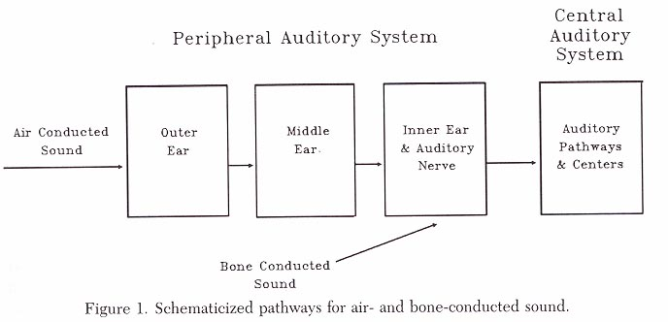
Pure Tone Audiometry
Most common test
Threshold of audibility
Activation of auditory system
Energy formatted into neural code
Air conduction assesses entire system
Bone conduction assesses cochlea onwards

Slide 28
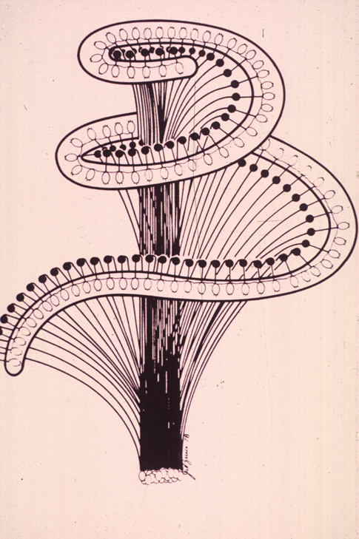
Pure Tones
Auditory acuity
Spectrally specific
High frequency tones stimulate basal turn of the cochlea
Low frequency tones stimulate apical turn of the cochlea

Slide 29
Assessment of thresholds
Octave frequencies tested
Bone conduction thresholds
Mastoid or forehead used
Mastoid preferred because less intensity required
Occlusion effect
Ascending series of tone presentations

Slide 30
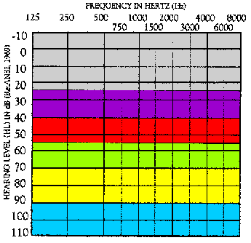
Ranges of Hearing Loss
-10 – 25 dB HL = Normal range
26 – 40 dB HL = Mild hearing loss
41 – 55 dB HL = Moderate
56 – 70 dB HL = Moderately Severe
71 – 90 dB HL= Severe
Greater than 90 dB HL = Profound

Slide 31
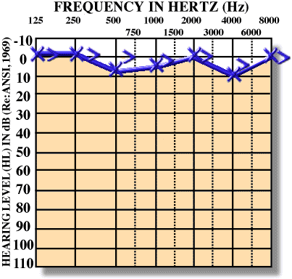
Normal Hearing

Slide 32
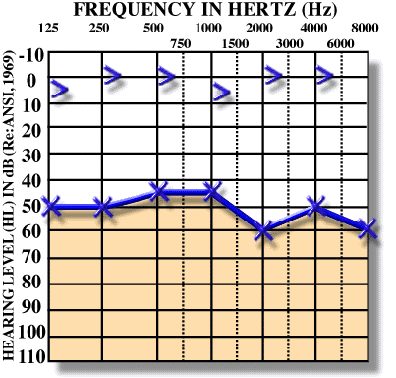
Conductive Hearing Loss

Slide 33
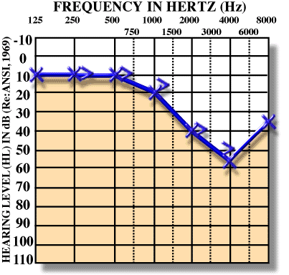
Sensorineural Hearing Loss

Slide 34
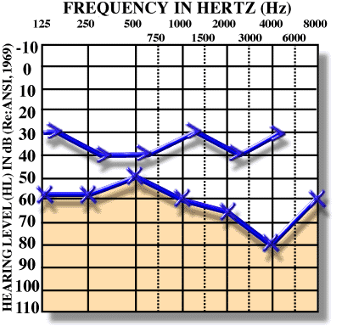
Mixed Hearing Loss

Slide 35
Speech Audiometry
Speech Reception Threshold using spondaic words
Standardized word lists
Familiarization with spondees
Ascending series of presentation
Excellent speech discrimination in conductive hearing loss patients
Poor speech discrimination in cochlear hearing loss patients
Poorest speech discrimination in retrocochlear hearing loss patients

Slide 36
Clinical Masking
Nontest ear can influence thresholds of test ear
Shadow curve apparent without masking
Interaural attenuation varies from 40 to 80 dB with air conduction
Interaural attenuation is about 0 dB with bone conduction

Slide 37
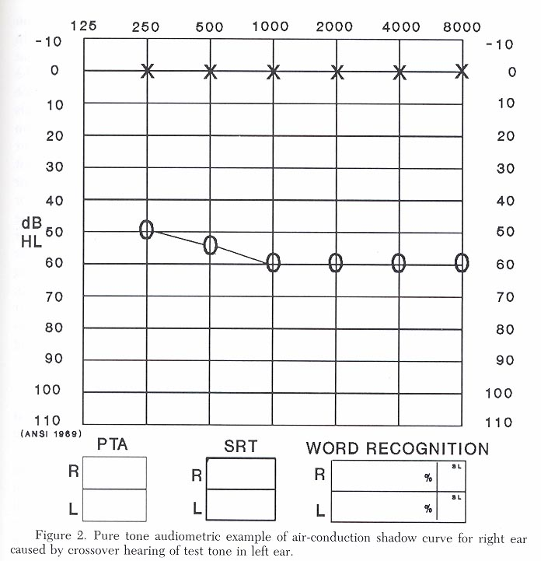
Shadow Curve

Slide 38
Clinical Masking cont.
Compare bone conduction threshold of nontest ear with air conduction threshold of test ear to determine whether masking is necessary

Slide 39
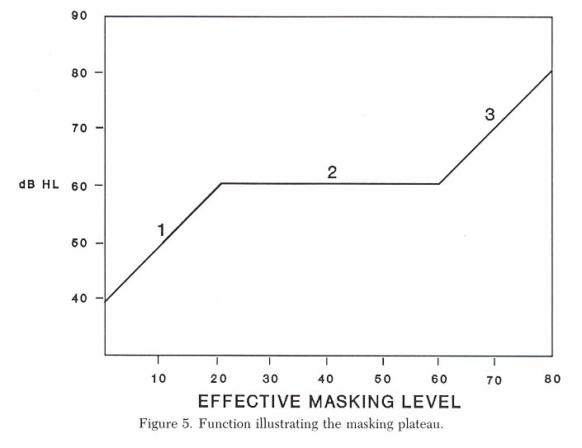
Plateau method
Mask nontest ear with progressively greater amounts of sound until threshold does not rise.
Masking Dilemma

Slide 40
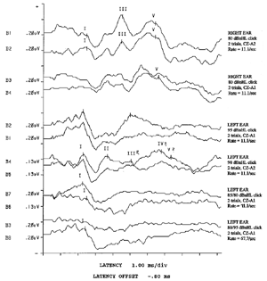
Objective Audiological Tests

Slide 41




Electrophysiological Tests
Immittance
Evoked Potential
Otoacoustic Emissions

Slide 42
Immittance
Ear Canal Volume
Tympanometry
Static Compliance
Acoustic Reflex, Decay, & Latency

Slide 43
Ear Canal Volume
Measure at +200 mmH20
Provides measure of volume of external ear canal
Volumes based on age
Volumes greater than 2.5 suggest:
  Perforation or
  Patent V. tube

Slide 44

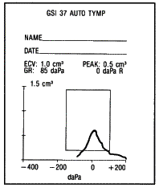
Tympanometry
Objective measure of the function of the TM and middle ear
5 or 6 basic shapes

Slide 45
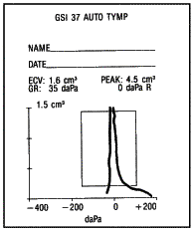
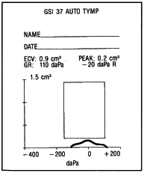
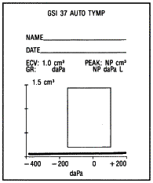
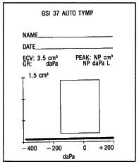
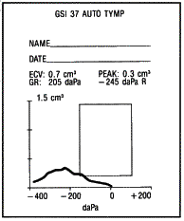
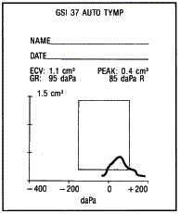
Tympanogram Types

Slide 46
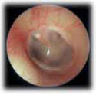
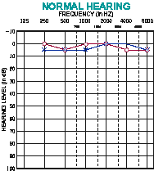
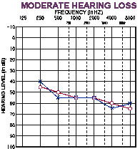
Type A Tympanogram
OE | ME | IE | AN | CNS
AC
A
BC
Normal or SN

Slide 47
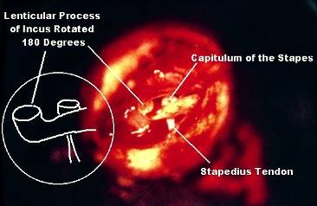
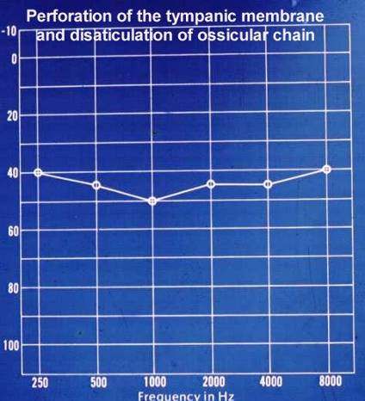
Type AD Tympanogram
OE | ME | IE | AN | CNS
AC
A
D
BC
Disarticulation

Slide 48
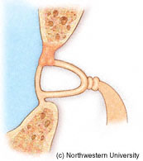
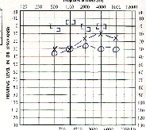
Type AS Tympanogram
OE | ME | IE | AN | CNS
AC
A
S
BC
Otosclerosis

Slide 49
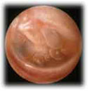
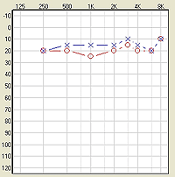
Type BLow Tympanogram
OE | ME | IE | AN | CNS
AC
B
Low
BC
OME

Slide 50
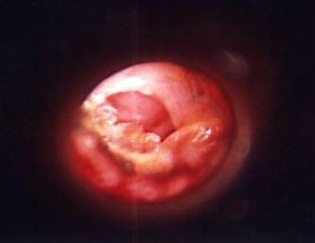

Type BHi Tympanogram
OE | ME | IE | AN | CNS
AC
B
Hi
BC
Perforation

Slide 51
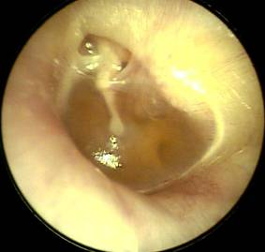
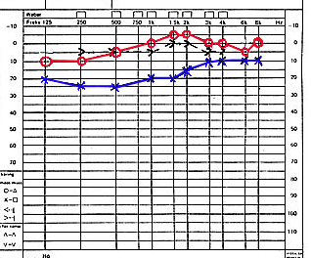
Type C Tympanogram
OE | ME | IE | AN | CNS
AC
C
BC
Eustachian Tube Dysfunction

Slide 52
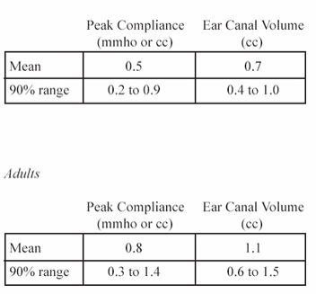
Static Compliance
(Peak Compliance)
Acceptable Range by Age
Flaccid: disarticulation, flaccid TM, etc.
0.9
1.4
Normal mobility
0.2
0.3
Stiff: otosclerosis fluid, tympanosclerosis, etc.
Child
Adult

Slide 53
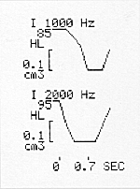
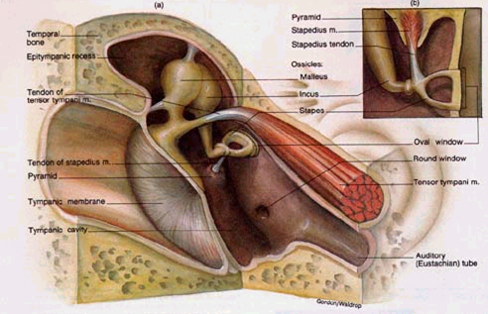
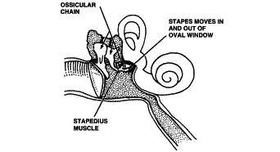
ART

Slide 54
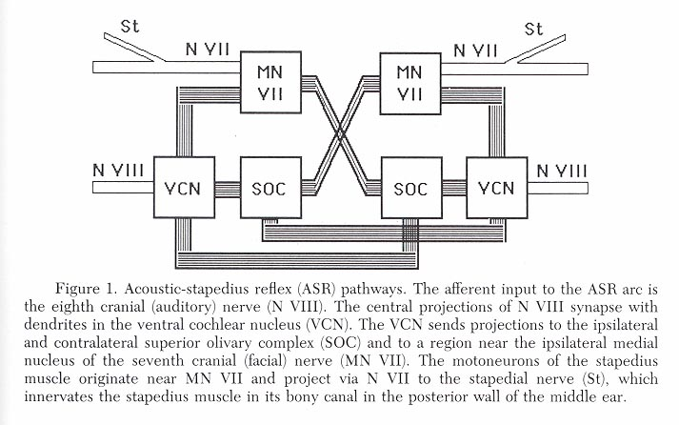
Acoustic Reflex Threshold
Stapedial muscle contraction
Temporary increase in middle impedance
Bilateral Stimulation
Adaptation
Neural network in lower brainstem

Slide 55
Clinical application of ASR
Middle Ear Disease
Otosclerosis
Cochlear hearing loss and loudness recruitment
Retrocochlear lesions may abolish the ASR
Brainstem lesions may abolish the contralateral reflexes
Determination of site of a seventh nerve lesion
Acoustic Reflex Decay

Slide 56
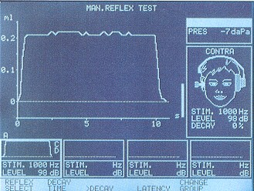
Reflex Decay

Slide 57
otoacoustic emissions

Slide 58
Background
The presence of cochlear emissions was hypothesized in the 1940’s on the basis of mathematical models of cochlear nonlinearity.
However, OAEs could not be measured until the late 1970s, when technology created the extremely sensitive low-noise microphones needed to record these responses.
David Kemp first discovered Otoacoustic emissions in 1978.

Slide 59
Otoacoustic Emissions
Otoacoustic emissions are sounds that are produced by healthy ears in response to acoustic stimulation.
OAE’s arise because our ears have evolved a special mechanism to give us extra hearing sensitivity and frequency responsiveness. The mechanism is known as the cochlear amplifier and it depends on a specialized type of cell called “outer hair cells.”
It’s the job of the cochlea to receive the sound energy collected by the outer and middle ear and to prepare it for neural transmission.

Slide 60
Purpose of OAE’s
The primary purpose of otoacoustic emission (OAE) tests is to determine cochlear status, specifically hair cell function. This information can be used to
(1) screen hearing
(2) partially estimate hearing sensitivity within a limited range
(3) differentiate between the sensory and neural components of sensorineural hearing loss
(4) test for functional hearing loss.

Slide 61
Types of OAE’s

Slide 62
Spontaneous OAE’s
Occurs in the absence of any intentional stimulation of the ear.
Prevalence is in about 40-60% of normal hearing people.
When you record SOAE’s, you average the number of samples of sounds in the ear and perform a spectral analysis.
The presence of SOAE’s is usually considered to be a sign of cochlear health, but the absence of SOAE’s is not necessarily a sign of abnormality.

Slide 63
Distortion Product OAE’s
Result from the interaction of two simultaneously presented pure tones.
Stimuli consist of 2 pure tones at 2 frequencies (ie, f1, f2 [f2>f1]) and 2 intensity levels (ie, L1, L2). The relationship between L1-L2 and f1-f2 dictates the frequency response.
DPOAEs allow for a greater frequency specificity and can be used to record at higher frequencies than TOAE’s. Therefore, DPOAE’s may be useful for early detection of cochlear damage as they are for ototoxicity and noise-induced damage.
DPOAEs often can be recorded in individuals with mild-to-moderate
hearing losses for whom TOAE’s are absent.
*DPOAE’s do not occur in the frequency
regions with more than 50-55dB Hearing loss.
* DPOAE’s can be elicited from ears that
have a greater hearing loss than TEOAE’s.

Slide 64
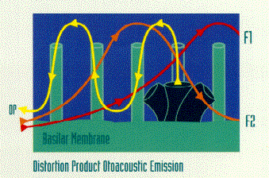
DPOAEs
2 tone stimuli (F1 and F2)
Cochlea hair cells generate a resonance

Slide 65
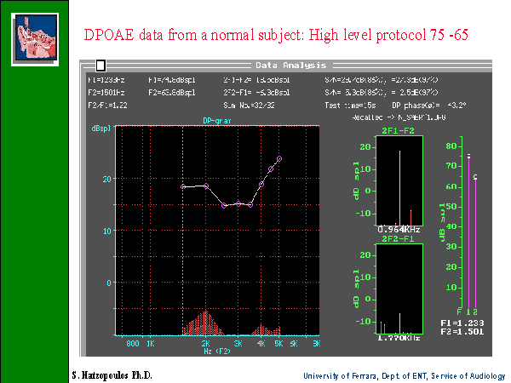
RESPONSE
NOISE

Slide 66
Transient Evoked OAE
TEOAE’s are frequency responses that follow
a brief acoustic stimulus, such as a click or tone burst.
The evoked response from this type of stimulus covers the frequency range up to around 4 kHz.
In normal adult ears, the click-elicited TEOAE typically falls off for frequencies more than 2 kHz, and is rarely present over 4 kHz, because of both technical limitations in the ear-speaker at higher frequencies and the physical features of adult ear canals so that is why DPOAE’s would be more efficacious.
For newborns and older infants, the TEOAE is much more robust by about 10 dB and typically can be measured out to about 6 kHz indicating that smaller ear canals influence the acoustic characteristics of standard click stimuli much differently than do adult ears.
TEOAE’s do not occur in people with a hearing loss greater than 30dB.

Slide 67
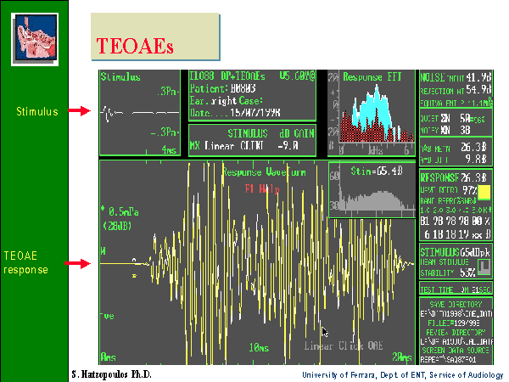

Slide 68

TEOAE results
Normal hearing
High frequency HL
Severe SN HL

Slide 69


TEOAE & DPOAE

Slide 70
Recording OAE’s
OAEs are measured by presenting a series of very brief acoustic stimuli, clicks, to the ear through a probe that is inserted in the outer third of the ear canal. The probe contains a loudspeaker that generates clicks and a microphone that measures the resulting OAE’s that are produced in the cochlea and are then reflected back through the middle ear into the outer ear canal.
The resulting sound that is picked up by the microphone is digitized and processed by specially designed hardware and software. The very low-level OAEs are separated by the software from both the background noise and from the contamination of the evoking clicks.

Slide 71

anatomy
Left
Auditory
cortex
Right
Auditory
cortex
Cochlea
Medial geniculate nucleus
Inferior colliculus
Auditory
nerve fiber
Superior
Olivary
nucleus
Ipsilateral
Cochlear
nucleus

Slide 72
SOUND IN EAR CANAL
TRAVEL THRU ME
FWD COCHLEA
BWD COCHLEA
TRAVEL THRU ME
SOUND IN EAR CANAL
Response detected

Slide 73
OAEs
Otoacoustic emissions
“Echo”-like response of outer hair cells of the cochlea
Can only indicate functioning outer hair cells and good middle ear function.

Slide 74
Types of OAEs
Spontaneous
  20-60% of population, related to age
  Not clinically useful
  Not related to tinnitus
Evoked
  Present in normal ears
  Not present in ears with SNHL greater than 25-30 dB
  Absent in presence of conductive hearing loss. WHY?

Slide 75


Evoked OAEs
Types
  Click (transient) evoked OAE- TEOAE
    Absent for sensori neural loss greater than 20-30dB HL
  Distortion product OAE (DPOAE)
    Absent in sensori neural losses greater than 45-55 dB HL

Slide 76
Acquisition
Not affected by sleep but needs test subject to be still and compliant
Very quick

Slide 77
clinical applications
Quick screening tool
Good indicator of cochlear reserve- correlated with hearing
Monitoring
TEOAE present with hearing loss up to 30dBHL
DPOAE present with hearing loss up to 50dB HL
Monitoring of drug ototoxicity (can affect OAE before HL present)
Sensory vs. neural HL

Slide 78
clinical limitations
Problems because of middle ear disease
Not sensitive for neonates within 24 hours of birth
Results affected by test conditions
  Noise
  Electrical interference
Not a test of hearing- limited application

Slide 79
electrocochleography

Slide 80
history
Little confusion in the literature, apart from what letters of the original appear in the abbreviation
Animal models first discovered in 1930s
Clinical applications started in 1960s

Slide 81
components
Cochlear microphonic: outer hair cell response
Summating potential: cochlear activity
Action potential: Firing of auditory nerve (same as ABR wave 1)
All occur within the first 1.5-2 ms after an acoustic stimulus

Slide 82
anatomy
Left
Auditory
cortex
Right
Auditory
cortex
Cochlea
Medial geniculate nucleus
Inferior colliculus
Auditory
nerve fiber
Superior
Olivary
nucleus
Ipsilateral
Cochlear
nucleus

Slide 83
stimulus & acquisition
Recording electrode must be as close to response as possible (transtympanic)
Children: general anaesthetic
Adults: may be done without anaesthetic
resistant to effects of drugs and subject state of arousal
Can be used in pre-implant assessment to test cochlear function

Slide 84
clinical applications
Diagnosis of Meniere’s disease
Diagnosis of cochlear hearing loss/auditory dysynchrony, sensory vs neural.
Assessment of hearing status for difficult to test subjects

Slide 85
clinical limitations
Auditory information only provided to cochlea
Very invasive
Results can vary up to 20dB from actual hearing
Limited frequency specificity
expensive

Slide 86
auditory brainstem response

Slide 87
history
First complete description in 1970s
Response found between 1-15ms after stimulation.
Recording has 7 peaks, peak five being the most prominent.
  The amplitudes, latencies and relationship of those peaks can be used to diagnose certain pathological conditions.

Slide 88
What is an ABR?
The Auditory Brainstem Response is the representation of electrical activity generated by the eighth cranial nerve and brainstem in response to auditory stimulation

Slide 89
How is an ABR recorded?
Electrodes are placed on the scalp and coupled via leads to an amplifier and signal averager. EEG activity from the scalp is recorded while the ear(s) are stimulated via earphones with brief clicks or tones.
A series of waveforms unique to the auditory neural structures is viewed after time-locking the EEG recording to each auditory stimulus and averaging several thousand recordings.

Slide 90

components
Response occurs within 5-6ms after stimulus is presented

Slide 91
Generators of the ABR
VI
V
IV
III
II
I

Slide 92
Latency, ms

Slide 93
anatomy
proximal VIIIth nerve
Multiple generators
Distal VIIIth nerve

Slide 94
stimulus & acquisition
Short clicks or tone bursts used
Rate of around 20/sec or faster
Responses can be + or – 20dB on true thresholds, mixed in with EEG
Electrodes on head (surface electrodes)
Can be influenced by subject characteristics (age, gender, body temperature)
Not affected by arousal state or most drugs

Slide 95
Differential amplifier
Transducer (HP)
Analog filter
Stimulus generator
Trigger
Signal averager
Display/analysis

Slide 96

Example Normal Hearing
18 Month-Old – 2000 Hz Tone-Burst
70 dBnHL
10 dBnHL

Slide 97

clinical applications
Basis of Newborn screening tests: non-invasive, high success rate
Estimation of thresholds for difficult to test people
Neurodiagnosis of VIIIth nerve/ brainstem problems
Intraoperative monitoring
Cochlear implant evoked responses
Test-retest reliability

Slide 98
Why use ABR testing?
DIAGNOSIS OF SOME CONDITIONS
SCREENING FOR HEARING LOSS
THRESHOLD TESTING
(FREQ SPECIFIC)

Slide 99
Left
Auditory
cortex
Right
Auditory
cortex
Cochlea
Medial geniculate nucleus
Inferior colliculus
Auditory
nerve fiber
Superior
Olivary
nucleus
Ipsilateral
Cochlear
nucleus

Slide 100

Retrocochlear lesion

