Slide 1
Uterine Cancer
Dr Khalid Akkour MD FRCSC
Assistant Professor Gynecologic Oncology
King Saud University Medical City

Slide 2
STRUCTURED OSCE - ENDOMETRIAL CA
61 F with post-menopausal bleeding.

Slide 3
1. Take a focused history

Slide 4
Age
Ethnicity
HPI
  Timing
  Amount of bleeding – pad counts/hemorrhage/ER visits?
  Time since menopause
  Presence of vaginal discharge
  Use of HRT
  Other symptoms – weight loss, back pain, pelvic pressure, bloating, bowel/bladder complaints, leg swelling
  Any previous work-up/investigations done

Slide 5
Past Gyne Hx
  Age of menarche, menopause
  Cycles – regular?
  Use of OCP
  Pap smear
  Hx of: infertility, PCOS
  STI’s
  Gyne surgery

Slide 6
Past OBS Hx
Past Medical Hx
  Cancer – breast, colon
  Hypertension
  Diabetes
  Obesity
  Gallbladder disease
  Screening – mammogram/colonoscopy/BMD
Past Surgical Hx
Meds / treatments
  Hormones (HRT, OCP, progestins)
  ASA
  NSAIDs
  Coumadin
  Previous pelvic radiation

Slide 7
Allergies
Social Hx
  Employment, profession
Habits
  Smoking
  EtOH
  Drugs
  Exercise
Family Hx
  Breast/ov/uterine/colon/prostate ca

Slide 8
2. Name 5 causes of postmenopausal bleeding

Slide 9
Vaginal atrophy
Endometrial polyps
Endometrial hyperplasia
Endometrial CA
Cervical CA
Fibroids

Slide 10
3. What is the most common cause of postmenopausal bleeding?

Slide 11
Endometrial atrophy (60-80%)
Estrogen replacement therapy (15-25%)
Endometrial polyps (2-12%)
Endometrial hyperplasia (5-10%)
Endometrial cancer (10%)

Slide 12
4. What proportion of women with endometrial cancer are asymptomatic?

Slide 13
< 5%

Slide 14
5. What percentage of women with PMB will have endometrial cancer?

Slide 15
10%

Slide 16
6. What proportion of women with endometrial cancer present with PMB?

Slide 17
66 % (2/3)

Slide 18
7. What is the lifetime risk of developing endometrial cancer

Slide 19
2-3%

Slide 20
What % are diagnosed in pre menopausal women?

Slide 21
20 % (5% before the age of 40)

Slide 22
8. Why is the incidence of endometrial cancer raising?

Slide 23
  Aging population
  Obesity epidemic

Slide 24
9. What are risk factors for endometrial cancer?

Slide 25
Age (older) RR: 2-3
White race RR: 2
North America / Northern Europe RR: 3-18
Higher level of education or income RR: 1.5-2
Obesity RR 3 (21-50 lbs), RR 10 (> 50 lbs)
PCOS RR > 5
Nulliparity RR 2-3
Infertility RR: 2-3
Late menopause RR 2.4
Menstrual irregularities RR: 1.5
Unopposed estrogen RR 4-8
Tamoxifen RR 3-7
Long-term use of high-dose menopausal estrogens RR: 10-20
Atypical endometrial hyperplasia (Risk 8%-29%)
Diabetes RR 2.8
HTN RR: 1.3-3
Gallbladder disease RR: 1.3-3

Slide 26
Protective
Long-term use OCP (RR: 0.3-0.5)
Cigarette smoking (RR: 0.5)
Pregnancy
Late Menarche (> 15 years of age)
Pregnancy (Orlando course)

Slide 27
10. Why are obese people at increased risk of endometrial cancer?

Slide 28
Excess adipose tissue increases peripheral aromatization of androstenedione to estrone.
Pre-menopausal women with increased estrone have abnormal feedback to HPA axis, resulting in oligo-anovulation, causing unopposed endometrial estrogen stimulation

Slide 29
11. What hereditary syndrome is associated with endometrial cancer?

Slide 30
  HNPCC (Lynch syndrome)
  Lifetime risk of endometrial cancer 40-60%
  Patients present with diagnosis about 10 years earlier
(ie: endometrial cancer in 50s)- Orlando course

Slide 31
12. What would you perform on physical exam?

Slide 32
General : Obesity, pale / sick?
Vitals : Hypertension
HEENT : Supraclavicular nodes, evidence of anemia
Resp : ? Lung metastases
Breast : Masses, axillary lymphadenopathy
Abd : Masses, ascites, liver enlargement, digital rectal exam
Pelvic : Vulvar lesions, evidence of vaginal atrophy/lesions,
cervical lesions, uterine size, adnexal masses,
PV/PR : Posterior masses, parametrial thickness / masses, cul de sac nodularity
PV : Leg swelling

Slide 33
13. Your patient is African-American, obese (BMI: 31), with mild HTN, taking no meds, but fatigued. What initial investigations would you order and WHY?

Slide 34
CBC (Hb, RDW, platlets) – anemia
T & S
Iron, Ferritan, TIBC, Transferrin (chronic anemia, iron stores)
Tumor markers (CA-125, CEA)
Pap smear
EMB
TVUS

Slide 35
What % of women with endometrial cancer will have an abnormal pap test?
30-50% (Orlando course)

Slide 36
14. The TVUS shows normal uterine size, anteverted, with an endometrial thickness of 4mm. What is the negative predictive value of this result? Would you do an EMB? Why?

Slide 37
99% if <6mm (SOGC)
Type II endometrial cancers – not associated with hyperplasia

Slide 38
15. The biopsy samples get mixed up, the pathologist takes stress leave and you are presented with the following 5 results. Identify each smear.

Slide 39
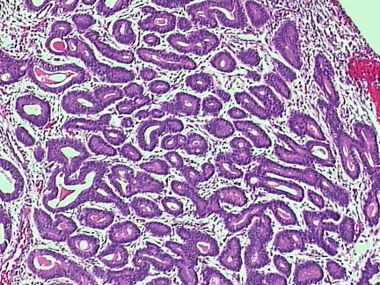
“A”

Slide 40
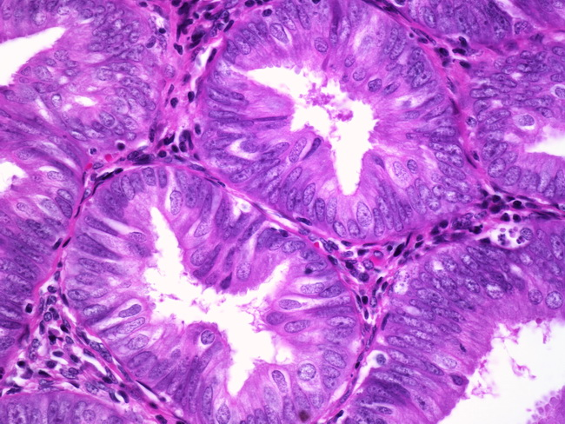
“B”

Slide 41
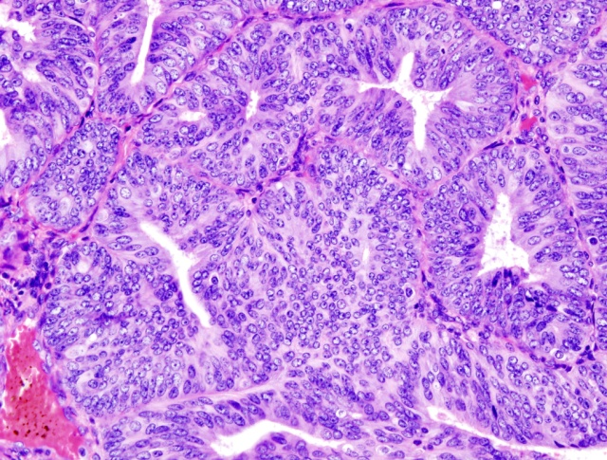
“C”

Slide 42
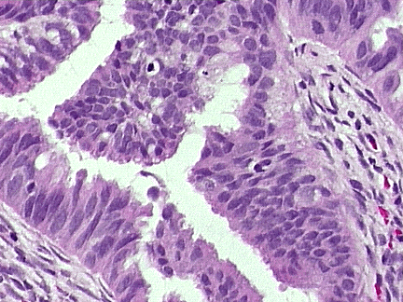
“D”

Slide 43
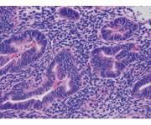

Slide 44
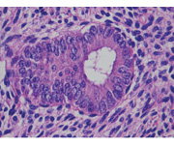
“E”

Slide 45
Simple hyperplasia, no atypia (1% progression to ca)
Complex hyperplasia, with ATYPIA (29%)
Endometrial carcinoma (100%)
Complex hyperplasia, no atypia (3%)
Simple hyperplasia, with ATYPIA (8%)

Slide 46
16. What are the histological criteria for endometrial hyperplasia, with and without, atypia?

Slide 47
Hyperplasia is the proliferation of glands, characterized by irregular size and shape, increased gland-to-stroma ratio, but with no back-to-back or cribiform glands
Simple hyperplasia
  Glandular crowding
  Mild architectural complexity
  Virutally all glands are tubular.
  Occasional glands have inspissated secretions.
  The nuclei are basal.
HINT: Atypia is best diagnosed with high power magnification

Slide 48
Complex hyperplasia
  Extensive glandular crowding
  Architextural complexity
  The cells lining this complex gland are pseudostratified.
  The nuclei are elongated and hyperchromatic.
  Nucleoli are not prominent.
  The cells retain in general their orientation to the lumen.
No Atypia
With Atypia
  Nuclear enlargement (elongated, hyperchromatic)
  Nucleoli are prominent
  Variation in nuclear size and shape
  Atypical mitosis
TREATMENT OF ENDOMETRIAL HYPERPLASIA
NO ATYPIA
Low dose Progestins
MPA 10 mg qd x 6 months
High dose progestins
MPA 200 qd
Megestrol acetate 160 qd
Micronized progesterone 200 qd
Mirena
WITH ATYPIA
Hysterectomy & BSO
High dose progestins
Mirena
EMB q3-6 MONTHS

Slide 49
Endometrial carcinoma
  Crowded glands, with little or no stroma
  Stromal inflammatory reaction surrounding endometrial gland
  Malignant nuclei (by HPF): round, course, chromatin clumping

Slide 50
17. Your patient is smear #4. What is your diagnosis? What is this patient’s risk of endometrial cancer?

Slide 51
COMPLEX HYPERPLASIA, WITHOUT ATYPIA (3 %)

Slide 52
18. What are your management options ?

Slide 53
Low dose Progestins (intermittent or continuous)
  Post menopausal:
Medroxyprogesterone Acetate (MPA) 10 mg
po qd x 6 months
  Mirena (Levonorgestrol)
  In young, anovulatory women – CYCLIC
• Medroxyprogesterone 10 mg / day x 10 days
Diagnostic D & C / hysteroscopy
  Improves tissue diagnosis
  Improves symptoms
Endometrial ablation
Repeat EMB x 6 months
Hysterectomy
Weight loss

Slide 54
19. Whats the prevalence of endometrial cancer if the pathology had showed complex endometrial hyperplasia with atypia?

Slide 55
  43%

Slide 56
20. What is the success rate of progestin therapy for non-atypical endometrial hyperplasia?

Slide 57
  90%

Slide 58
21. 1 year later, your patient’s biopsy is repeated. With the same result (Smear 4 above). What is your management?

Slide 59
High dose progestins
  MPA 200 mg po qd
  Megestrol acetate 160 mg po qd (40 mg qid, 80 BID)
  Micronized progesterone 200 mg po qd
  Mirena
  Depot provera 150 q12 weeks (orlando course)
Repeat EMB (3-6 months)
Hysterectomy

Slide 60
22. 6 months later, your patient’s biopsy result is Slide 2 above. What is the diagnosis? What is the risk of progression to endometrial carcinoma? What % of these biopsies are actually positive for cancer?

Slide 61
SLIDE 2: complex hyperplasia, with atypia
29%
40-50%

Slide 62
23. What is your management?

Slide 63
  Hysterectomy
  Poor surgical candidates or fertility preservation
  Continuous High dose progestin therapy
    MPA 200 mg po qd
    Megestrol acetate 160 mg po qd (40 mg qid)
    Micronized progesterone 200 md po qd
  EMB q 3 months
  Long term follow-up

Slide 64
24. What is the diagnostic accuracy of endometrial biopsy?

Slide 65
93-98%

Slide 66
25. Your patient requested hormonal therapy, for personal reasons. She returns 9 months later, with a biopsy result – SLIDE 3 above. What is her diagnosis? Management?

Slide 67
Endometrial carcinoma
Management:
Gyne-Onc consultation
Surgical staging
TAHBSO
Peritoneal washings – but it doesn’t change the staging anymore
PLND
Frozen section

Slide 68
26. What are the indications for surgical staging in endometrial CA?

Slide 69
Histology: Grade > 1 (includes serous, clear cell etc)
Myometrial invasion > 50%
Cervical extension
Extrauterine spread
Enlarged lymph nodes
(Orlando course)

Slide 70
27. List 5 histological types of primary endometrial adenocarcinoma.

Slide 71
Endometroid adenocarcinoma
  With squamous differentiation (elements)
  Villoglandular variant
  Secretory variant
  Ciliated variant
Clear cell
Papillary Serous
Mucinous
Squamous
Mixed
Undifferentiated

Slide 72
28. Distinguish the 2 categories of endometrial adenocarcinoma.

Slide 73
TYPE 1: 75%
Endometroid
Estrogen dependent (PCOS, DM, obesity)
Premenopausal (25%) & Post-menopausal (75%) women
White
U/S: Endometrial hyperplasia
Low grade
Minimal myometrial invasion
Stable tumors

Slide 74
TYPE 2: 25%
Papillary serous, clear cell
Non-estrogen dependent / less likely
Post-menopausal
No endometrial hyperplasia
Black
Grade 3
Deep myometrial invasion
Aggressive

Slide 75
29. List the prognostic factors for endometrial cancer

Slide 76
  Age (> 60, worst prognosis)
  Histological type (poor = pap serous or clear cell)
  Histological / nuclear grade (G3 worst prognosis)
  Vascular space invasion
  Myometrial invasion
  Tumor size
  Peritoneal cytology
  Lymph node metastasis
  Adnexal metastasis
  High expression levels of ER + PR = POOR

Slide 77
30. How are Type 1 and Type 2 endometrial cancers spread?

Slide 78
Type 1 : order of spreading
  Direct extension
  Lymphatic metastasis
  Hematogenous
  Intraperitoneal
Type 2: simultaneous

Slide 79
31. What is the pattern of lymphatic spread of endometrial cancer?

Slide 80
32. What are the histological risk factors for lymph node metastasis in endometrial cancer?

Slide 81
  Tumor Stage
  Depth of myometrial invasion
  Histological / nuclear Grade
  Degree of tumor differentiation
  Histological Type

Slide 82
33. What is the chance that a Grade 3 endometrial carcinoma, with > 50% invasion of the myometrium will have positive pelvic and paraaortic lymph nodes

Slide 83
  Pelvic LN – 37%
  Peri-aortic LN – 13%
Table 33-7 Correlation of Histologic Grade and Depth of Myometrial Invasion with Risk of Nodal Metastases
 | Pelvic Lymph Nodes |  |  | Para-aortic Lymph Nodes
Myometrial Invasion | G1 | G2 | G3 | G1 | G2 | G3
None | 1% | 7% | 16% | <1% | 2% | 5%
50% | 2% | 6% | 10% | <1% | 2% | 4%
>50% | 11% | 21% | 37% | 2% | 6% | 13%

Slide 84
33. For what type of tumor is surgical staging not required? Why?

Slide 85
  Endometriod, Grade 1, superficial myometrial invasion
  Chance of LN metastasis low (Pelvic: 1%, Peri-aortic: <1%)

Slide 86
35. What are the histopathological criteria for assessing tumor GRADE?

Slide 87
  Grade 1: < 5% nonsquamous or non-morular solid growth pattern
  Grade 2: 6-50% nonsquamous or non-morular solid growth pattern
  Grade 3: > 50% nonsquamous or non-morular solid growth pattern

Slide 88
36. What is the best management of your patient at this point?

Slide 89
STAGING SURGERY: TAHBSO, peritoneal washings, pelvic and para-aortic lymphadenectomy,
If serous or clear cell features on pre-op biopsy: infracolic omentectomy, and biopsies of peritoneum, pericolic gutter, diaphragm.

Slide 90
37. What is the best surgical approach? List 3 advantages & disadvantages of MIS.

Slide 91
SURGICAL APPROACH
  Laparoscopic TAH & lymphadenectomy
  Laparoscopic-assisted robotic TAH / lymphadenectomy
  Laparotomy
Advantages of Laparoscopic staging surgery
  Obese population
  Decreased blood loss
  Fewer blood transfusions
  Lower perioperative morbidity
  Faster recovery time
  Shorter hospital stay
  Decreased post-operative pain
  Fewer would infections
  Less loss of income
  Improved quality of life
  Similar survival rates
Disadvantages of laparoscopy
  Surgeon-skill dependent
  Prolonged surgical time
  Equipment
  Conversion to laparotomy is a risk
  Incomplete staging – is a risk
  Complications (damage to adjacent structures-ureter, bladder)

Slide 92
38. You obtain informed CONSENT for your patient. What will you tell her?

Slide 93
Diagnosis
Description of suggested treatment
Explanation of what the treatment will do / mechanism
Prognosis with the treatment
Side effects of treatment
Adverse events associated with this treatment
Therapeutic alternatives: including their benefits, side effects, prognosis
Prognosis – with no therapy

Slide 94
39. The patient is booked for surgery, cancelled twice due to lack of surgical beds and 8 months later receives a TAHBSO, washings + LND (pelvic & perioaortic). RESULTS:

Slide 95
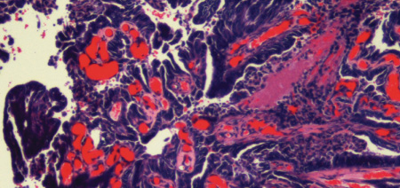
SLIDE A

Slide 96
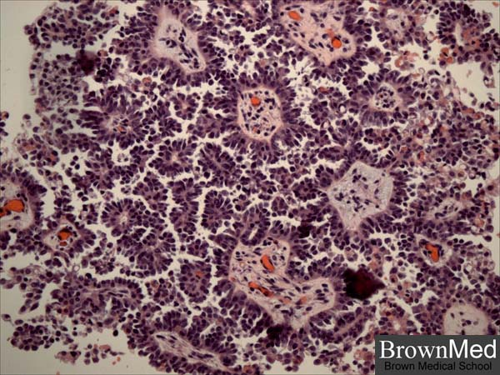
SLIDE B

Slide 97
Slide A: Identify the type, grade, incidence & prognosis:

Slide 98
  Papillary serous carcinoma of the endometrium (Type II)
  Grade 3
  Incidence: 5-10% of endometrial carcinomas

Slide 99
Slide B: Identify. What % of these tumors will have this finding? List 3 tumors where these structures are found.

Slide 100
  Psammoma bodies: A psammoma body is a round collection of calcium, seen microscopically.
  30% of UPSC (uterine papillary serous carcinoma) – because histologically they resemble epithelial ovarian cancer
  TUMORS with psammoma bodies:
    Endometrial PAP-SEROUS
    Ovarian PAP-serous
    Thyroid papillary CA
    Renal papillary CA
    Breast
    pancreas

Slide 101
Pathology report: Tumor invasion to the left parametrium, with 6 + iliac lymph nodes. What is her stage? How will you treat her?

Slide 102
  STAGE III C1
  Adjuvant Chemotherapy +/or tumor-directed external beam radiotherapy

Slide 103
40. Your keen junior resident asks you to summarize the latest FIGO staging for endometrial cancer and the management.

Slide 104
NCCN 2011 Guidelines – Treatment of Endometrial CA (COMPLETELY SURGICALLY STAGED)
STAGE | CRITERIA | ADVERSE FACTOR | Adjuvant Therpay G1 | Adjuvant Therpay G2 | Adjuvant Therpay G3
1A | CONFINED TO UTERUS < 50 % myometrial invasion | NEG | Observe | Observe or vaginal brachytherapy | Observe or vaginal brachytherapy
“ | “ | POS | Observe or vaginal brachytherapy | Observe or vaginal brachytherapy and/ or pelvic RT | Observe or vaginal brachytherapy and/ or pelvic RT
1B | > 50% myometrial invasion | NEG | Observe or vaginal brachytherapy | Observe or vaginal brachytherapy | Observe or vaginal brachytherapy and /or pelvic RT
“ | “ | POS | Observe or vaginal brachytherapy and/ or pelvic RT | Observe or vaginal brachytherapy and /or pelvic RT | Observe or pelvic RT and/or vaginal brachytherapy, +/- chemotherapy
II | Tumor invades cervical stroma, but does not extend beyond the uterus | POS | Vaginal brachytherapy and /or pelvic RT | Pelvic RT and vaginal brachytherapy | Pelvic RT and vaginal brachytherapy +/- chemotherapy
IIIA | Tumor invades serosa and/or adnexae | POS | -Chemotherapy +/- RT -Tumor directed RT +/- chemotherapy -Pelvic RT +/- vaginal brachytherapy | -Chemotherapy +/- RT -Tumor directed RT +/- chemotherapy -Pelvic RT +/- vaginal brachytherapy | -Chemotherapy +/- RT -Tumor directed RT +/- chemotherapy -Pelvic RT +/- vaginal brachytherapy
IIIB | Vaginal and/or parametrial involvement | POS | CHEMOTHERAPY +/- TUMOR-DIRECTED RT
IIIC | Metastasis to pelvic and/or paraortic lymph noes | POS | CHEMOTHERAPY +/- TUMOR-DIRECTED POST-OP EXTERNAL BEAM RT
IIIC1 | Pelvic | POS
IIIC2 | Para-aortic | POS
IV | Distant metastasis, or invasion of bladder or bowel mucosa |  | CHEMOTHERAPY +/- RADIOTHERAPY
IV A | Bladder or bowel | POS
IV B | Intraabdominal or inguinal LNs | POS

Slide 105
*ADVERSE RISK FACTORS: Age, positive lymphovascular invasion, tumor size, lower uterine segment involvement (cervical/ glandular)

Slide 106
41. What is 1st line chemotherapy in the treatment of uterine adenocarcinoma?

Slide 107
  Cisplatinum & Doxorubicin (adriamycin)
  Cisplatinum, Doxorubicin, Paclitaxel (TAP- superior to above)
  Carboplatinum & Paclitaxel

Slide 108
CHEMOTHERAPY – ENDOMETRIAL CARCINOMA
CLASS | Drug | Mechanism of action | Indication | Side Effects | Potentially Lethal Effects
PLATINUM- BASED | Cisplatinum | Platinum complexes bind DNA, causes interference with DNA processing & replication -Blocks DNA throughout cell cycle | Ovarian, tubal, peritoneal, endometrial, cervical and vulvar cancers | Ototoxicity Severe peripheral neuropathy Electrlytes: Hypo-Mg Hypo-K Seizures Nausea/V | Nephrotoxic Mylosuppresion
PLATINUM- BASED | Carboplatinum | “ | “ NOT nephrotoxic | Nausea/V Alopecia rash | Leukopenia Thrombocytopenia Anemia Hepatotoxicity
PLANT ALKYLOIDS | Paclitaxol Taxotere YEW tree | Inhibits MITOSIS – blocks spindle formation by promoting microtubule assembly. Inhibits depolymerization of tubulin during mitosis. Arrests cell division in the M phase. | Ovarian CA, cervical, endometrial, sarcomas | Hypotension Sensory & peripheral neuropathy, Bowel performation | Hypersensitivity Neutropenia Bradycardia & cardiomyopathy (rare)
ANTI-TUMOR ANTIBIOTICS | Doxorubicin (Adriamycin) | Streptomyces peucetius -binds DNA -G1 and S phases -inhibits topoisomerase II in G2, blocks supercoiling of DNA | Ovarian Ca, Endometrial, Cervical | Alpecia Skin toxicity: Necrosis, soft tissue ulceration, palmar plantar dysesthesia | Congestive heart failure, Cardiomyopathy
ALKALATING AGENTS | Cyclo - phosphamide Ifosfamide | Facilitates transfer of alkyl groups to DNA -blocks G1-S Blocks N7 position of guanine, causing cross link bridges in DNA | Rarely used as primary treatment in gyne malignancies | Hemorrhagic cystitis, Leukopenia Alopecia, amenorrhea, nausea/V, | Mylosuppression (bone marrow) Renal failure Thrombocytopenia Leukemia
NCCN Feb-2011

Slide 109
42. What is the prognosis (by stage) in endometrial cancer?

Slide 110
STAGE I (A/B): 91%
STAGE II : 70%
STAGE III : 50%
STAGE IV : 10-20%

Slide 111
43. How would you treat a grade 3 adenocarcinoma of the uterus?

Slide 112
Treatment is INDIVIDUALIZED
Comprehensive surgical staging should be done, including
  TAHBSO, BSO, Washings
  Lymphadenectomy: pelvic, perioartic
  Infracolic omentectomy
  Peritoneal biopsies: pelvic side wall, pericolic gutter diaphragm
  Optimal debulking
Adjuvant treatment (chemotherapy, brachytherapy, pelvic radiatherapy

Slide 113
44. AFTER STAGING SURGERY, for which tumor stage / grade is OBSERVATION appropriate? (updated from SOGC)

Slide 114
Stage IA (no/minimal myometrial invasion), G1/G2
Stage IB (< 50% (minimal) myometrial invasion), G1/2
Adjuvant treatment
  Stage IB grade 1,2 or Stage 1A grade 3 endometrial adenoca (intermed. risk)
  Stage II decided on an individual basis
  Stage III and IV endometrial cancer - individualize – chemo/radio or both
  High risk histology eg. Clear cell, serous

Slide 115
45. For which tumor stage / grade is RADICAL HYSTERECTOMY appropriate?

Slide 116
Stage II (Tumor invades cervical stroma)

Slide 117
46. Why do we bother taking peritoneal washings?

Slide 118
Positive peritoneal washings are poor prognostic factor (adverse condition)
Washings are no longer part of FIGO staging

Slide 119
46. What would be the stage of a tumor involving > 50% of the myometrium, with endocervical gland involvement? What surgery should done?

Slide 120
  Stage 1b (endocervical glands are no longer stage II)
  TAHBSO + staging – not radical hyst

Slide 121
48. Your patient recovers from surgery, receives 6 cycles of adjuvant carbotaxol with minimal complication and returns to her usual life activities. How will you follow her up?

Slide 122
5 year follow-up
YEARS 1 & 2:
  Pt counselling: re symptoms
  Physical exam q3-6 months x 2 years
  PAP q 6months x 2 years (not supported by data)
  Annual CXR
  Annual CA-125 (optional)
  CT-abdomen & pelvis: as clinically indicated
  Genetic counselling (if strong family hx – ie. Lynch)
YEARS 3,4,5
  Physical exam q6months or annually
  PAP – annually?
  CXR - Annually ?
  CA-125?
  CT-abdomen & pelvis: as clinically indicated

Slide 123
49. What % of patients will have recurrent endometrial cancer more than 5 years after initial diagnosis? To which organs?

Slide 124
      10%
      Metastasis in recurrent endometrial CA
        Pelvis & vagina (50%)
        Lung (17%)
        Upper abdomen (10%)
        Bone (6%)
Source: Aalders et al

Slide 125
50. Your patient has a disease-free-interval of 3 years, but returns to you with a new vaginal lesion.. What treatment options are available for recurrent endometrial CA?

Slide 126
Radiation: for local recurrences (vaginal mucosa)
Surgery: for resectable nodules
Hormonal treatments: studies showed improved survival rates
Chemotherapy

Slide 127
51. List the hormonal treatment options are available for advanced or recurrent endometrial cancer

Slide 128
• Progestins (high dose)
• Aromatase inhibitors
• Tamoxifen

Slide 129
CASE 2 – Fertility Preservation in Endometrial CA

Slide 130
A 34 woman, with an EMB showing Grade 1 Adenocarcinoma of the endometrium, endometroid type, wants to preserve her fertility. What is your management?.

Slide 131
  Referal to gyne onc
  Radiographic imaging (CT abdomen & pelvis, or MRI pelvis)
  Indications for fertility sparing management: WG
    Grade 1 endometroid (Type 1) tumors, Grade 2 (rarely)
    No evidence myometrial invasion (by radiography)
    Diagnostic Laparoscopic (for Grade 2) – must be negative
  Hormonal therapy
    Megestrol acetate 160 mg po qd
    MPA 200 mg po / im qd
    Progestins + Tamoxifen + GnRH agonists (less frequently used)
  Informed consent
    Risks of disease progression
    If treatment successful, risk of relapse is high
    Risk of infertility
    Risk of needing curative surgery anyhow
  Long Term Observation
    Repeated EMB or D & C – q 3 months
    If lesion does not regress – hysterectomy
  Infertility – increased incidence. Refer to fertility center.

Slide 132
CASE 3 – INCOMPLETE STAGING (Endometrial CA)

Slide 133
You do a TAH + BSO on a 48 year woman for menorragia. The pathology comes back Grade 3 endometroid adenocarcinoma of ovary, 75% myometrial invasion, confined to the uterus.
Q1: How will you manage this pt? What are HER management options?

Slide 134
  MANAGEMENT – as a general gynecologist
    Counsel the patient
    Refer to Gynecology-oncology
    Arrange initial investigations:
      Physical exam: lymphadenopathy
      CXR
      Tumor Markers
      Labs: CBC, electrolytes
      CT-abdomen & pelvis (lymphadenopathy)
  MANAGEMENT OPTIONS for this patient
    Do nothing – expectant management (not recommended – G3)
    Radiographic imaging (CT abdomen & pelvis)
      If positive findings - SURGICALLY RESTAGE
        Laparoscopic Lymphadendectomy
        Laparotomy
      If negative radiographic evidence, refer to radiation oncology:
        Pelvic radiotherapy or
        Vaginal brachytherapy, +
    Surgically restage (regardless of imaging)
    +/- Chemotherapy (for Grade 3 tumors)

Slide 135
Q2. What will you tell your patient?

Slide 136
  Patient communication
    Explain the results of the surgery – intraoperative
    Explain the pathology findings – she has cancer
    Educate pt regarding cancer staging and grading & importance for treatment
    Inform pt: incomplete surgical staging
    Explain her preliminary diagnosis (stage, grade) – she will ask
    At least stage IB, Grade 3, but we cannot comment on prognosis because further work-up is warrented
    Do NOT discuss prognosis to the patient – b/c we don’t know
    Emphasize aggressive tumor grade, the high risk of LN metastasis, the improvement of outcome with proper staging - she needs surgery
    Explain – she will be referred to gynecology oncology

Slide 137
Q3. What increases the risk of LN metastasis in endometrial cancer?

Slide 138
  The risk of LN metastasis increases with:
    Stage
    Depth of invasion
    Grade

Slide 139
Q4. What is the approximate risk of LN invasion (pelvic and periaortic)?

Slide 140
Table 32-7 -- FIGO Staging and Nodal Metastasis
From Creasman WT, Morrow CP, Bundy BN, et al: Surgical pathologic spread patterns of endometrial cancer. Cancer 60:2035, 1987. Reprinted with permission.
  Based on current information, the patient has AT LEAST G3, Stage 1b
    Risk of pelvic lymph node metastasis: 26%
    Risk of peri-aortic LN metastasis: 16%
 | METASTASIS
Staging | Pelvic | Aortic
IA G1 (n = 101) | 2 (2%) | 0 (0%)
G2 (n = 169) | 13 (8%) | 6 (4%)
G3 (n = 76) | 8 (11%) | 5 (7%)
IB G1 (n = 79) | 3 (4%) | 3 (4%)
G2 (n = 119) | 12 (10%) | 8 (7%)
G3 (n = 77) | 20 (26%) | 12 (16%)

Slide 141
Q4. Your patient is reluctant to undergo another surgery after what she’s been through. How do you counsel her?

Slide 142
  Explain the theoretical risks of lymph node metastasis and encourage her to;
    see the gynecology-oncology specialists
    Receive a proper staging surgery
Sources: NCCN 2011, Comprehensive (5th): pg. 824

Slide 143
LEIOMYOSARCOMA

Slide 144
Introduction
ULMS incidence is 0.7-1.0/100,000
Most ULMS are high grade sarcomas with high risk of recurrence & progression.
Overall survival is dependant on the stage , 5y survival for
- stage 1 = 76% , stage 2 = 60%, stage 3 = 45% stage 4 = 29%.
Metastatic disease usually in the 5th decade or before in a women with a good performance status.
Response rate for chemotherapy in the metastatic setting is reported to bé 15-54%.

Slide 145
Diagnosis
Some small studies showed that MRI can distinguish benign from malignant lesions
Intrauterine tumors increasing in size after menopause should rise the suspecion for malignancy.
In most patients, the diagnosis of LMS is made at the time of myomectomy or hysterectomy for persumed benign disease.

Slide 146
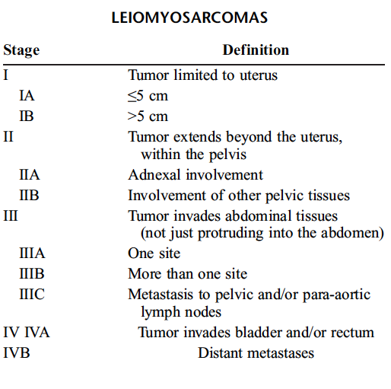
Staging - FIGO 2009

Slide 147
Initial Treatment
Surgery :
for patients whose disease is limited to the uterus, hysterectomy is recommended.
if malignancy is suspected preoperatively , no mocellation US-FDA issued a safety alert 2014 against power morcellators .
routine LN dissection is not recommended , only large or suspecious nodes have to bé removed.
BSO is reasonable in perimenopausal & postmenopausal women . No survival benefits.
40-70% of ULMS are ER &/or PR positive
PATIENTS < 50 Y with disease limited to uterus , no difference whether BSO is done or not.

Slide 148
Initial Treatment
If the disease is locally advanced but potentially completely resectable, an attempt to resect it is reasonable, optimal cytoreduction increased both PFS & OS.
For multisite metastasis or unresectable disease >> no role for hysterectomy ( only palliative e.g severe uterine bleeding )
Laparoscopic re-evaluation after morecellation hysterectomy should bé considered to evaluate for & resect any residual disease.
Resection of the cervix & doing BSO if not yet done is reasonable for those had only supracervical hysterectomy.

Slide 149
Post-resection management of uterus-limited disease
Although the risk of recurrent disease is >50%, no adjuvant intervention has been shown to improve PFS or OS.
The standard management is observation.
30% of patients found to have ULMS at the time of surgery will have metastatic disease.
CT , PET/CT or MRI is recommended postoperatively to r/o distant mets.
Adjuvant radiation did not show any survival benefit (local recurrence was the same for the radiation & the control group).

Slide 150
Post-resection management of uterus-limited disease
Adjuvant chemotherapy with doxyrubicin did not show a survival benefit.
Adjuvant docetaxel + Gemcitabine followed by doxyrubicin improved 2y PFS to 78% but failed to improve OS.
An International randomized phase III trial of observation versus Gemcitabine/docetaxel for 4 cycles followed by doxyrubicine 4 cycles is ongoing - GOG 277)

Slide 151
Post-resection management of locally advanced disease
No consensus
Observation, Chemo , radiation or hormone blockade therapy are acceptable options.

Slide 152
Metastatic disease
If complete resection of the metastatic disease is possible >> survival benefit.
No consensus for the adjuvant treatment

Slide 153
Systemic treatment options for unresectable or metastatic disease
No established superior 1st line chemotherapy.
Reasonable regimens to consider :
- doxyrubicin , 19% RR
- doxyrubicin/ifosfamide 30% RR
- gemcitabine 20% RR
- gemcitabine/docetaxel 27% RR
- ifosfamide 17% RR
Other chmotherapeutic agents used as 2nd line are : pazopanib 6% RR, trabectudine 10-16% , decarbazine or temzolomide.
Hormonal therapy such as aromatase inhibitors should bé considered when hormone receptors are positive >>10% survival benefit in a small burden/indolent disease.

Slide 154
Thank You

