Slide 1
Non-epithelial ovarian cancer
Dr Khalid Akkour MD FRCSC
Assistant Professor Gynecologic Oncology
King Saud University Medical City

Slide 2
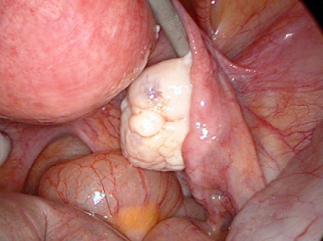
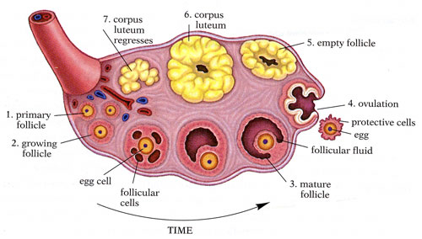
Types of Ovarian Cancer
Epithelial Ovarian Cancer (90%)
Serous/Papillary serous (80%)
Mucinous (10%)
Endometrioid (10%)
Clear Cell
Brenner Tumors
*Borderline Tumors*
Germ Cell Tumors
Dysgerminoma
Yolk Sac Tumors/Endodermal sinus tumor
Embryonal Carcinoma
Choriocarcinoma
Teratomas
Sex-cord Stromal Tumors
Granulosa Cell Tumors
Fibrosarcoma
Sertoli-Leydig Tumors

Slide 3
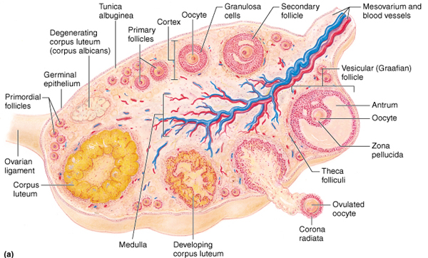

Slide 4
Germ Cell Tumors
20% of all ovarian tumors
2-3% of ovarian malignancies
Presentation at young age (early 20’s)
Tumor markers
hCG
αFP
LDH

Slide 5
Evolution of Germ Cell Tumors
Dysgerminoma
Germ cell
Embryonal Carcinoma
Polyembryoma
Morula
Embryo
Teratoma
Endodermal sinus tumor
Choriocarcinoma
Yolk sac
Blastula

Slide 6
Germ Cell Tumors
Dysgerminoma
Endodermal sinus tumor
Teratoma
Immature
Mature
Struma ovarii
Carcinoid
Choriocarcinoma
Embryonal carcinoma
Polyembryoma
Mixed GCT
Combo GCT/Stromal
Gonadoblastoma
Other
Notes:
Carcinoid develops in mature teratomas, usually in older women. Can have malignant potential, but generally have an indolent course and rarely metastasize.

Slide 8
Dysgerminoma
Incidence
1-2% of ovarian tumors
3-5% of ovarian malignancies
40% of all GCT
Peak incidence age 19
67% stage IA
10-15% bilaterality
20% in “normal appearing” opposite ovary

Slide 9
Dysgerminoma
Notes:
Large, white to grey, fleshy, lobulated masses.

Slide 10
Dysgerminoma
Notes:
No or very little areas of hemorrhage or necrosis – if these are present, think about a mixed germ cell tumor.

Slide 11
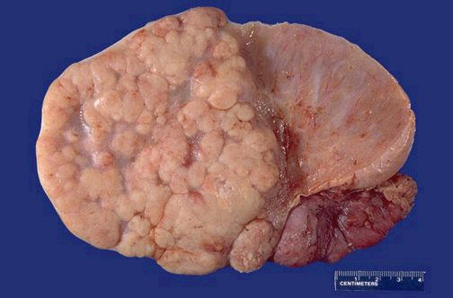
Dysgerminoma
Presentation
Solid, lobulated, and can be large
15% associated with mature cystic teratoma
Associated with gonadal dysgenesis and gonadoblastoma
High growth fraction, lymphatic spread
Tumor markers
LDH, placental alkaline phosphatase
Survival
Overall =86%
Stage I =90%

Slide 12
Dysgerminoma
Fertility-sparing surgery
85% of patients are younger than 35 yo
Consider uterine preservation (IVF)
Radiosensitive
Chemosesitive

Slide 13
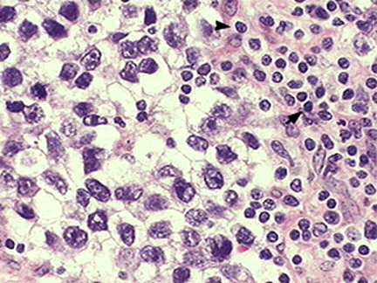
Dysgerminoma
Large, round, ovoid or polygonal cells
Nest and cords of primitive appearing germ cells
Lymphatic space invasion is common

Slide 14
Dysgerminoma
 | Incidence | Survival
Stage IA | 70% | 92% 10-year
Stage IB | 10% | >90% 5-year
Stage II, III | 15% | >90%
Stage IV | 5% | 80%

Slide 15
Endodermal Sinus Tumor
Presentation
20% of all GCT
Median age 19 yo
Abdominal pain, large mass
10-30 cm common
Very rapid growth, intra-abdominal and hematological spread
Tumor marker: AFP, α₁ antitrypsin
Synonyms
Yolk sac tumor
Survival
Overall survival =70%
Stage I =90%

Slide 16
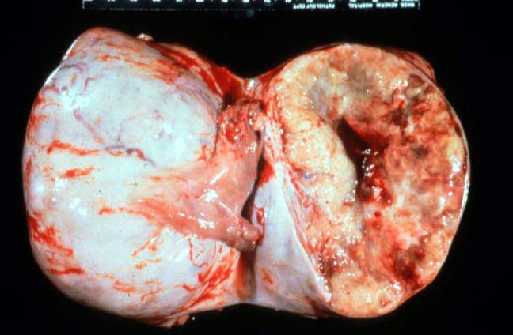
Endodermal Sinus Tumor
Solid tumor with hemorrhage and gelatinous necrosis on cut surface
Microscopy
Hyaline globules
Reticular Pattern
Schiller-Duval bodies
Single blood vessel surrounded by neoplastic cells

Slide 17
Endodermal Sinus Tumor
Schiller-Duval bodies

Slide 18
Teratomas
Immature
Mature
Specialized
Struma ovarii
Carcinoid

Slide 19
Immature Teratoma
Presentation
20% of all GCT
75% in first 2 decades of life
12-15% bilateral
60-70% are Stage I
Rarely produce tumor markers: αFP and CA-125
Grade is determined by % immature neural tissue
Stage IA grade 1 → no adjuvant therapy
Survival
Overall =63%
Stage I =75%

Slide 20
Immature Teratoma
Notes:
Solid with cystic areas. Cut surface is soft fleshy or encephaloid.

Slide 21
Choriocarcinoma
Presentation
Uncommon, aggressive tumor
Often part of mixed GCT
Consider met from gestational chorioCA
Mean age 20 yo, children common
Half of premenarchal → precocious puberty
Tumor marker
hCG

Slide 22
Choriocarcinoma
Cytotrophoblast
Cytotrophoblast
Smaller cells
Smaller nuclei
Syncitiotrophoblast
Larger cells
Eosinophilic cytoplasm
Bizarre nuclei
Hemorrhage
Syncitiotrophoblast

Slide 23
Embryonal Carcinoma
Presentation
Mean age < 30 yo
Only 4% of GCT and often part of mixed tumor
60% Stage IA
Poorly differentiated germ cell tumor
Aggressive, intra-abdominal spread and mets common
Tumor markers: hCG, αFP
Survival
Overall =40%
Stage I =75%

Slide 24
Polyembryona
Best classified as a mixed tumor
Never found in pure form
Fewer than 50 cases
All under age 40
Resembles embryonal carcinoma
Embryo days 13-15
Treated like other mixed GCT
Tumor markers: hCG, αFP

Slide 25
Gonadoblastoma
Combined Germ Cell / Sex Cord Stromal Tumor
Presentation
Age 1-38
Small tumors
Phenotypic ♀ with virilization
90% have Y chromosome
22% from streak gonads
Bilaterality 30-50%
Check chromosomes for dysgenic gonads
BSO if Y present
If testicular feminization syndrome, await puberty before BSO

Slide 26
Tumor Markers Germ Cell Tumors
Histology | AFP | hCG | LDH | PLAP | CA-125
Dysgerminoma | - | + | + | + | +
Endodermal sinus tumor | + | - | + | - | +
Immature teratoma | + | - | - | - | +
Embryonal CA | + | + | - | + | -
ChorioCA | - | + | - | + | -

Slide 27
Germ Cell Tumors Treatment
Surgery
staging in early disease
Fertility-sparing surgery
Can preserve uterus for future IVF, even if BSO
Debulking improves outcome

Slide 28
Chemotherapy Germ Cell Tumors
BEP
Bleomycin 20 U/m² weekly x 9
Etoposide 100 mg/m² days 1-5 q 3 weeks x 3
Cisplatin 20 mg/m² days 1-5 q 3 weeks x 3
VAC
Vincristine 105 mg/m² weekly x 12
Act D 0.5 mg days 1-5 q 4 weeks
Cytoxan 5-7 mg/kg days 1-5 q 4 weeks
VBP
Vinblastine 12 mg/m² q 3 weeks x 4
Bleomycin 20 U/m² weeks x 7, 8 on week 10
Cisplatin 20 mg/m² days 1-5 q 3 weeks x 3

Slide 29
Sex-cord Stromal Tumors
Granulosa cell tumors
Inhibin,AMH & CA-125
Sertoli-Leydig tumors
CA-125, αFP, sTest

Slide 30
Granulosa Cell Tumor
Presentation
Adult (95%) and juvenile types
Solid and/or cystic- variable
Estrogen, occasional androgen
80% palpable on examination
Hemoperitoneum in 15%
80-90% Stage I
Low grade, late relapse
Estrogen excess and the endometrium
25% proliferative
55% hyperplastic
13% adenocarcinoma

Slide 31
Granulosa Cell Tumor Treatment
Juvenile
High cure rate
Adult
Resection
Chemotherapy
BEP
Carboplatin and Taxol
GnRH analogs

Slide 32
Granulosa Cell Tumor

Slide 33
Granulosa Cell Tumor

Slide 34
Granulosa Cell Tumor
Call-Exner bodies

Slide 35
Sertoli-Leydig Tumors
Benign
Sertoli cell tumors→ no hormones
Leydig tumors→ testosterone
Potentially Malignant
Sertoli-Leydig tumors
Arrhenoblastoma, androblastoma
Grade 3
44% five-year survival
Grade | % Cancer
1 | 0
2 | 10
3 | 60

Slide 36
Take home message

Slide 37
Dysgerminoma | USO staging if possible | BEP x 3 cycles if stage II-IV
Endodermal sinus tumor | Debulk but preserve fertility | BEP x 3-4 cycles
Embryonal carcinoma | Debulk but preserve fertility | BEP x 3-4 cycles
Immature teratoma | Debulk but preserve fertility | BEP x 3-4 cycles if > grade 1 even if stage 1A
Granulosa cell tumor | USO is enough if stage 1A otherwise debulking | BEP x 3-4 cycles Carbo/taxol.
Sertoli-leydig cell | Debulk but preserve fertility | BEP x 3-4 cycles

Slide 38
Take home message
Common in young women
Tumor markers
Treatment
Fertility-sparing surgery
Chemosensitive→ BEP for 3-6 cycles
Radiosensitive
No adjuvant chemo for:
Stage I pure dysgerminoma
Stage IA grade 1 immature teratoma

