Slide 1
OB-GYN COURSE 482
King Saud University
College of Medicine
Department of Obstetrics & Gynecology
GENERAL ORIENTATION

Slide 2
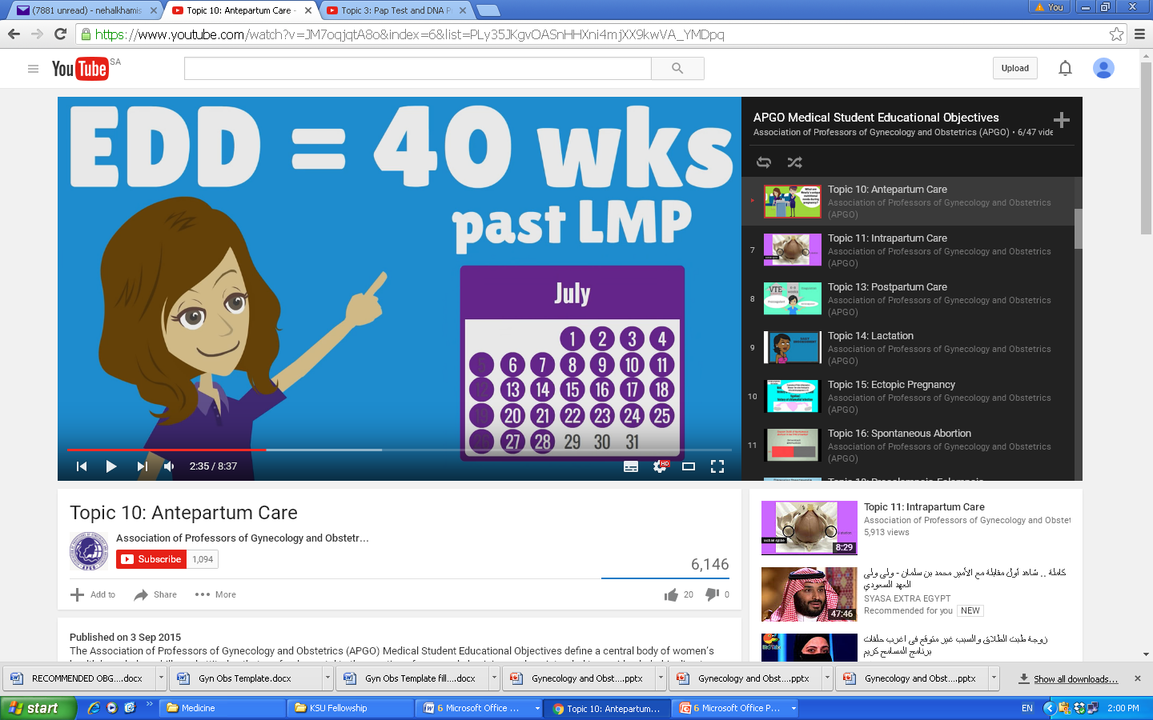
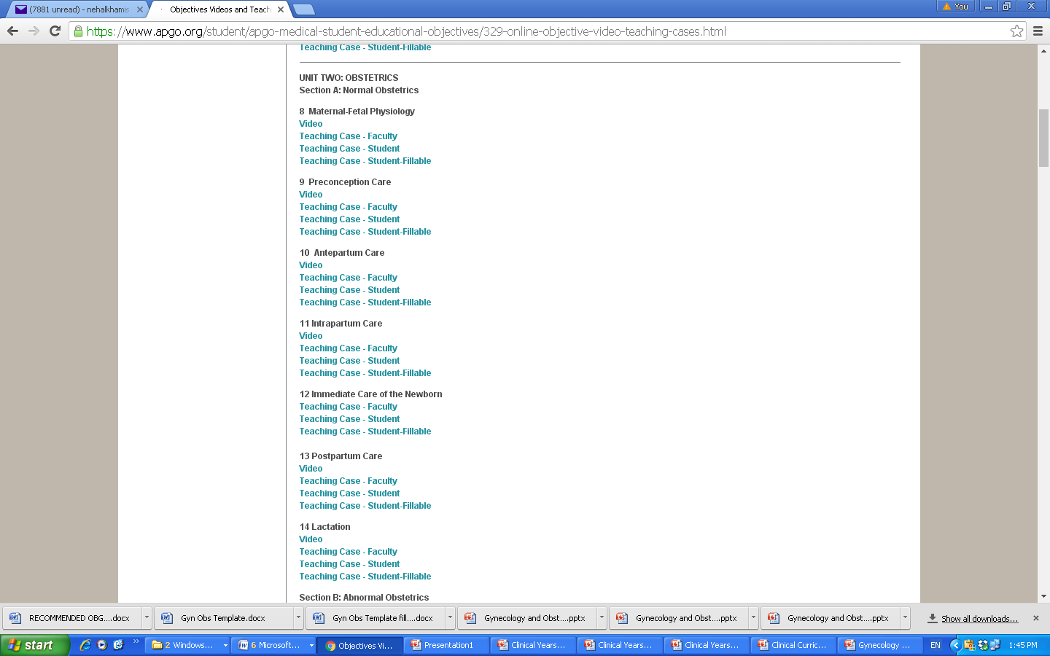
Teaching and Learning Methods
APOG Agreement
Sites and Contexts:
Interactive lectures
Flipped Classrooms
Clinical Skills Labs
Clinical Teaching sites:
Obstetrics:
  Labor and delivery Unit
  Triage/urgent care
  Antepartum wards
  Postpartum wards
Gynecology:
  Operating Room
  Inpatient Wards
  Outpatient Clinics
  Log Book (Performed, Observed, Alternative?)

Slide 3
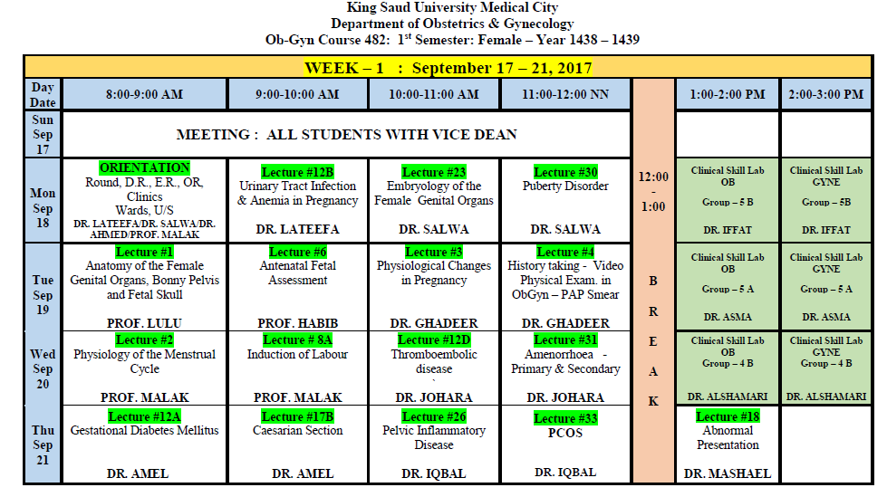
LECTURES

Slide 4
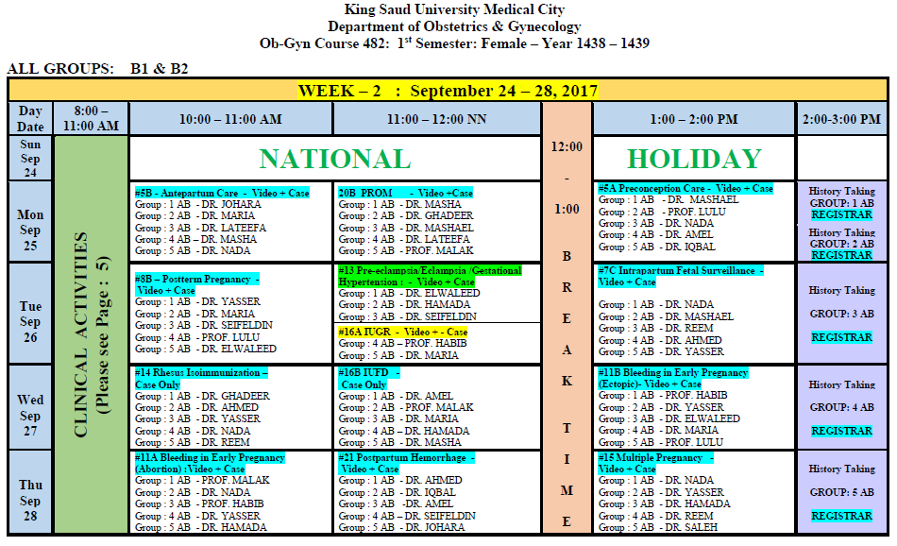
VIDEO PRESENATIONS

Slide 5
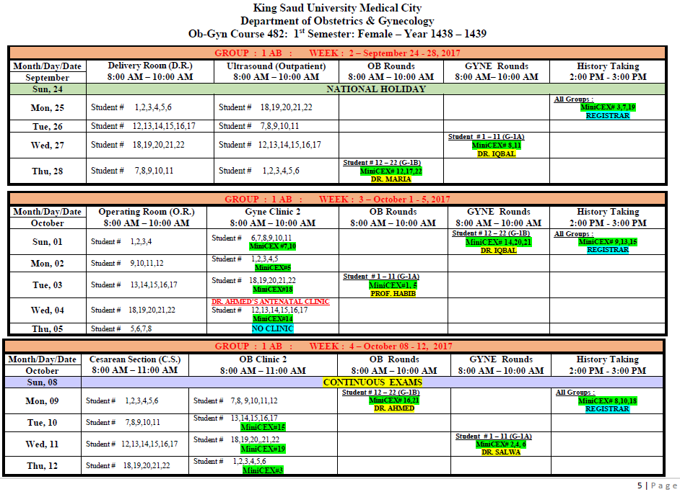
CLINICAL ROTATIONS

Slide 6
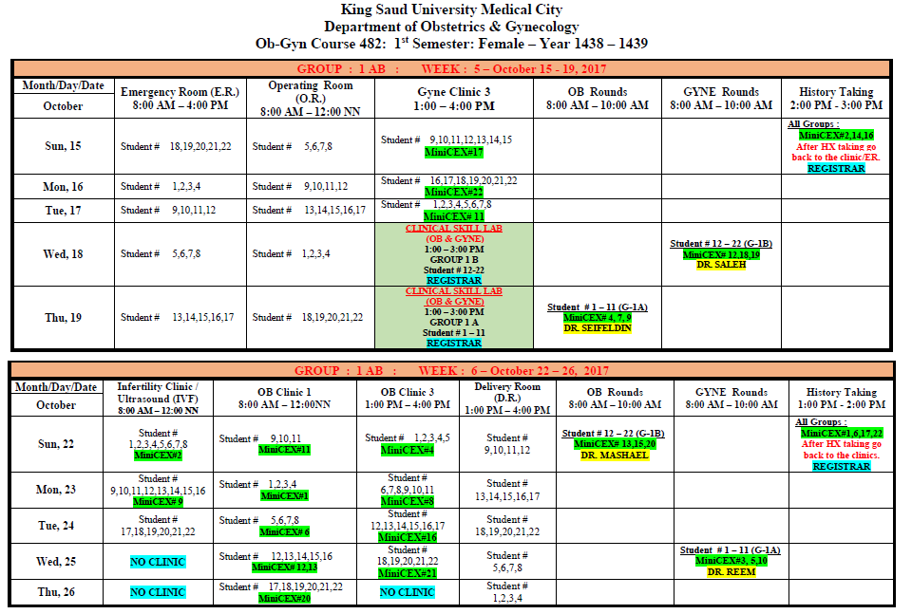
CLINICAL ROTATIONS

Slide 7


Slide 8
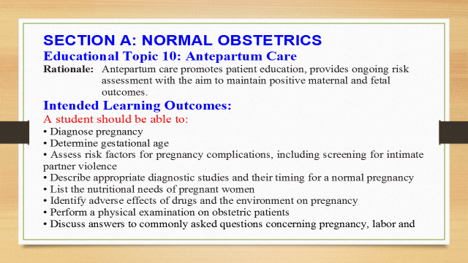

Slide 9
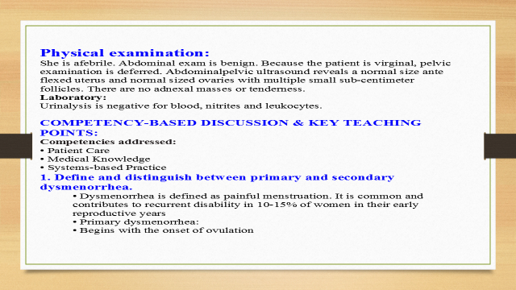

Slide 10
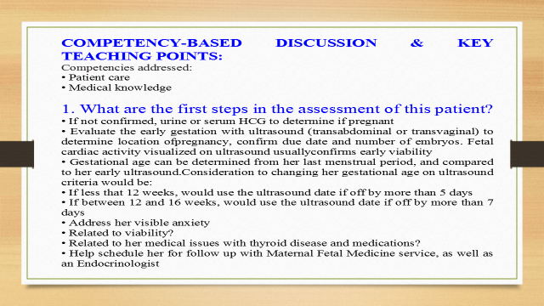

Slide 11
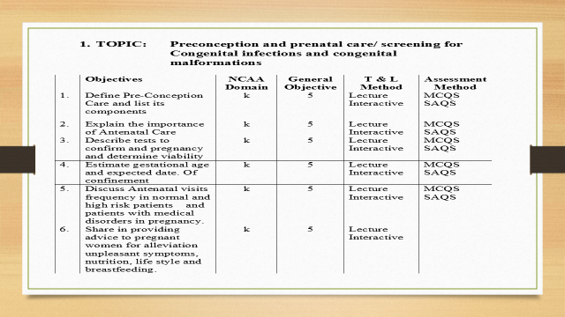

Slide 12
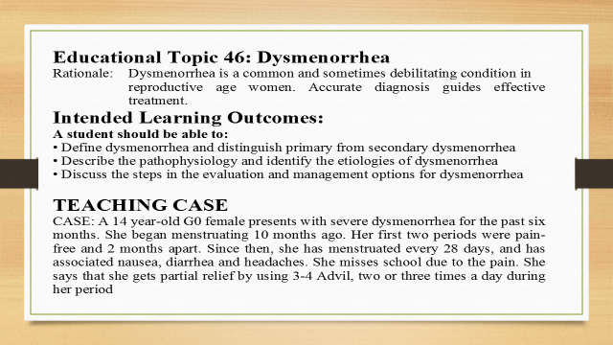

Slide 13
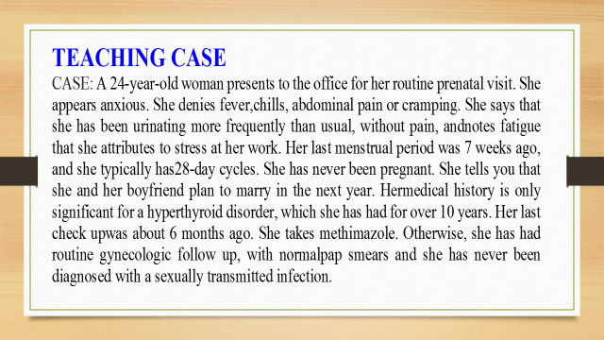

Slide 14
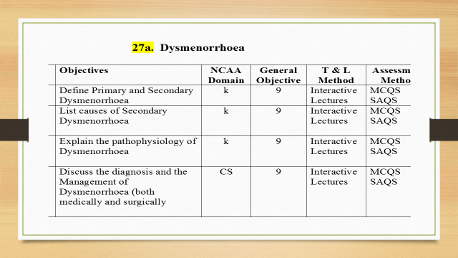

Slide 15
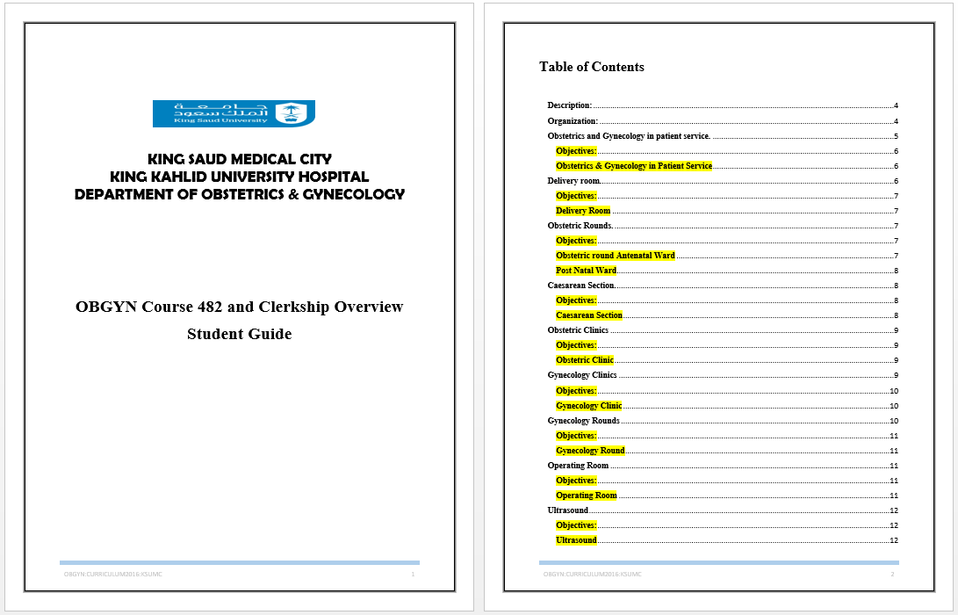
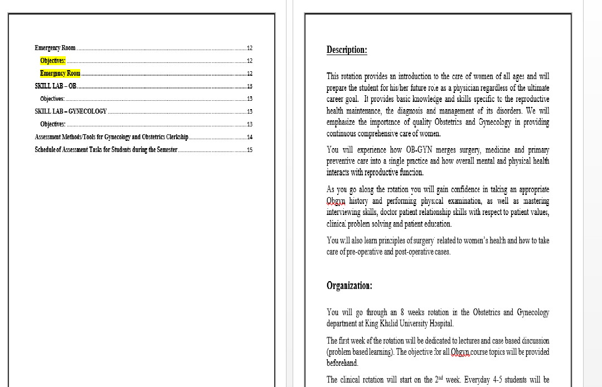

STUDENT GUIDE / FACULTY GUIDE

Slide 16
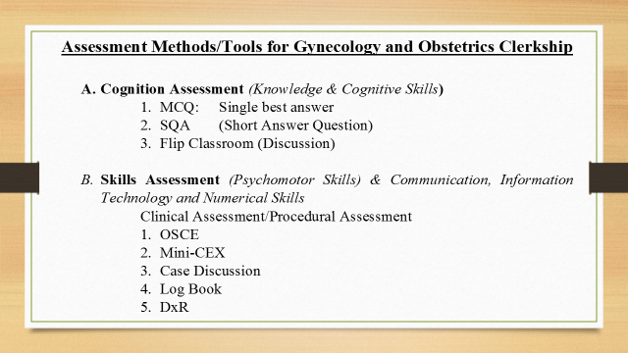

Slide 17
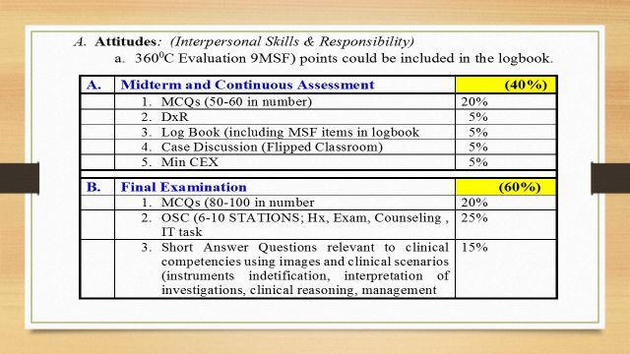

Slide 18
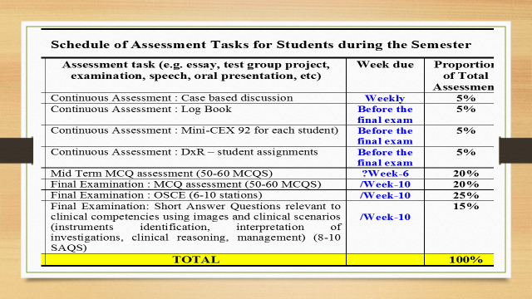

Slide 19
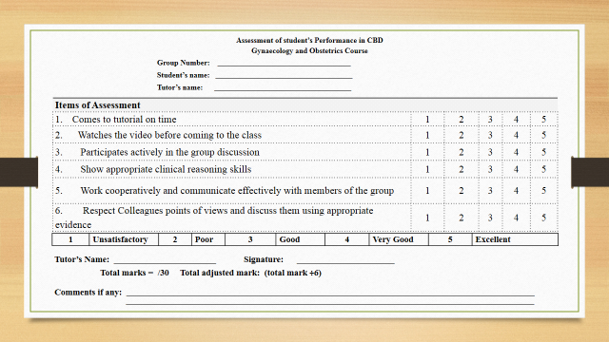

Slide 20
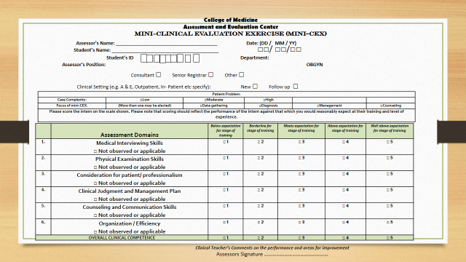

Slide 21
Obstetrics and Gynecology Rotation Evaluation Form | Strongly |  | Not |  | Strongly
 | Agree | Agree | Sure | Disagree | Disagree
1. I received clear learning objectives for the clerkship from the start of the course. | 46% | 41% | 5% | 3% | 4%
2. I received a clear description of the learning resources at the beginning of the course | 48% | 38% | 8% | 3% | 3%
3. I received clear description of responsibility and duties at the beginning of the course | 33% | 43% | 17% | 4% | 3%
4. I received clear explanation of assessment methods and requirements to pass the course | 35% | 45% | 11% | 5% | 3%
5. Faculty were punctual in terms of the educational activities dates and times | 36% | 45% | 9% | 6% | 4%
6. Faculty presented the lectures material in clear, concise, organized way | 28% | 43% | 13% | 10% | 5%
7. I was able to find teaching staff outside teaching sessions for questions and discussions | 24% | 27% | 38% | 6% | 5%
8. The learning resources were available | 38% | 40% | 13% | 5% | 5%
9. The learning resources were appropriate and useful | 27% | 38% | 19% | 10% | 6%

Slide 22
Obsterics and Gynecology Rotation Evaluation Form | Strongly |  | Not |  | Strongly
 | Agree | Agree | Sure | Disagree | Disagree
10. Flipped classroom improved my ability of integration and application of knowledge | 20% | 46% | 28% | 2% | 4%
11. CBD facilitated my development of clinical reasoning | 19% | 56% | 18% | 4% | 3%
12. CBD complemented the clinical activities | 20% | 59% | 14% | 4% | 3%
13. I had the opportunity to follow a variety of different patients (with different medical conditions). | 16% | 49% | 17% | 16% | 3%
14. I was able to care for an adequate number of patients on this rotation. | 6% | 37% | 26% | 22% | 9%
15. There was a balance between inpatient and outpatient activities | 14% | 40% | 27% | 15% | 4%
16. There was a balance between clinical activities and lectures | 17% | 33% | 19% | 20% | 10%
17. I was given the opportunity to share in the responsibility of patient care | 11% | 30% | 31% | 17% | 11%
18. The faculty encouraged my participation on the team. | 15% | 48% | 21% | 11% | 5%

Slide 23
Obsterics and Gynecology Rotation Evaluation Form | Strongly |  | Not |  | Strongly
 | Agree | Agree | Sure | Disagree | Disagree
19. My time in the clinical setting was productive. | 18% | 42% | 26% | 10% | 4%
20. The faculty treated the healthcare team with respect & compassion. | 32% | 52% | 11% | 3% | 2%
21. The faculty provided effective clinical teaching during the clerkship. | 22% | 55% | 16% | 4% | 3%
22. The faculty provided me with sufficient feedback on my performance. | 12% | 37% | 27% | 9% | 15%
23. The faculty provided me with feedback in a timely manner. | 14% | 31% | 28% | 16% | 11%
24. The faculty created a good learning environment. | 18% | 61% | 15% | 3% | 2%
25. A member of the healthcare team personally observed me performing a physical examination during this rotation. | 13% | 29% | 14% | 25% | 19%
26. Overall, the clerkship allowed me to learn valuable skills. | 16% | 53% | 14% | 12% | 5%
27. The skills lab session was a useful part of my rotation | 21% | 37% | 21% | 12% | 9%

Slide 24
Obsterics and Gynecology Rotation Evaluation Form | Strongly |  | Not |  | Strongly
 | Agree | Agree | Sure | Disagree | Disagree
28. I improved on history taking | 17% | 39% | 26% | 12% | 6%
29. I improved on physical examination | 11% | 23% | 37% | 21% | 8%
30. I improved on patient doctor relationship | 18% | 45% | 26% | 6% | 5%
31. I improved on clinical reasoning | 20% | 48% | 21% | 9% | 3%
32. I improved on technical skills | 17% | 35% | 38% | 5% | 6%
33. The clerkship promoted my professionalism skills | 19% | 46% | 27% | 5% | 3%
34. The conduct of the course was consistent with the course outline | 19% | 49% | 17% | 9% | 6%
35. Overall, the clerkship gave me a positive attitude towards this discipline. | 26% | 49% | 17% | 3% | 5%
36. Overall rating of the clerkship | 16% | 48% | 20% | 13% | 4%
At this moment in time are you considering a career in Gyne and Obs | YES | NO | ABSTAIN
 | 32% | 51% | 15%

Slide 25
