Slide 1
Strabismus,Amblyopia& leukocoria
Elham ALQahtani,MD.
Pediatric opthalmology &Strabismus
Assisstant professor,KSU

Slide 2
Strabismus
ocular misalignment .
2%-3% of children and young adults.
Male=Female
Notes:
due to extraocular muscle imbalance.

Slide 3
Causes of Strabismus:
Inherited pattern.
Idiopathic.
Neurological conditions
(CP,Hydrocephalus & brain tumors).
4.Down syndrome.
5.A congenital cataract , Eyes Tr.
Notes:
Strabismus has inhereted pattern i.e., it is much more likely to occur if one or both parents are affected. However, many cases occur without any family history of the disorder.
unknown. However, strabismus is certainly more common in families with a history of the disorder. Several neurological conditions are more commonly associated with strabismus, including Down’s syndrome, cerebral palsy, hydrocephalus, and brain tumors.

Slide 4
Why we are concerned about strab ?
Binocular single vision.
Double vision.
Cosmetic.
Notes:
It is important for functional and cosmetic reasons. Strabismus is associated with reduction of depth perception and, if onset is in adulthood, double vision. Furthermore, strabismus presents a cosmetic concern, especially for school-age children.

Slide 5
Consequenses
Lazy eye (amblyopia) .
Double vision.
Notes:
When an individual's eyes are straight, they are said to have orthotropia. This indicates that both eyes are aimed at the same spot. The brain fuses the two separate images into one three-dimensional image.
This allows a high degree of depth perception. If the eyes are misaligned, depth perception is substantially reduced. Furthermore, when one eye is deviated in early childhood, the brain may learn to ignore the image from that eye, and amblyopia (lazy eye) often results.
If strabismus develops for the first time in adulthood, the affected individual usually experiences double vision. This occurs because the brain, which no longer has the "plasticity

Slide 6
Tests for deviation
1.Hirschberg test :
1mm from pupil center=15PD or 7º .
2-Krimsky :
place prism on fixating eye until control reflex in deviated eye .
3.Cover test .
4.Prism cover test.

Slide 7
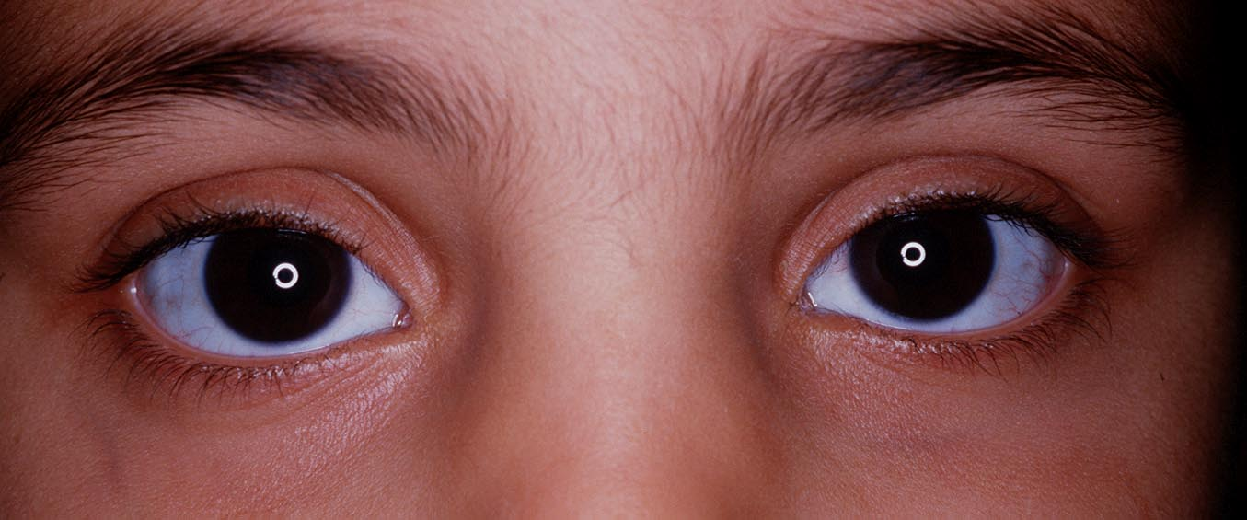
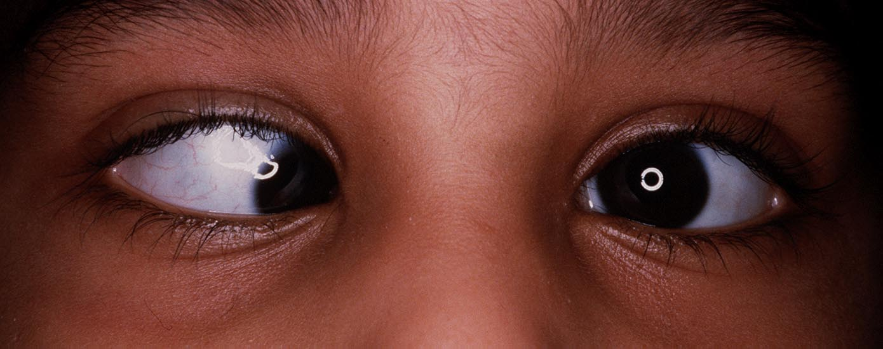
Hirschberg test

Slide 8
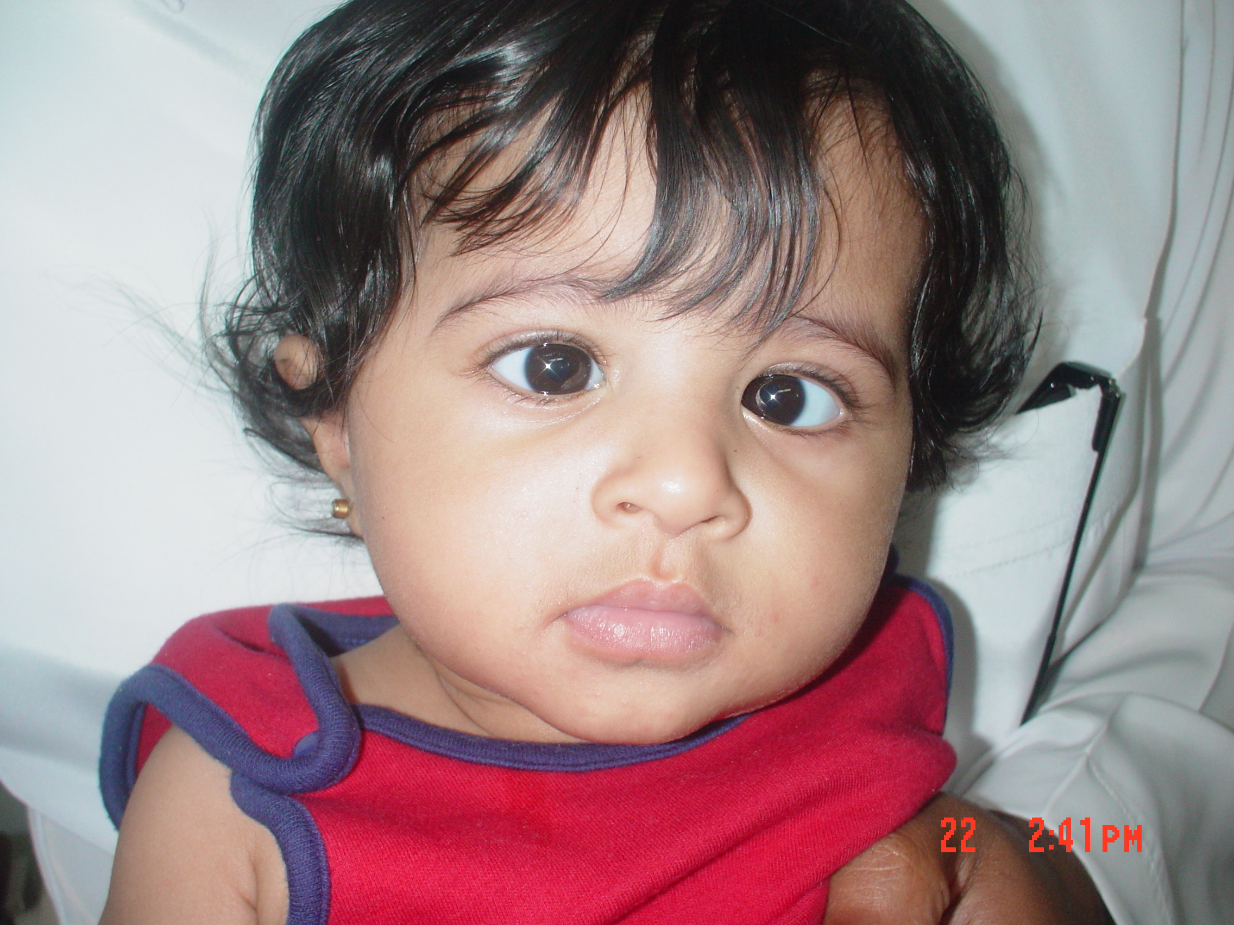

Slide 9
Krimsky test

Slide 10
Cover test

Slide 11
Prism cover test

Slide 12
Pseudostrabismus
Pseudoesotropia is a condition in which alignment of the eyes is straight (also known as orthotropic); however, they appear to be crossed.

Slide 13
Pseudostrabismus
a flat nasal bridge
prominent epicanthal folds.

Slide 14
pseudostrabismus
A careful ocular examination (eg, pupillary light reflex, cover test) reveals that the eyes are straight.

Slide 15
Types of Strabismus
1.Commitant : XT or ET
Almost same angle in any direction of gaze .
2.Non-Commitant: XT or ET
angle change with direction of gaze(Paretic, restrictive).

Slide 16
Commitant strabismus
ET20
ET 25 ET30 ET25
ET30

Slide 17
Non-commitant
ET 20
ET 10 ET 12 ET40
ET18

Slide 18
Types of strabismus
Esotropia (ET).
Exotropia (XT).
Hypertropia (HT).
Hypotropia(HPO).

Slide 19
Esotropia
1.Infantile (congintal) ET.
2.Accomodative ET:
a.hypermetropic(refractive)
b.high AC/A ratio.
c.partially accommodative ET.
3.Aquired non acommodative ET(DIVERGENCE paralysis).
4.Sensory ET.
5.Cyclic ET.
Notes:
Infantile esotropia is the inward deviation of the eyes noted before the patient reaches age 6 months.

Slide 20
Infantile ET
Large Angle.
Small hypermetropia .
Before age of 6months .
Cross fixation (turning the face to fixate the eye contralateral to the target).
Notes:
Unknown etiology

Slide 21
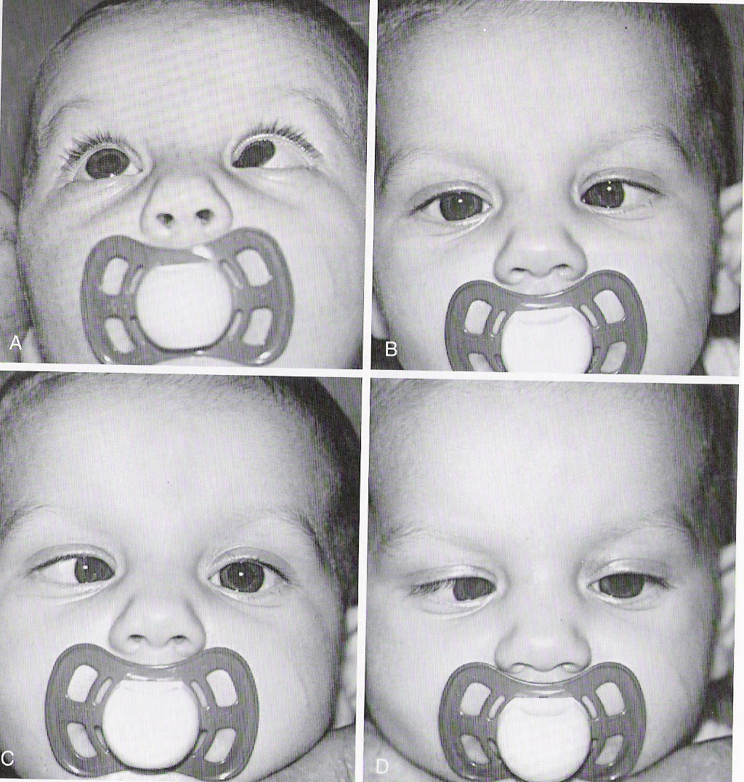

Slide 22
Treatment of infantile ET
Surgically by weakening the medial rectus muscles at age of 10-11months to achieve monofixation syndrome.
Prognosis: gross stereopsis .
Notes:
Although some binocular vision is achieved, it generally is subnormal, often involving peripheral fusion. Factors contributing to poor ocular alignment and visual prognosis include persistent preoperative amblyopia, latent manifest nystagmus, and myopia from -2.5 to 5.0 D.

Slide 23
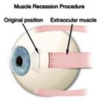

Slide 24
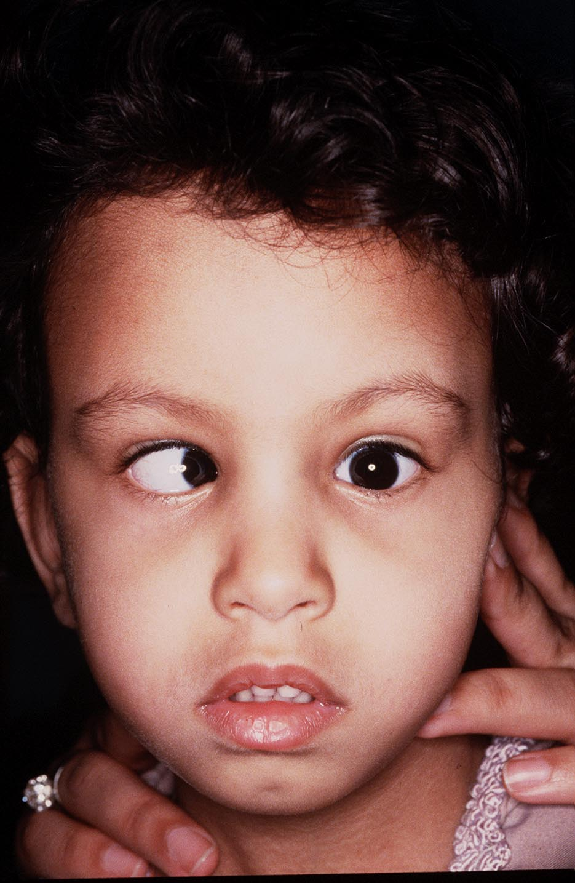

Slide 25
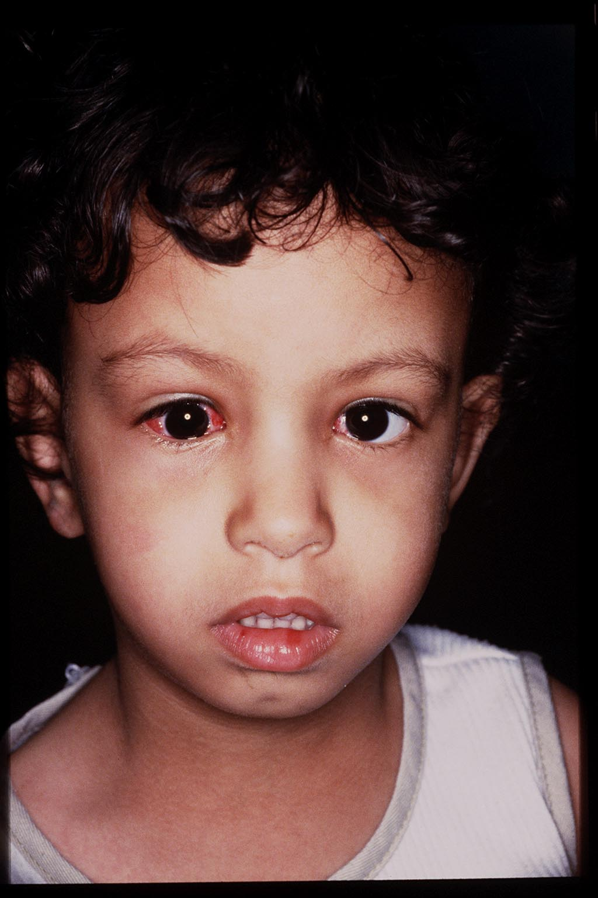

Slide 26
Clinical example
A 4-month-old healthy child presents with a history of his eyes turning in most of the time, since about 8 weeks of age.

Slide 27
Examination:
ET for both distance and near 60 PD.
EOM is Full.
Cycloplegic retinoscopy is +1.25 D
Fundus :normal.

Slide 28
Acc ET
1.>+2.00 hypermetropia.
2.age>6mo-7years (4yrs).
3.High risk of amblyopia.
5.Intermettent at onset then constant .
4. Corrected totally (<10PD residual N+D) with glasses.

Slide 29
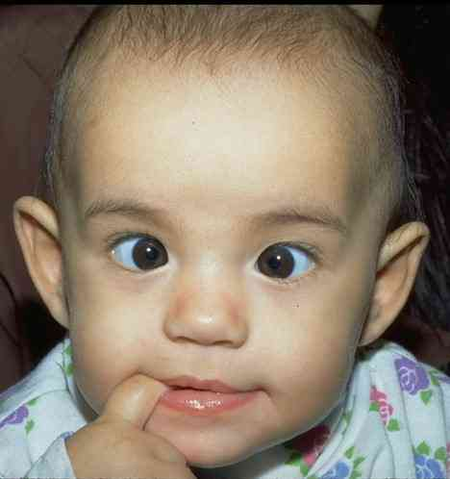
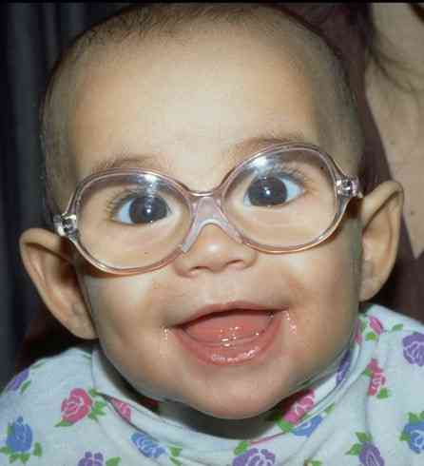

Slide 30
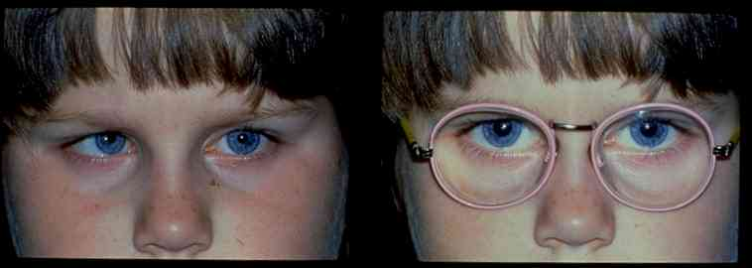

Slide 31
High AC/A ratio ET
-The accommodative convergence/accommodation (AC/A) ratio gives the relationship between the amount of convergence (in-turning of the eyes) that is generated by a given amount of accommodation (focusing effort).
-Esotropia with high AC/A ratio (also termed nonrefractive accommodative esotropia).

Slide 32
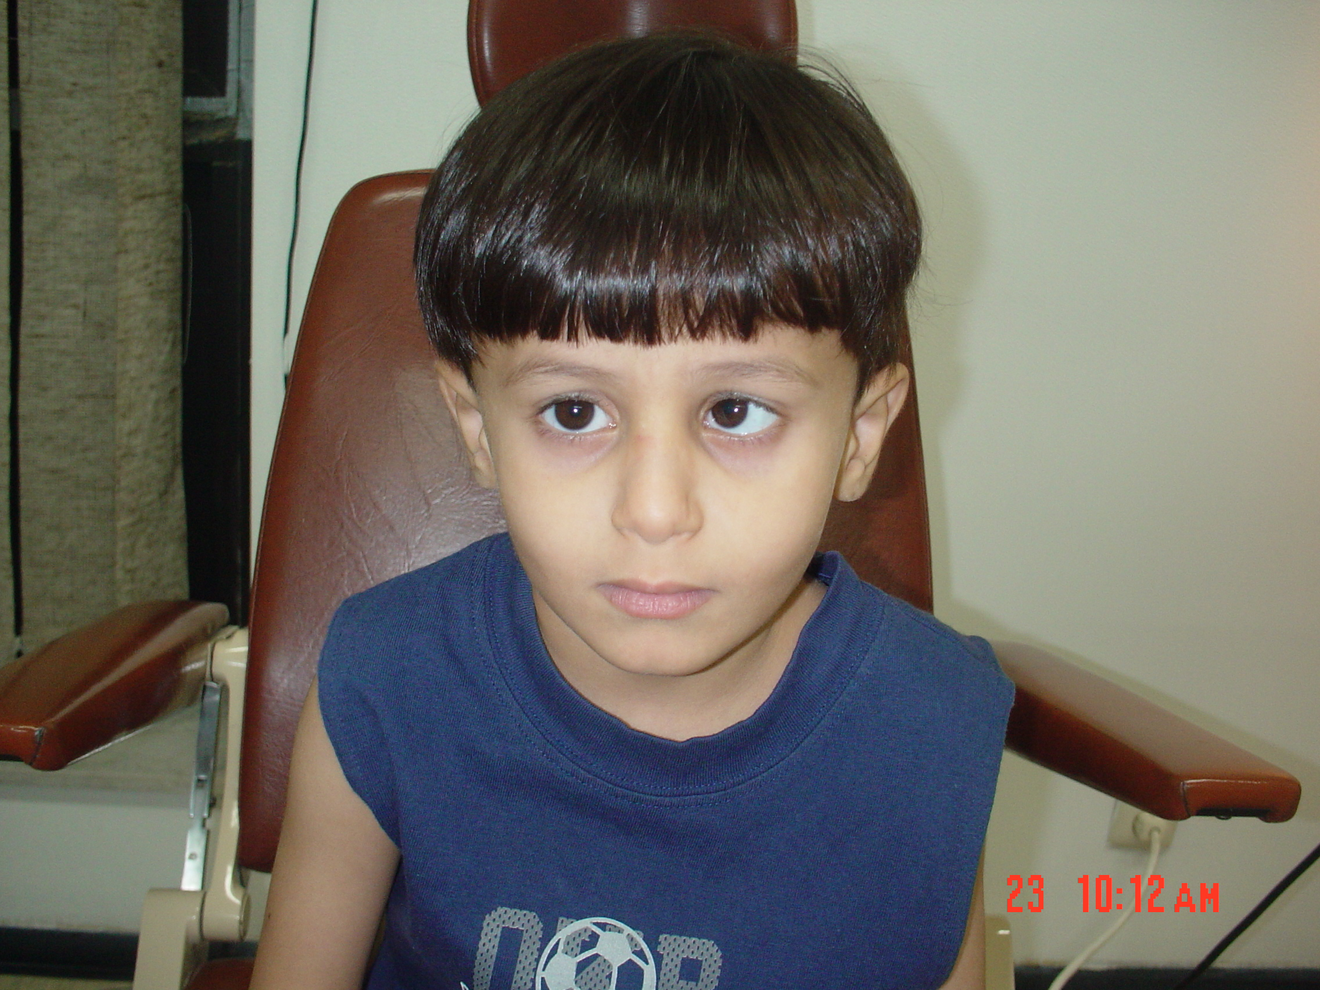

Slide 33
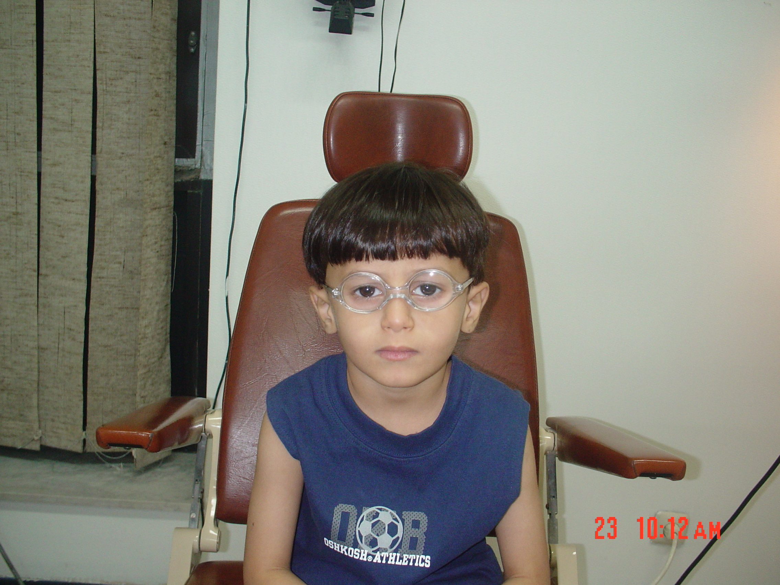

Slide 34
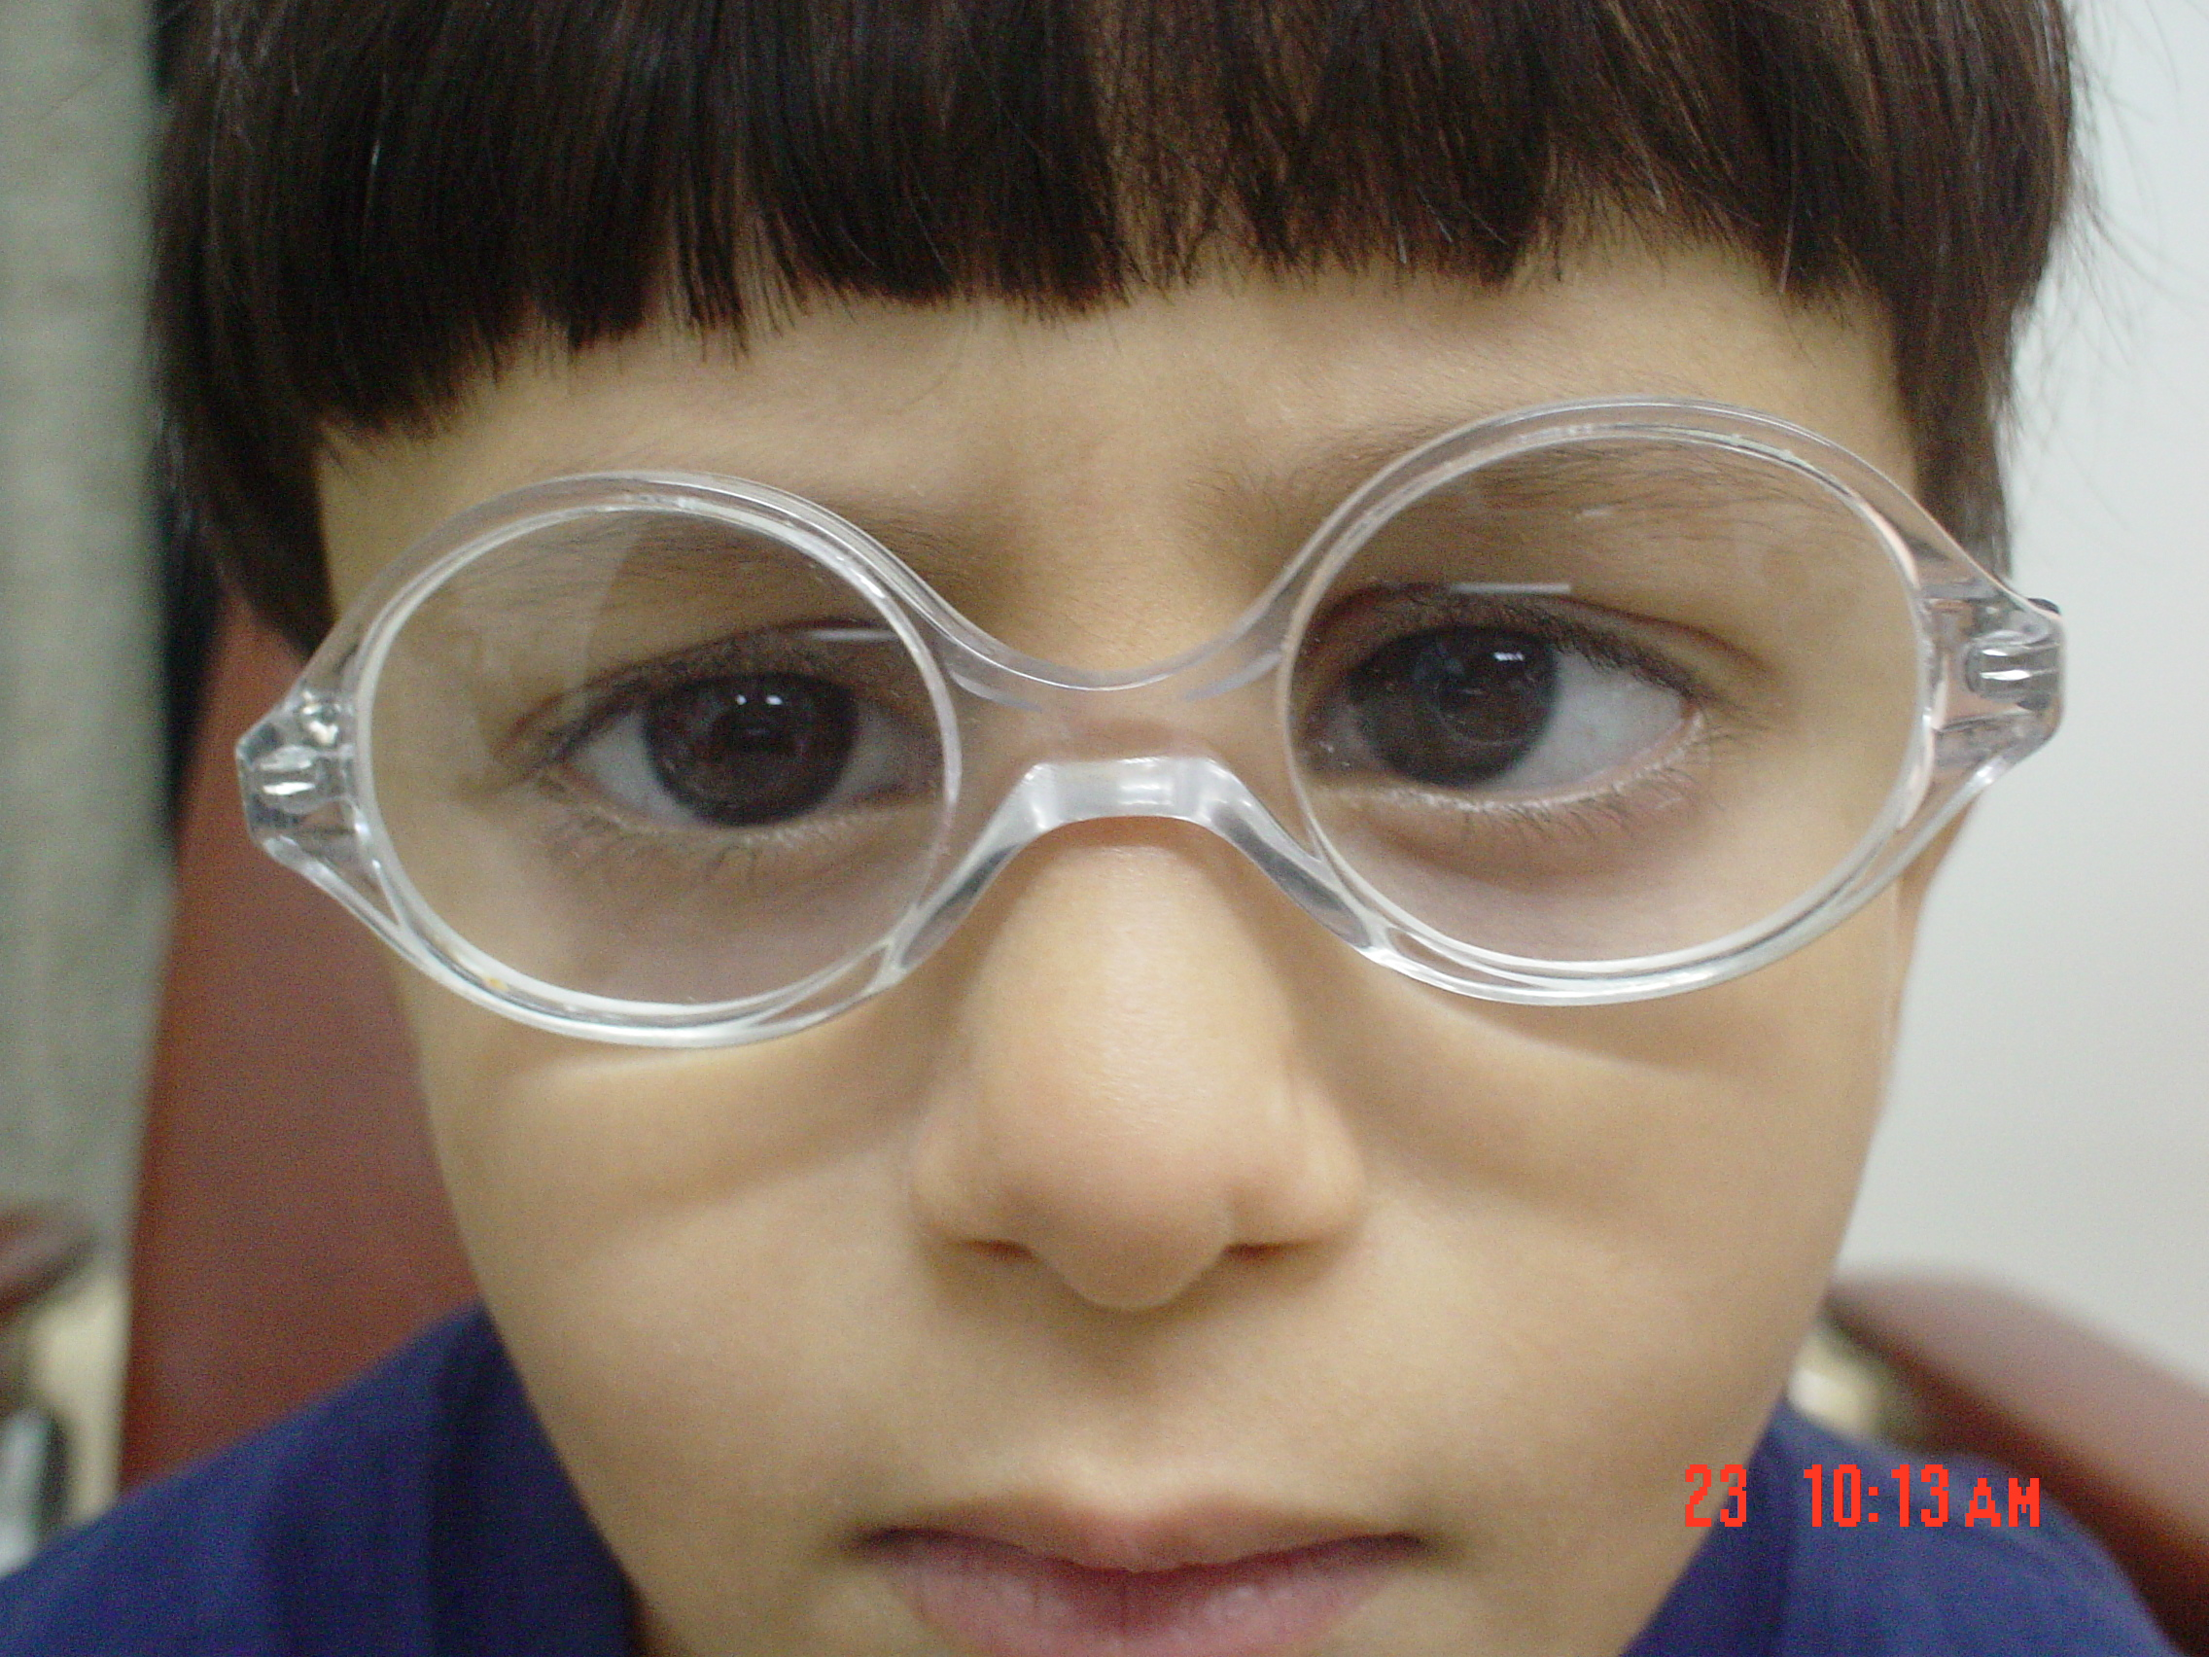

Slide 35
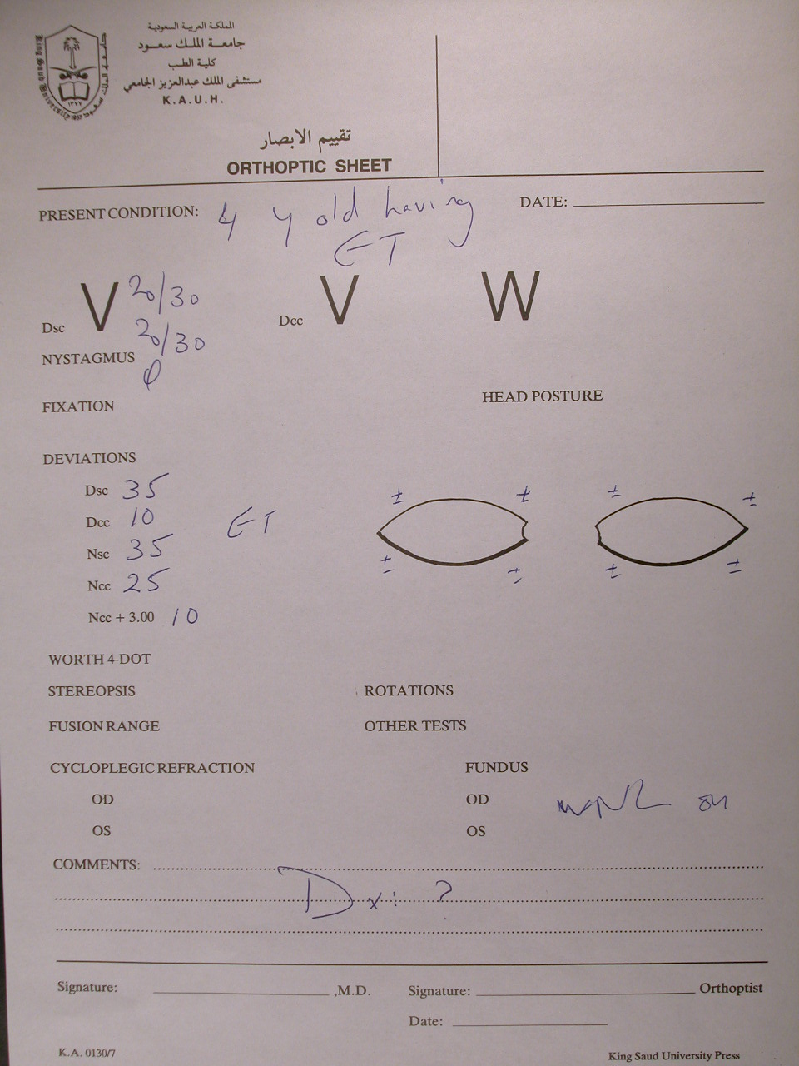

Slide 36
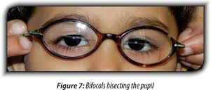
Treatment of highh AC/A

Slide 37
Partial acc ET
>10 PD residual for D+N with full hypermetropic correction.
Treatment :
Surgery Sx for the residual deviation .

Slide 38
Divergence paralysis
ET at D>N .
MRI : arnold chiari,pontine Tr.

Slide 39
Sensory ET
ET due to unilatral blindness.
Treatment: Sx

Slide 40
Cyclic ET
Very rare.
Acquired(2-6yrs).
Cycle between straight and ET.
Treatment: if hypermetropia ~glasses
if not hypermetropia ~ Sx

Slide 41
Exodeviation
a horizontal form of strabismus characterized by visual axes that form a divergent angle.

Slide 42
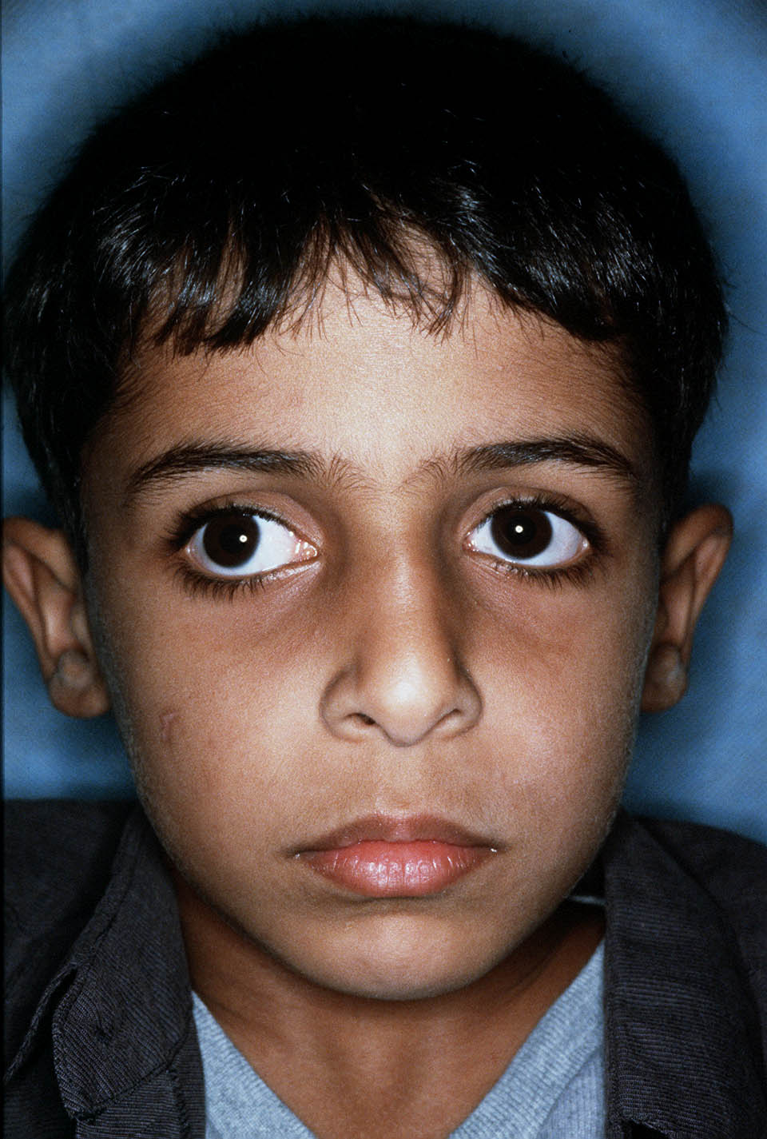

Slide 43
XT Types
Intermittent exotropia X(T) .
Congenital XT.
Sensory XT.
Convergence insufficiency.

Slide 44
Intermittent exotropia
Acquired.
Early childhood.
Intermittently controlled by fusional convergence.
Close one eye n the bright light.

Slide 45
This deviation may later progress to constant exotropia

Slide 46
Treatment
1.Surgical treatment.
2. non surgical: alternate patching .
over minus.

Slide 47
Indications of surgery :
1.poor control.
2.The deviation ocures more than 50% of time.
3.Lost distance stereopsis .

Slide 48
Types of X(T)
Basic
XT D=N
BLR weakening
Pseudo divergence excess
Xt D>N
Patch 30-60min
True divergence excess
XT D>N
R&R
XT D=N
BLR weakening
Patch 30-60min
XT D>N

Slide 49
Congenital XT
Very rare.
Constant large angle
Poor fusion prognosis
High risk of amblyopia
Associated with craniofacial abnormalities,albinism,CP.
Tx: BLR Weakening.

Slide 50
Sensory XT
Blind eye drift outward .
SX.

Slide 51
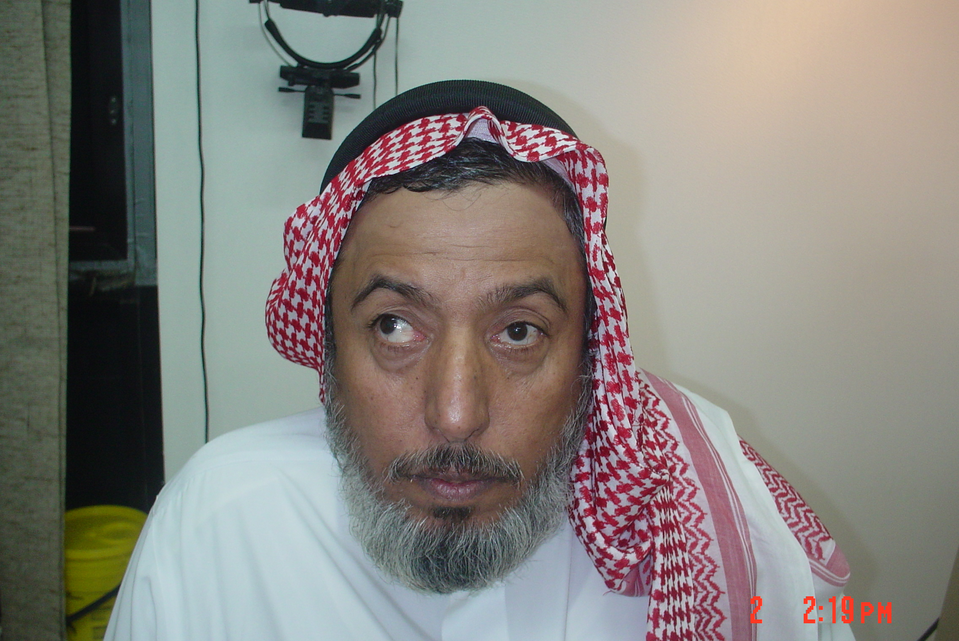

Slide 52
Convergence insufficiency
Inability to maintain the convergence on objects approching from D to N.
C/O: asthenopia, diplopia .
X or XT at N ,Stright at D.
Remote near point of convergence (normal5-6cm).
Tx: orthoptic exercise.

Slide 53
Amblyopia
Amblyopia refers to reduced vision, uncorrectable with glasses or contact lenses, due to failure or incomplete development of the visual cortex of the brain.
Notes:
Strabismus is important to recognize, primarily because, in childhood, it is often associated with the development of amblyopia, or lazy eye.

Slide 54
Amblyopia
VA is <20/40 or 2 lines below the good eye .
2 ~4%.
Almost during visual immaturity till the 9th BD.
Unilateral or bilateral.

Slide 55
Calssification
Strabismus Amblypoia
Refractive Amblypoia
Occlusive :organic ,cataract
Idiopathic ,2ry to nystagmus
Notes:
Most common cause is strab
Then anisometropia

Slide 56
Criteria of Dx
VA<20/40 OU or in one eye.
FHx.
Hx of visual deprivation during infancy .

Slide 57
Treatment
Optical correction.
PTO.
Defocusing (penalization).
Notes:
Penelization:optically by adding+3 to +5 lens on top of full cycloplegic refraction
Atropine every 1-3 /7 in good eye

Slide 58
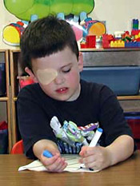
Patching

Slide 59
Leukocoria

Slide 62
Leukocoria
Cataract .
RB.
PHPV
COLOBOMA
RD.
Astrocytoma
Coat’s disease, uveitis .

Slide 63
Thank you

