Slide 1
Ocular Emergency & Red Eye
Prof. Mubarak F. Al-Faran, MD,
FRCS, FKSU (Ophth),FACS, Ar.BO (Hon).
Professor & Senior Consultant
Ophthalmic Surgeon ,
College of Medicine ,
King Saud University Medical City,
KSU, Riyadh, Saudi Arabia.

Slide 2
Sudden Loss of Vision
No Redness or Pain
1-Unilateral Blindness
CRA Embolus
Traumatic damage to optic nerve

Slide 3
Sudden Loss of Vision
No Redness or pain
2. Unilateral Decrease in Vision
=CRV Thrombosis
=Vitreous Hemorrhage
=Acute Keratoconus

Slide 4
Sudden loss of vision
No Redness or pain
3- Unilateral visual field loss :
BRA embolus
BRV thrombosis
RD

Slide 5
Sudden loss of vision
No Redness or Pain
4-Bilateral decrease in vision :
Stroke
Hemorrhage
Trauma to optic radiation
Increase ICP
Potential CO

Slide 6
Progressive visual loss
Without redness or pain
1- Cloudy vision :
Corneal opacity
Corneal dystrophy
Cataract
Vitreous opacity

Slide 7
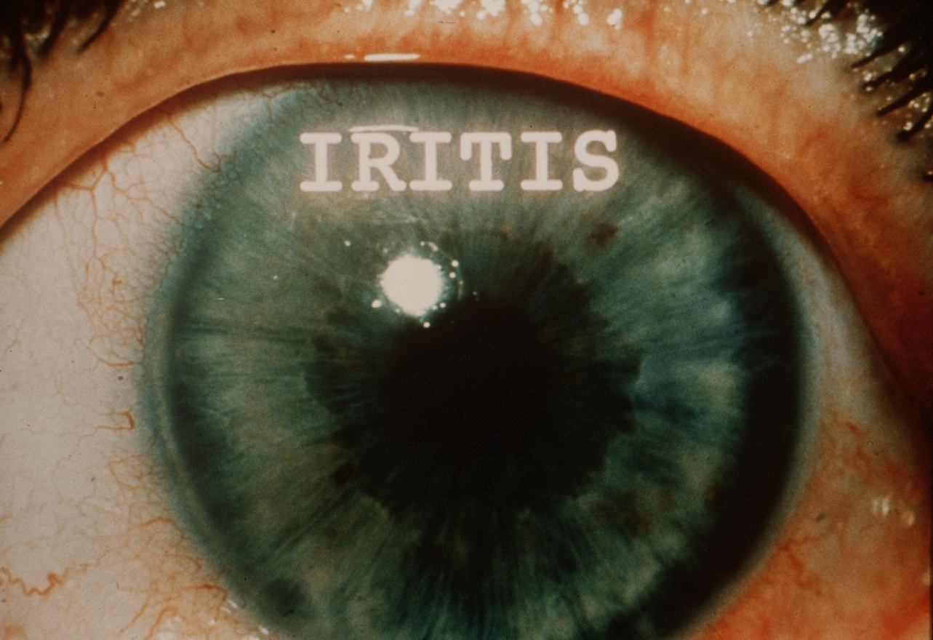
Visual loss
With redness or ocular complaint
Keratitis
Iritis
Cyclitis

Slide 8
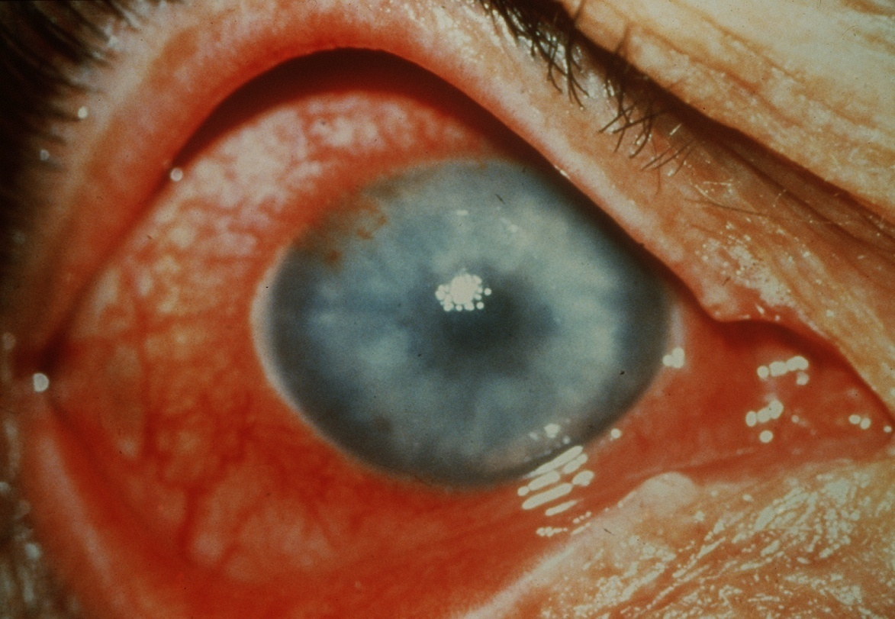
Cloudy vision
With eye pain and headache :
ACG , Secondary glaucoma to rubeosis , etc.
Optic neuritis
Endophthalmitis

Slide 9
Visual loss
With hyperemia , hypotonia :
Choroidal detachment
Phthisis bulbi following inflammation or perforating injury

Slide 10
Visual loss
With hyperemia and exophthalmus :
Orbital cellulitis
Pulsating exophthalmos
Cavernus sinus thrombosis

Slide 11
Symptoms
1- disturbance of vision
Decreased visual acuity
Sudden Gradual
- unilateral - unilateral
- bilateral - bilateral

Slide 12
Symptoms
1- Disturbance of vision
Abnormal visual field
- unilateral in retinal , optic nerve disease
- bilateral in symmetric defects or post to chiasm

Slide 13
Symptoms
1- Disturbance to vision
Floaters . R/O RD
Cortical Blindness ,
Bilateral Lesions of occipital lobe
Diplopia – physiologic
_ ocular muscle weakness

Slide 14
Symptoms
2-Pain in one or both eyes or headache:
superficial F B
Deep pain in the eye
Headache
photophobia

Slide 15
Symptoms
3- Abnormal secretions from the eye:
Lacrimation
Mucus
Pus
Dryness

Slide 24
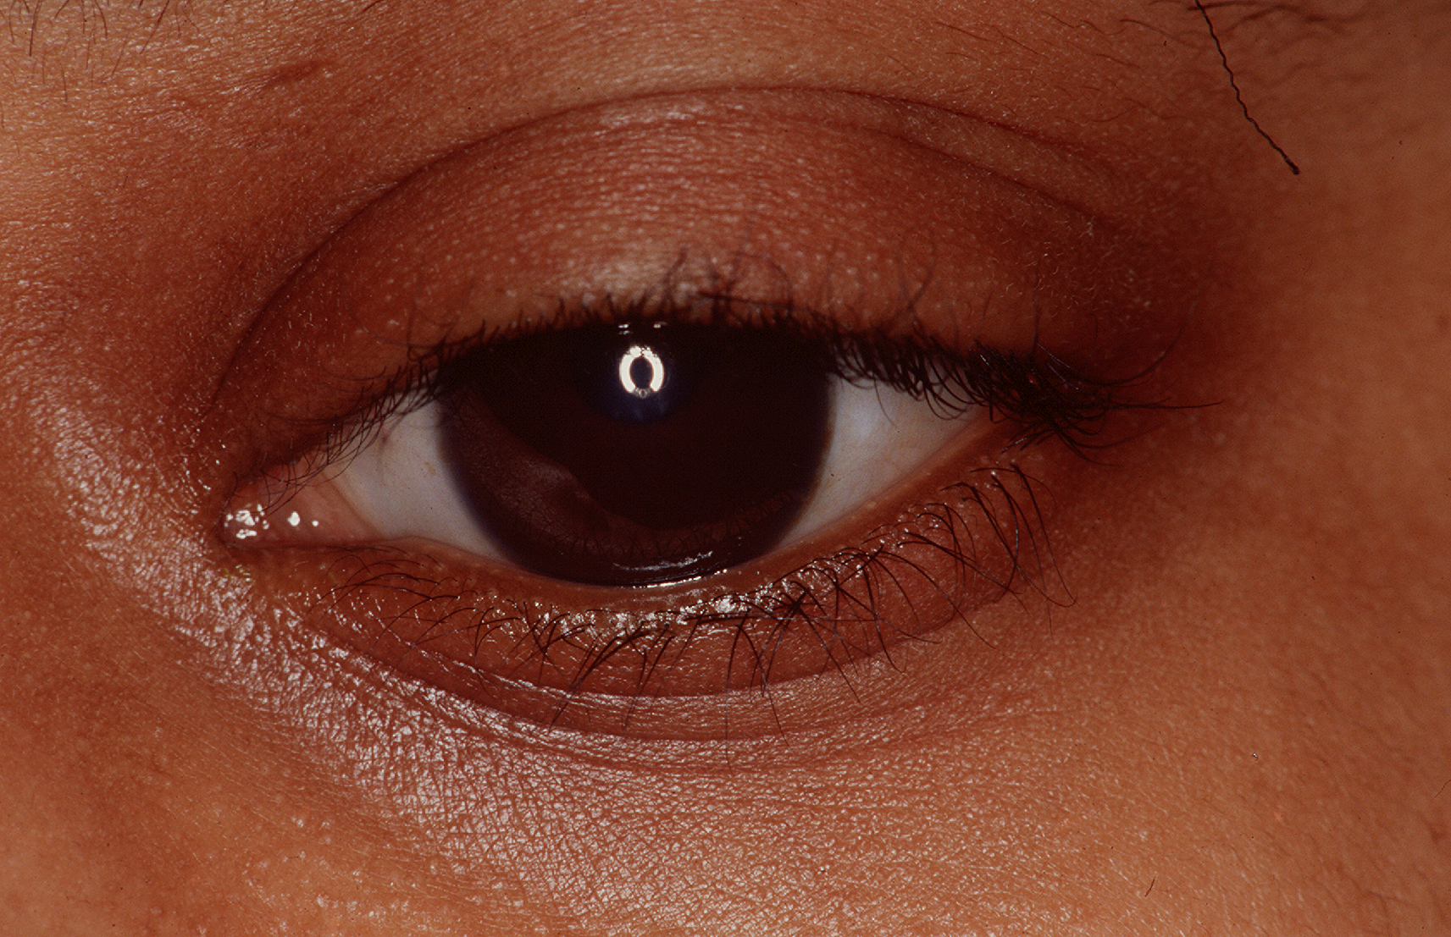

Slide 25
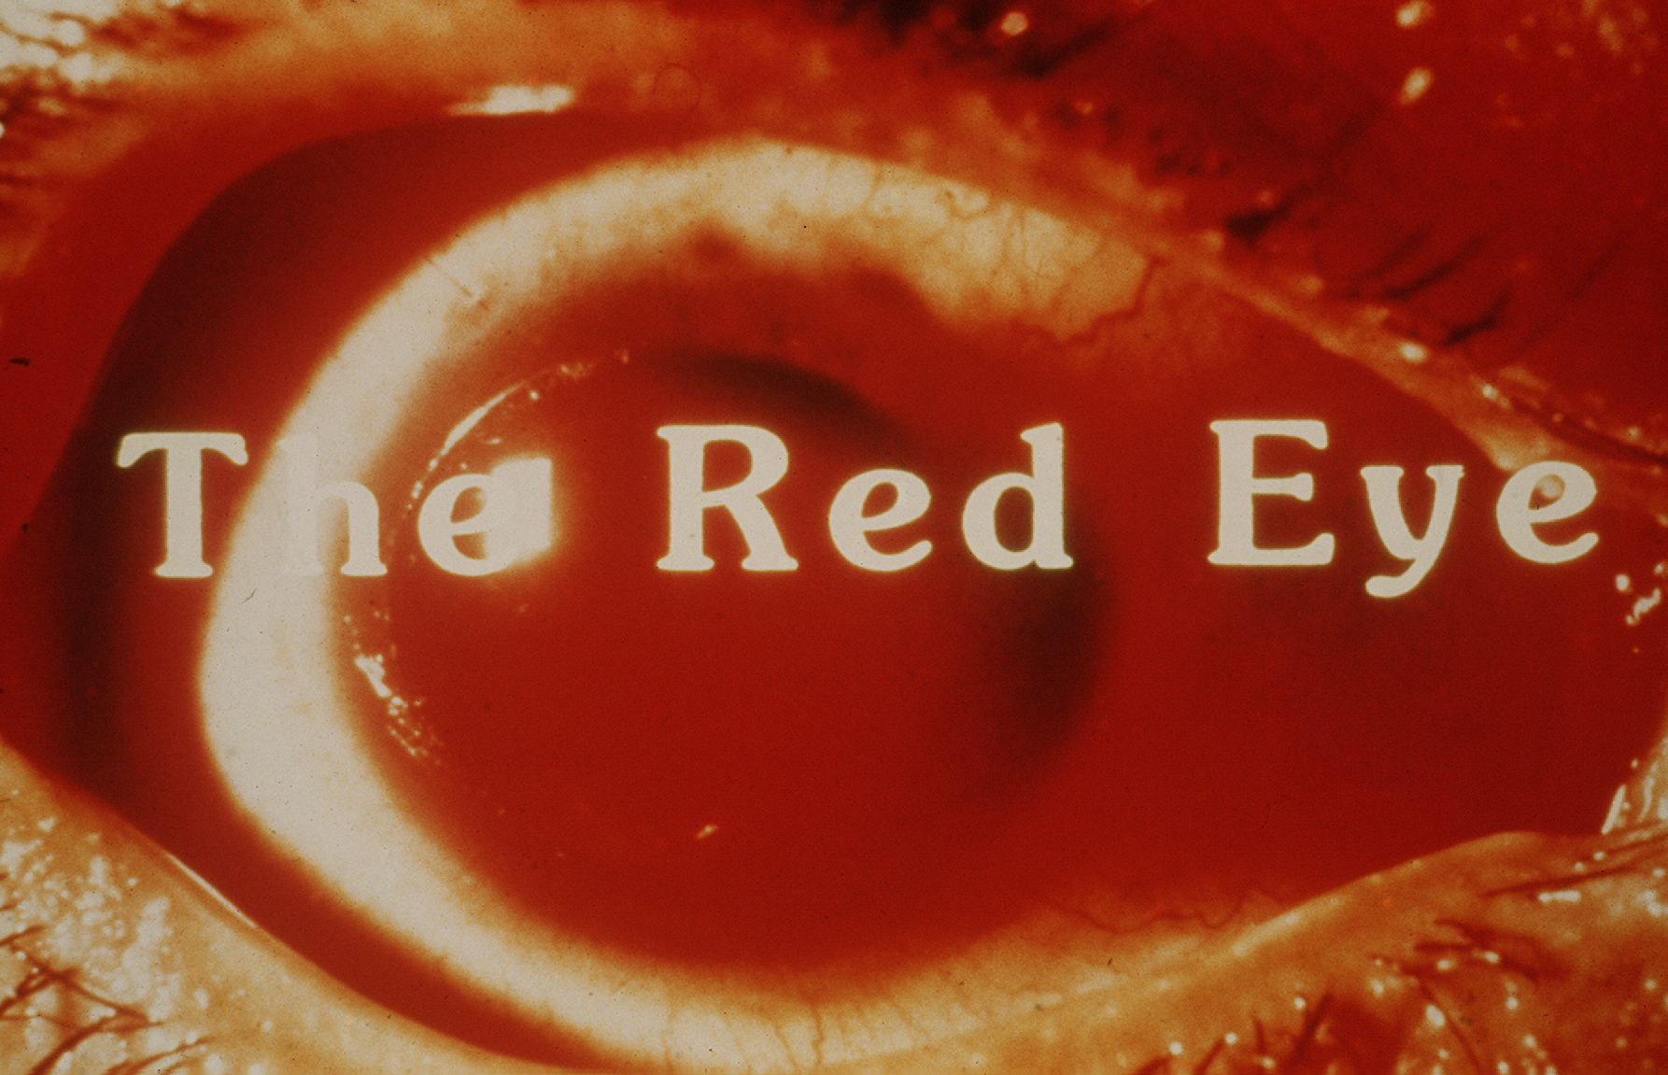

Slide 28
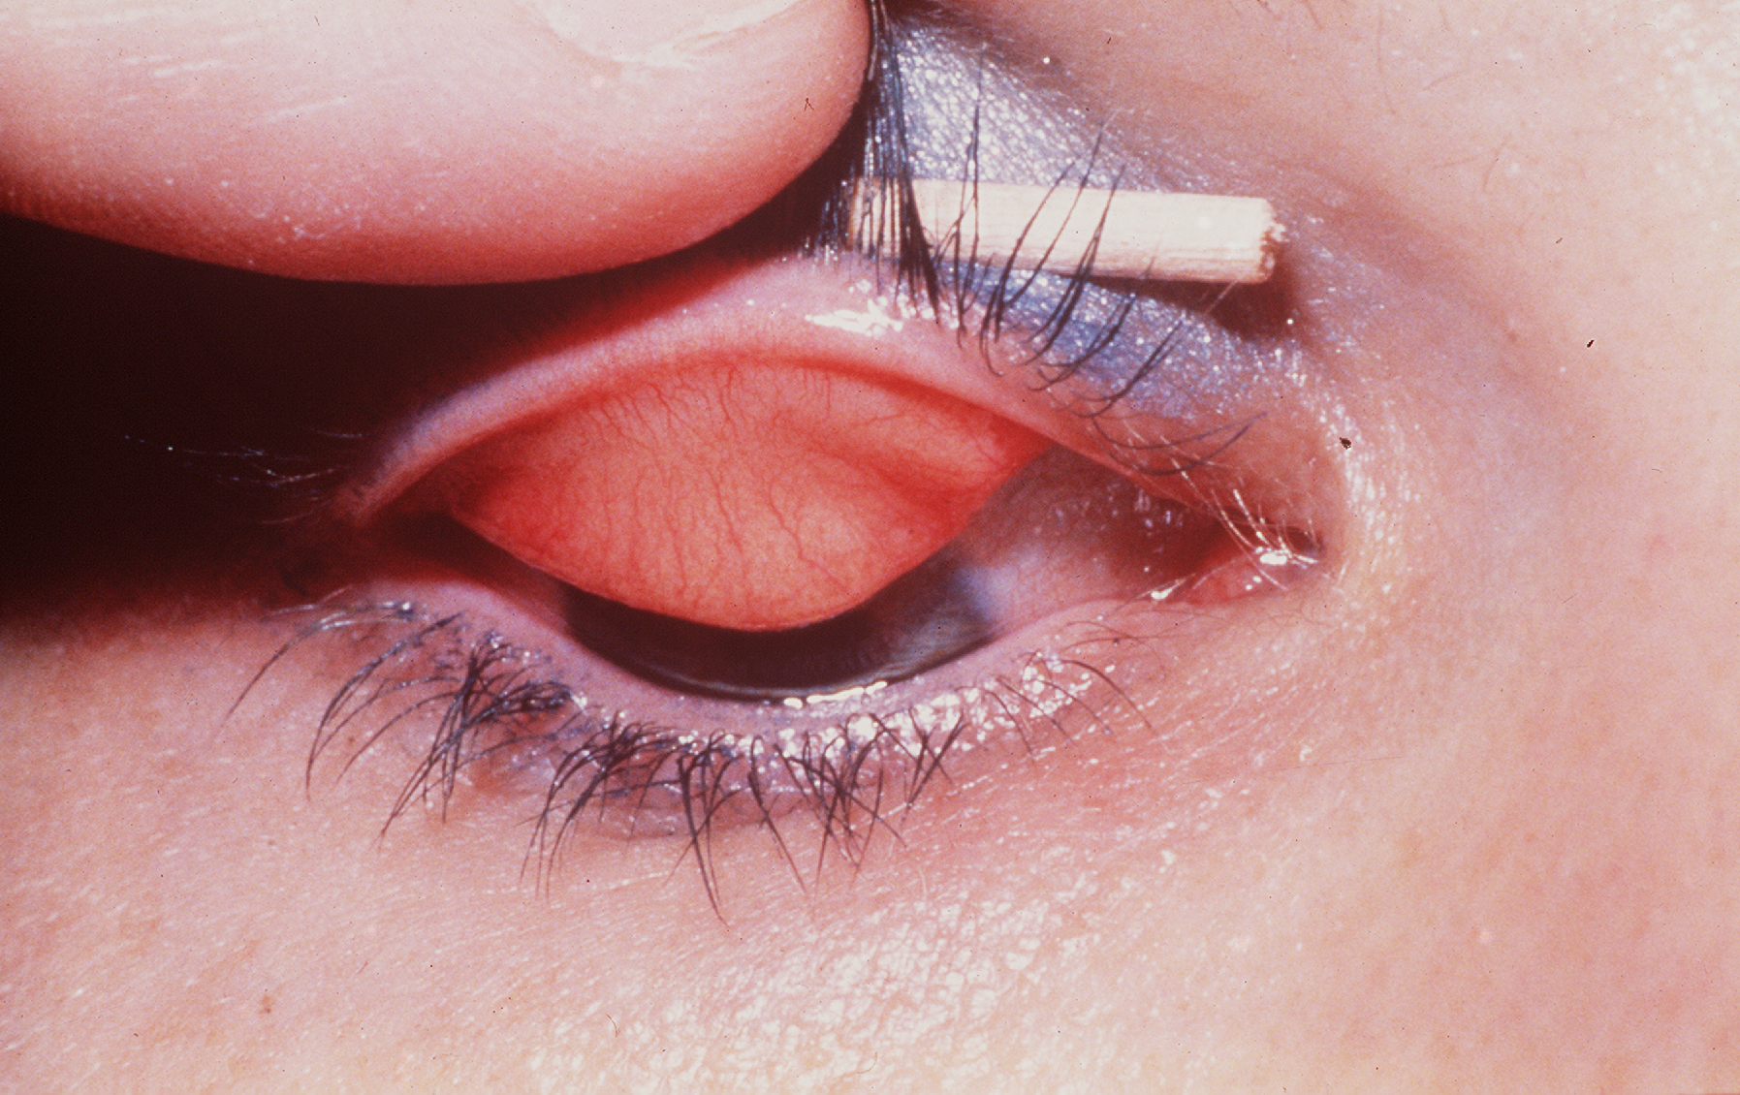

Slide 30
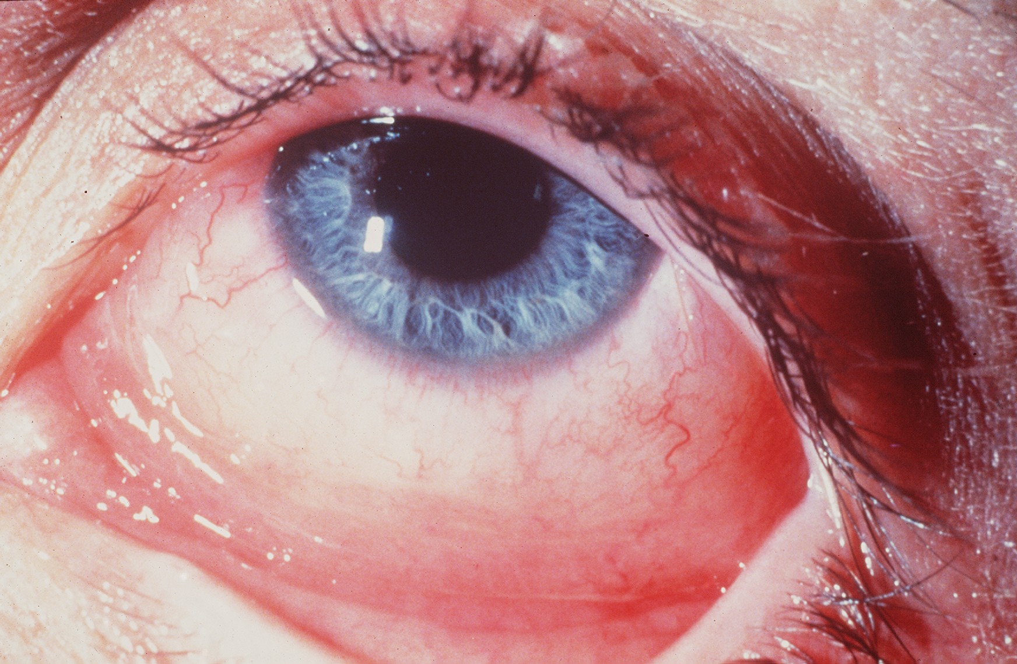

Slide 33
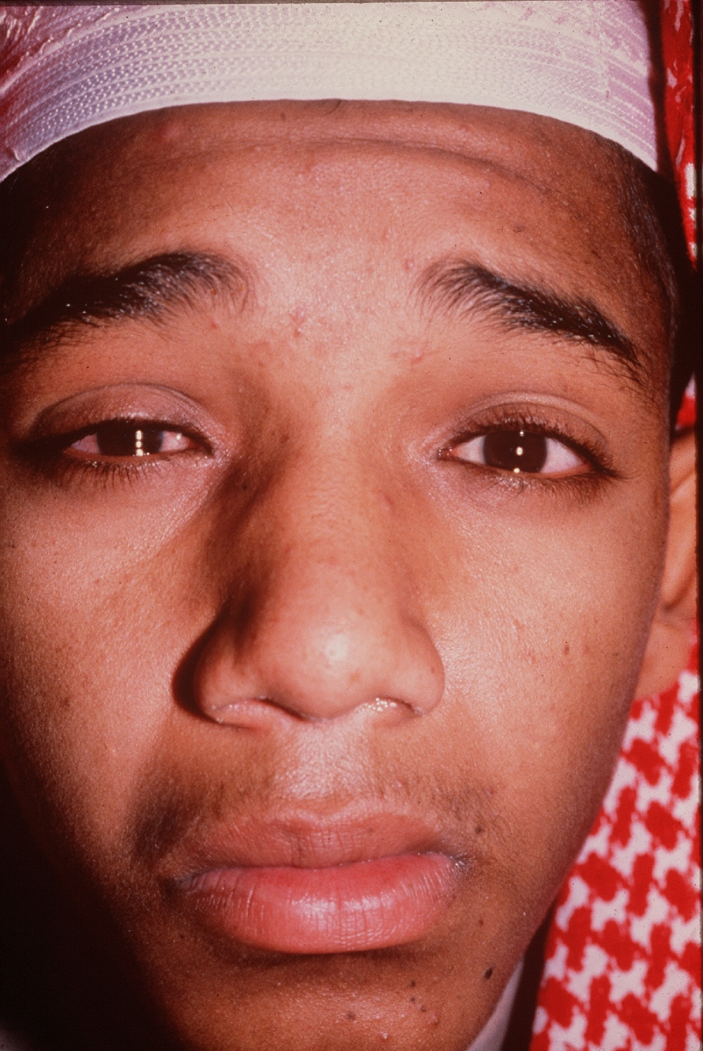

Slide 34
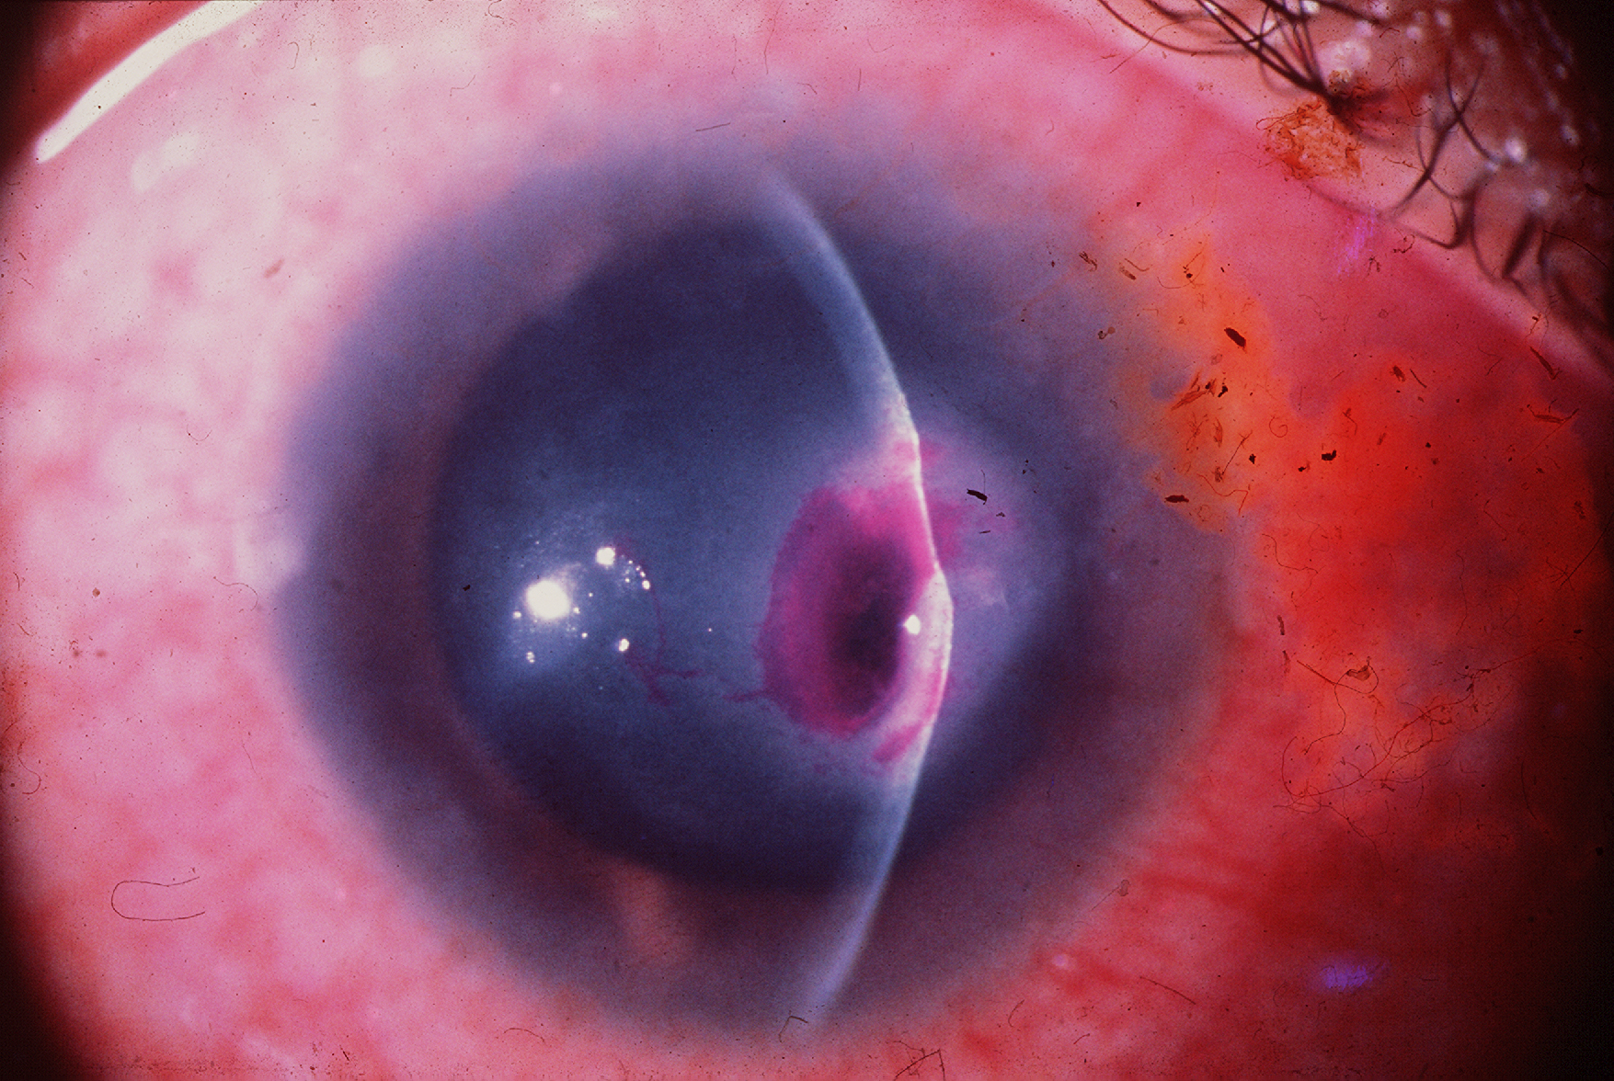

Slide 35
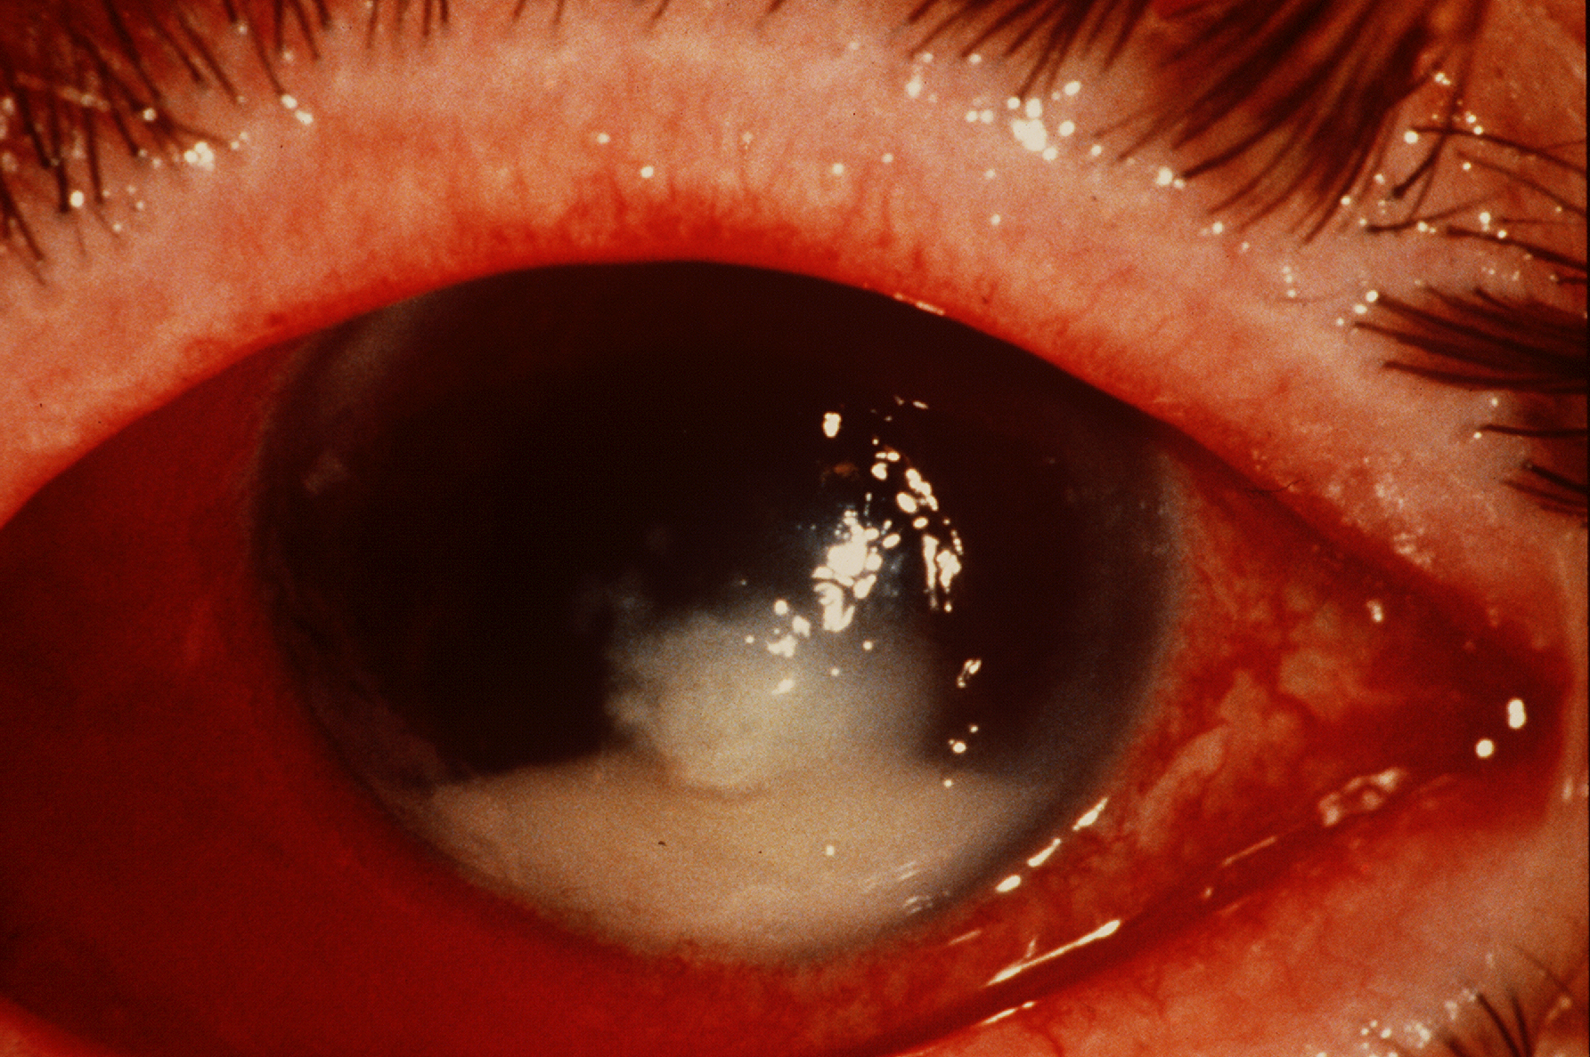

Slide 39
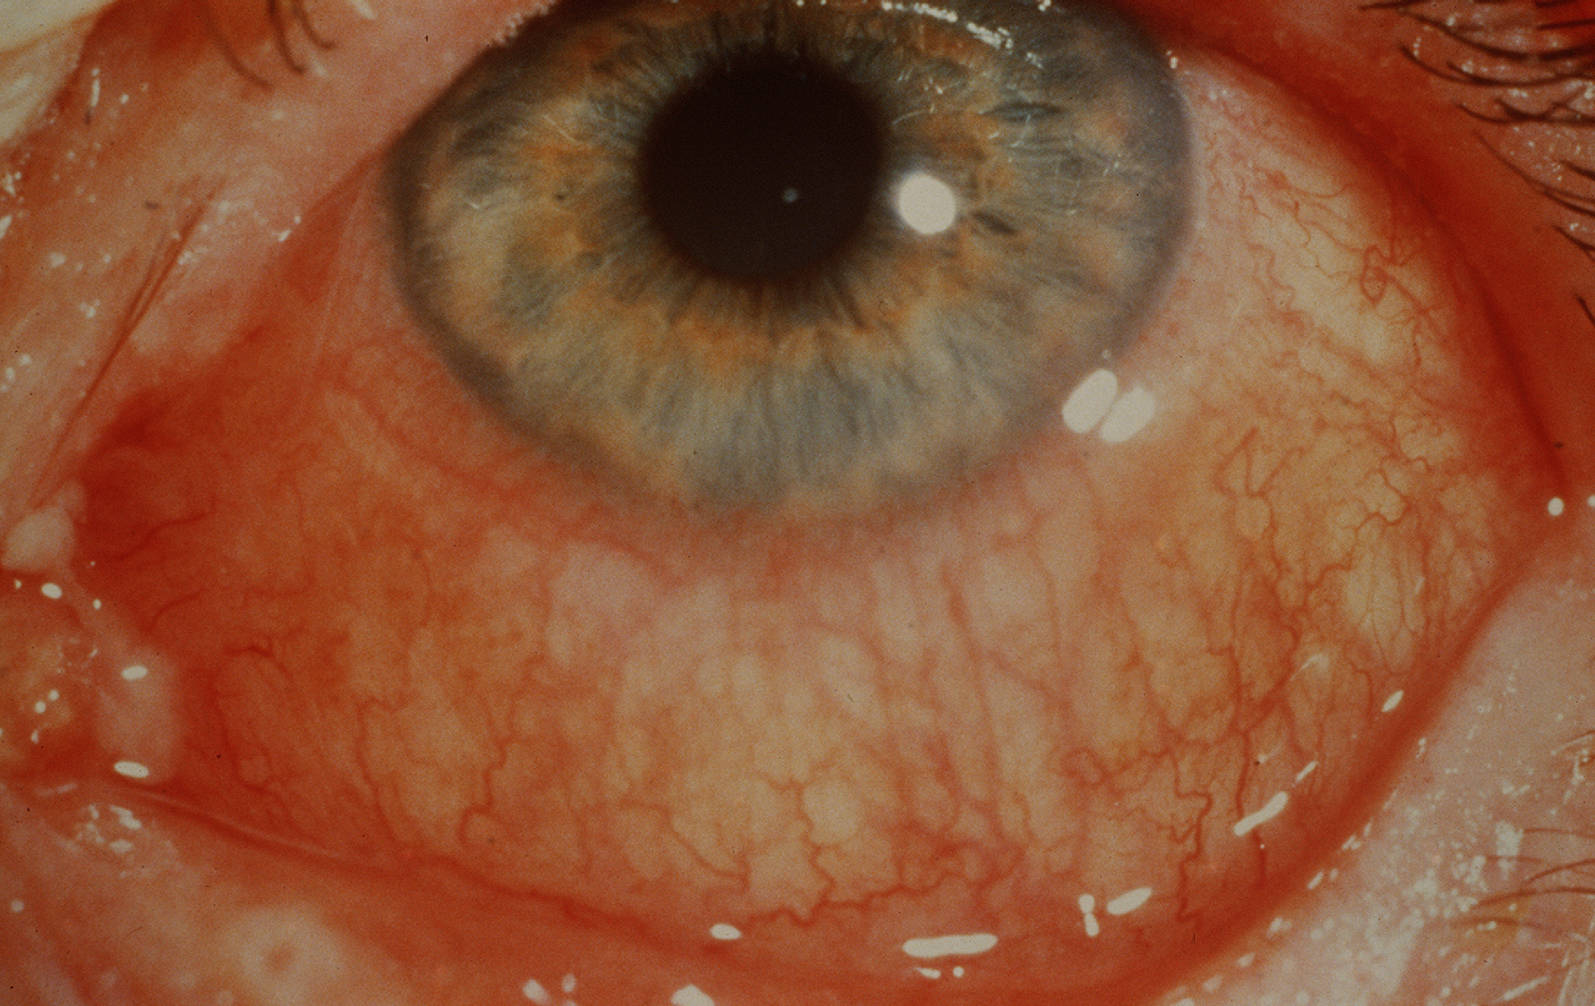

Slide 40
Any noxious agent to the eye can cause its redness
There are only four major serious causes :
1. Keratitis
2. Iritis
3. Acute Glaucoma
4.Conjunctivitis

Slide 41
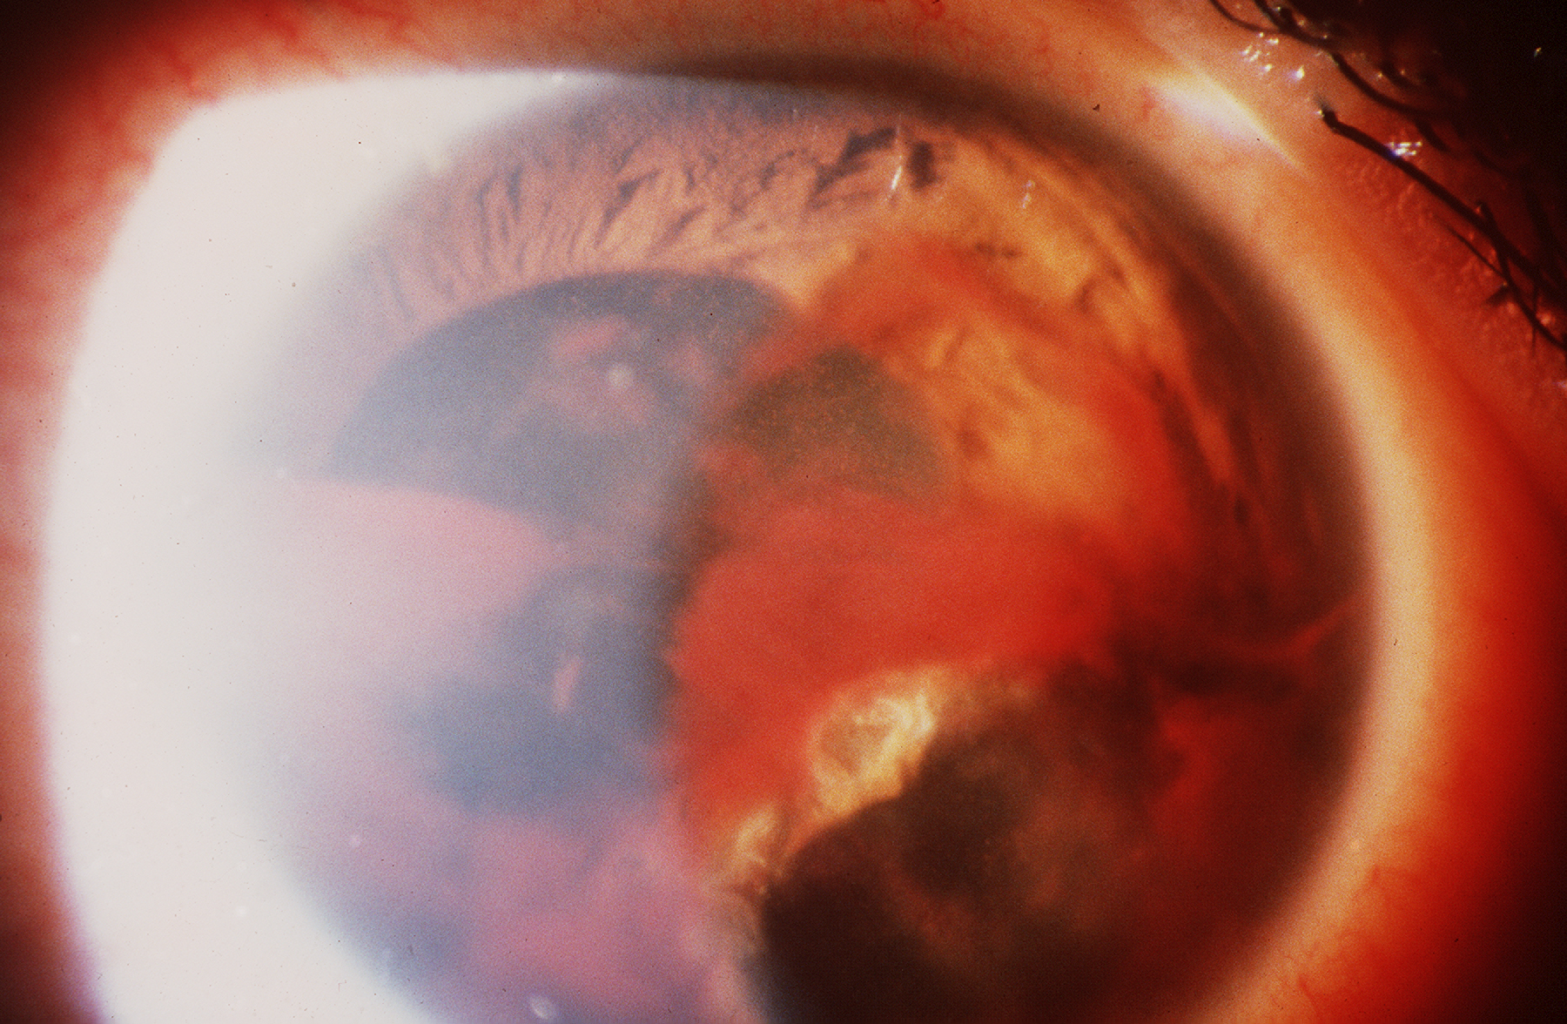

Slide 42
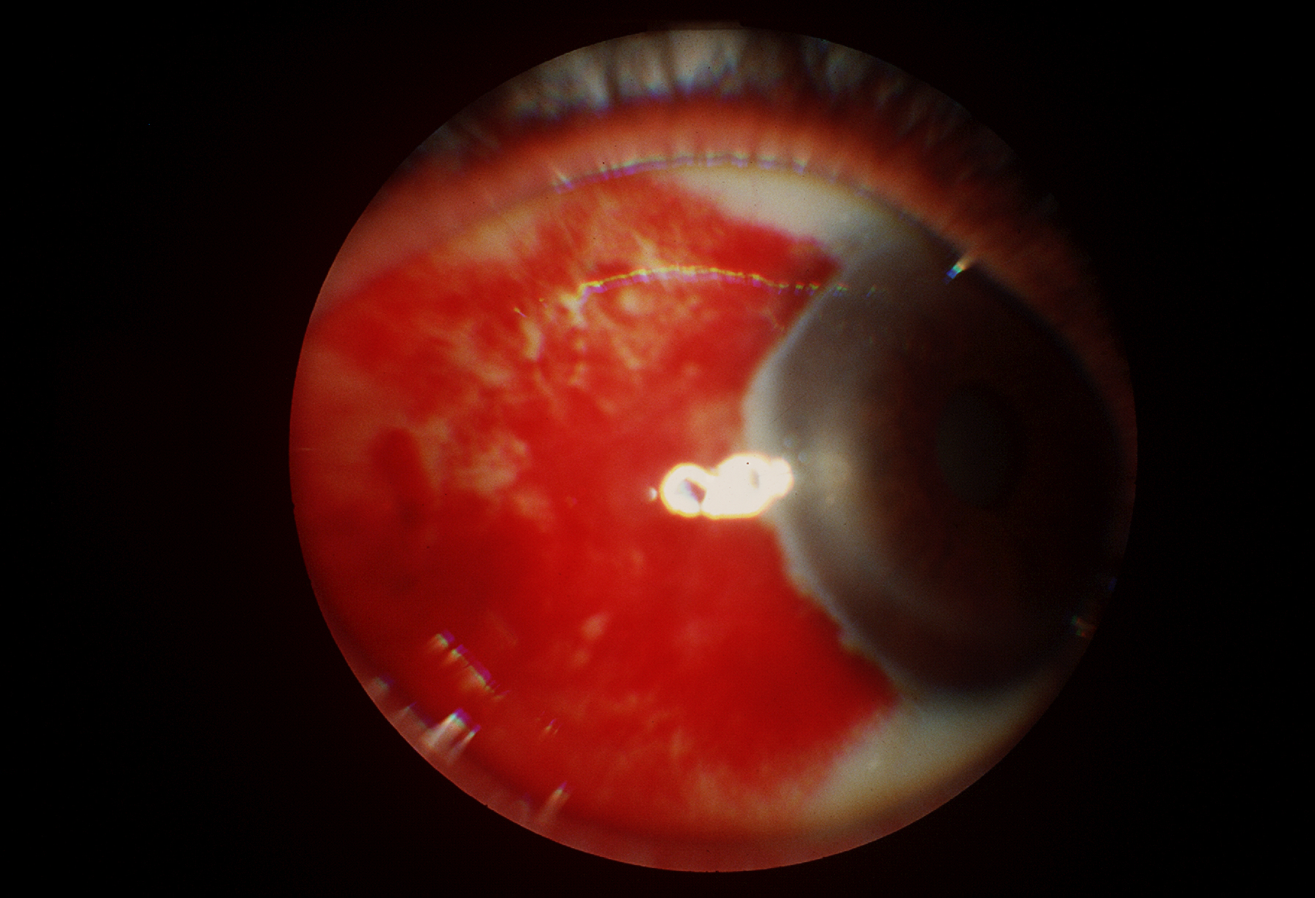

Slide 43
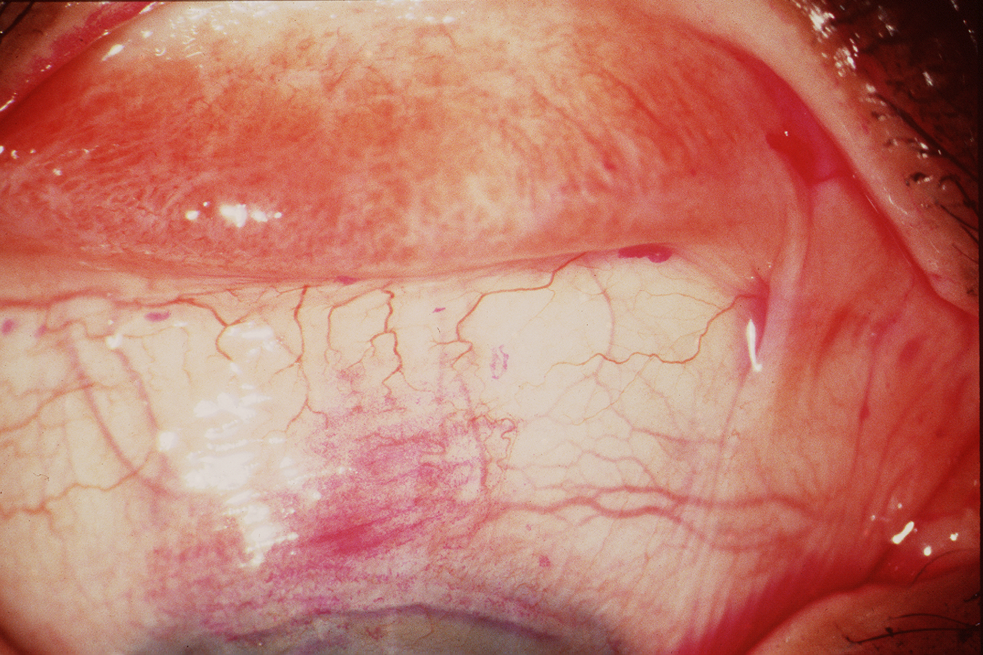

Slide 44
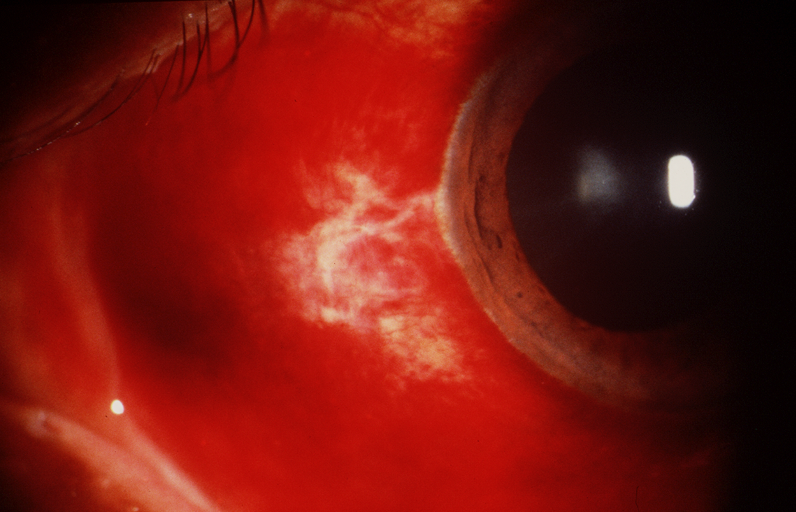

Slide 45
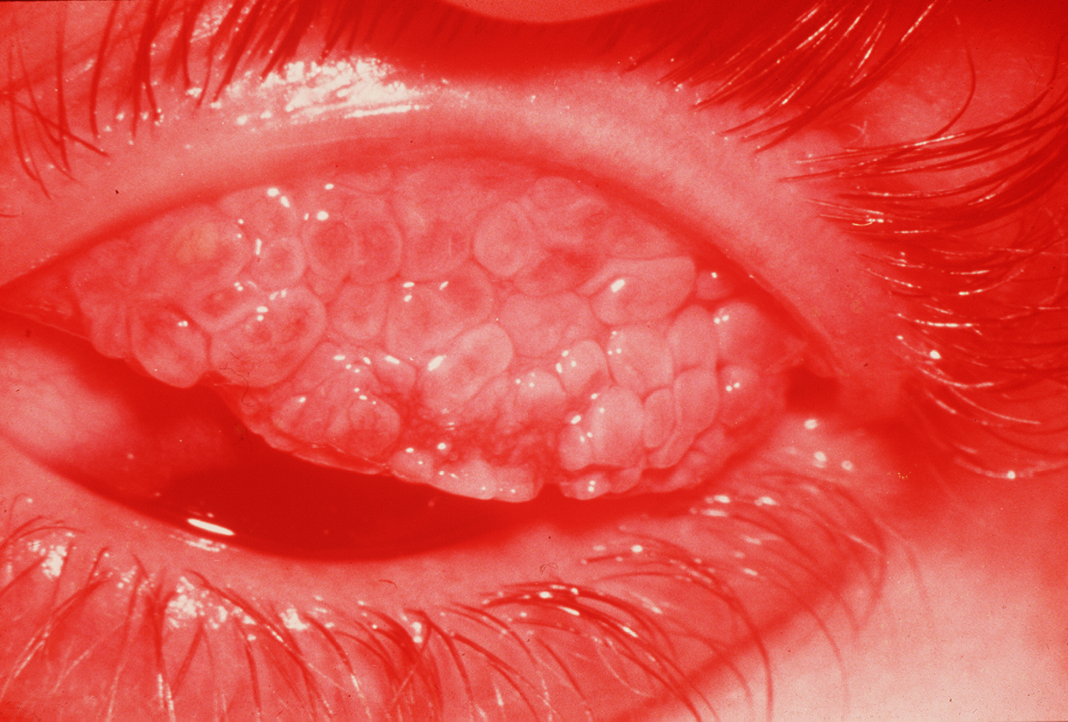

Slide 46
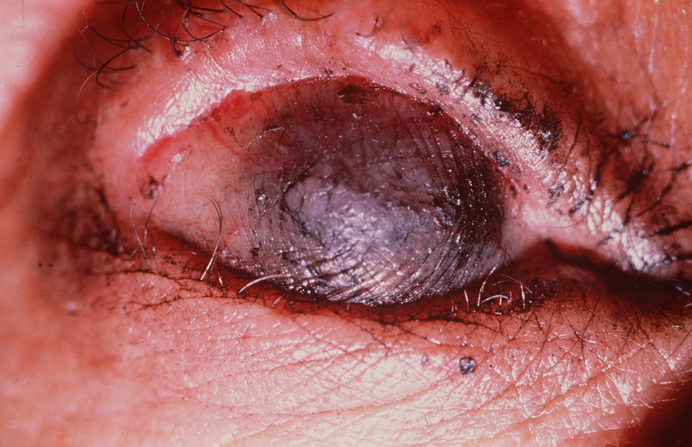

Slide 48
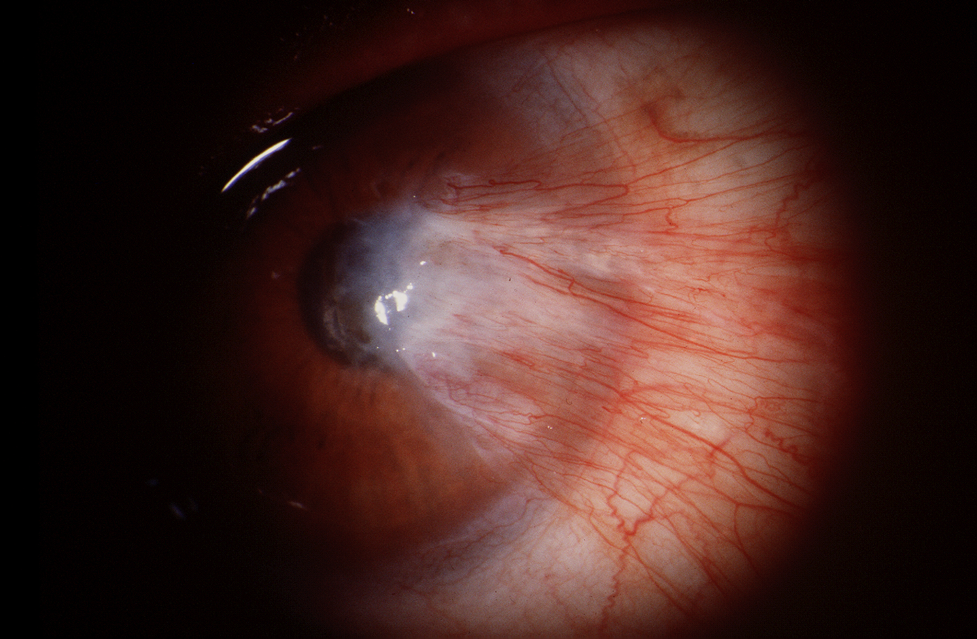

Slide 49
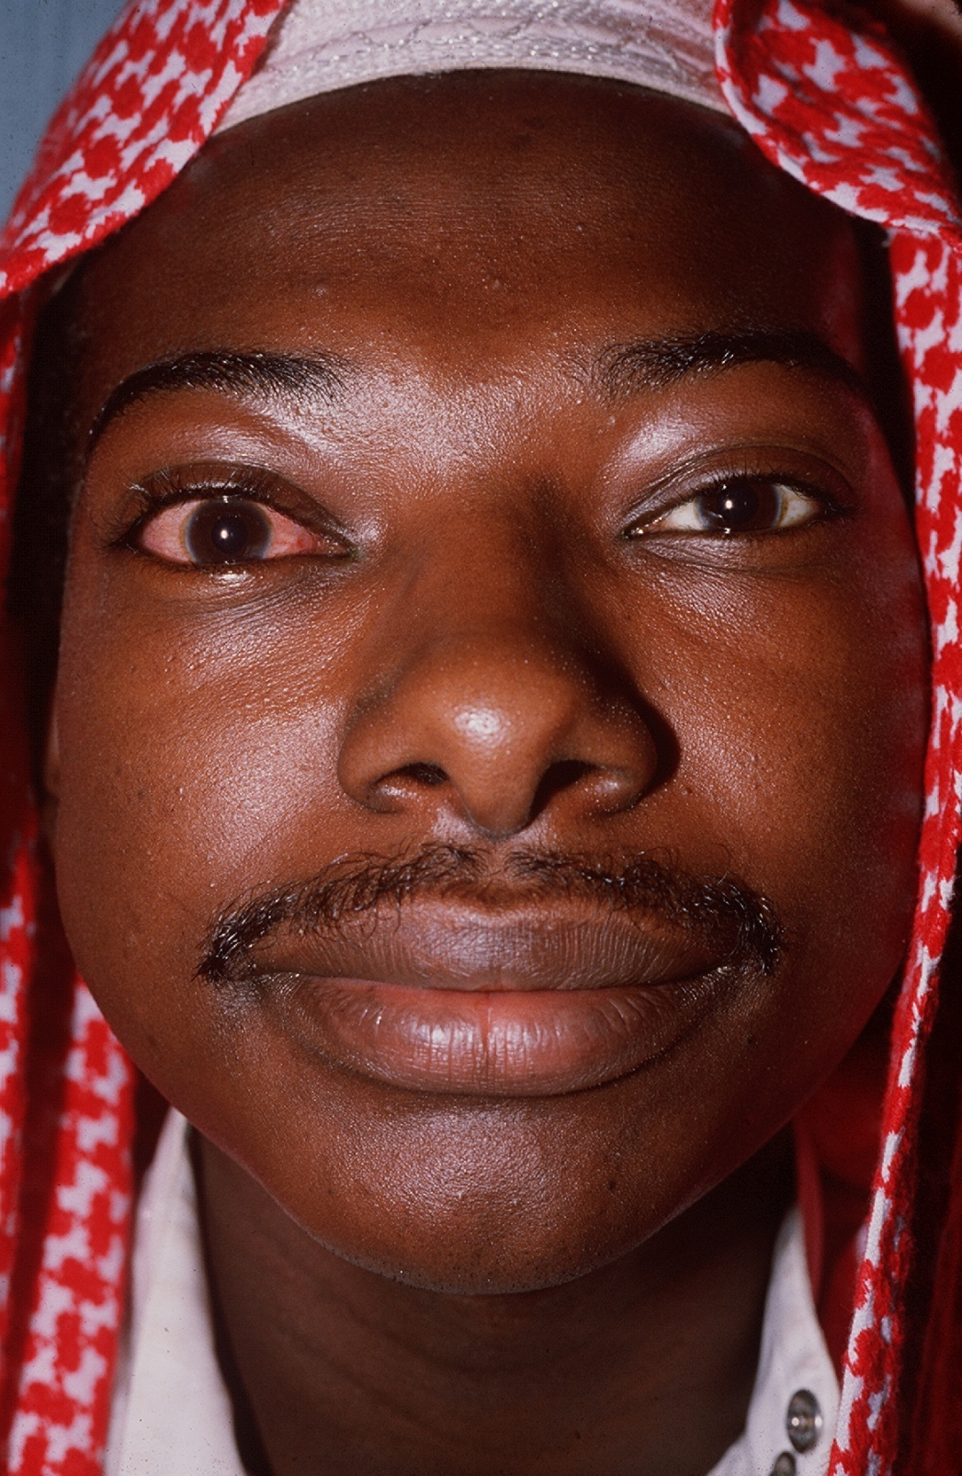

Slide 50
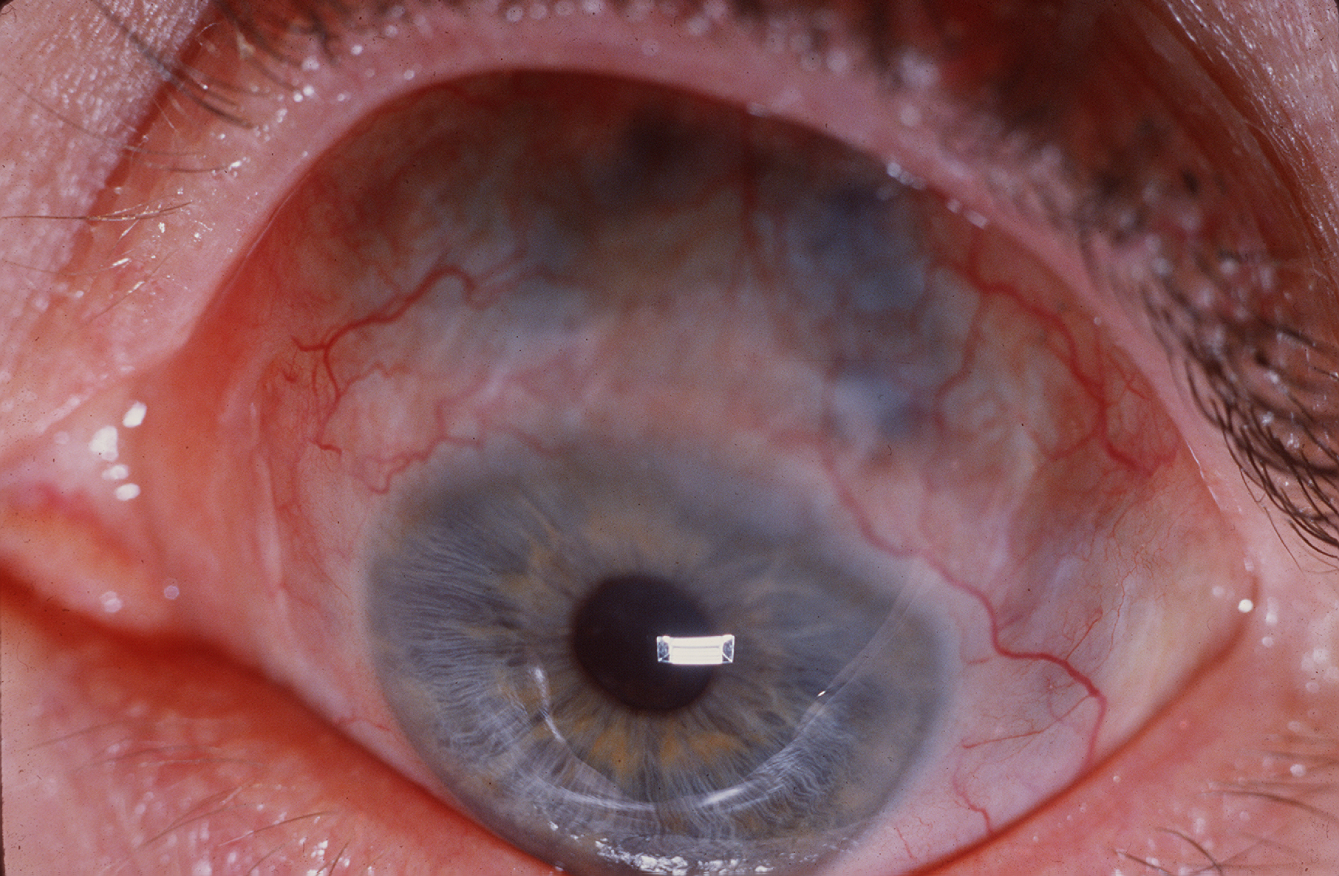

Slide 51
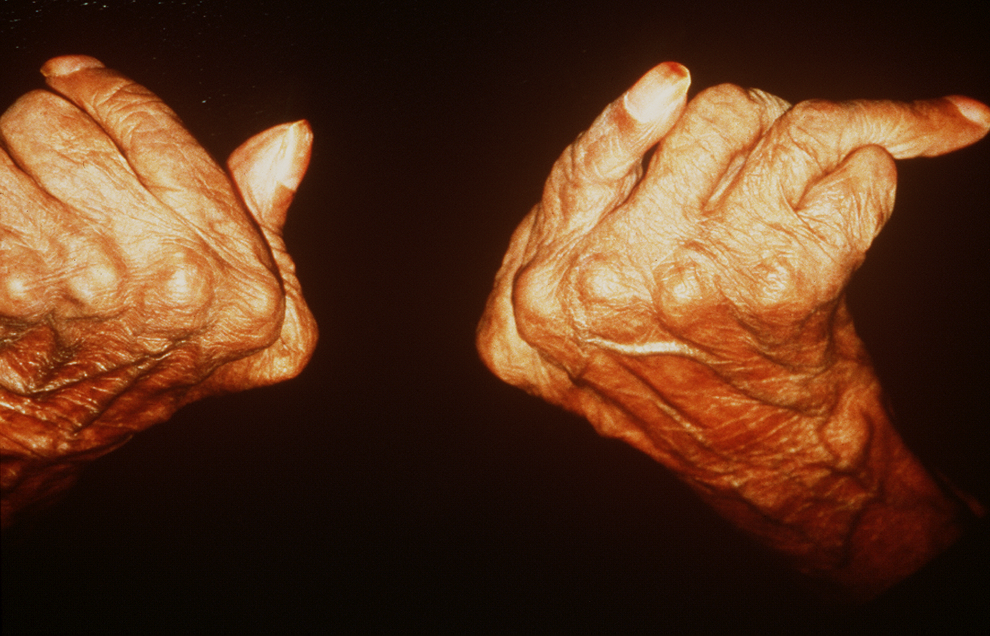

Slide 52
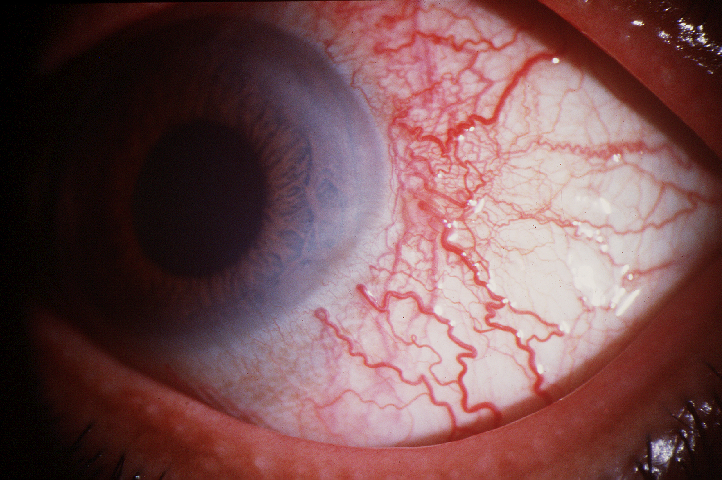

Slide 53
Thank you
for your attention
and
participation

Slide 54
