Slide 1
بسم الله الرحمن الرحيم

Slide 2
Basic anatomy and physiology
Dr. Abdullah Almousa M.D, FRCSC

Slide 3
Lecture Objectives..
Discuss embryology of the eye.
Explore anatomy of the orbit.
Explore anatomy and physiology of EOM.
Explore anatomy of the eyelid and conjunctiva.
Explore anatomy of the globe .
Explore anatomy of the visual pathway.
Understand the physiology of vision, accommodation, pupillary reflex and tear drainage.

Slide 4
Reference books..
Basic Ophthalmology (Cynthia Bradford)
Basic Ophthalmology
(Frank Berson)
General Ophthalmology
(Vaughan, Asbury and Tabbara)
Lecture notes in Ophthalmology (Bruce James, Chris Chew, Antony Bran)

Slide 5
EMBRYOLOGY OF THE EYE
This highly specialized sensory organ is derived from neural ectoderm, mesoderm and surface ectoderm.
The eye is essentially an outgrowth from the brain (neural ectoderm).
Start as the Optic vesicle connected to the forebrain by Optic stalk.
Notes:
The optic stalk later on forms the optic nerve

Slide 6
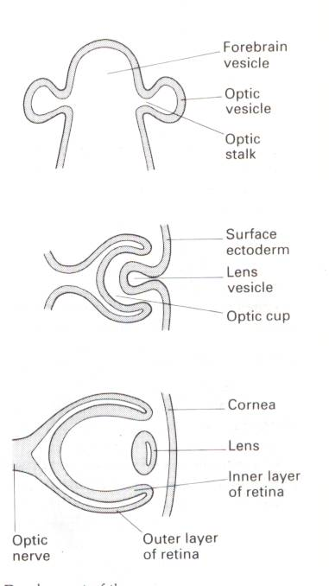
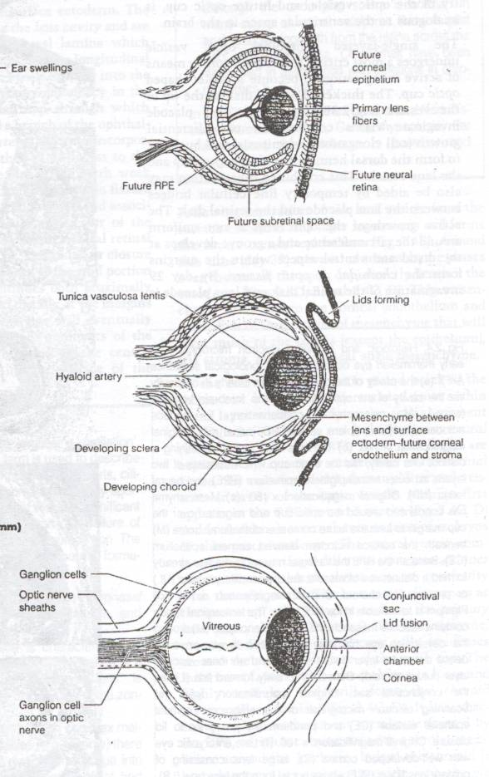
Notes:
So the eyes at first are formed laterally, then starts to go anteriorly.
Outer layer of the retina mainly gives the pigment layer. Inner layer of retina gives the other 9 layers of neurosensory layers (photoreceptors).
Between the outer and the inner retinal layers there is a potential space. That’s why detachment doesn’t occur there?

Slide 7
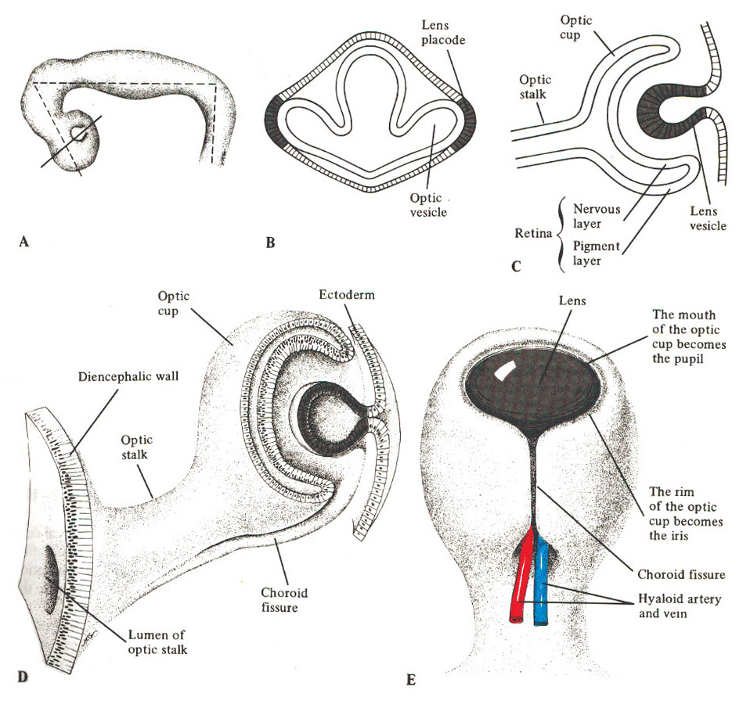

Slide 8
DEVELOPMENT OF THE EYE AFTER BIRTH
At birth, the eye is relatively large in relation to the rest of the body.
The eye reaches full size by the age of 8 years.
The lens continues to enlarge throughout life.
The iris has a bluish color due to little or no pigment on the anterior surface.
During early infant life, the cornea & sclera can be stretched by raised IOP → enlargement of the eye.
Notes:
The eyes continue to grow until the child reaches 8 years, at which it has reached its peak size (the eyes of an 8 year old is the same size as an adult eye).
The lens however, continues to grow throughout life. It grows by forming new epithelial cells (which are only found on the anterior surface of the lens), and pushing the old ones to the periphery of the lens, which then elongate and become fibrous, and start going towards the center (not anterior) of the lens and accumulate there, making the lens more dense, and leading to visual impairment (this happens normally with increasing age.
The iris usually grows as a circle and the two sides fuses inferomedially. If the iris didn’t fuse inferomedially, a coloboma will form.
https://www.google.com.sa/search?safe=strict&q=coloboma&oq=coloboma&gs_l=psy-ab.3..0l2j0i131k1l2j0l6.185992.186864.0.186990.8.6.0.0.0.0.210.210.2-1.1.0....0...1.1.64.psy-ab..7.1.210....0.vaAlV-q7NbM
While the eye are still growing (less than 8 years) any increase in the intra ocular pressure (IOP) may lead to increase in the eye size (leading to myopia). This is true in patients with congenital glaucoma. If there is a bilateral congenital glaucoma, the patient ,oght present late because there will be no difference in the eye sizes.
In pediatrics, having a large eye will lead to myopia (near sightedness) (the focus of the lights will be infront of the fovea, so the patient will see close objects clearly, but distant objects will be blurry). The large eye will basically have its fovea behind where it should normally be, and since the lens and the cornea are normal, they would focus the light on the position of the original eye (as if no enlargement happened), so the focus of light will be infront of the fovea, not on it, causing myopia.
Also in pediatrics, having a small eye will lead to hypermetropia, or far sightedness, for the same but opposite reason mentioned above (the eye is now smaller, so the focus done by the normal cornea and lens will put the focus behind the fovea, so the patient will only be able to see distant objects, not close ones).
Hypermetropia of up to 1.5 diopters in children is normal.

Slide 9
ORBIT

Slide 11
THE ORBIT
As a socket, contains & protect the eye.
The weakest parts are the floor & the medial wall.
Seven bones contribute the bony orbit.
Surrounded by nasal sinuses.
Important openings are:
Optic foramen.
Superior orbital fissure.
Inferior orbital fissure.
Notes:
The periosteum of the orbital bones forms a periosteal curtain that holds the eye in its position with the help of EOM (extra ocular muscles) and the skin. It also prevents infections.
The orbit is made up of 7 bones:
Frontal bone 2. maxillary bone 3. zygomatic bone 4. ethmoid bone (medial) 5. palatine bone
Lacremal bone 7. greater wing of sphenoid bone (lateral)
Optic foramen contains the optic nerve and ophthalmic artery only.
Inferior orbital fissure contains the zygomatic branch of the maxillary nerve (trigeminal V2 nerve) and the Inferior division of ophthalmic vein.
All other contents of the eye pass through the superior orbital fissure.
Eye infections can spread to the veins and go through the cavernous sinus to the brain. The septum is important to protect other structures and the eye. Infections behind the septum is more serious

Slide 13
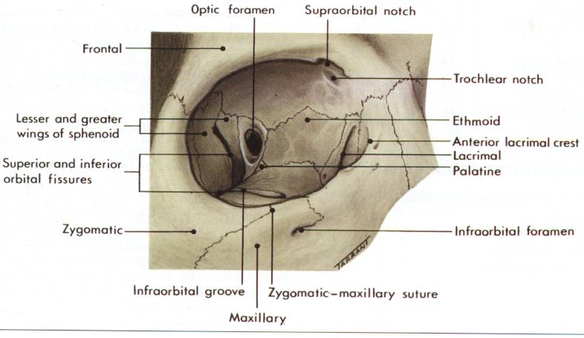
Right Orbit
Notes:
The orbit is made up of 7 bones:
Frontal bone 2. maxillary bone 3. zygomatic bone 4. ethmoid bone (medial) 5. palatine bone
Lacremal bone 7. greater wing of sphenoid bone (lateral)

Slide 14
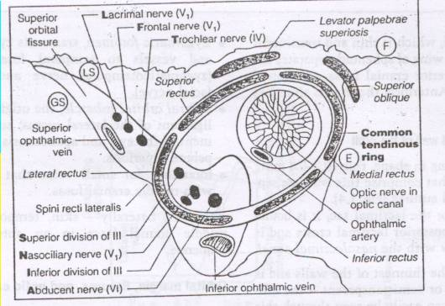

Slide 15
Notes:
The medial side of the orbit is straight and contains the optic nerve.
The lateral side of the orbit is curved.

Slide 16
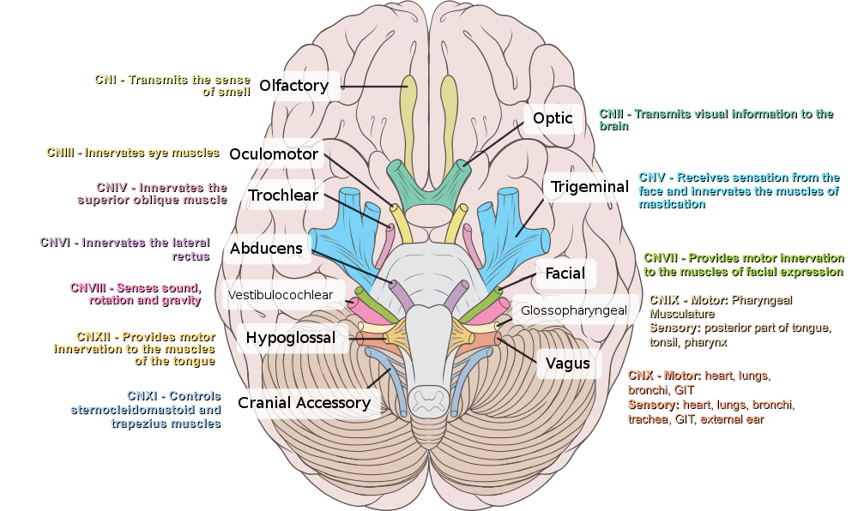

Slide 17
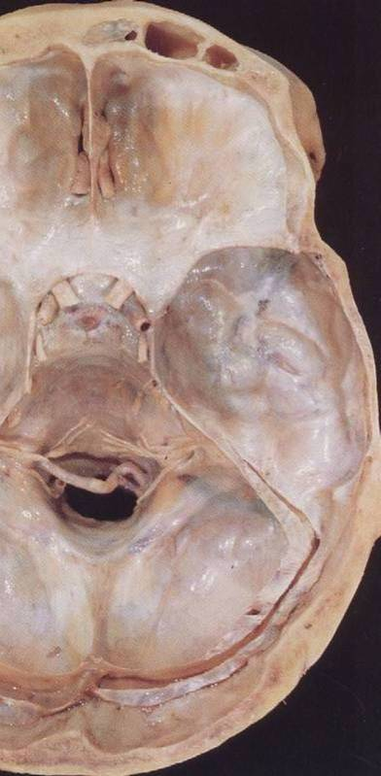
Notes:
Here we see the cella turcica, the area which contains the pituitary gland and the optic chiasm. Any adenoma or tumor on the pituitary might present with bilateral hemianopia

Slide 18
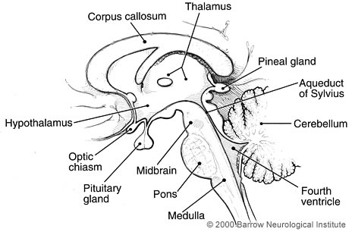

Slide 19
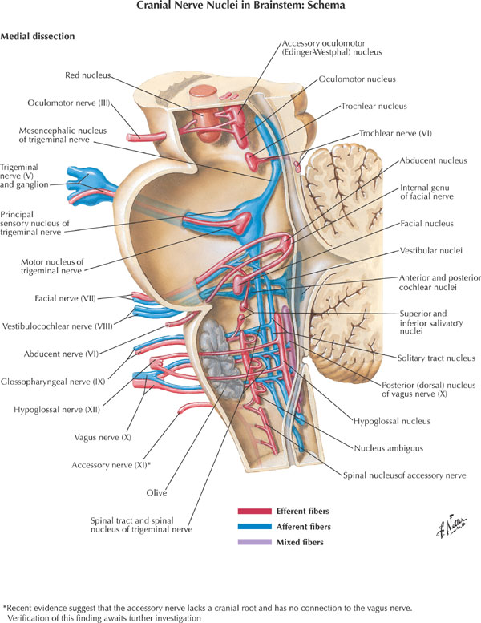

Slide 21
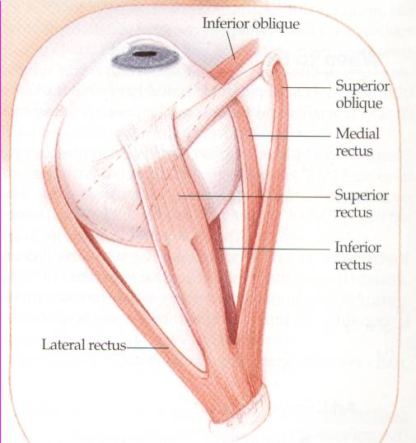
THE EXTRAOCULAR MUSCLES
Four recti & two oblique muscles.
All are supplied by Oculomotor n. except superior oblique (Trochlear n.) & lateral rectus (Abducent n.).
Notes:
LR6 SO4
Lateral Rectus 6 (abducent), Superior oblique 4 (trochlear)
Fun fact: trochlear nerve is called trochlear because the superior oblique looks like a hook. It hooks to something above the eye, then attaches to the eye and causes downward movement of the eyes when medial. It is the muscle of reading.

Slide 22
Attachment of eye muscles:
IO
IR
Notes:
IO: inferior oblique (makes eye look upwards and medially.
IR: inferior rectus (makes eye look inferiorly)

Slide 23
Attachment of eye muscles:
SO
4th n.
IO
SR
IR
MR
LR
6th n.
Notes:
SO: Superior oblique (trochlear)
SR: Superior rectus
MR: medial rectus

Slide 24
Innervation & action of eye muscles:
elevation
extorsion
intorsion
abduction (lateral rotation)
adduction (medial rotation)
midline
depression
Notes:
Intorsion and extorsion is used to stabilize the image in our minds when we tilt our heads to the right or left. The main function of the obliques is to do intorsion and extortion.
All superior muscles (Superior rectus and superior oblique) cause intorsion
All inferior muscles (inferior rectus and inferior oblique) causes extorsion
No role for medial and lateral recti here.

Slide 25
Hence for clinical test :
Direction to look
SO Down and in
IO Up and in
SR Up and out
IR Down and out
[R=O, O=I]
Notes:
SO looks down WHEN in (looking medially) (the superior oblique works alone when the eye is looking medially. This is because when the eye is looking medially ,the axis of the eye will be perpendicular to superior oblique.
So the obliques mostly work ALONE when we are looking medially. The recti mostly work ALONE when we are looking laterally. So if we want to test individual muscles, we should keep this in mind. (if we want to test the superior oblique, we ask the patient to look medially and inferiorly. This will ensure that only the superior oblique is causing the downward looking, with no help from inferior rectus).
If you’re looking medially, the obliques will work alone. If you are looking laterally, the recti will work alone.
Please note that the superior oblique doesn’t cause the medial looking, instead the medial rectus does that.

Slide 26
THE EYELIDS
They provide a protective covering for the eye.
The lids are closed by Orbicularis oculi muscle (Facial n.) and opened with Levator palpebrae muscle (Oculomotor n.), Muller’s muscle (Sympathetic supply) & Lower lid retractors.
Notes:
Muller’s muscle gives us the 2 mm opening of the eye lids when there is an emotional distress, so it is affected by the sympathetic nervous system.
The thyroid (graves disease) acts on the muller’s muscles to cause exophthalmous and lid retraction
Lagophthalmos is defined as the inability to close the eyelids completely

Slide 27
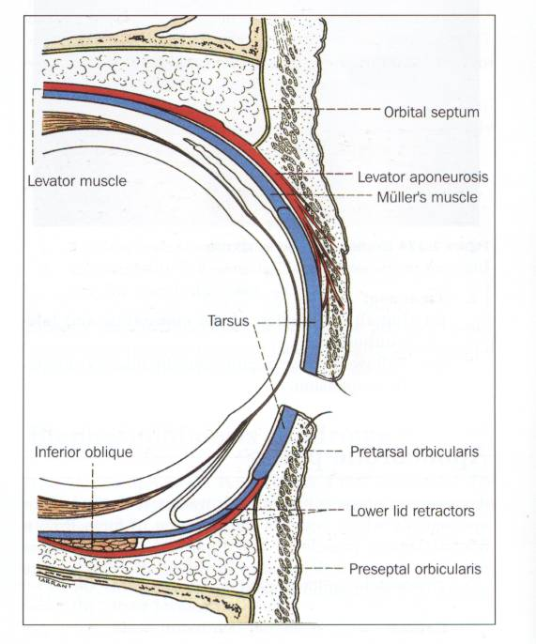
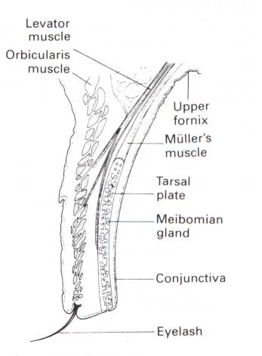
Notes:
The normal direction of the eye lashes is anterio inferior.
Trichiasis is a common eyelid abnormality in which the eyelashes are misdirected and grow inwards toward the eye. Usually happens due to trauma to the conjunctiva. The inward direction of the lashes might lead to infections.
To remove a foreign object inside the eye lids, ask the patient to look down (not close eyes) because this will relax the levator palpebrea, then hold the end of the eye lashes and fold the eyelid. This is possible only if the patient looks downwards.

Slide 28
CONJUNCTIVA
Three parts:
Bulbar conjunctiva.
Palpebral conjunctiva.
Forniceal conjunctiva.
The stroma (no adenoid tissues until 3 months after birth).
Follicles & Papillae.
Injection and chemosis.
Limbus.
Notes:
The corneal limbus is the border of the cornea and the sclera (the white of the eye).
Limbus is the junction between conjunctiva and cornea. Limbus has stemm cells, so it is important in healing and surgery.

Slide 29
Notes:
The red eye is caused by the conjunctiva (which is highly vascular) when its vessels gets congested.

Slide 30
Notes:
To remove a foreign object inside the eye lids, ask the patient to look down (not close eyes) because this will relax the levator palpebrea, then hold the end of the eye lashes and fold the eyelid. This is possible only if the patient looks downwards.

Slide 31
THE LACRIMAL APPARATUS
Lacrimal gland secrets tears into the upper fornix of the conjunctival sac which are spread over the surface of the cornea as a tear film by blinking of the lids.
Tears accumulate at the inner canthus and drain into the lacrimal sac via the puncta & canaliculi.
The sac is continuous inferiorly with the nasolacrimal duct which opens into the nasal cavity just beneath the inferior turbinate.
Notes:
The lacremal glands are situated superiolaterally to the eye. It produces tears, and the tears are secreted whenever we blink because when we blonk we basically squeeze the lacremal gland. Blinking also pushed the tears towards the lacremal duct.
The tears drain to the inner canthus (lacremal duct), which is inferomedially located (opposite to lacremal gland).
Tears move from the inner canthus to the puncta and canaliculi, then drain to the lacrimal sac, then go to the nasolacrimal duct to open in the nasal cavity beneath the inferior tubinate

Slide 34
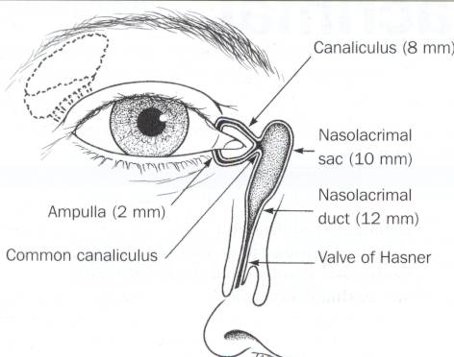
Notes:
The tears drain to the inner canthus, which is inferomedially located (opposite to lacremal gland).
Tears move from the inner canthus to the puncta and canaliculi, then drain to the lacrimal sac, then go to the nasolacrimal duct to open in the nasal cavity beneath the inferior tubinate

Slide 35
THE EYE (GLOBE)
Two spheres with different radii:
- Cornea, window of the eye.
- Sclera, opaque shell.
*** The eye measures approximately 24 mm in all its main diameters.

Slide 36
The coats of the eye
*** Three layers:
The outer: inelastic coat, transparent cornea and opaque sclera.
The middle: vascular coat, The Uvea:
choroid, ciliary body and iris.
The inner: The Retina, extends forwards to within 6 mm of the limbus.
Notes:
Choroid has lots of melanin pigment to prevent light scattering.

Slide 37
Notes:
The fovea is responsible for sharp vision (center of the visual field). It is tested by visual acuity.
Visual field tested by looking straight and asking how many fingers am I holding on the prefery

Slide 38
The Chambers of The Eye
***Three optically clear spaces:
The anterior chamber, in front of the iris
The posterior chamber, immediately behind the iris. These two chambers which communicate through the pupil are filled with clear aqueous humour.
The vitreous cavity: filled by gel-like structure, The Vitreous.
Notes:
The clear aqueous humour provides nutrition for the structures in the anterior and posterior chambers, since they are avascular (cornea and lens).
10-21 mmHg is the normal ocular pressure. Any increase in this pressure leads to glaucoma. There are two types of glaucoma: open and closes angle. Open angle is treated medically, while closed angle is treated surgically.
http://www.glaucoma.org/glaucoma/types-of-glaucoma.php

Slide 39
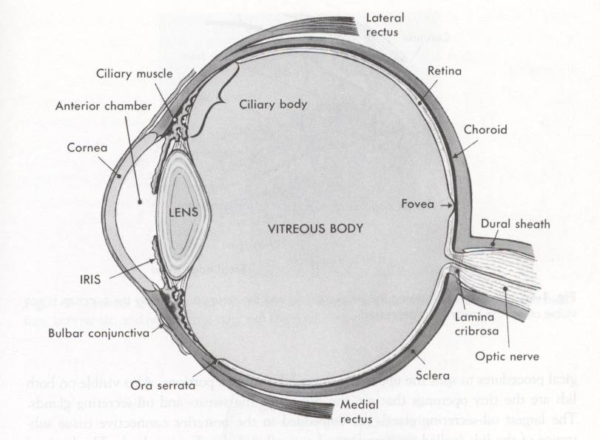

Slide 40
The Lens
The crystalline lens is the only structure continuously growing throughout the life.
Changeable refractive media.
Capsule, epithelium and lens fibers.
Congenital anomalies and effect of systemic diseases.
Cataract.
Notes:
The lens has 1/3 of the refractive power of the eye. 2/3 are for the cornea.
In humans, the total optical power of the relaxed eyeis approximately 60 dioptres. The cornea accounts for approximately two-thirds of this refractive power(about 40 dioptres) and the crystalline lens contributes the remaining one-third (about 20 dioptres).
The pathway in front of the fovea needs to be clear from any objects for the vision to be clear. Cataracts cause water to develop in the lens, so view will be blurred. Cataracts can happen anywhere in the lens.

Slide 41
Notes:
The lens has the ability to accommodate. It is connected to the ciliary bodies by tendons.
When the ciliary body contracts, the tendons relax (ciliary body gets closer to the lens, so distance of tendon decreases so it relaxes), and there will be increased curvature of the lens which will lead to more refraction (close objects)
When the ciliary body relaxes, the tendons contract (ciliary body gets away from the lens. So distance of tendon increases so it is stretched), and there will be a decreased curvature of the lens (far objects(

Slide 42
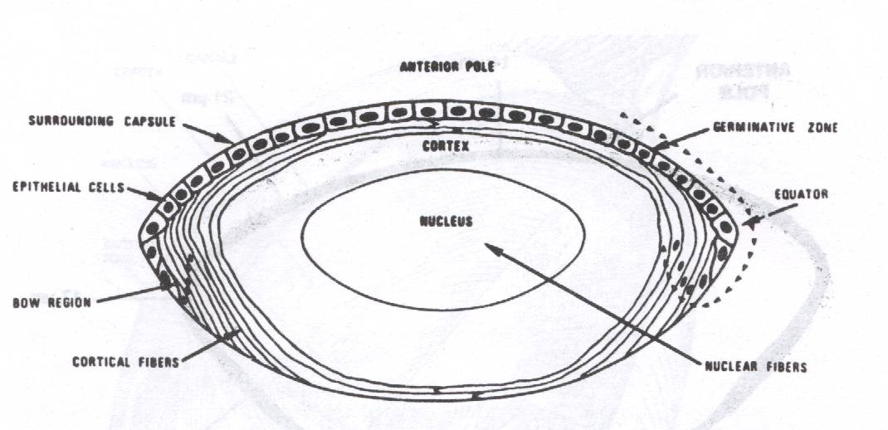
Notes:
The lens has anterior epithelial cells only which are renewed a lot. The old epithelial cells are pushed laterally, then becomes fibrous and elongated. This is the lens growth, and it grows in density rather than in size. This causes the visual impairment in old patients.

Slide 43
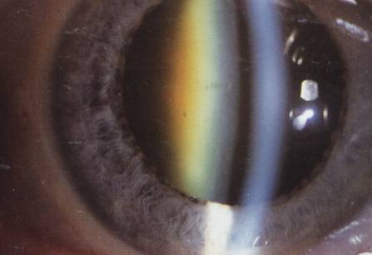
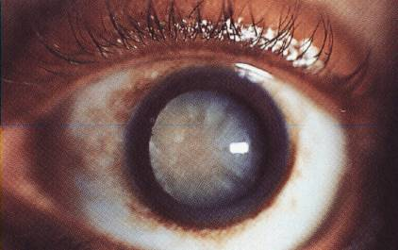
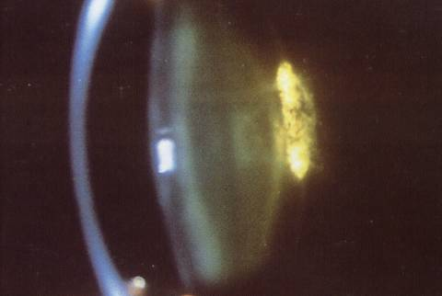

Slide 44
Retina and Vitreous
Vitreous attachments:
Optic nerve head, macula, fovea, Ora serrata, and retinal vasculature.
Effect of systemic diseases on the retina.
Retinal detachment.

Slide 45
Notes:
The bright area on the right is the optic nerve
The dark spot near the middle is the fovea. It has no vessels because it needs to be clear of anything for vision to be sharp. It has lots of cones.

Slide 46
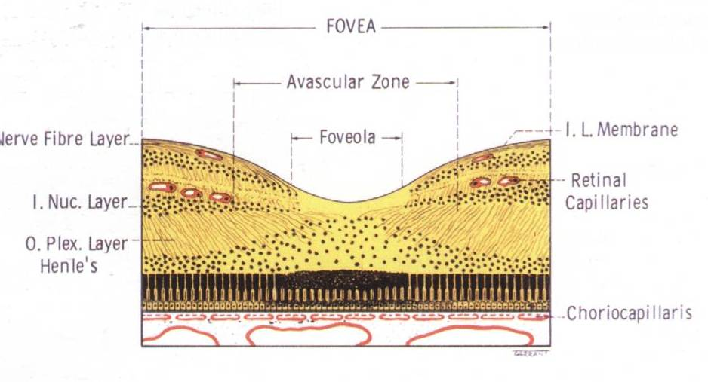

Slide 47
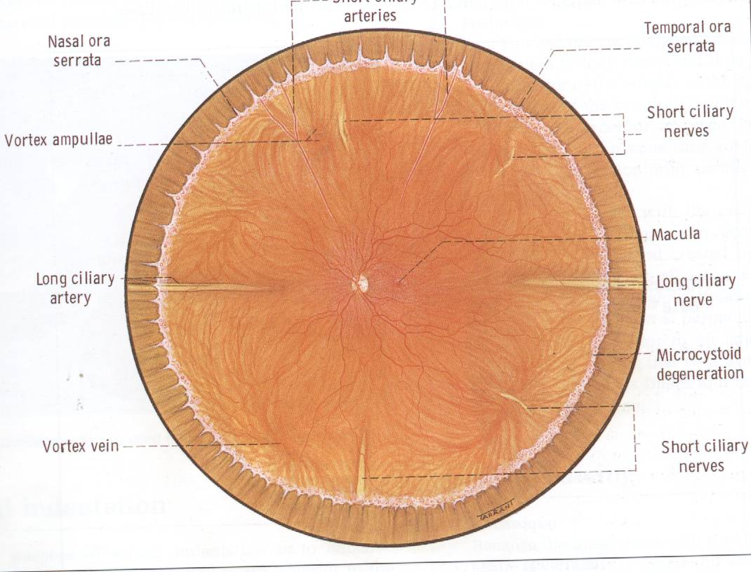

Slide 49
Notes:
Optic nerve atrophy causes pale optic nerve

Slide 50
Notes:
Swollen due to pappillidema

Slide 51
Notes:
Cupped retina usually due to glaucoma

Slide 53
Notes:
Retinitis pigments

Slide 55
PHYSIOLOGY

Slide 56
VISION
Function of the eye:
Receive the image and change it into language that the brain can understand
The retina:
- To function you need: retinal pigment epithelium & neurosensory retina.
- Photoreceptors contains visual pigment
(11-cis-retinal) that changes into (all trans retinal) upon light stimulation

Slide 57
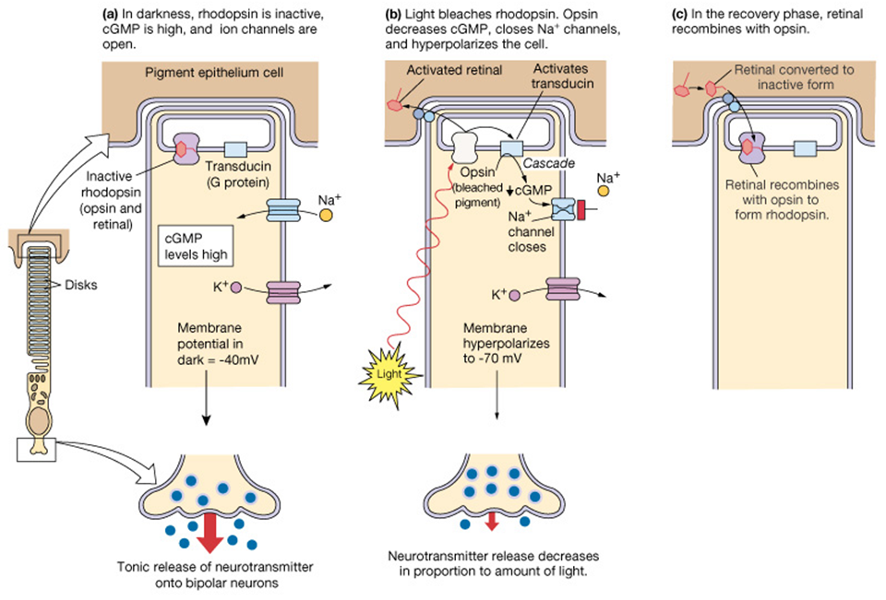
VISION
The visual cycle is the biological conversion of a photon into an electrical signal in the retina.

Slide 58
The Visual Pathway
Visual Pathway: Three neurons
1. Bipolar cell, lies within the retina.
2. Ganglion cell, synapse in lateral geniculate body.
3. Third neuron terminates in visual cortex.

Slide 59
Pupil light reflex

Slide 60
Accomodation

Slide 61
The intraocular pressure
The pressure within the eye is maintained at a steady level by continuous formation & drainage of aqueous.
Aqueous is secreted by the ciliary epithelium → posterior chamber → anterior chamber (through the pupil ) → drained through the anterior chamber angle.
The intraocular pressure, (IOP), is normally 10 – 21 mmHg; increased IOP is called Glaucoma.
High IOP almost always due to an obstruction of aqueous outflow.

Slide 63
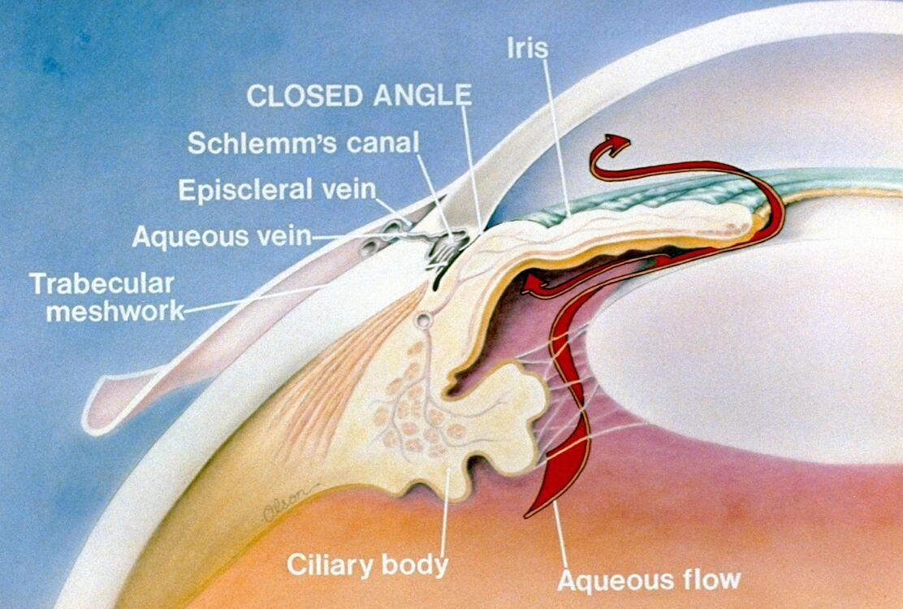

Slide 64
Lacrimal Apparatus
Tear secretion.
Layers of precorneal tear film.
Drainage of tear.

Slide 65
Q1
Regarding embryology and development of the eye, all are false EXCEPT:
The eye is derived from endoderm, mesoderm and surface ectoderm.
The iris coloboma has to be superio-temporal in location.
The eye reaches full size at puberty.
The lens continues to enlarge throughout the life.
During early infant life, the cornea & sclera can not be stretched by raised IOP.
Notes:
ANSWER BELOW
D

Slide 66
Q2
Regarding anatomy of the orbit, all are true EXCEPT:
The thinnest wall is the medial wall.
The weakest wall is floor.
The ophthalmic artery passes through optic canal.
The superior division of oculomotor nerve passes through the superior orbital fissure.
The inferior division of oculomotor nerve passes through the inferior orbital fissure.
Notes:
ANSWER BELOW
E

Slide 67
Q3
Regarding Extraocular muscles, all are true EXCEPT:
All are supplied with oculomotor nerve except the lateral rectus.
Superior rectus elevates the eye on abduction.
Inferior rectus depresses the eye on abduction.
Superior oblique depresses the eye on adduction.
Inferior oblique elevates the eye on adduction.
Notes:
ANSWER BELOW
A

Slide 68
Q4
Regarding Eyelid and conjunctiva, all are true EXCEPT:
The lids are closed by Orbicularis oculi (facial n.).
The lids are opened with Levator palpebrae muscle (oculomotor n.) and Muller’s muscle (parasympathetic supply).
The tarsus is the skeleton of the eyelid.
The orbital septum is a strong barrier against infection.
The conjunctiva has 3 parts: bulbar, palpebral and forniceal conjunctiva.

Slide 69
Q5
Regarding lacrymal apparatus, all are false EXCEPT:
Lacrimal gland locates at the inferio-nasal aspect of the orbit.
Lacrimal gland is the only source of tears.
The tears are spread over the surface of the cornea as a tear film by blinking of the lids.
Tears drain into the lacrimal sac via the puncta & nasolacrimal duct.
The facial nerve has no role in tear drinage.
Notes:
ANSWER BELOW
C
It is not D because the nasolacrimal duct drains from the lacremal sack to the nose.

Slide 70
Q6
Regarding the globe, all are true EXCEPT:
The eye measures approximately 24 mm in all its main diameters.
The anterior and posterior chambers are filled with clear aqueous humour.
Anterior chamber angle examination is essential in diagnosis of glaucoma.
The fovea is highly vascular.
The optic nerve cup/disc ratio is normally 0.3.
Notes:
ANSWER BELOW
D

Slide 71
Thank you

