Slide 1
بسم الله الرحمن الرحيم

Slide 2
Basic anatomy and physiology
Dr. Abdullah Almousa M.D, FRCSC

Slide 3
Lecture Objectives..
Discuss embryology of the eye.
Explore anatomy of the orbit.
Explore anatomy and physiology of EOM.
Explore anatomy of the eyelid and conjunctiva.
Explore anatomy of the globe .
Explore anatomy of the visual pathway.
Understand the physiology of vision, accommodation, pupillary reflex and tear drainage.

Slide 4
Reference books..
Basic Ophthalmology (Cynthia Bradford)
Basic Ophthalmology
(Frank Berson)
General Ophthalmology
(Vaughan, Asbury and Tabbara)
Lecture notes in Ophthalmology (Bruce James, Chris Chew, Antony Bran)

Slide 5
EMBRYOLOGY OF THE EYE
This highly specialized sensory organ is derived from neural ectoderm, mesoderm and surface ectoderm.
The eye is essentially an outgrowth from the brain (neural ectoderm).
Start as the Optic vesicle connected to the forebrain by Optic stalk.

Slide 6
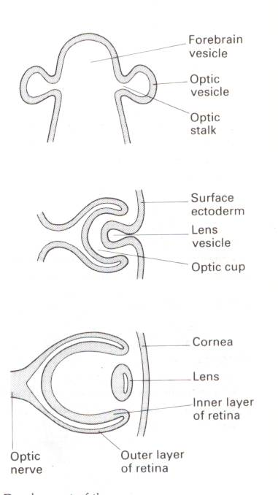
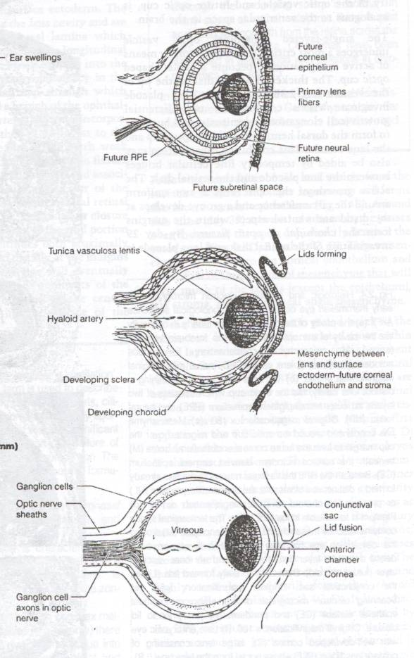

Slide 7
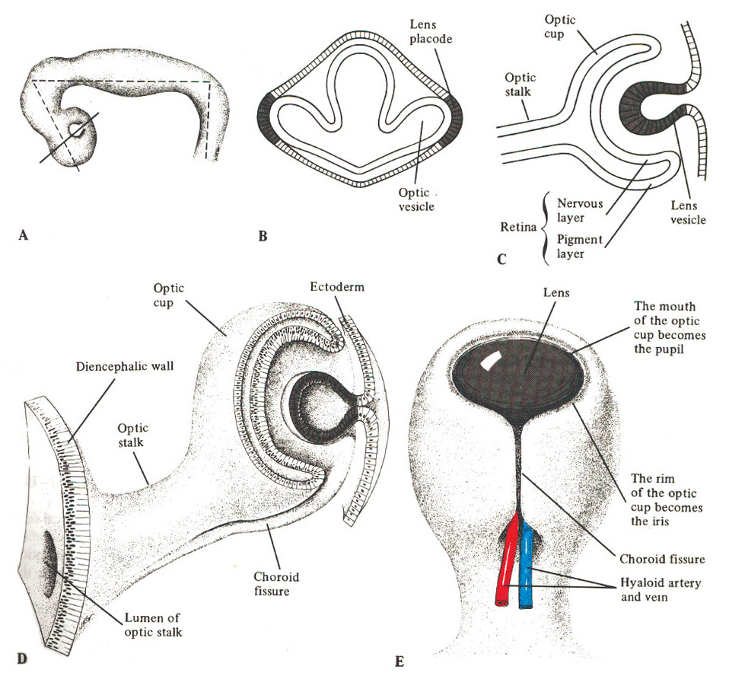

Slide 8
DEVELOPMENT OF THE EYE AFTER BIRTH
At birth, the eye is relatively large in relation to the rest of the body.
The eye reaches full size by the age of 8 years.
The lens continues to enlarge throughout life.
The iris has a bluish color due to little or no pigment on the anterior surface.
During early infant life, the cornea & sclera can be stretched by raised IOP → enlargement of the eye.

Slide 9
ORBIT

Slide 11
THE ORBIT
As a socket, contains & protect the eye.
The weakest parts are the floor & the medial wall.
Seven bones contribute the bony orbit.
Surrounded by nasal sinuses.
Important openings are:
Optic foramen.
Superior orbital fissure.
Inferior orbital fissure.

Slide 13
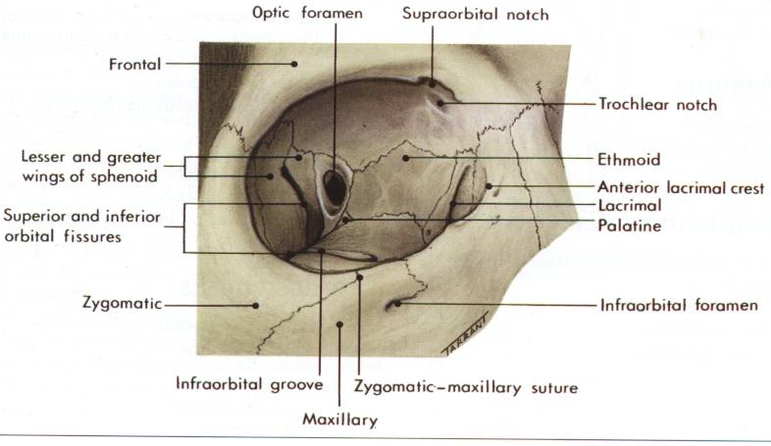
Right Orbit

Slide 14
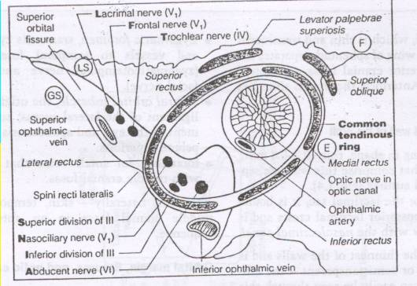

Slide 16
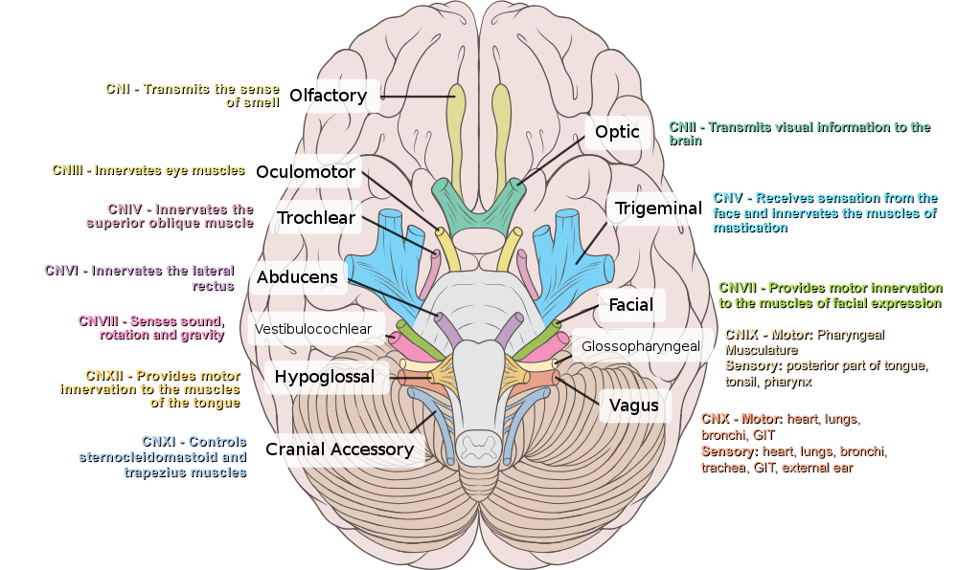

Slide 17
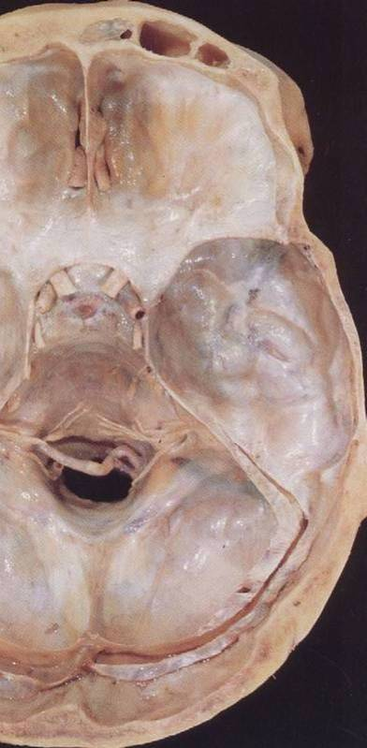

Slide 18
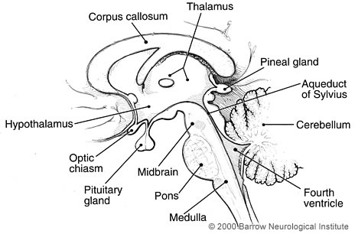

Slide 19
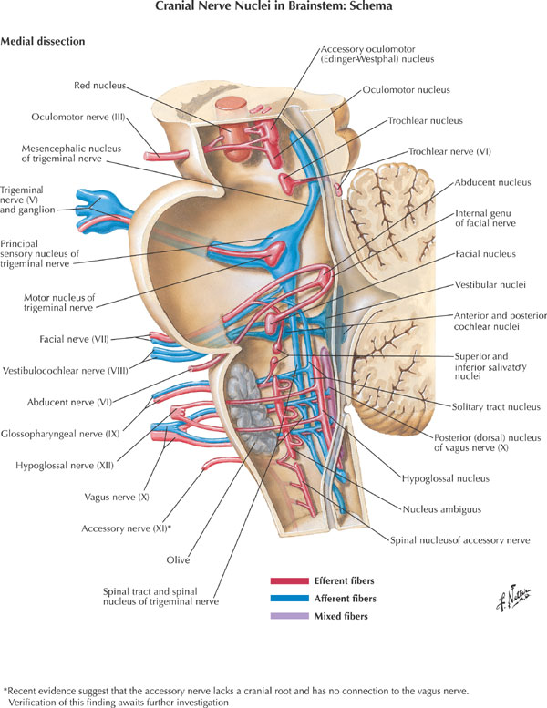

Slide 21
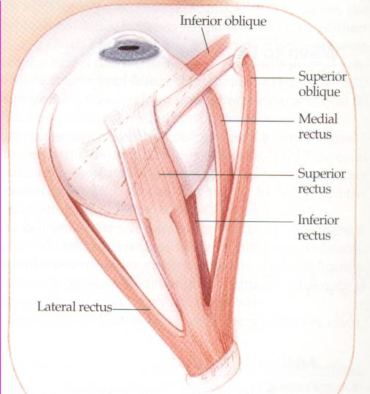
THE EXTRAOCULAR MUSCLES
Four recti & two oblique muscles.
All are supplied by Oculomotor n. except superior oblique (Trochlear n.) & lateral rectus (Abducent n.).

Slide 22
Attachment of eye muscles:
IO
IR

Slide 23
Attachment of eye muscles:
SO
4th n.
IO
SR
IR
MR
LR
6th n.

Slide 24
Innervation & action of eye muscles:
elevation
extorsion
intorsion
abduction (lateral rotation)
adduction (medial rotation)
midline
depression

Slide 25
Hence for clinical test :
Direction to look
SO Down and in
IO Up and in
SR Up and out
IR Down and out
[R=O, O=I]

Slide 26
THE EYELIDS
They provide a protective covering for the eye.
The lids are closed by Orbicularis oculi muscle (Facial n.) and opened with Levator palpebrae muscle (Oculomotor n.), Muller’s muscle (Sympathetic supply) & Lower lid retractors.

Slide 27
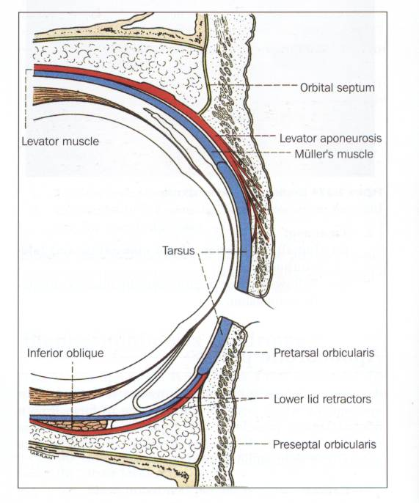
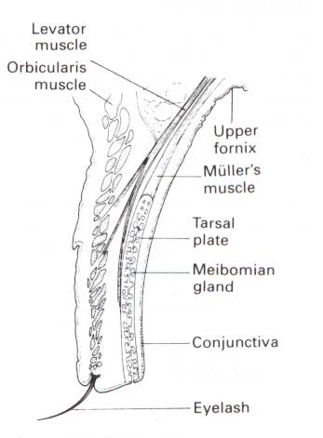

Slide 28
CONJUNCTIVA
Three parts:
Bulbar conjunctiva.
Palpebral conjunctiva.
Forniceal conjunctiva.
The stroma (no adenoid tissues until 3 months after birth).
Follicles & Papillae.
Injection and chemosis.
Limbus.

Slide 31
THE LACRIMAL APPARATUS
Lacrimal gland secrets tears into the upper fornix of the conjunctival sac which are spread over the surface of the cornea as a tear film by blinking of the lids.
Tears accumulate at the inner canthus and drain into the lacrimal sac via the puncta & canaliculi.
The sac is continuous inferiorly with the nasolacrimal duct which opens into the nasal cavity just beneath the inferior turbinate.

Slide 34
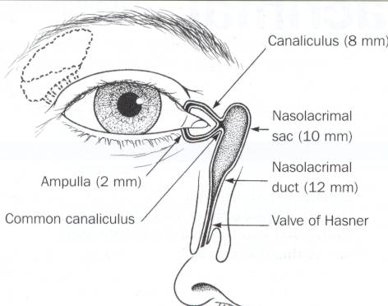

Slide 35
THE EYE (GLOBE)
Two spheres with different radii:
- Cornea, window of the eye.
- Sclera, opaque shell.
*** The eye measures approximately 24 mm in all its main diameters.

Slide 36
The coats of the eye
*** Three layers:
The outer: inelastic coat, transparent cornea and opaque sclera.
The middle: vascular coat, The Uvea:
choroid, ciliary body and iris.
The inner: The Retina, extends forwards to within 6 mm of the limbus.

Slide 38
The Chambers of The Eye
***Three optically clear spaces:
The anterior chamber, in front of the iris
The posterior chamber, immediately behind the iris. These two chambers which communicate through the pupil are filled with clear aqueous humour.
The vitreous cavity: filled by gel-like structure, The Vitreous.

Slide 39
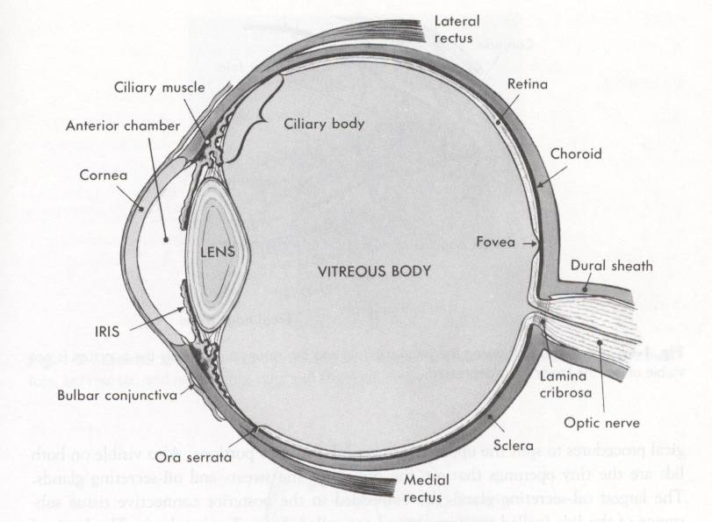

Slide 40
The Lens
The crystalline lens is the only structure continuously growing throughout the life.
Changeable refractive media.
Capsule, epithelium and lens fibers.
Congenital anomalies and effect of systemic diseases.
Cataract.

Slide 42
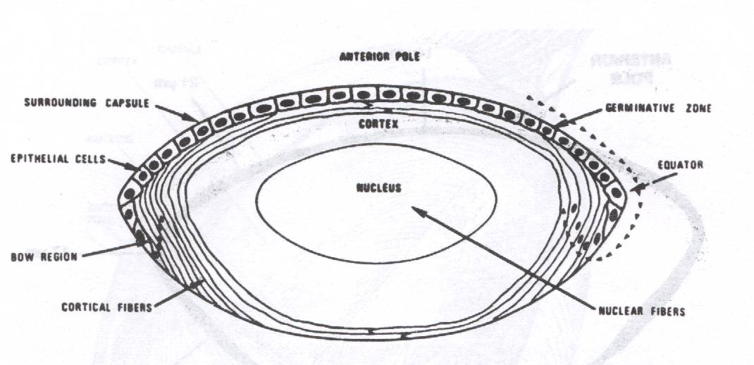

Slide 43
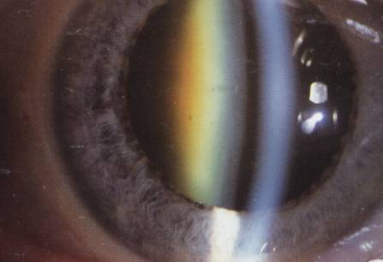
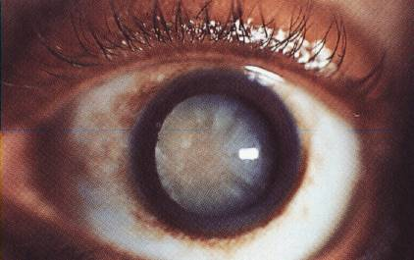
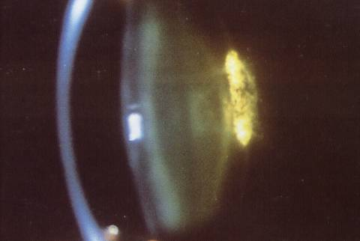

Slide 44
Retina and Vitreous
Vitreous attachments:
Optic nerve head, macula, fovea, Ora serrata, and retinal vasculature.
Effect of systemic diseases on the retina.
Retinal detachment.

Slide 46
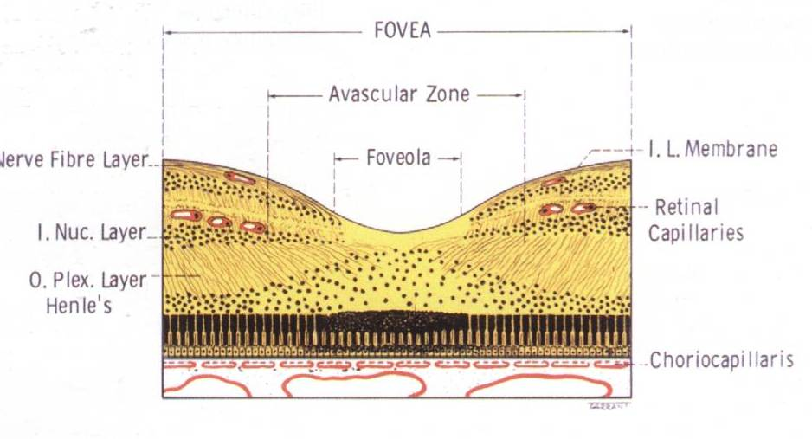

Slide 47
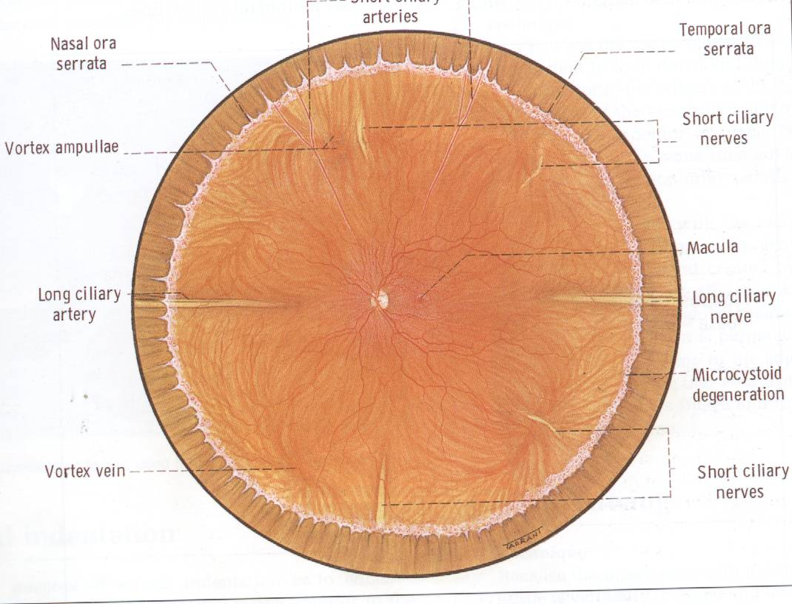

Slide 55
PHYSIOLOGY

Slide 56
VISION
Function of the eye:
Receive the image and change it into language that the brain can understand
The retina:
- To function you need: retinal pigment epithelium & neurosensory retina.
- Photoreceptors contains visual pigment
(11-cis-retinal) that changes into (all trans retinal) upon light stimulation

Slide 57
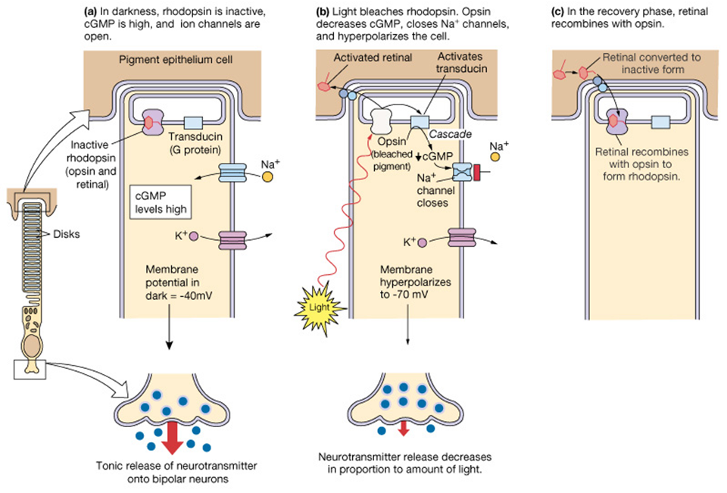
VISION
The visual cycle is the biological conversion of a photon into an electrical signal in the retina.

Slide 58
The Visual Pathway
Visual Pathway: Three neurons
1. Bipolar cell, lies within the retina.
2. Ganglion cell, synapse in lateral geniculate body.
3. Third neuron terminates in visual cortex.

Slide 59
Pupil light reflex

Slide 60
Accomodation

Slide 61
The intraocular pressure
The pressure within the eye is maintained at a steady level by continuous formation & drainage of aqueous.
Aqueous is secreted by the ciliary epithelium → posterior chamber → anterior chamber (through the pupil ) → drained through the anterior chamber angle.
The intraocular pressure, (IOP), is normally 10 – 21 mmHg; increased IOP is called Glaucoma.
High IOP almost always due to an obstruction of aqueous outflow.

Slide 63
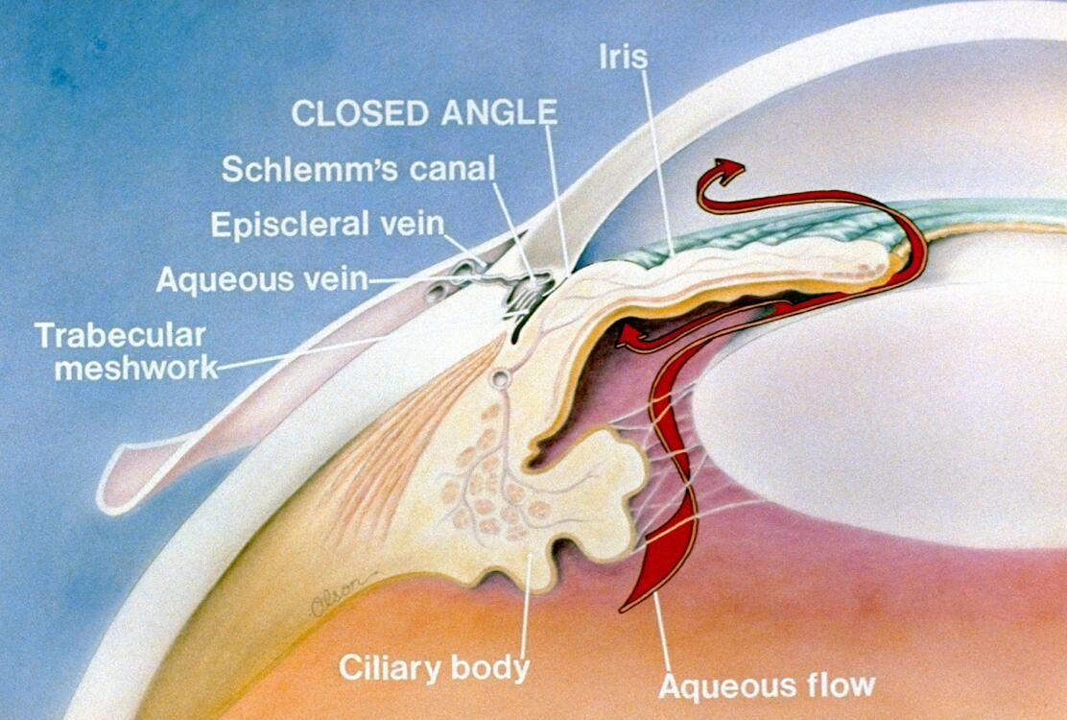

Slide 64
Lacrimal Apparatus
Tear secretion.
Layers of precorneal tear film.
Drainage of tear.

Slide 65
Q1
Regarding embryology and development of the eye, all are false EXCEPT:
The eye is derived from endoderm, mesoderm and surface ectoderm.
The iris coloboma has to be superio-temporal in location.
The eye reaches full size at puberty.
The lens continues to enlarge throughout the life.
During early infant life, the cornea & sclera can not be stretched by raised IOP.

Slide 66
Q2
Regarding anatomy of the orbit, all are true EXCEPT:
The thinnest wall is the medial wall.
The weakest wall is floor.
The ophthalmic artery passes through optic canal.
The superior division of oculomotor nerve passes through the superior orbital fissure.
The inferior division of oculomotor nerve passes through the inferior orbital fissure.

Slide 67
Q3
Regarding Extraocular muscles, all are true EXCEPT:
All are supplied with oculomotor nerve except the lateral rectus.
Superior rectus elevates the eye on abduction.
Inferior rectus depresses the eye on abduction.
Superior oblique depresses the eye on adduction.
Inferior oblique elevates the eye on adduction.

Slide 68
Q4
Regarding Eyelid and conjunctiva, all are true EXCEPT:
The lids are closed by Orbicularis oculi (facial n.).
The lids are opened with Levator palpebrae muscle (oculomotor n.) and Muller’s muscle (parasympathetic supply).
The tarsus is the skeleton of the eyelid.
The orbital septum is a strong barrier against infection.
The conjunctiva has 3 parts: bulbar, palpebral and forniceal conjunctiva.

Slide 69
Q5
Regarding lacrymal apparatus, all are false EXCEPT:
Lacrimal gland locates at the inferio-nasal aspect of the orbit.
Lacrimal gland is the only source of tears.
The tears are spread over the surface of the cornea as a tear film by blinking of the lids.
Tears drain into the lacrimal sac via the puncta & nasolacrimal duct.
The facial nerve has no role in tear drinage.

Slide 70
Q6
Regarding the globe, all are true EXCEPT:
The eye measures approximately 24 mm in all its main diameters.
The anterior and posterior chambers are filled with clear aqueous humour.
Anterior chamber angle examination is essential in diagnosis of glaucoma.
The fovea is highly vascular.
The optic nerve cup/disc ratio is normally 0.3.

Slide 71
Thank you

