Slide 1
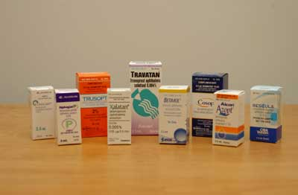
Ocular pharmacology and toxicology
Yasser Al-Faky, MD, FRCS
Professor of Ophthalmology,
Oculoplastic Division,
Chief Ophthalmic Unit, KAUH
College of Medicine, KSU

Slide 2
Objectives..
General pharmacological principles
Pharmacodynamics
Pharmacokinetics
Factors influence drug penetration
Ocular drug preparations
Ocular pharmacotherapeutics
Ocular side effects of systemic drugs

Slide 3
General pharmacological principles

Slide 4
Pharmacodynamics
Mechanism of action
Most drugs act by binding to regulatory macromolecules
Neurotransmitters
Enzymes
Hormonal receptors
Agonist or antagonist (receptor level)
Activator or inhibitor (enzyme level)

Slide 5
Pharmacokinetics
It is the absorption, distribution, metabolism, and excretion of the drug
A drug can be delivered to ocular tissue as:
Locally:
Eye drop
Ointment
Periocular injection
Intraocular injection
Systemically:
Orally
IV

Slide 6
Factors influencing local drug penetration into ocular tissue
Drug concentration:
The higher the concentration the better the penetration e.g. pilocarpine 1-4%
Viscosity:
Higher viscosity increases drug penetration by:
increasing the contact time with the cornea
altering corneal epithelium
Lipid solubility:
The higher lipid solubility the more the penetration (lipid rich environment of the epithelial cell membranes)
pH:
The normal tear pH is 7.4 and if the drug pH is much different, this will cause reflex tearing

Slide 7
Mode of Local Ocular Drug Delivery

Slide 8
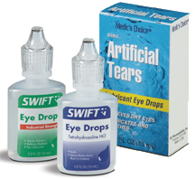
Eye drops
Eye drops: most common
one drop = 50 µl
volume of conjunctival cul-de-sac 7-10 µl
measures to increase drop absorption:
-wait 5-10 minutes between drops
-compress lacrimal sac
-keep lids closed for 5 minutes after instillation

Slide 9
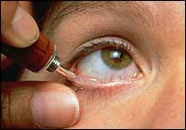
Ointments
Increase the contact time of ocular medication to ocular surface thus better effect
It has the disadvantage of vision blurring
The drug has to be high lipid soluble with some water solubility to have the maximum effect as ointment

Slide 10
Peri-ocular injections
Reach behind iris-lens diaphragm better than topical application
e.g. subconjunctival, subtenon, peribulbar, or retrobulbar
This route bypass the conjunctival and corneal epithelium
good for drugs with low lipid solubility (e.g. penicillins)
Also steroid and local anesthetics can be applied this way

Slide 11
Intraocular injections
Intracameral or intravitreal
Intracameral acetylcholine (miochol) during cataract surgery
Intravitreal antibiotics in cases of endophthalmitis
Intravitreal steroid in macular edema
Intravitreal anti-VEGF for DR

Slide 12
Sustained-release devices
These are devices that deliver an adequate supply of the medication at a steady-state level
e.g.
Ocusert delivering pilocarpine
Timoptic XE delivering timolol
Ganciclovir sustained-release intraocular device
Collagen shields
Liposomes

Slide 13
Systemic drugs
Oral or IV
Factor influencing systemic drug penetration into ocular tissue:
lipid solubility of the drug: more penetration with high lipid solubility
Protein binding: more effect with low protein binding
Eye inflammation: more penetration with ocular inflammation

Slide 14
Ocular pharmacotherapeutics

Slide 15
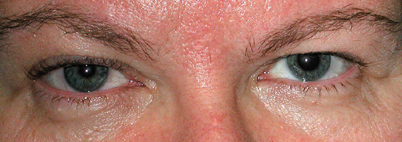
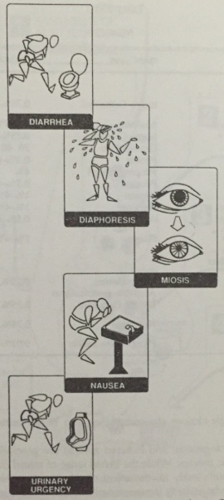
Cholinergic agents (agonists)
Directly acting agonists: [e.g. pilocarpine, acetylcholine]
Uses: miosis (glaucoma)
Mechanisms:
Miosis by contraction of the iris sphincter muscle
Accommodation by circular ciliary muscle contraction
increases aqueous outflow through the trabecular meshwork by longitudinal ciliary muscle contraction
Side effects:
Local: diminished vision (myopia), headache, cataract, miotic cysts, and rarely retinal detachment
Systemic side effects: diarrhea, lacrimation, salivation, perspiration, bronchial spasm, nausea, vomiting and urinary urgency

Slide 16
Cholinergic agonists
Indirectly acting (anti-cholinesterases) :
More potent with longer duration of action
Reversible inhibitors [e.g. physostigmine]
Used in glaucoma and lice infestation of lashes
Side effect: CNS side effects
Irreversible inhibitors [e.g. phospholine iodide]
Used in accommodative esotropia
Side effect: iris cyst and anterior subcapsular cataract
Contraindications: asthma, Parkinsonism

Slide 17
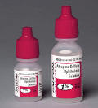
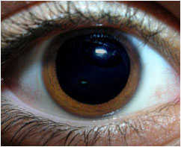
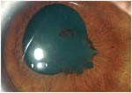
Cholinergic antagonists
E.g. tropicamide, cyclopentolate, homatropine, atropine
Cause mydriasis (by paralyzing the sphincter muscle) with cycloplegia (by paralyzing the ciliary muscle)
Uses: fundoscopy, cycloplegic refraction,
anterior uveitis
Side effects:
local: allergic reaction, blurred vision
Systemic: nausea, vomiting, pallor, vasomotor collapse, constipation, urinary retention, and confusion
Specially in children they might cause flushing, fever, tachycardia, or delerium
Treatment by DC or physostigmine

Slide 18
Adrenergic agonists
Non-selective agonists (α₁, α₂, β₁, β₂)
E.g. epinephrine, depevefrin (pro-drug of epinephrine)
Uses: glaucoma
Side effects: headache, arrhythmia, increased blood pressure, conjunctival adrenochrome, cystoid macular edema in aphakic eyes
Contraindication in closed angle glaucoma

Slide 19
Adrenergic agonists
Alpha-1 agonists (e.g. phenylepherine)
Uses: mydriasis (without cycloplegia), decongestant
Adverse effect:
Can cause significant increase in blood pressure specially in infant and susceptible adults
Rebound congestion
Induce acute angle-closure glaucoma in patients with narrow angles

Slide 20
Adrenergic agonists
Alpha-2 agonists (e.g. brimonidine, apraclonidine)
Uses: glaucoma treatment and prophylaxis after glaucoma laser procedures
Mechanism: decrease aqueous production, and increase uveoscleral outflow
Side effects:
local: allergic reaction, mydriasis, lid retraction
systemic: oral dryness, headache, fatigue, drowsiness, orthostatic hypotension, vasovagal attacks
Contraindications: infants, MAO inhibitors users
Notes:
MAO : monoamine oxidase inhibitors for depression

Slide 21
Alpha adrenergic antagonists
E.g. thymoxamine, dapiprazole
Uses: to reverse pupil dilation produced by phenylepherine
Not widely used

Slide 22
Beta-adrenergic blockers
E.g.
non-selective: timolol, carteolol
selective: betaxolol (beta 1 “cardioselective”)
Uses: glaucoma
Mechanism: reduce the formation of aqueous humor by the ciliary body
Side effects: bronchospasm (less with betaxolol), cardiac impairment

Slide 23
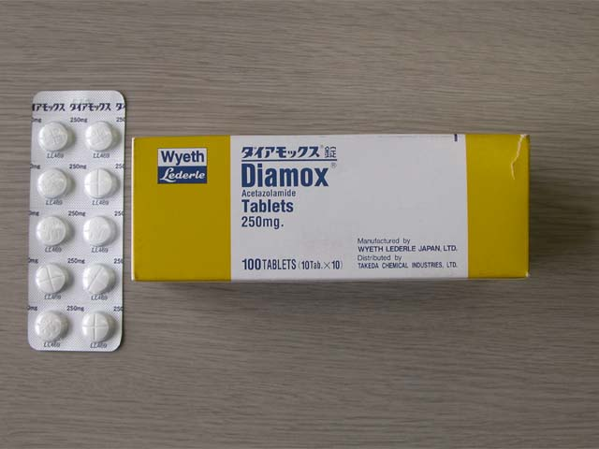
Carbonic anhydrase inhibitors
E.g. acetazolamide, dorzolamide
Uses: glaucoma, cystoid macular edema, pseudotumour cerebri
Mechanism: aqueous suppression
Side effects: myopia, parasthesia, GI upset, headache, altered taste and smell, Na and K depletion, metabolic acidosis, renal stone, bone marrow suppression “aplastic anemia”
Contraindication: sulpha allergy, digitalis users, pregnancy

Slide 24
Osmotic agents
Dehydrate vitreous body which reduce IOP significantly
E.G.
Glycerol 50% syrup (cause nausea, hyperglycemia)
Mannitol 20% IV (cause fluid overload, avoid in heart failure)

Slide 25
Prostaglandin analogues
E.g. latanoprost, bimatoprost, travoprost, unoprostone
Uses: glaucoma
Mechanism: increase uveoscleral aqueous outflow
Side effects: darkening of the iris (heterochromia iridis), lengthening and thickening of eyelashes, intraocular inflammation, macular edema

Slide 26
Anti-inflammatory
Corticosteroid
NSAID

Slide 27
Notes:
Proinflamatory potent leucotrines LT

Slide 28
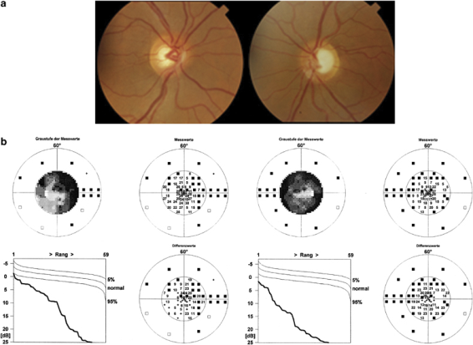
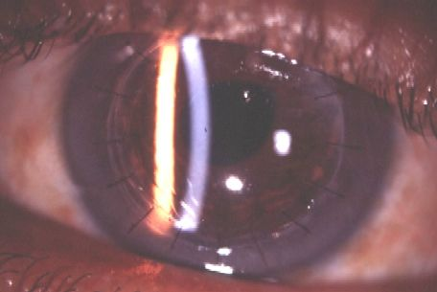
Corticosteroids
Topical
E.g. fluorometholone, hydrocortisone, remixolone, prednisolone, dexamethasone.
Mechanism: inhibition of arachidonic acid release from phospholipids by inhibiting phosphlipase A2
Uses: postoperatively, anterior uveitis, severe allergic conjunctivitis, vernal keratoconjunctivitis, prevention and suppression of corneal graft rejection, episcleritis, scleritis
Side effects: susceptibility to infections, glaucoma, cataract, ptosis, mydriasis, scleral melting, skin atrophy

Slide 29
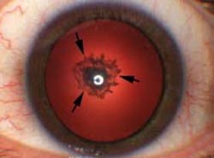
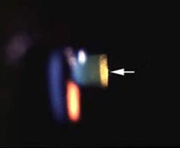
Corticosteroids
Systemic:
E.g. prednisolone
Uses: posterior uveitis, optic neuritis, temporal arteritis with anterior ischemic optic neuropathy
Side effects:
Local: posterior subcapsular cataract, glaucoma, central serous retinopathy
Systemic: suppression of pituitary-adrenal axis, hyperglycemia, osteoporosis, peptic ulcer, psychosis

Slide 30
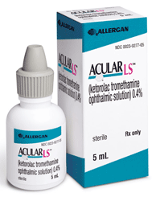
NSAID
E.g. ketorolac, diclofenac, flurbiprofen
Mechanism: inactivation of cyclo-oxygenase
Uses: postoperatively, mild allergic conjunctivitis, episcleritis, mild uveitis, cystoid macular edema, preoperatively to prevent miosis during surgery
Side effects: stinging

Slide 31
Anti-allergics
Avoidance of allergens, cold compress, lubrications
Antihistamines (e.g.pheniramine, levocabastine)
Decongestants (e.g. naphazoline, phenylepherine, tetrahydrozaline)
Mast cell stabilizers (e.g. cromolyn, lodoxamide, pemirolast, nedocromil, olopatadine)
NSAID (e.g. ketorolac)
Steroids (e.g. fluorometholone, remixolone, prednisolone)
Drug combinations

Slide 32
Antibiotics
Penicillins
Cephalosporins
Sulfonamides
Tetracyclines
Chloramphenicol
Aminoglycosides
Fluoroquinolones
Vancomycin
macrolides

Slide 33
Antibiotics
Used topically in prophylaxis (pre and postoperatively) and treatment of ocular bacterial infections.
Can be injected intravitrally for the treatment of endophthalmitis
Used orally for the treatment of preseptal cellulitis
Used intravenously for the treatment of orbital cellulitis

Slide 34
Antibiotics
Trachoma can be treated by topical and systemic tetracycline or systemic azithromycin.
Bacterial conjunctivitis is usually self limited but topical erythromycin or fluoroquinolones can be used
Bacterial keratitis (bacterial corneal ulcers) can be treated by topical fortified antibiotics (cephalosporins, aminoglycosides, vancomycin, or fluoroquinolones)

Slide 35
Antifungals
Uses: fungal keratitis, fungal endophthalmitis
Polyenes
damage cell membrane of susceptible fungi
e.g. amphotericin B, natamycin
side effect: nephrotoxicity
Imidazoles
increase fungal cell membrane permeability
e.g. miconazole, ketoconazole
Flucytocine
act by inhibiting DNA synthesis

Slide 36
Antivirals
Acyclovir
interact with viral thymidine kinase (selective)
used in herpetic keratitis
Trifluridine
more corneal penetration
can treat herpetic iritis
Ganciclovir
used intravenously for CMV retinitis

Slide 37
Ocular diagnostic drugs
Fluorescein dye
Available as drops or strips
Uses: stain corneal abrasions, applanation tonometry, detecting wound leak, NLD obstruction, fluorescein angiography
Caution:
stains soft contact lens
Fluorescein drops can be contaminated by Pseudomonas sp.

Slide 38
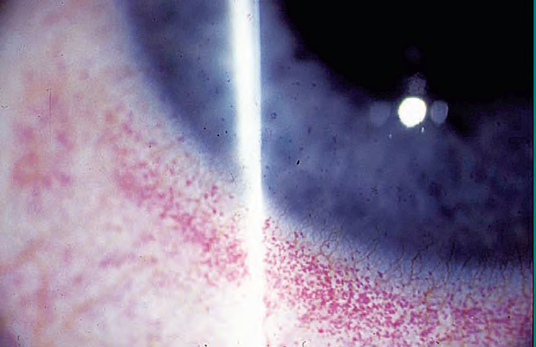
Ocular diagnostic drugs
Rose bengal stain
Stains devitalized epithelium
Uses: severe dry eye, herpetic keratitis

Slide 39
Local anesthetics
Topical:
E.g. propacaine, tetracaine
Uses: applanation tonometry, goniscopy, removal of corneal foreign bodies, removal of sutures, examination of patients who cannot open eyes because of pain
Adverse effects: toxic to corneal epithelium, allergic reaction rarely

Slide 40
Local anesthetics
Orbital infiltration:
peribulbar or retrobulbar
causes anesthesia and akinesia for intraocular surgery
e.g. lidocaine, bupivacaine

Slide 41
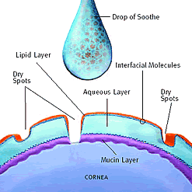
Other ocular preparations
Lubricants
drops or ointments
Polyvinyl alcohol, cellulose, methylcellulose
Preserved or preservative free

Slide 42
Intravitreal Injections
Anti VEGF (anti vascular endothelial growth factors) :
bevacizumab (Avastin)
Ranibizumab (Lucentis)
Uses :
Age related macular degeneration (AMD)
DM (macular edema, PDR).
CRVO/BRVO

Slide 43
Ocular toxicology

Slide 44
Complications of topical administration
Mechanical injury from the bottle e.g. corneal abrasion
Ocular damage: e.g. topical anesthetics, benzylkonium
Pigmentation: e.g. epinephrine- adrenochrome
Hypersensitivity: e.g. atropine, neomycin, gentamicin
Systemic effect: topical phenylephrine can increase BP

Slide 45
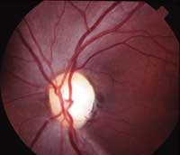
Amiodarone
A cardiac arrhythmia drug
Causes optic neuropathy (mild decreased vision, visual field defects)
Also causes corneal vortex keratopathy (corneal verticillata) which is whorl-shaped pigmented deposits in the corneal epithelium

Slide 46
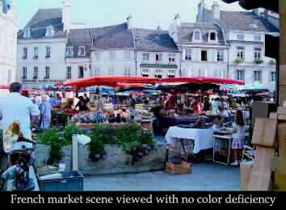
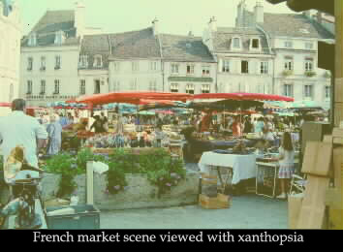
Digitalis
A cardiac failure drug
Causes chromatopsia (objects appear yellow) with overdose

Slide 47
Chloroquines
E.g. chloroquine, hydroxychloroquine
Used in malaria, rheumatoid arthritis, SLE
Cause retinopathy (bull’s eye maculopathy)
Also cause vortex keratopathy (corneal verticillata) which is usually asymptomatic but can present with glare and photophobia

Slide 48
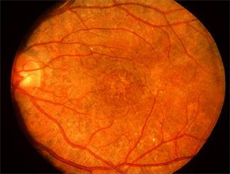
Thioridazine
A psychiatric drug
Causes a pigmentary retinopathy after high dosage

Slide 49
Chorpromazine
A psychiatric drug
Causes corneal punctate epithelial opacities, lens surface opacities
Rarely symptomatic
Reversible with drug discontinuation

Slide 50
Diphenylhydantoin
An epilepsy drug
Causes dosage-related cerebellar-vestibular effects:
Horizontal nystagmus in lateral gaze
Diplopia, ophthalmoplegia
Vertigo, ataxia
Reversible with the discontinuation of the drug

Slide 51
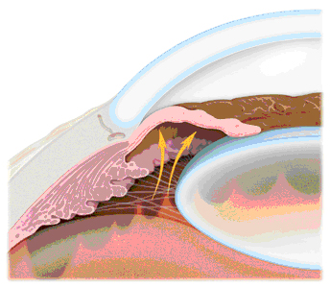
Topiramate
A drug for epilepsy
Causes acute angle-closure glaucoma (acute eye pain, redness, blurred vision, haloes)

Slide 52
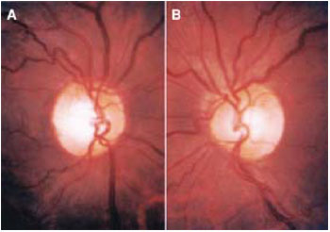
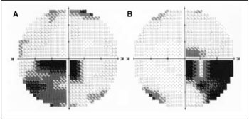
Ethambutol
An anti-TB drug
Causes a dose-related optic neuropathy
Usually reversible but occasionally permanent visual damage might occur

Slide 53
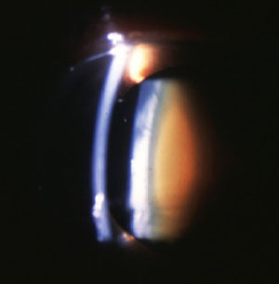
HMG-CoA reductase inhibitors (statins)
Cholesterol lowering agents
E.g. pravastatin, lovastatin, simvastatin, fluvastatin, atorvastatin, rosuvastatin
Can cause cataract in high dosages specially if used with erythromycin

Slide 54
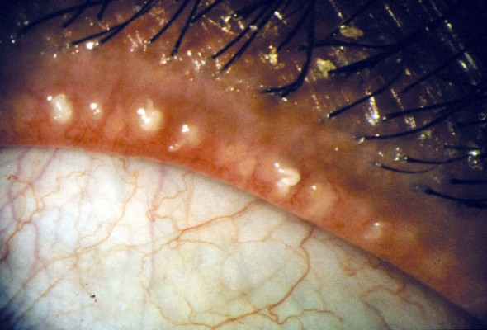
ROACCUTANE
Isotretinoin (Retinoid agents)
Used in Acne
Avoid tetracycline
Severe dry eye (evaporative) with rec. chalazia

Slide 55
Other agents
Methanol – optic atrophy and blindness
Chloramphenicol & streptomycin – optic atrophy
Contraceptive pills – pseudotumor cerebri (papilledema), and dryness (CL intolerance)
Hypervitaminosis A – yellow skin and conjunctiva, pseudotumor cerebri (papilledema), retinal hemorrhage.
Hypovitaminosis A – night blindness (nyctalopia), keratomalacia.

