Slide 1
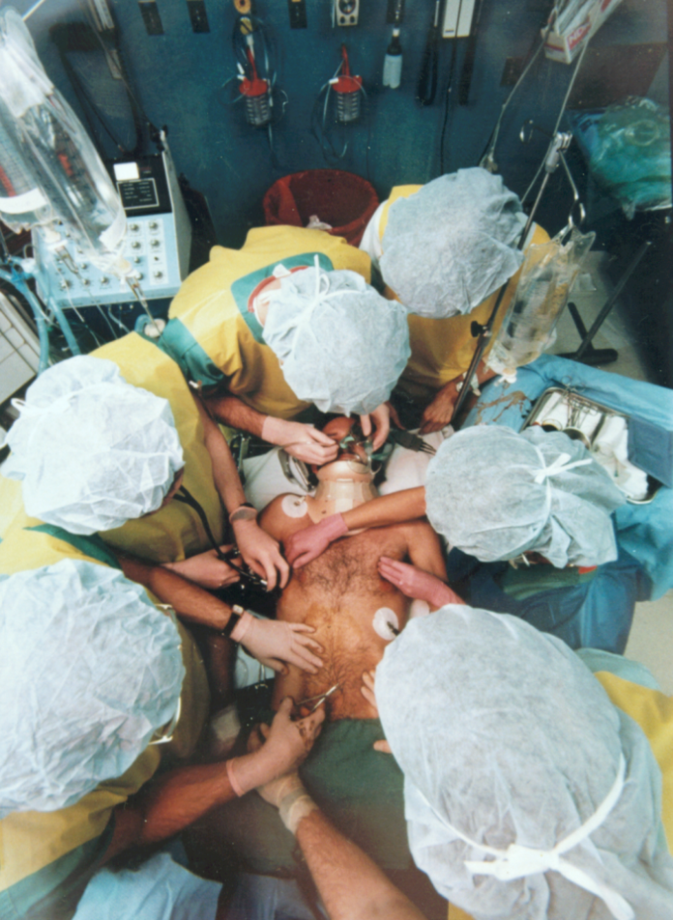
Initial Assessment of Trauma Patient
Dr Amjad Obeid
Consultant Emergency Medicine
KSUMC

Slide 2
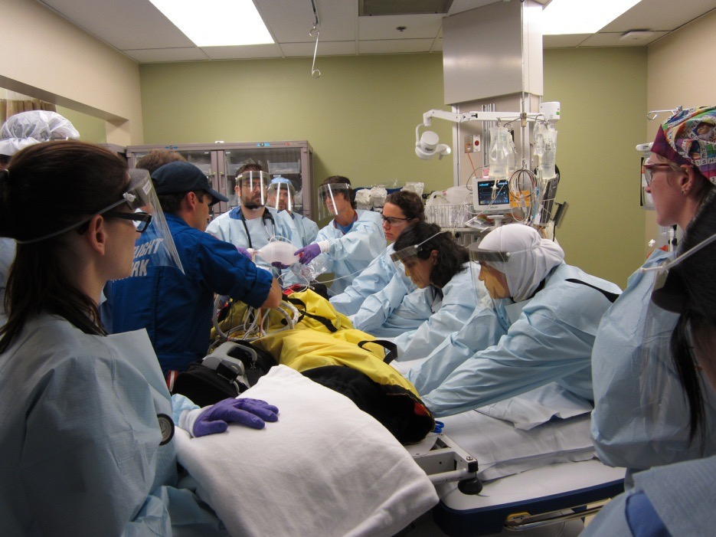
Case Scenario
44-year-old male driver who crashed head-on into a wall
Patient found unresponsive at the scene
Arrives at hospital via basic life support with c-collar in place and strapped to a backboard; technicians assisting ventilations with bag-mask

Slide 3
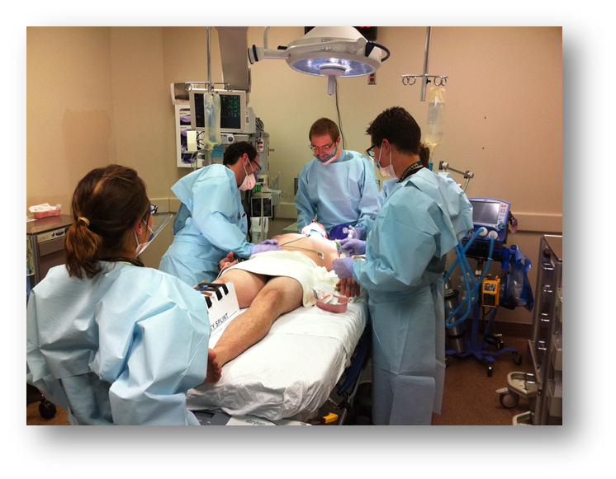
Standard Precautions
Cap
Gown
Gloves
Mask
Shoe covers
Protective eyewear / face shield

Slide 4
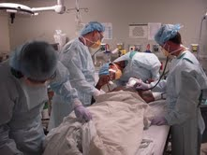
Initial Assessment
Primary survey and resuscitation of vital functions are done simultaneously using a team approach.

Slide 5
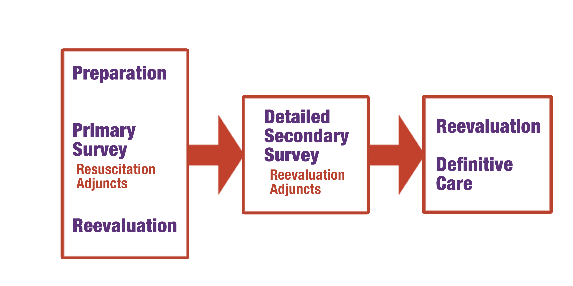
Concepts of Initial Assessment

Slide 6
Quick Assessment
What is a quick, simple way to assess a patient in 10 seconds?

Slide 7
Quick Assessment
What is a quick, simple way to assess a patient in 10 seconds?
Ask the patient his or her name
Ask the patient what happened

Slide 8
Appropriate Response Confirms
A Patent airway
B Sufficient air reserve to permit speech
C Sufficient perfusion
D Clear sensorium

Slide 9
Primary Survey
Airway with c-spine protection
Breathing and ventilation
Circulation with hemorrhage control
Disability: Neuro status
Exposure / Environmental control

Slide 10
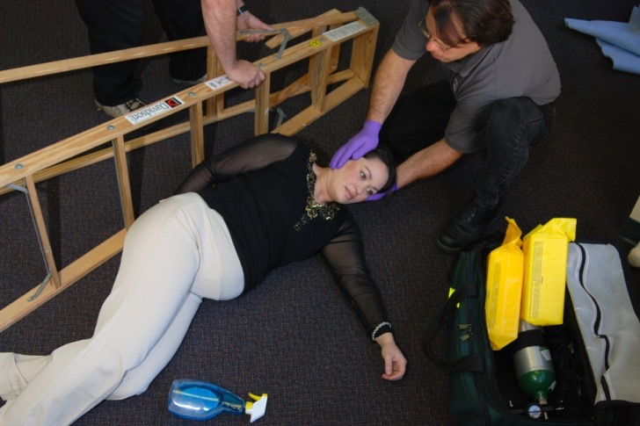
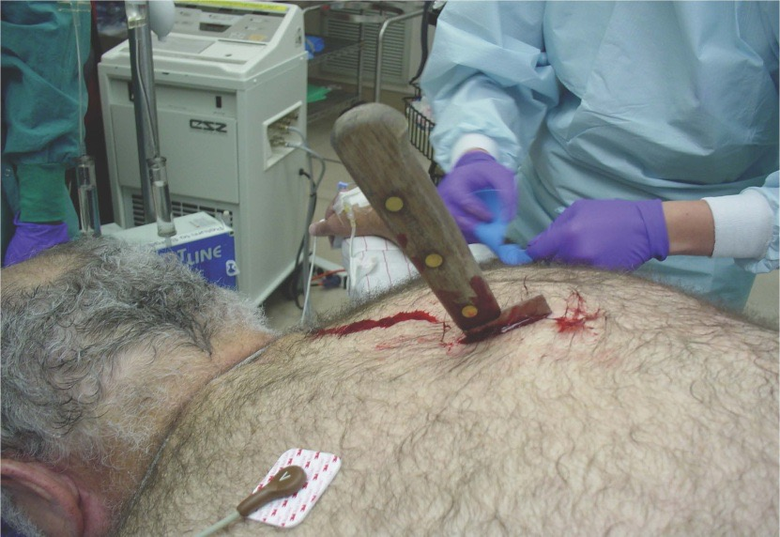
Primary Survey
The priorities are the same for all patients.

Slide 11
Special Populations
Elderly
Infants and Children
Pregnant Women
Obese
Athletes

Slide 12
Primary Survey
Airway
Pitfalls
Occult airway injury
Progressive loss of airway
Equipment failure
Inability to intubate
Establish patent airway and protect c-spine

Slide 13
Primary Survey
Breathing and Ventilation
Respiratory rate
Chest movement
Air entry
Oxygen saturation
Assess and ensure adequate oxygenation and ventilation

Slide 14
Primary Survey
Breathing and Ventilation
Pitfalls
Airway versus ventilation problem?
Iatrogenic pneumothorax or tension pneumothorax?

Slide 15
Primary Survey
Circulation
(including hemorrhage control)
Level of consciousness
Skin color and temperature
Pulse rate and character
Assess for organ perfusion

Slide 16
Primary Survey
Circulatory Management
Pitfalls
Control hemorrhage
Restore volume
Reassess patient
Elderly
Children
Athletes
Medications

Slide 17
Primary Survey
Disability
Baseline neurologic evaluation
Glasgow Coma Scale score
Pupillary response
Caution
Observe for neurologic deterioration

Slide 18
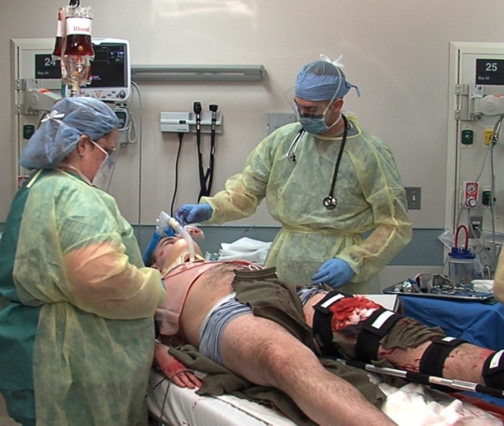
Primary Survey
Exposure / Environment
Completely undress the patient
Caution
Prevent hypothermia
Pitfalls
Missed injuries

Slide 19
Resuscitation
Protect and secure airway
Ventilate and oxygenate
Stop the bleeding!
Crystalloid / blood resuscitation
Protect from hypothermia

Slide 20
Adjuncts to Primary Survey
Vital signs
ECG
ABGs
PRIMARY SURVEY
Pulse
oximeter
and CO₂
Urinary
output
Urinary / gastric catheters
unless contraindicated

Slide 21
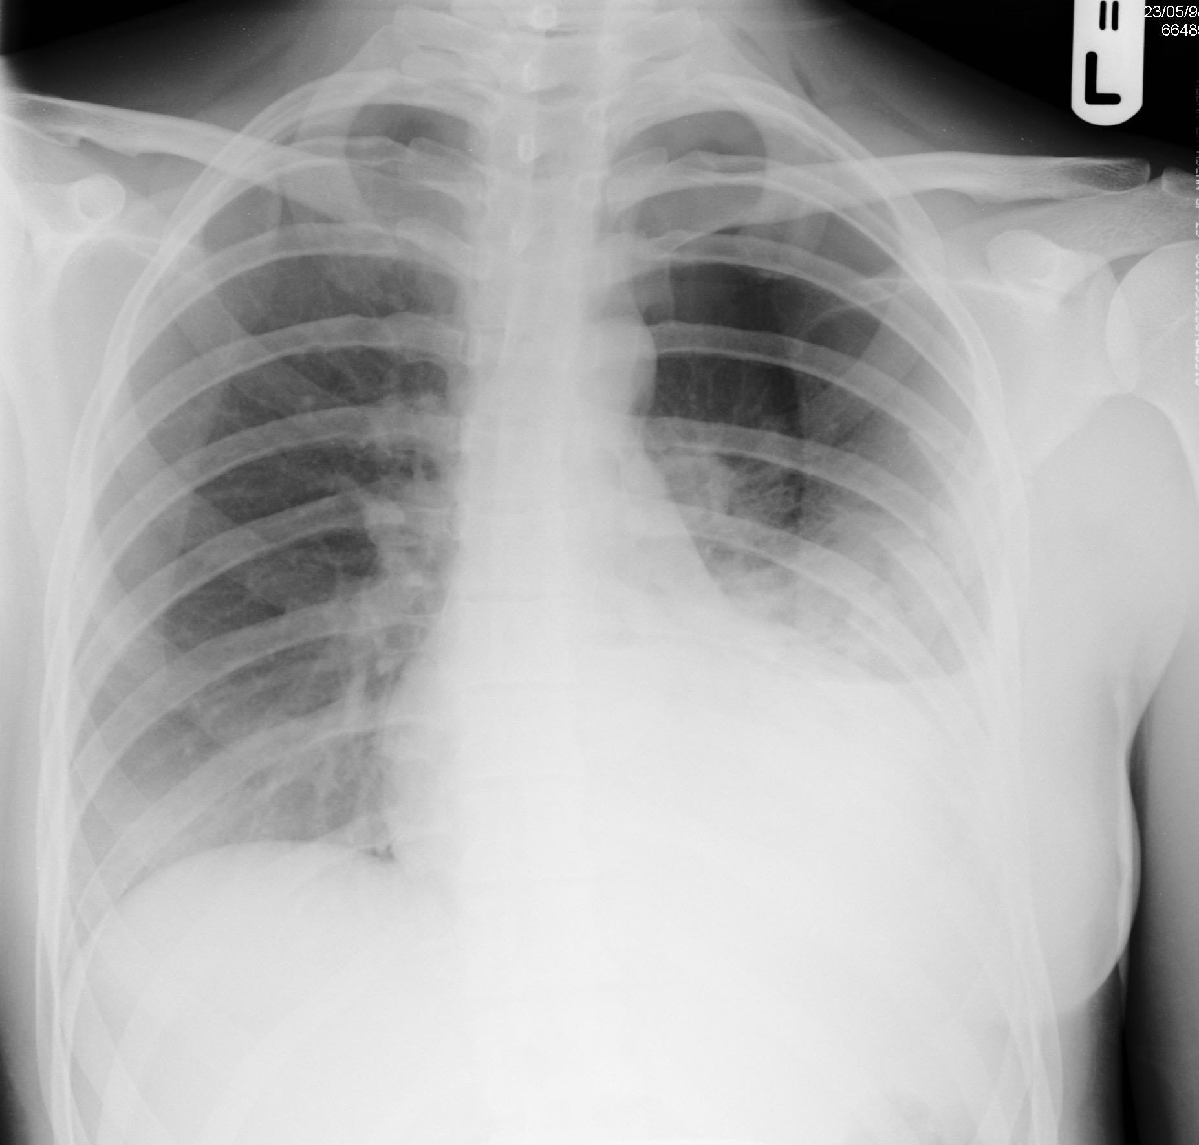
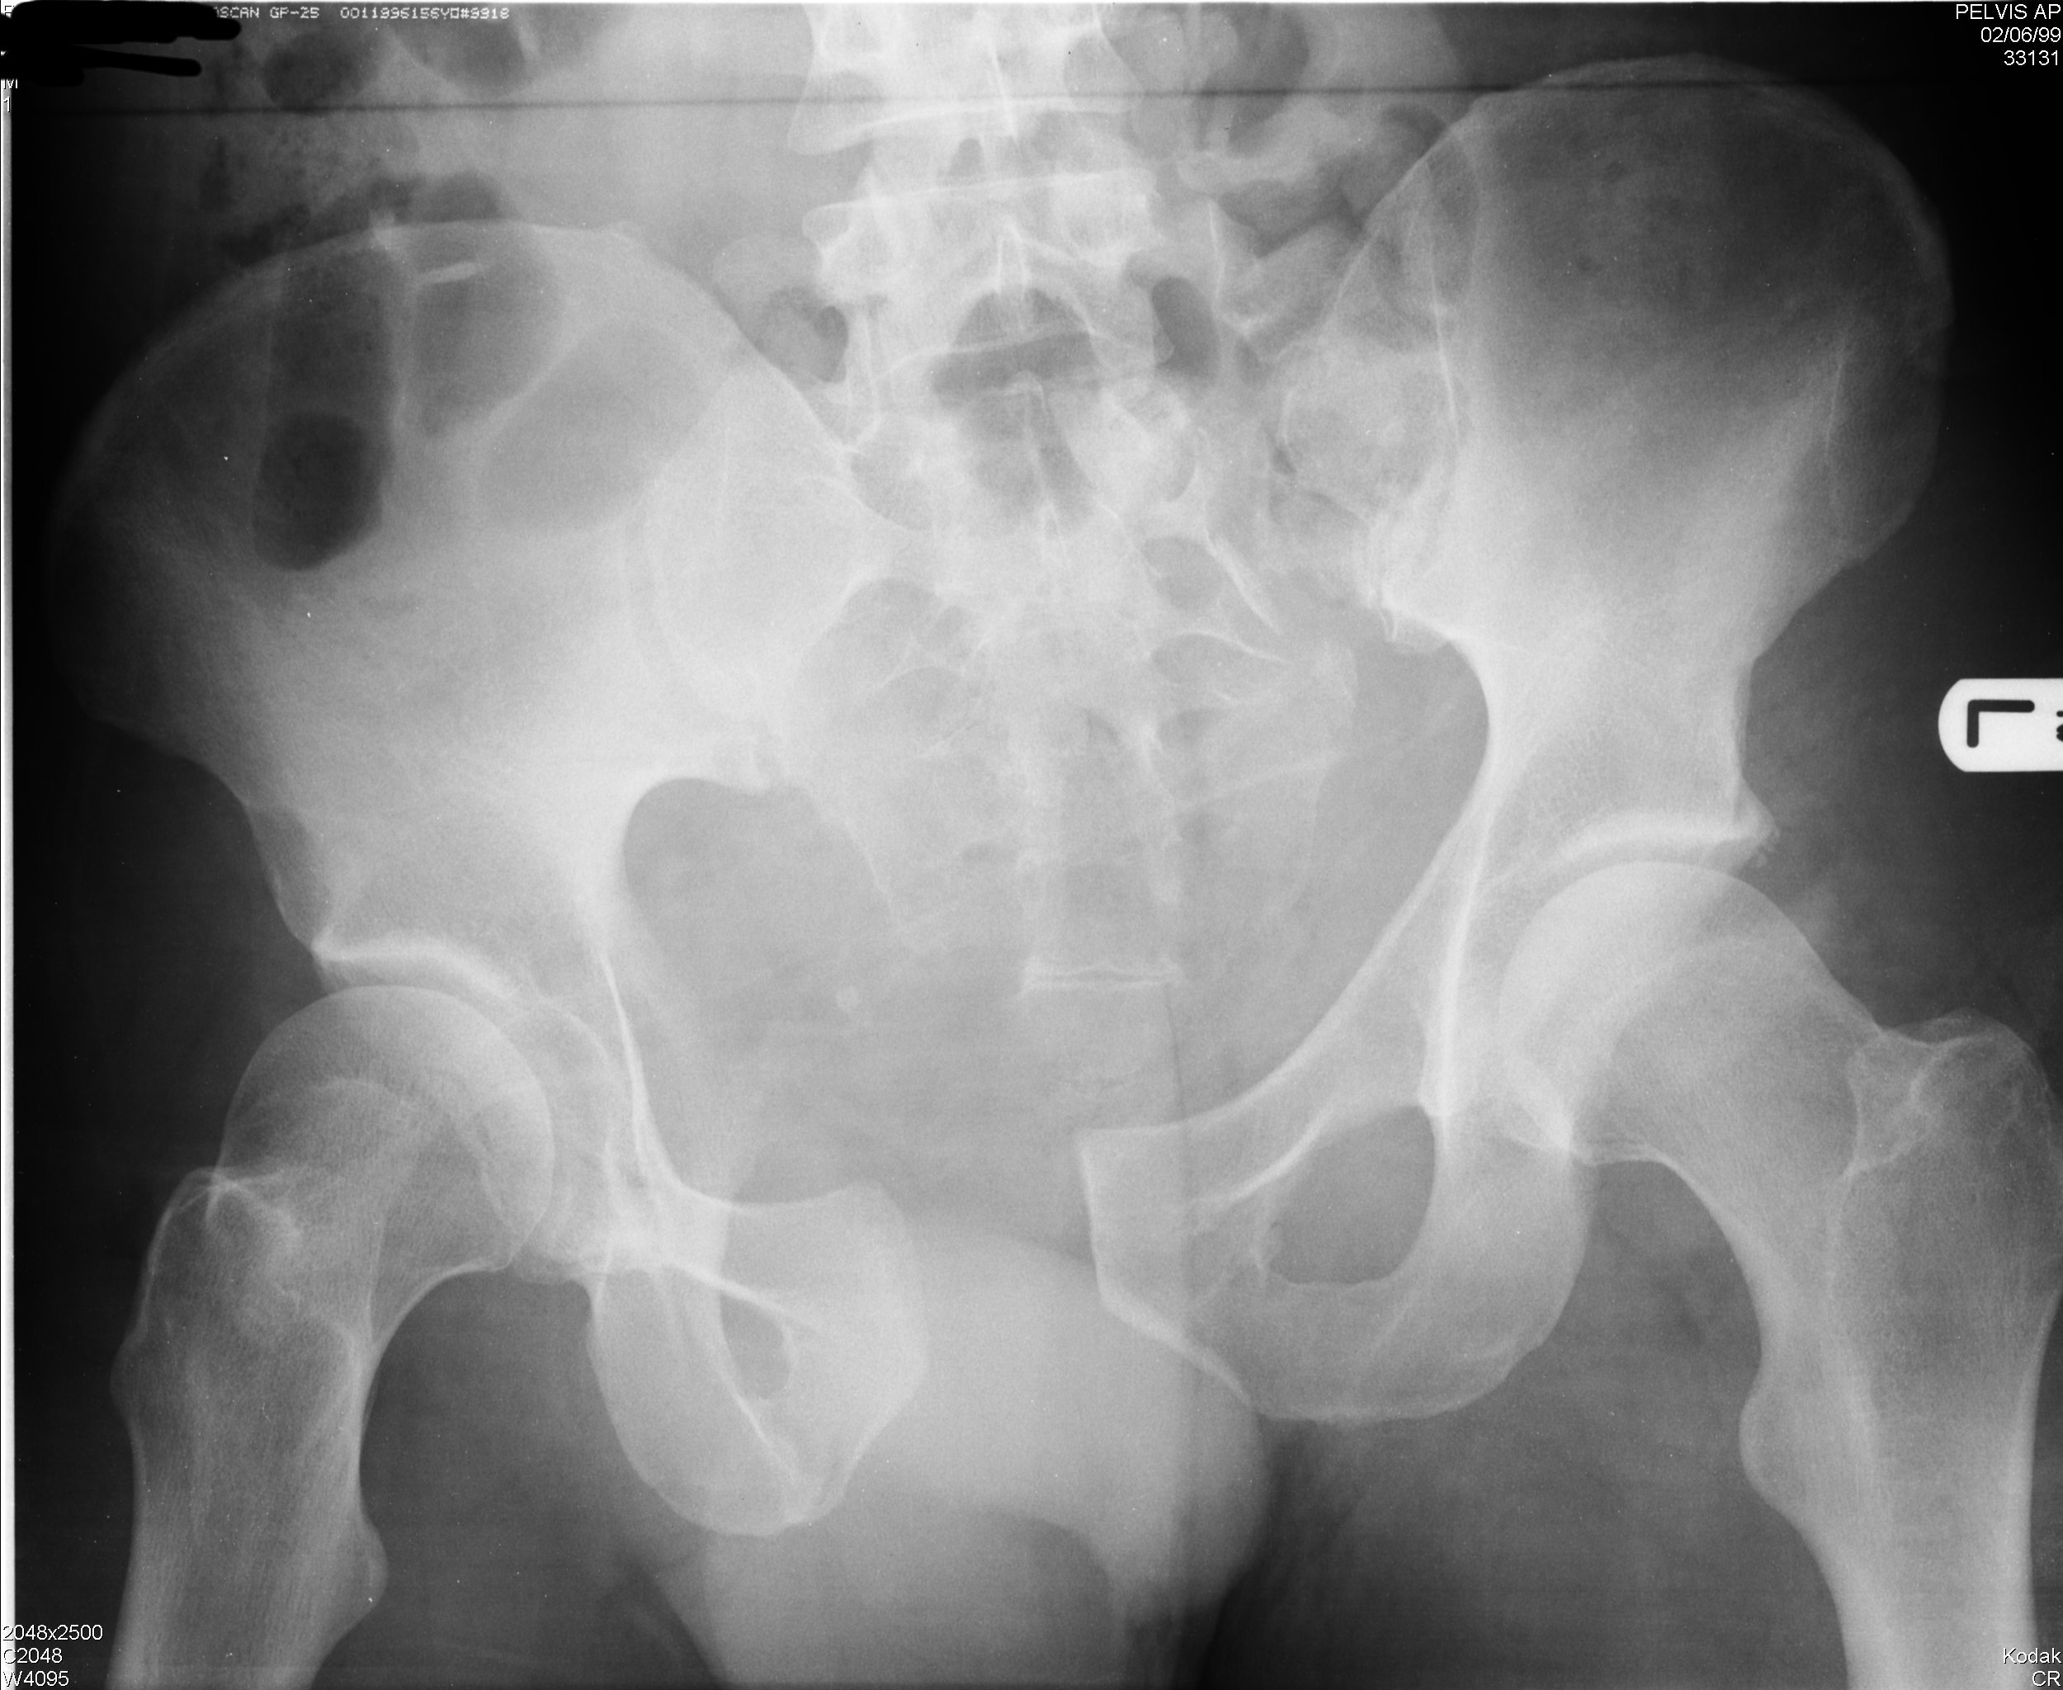
Adjuncts to Primary Survey
Diagnostic Tools

Slide 22
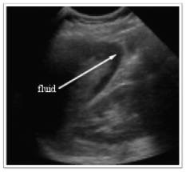
Adjuncts to Primary Survey
Diagnostic Tools
FAST
DPL

Slide 23
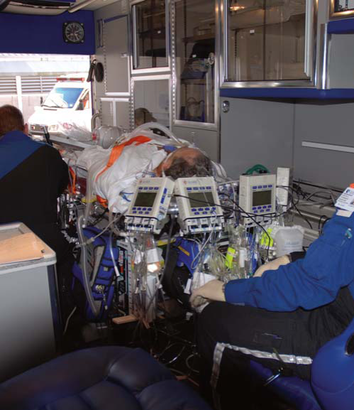
Adjuncts to Primary Survey
Consider Early Transfer
Use time before transfer for resuscitation
Do not delay transfer for diagnostic tests

Slide 24
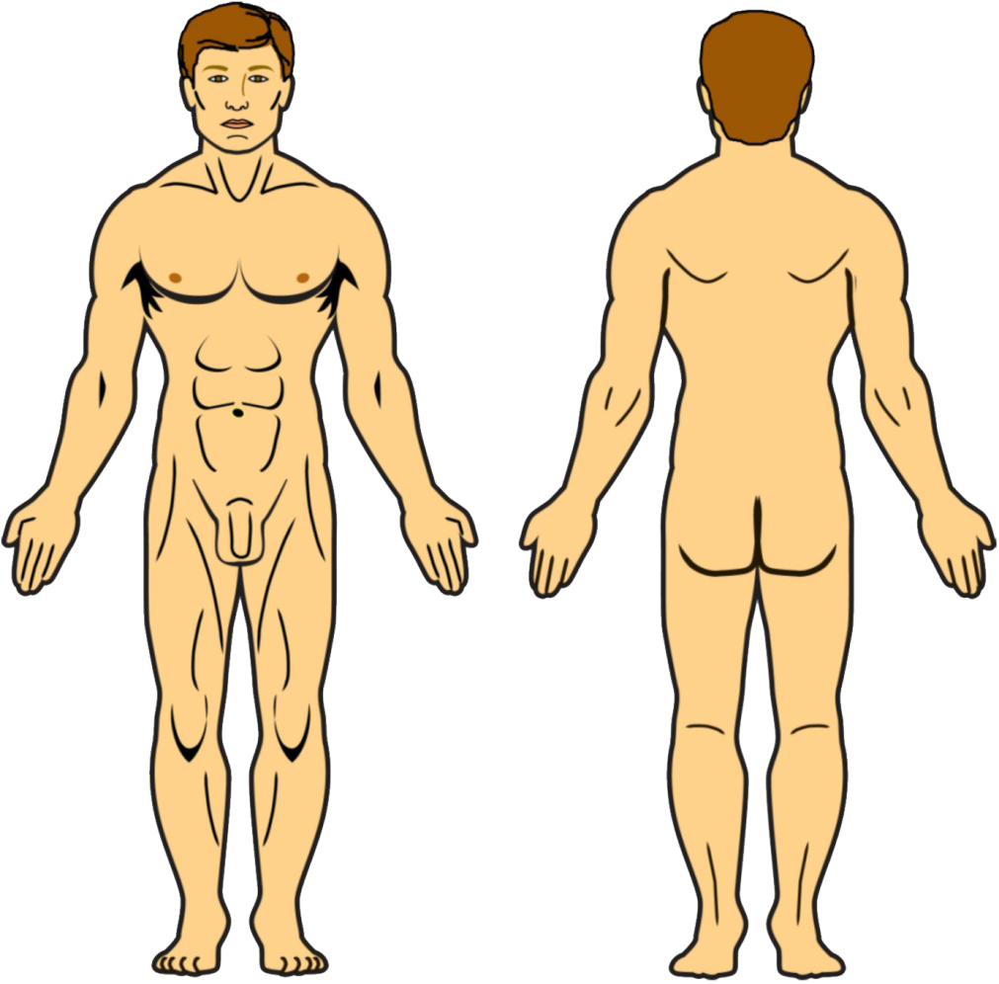
Secondary Survey
What is the secondary survey?
The complete history and physical examination

Slide 25
Secondary Survey
When do I start the secondary survey?
After
Primary survey is completed
ABCDEs are reassessed
Vital functions are returning to normal

Slide 26
Secondary Survey
Components of the secondary survey
History
Physical exam: Head to toe
Complete neurologic exam
Special diagnostic tests
Reevaluation

Slide 27
Secondary Survey
History
Allergies
Medications
Past illnesses / Pregnancy
Last meal
Events / Environment / Mechanism

Slide 28
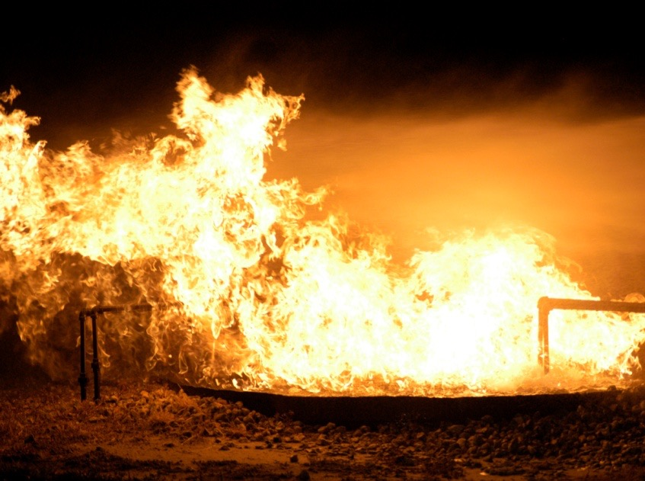
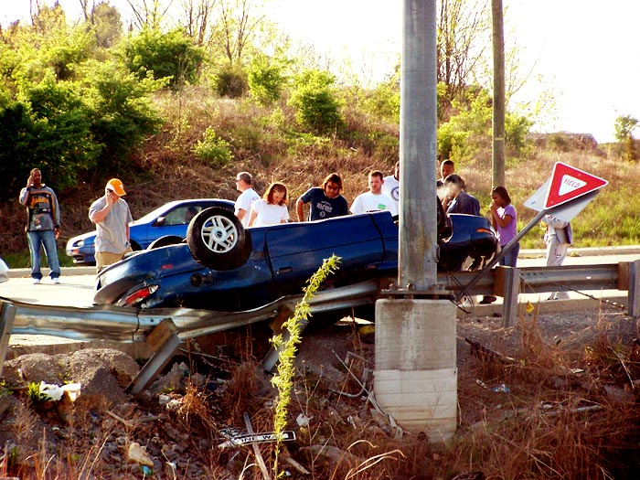
Secondary Survey
Mechanisms of Injury

Slide 29
Secondary Survey
Head
External exam
Scalp palpation
Comprehensive eye and ear exam
Include visual acuity
Pitfalls
Unconsciousness
Periorbital edema
Occluded auditory canal

Slide 30
Secondary Survey
Maxillofacial
Bony crepitus
Deformity
Malocclusion
Pitfalls
Potential airway obstruction
Cribriform plate fracture
Frequently missed

Slide 31
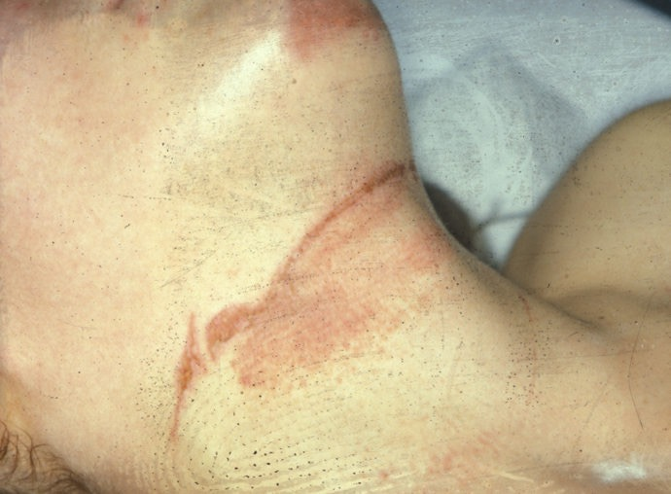
Secondary Survey
Neck (Soft Tissues)
Mechanism: Blunt versus penetrating
Symptoms: Airway obstruction, hoarseness
Findings: Crepitus, hematoma, stridor, bruit
Pitfalls
Delayed signs and symptoms
Progressive airway obstruction
Occult injuries

Slide 32
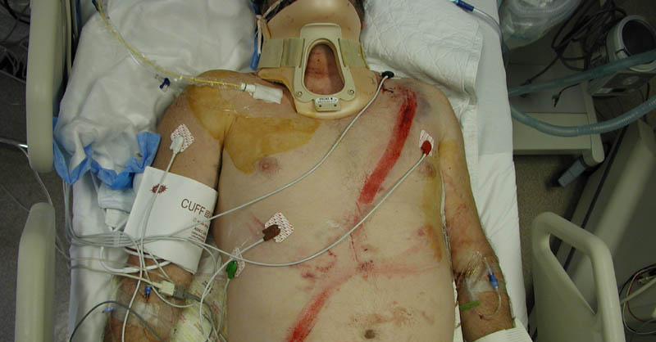
Secondary Survey
Chest
Inspect
Palpate
Percuss
Auscultate
X-rays

Slide 33
Secondary Survey
Abdomen
Inspect / Auscultate
Palpate / Percuss
Reevaluate
Special studies
Pitfalls
Hollow viscus injury
Retroperitoneal injury

Slide 34
Secondary Survey
Perineum
Contusions, hematomas, lacerations, urethral blood
Rectum
Sphincter tone, high-riding prostate, pelvic fracture, rectal wall integrity, blood
Pitfalls
Vagina
Urethral injury
Pregnancy
Blood, lacerations

Slide 35
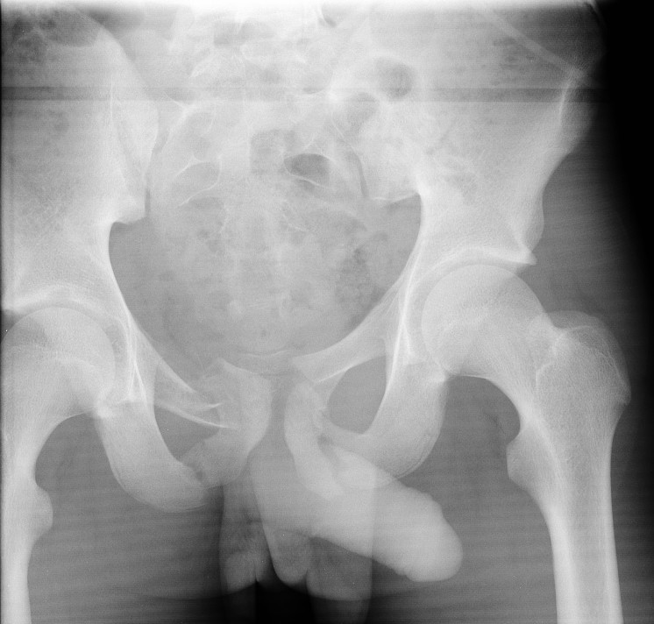
Secondary Survey
Pelvis
Pain on palpation
Leg length unequal
Instability
X-rays as needed
Pitfalls
Excessive pelvic manipulation
Underestimating pelvic blood loss

Slide 36
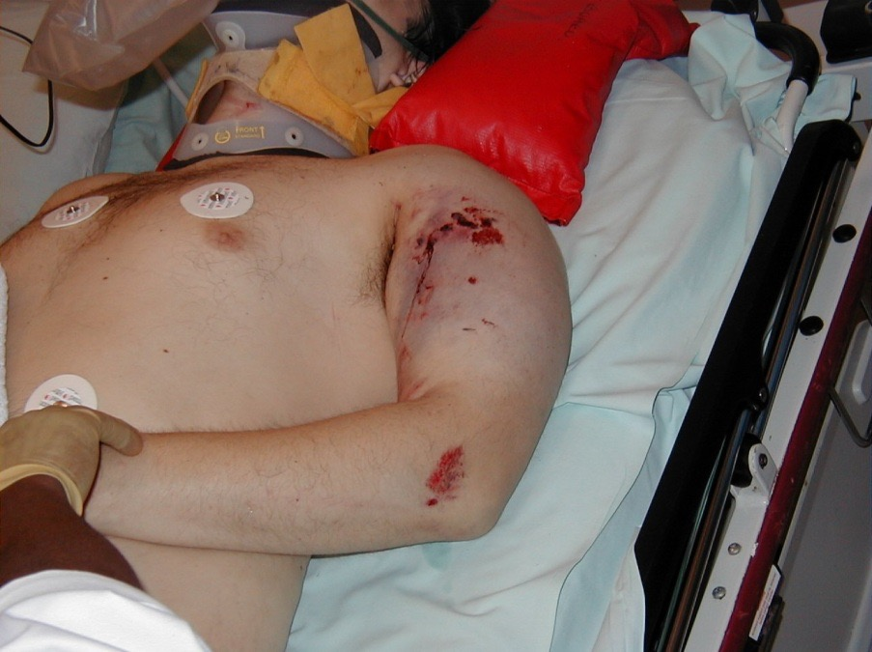
Secondary Survey
Extremities
Contusion, deformity
Pain
Perfusion
Peripheral neurovascular status
X-rays as needed

Slide 37
Secondary Survey
Musculoskeletal System
Pitfalls
Potential blood loss
Missed fractures
Soft tissue or ligamentous injury
Compartment syndrome

Slide 38
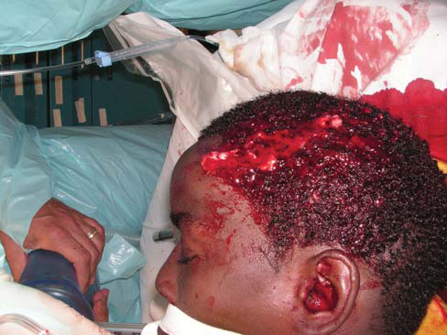
Secondary Survey
Neurologic: Brain
GCS
Pupil size and reaction
Lateralizing signs
Frequent reevaluation
Prevent secondary brain injury
Early neurological consult

Slide 39
Secondary Survey
Neurologic: Spinal Assessment
Whole spine
Tenderness and swelling
Complete motor and sensory exams
Reflexes
Imaging studies
Pitfalls
Altered sensorium
Inability to cooperate with clinical exam

Slide 40
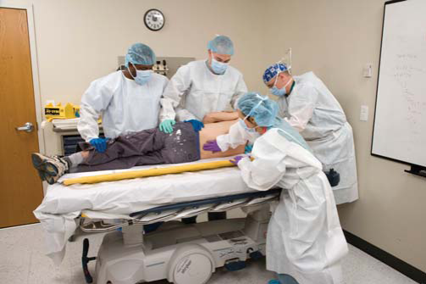
Secondary Survey
Conduct an in-depth evaluation of the patient’s spine and spinal cord
Neurologic: Spine and Spinal Cord
Early neurological /
orthopedic consult

Slide 41
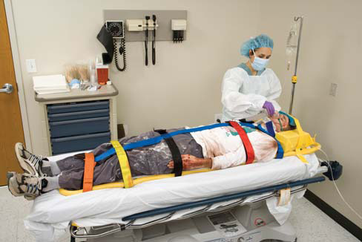
Secondary Survey
Neurologic
Pitfalls
Incomplete immobilization
Neurologic deterioration

Slide 42
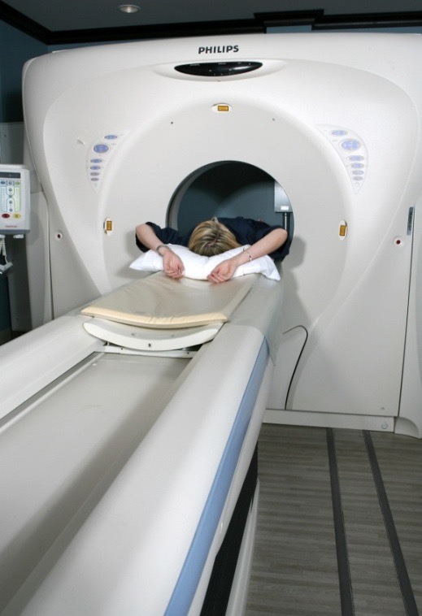
Adjuncts to Secondary Survey
Special Diagnostic Tests as Indicated
Pitfalls
Patient deterioration
Delay of transfer
Deterioration during transfer
Poor communication

Slide 43
How do I minimize missed injuries?
High index of suspicion
Frequent reevaluation and monitoring

Slide 44
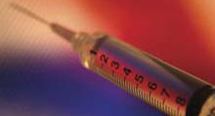
Pain Management
Relief of pain / anxiety as appropriate
Administer intravenously
Careful monitoring is essential

Slide 45
Transfer to Definitive Care
Which patients do I transfer to a higher level of care?
Those whose injuries exceed institutional capabilities:
Multisystem or complex injuries
Patients with comorbidity or age extremes

Slide 46
Summary

