Slide 1
Common Pediatric Fractures &Trauma
Dr. Abdulmonem Alsiddiky
Professor & Consultant
Pediatric orthopedic & spinal deformities

Slide 2
Introduction
Why should we differentiate adult trauma from kids?
What are the Differences between adult & pediatric bone ?
Mechanism of injury
Rate of trauma

Slide 7
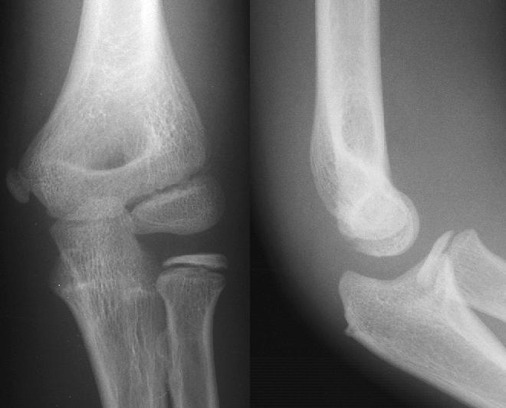

Slide 10
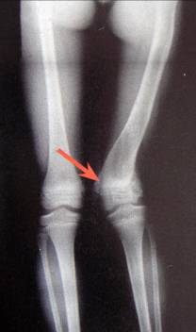
It is different
1- Growth plate:
Provides perfect remodeling power
Injury of growth plate causes deformity
A fracture might lead to overgrowth

Slide 11
It is different
2- Bone:
Increased collagen/bone ratio makes the bone
Less brittle ( ELASTIC )
deformation

Slide 12
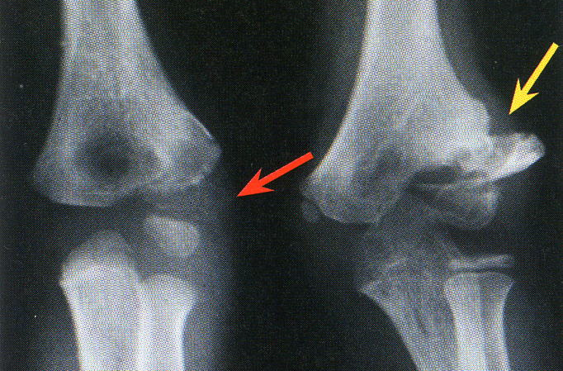
It is different
3- Cartilage:
Difficult x-ray evaluation
Size of articular fragment often under-estimated

Slide 13
It is different
4- Periosteum:
active in metabolism
more callus, rapid union, increased remodeling
Thickness and strength
Intact periosteal hinge affects fracture pattern
Interposition

Slide 14
It is different
5- Ligaments:
ligaments in children are functionally stronger than bone.
Therefore, a higher proportion of injuries that produce sprains in adults result in fractures in children.

Slide 15
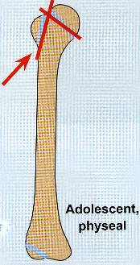
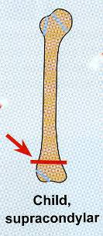
It is different
7- Age related fracture pattern:
Infants: diaphyseal fractures
Children: metaphyseal fractures
Adolescents: epiphyseal injuries

Slide 16
It is different
8- Physiology
Better blood supply
Better healing
rare incidence of delayed and non-union
Remodeling

Slide 17
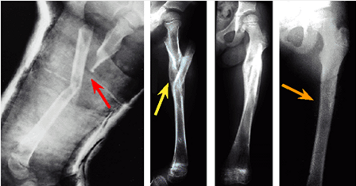
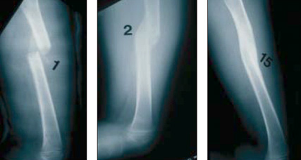

Slide 18
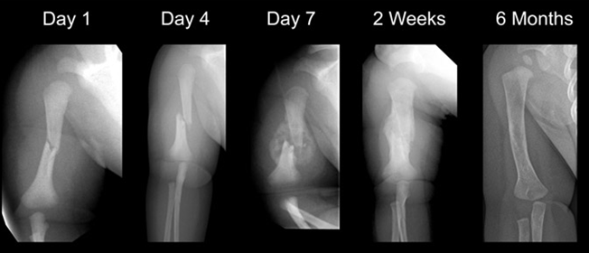

Slide 22
Physeal injuries
Account for ~25% of all children’s fractures.
More in boys.
More in upper limb.
Most heal well rapidly with good remodeling.
Growth may be affected.

Slide 23
Physeal injuries
Classification:
Salter-Harris

Slide 24
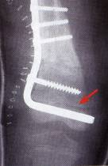
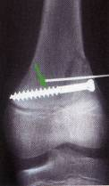
Physeal injuries
Small bridges (<10%) may lyse spontaneously.
Central bridges more likely to lyse.
Peripheral bridges more likely to cause deformity
Avoid injury to physis during fixation.
Monitor growth over a long period.
Image suspected physeal bar (CT, MRI)

Slide 25
General Management
Indications for surgery
Head injury
Multiple injuries
Open fractures
Displaced intra articular fractures
( Salter-Harris III-IV )
Adolescence
Failure of conservative means (irreducible or unstable fractures)
Severe soft-tissue injury or fractures with vascular injury
Neurological disorder
Malunion and delayed union
?Compartment syndrome

Slide 26
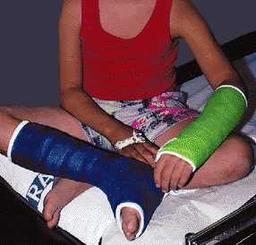
Aim of treatment
achieve reduction
Maintain reduction
Casting
K-wires
Elastic nails
Screws
Plate & screws
IM nails
Ex. Fix
Healing

Slide 27
Methods of Fixation
Casting
Still the commonest

Slide 28
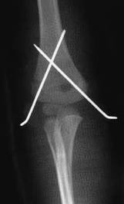
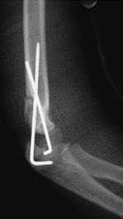
Methods of Fixation
K-wires
Most commonly used int fix
Metaphyseal fractures

Slide 29
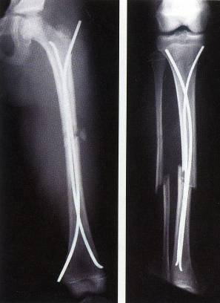
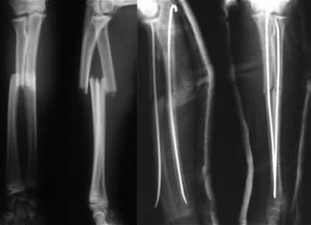
Methods of Fixation
Intramedullary wires, elastic nails

Slide 30
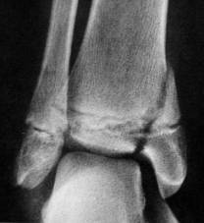
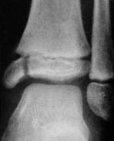
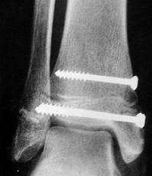
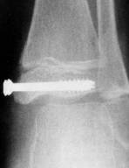
Methods of Fixation
Screws

Slide 31
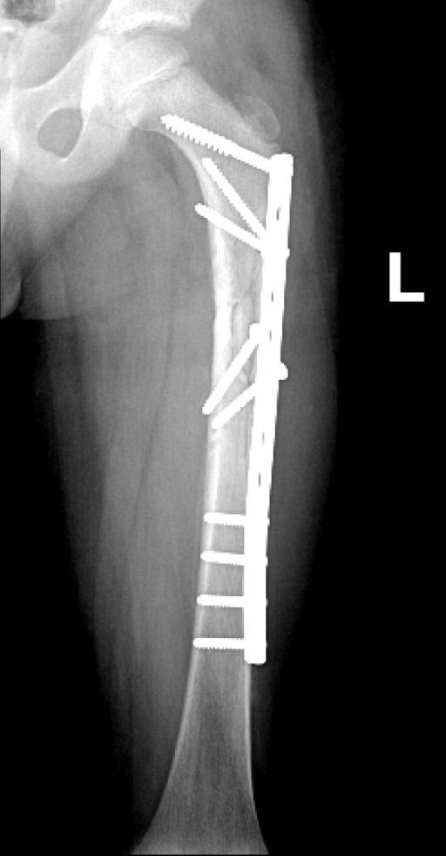
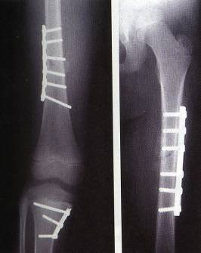
Methods of Fixation
Plates – multiple trauma

Slide 32
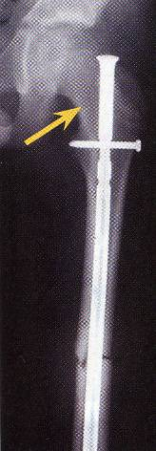
Methods of Fixation
IMN - adolescents

Slide 33
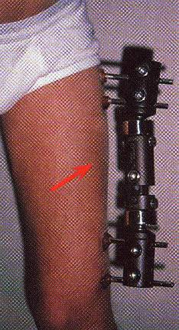
Methods of Fixation
Ex-fix – usually in open fractures

Slide 34
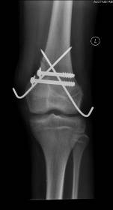
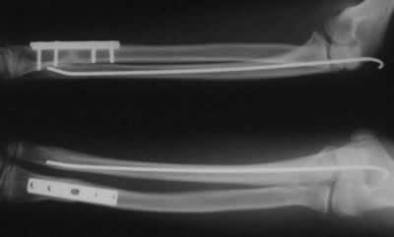
Methods of Fixation
Combination

Slide 36
Common Pediatric Fractures
Upper limb
a. Clavicle .
b. Supracondylar Fracture.
c. Distal Radius .
CHILD ABUSE
Lower Limbs
. Femur fractures

Slide 37
Fracture Clavicle
80% of clavicle fractures occur in the shaft
The periosteal sleeve always remains in the anatomic position. Therefore, remodeling is ensured.

Slide 38
Fracture Clavicle
Mechanism of Injury:
Indirect: Fall onto an outstretched hand
Direct: it carries the highest incidence of injury to the underlying neurovascular and pulmonary structures
Birth injury

Slide 39
Fracture Clavicle
Clinical Evaluation:
Painful palpable mass along the clavicle
Tenderness, crepitus, and ecchymosis
May be associated with neurovascular injury
Pulmonary status must be assessed.

Slide 40
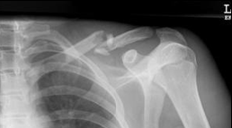
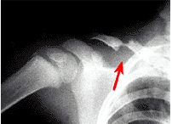
Fracture Clavicle
Radiographic Evaluation:
AP view

Slide 41
Fracture Clavicle
Classification:
Location
Open or closed
Displacement
Fracture type
segmental, comminuted, greenstick

Slide 42
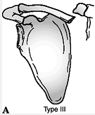
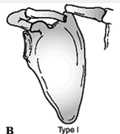
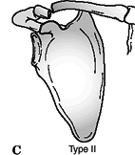
Fracture Clavicle
Allman classification:
Type I: Medial third
Type II: Middle third (most common)
Type III: Lateral third

Slide 43
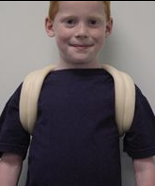
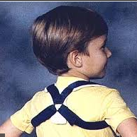
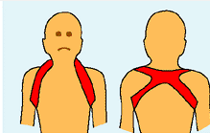
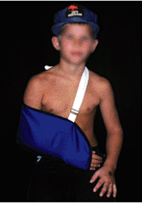
Fracture Clavicle
Treatment:
Newborn:
unite in 1 week
Up to 2 years:
figure-of-eight for 2 weeks
Age 2-12 Years:
A figure-of-eight or sling for 2-4 weeks

Slide 44
Fracture Clavicle

Slide 45
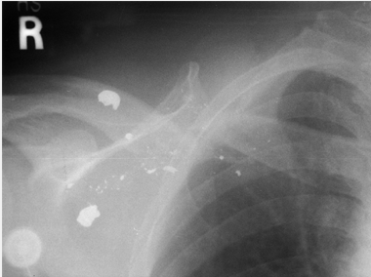
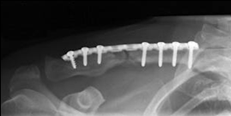
Fracture Clavicle
Indications of operative treatment:
Open fractures
Neurovascular compromise

Slide 46
Fracture Clavicle
Complications: Rare
Neurovascular compromise
Malunion
Nonunion
Pulmonary injury

Slide 48
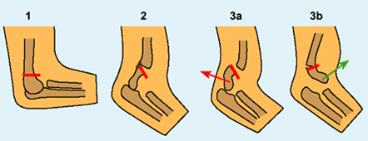
Supracondylar Humeral Fracture
55-75% of all elbow fractures
The male-to-female ratio is 3:2
5 to 8 years
The left, or nondominant side, is most frequently injured

Slide 49
Supracondylar Humeral Fracture
Mechanism of Injury:
Indirect
Extension type >95%
Direct
Flexion type < 3%

Slide 50
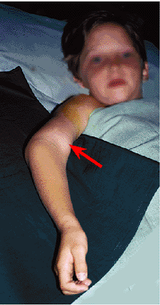
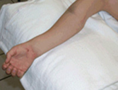
Supracondylar Humeral Fracture
Clinical Evaluation:
Swollen, tender elbow with painful ROM
S-shaped angulation
Pucker sign (dimpling of the skin anteriorly )
Neurovascular examination

Slide 51
Supracondylar Humeral Fracture Classification (Gartland)
Complete displacement (extension type) may be posteromedial (75%) or posterolateral (25%)

Slide 52
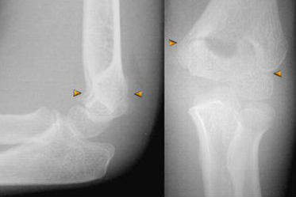
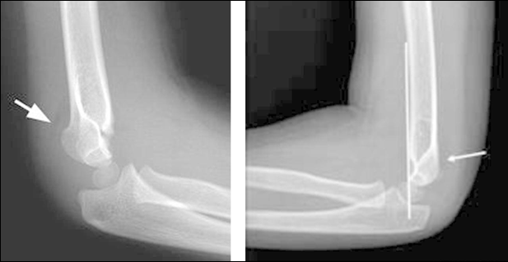
Type 1

Slide 53
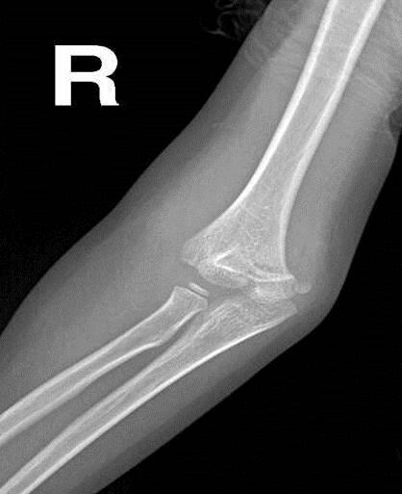
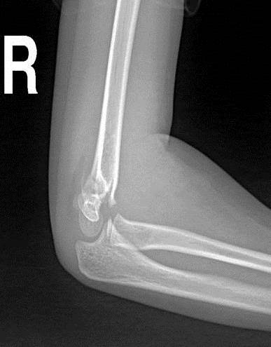
Type 2

Slide 54
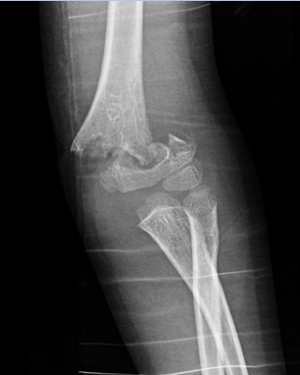
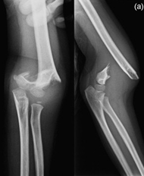
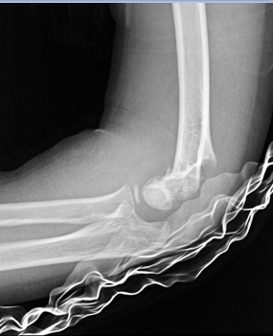
Type 3
Flexion type
Extension type

Slide 55
Supracondylar Humeral Fracture Treatment
Type I:
Immobilization in a long arm cast or splint at 60 to 90 degrees of flexion for 2 to 3 weeks
Type II:
Closed reduction followed by casting or pinning if unstable or sever swelling

Slide 56
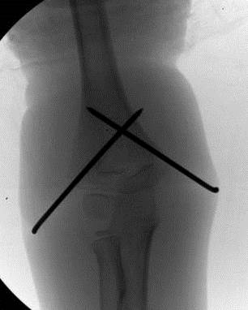
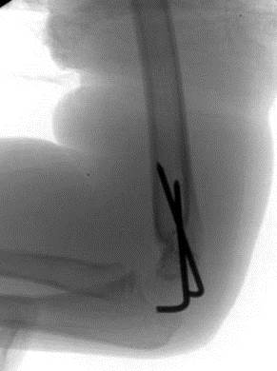
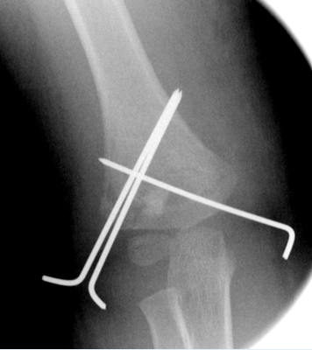
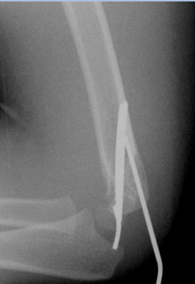
Supracondylar Humeral Fracture Treatment
Type III:
Attempt closed reduction and pinning
Open reduction and internal fixation may be necessary for unstable fractures, open fractures, or those with neurovascular injury

Slide 57
Supracondylar Humeral Fracture Complications
Neurologic injury (7% to 10%)
Most are neurapraxias requiring no treatment
Median and anterior interosseous nerves (most common)
Ulnar nerve (Iatrogenic)
Vascular injury (0.5%)
Direct injury to the brachial artery or secondary to swelling

Slide 58
Supracondylar Humeral Fracture Complications
Loss of motion
Myositis ossificans
Angular deformity (cubitus varus)
Compartment syndrome

Slide 59
Supracondylar Humeral Fracture Complications
Loss of motion
Myositis ossificans
Angular deformity (cubitus varus)
Compartment syndrome

Slide 61
Distal Radius Physeal Injuries
Distal Radius Physeal Injuries
Type 1

Slide 62
Distal Radius Physeal Injuries
Distal Radius Physeal Injuries
Type 2 Type 3

Slide 63
Distal Radius Physeal Injuries
Treatment
Salter-Harris Types I and II
Closed reduction followed by long arm cast with the forearm pronated
50% apposition with no angular or rotational deformity is acceptable
Growth arrest can occur in 25% with repeated manipulations
Open reduction is indicated
Irreducible fracture
Open fracture

Slide 64
Distal Radius Physeal Injuries
Treatment

Slide 65
Distal Radius Physeal Injuries
Treatment
Salter-Harris Type III
Anatomic reduction is necessary
ORIF with smooth pins or screws
Salter-Harris Types IV and V
Rare injuries
Need ORIF

Slide 66
Distal Radius Physeal Injuries
Complications
Physeal arrest
Shortening
Angular deformity
Ulnar styloid nonunion
Carpal tunnel syndrome

Slide 68
Distal Radius Metaphyseal Injuries
Classification
Direction of displacement
Involvement of the ulna
Biomechanical pattern
Torus (only one cortex is involved)
Incomplete (greenstick)
Complete

Slide 69
Distal Radius Metaphyseal Injuries
Torus fracture
Stable
Immobilized for pain relief

Slide 70
Distal Radius Metaphyseal Injuries
Incomplete (greenstick)
Greater ability to remodel in the sagittal plane
Closed reduction and above elbow cast with supinated forearm to relax the brachioradialis muscle

Slide 71
Distal Radius Metaphyseal Injuries
Complete fracture
Closed reduction
Well molded long arm cast for 3 to 4 weeks

Slide 72
Distal Radius Metaphyseal Injuries
Complete fracture
Indications for percutaneous pinning without open reduction
loss of reduction
Excessive swelling
Floating elbow
Multiple manipulations

Slide 73
Distal Radius Metaphyseal Injuries
Complete fracture
Indications for ORIF
Irreducible fracture
Open fracture
Compartment syndrome

Slide 74
Distal Radius Metaphyseal Injuries
Complications
Malunion
Residual angulation may result in loss of forearm rotation
Nonunion
Rare
Refracture
With early return to activity (before 6 weeks)
Growth disturbance
Overgrowth or undergrowth
Neurovascular injuries
With extreme positions of immobilization

Slide 76
Femoral Shaft Fractures
Boys > girls
2 to 4 years of age, mid-adolescence
In children younger than walking age, 80% of these injuries are caused by child abuse
In adolescence, >90% due to RTA

Slide 77
Femoral Shaft Fractures
Mechanism of Injury
Direct trauma
RTA, fall, or child abuse
Indirect trauma
Rotational injury
Pathologic fractures
Osteogenesis imperfecta, nonossifying fibroma, bone cysts, and tumors

Slide 78
Femoral Shaft Fractures
Clinical Evaluation
Pain, swelling, inability to ambulate, and variable gross deformity
Careful neurovascular examination is essential
Careful examination of the overlying soft tissues to rule out the possibility of an open fracture

Slide 79
Femoral Shaft Fractures
Radiographic Evaluation
AP and lateral views
Must include hip, knee joints

Slide 80
Femoral Shaft Fractures
Classification
Descriptive
Open or closed
Fracture pattern:
transverse, spiral, oblique, butterfly fragment
Comminution
Displacement
Anatomic
Subtrochanteric
Shaft
Supracondylar

Slide 81
Femoral Shaft Fractures
Less than 6 Months
Pavlik harness
Traction and spica casting
Treatment

Slide 82
Femoral Shaft Fractures
6 Months to 4 Years
CR and immediate casting (>95%)
Traction followed by spica casting if there is difficulty to maintain length and acceptable alignment
Treatment

Slide 83
Femoral Shaft Fractures
Treatment
4 to 12 Years
Flexible IMN
Bridge Plating
External Fixation

Slide 84
Femoral Shaft Fractures
Treatment
6 to 12 Years
Flexible IMN
Bridge Plating
External Fixation

Slide 85
Femoral Shaft Fractures
Treatment
6 to 12 Years
Flexible IMN
Bridge Plating
External Fixation
Multiple injuries
Open fracture
Comminuted #
Unstable patient

Slide 86
Femoral Shaft Fractures
Treatment
12 Years to Maturity
Intramedullary fixation with either flexible or interlocked nails

Slide 87
Femoral Shaft Fractures
Complications
Malunion
Remodeling will not correct rotational deformities
Nonunion (Rare)
Muscle weakness
Leg length discrepancy
Secondary to shortening or overgrowth
Overgrowth of 1.5 to 2.0 cm is common in 2-10 year of age
Osteonecrosis with antegrade IMN <16 year

Slide 88
THANK YOU

